Slide 1
MECHANICS OF MATERIALS
Fall 2025
ME 323- 002
Instructor: Shubhra Bansal
Lecture 10: Stress Analysis of Members in Torsion

Slide 2
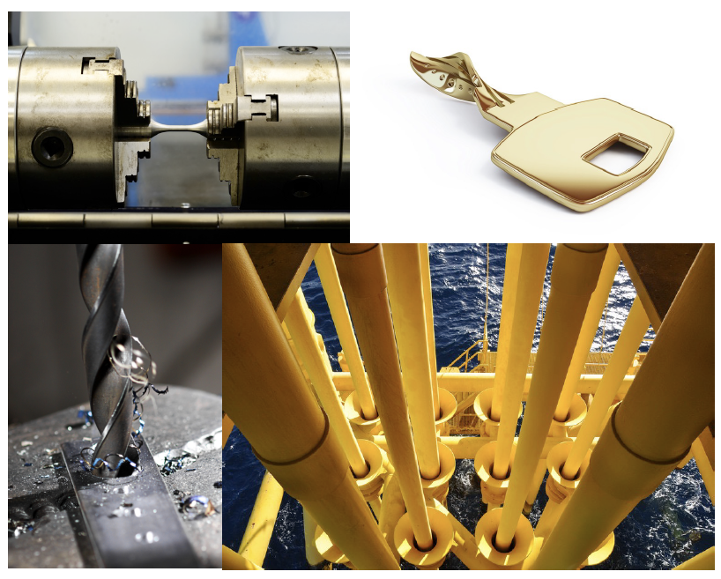
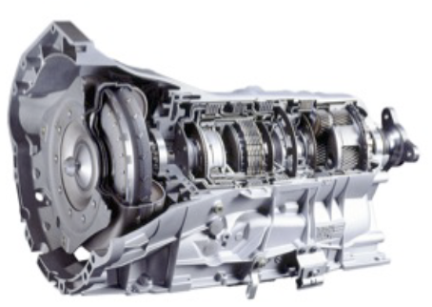
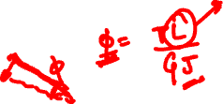
Understanding Torsion

Slide 3
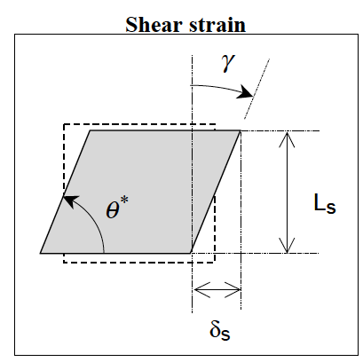
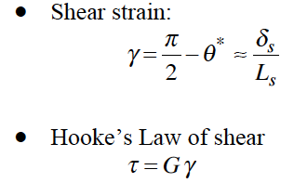
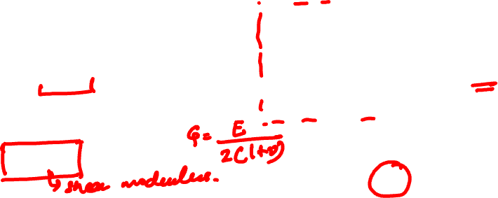
Stress Analysis of Members in Torsion
Objective: To study the stresses developed in circular cross-sectioned shafts experiencing torsion loading.

Slide 4
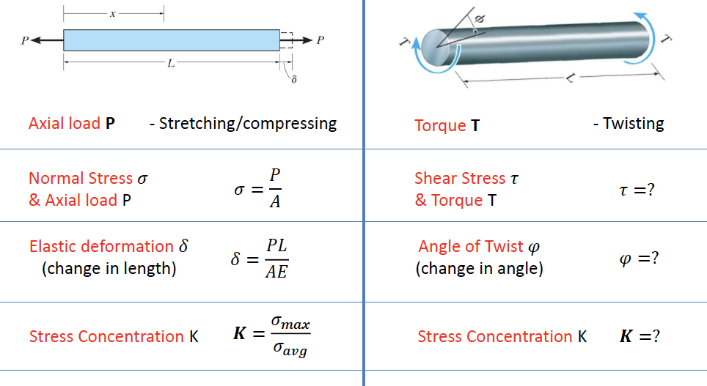
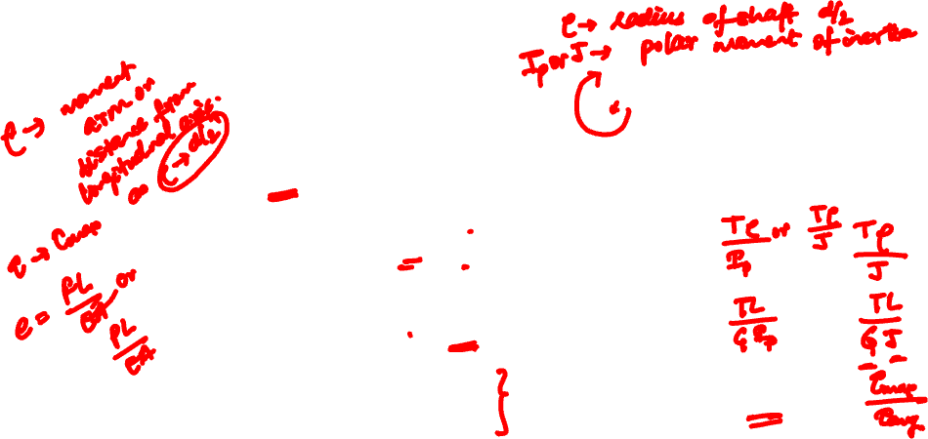
Axial Load vs. Torsion Load
Type of loading is different!
Type of stress/strain is different!

Slide 5
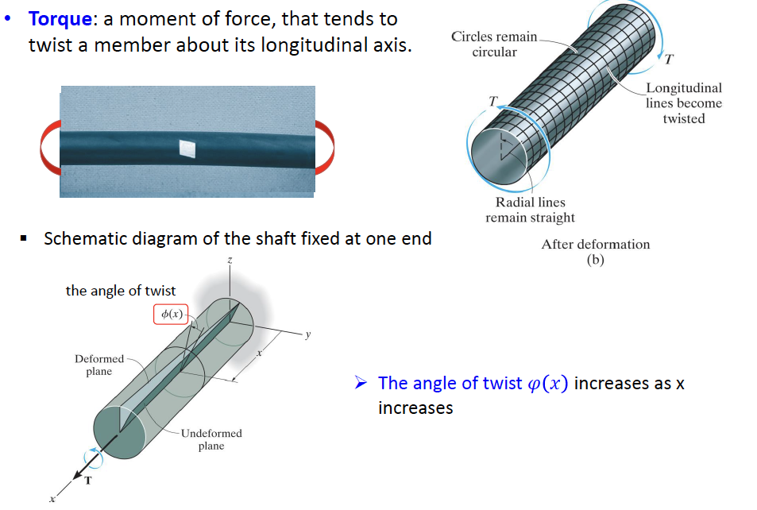
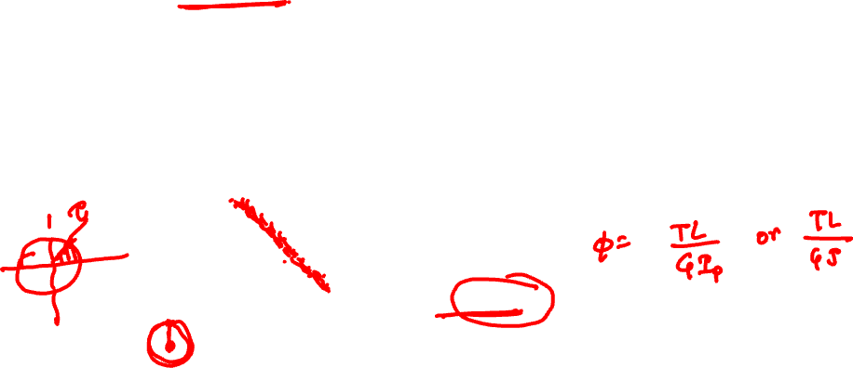
Torsional Deformation
**Note that torque (T) is a twisting force, and torsion is the twist that arises from the applied torque.

Slide 6
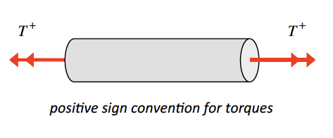
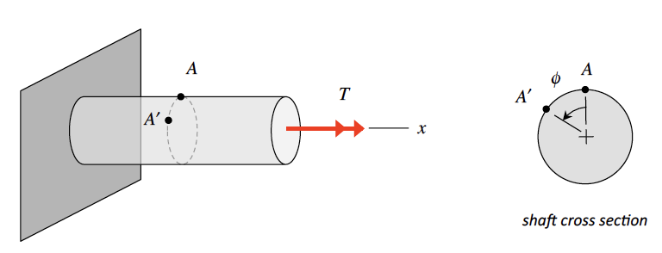
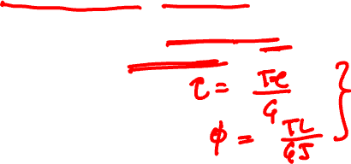
Torsional Deformation
Sign Convention
The sign of a torque T acting on a cut face of a shaft is determined by the right-hand rule.
Curling the fingers of your right hand in the direction of the torque has the thumb of that hand pointing in the direction of the torque
if the direction of the torque is pointing outward (inward) on a face of the shaft, then that torque is positive (negative).
Angle of Twist
Assumptions:
Only circular cross section shafts will be considered.
Cross sections remain perpendicular to shaft axis after deformation (this is not a valid assumption, in general, for non-circular cross section bars).
Radial lines remain radial (i.e., every point on a cross section rotates by the same amount).
Shaft axis remains straight.

Slide 7
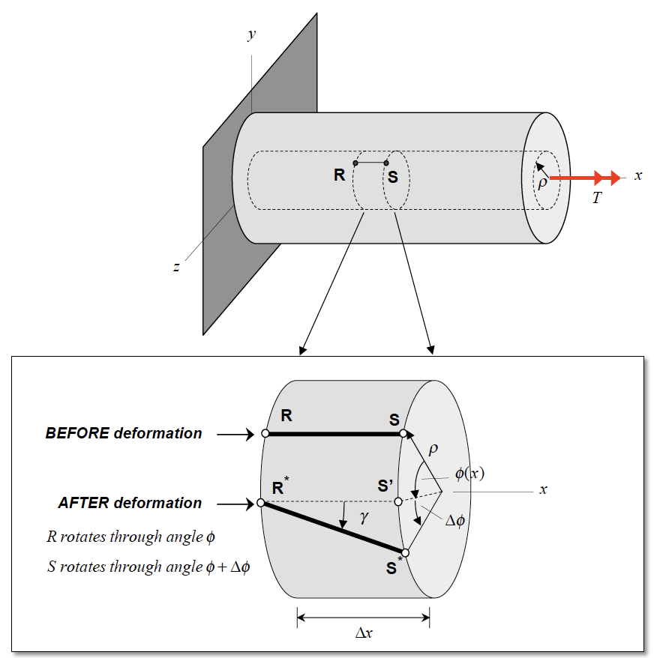



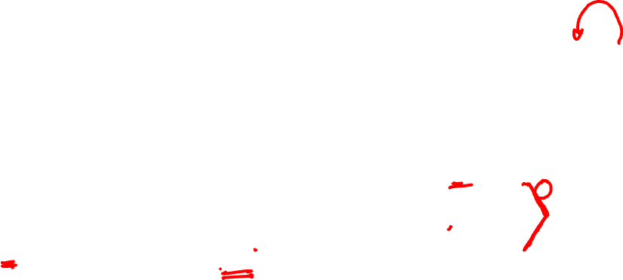
Shear Strain
Consider two points R and S on the surface of an annular section of the shaft of radius ρ and length Δx, where R is at a location x and S is at a location x + Δx .
As a result of the applied torque, the shaft experiences a rotational deformation, with R rotating through an angle of φ(x) to position R*, and S rotating through an angle of φ(x) + Δφ to position S*.
Shear Strain

Slide 8
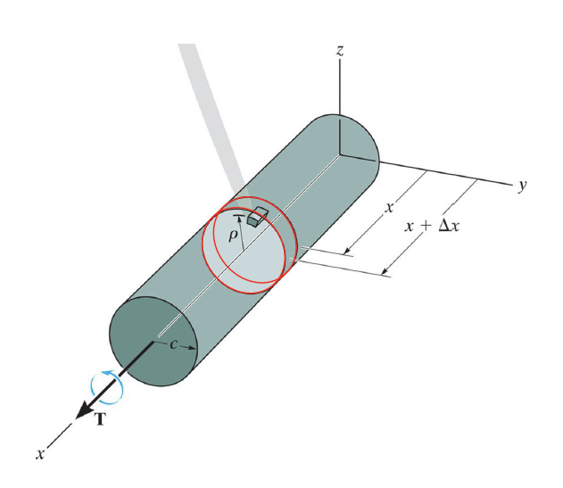
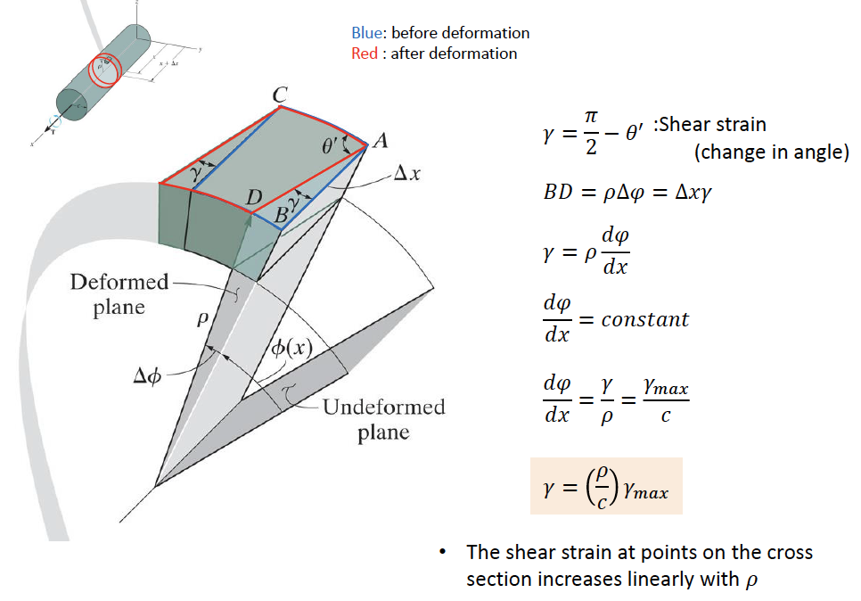
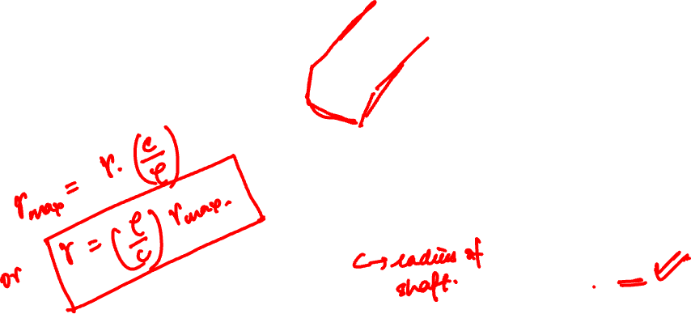

Slide 9
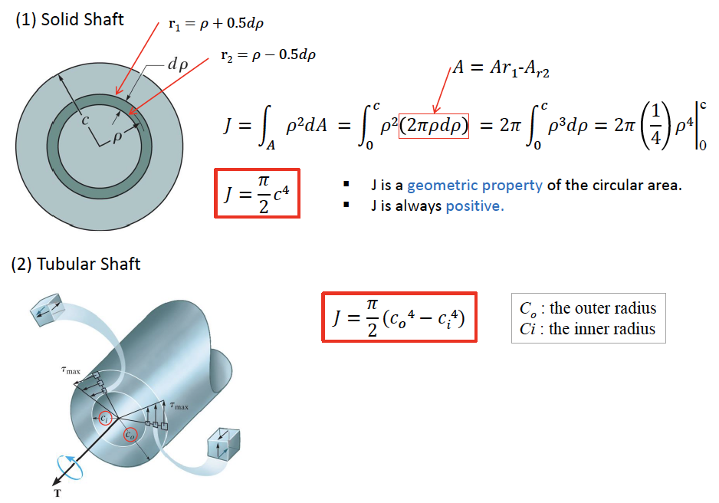
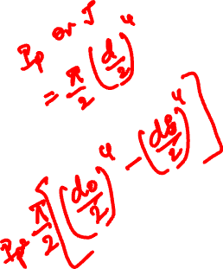
Polar Moment of Inertia
Polar Moment of Inertia (J or I_{P}):
The polar moment of inertia, or second polar moment of area, is a quantity that describes how well an object resists torsional deformation. It's a function of the object's shape and cross-section.

Slide 10
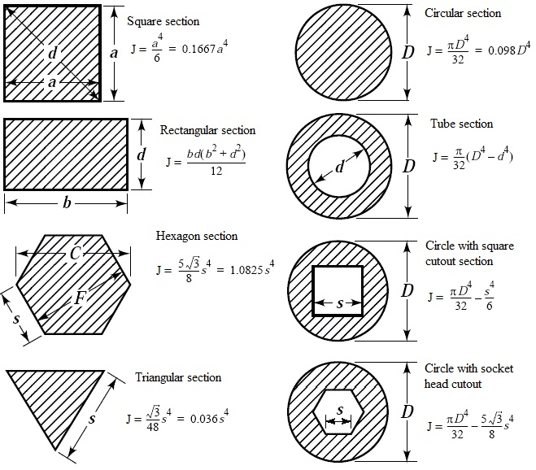


Slide 11
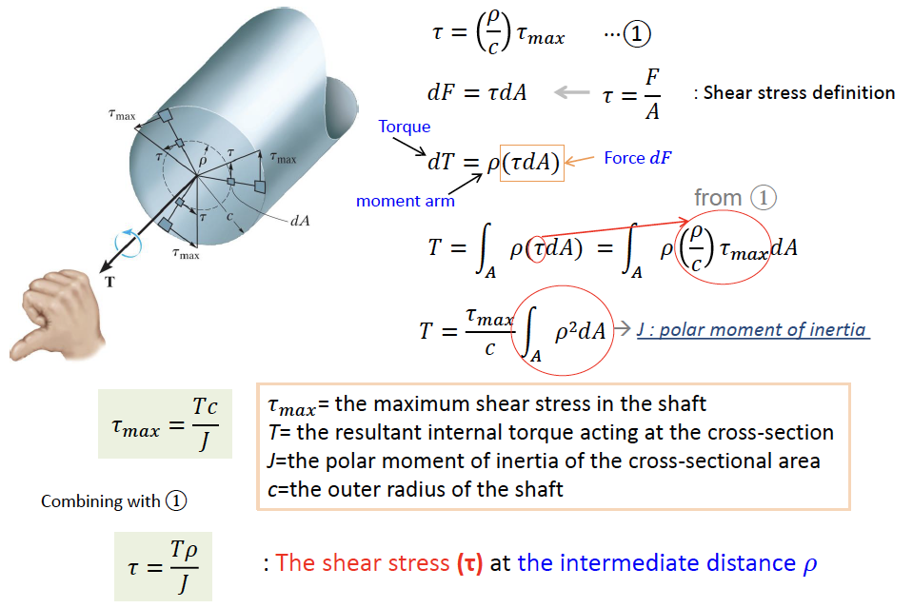
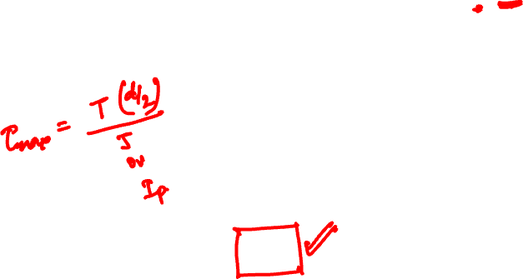
Shear Stress in Torsion

Slide 13

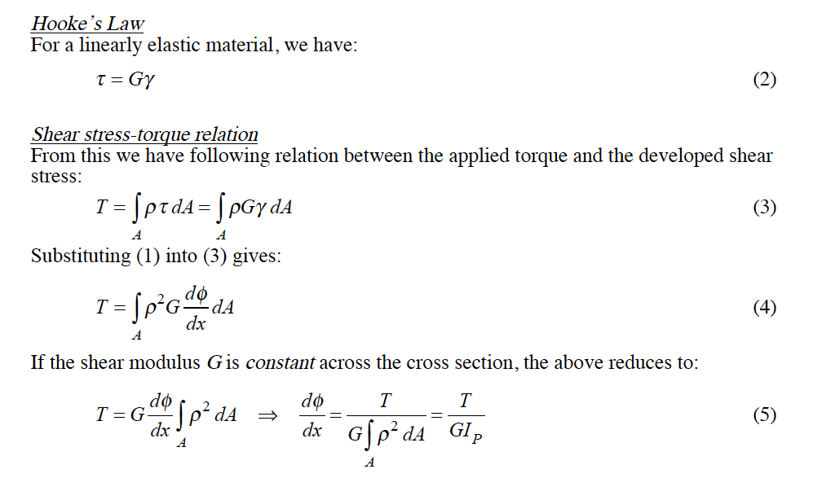
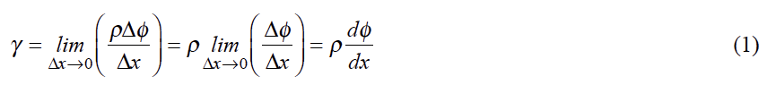
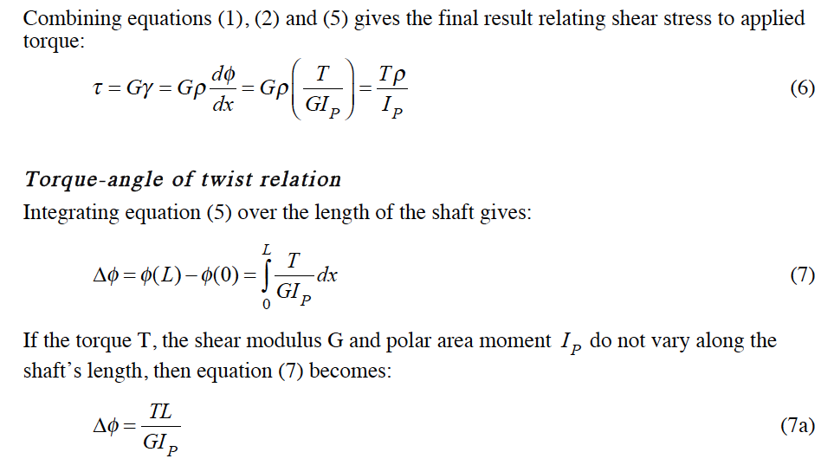
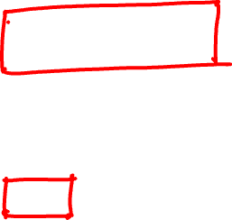
J

Slide 14
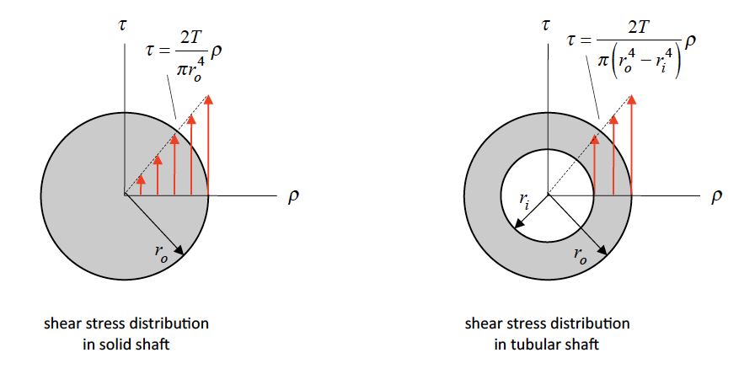
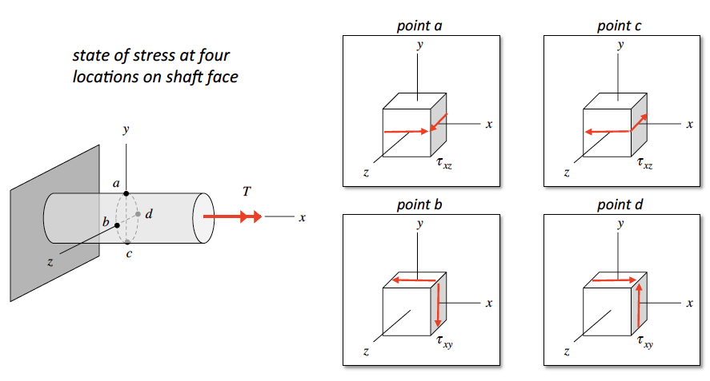
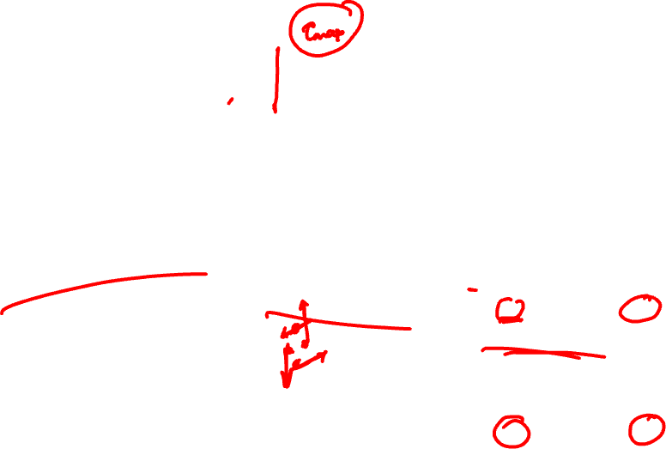
Shear Stress due to torque T
State of Stress
Consider the shaft shown below loaded with a torque T along the x-axis. Points on a given cross section of the shaft will experience a state of shear stress

Slide 15
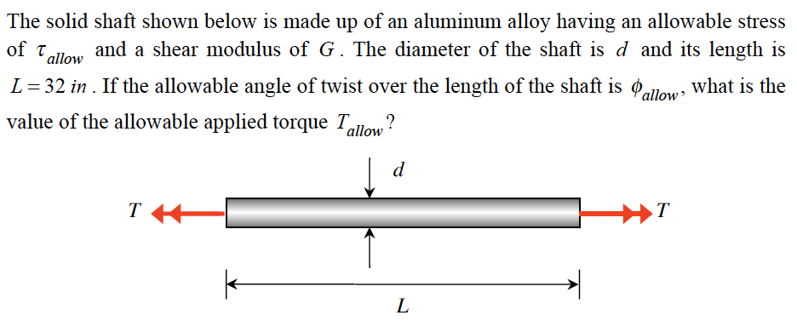
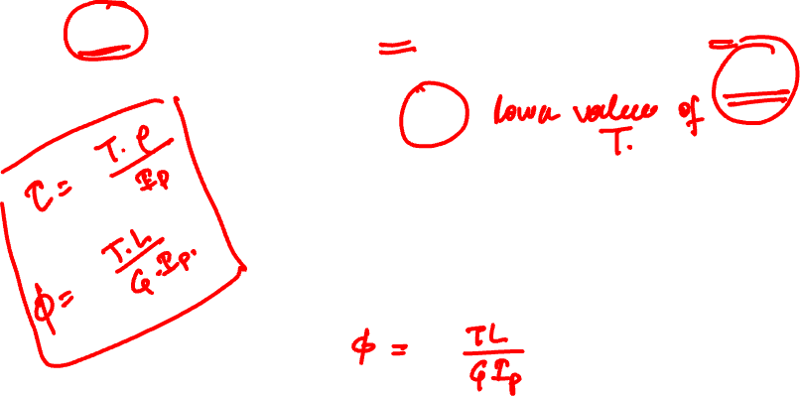
Example 8.1 from Lecture Book

Slide 16
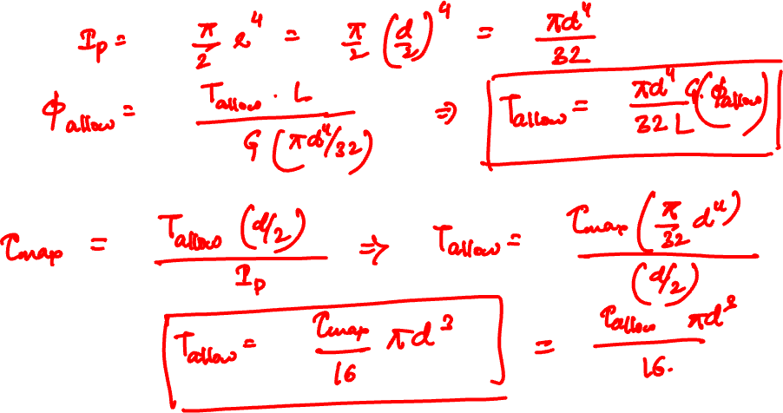

Slide 17
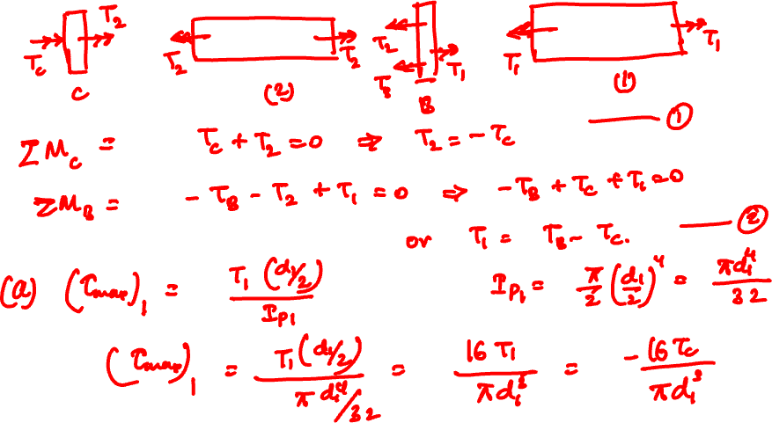

Slide 18
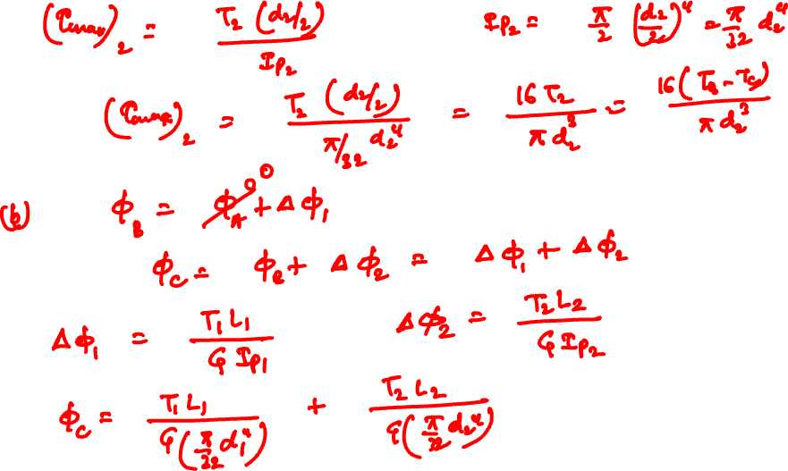

Slide 19
Thank You

