Slide 1
MECHANICS OF MATERIALS
Fall 2025
ME 323- 002
Instructor: Shubhra Bansal
Lecture 2: Normal Stress
Extensional Strain
Material Properties

Slide 2
Common States of Stress

Slide 3
Common States of Stress

Slide 4
Common States of Stress

Slide 5
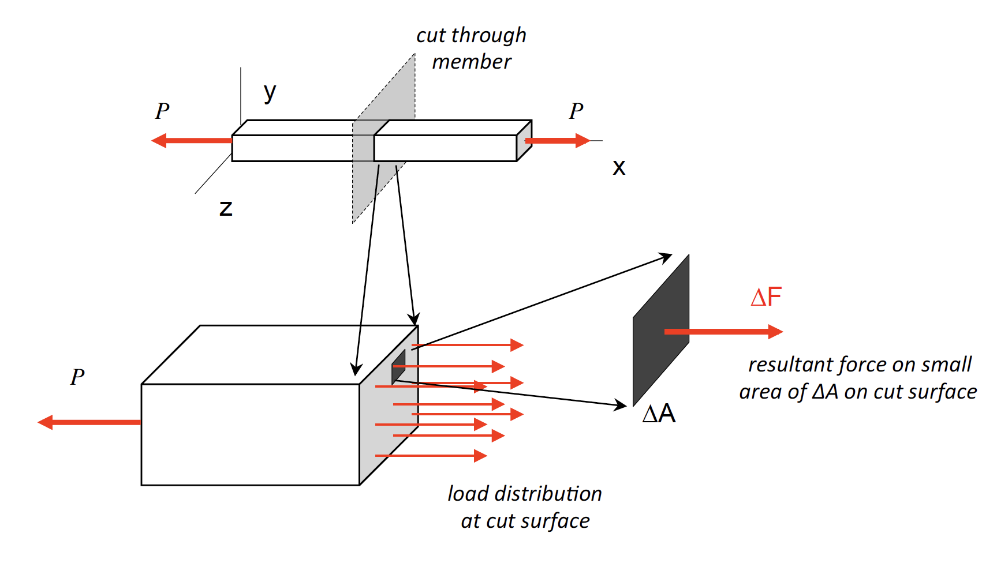
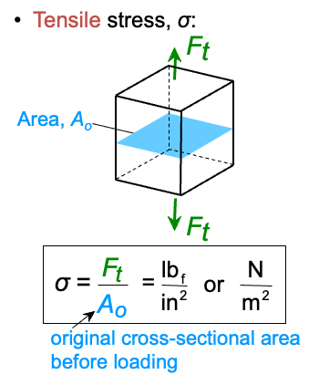
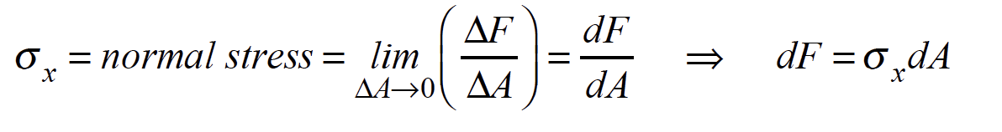
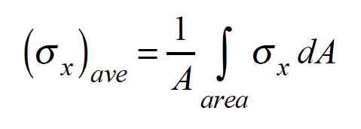
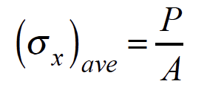
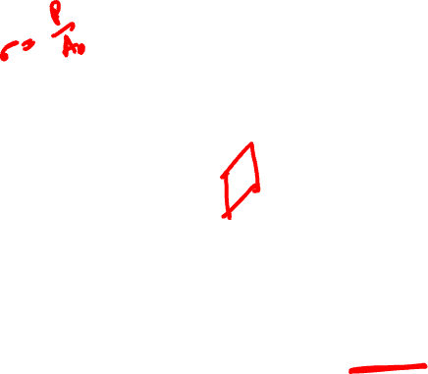
Normal or Axial Stress
Average normal stress
Assuming axial load is at the centroidal position
Material is homogeneous and isotropic
Tensile (+) and compressive (-)

Slide 6
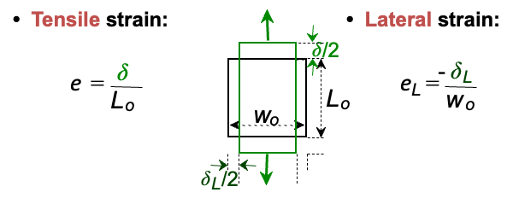
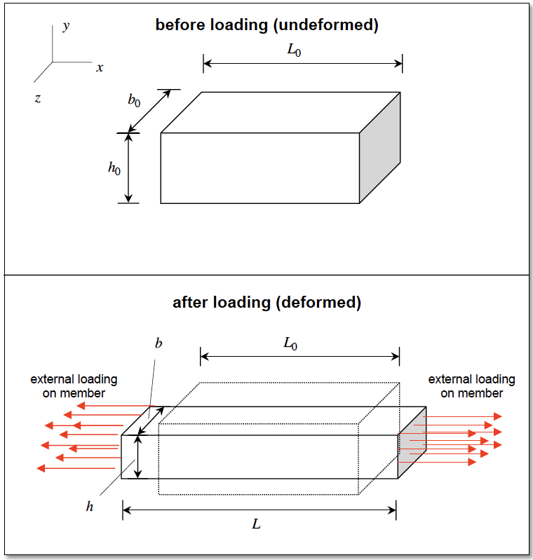
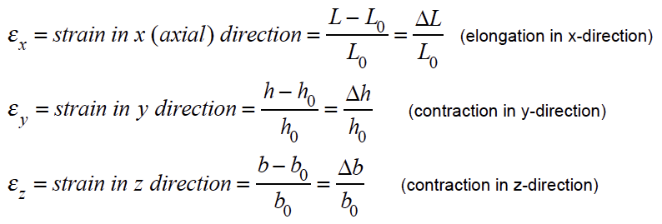
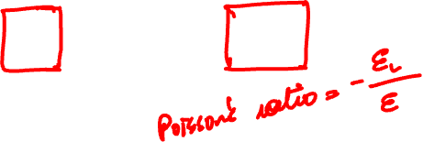
Axial Strain

Slide 7
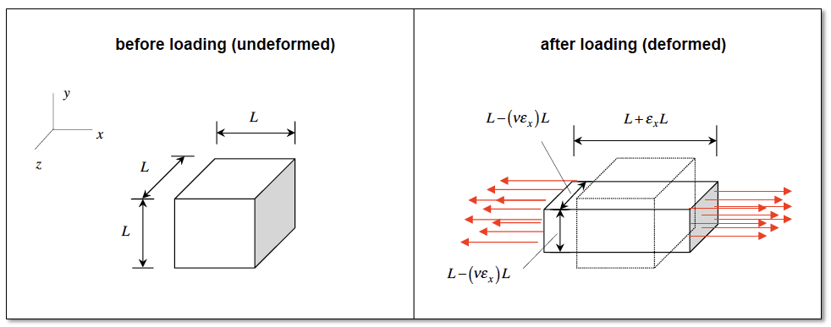
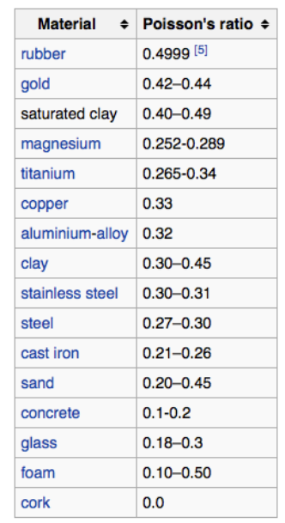
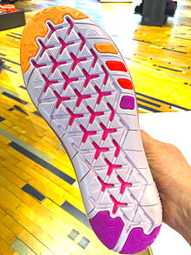
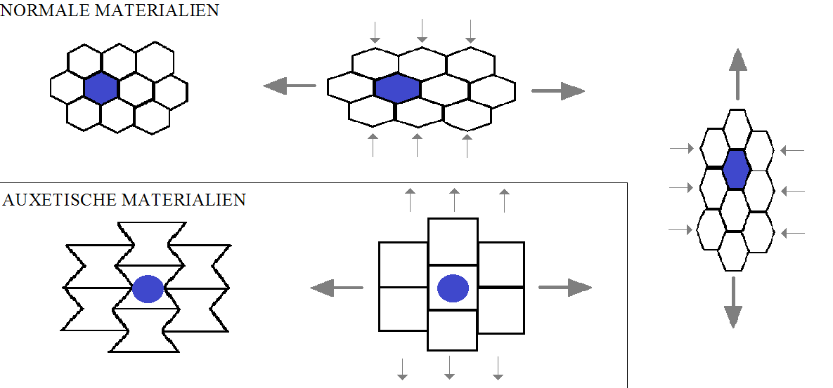

Poisson’s Ratio (𝝊)
Auxetic Materials- negative Poisson’s Ratio
In footwear, auxetic design allows the sole to expand in size while walking or running, thereby increasing flexibility.

Slide 8
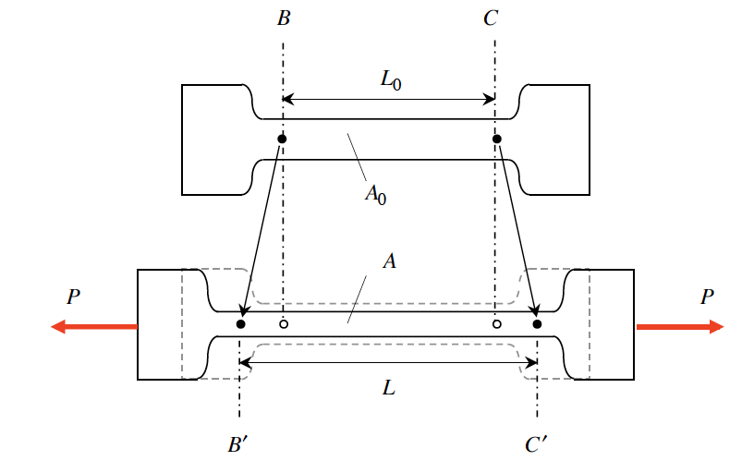
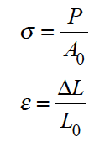
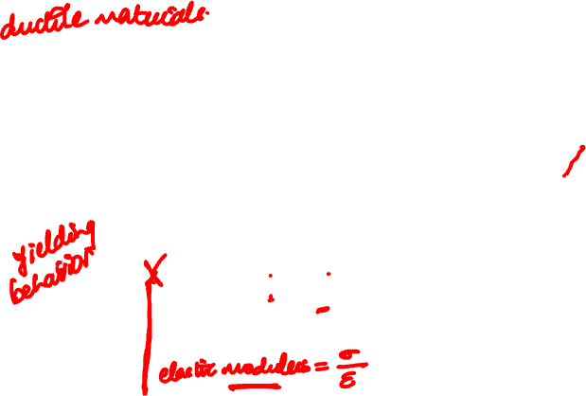
Mechanical Properties of Materials
Figures provided courtesy of Professor Thomas Siegmund, Purdue University

Slide 9
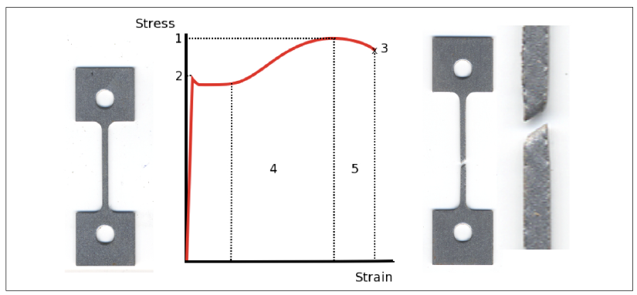
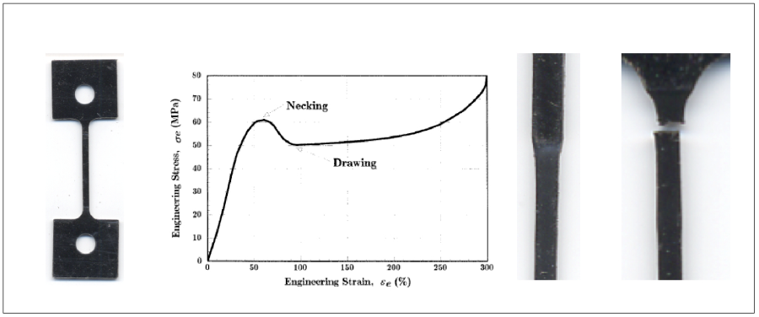
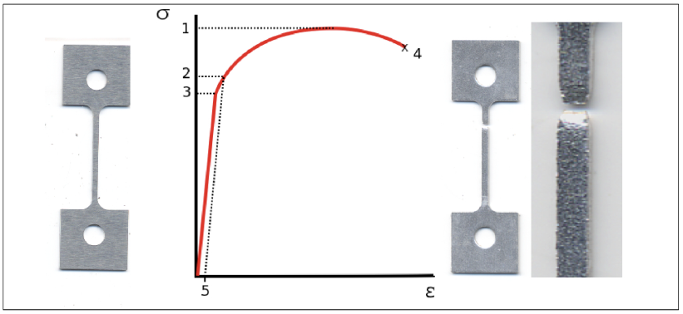
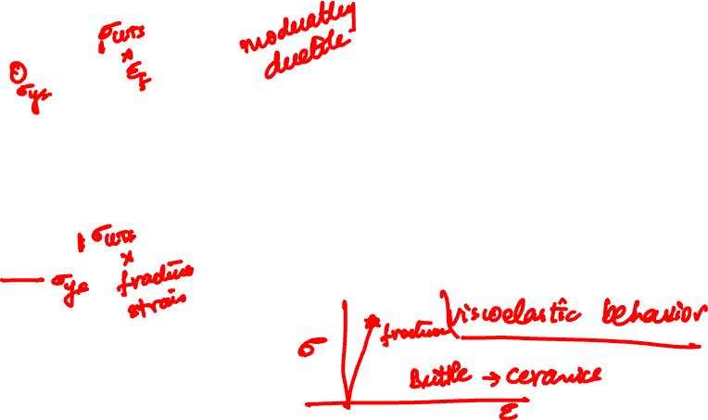
Stress-Strain Curves
Steel
Nylon
Aluminum
Figures provided courtesy of Professor Thomas Siegmund, Purdue University

Slide 10
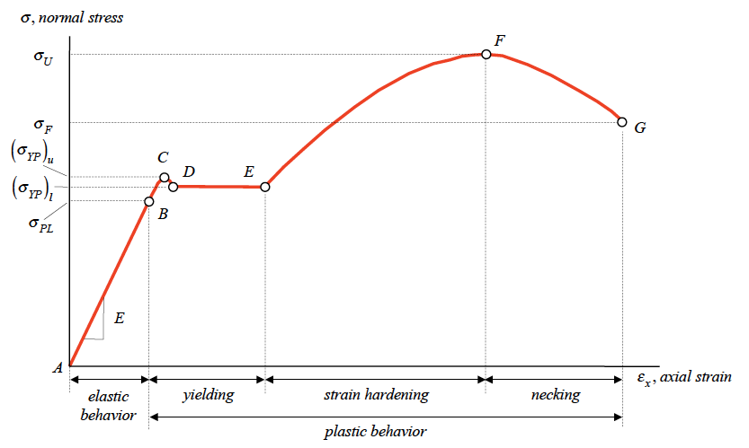
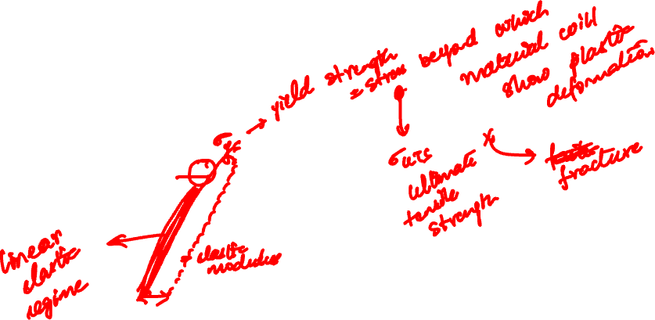



Stress-Strain Curves (Steel)
$${\left(σ_{YP}\right)}_{u}=upper yield point$$
$${\left(σ_{YP}\right)}_{l}=lower yield point$$
$${\left(σ_{PL}\right)}_{}=proportionality limit$$
Figures provided courtesy of Professor Thomas Siegmund, Purdue University

Slide 11
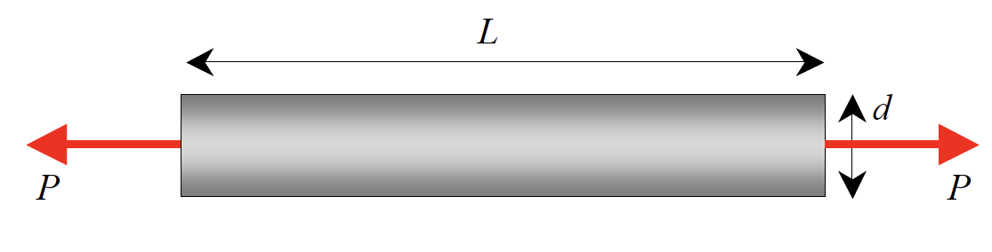
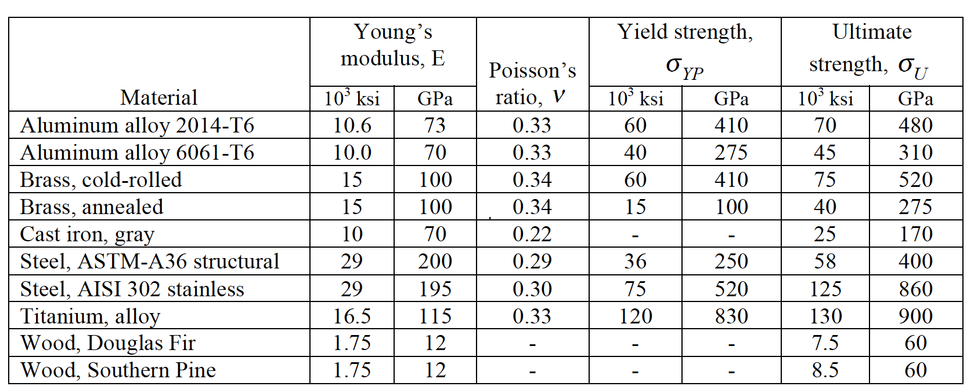
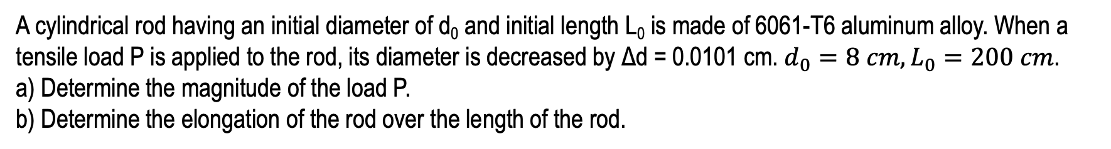
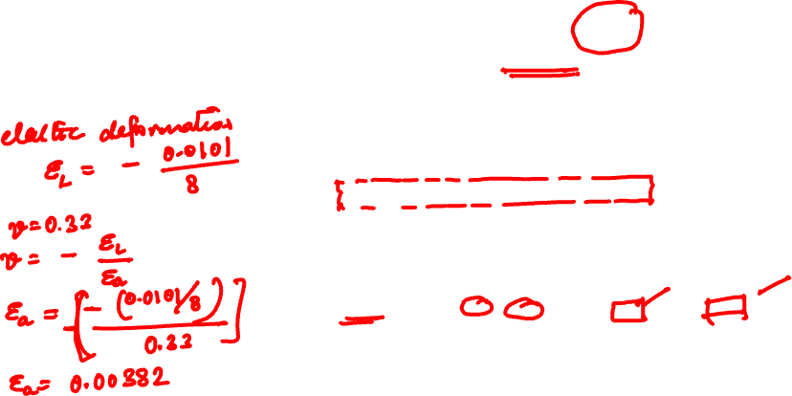
Example 2.4 from Lecture Book
A cylindrical rod having an initial diameter of d₀ and initial length L₀ is made of 6061-T6 aluminum alloy. When a tensile load P is applied to the rod, its diameter is decreased by Δd = 0.0101 cm. $d_{0}=8 cm, L_{0}=200 cm$.
a) Determine the magnitude of the load P.
b) Determine the elongation of the rod over the length of the rod.

Slide 12
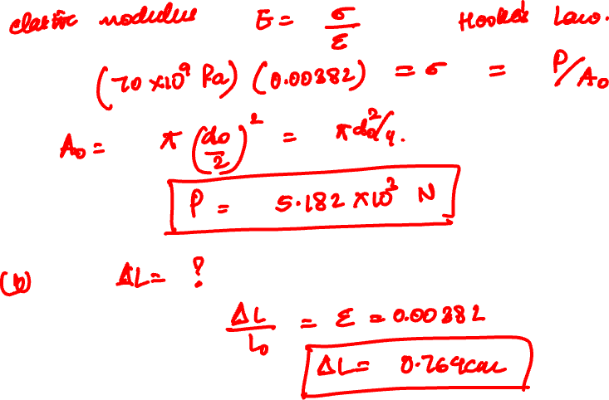

Slide 13
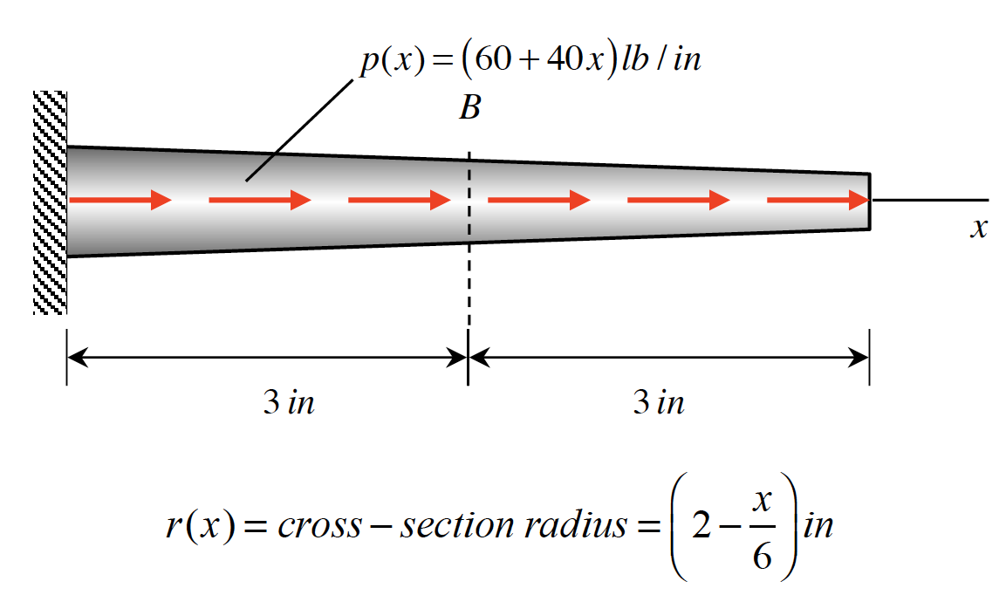
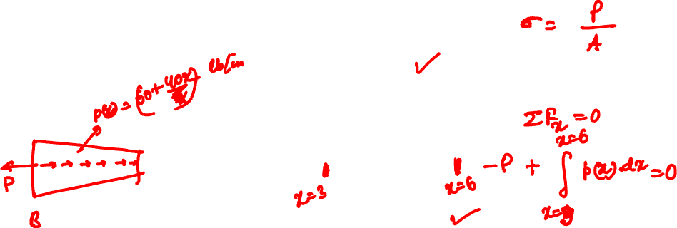
Example 2.6 from Lecturebook
The tapered rod has a radius of r=(2-x/6) in. and is subjected to the distributed loading of p = (60+40x) lb/in. Determine the average normal stress at the center of the rod, B.

Slide 14
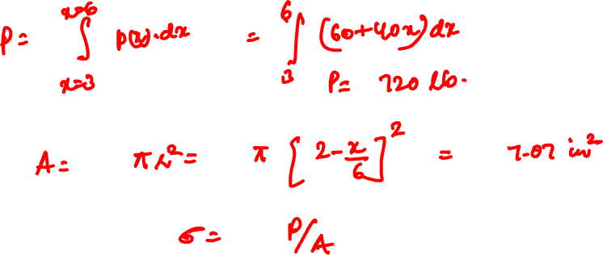
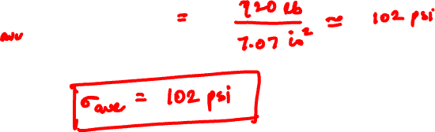

Slide 15
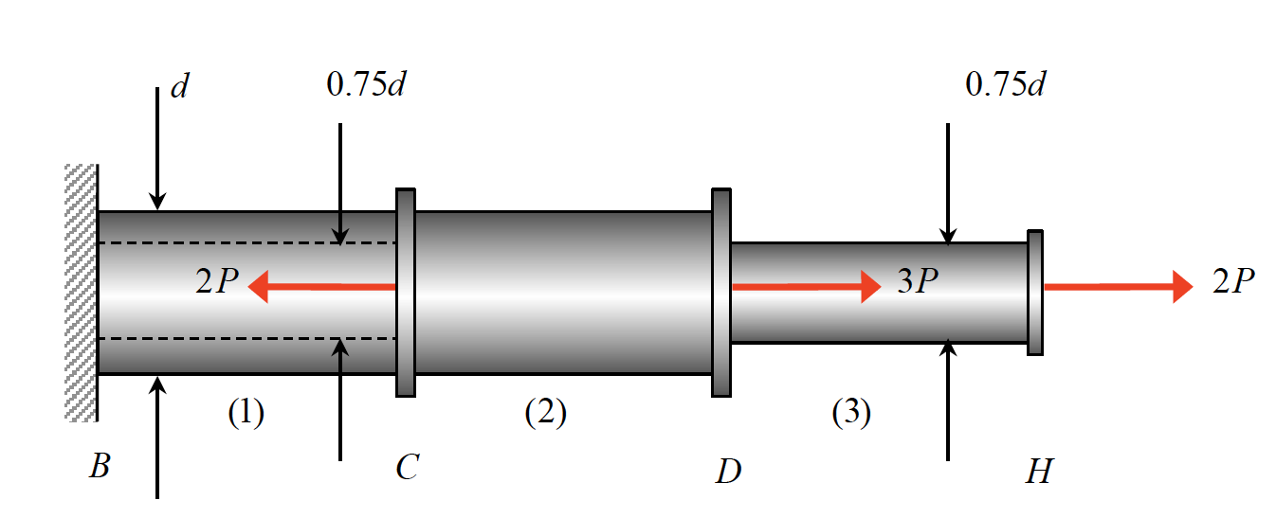
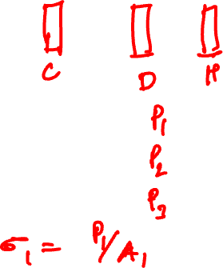
Example 2.7 from Lecturebook
The three-segment axially-loaded member shown below is made up of a tubular segment (1) with an outer diameter of d and inner diameter of 0.75d , a solid segment (2) of outer diameter of d and another solid segment (3) of outer diameter of 0.75d . A set of axial loads are applied at C, D and H. Determine the axial stresses in the three segments.

Slide 16
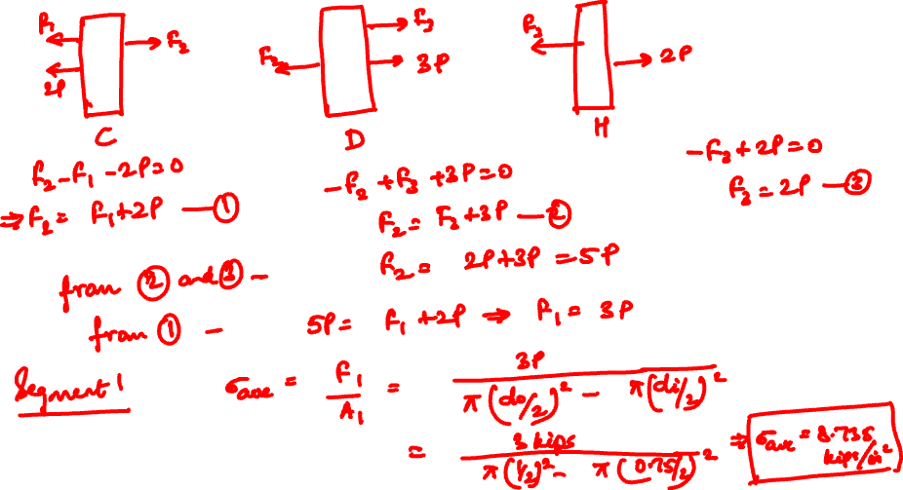

Slide 17
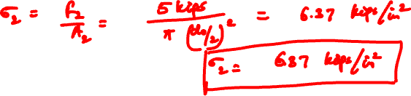
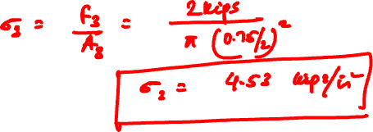

Slide 18
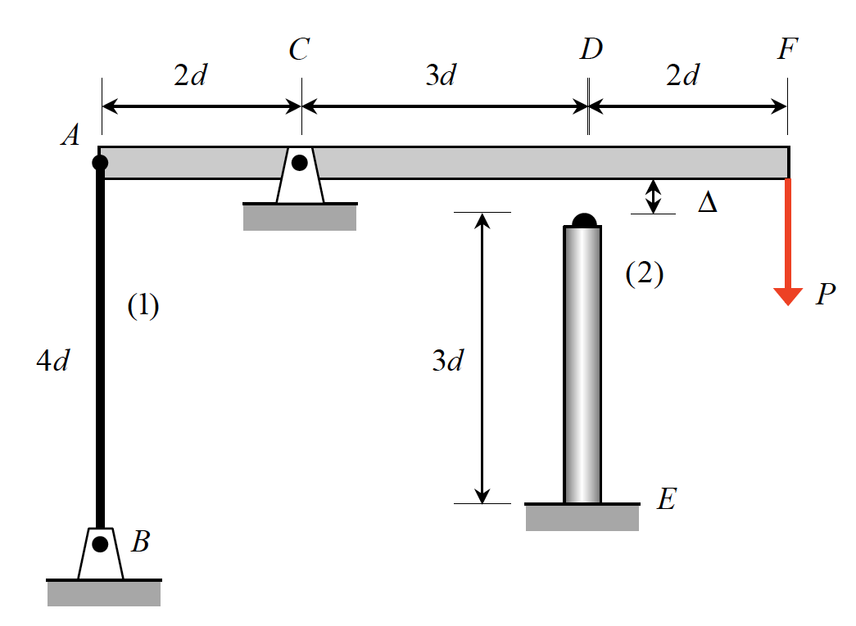
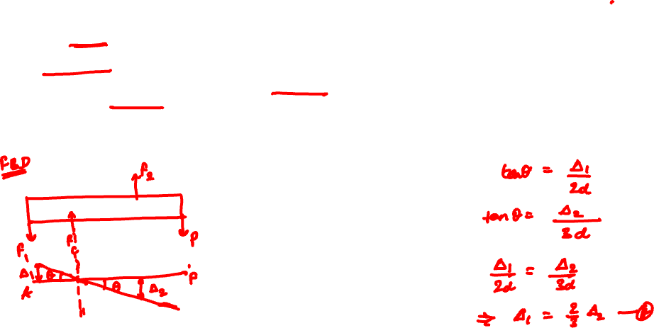
Example 2.2 from Lecturebook
For small loads P, the rotation of the rigid beam AF is controlled by the stretching of rod AB. For larger loads, the beam comes into contact with the top of column DE, and further resistance to rotation is shared by the rod and the column. Assume that the clockwise angle θ through which beam AF rotates is small enough to assume that points on the beam essentially move vertically. The cross-sectional areas of members (1) and (2) are A₁ and A₂, respectively, and the materials of members (1) and (2) have Young’s modulus of E₁ and E₂ , respectively.
A load P is applied that is just sufficient to close the Δ gap between the beam and the column. What is the strain ε₁ in rod AB for this value of P?
b) If the load P in a) is doubled, what is the corresponding strain ε₂ in column DE?

Slide 19
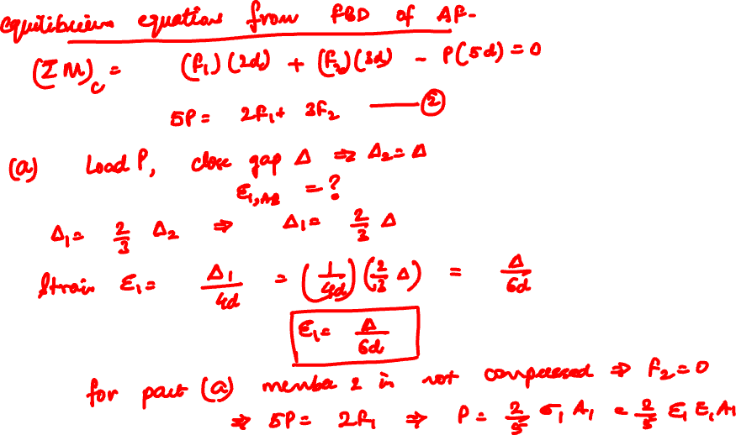

Slide 20
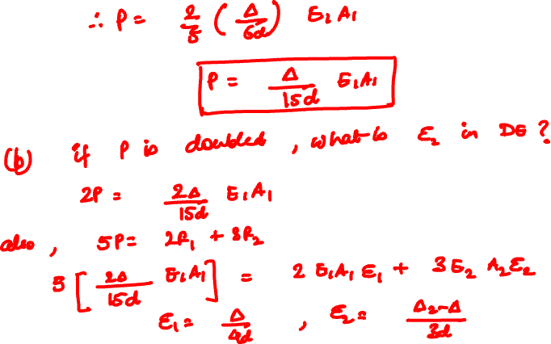

Slide 21
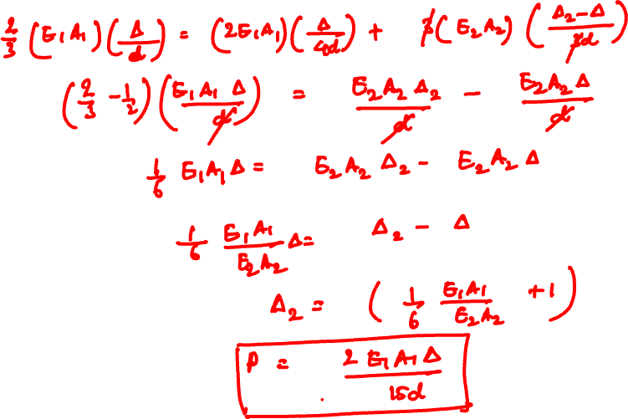

Slide 22
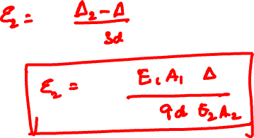

Slide 23
Thank You

