Slide 1
MECHANICS OF MATERIALS
Fall 2025
ME 323- 002
Instructor: Shubhra Bansal
Lecture 1: Introduction
Static Equilibrium

Slide 2
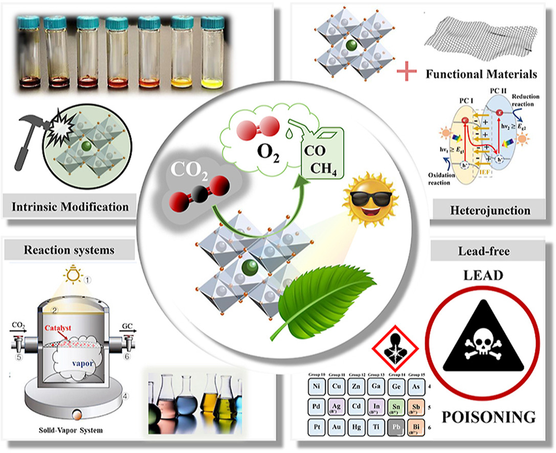
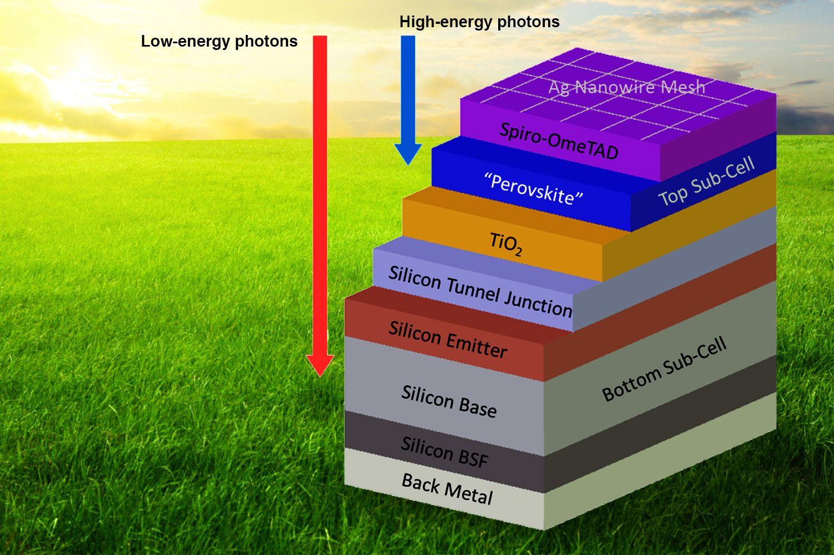
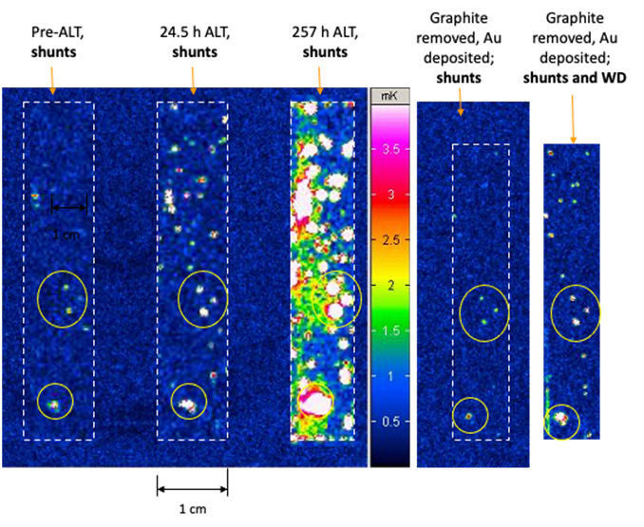
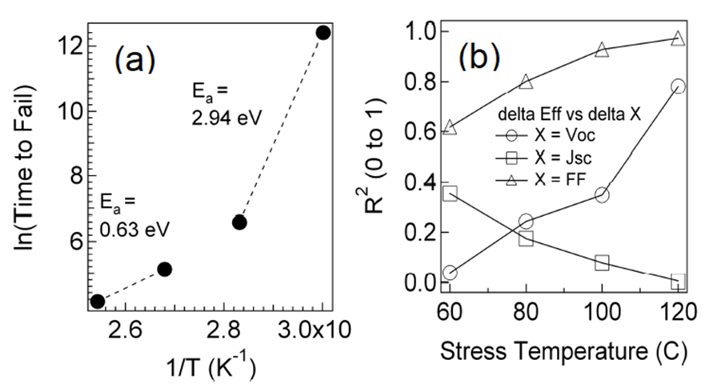
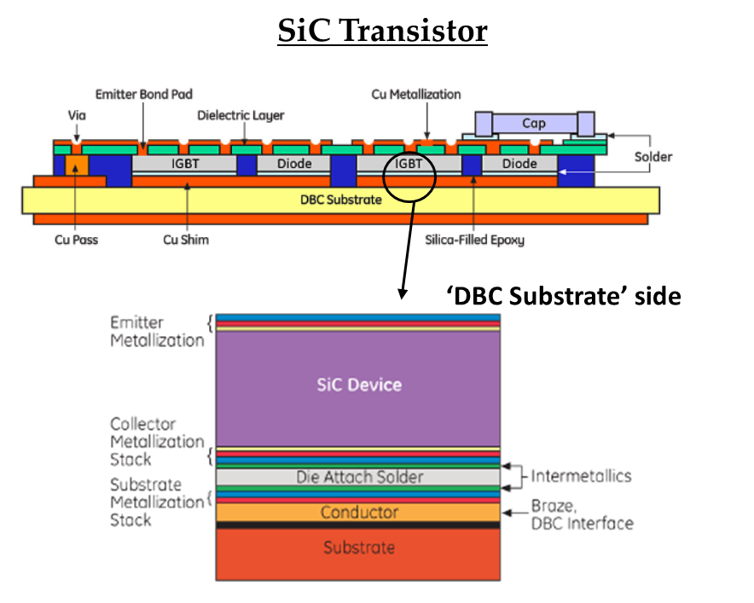
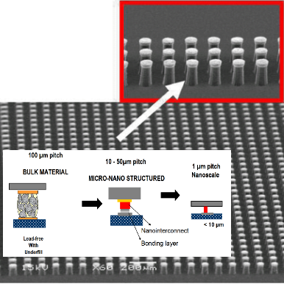
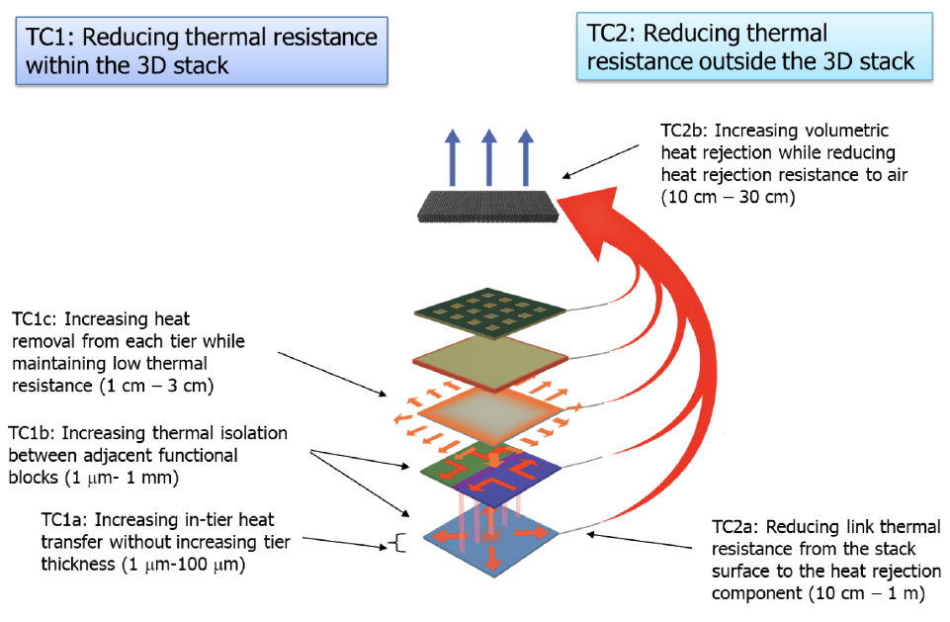
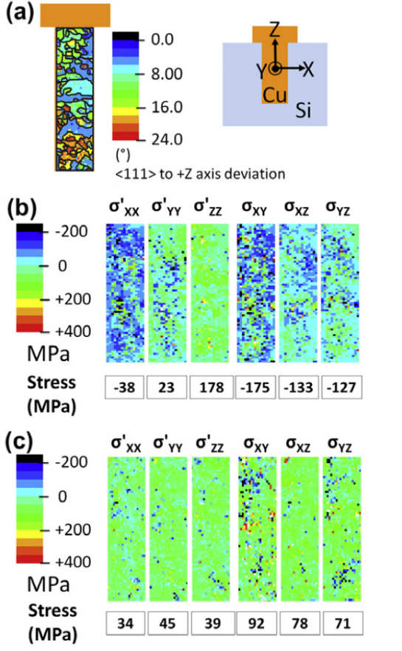
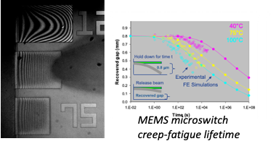
Halide and Chalcogenide Thin-Films
Dimensionally modified chalcogenides and perovskites
Thin-film tandem solar cells and clean energy generation
Electro-Optical-Thermal Reliability of Thin-film Solar Cells
  Metastability and long-term degradation in thin-film chalcogenide and halide perovskite solar cells
Solar Energy Materials
Thin-film solar cells degradation
Metastability in CIGS thin-film PV
Thin-film PEC devices for CO₂ reduction
High-efficiency thin-film tandem solar cells
Advanced Packaging Materials
Substrate, Interconnect, and thermal interface materials, assembly and reliability for heterogeneous integration for HPC/AI and Harsh Environment
Electro-Optical-Thermal In-Situ Reliability
Physics-based degradation models and life-prediction
Failures @ embedded interfaces
X-ray imaging synchrotron
High bandwidth Chip-to-substrate interconnects
Semiconductor Packaging
DARPA Minitherms3D
X-ray measurements for deviatoric stress for TSVs.

Slide 3
Course Description
Shubhra Bansal
Associate Professor
School of Mechanical Engineering, School of Materials Engineering
Office: FLEX 3081D
Email: bansal91@purdue.edu
Office Hours: M-W-F 10:30-11:30 am in ME 2008A

Slide 4
Teaching Assistants

Slide 5
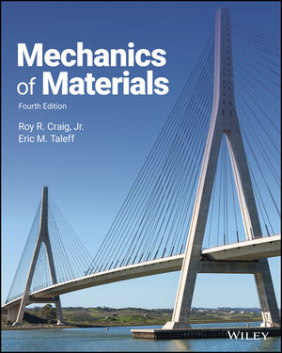
Reference Text
Required: Course lecture book to be purchased at University Bookstore.
Optional: Mechanics of Materials, R.R. Craig, Wiley, 3rd edition, 2011.
Reference texts: Copies of three different mechanics of materials textbooks (by authors Craig, Hibbeler and Philpot) will be available at the reserve desk for the Engineering/Science library on the second floor of WALC. These books will be available for two-hour checkout starting during the second week of classes.
Solutions to examples in pdf or Youtube videos
Discussion forum for students
COURSE BLOG https://www.purdue.edu/freeform/me323/

Slide 6
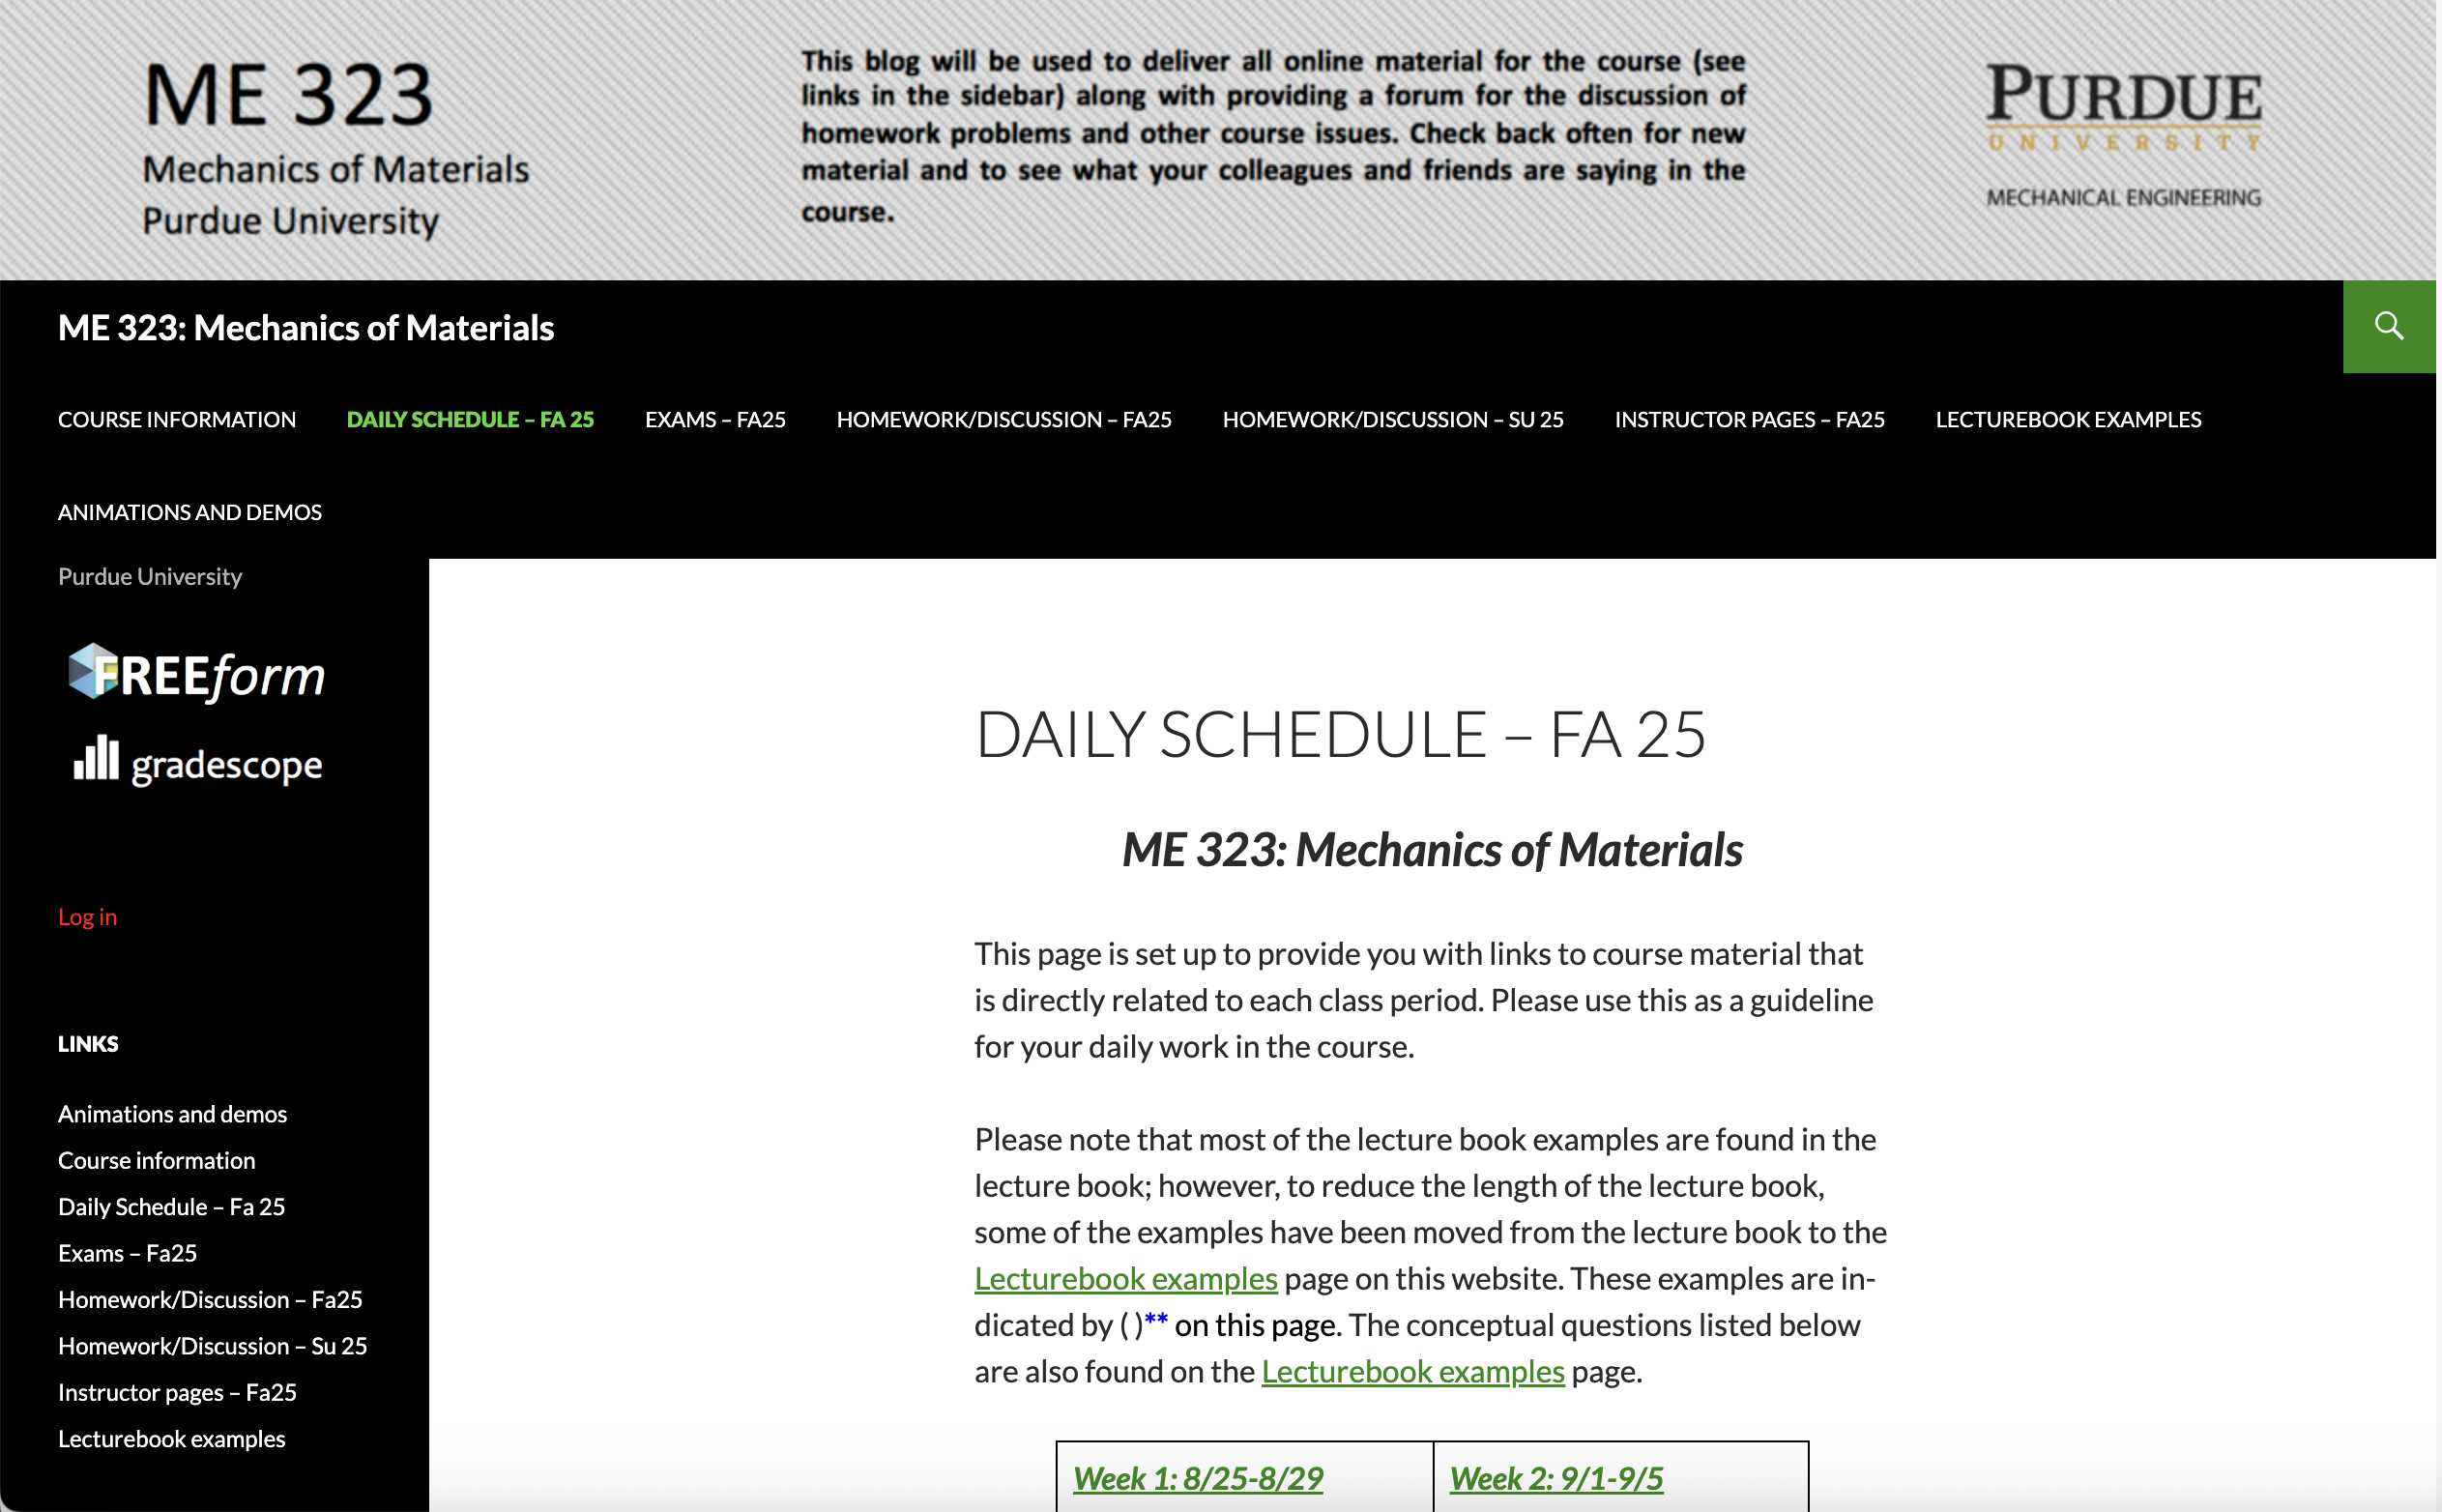
ME 323 Website
COURSE BLOG https://www.purdue.edu/freeform/me323/

Slide 7
Grading
Grade Categories | Percentage
Homework + Quizzes | 30%
Exam 1 and 2 | 25% or 45%
Final Exam | 45% or 25%
If you score better on the average of Exams 1 and 2 than you do on the Final, the average of these two midterm exams will count as 45% and the Final will count as 25% of your final grade, vice versa.

Slide 8
Homeworks and Quizzes
Weekly homework (Total 11 homeworks)
Typically, one homework set will be due every week, except for weeks during which exams are given. Homework must be submitted by 11:59pm (EST) on Friday unless otherwise posted. Please post your HW on Gradescope on the appropriate HW link using a single PDF file (you will be asked to prescribe which page(s) each problem is on in Gradescope).
The late submission window lasts for 24 hours after the initial due date. Late submission grading policy: -2.25 points for Questions 1-3. Please review your homework submission after it has been uploaded onto Gradescope to ensure that all work has been properly submitted. If for some reason you have problems posting your HW on Gradescope, please email the instructor the PDF of your HW before the 11:59pm (EST) deadline with an explanation. There is no specific format for submission of the HW. However, your work needs to be presented with a logical thought process and in a neat, easy-to-read style. Failure to do so can result in a loss of points in your homework grade.
Unannounced quizzes will be given regularly throughout the semester. Make-up quizzes will not be given.

Slide 9
Course Schedule
Bansal on travel, video lectures will be posted in Freeform Course Blog
No Lectures

Slide 10
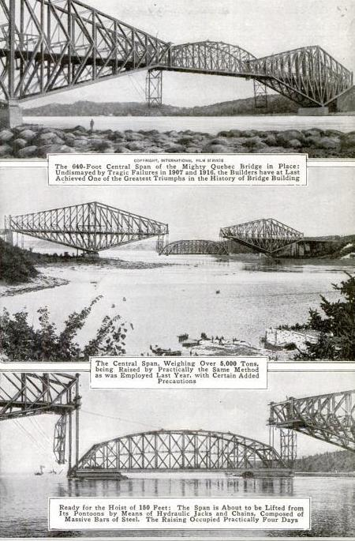
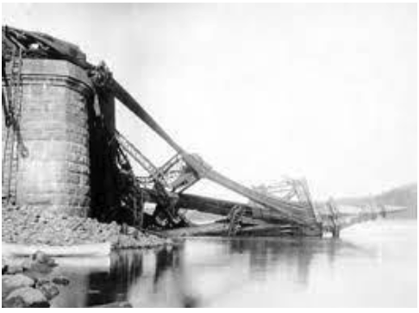
Infrastructure Disaster – Quebec Bridge 1907
Collapsed and killed 86 workers.
Collapsed again in 1916 and killed 15 workers.

Slide 11
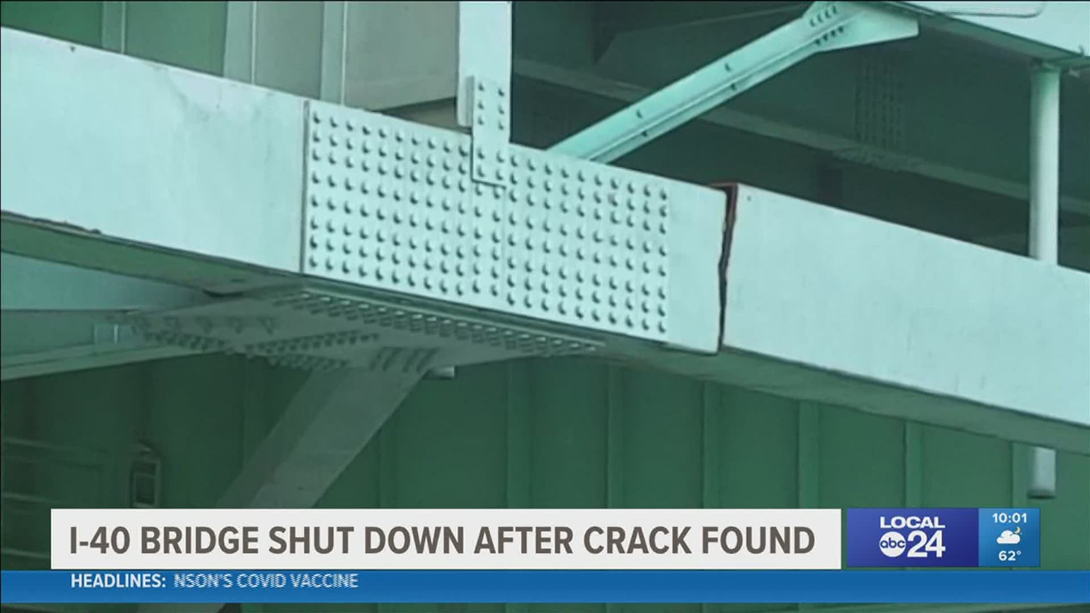
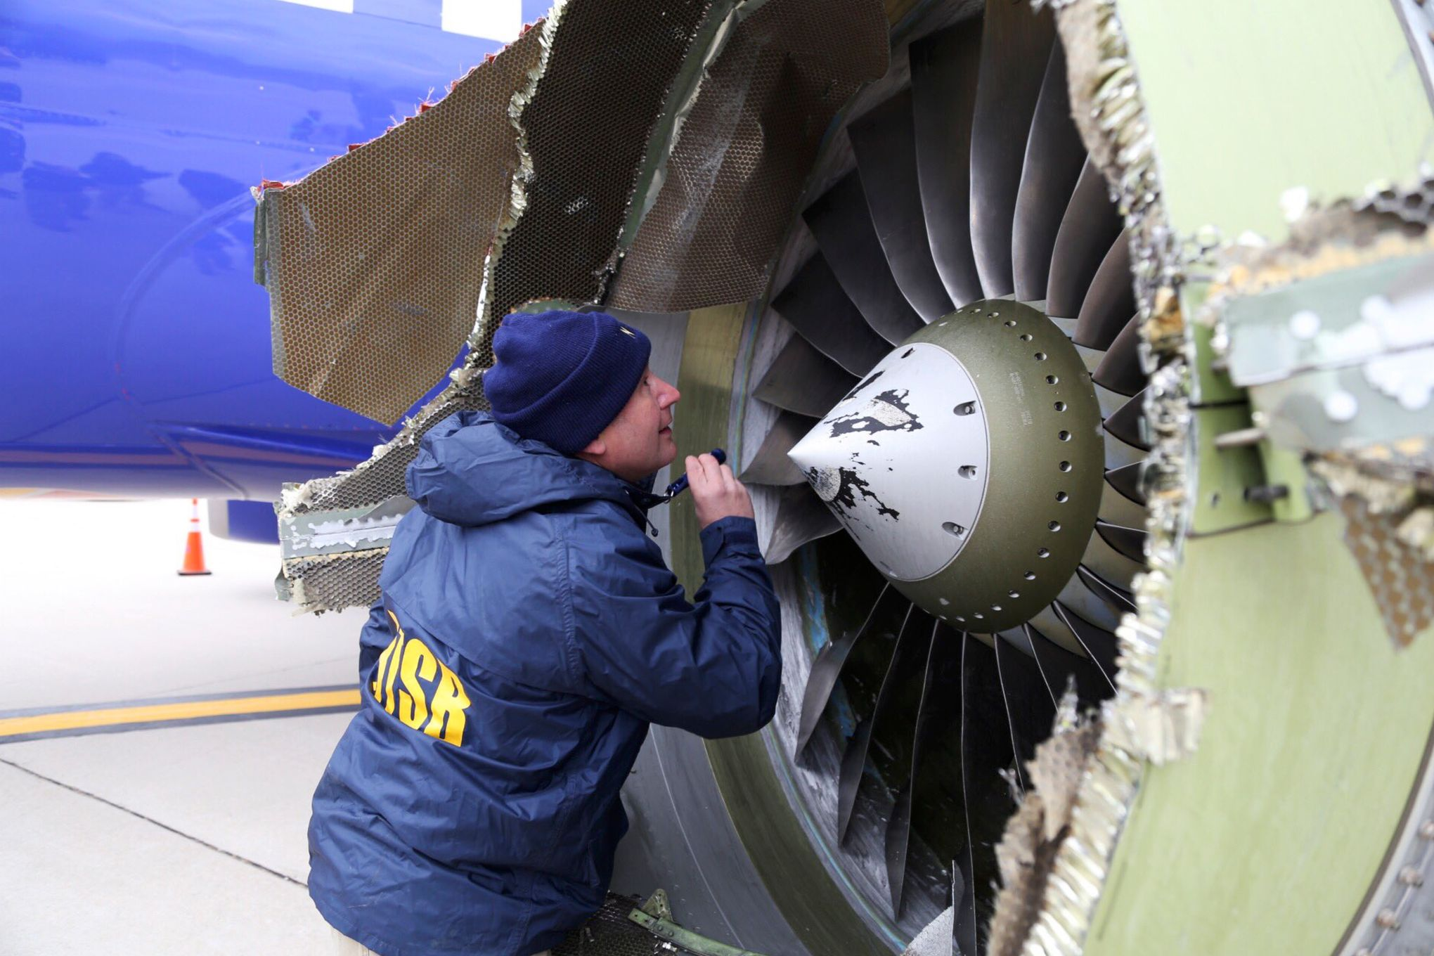
Modern Day Examples..
I-40 bridge, May 2021
Southwest 1380, April 2018

Slide 12
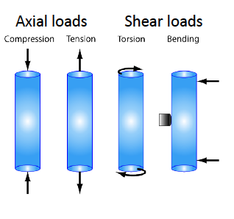
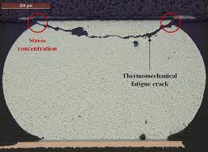
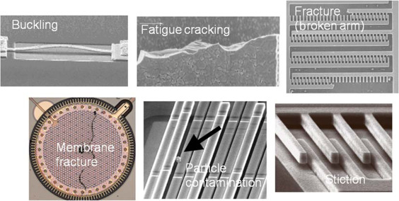
Mechanics of Materials
To study internal effects of stress and strain in a solid body that is subjected to an external loading..
In this course, we study the statics of deformable bodies upon applying external loads.
  Entry point into the studies of solid and continuum mechanics
  Design of structures against failure
Diverse applications:
  automobile components
  bridges, buildings
  bone mechanics and tissue engineering
  data storage systems
  electronic packaging
  Microelectromechanical systems (MEMS)
  packaging of consumer products
  sports equipment
Solder joint failure
MEMS device failures

Slide 13
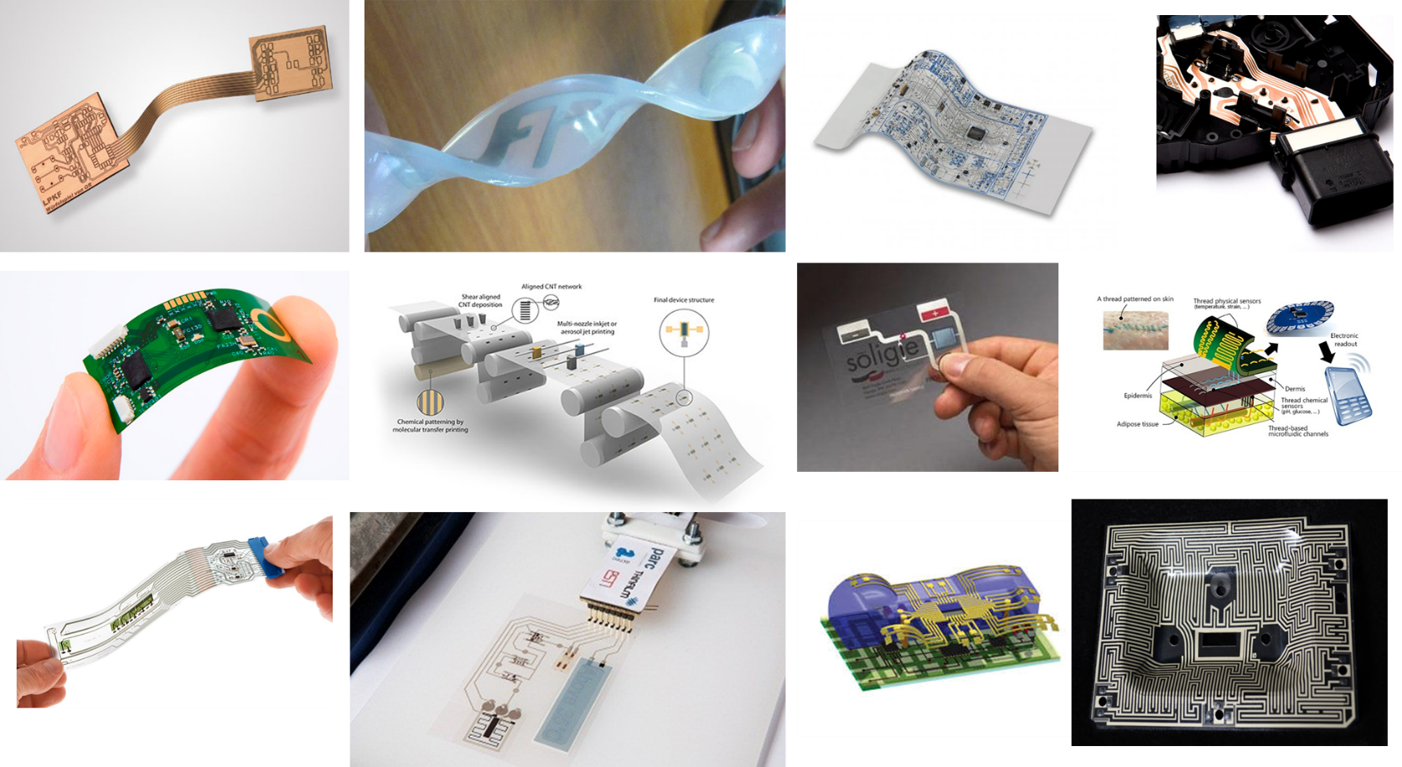
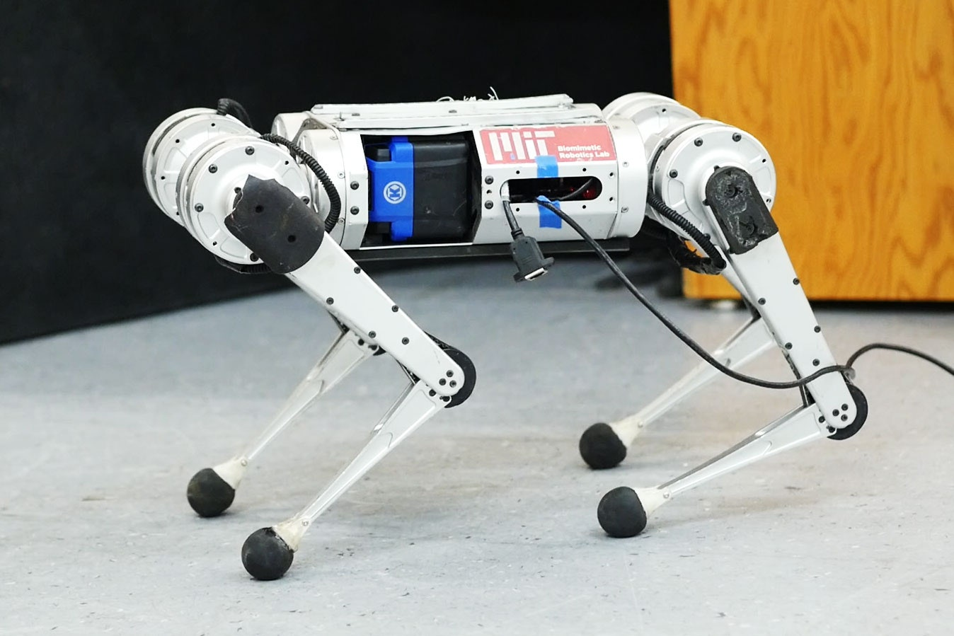
Modern Day Applications

Slide 14
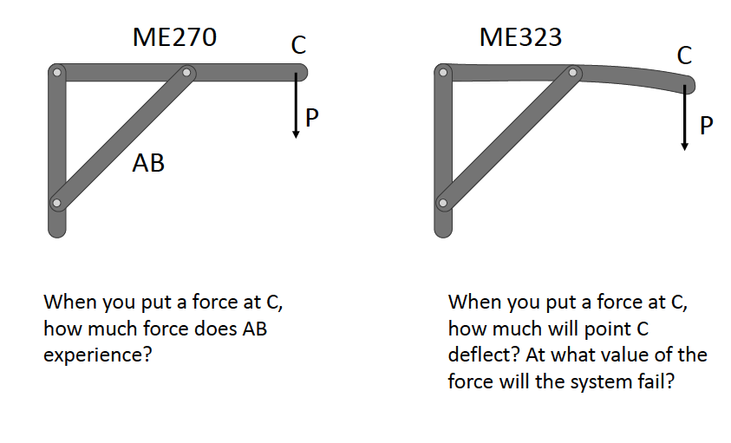
ME323: Statics with Deformable Structures

Slide 15
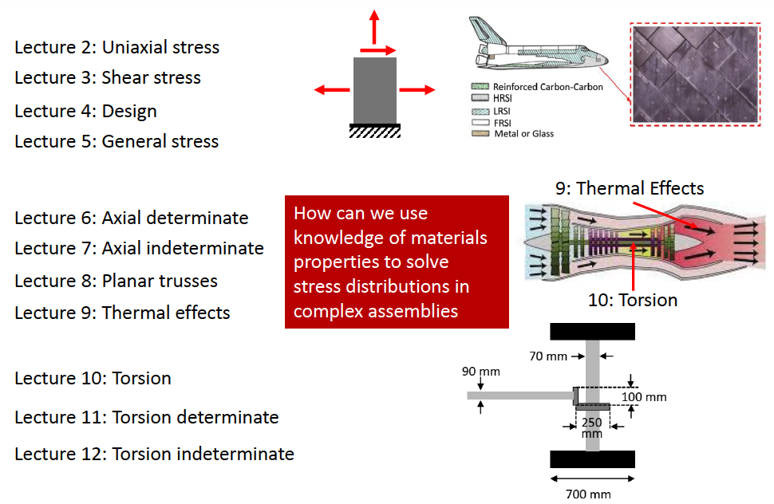
Course Overview

Slide 16
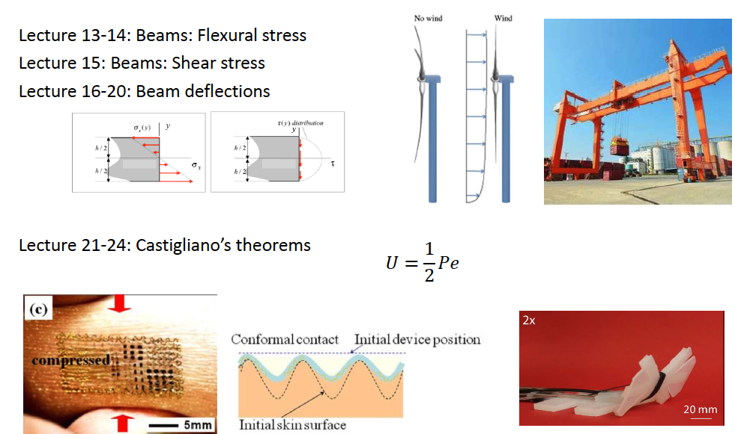
Course Overview

Slide 17
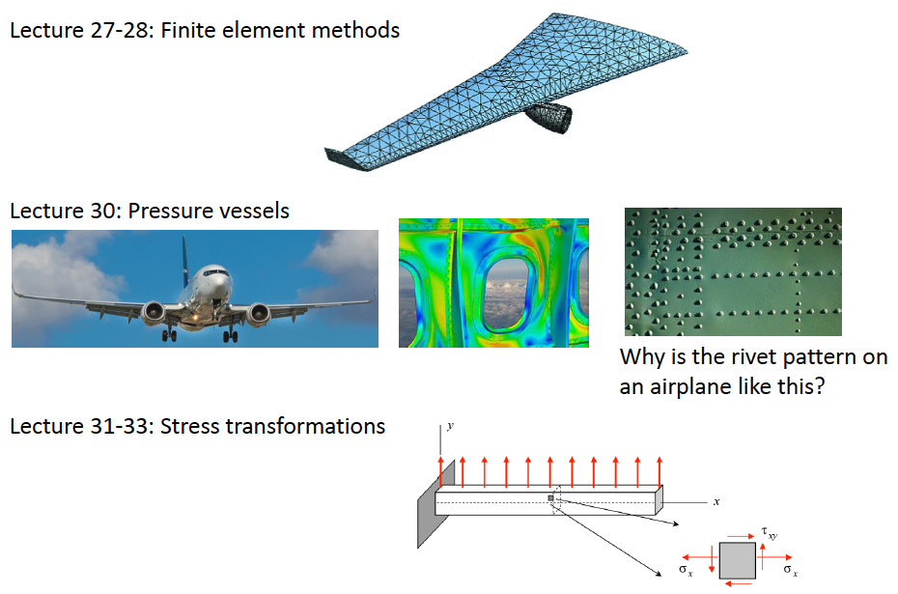
Course Overview

Slide 18
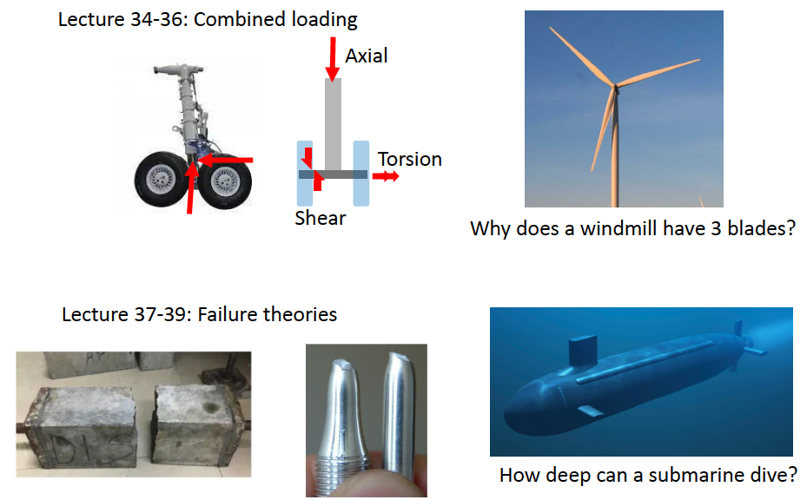
Course Overview

Slide 19
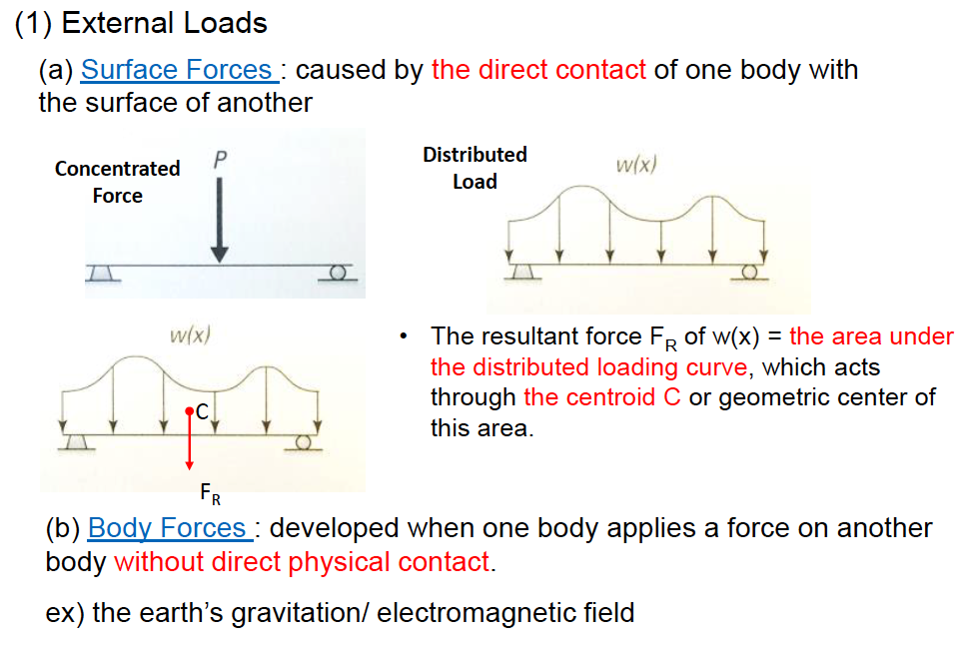
Equilibrium of Deformable Body
External Loads

Slide 20
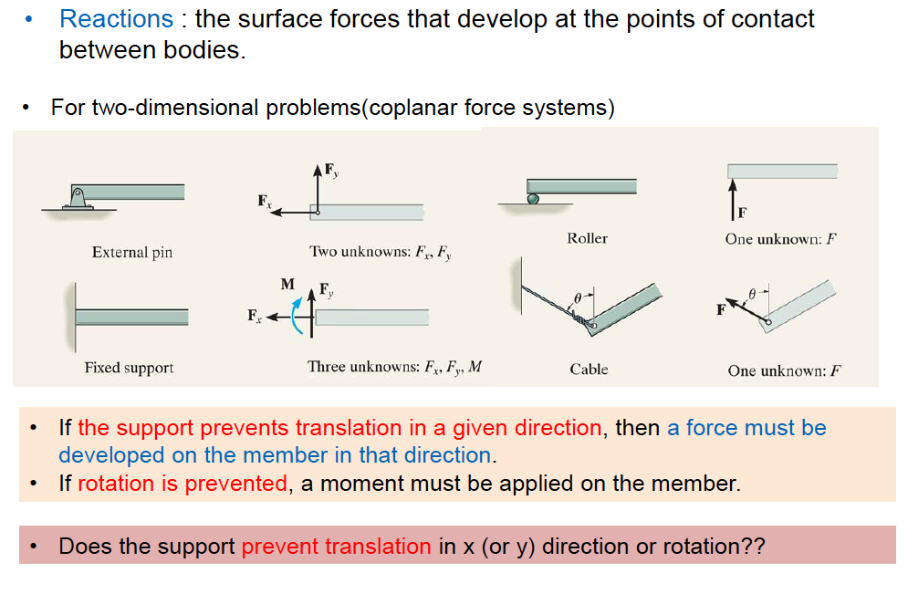
Support Reactions

Slide 21
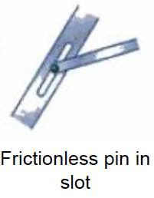
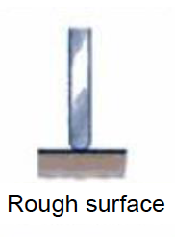
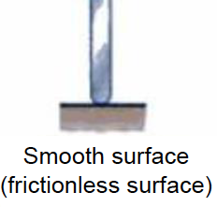
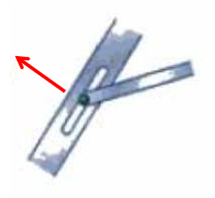
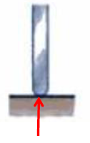
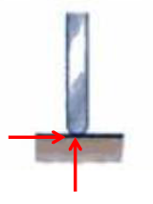
Support Reactions

Slide 22
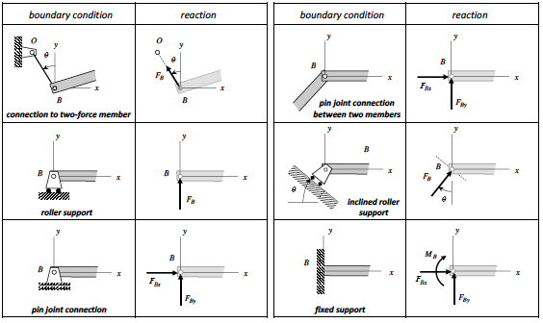
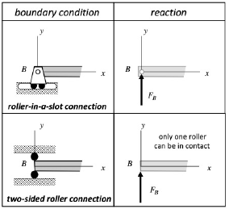
Support Reactions
In either case, only a single reaction force is produced, with the direction of the reaction force dictated by on which side of the slot or on which roller that contact is made. For the reactions shown here, contact with the bottom of the slot and contact with the lower roller is assumed in drawing the reaction force.

Slide 23
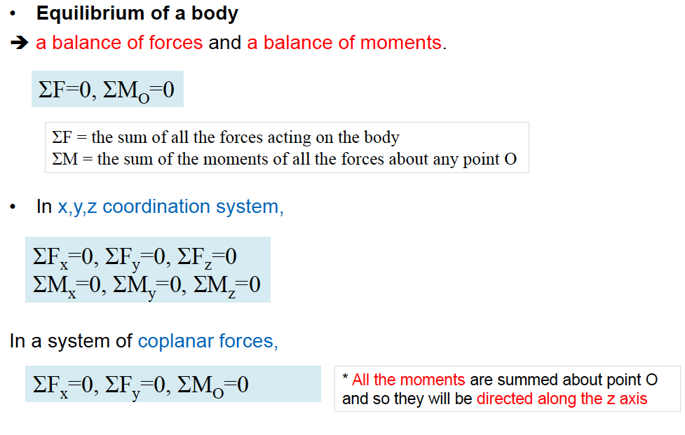
Equations of Equilibrium
Necessary conditions for equilibrium of a body (rigid or deformable)

Slide 24
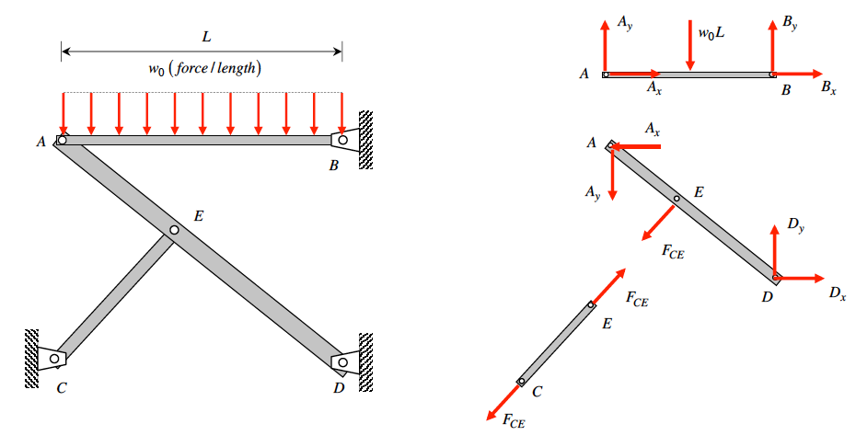
Free Body Diagrams
Determine the extent of the body to be included
Completely isolate this body from its supports/ other attached bodies
To determine internal resultants, use sectioning planes
Positive vs. negative forces (we will consider tension +ve)
Right hand rule to determine direction of moment vector

Slide 25
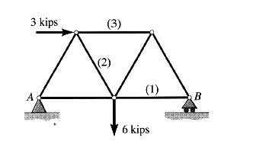
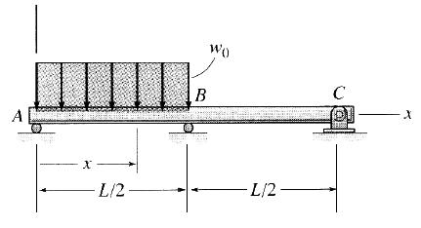
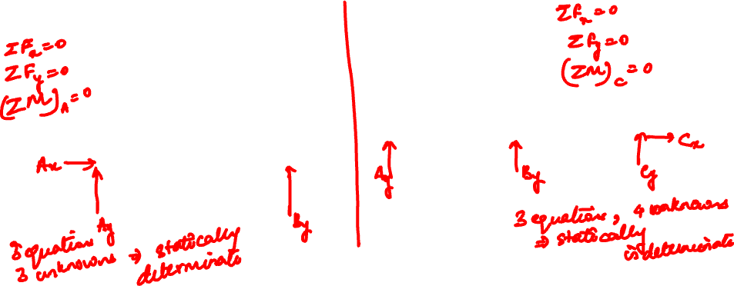
Example 1.1 from Lecturebook
Complete the free body diagrams below. Which of the following systems are statically determinate for the support reactions?
What are statically determinate and indeterminate problems?
Number of independent equilibrium equations
Number of variables

Slide 26
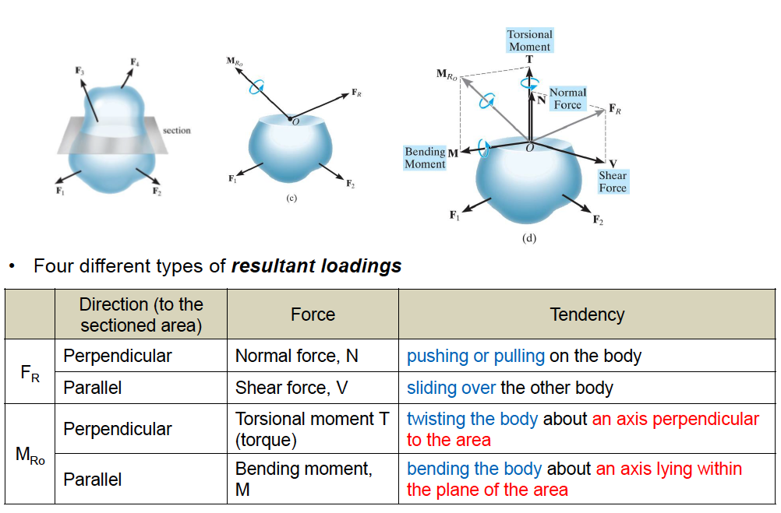
Internal Resultants

Slide 27
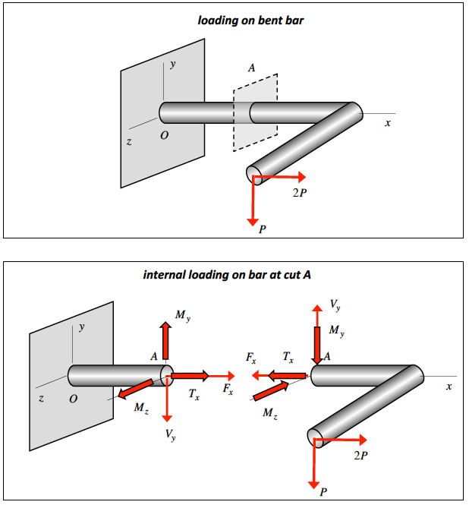
Internal Resultants

Slide 28
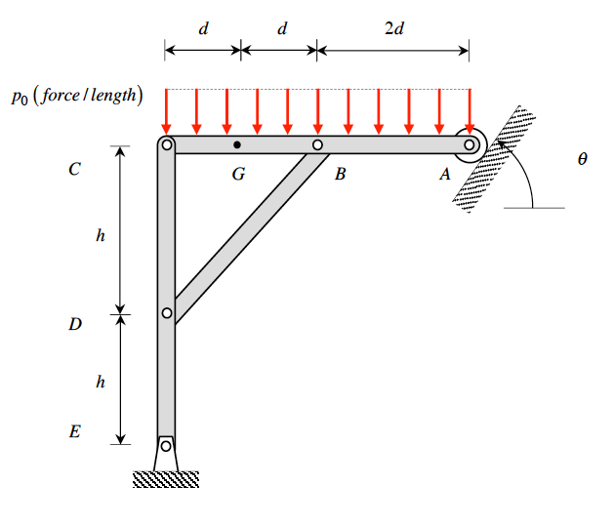
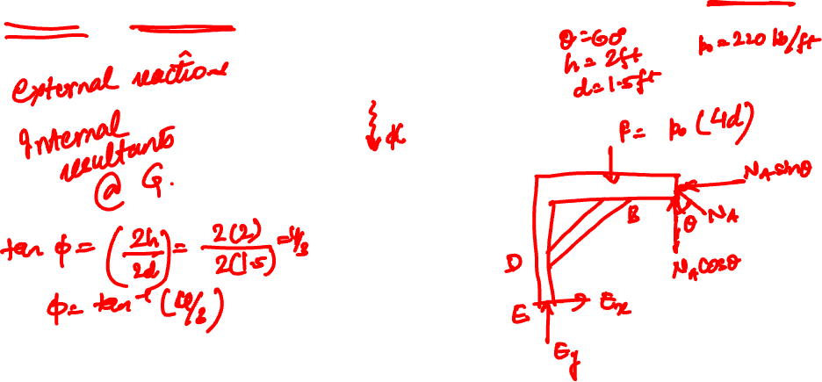
Example 1.3 from Lecturebook
The uniform distributed load on member AC has a magnitude of p₀ . Determine the internal axial force, shear force and bending moment acting on the left face of the cross section of member AC at G.
2

Slide 29
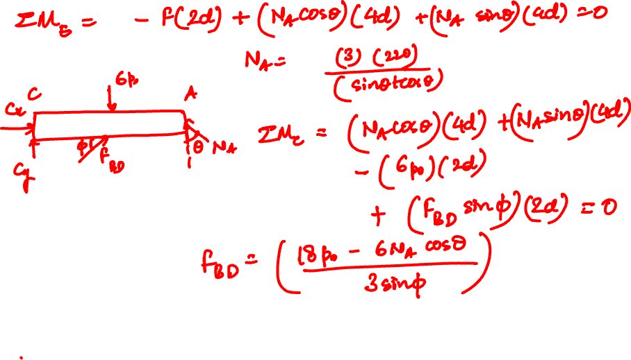

Slide 30
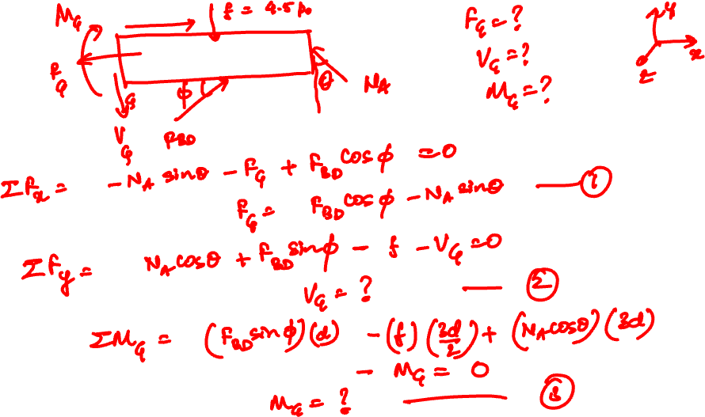

Slide 31
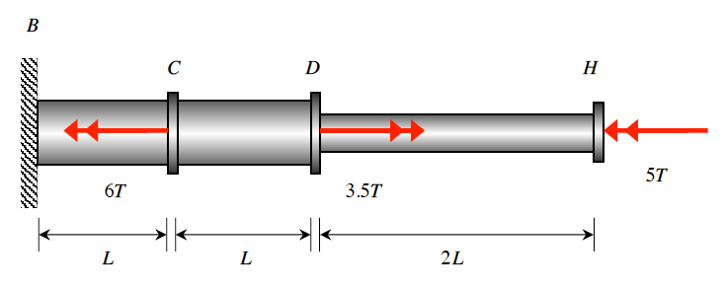
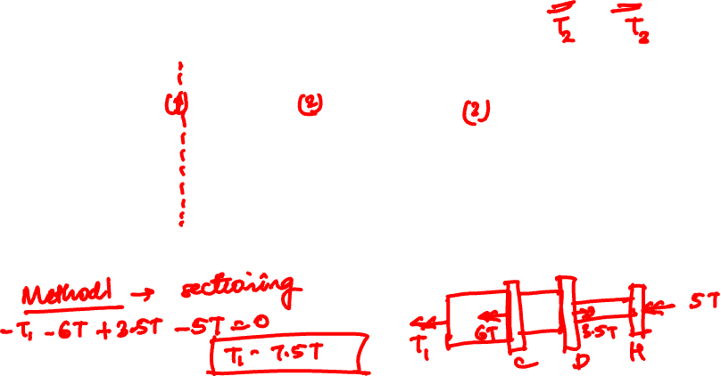
Example 1.6 from Lecturebook
Determine expressions for the internal resultant torques in sections CD and DH due to the applied torques at C, D and H.

Slide 32
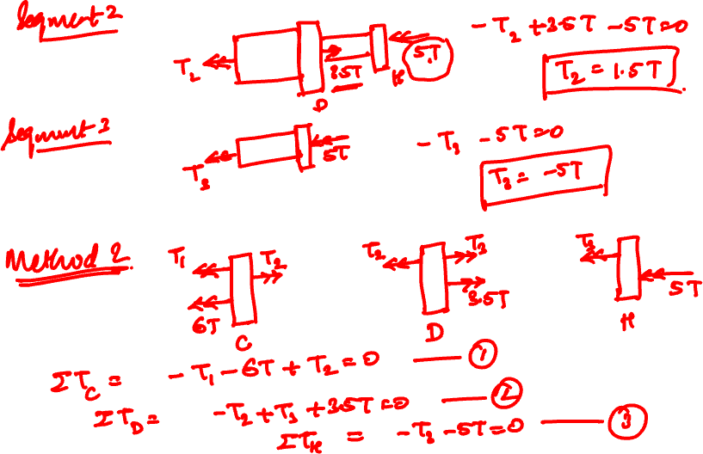

Slide 33
Thank You

