Slide 1
MECHANICS OF MATERIALS
Fall 2023
ME 323- 005
Instructor: Shubhra Bansal
Lecture 41: Practice Problems

Slide 2
Announcements
Course Evaluations
Dec 4, 6: Failure theory practice questions
Dec 8: Course revision
Exam time/date/location: Dec 16, 10:30am - 12:30pm
WTH 172
Final Exam:
  Q1, Q2, Q3 on material covered since Exam 2
  Q4 conceptual question is comprehensive

Slide 3
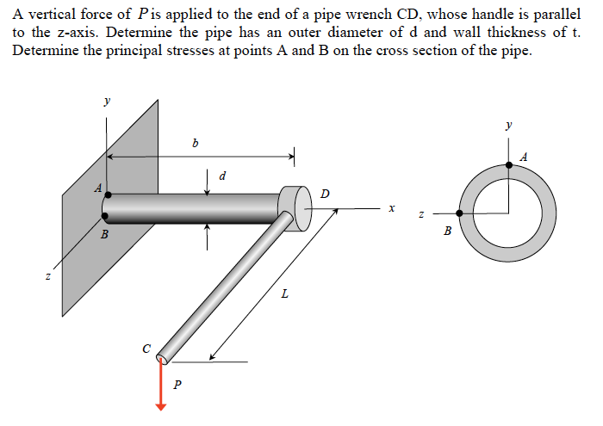
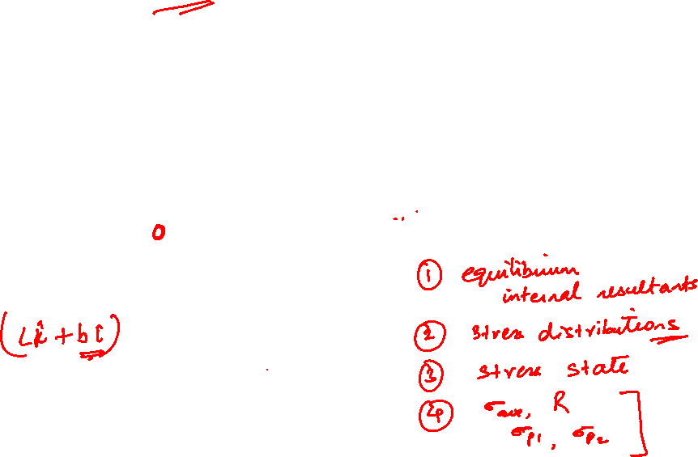
Example 14.4 from Lecturebook

Slide 4
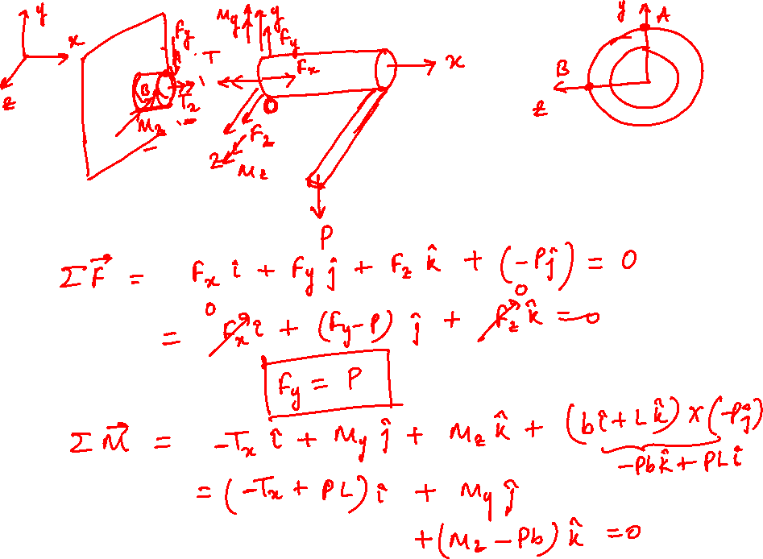

Slide 5
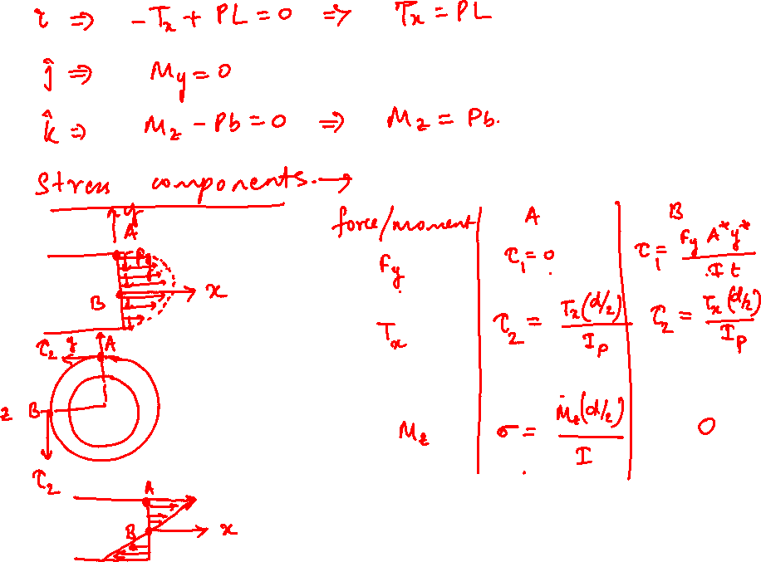

Slide 6
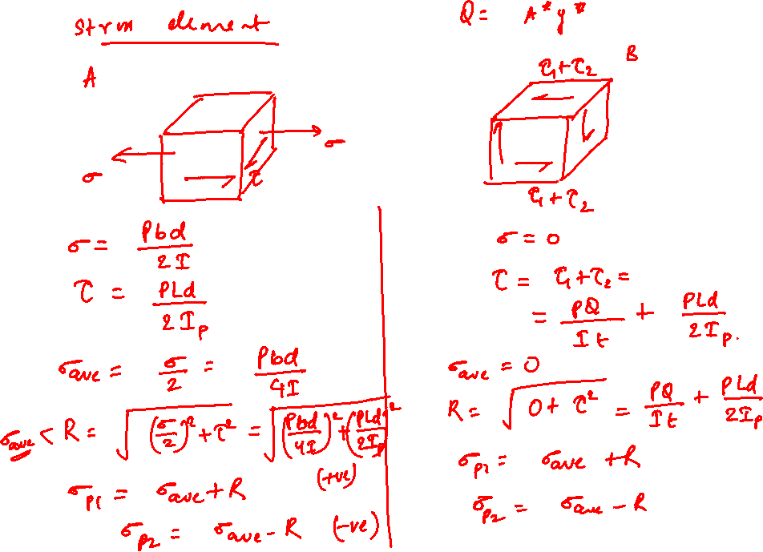

Slide 7
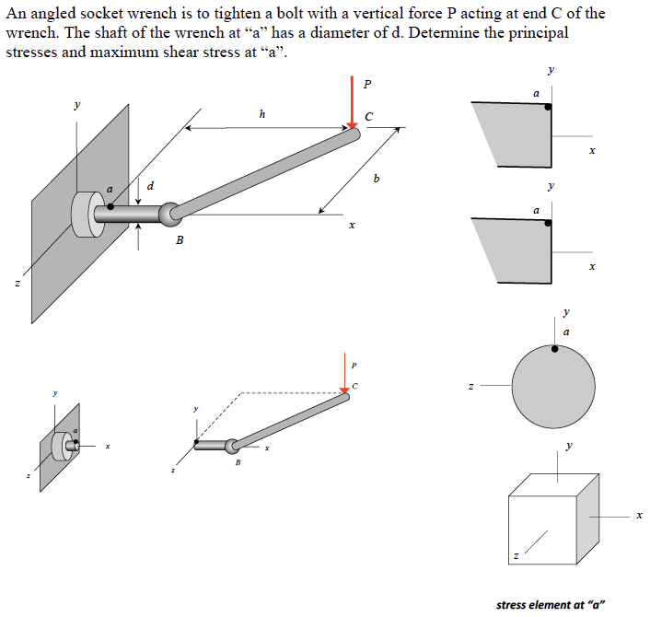
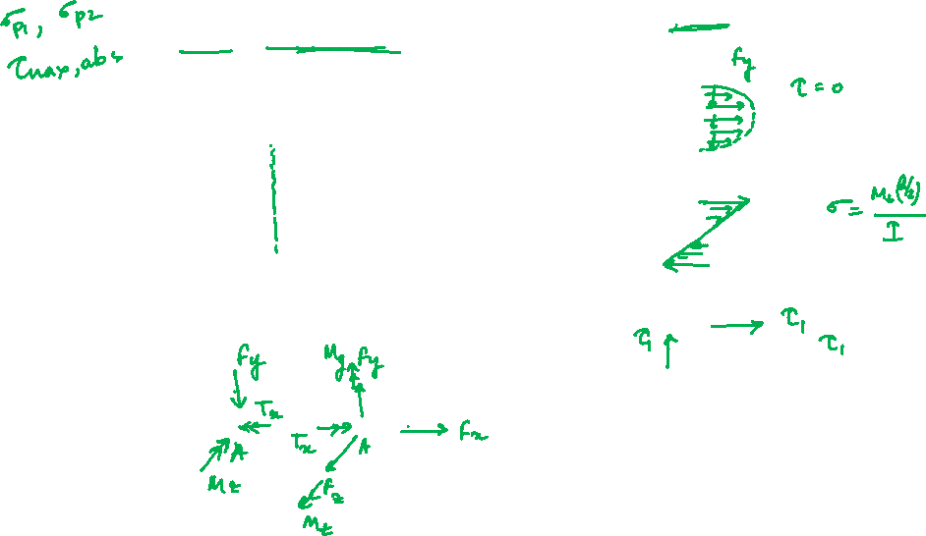
Example 14.11 from Lecturebook

Slide 8
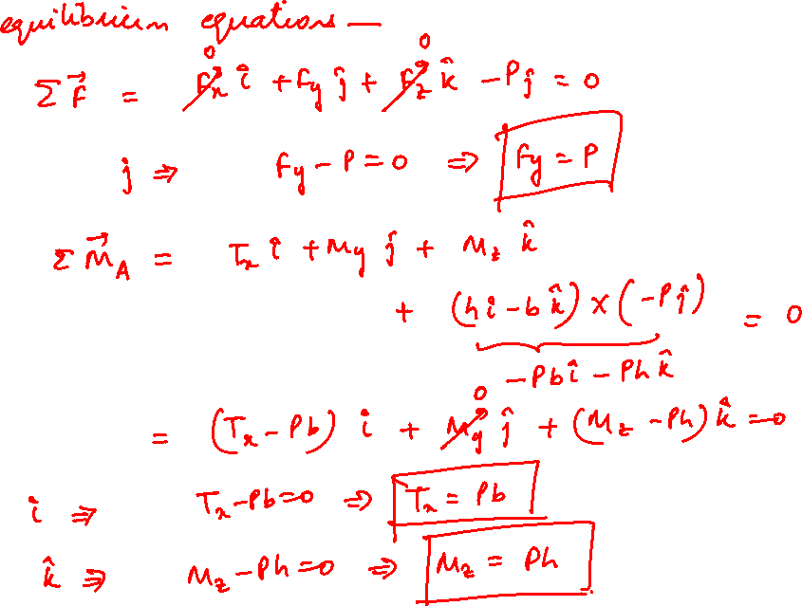

Slide 9
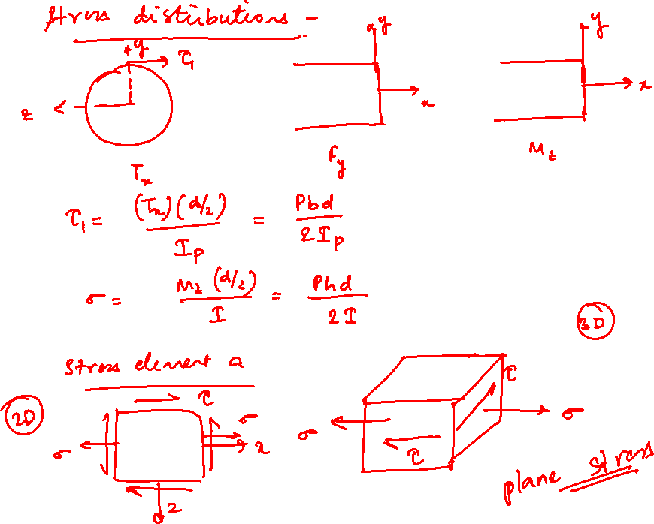

Slide 10
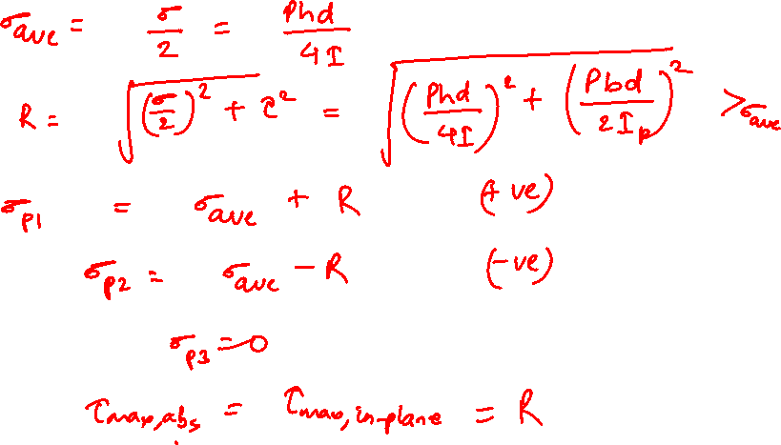

Slide 11
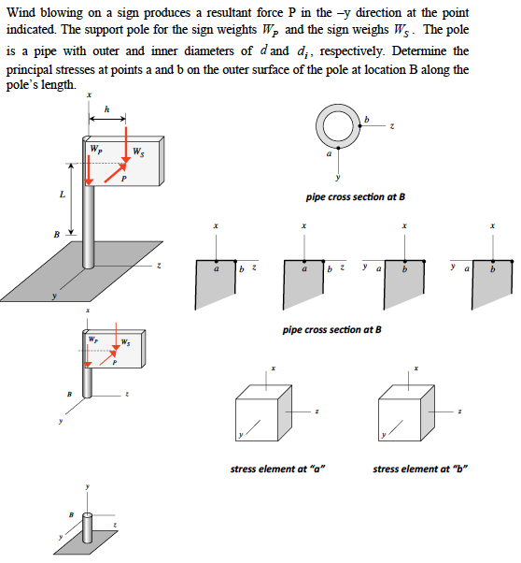
Example 14.12 from Lecturebook

Slide 12
Thank You

