Slide 1
MECHANICS OF MATERIALS
Fall 2023
ME 323- 005
Instructor: Shubhra Bansal
Lecture 40: Failure Theories Practice Problems

Slide 2
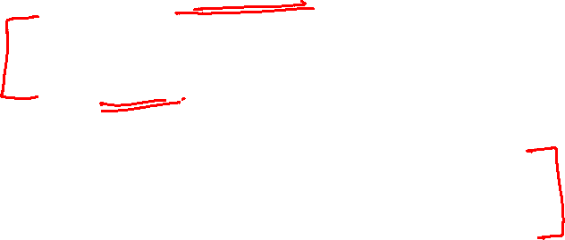
Announcements
Course Evaluations
Dec 4, 6: Failure theory practice questions
Dec 8: Course revision
Exam time/date/location: Dec 16, 10:30am - 12:30pm
WTH 172
Final Exam:
Q1, Q2, Q3 on material covered since Exam 2
Q4 conceptual question is comprehensive

Slide 3
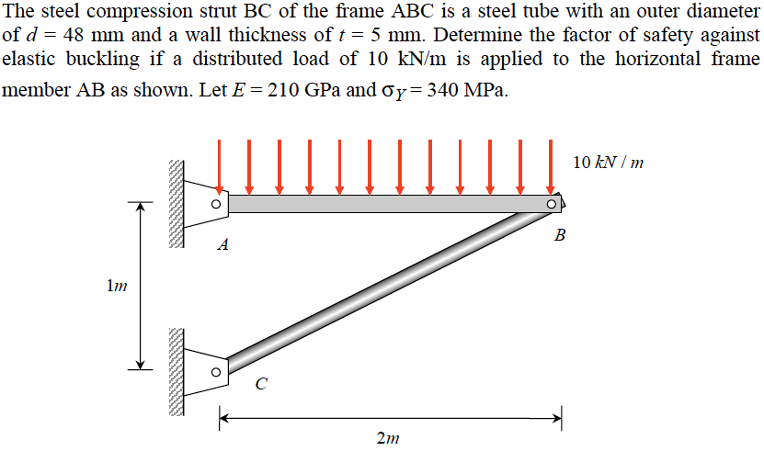
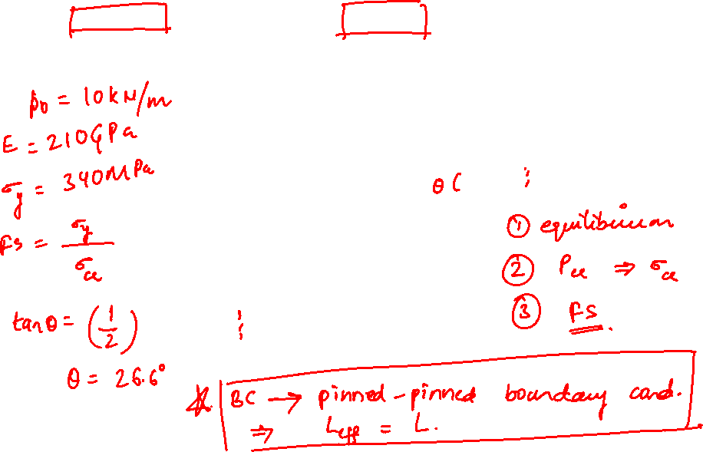
Example 18.2 from Lecturebook

Slide 4
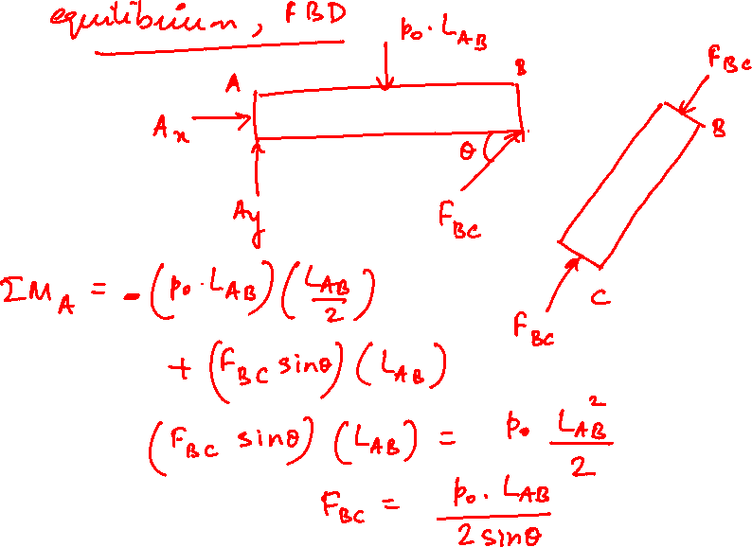

Slide 5
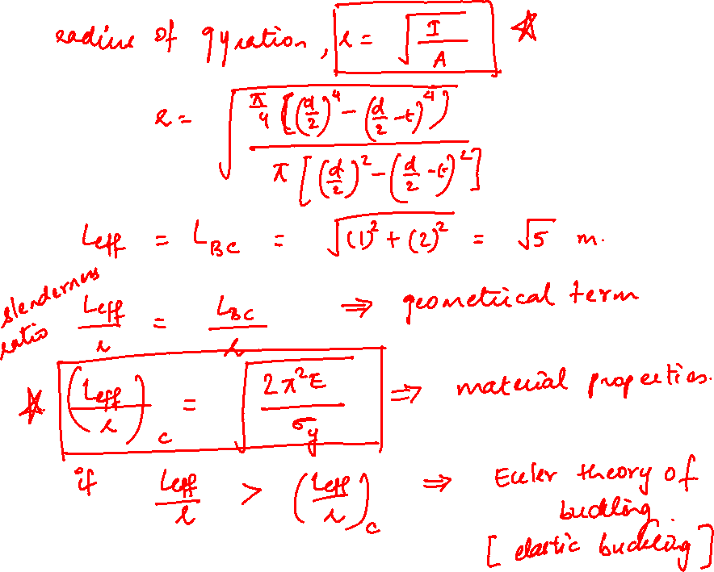

Slide 6
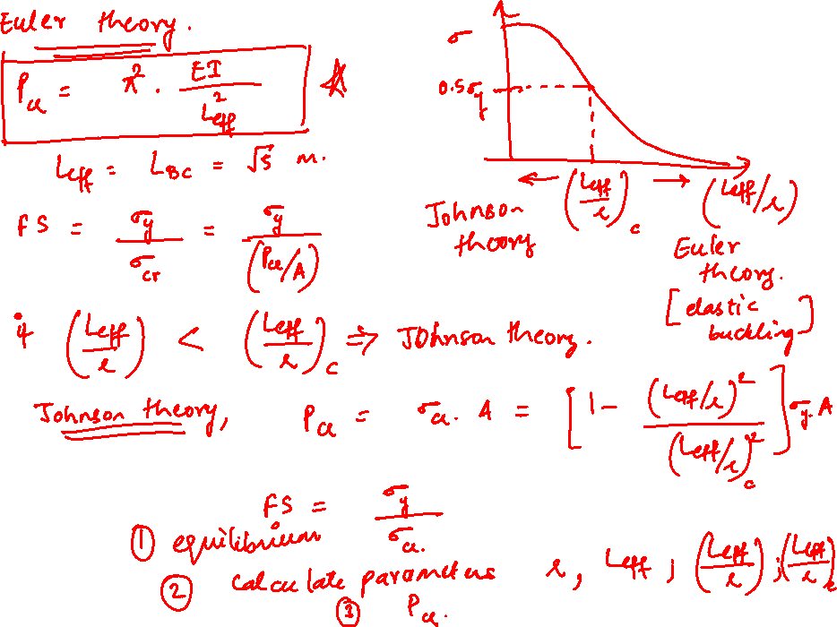

Slide 7
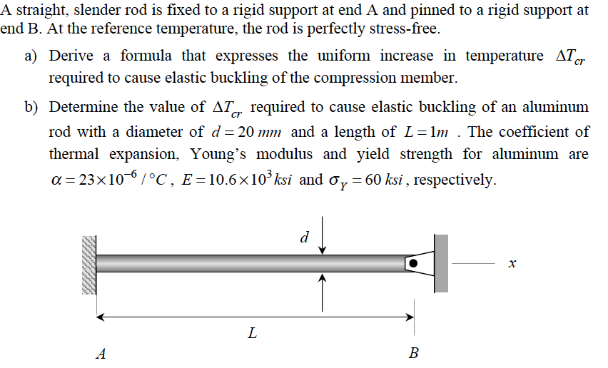
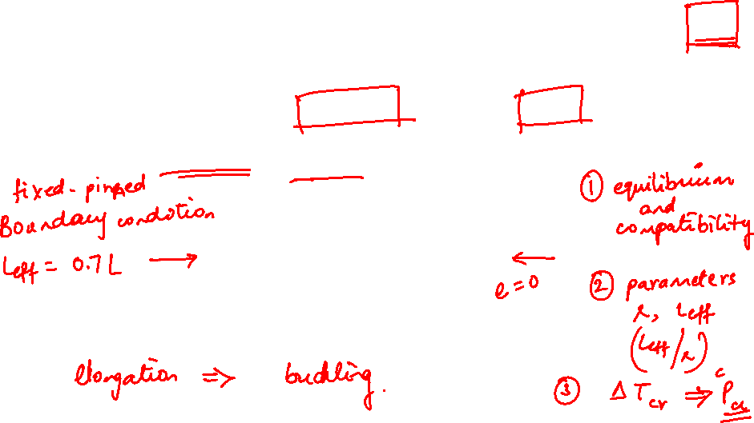
Example 18.4 from Lecturebook

Slide 8
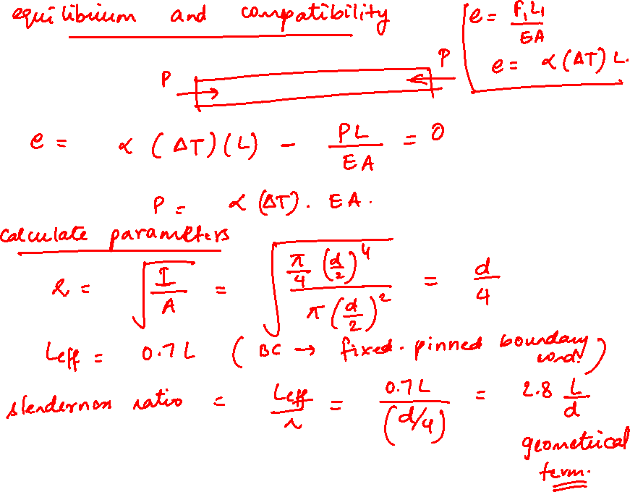

Slide 9
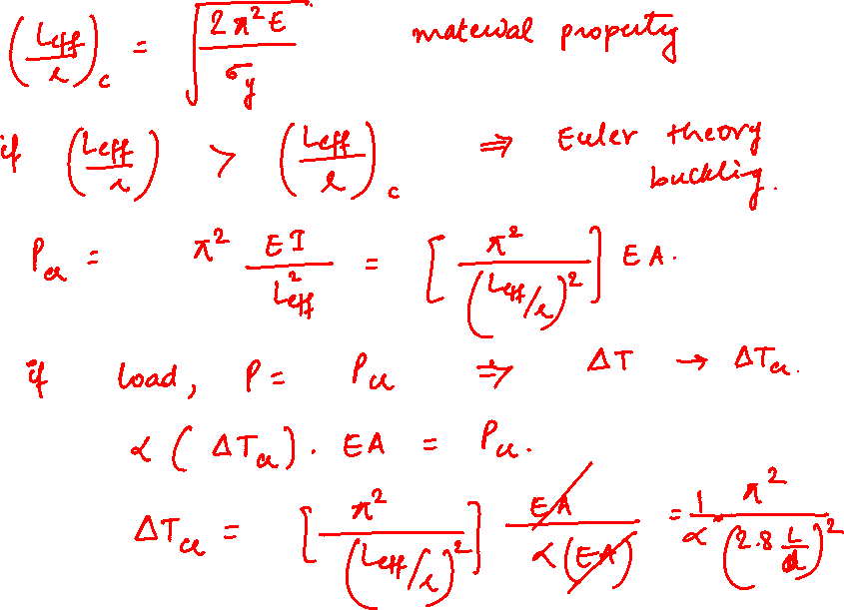

Slide 10
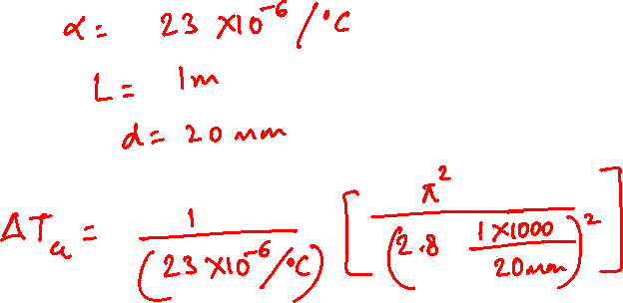

Slide 11
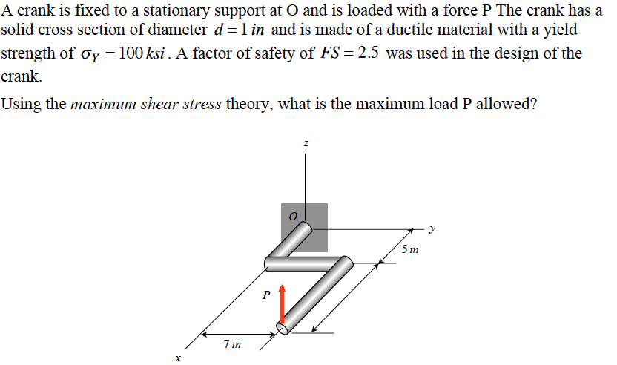
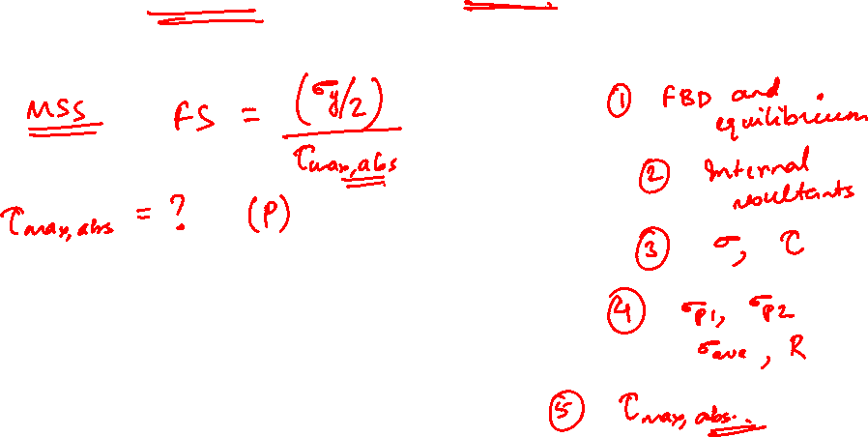
Example 15.4 from Lecturebook

Slide 12
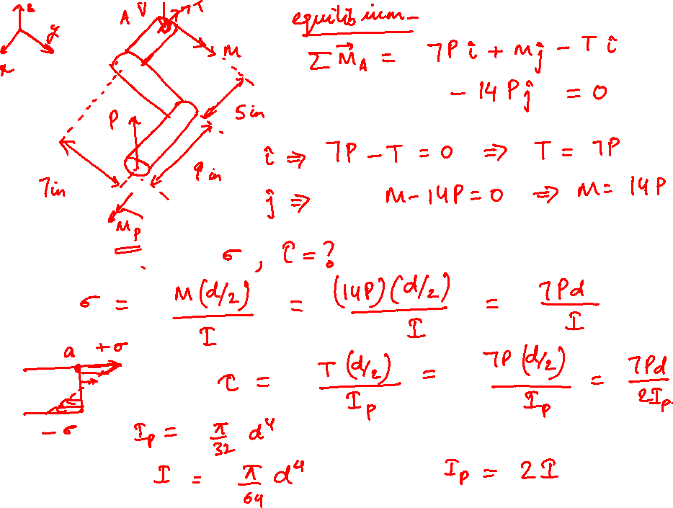

Slide 13
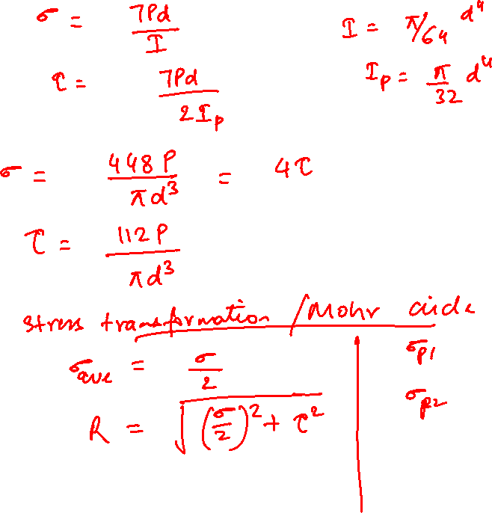


Slide 14
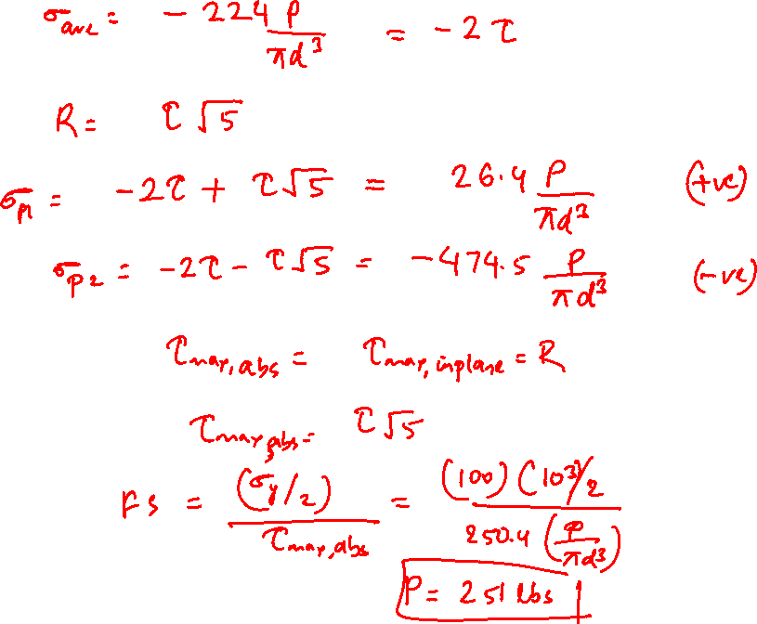

Slide 15
Thank You

