Slide 1
MECHANICS OF MATERIALS
Fall 2023
ME 323- 005
Instructor: Shubhra Bansal
Lecture 29: Introduction to Finite Element Methods

Slide 2
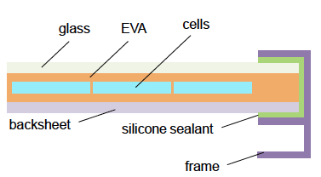
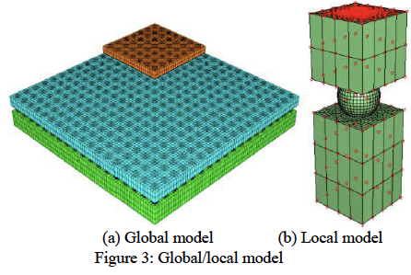
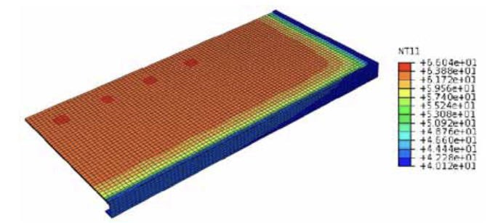
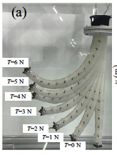
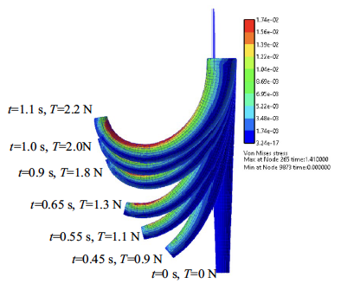
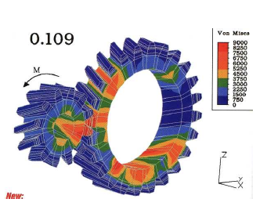
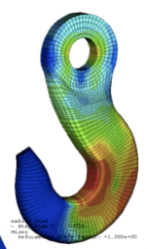
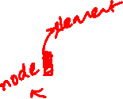
Finite Element Methods- Finite Element Analysis
Deformation in Solder Joints in Semiconductor Packages
Deformation/ Temperature Distribution in PV panels
Deformation in Soft Robots
Complex Geometries
In Real Systems: Geometries are complex, material properties may not linear!

Slide 3
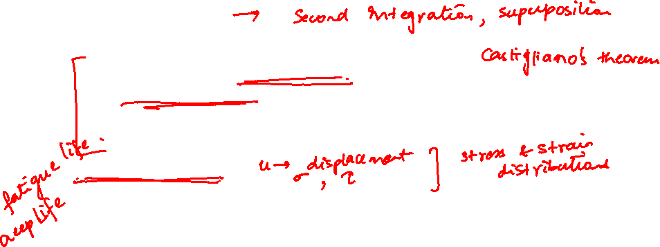
Finite Element Methods- Finite Element Analysis
The Finite Element Analysis (FEA) is a numerical method for solving problems of engineering and mathematical physics.
Useful for problems with complicated geometries, loadings, and material properties where analytical solutions can not be obtained.
Analytical Solutions:
  Stress analysis for trusses, beams, and other simple structures are carried out based on dramatic simplification and idealization:
    mass concentrated at the center of gravity
    beam simplified as a line segment (same cross-section)
    Design is based on the calculation results of the idealized
    structure & a large safety factor (1.5-3) given by experience
Finite Element Analysis:
  Design geometry is a lot more complex; and the accuracy requirement is a lot higher. We need
    To understand the physical behaviors of a complex object (strength, heat transfer capability, fluid flow, etc.)
    To predict the performance and behavior of the design; to calculate the safety margin; and to identify the weakness of the design accurately; and
    To identify the optimal design with confidence
FEA grew out of aerospace industry, paralleled the growth in computation!

Slide 4
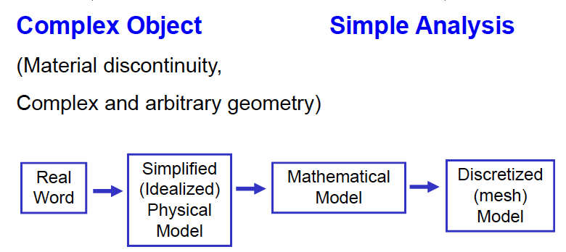
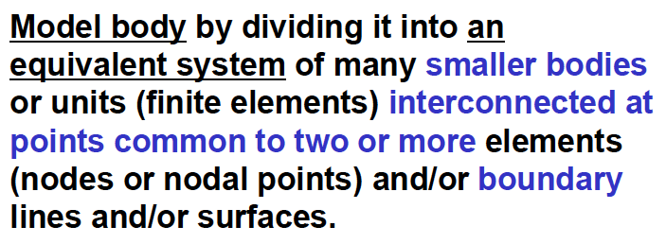
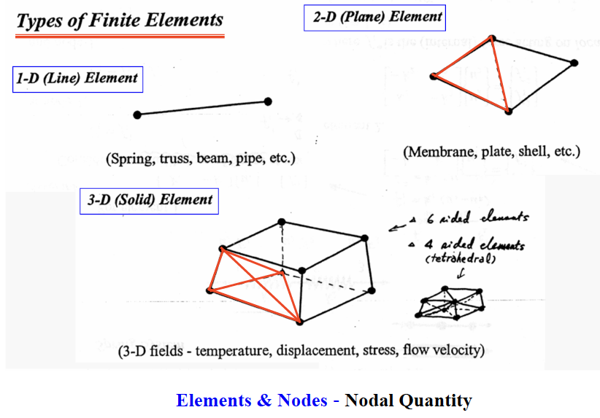

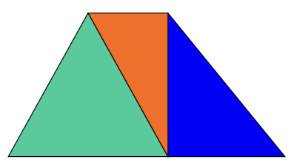
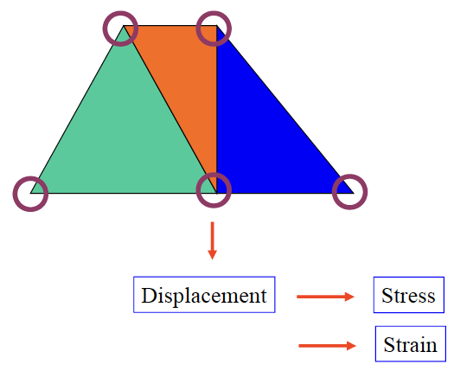
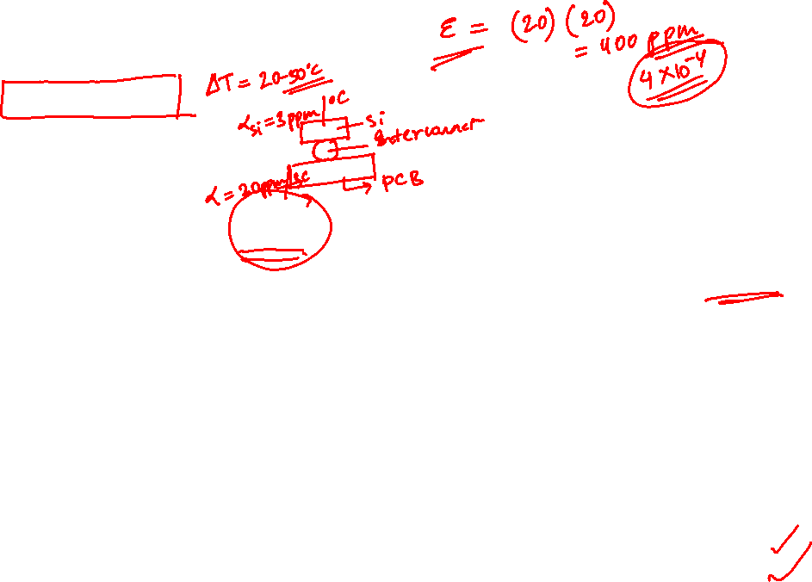
Finite Element Analysis
Discretization
Object
Elements
Nodes

Slide 5
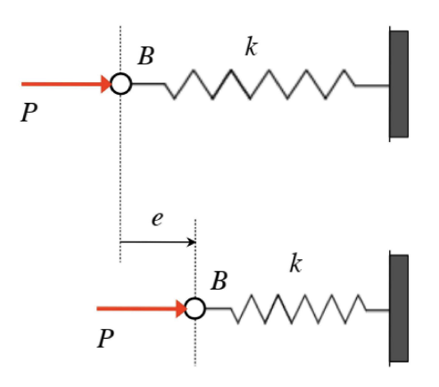
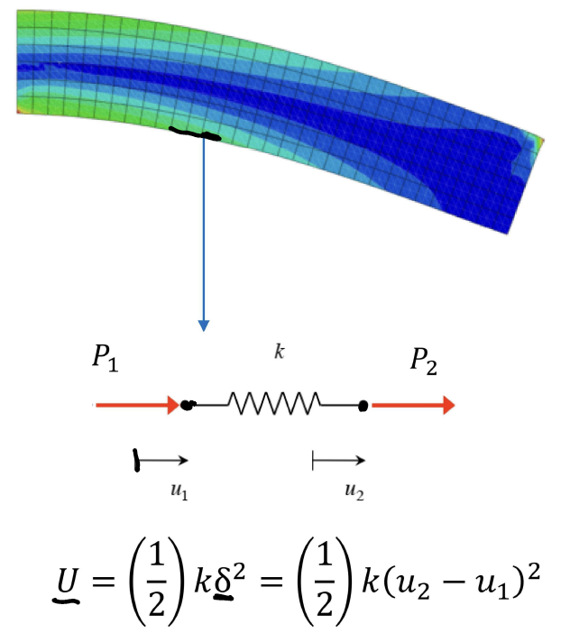
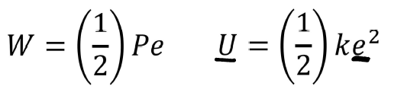
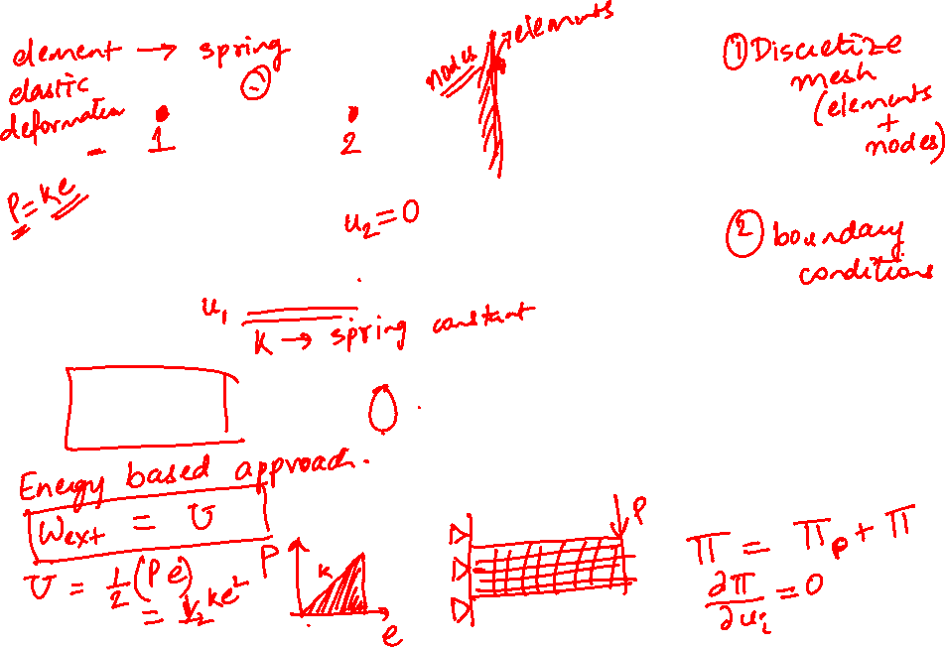
Finite Element- Energy Methods in a Matrix Form

Slide 6
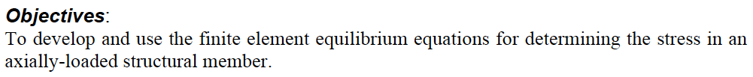
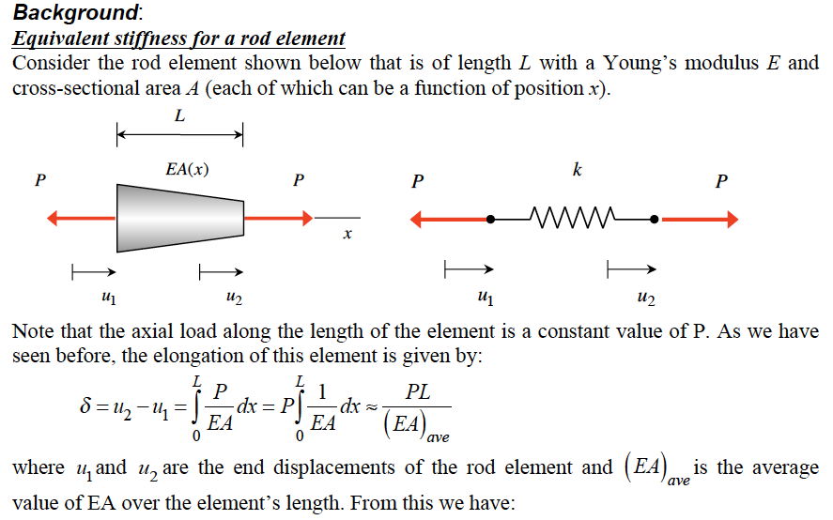
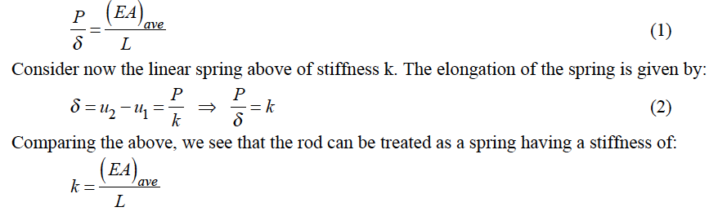
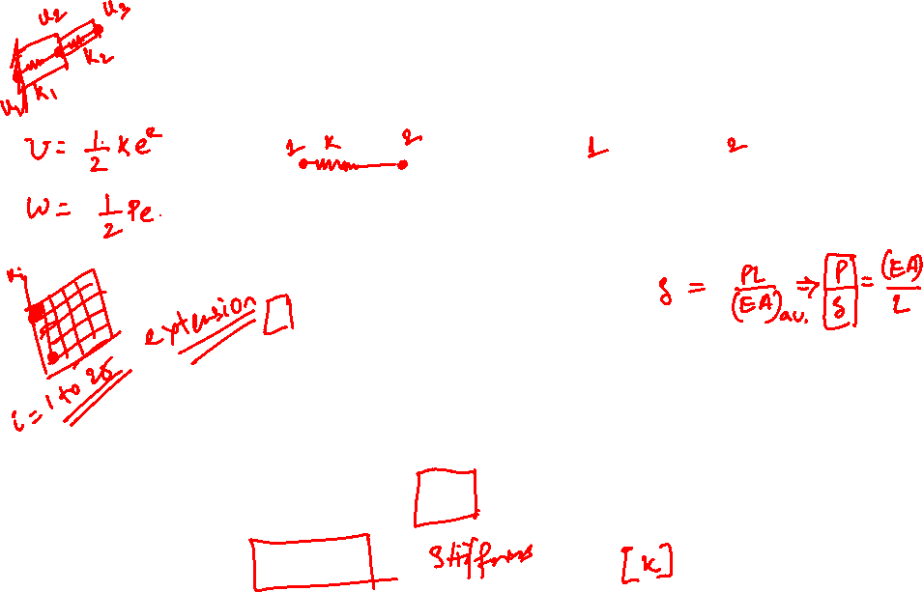

Slide 7
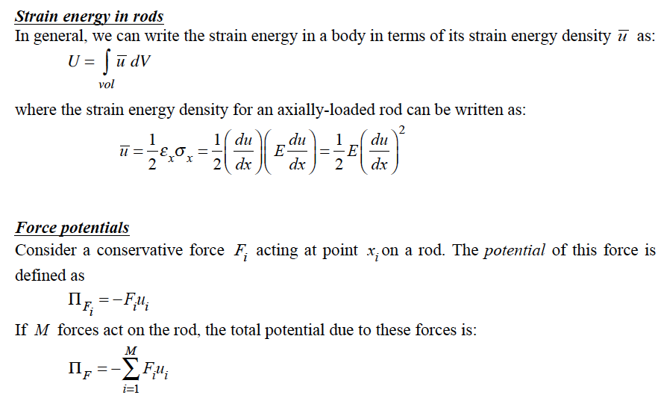
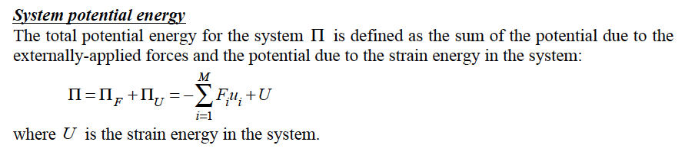
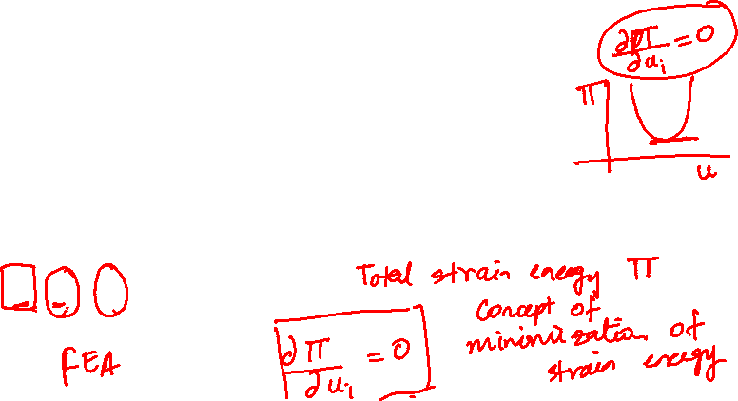

Slide 8
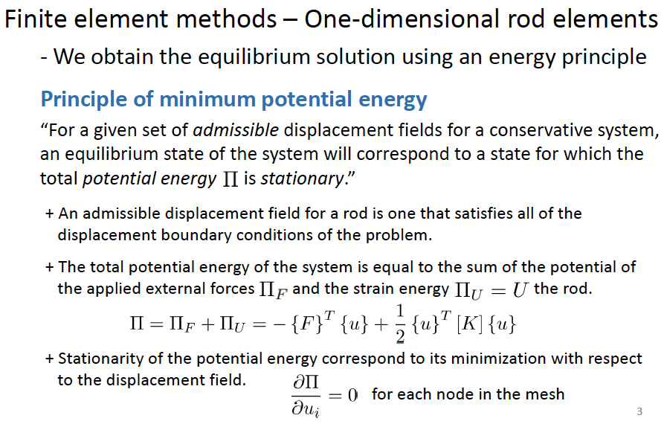
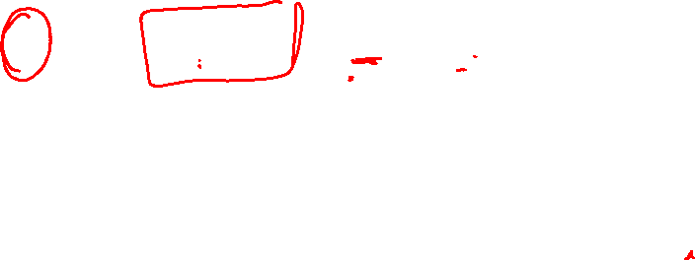
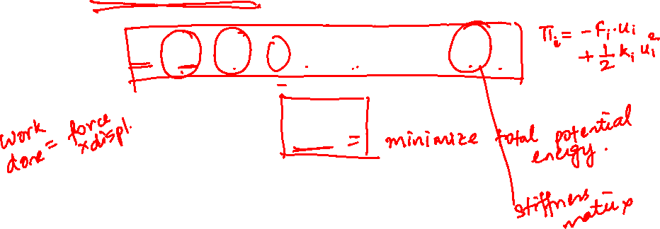
Stiffness Matrix: the matrix represents the resistance of the element to change when subjected to external influences.

Slide 9
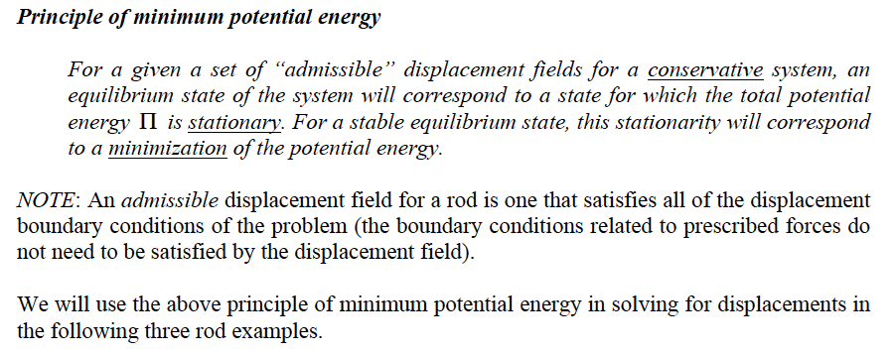
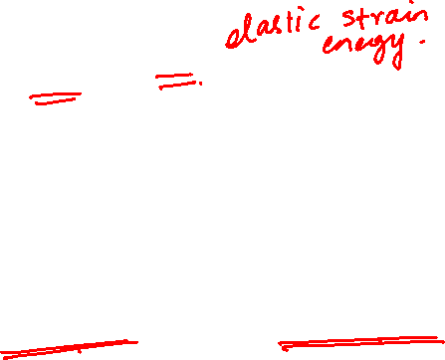
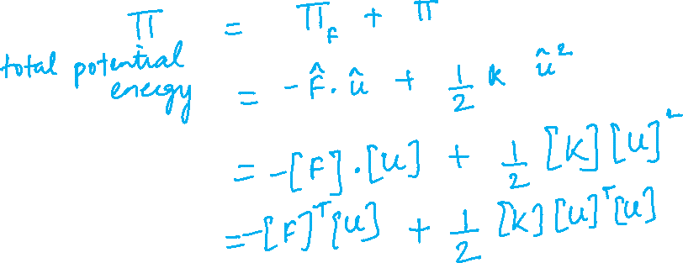

Slide 10
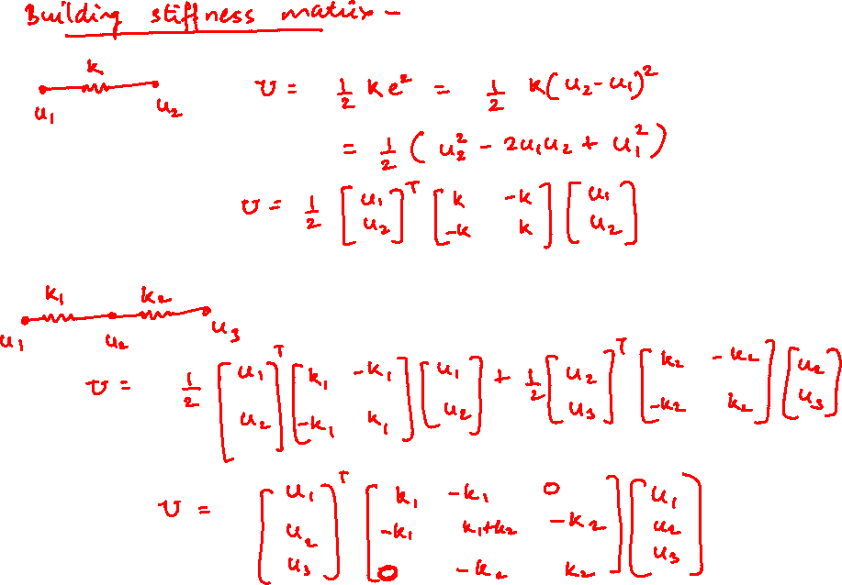
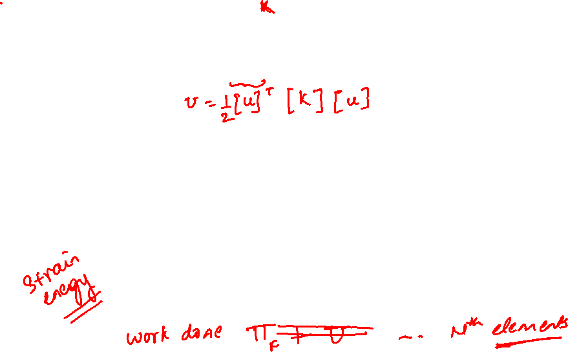

Slide 11
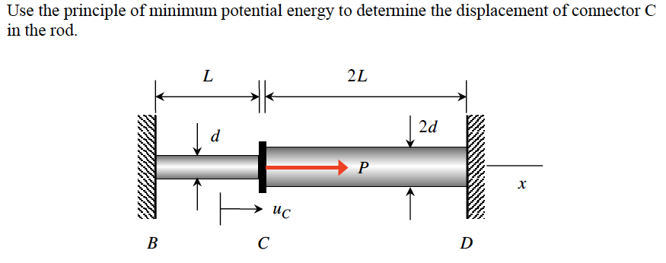
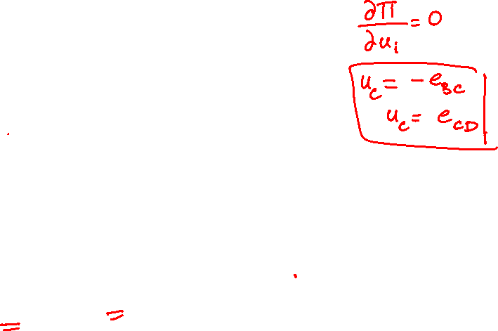

Example 17.1

Slide 12
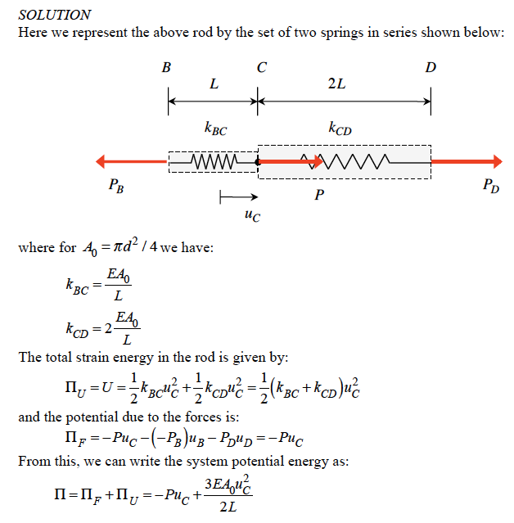
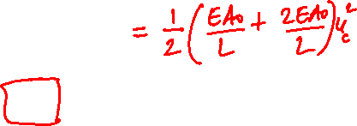
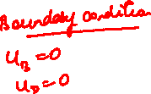

Slide 13
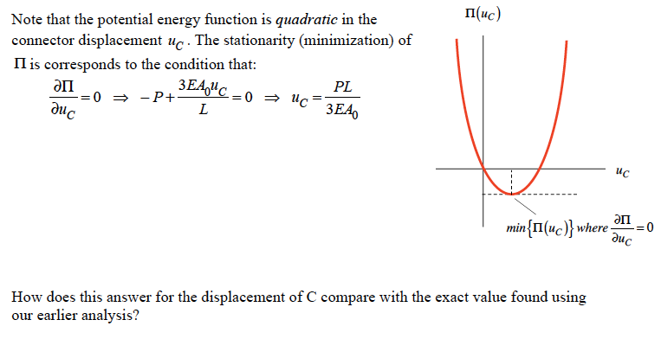
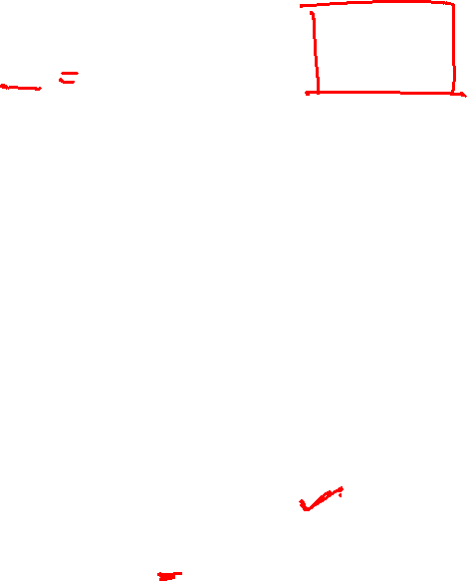
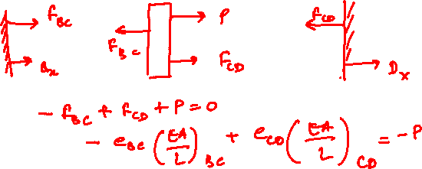

Slide 14
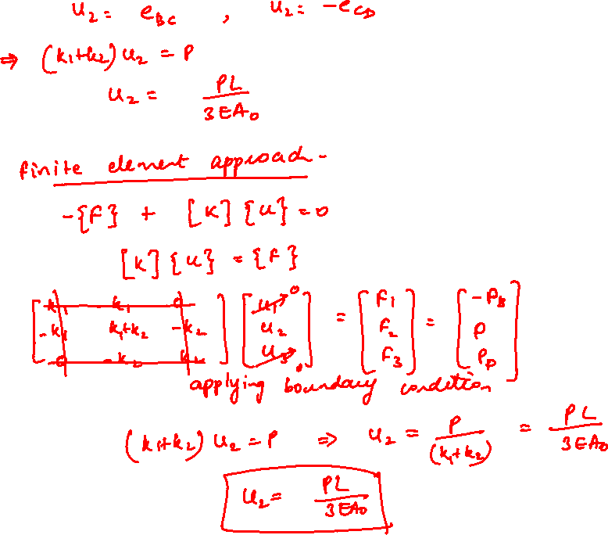
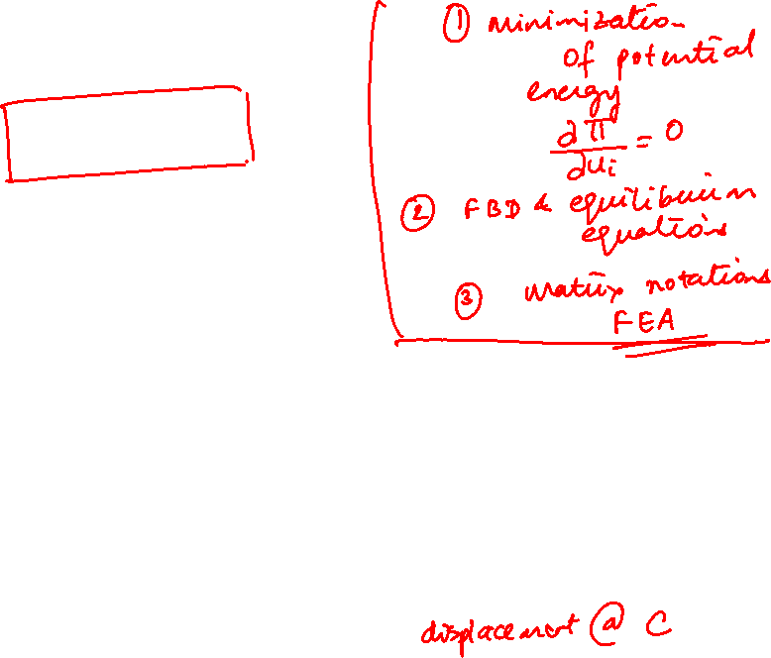

Slide 15
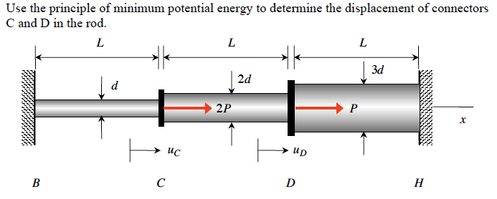
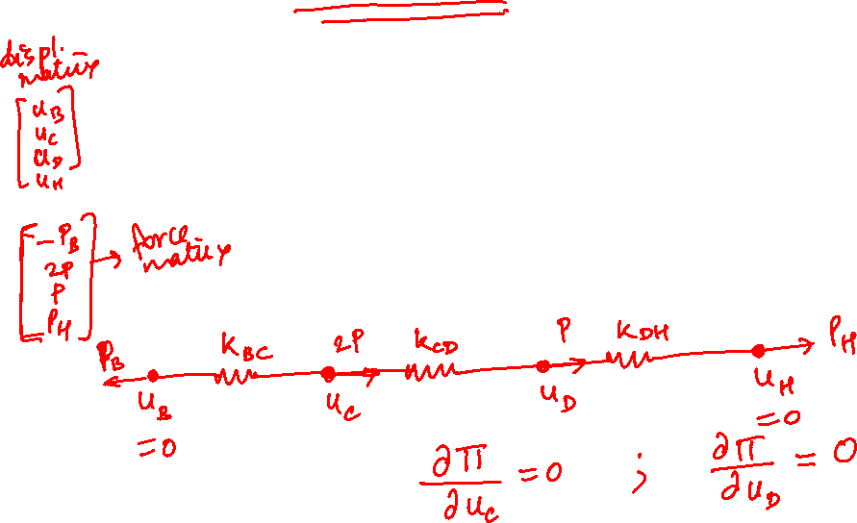
Example 17.2

Slide 16
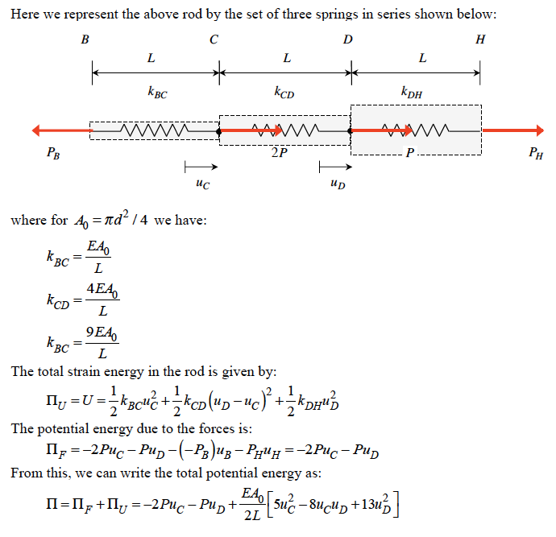

Slide 17
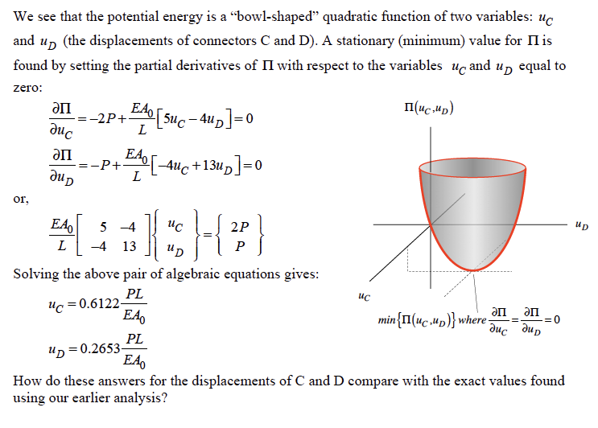
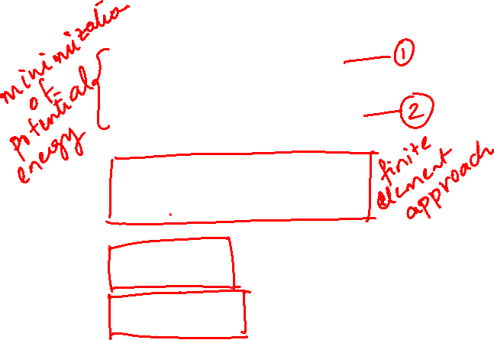

Slide 18
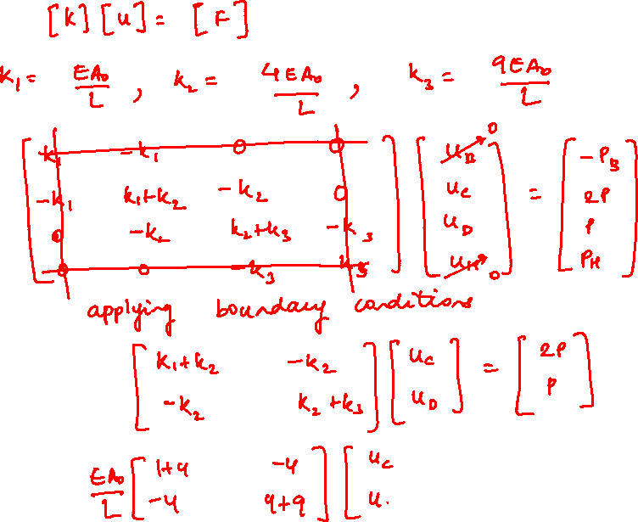



Slide 19




Slide 20
Thank You

