Slide 1
MECHANICS OF MATERIALS
Fall 2023
ME 323- 005
Instructor: Shubhra Bansal
Lecture 22: Energy Methods (Cont.)

Slide 2
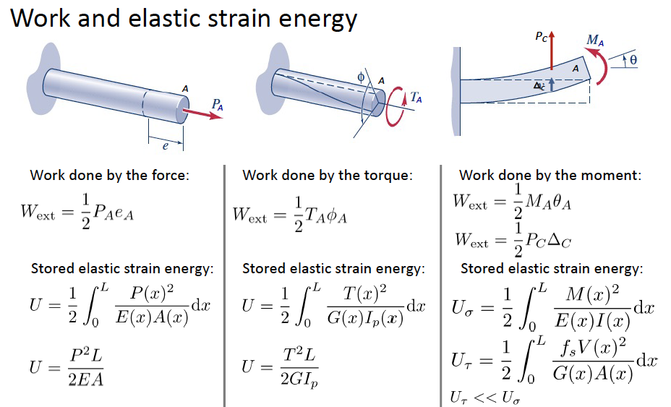
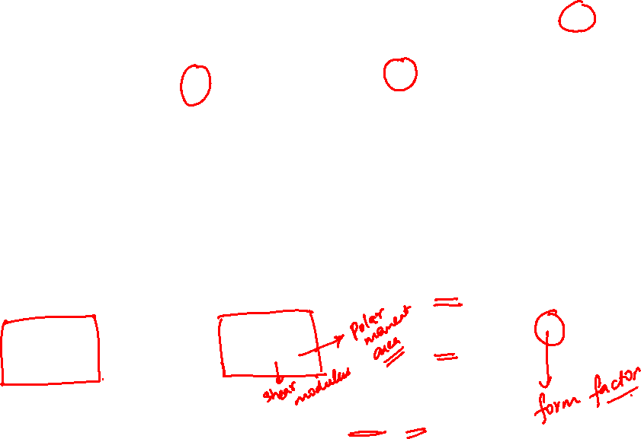

Energy Methods: Work-Energy Principle
Work Energy Principle: $W_{ext}=U$

Slide 3
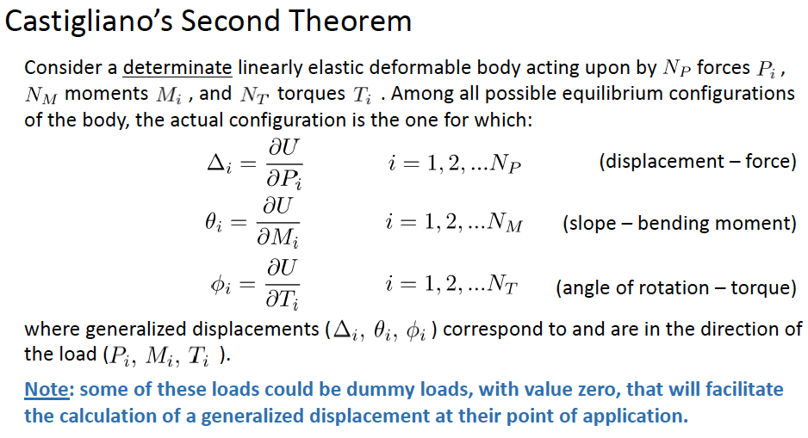

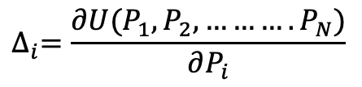
Energy Methods: Castigliano’s Second Theorem
$$∆_{i}=\frac{∂U(P_{1},P_{2}, ……….P_{N})}{∂P_{i}}$$

Slide 4
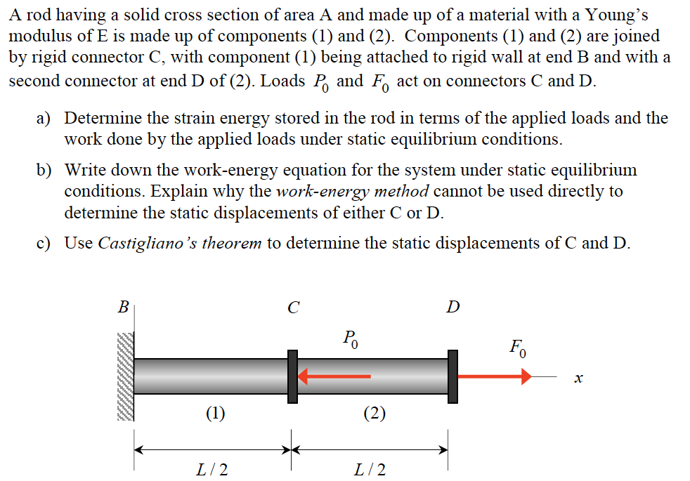
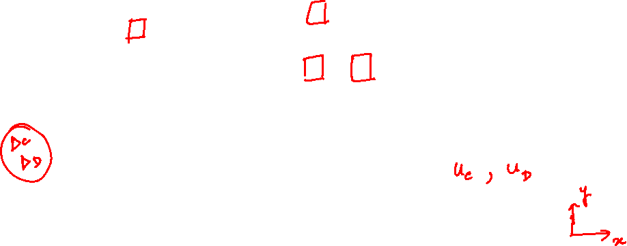
Example 16.1 from Lecture Book

Slide 5
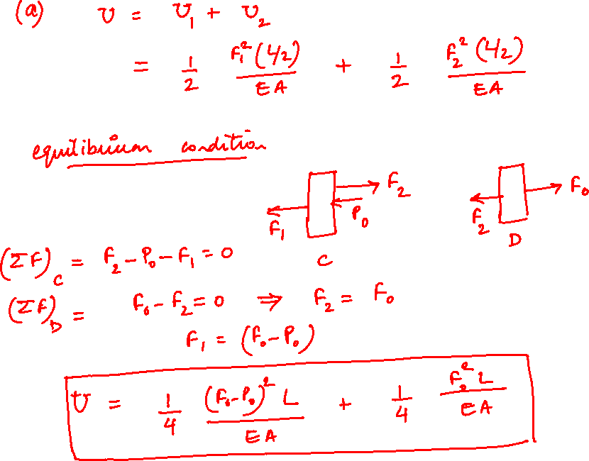

Slide 6
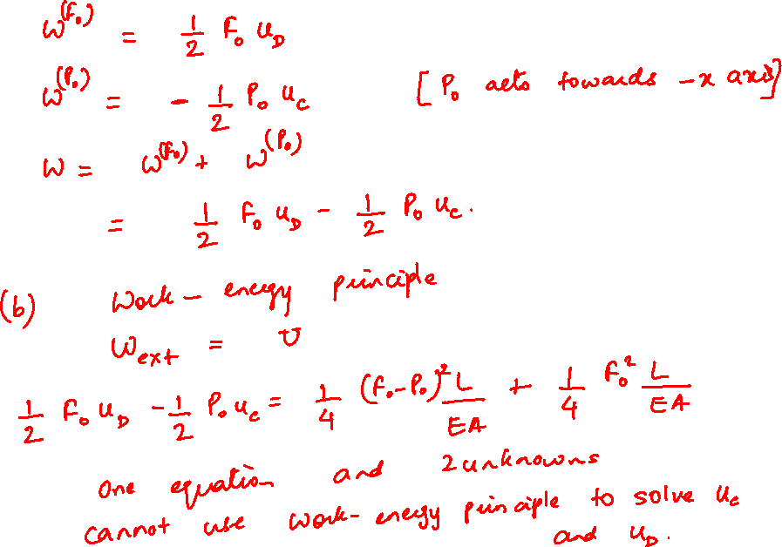

Slide 7
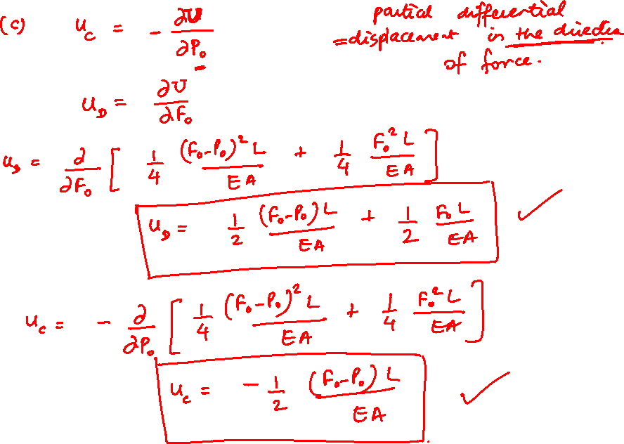

Slide 8
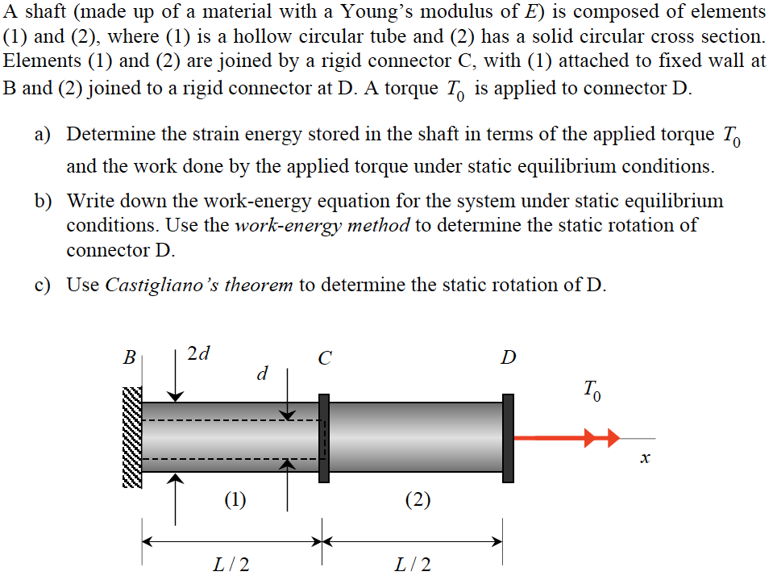
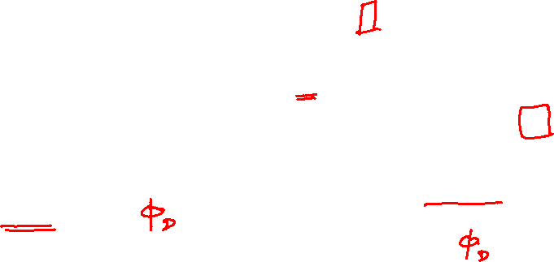
Example 16.2 from Lecture Book

Slide 9
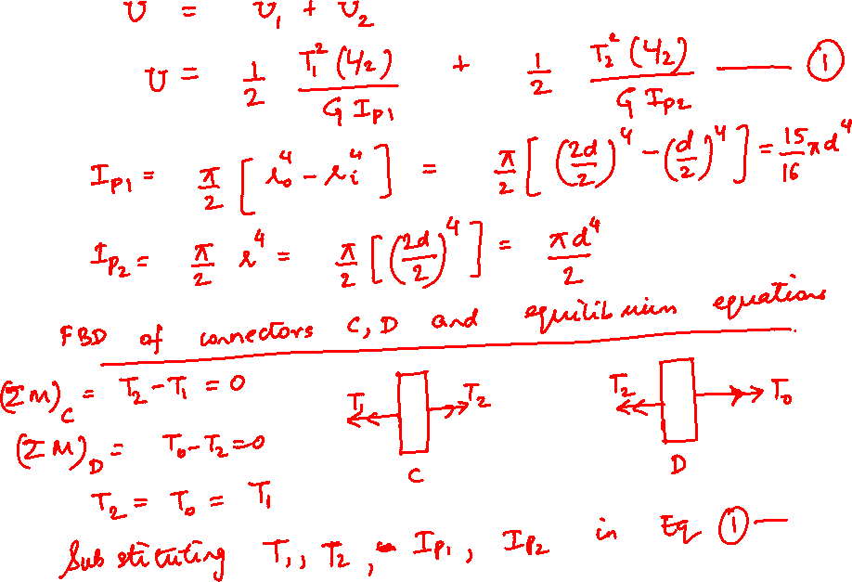

Slide 10
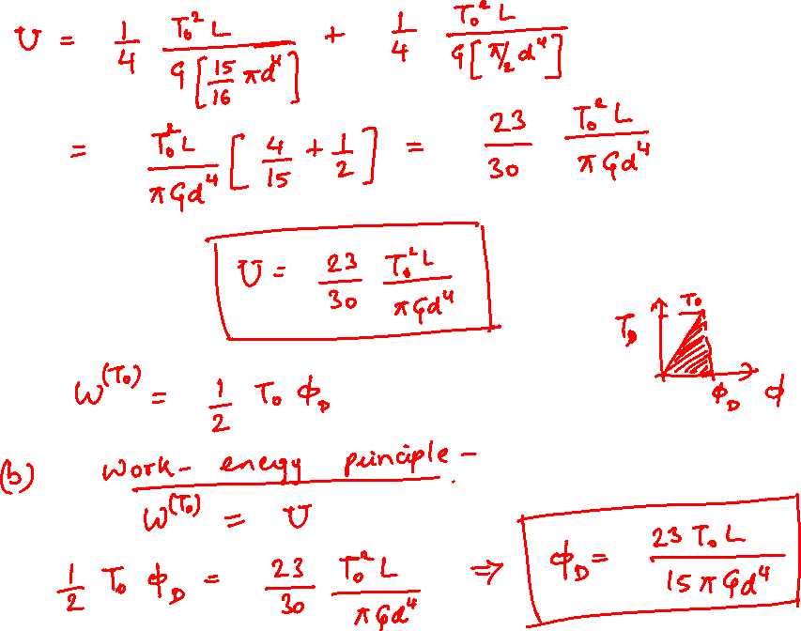

Slide 11
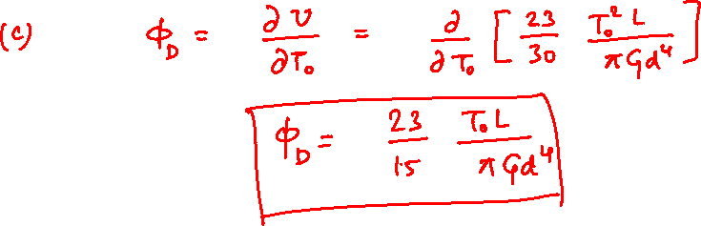

Slide 12
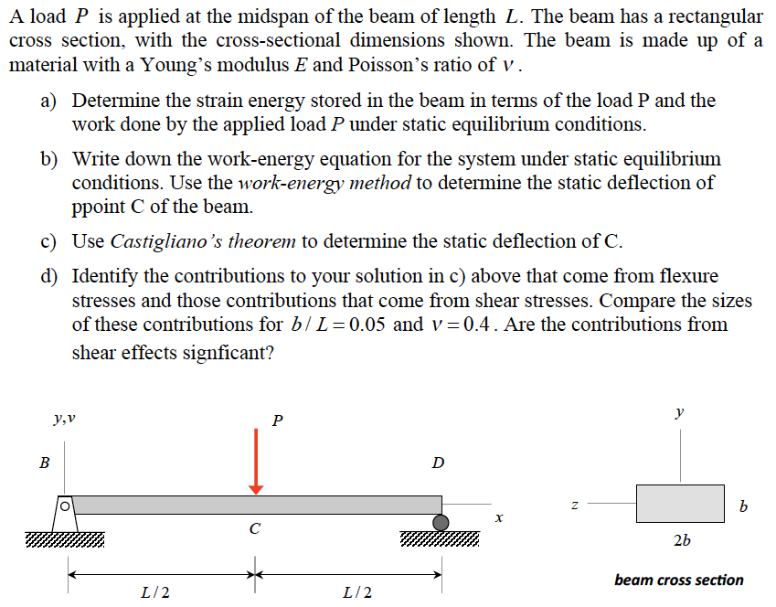
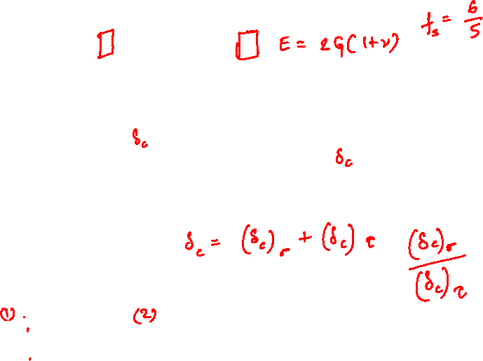
Example 16.3 from Lecture Book

Slide 13
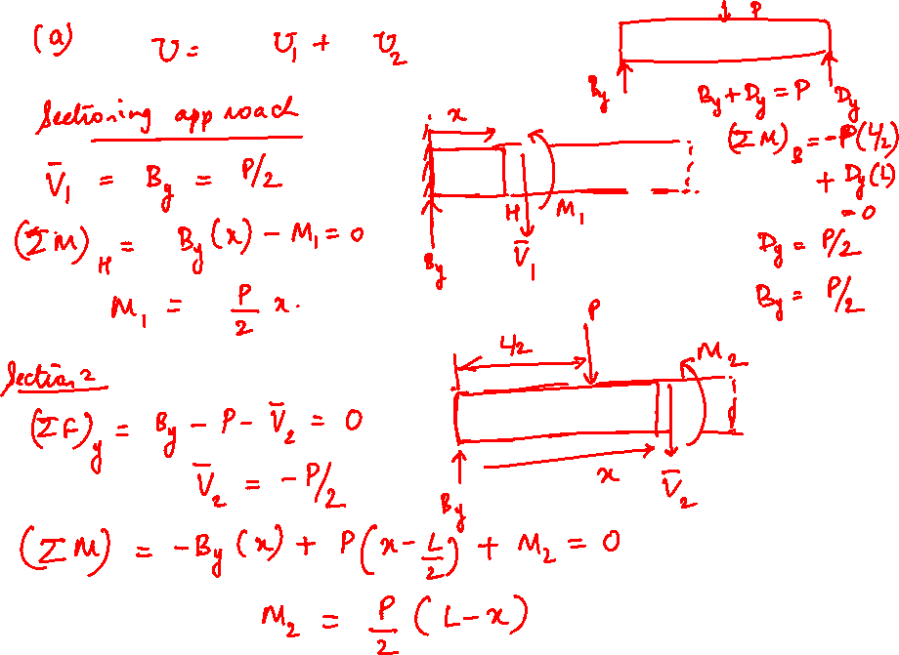

Slide 14
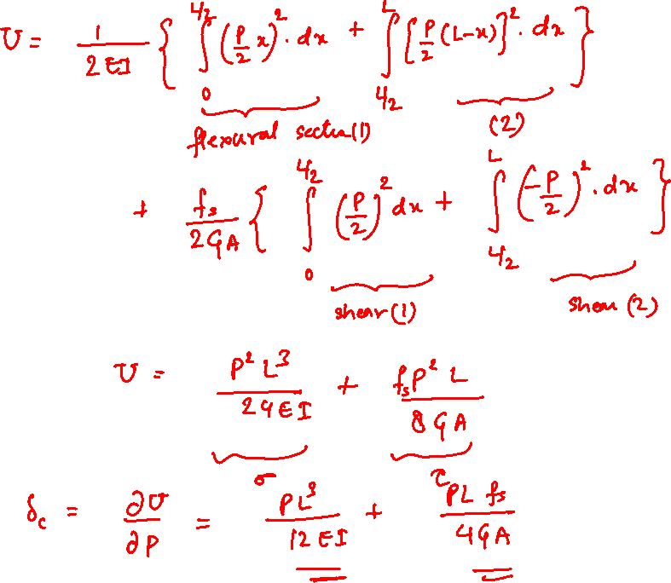

Slide 15
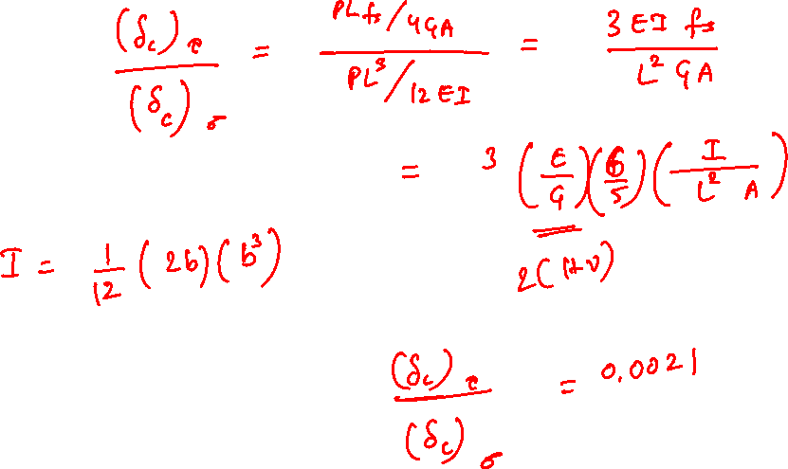

Slide 16
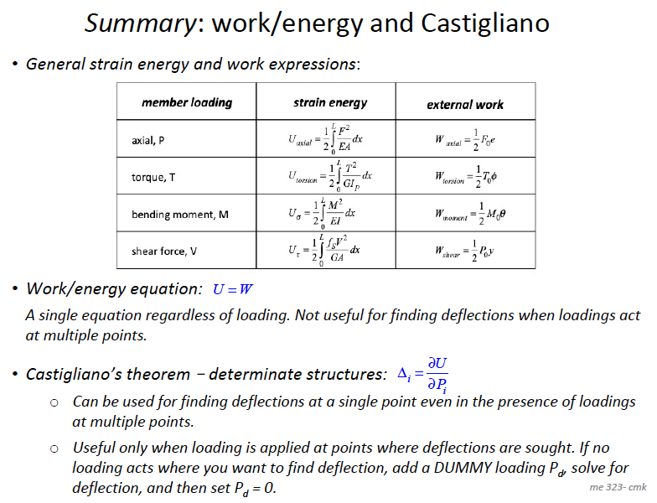

Slide 17
Thank You

