Slide 1
MECHANICS OF MATERIALS
Fall 2023
ME 323- 005
Instructor: Shubhra Bansal
Lecture 16: Coupled Loading in Beams

Slide 2
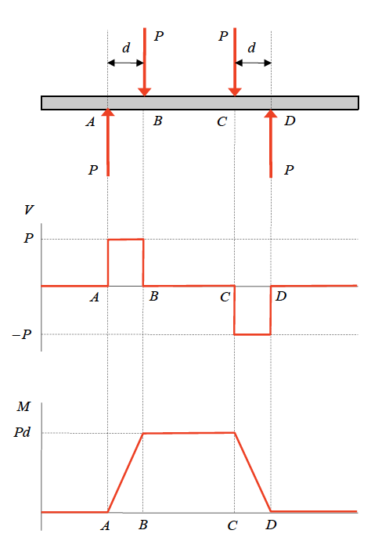
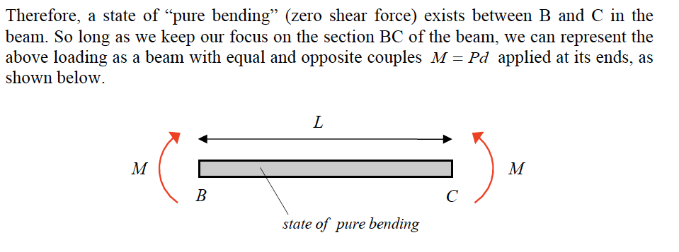
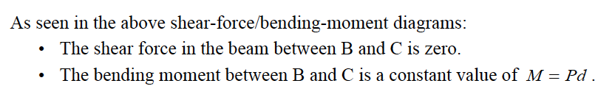
Shear Force/ Bending Moment Diagrams

Slide 3
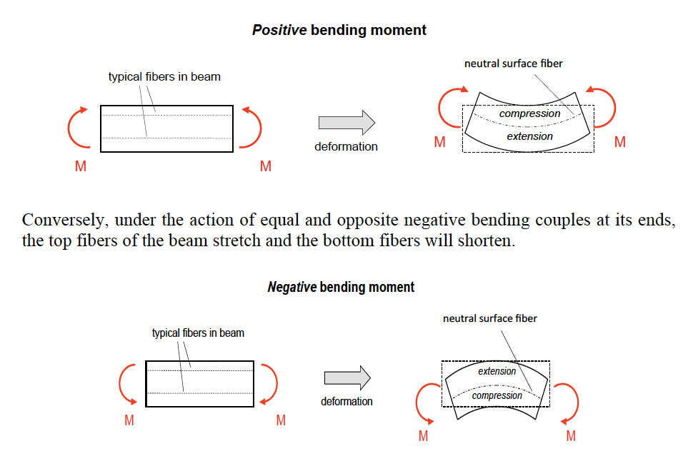
Strain for Pure Bending in Beams
The plane that divides the region of compression from the region of stretch is called “neutral surface” of the beam

Slide 4
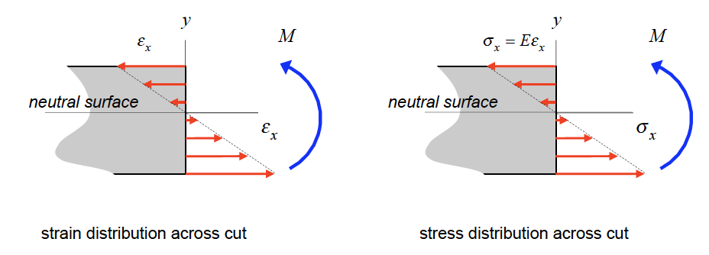


Flexural Stresses due to Bending
Axial Strain,
As a result of the above Euler-Bernoulli assumptions, it can be shown that the axial strain ε_{x} across a perpendicular cut in the beam where y is measured from the neutral surface of the beam and ρ is the radius of curvature of the deflection curve for the loaded beam.
For a linearly-elastic material for the beam, the normal stress distribution in y

Slide 5
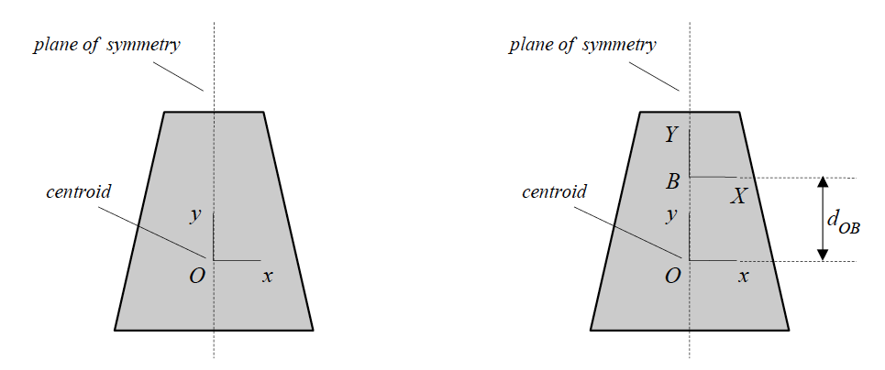



Calculation of Second Area Moment
Where, y = distance from centroid of the cross-section
Parallel-axis theorem
In order to determine the second area moment about an arbitrary point B on the plane of symmetry, simply add A*d_{OB}² to the centroidal second area moment I_{O}, where d_{OB} is the distance between O and B.

Slide 6
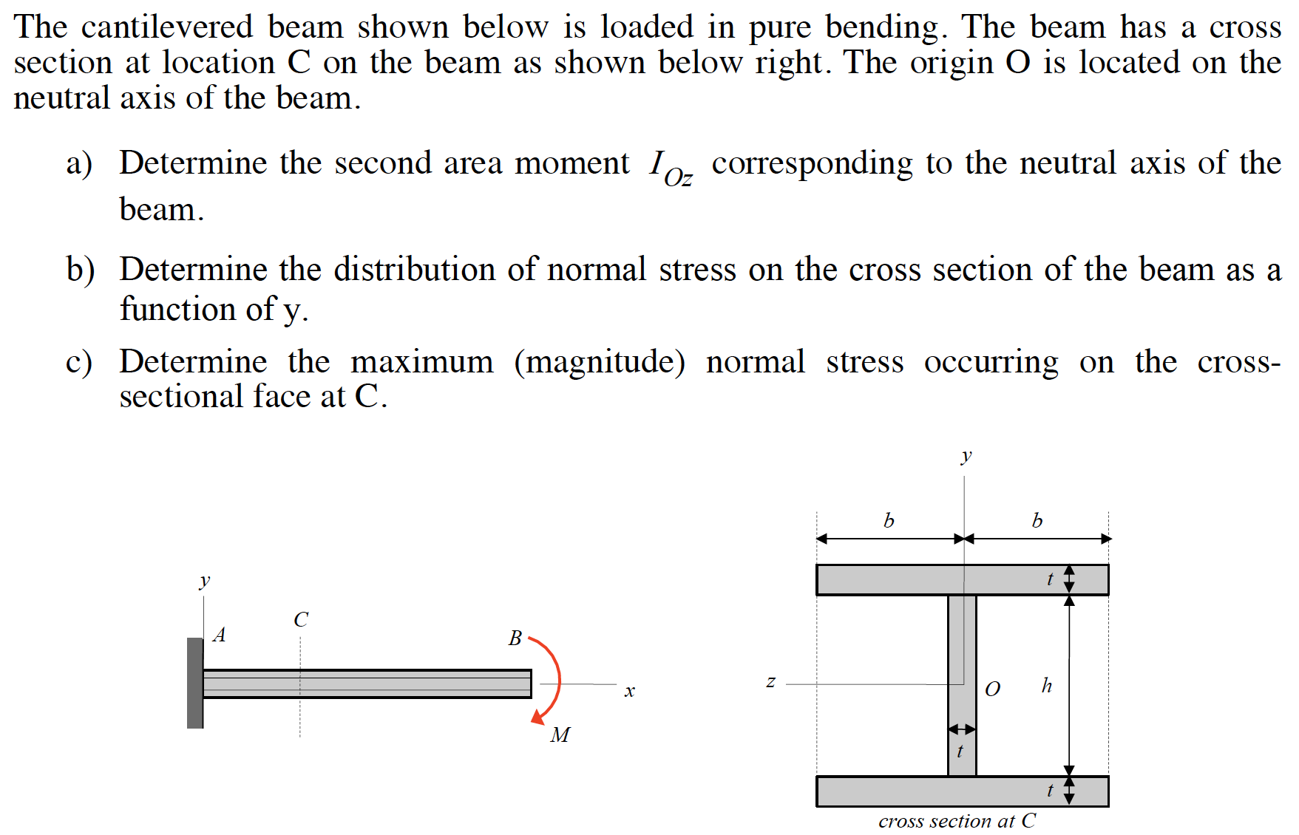
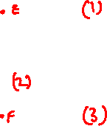
Example 10.5 from Lecture Book

Slide 7
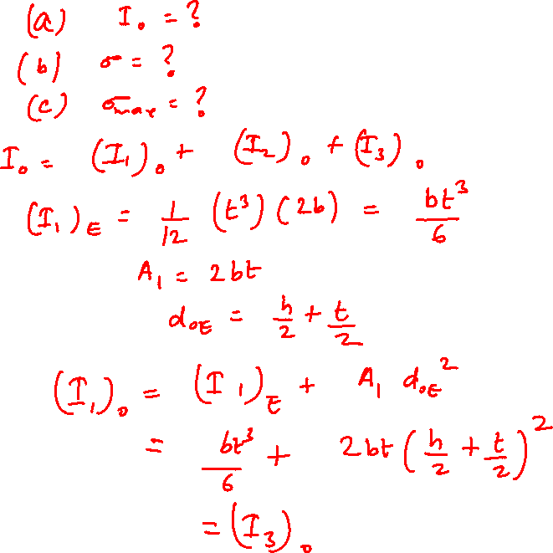

Slide 8
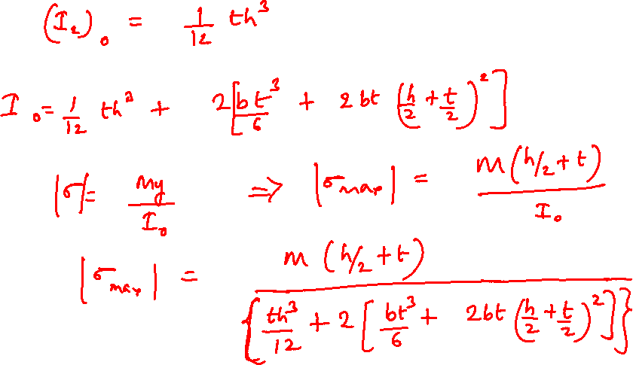

Slide 9
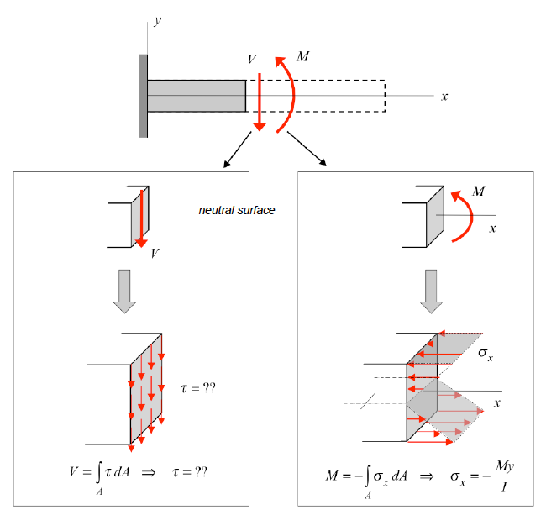
Couple Loading of Beams

Slide 10
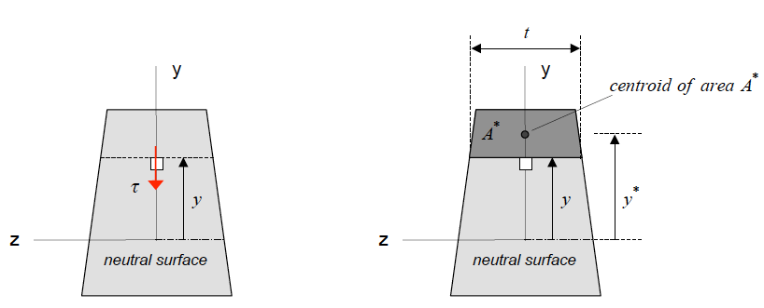
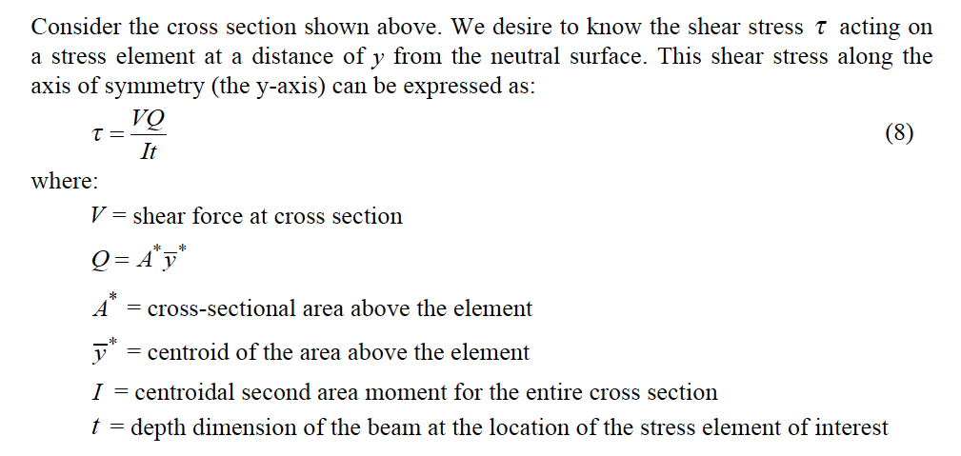

Slide 11
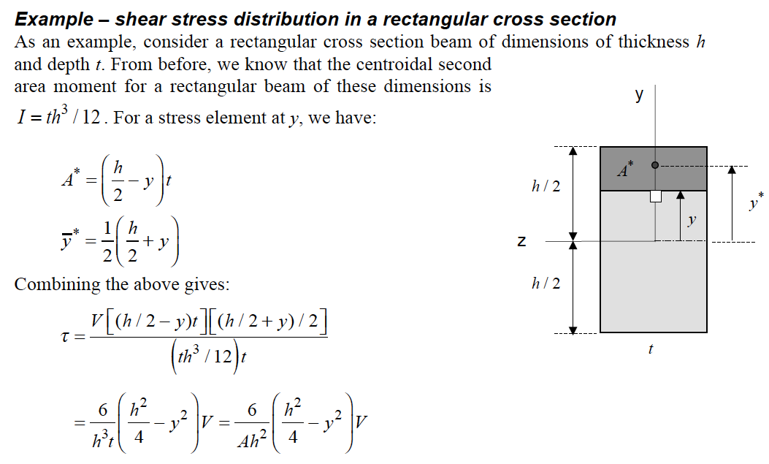
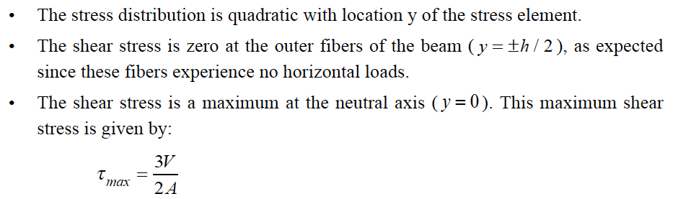

Slide 12
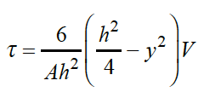
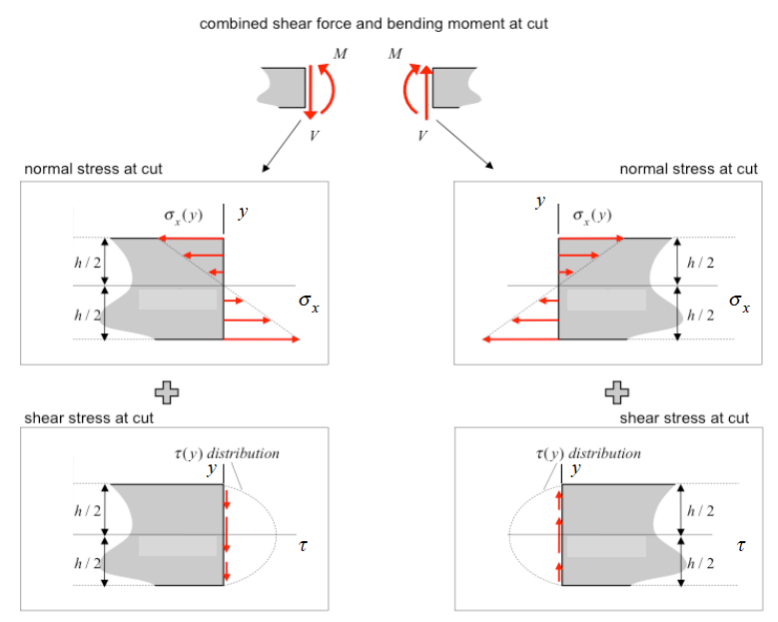

Slide 13
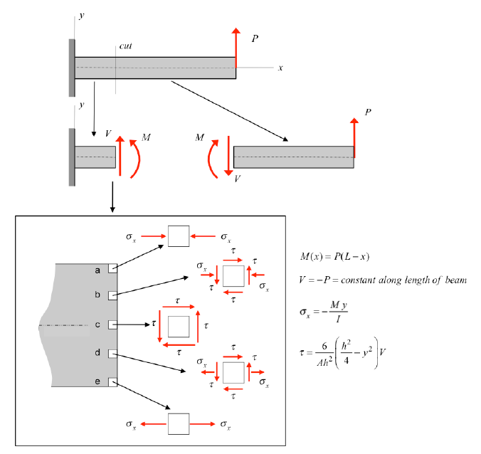

Slide 14
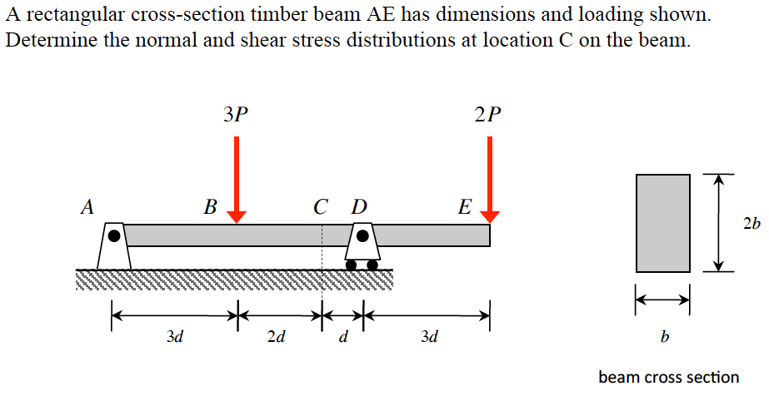
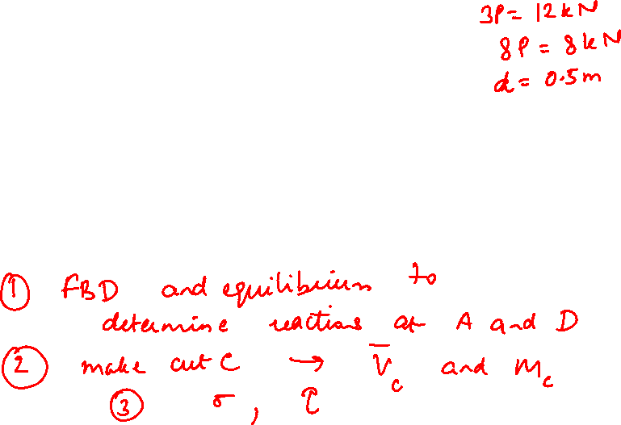
Example 10.7 from Lecture Book

Slide 15
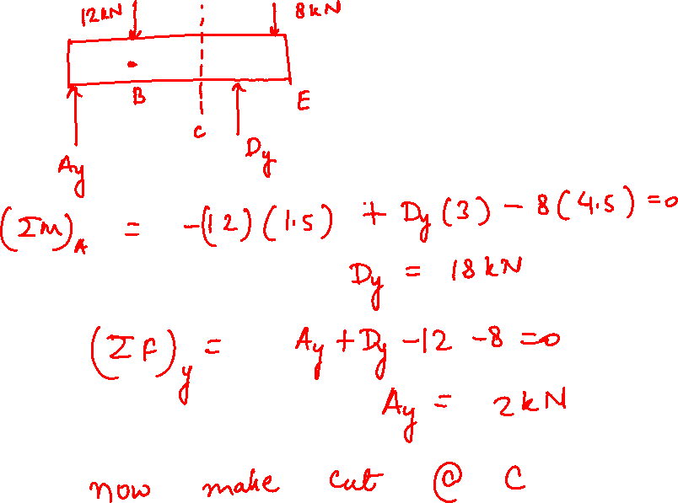

Slide 16
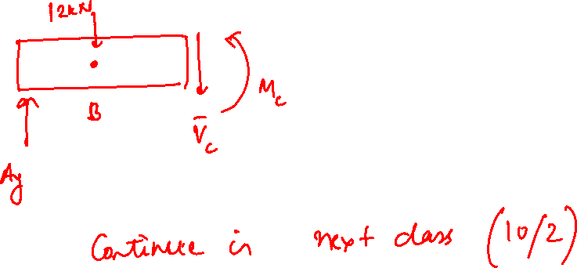

Slide 17
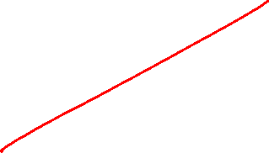

Slide 18
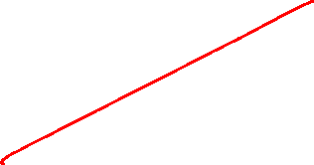

Slide 19
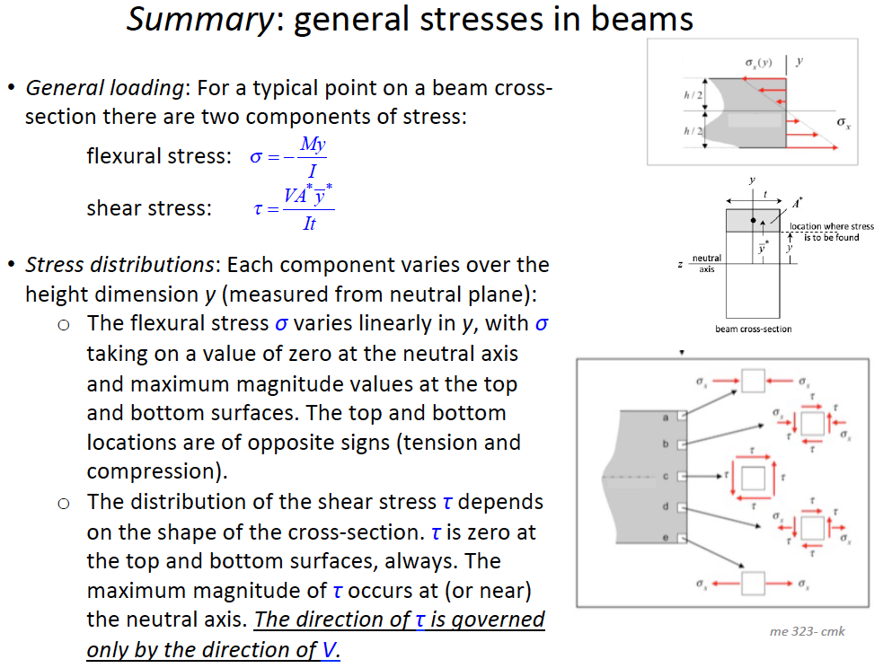

Slide 20
Thank You

