Slide 1
MECHANICS OF MATERIALS
Fall 2023
ME 323- 005
Instructor: Shubhra Bansal
Lecture 7: Axial Deformation- Statically Indeterminate Structures

Slide 2
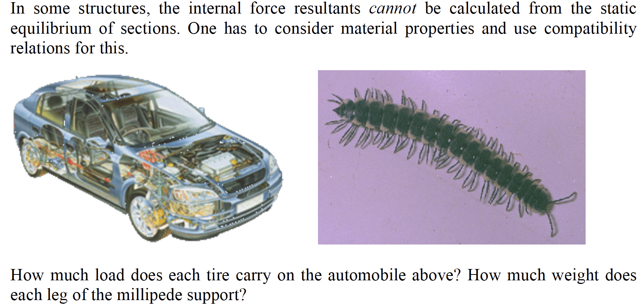
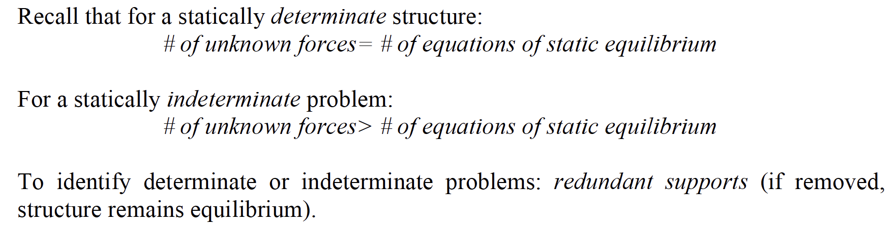

Stress Analysis for Statically Indeterminate Structures

Slide 3
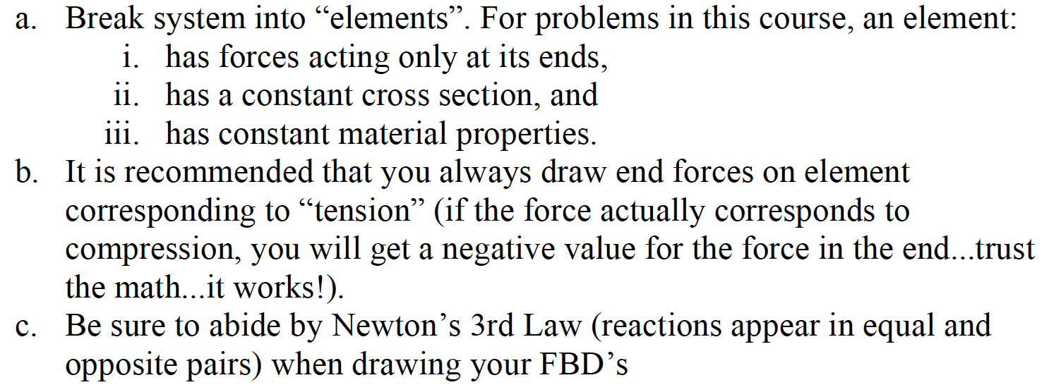
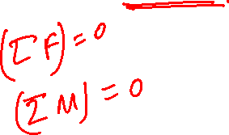
General Approach
Analysis of statically indeterminate structures involves three fundamental equations:
  Equilibrium: Force balance, moments. To determine if problem is statically determinate or indeterminate
  Element force-deformation behavior
  Geometry of deformation or compatibility equations. How do displacements relate to each other?
  Solve

Slide 4
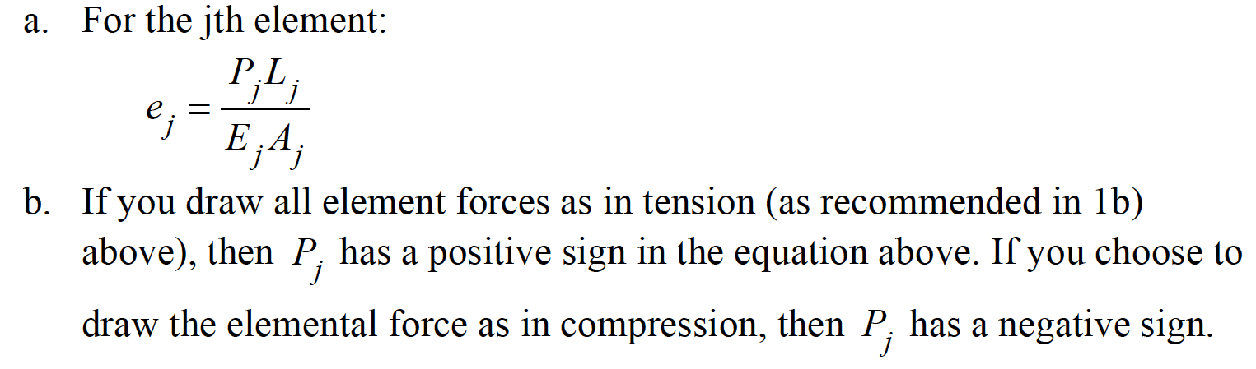
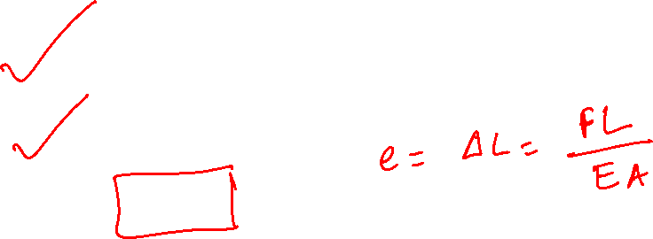
General Approach
Analysis of statically indeterminate structures involves three fundamental equations:
  Equilibrium: Force balance, moments. To determine if problem is statically determinate or indeterminate
  Element force-deformation behavior
  Geometry of deformation or compatibility equations. How do displacements relate to each other?
  Solve

Slide 5
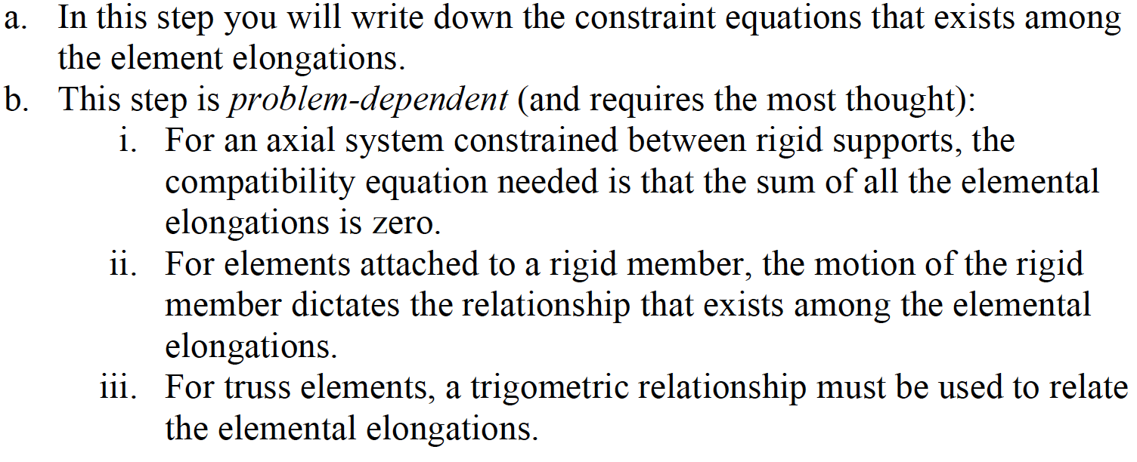
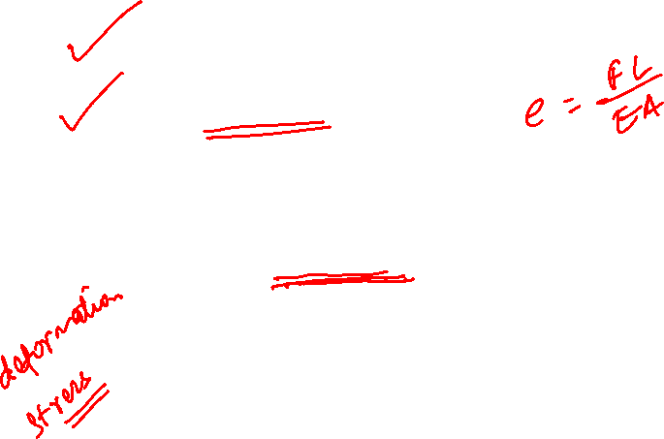
General Approach
Analysis of statically indeterminate structures involves three fundamental equations:
  Equilibrium: Force balance, moments. To determine if problem is statically determinate or indeterminate
  Element force-deformation behavior
  Geometry of deformation or compatibility equations. How do displacements relate to each other?
  Solve

Slide 6
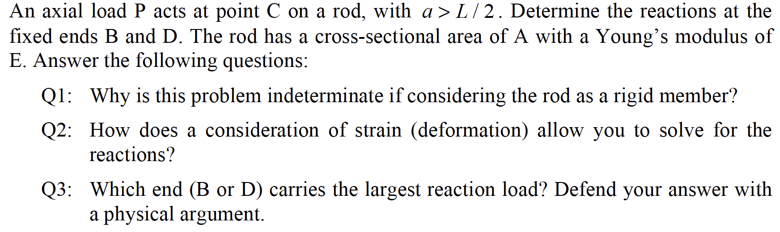
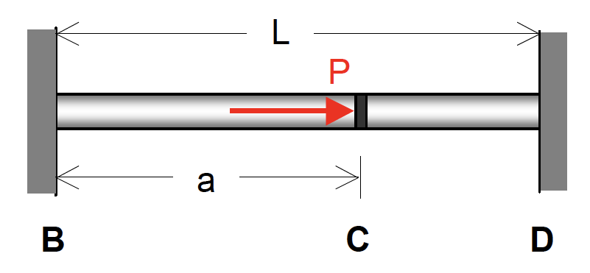
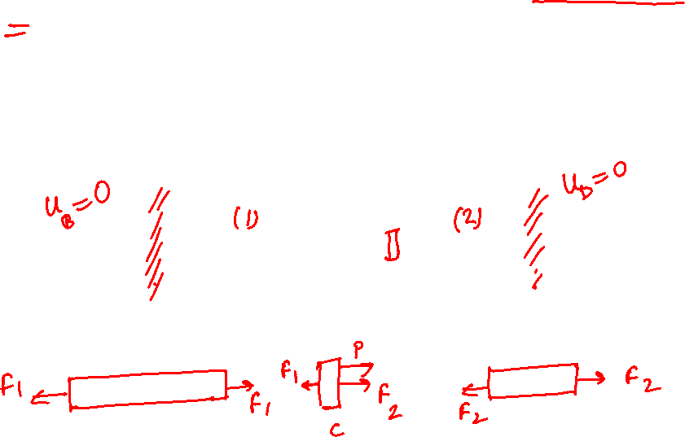
Motivating Example

Slide 7
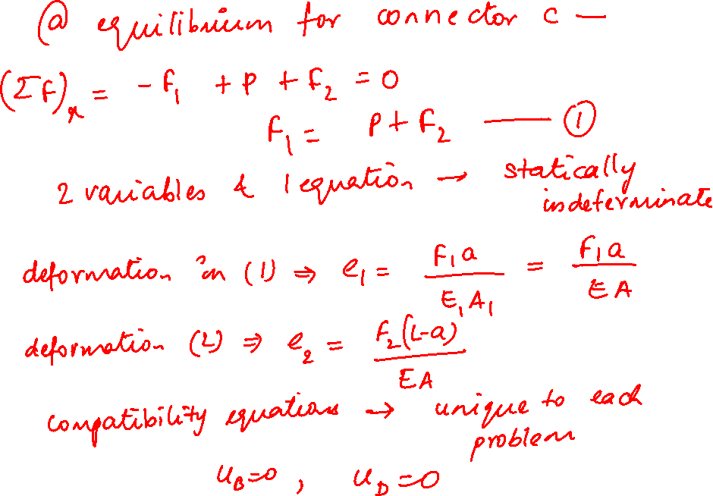

Slide 8
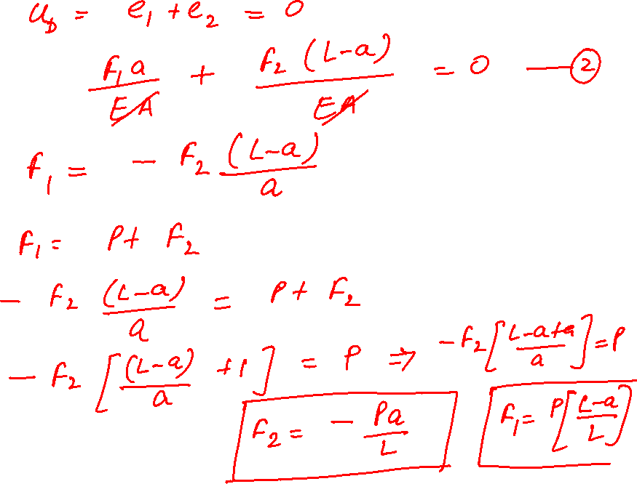

Slide 9
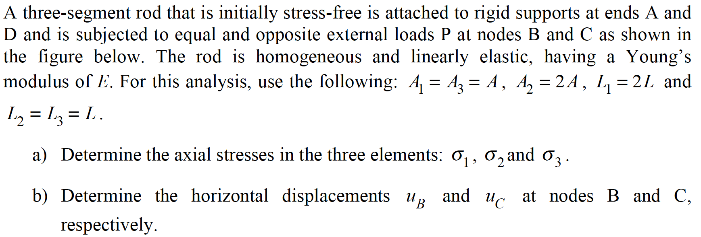
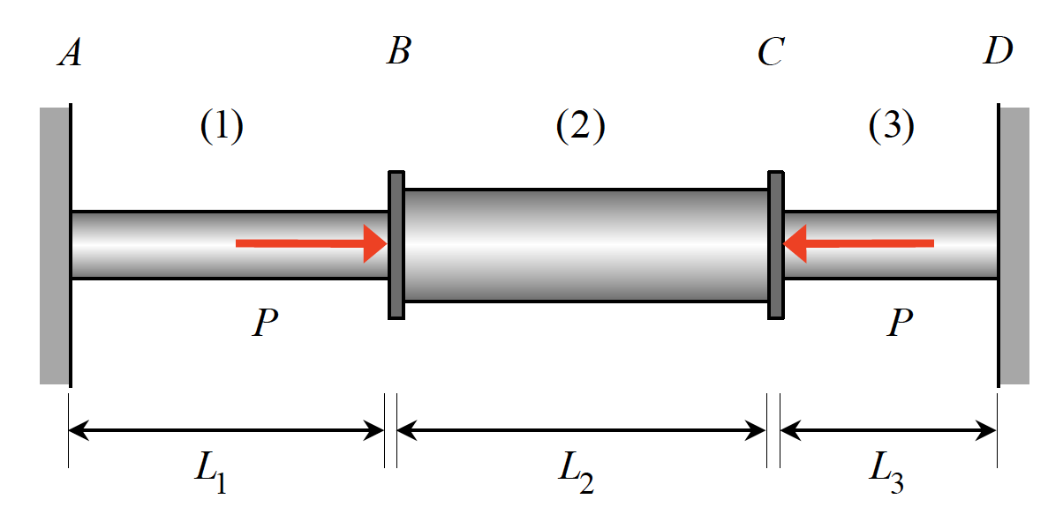
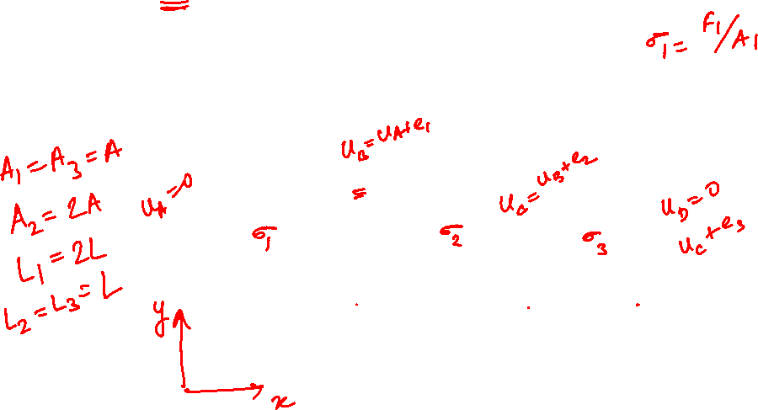
Example 6.7 from Lecturebook

Slide 10
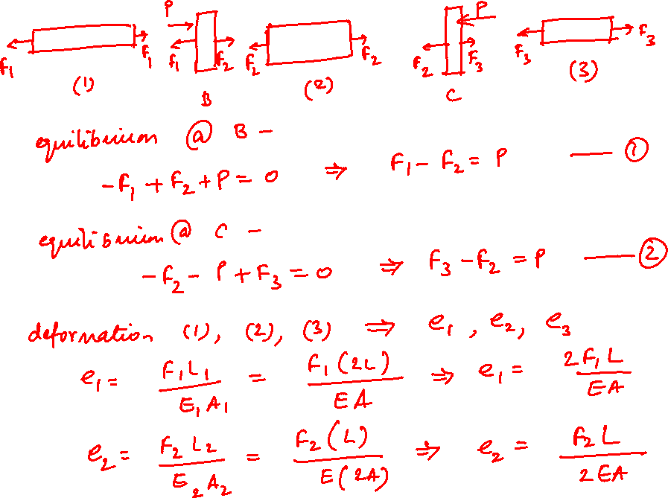

Slide 11
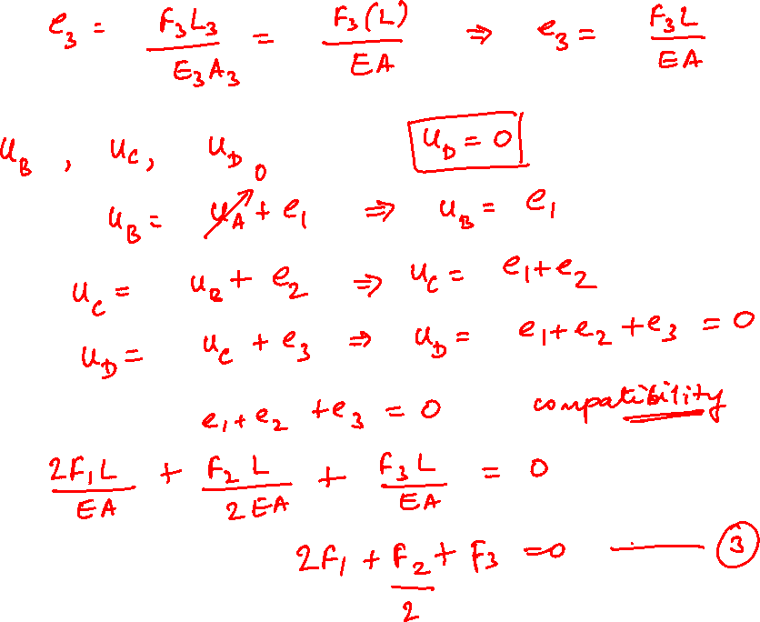

Slide 12
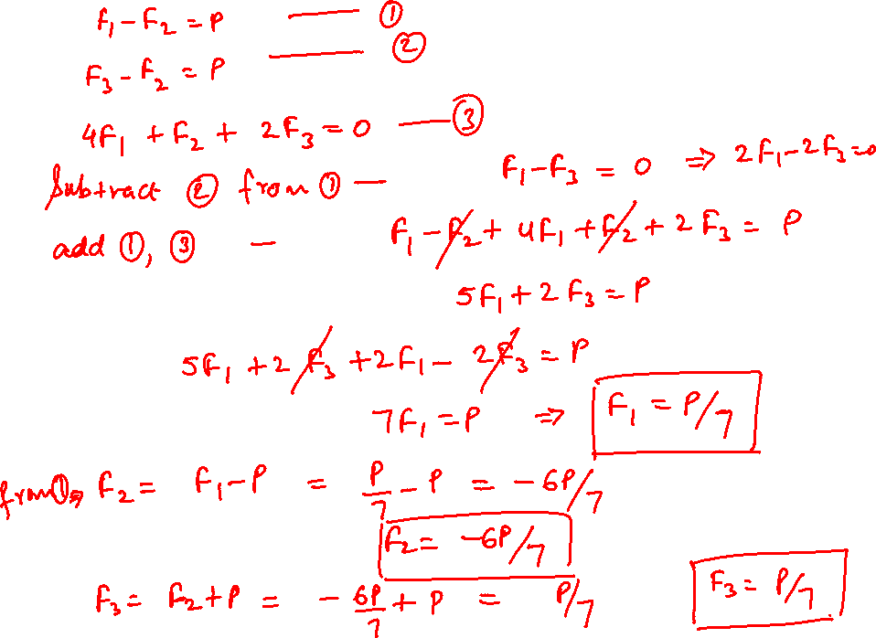

Slide 13
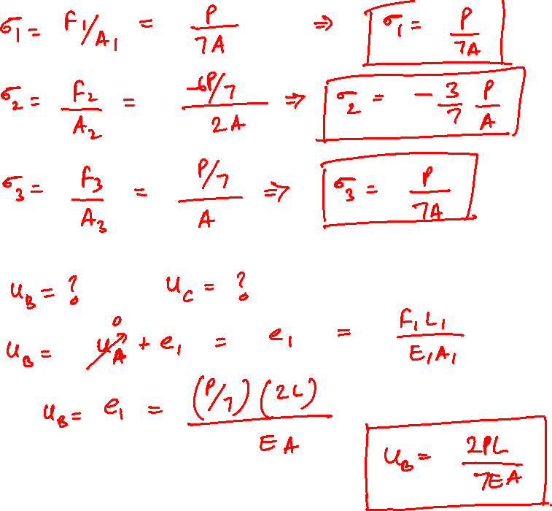

Slide 14
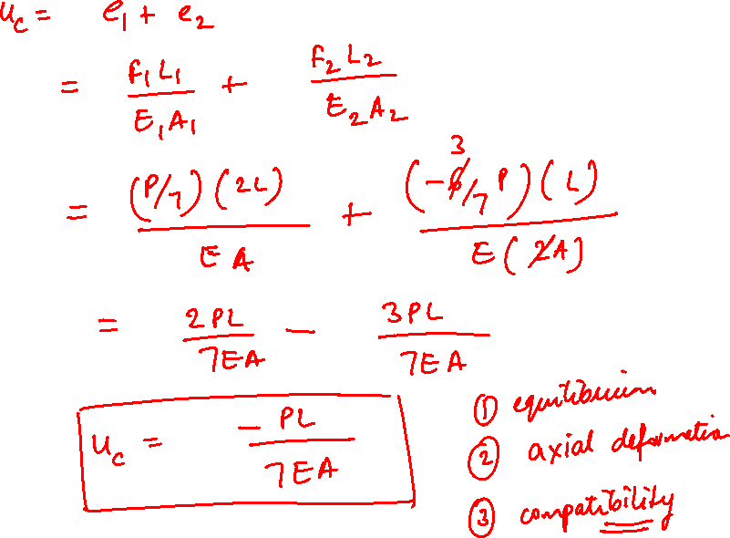

Slide 15
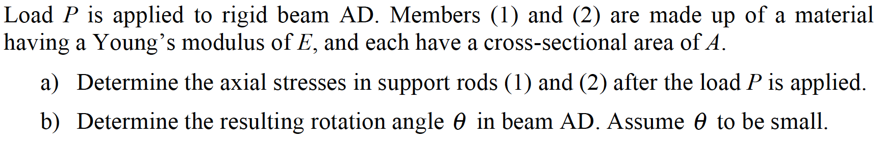
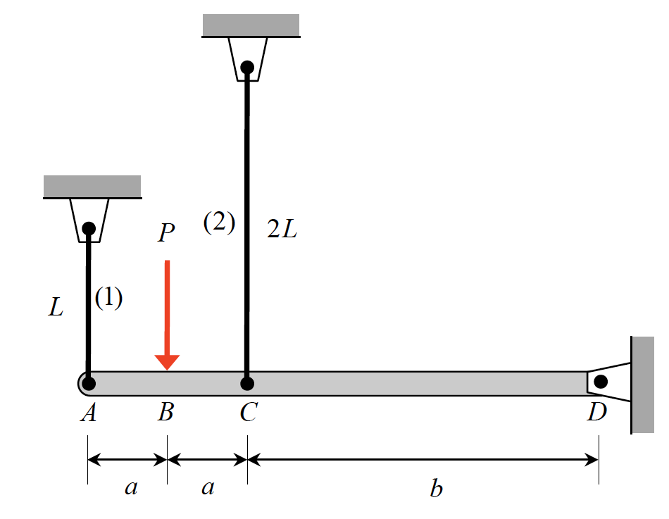
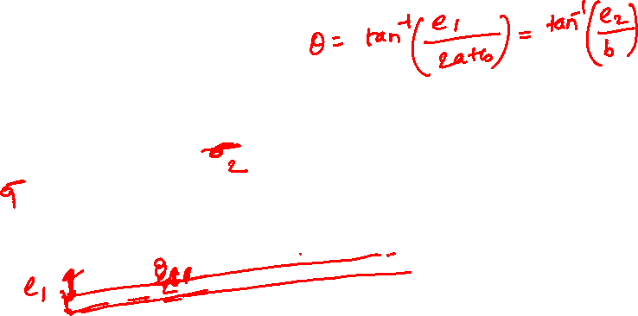
Example 6.8 from Lecturebook

Slide 16
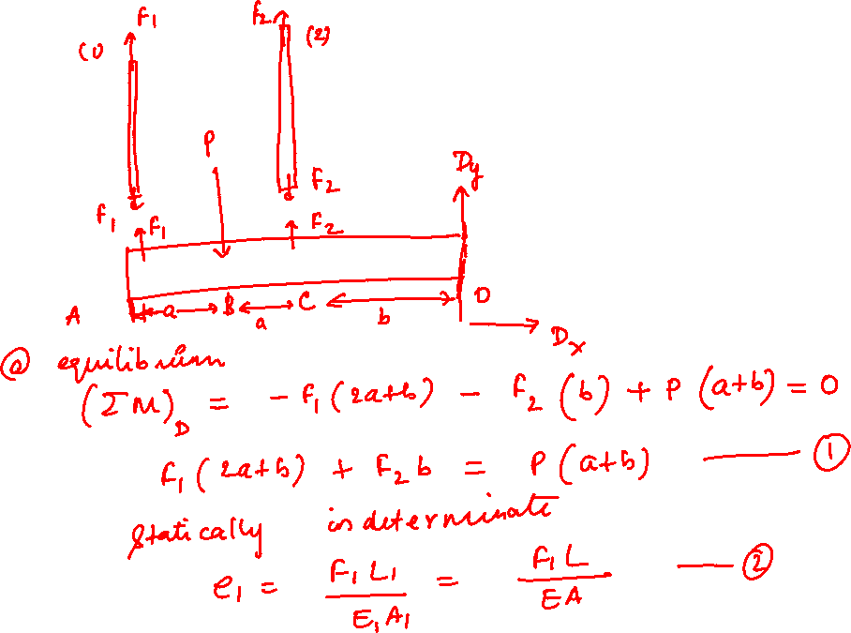

Slide 17
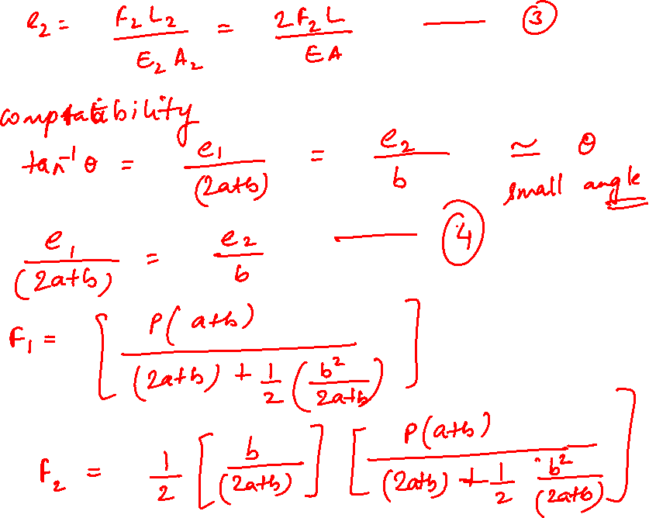

Slide 18
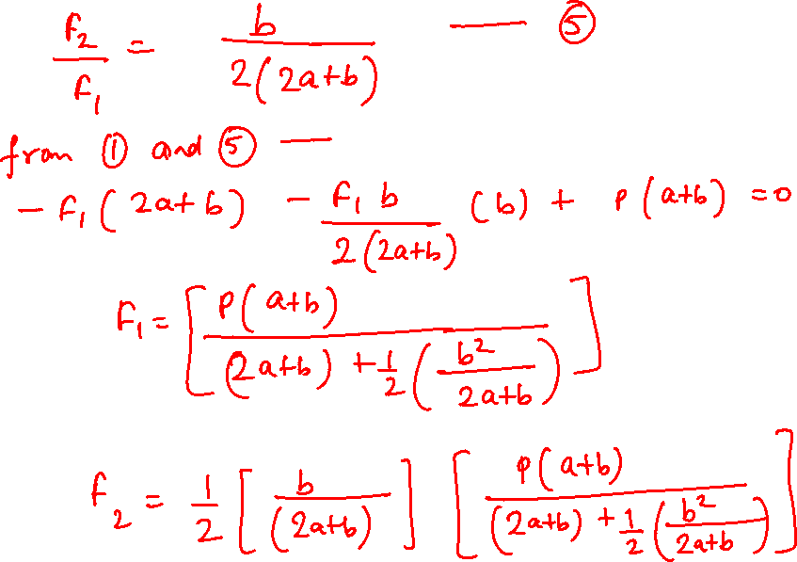

Slide 19
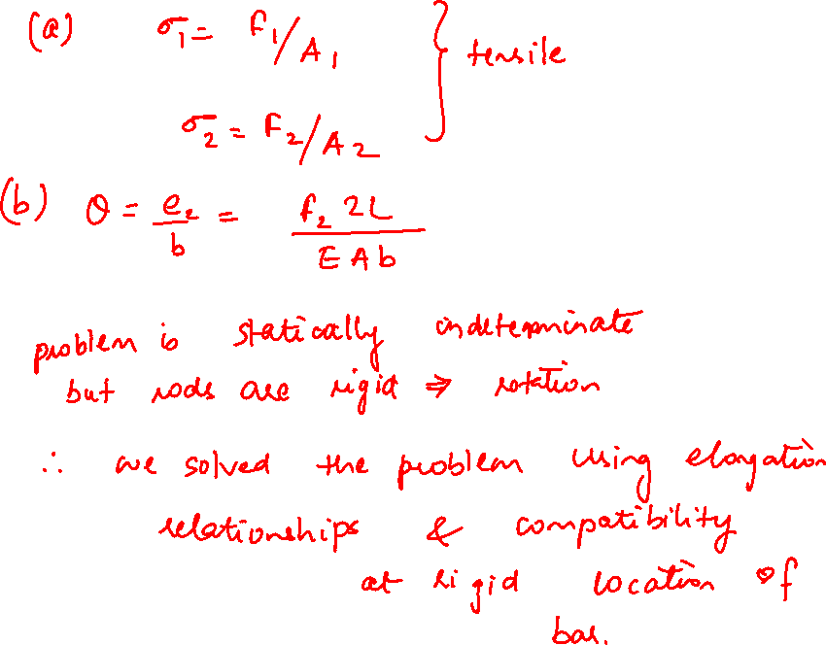

Slide 20
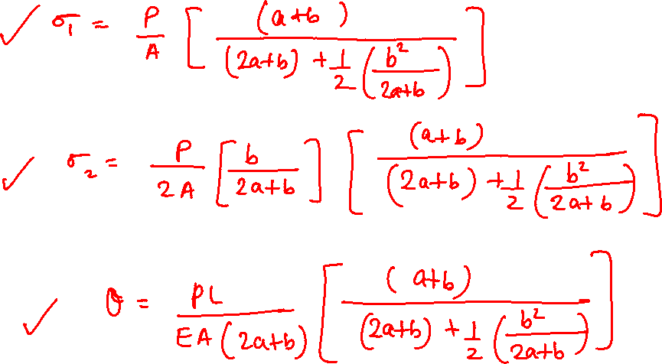

Slide 21
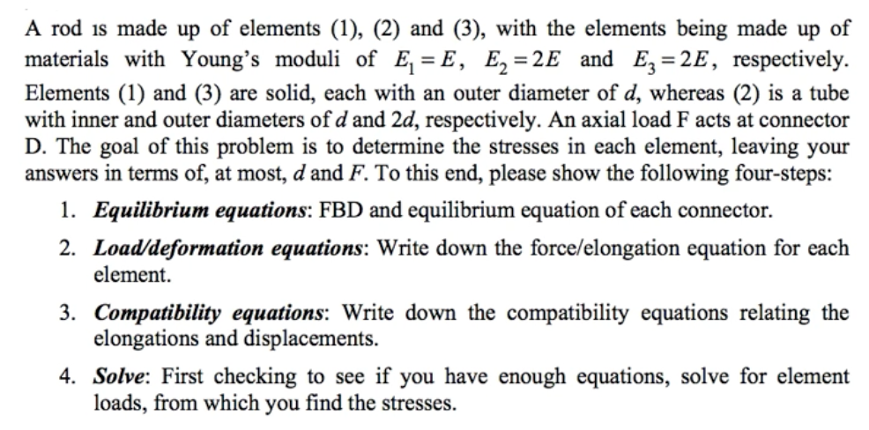
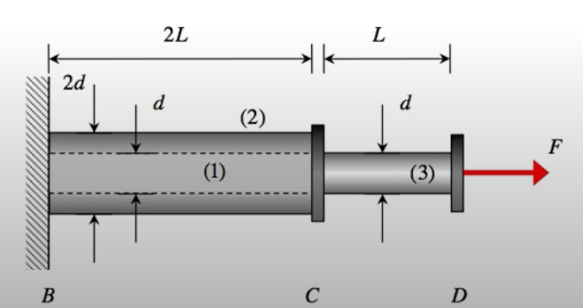
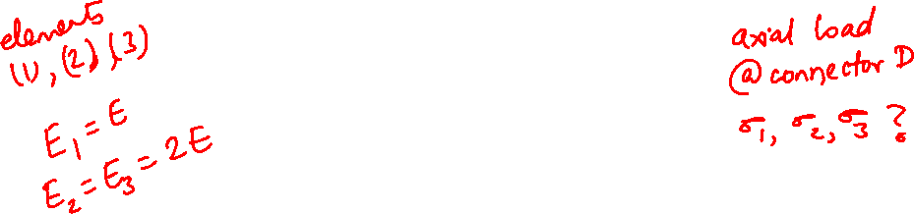

Example 6.13

Slide 22
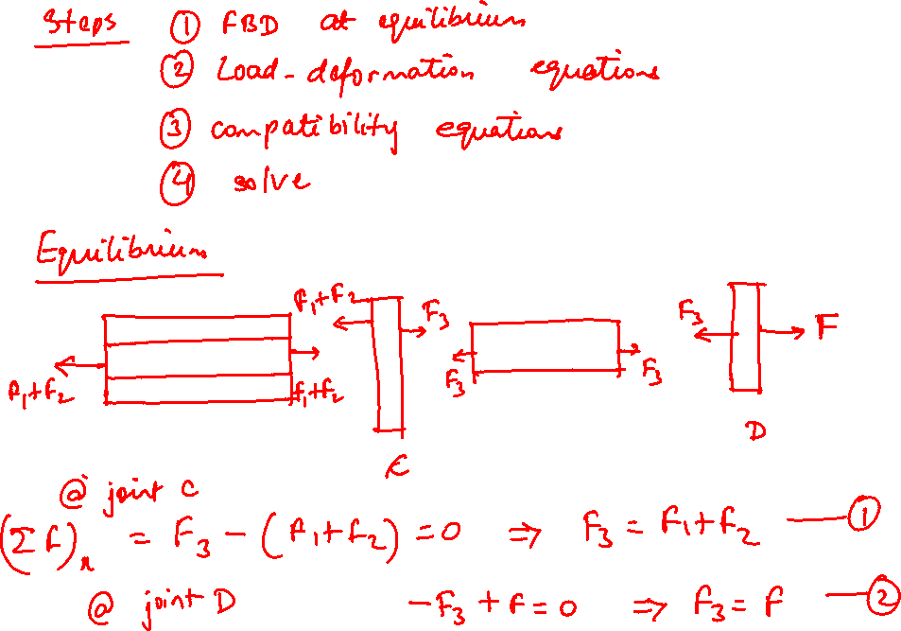

Slide 23
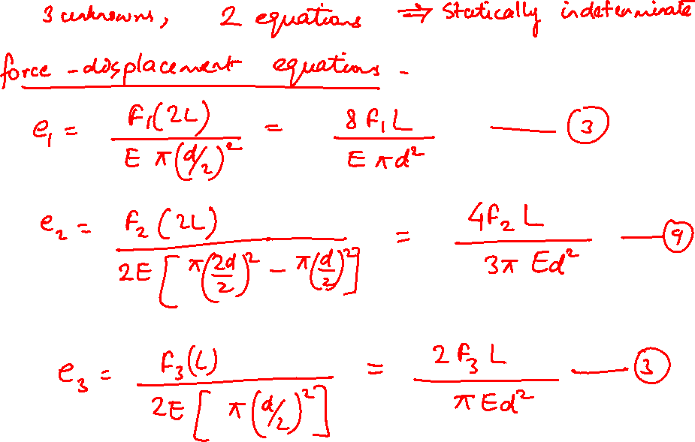

Slide 24
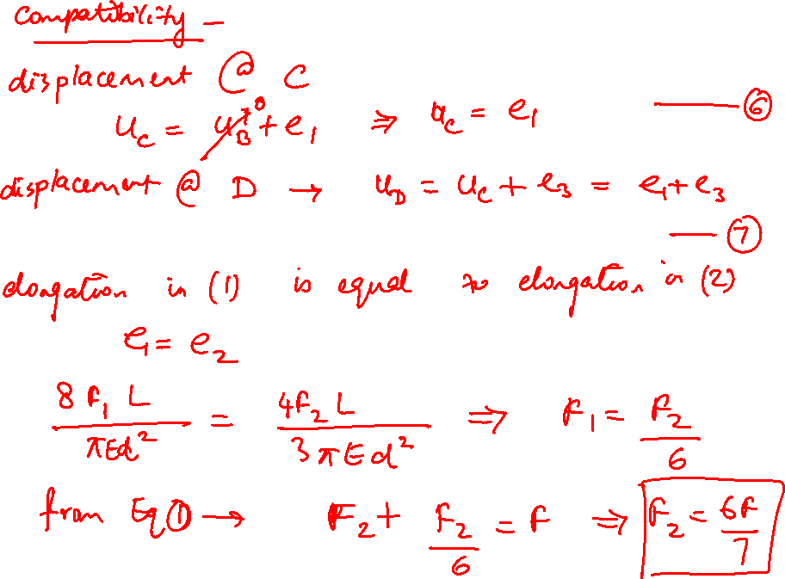

Slide 25
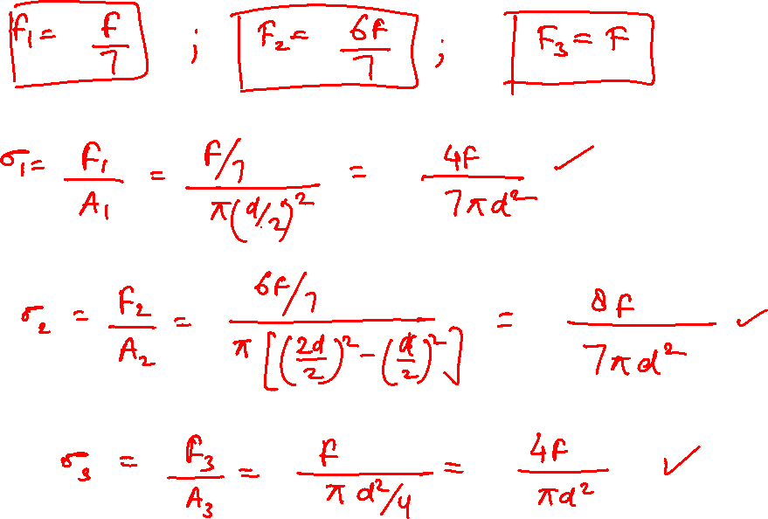

Slide 26
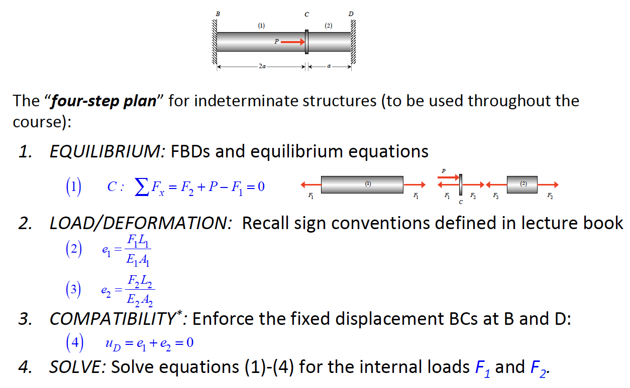

Slide 27
Thank You

