Slide 1
MECHANICS OF MATERIALS
Fall 2023
ME 323- 005
Instructor: Shubhra Bansal
Lecture 13: Beams- Flexural Stresses

Slide 2
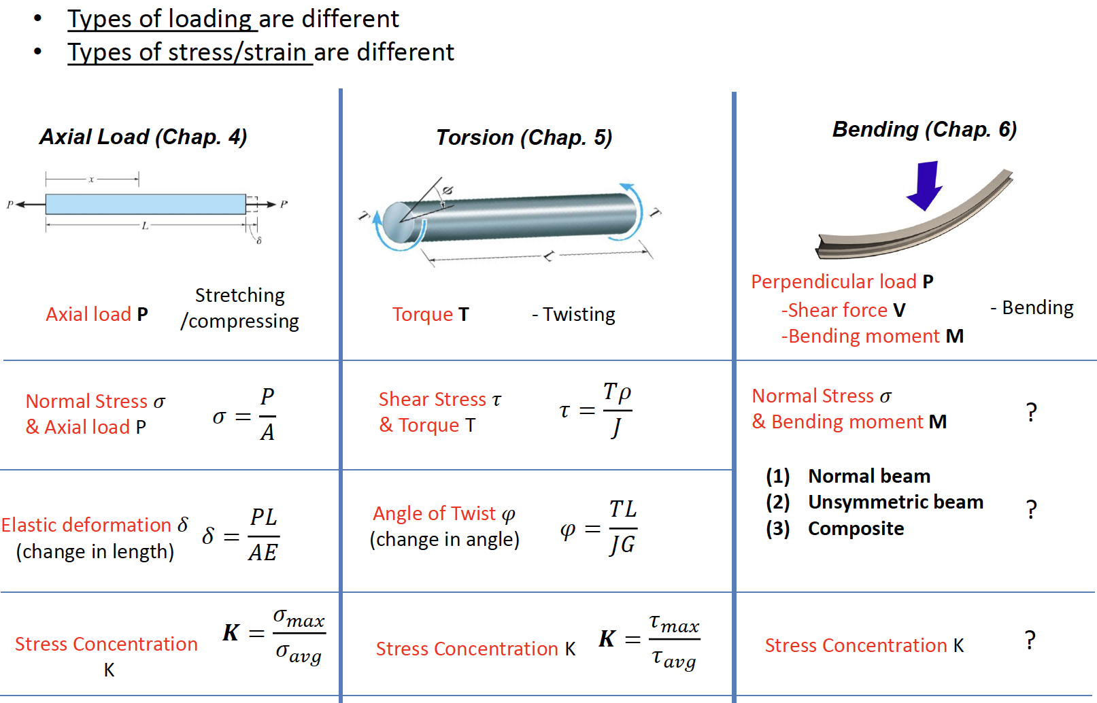
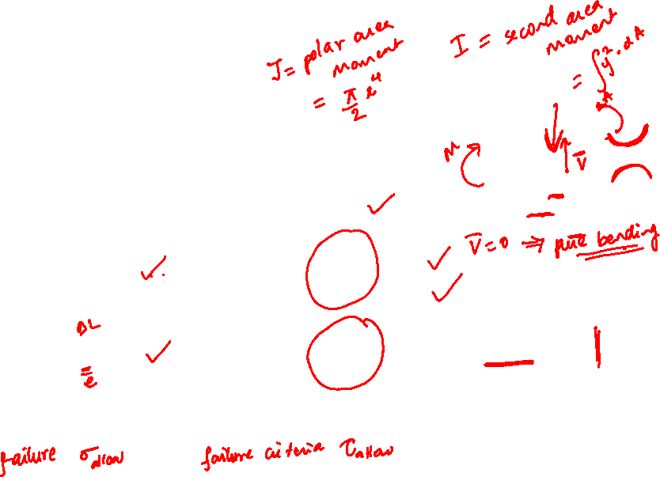
Axial Loading vs. Torsion vs. Bending

Slide 3
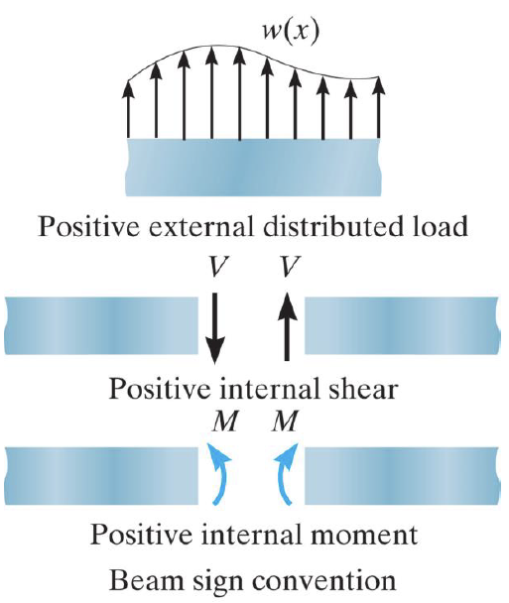
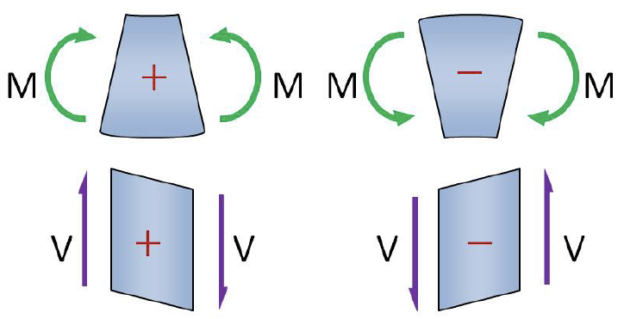
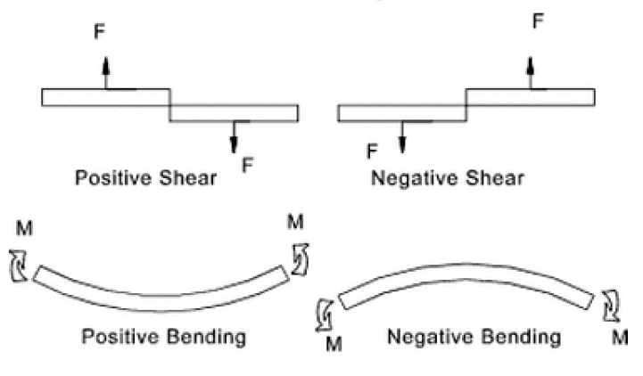
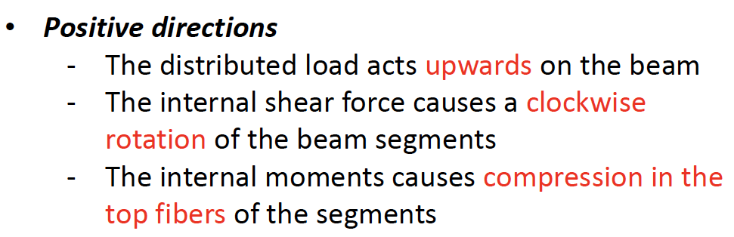
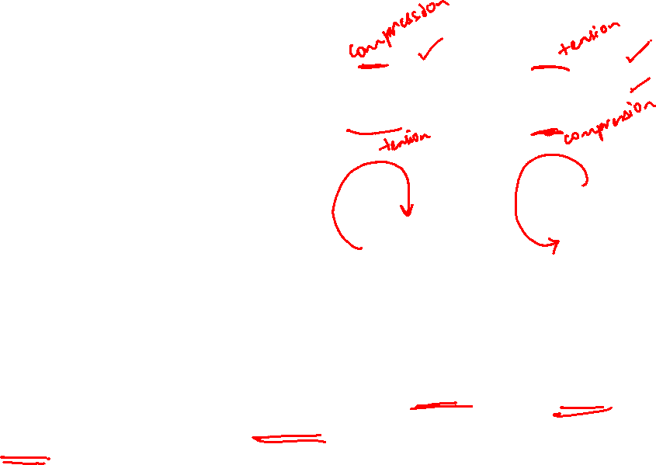
Beam Sign Convention

Slide 4
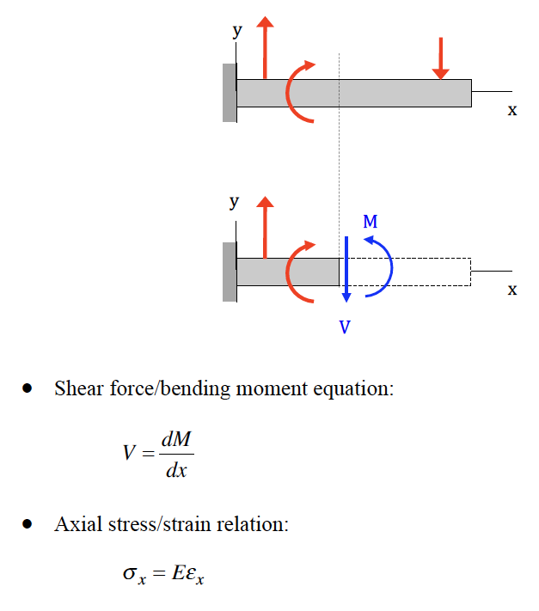
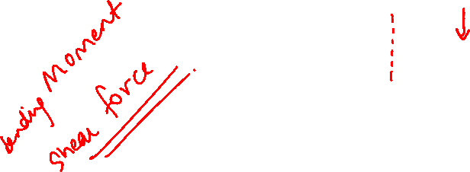
Shear Force/ Bending Moment

Slide 5
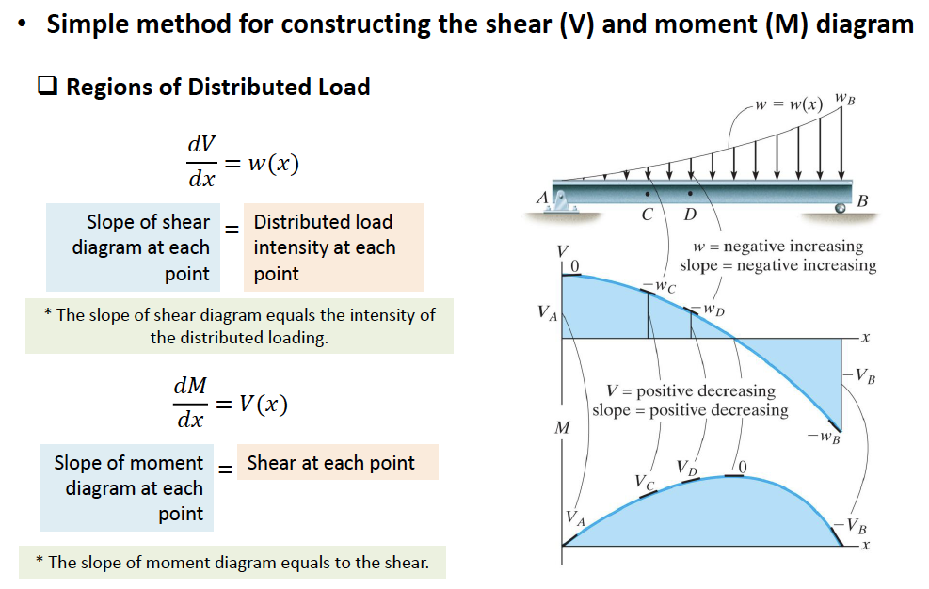
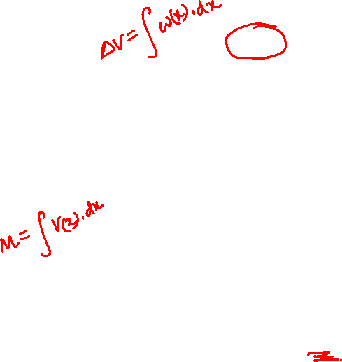
Shear Force/ Bending Moment Diagrams

Slide 6
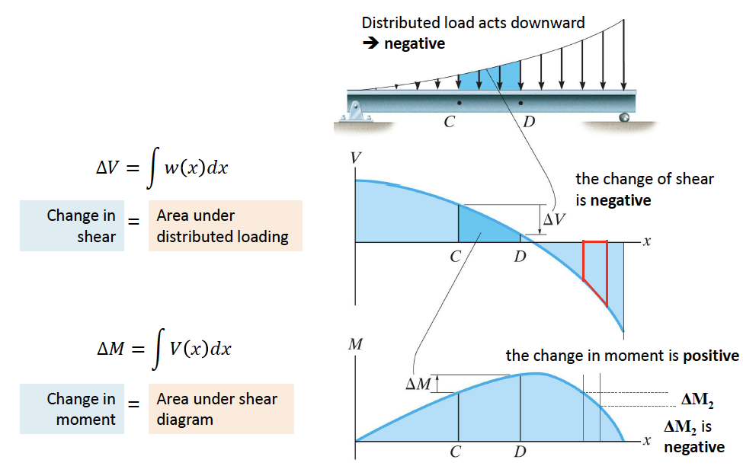

Shear Force/ Bending Moment Diagrams

Slide 7
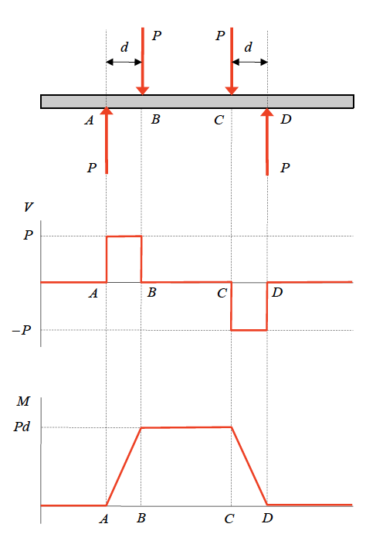
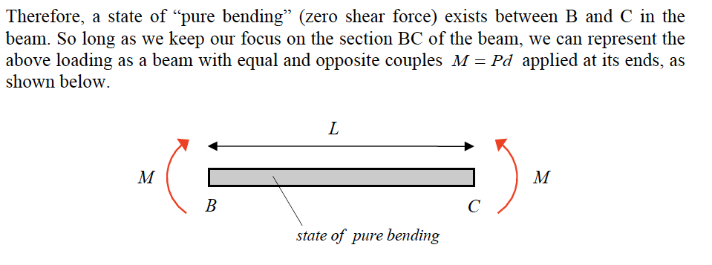
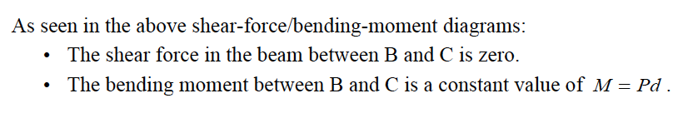
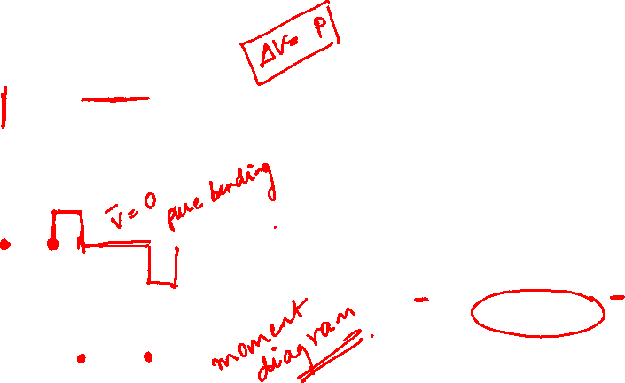
Shear Force/ Bending Moment Diagrams

Slide 8
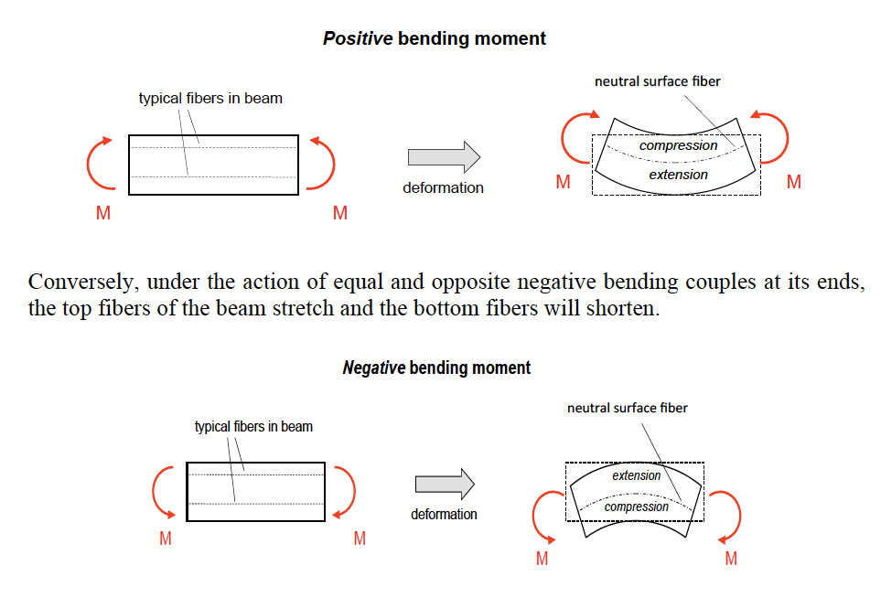
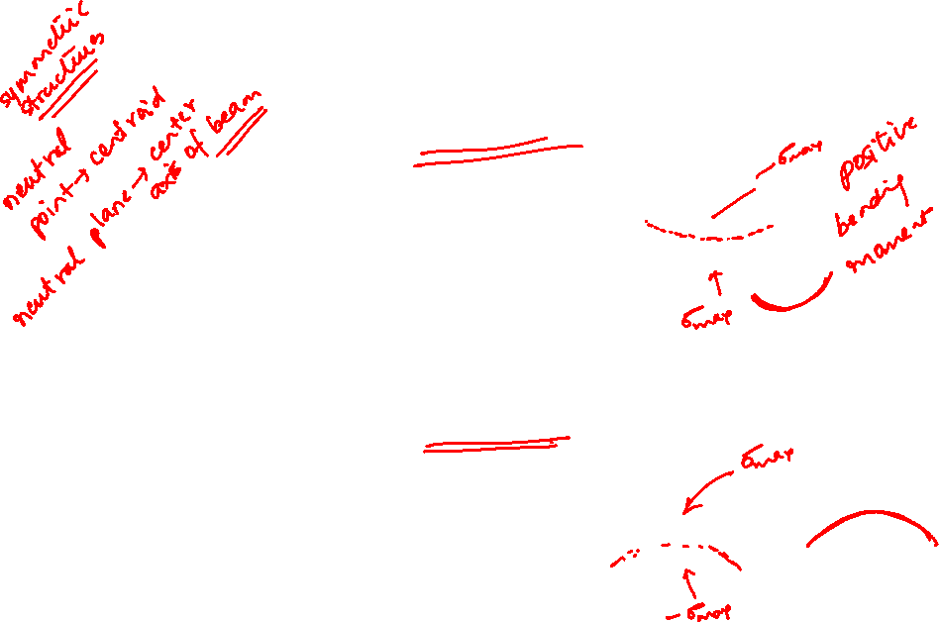
Strain for Pure Bending in Beams
The plane that divides the region of compression from the region of stretch is called “neutral surface” of the beam

Slide 9
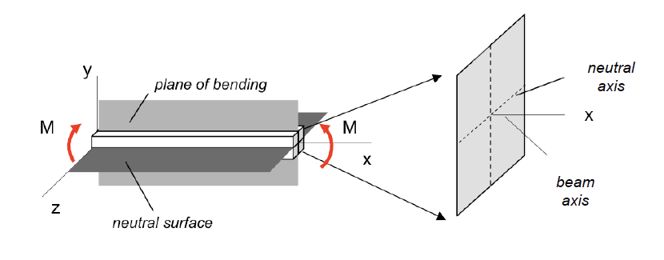
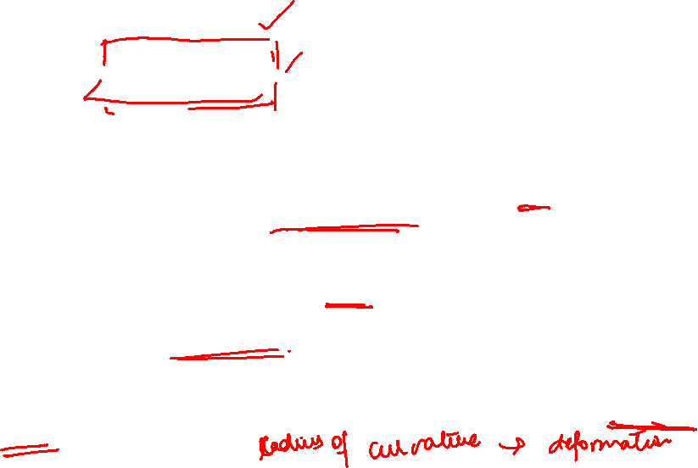
Euler-Bernoulli Assumptions for Thin-Beams (I)
The beam has a plane of longitudinal plane of symmetry (xy-plane as shown in following figure) called the “plane of bending”. Loading and supports for the beam are assumed to be symmetrical about the plane of bending.
The beam has a longitudinal plane (xz-plane as shown in following figure) perpendicular to the plane of bending on which there is zero longitudinal strain called the “neutral surface”. The intersection of the neutral surface with the plane of the cross section is called the “neutral axis” for the cross section.
The deformation of the initially-straight beam axis is known as the “deflection curve” of the beam.

Slide 10
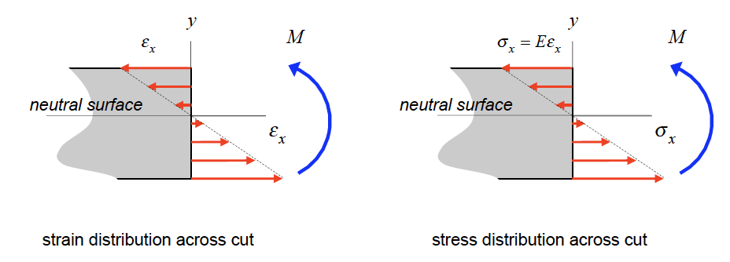


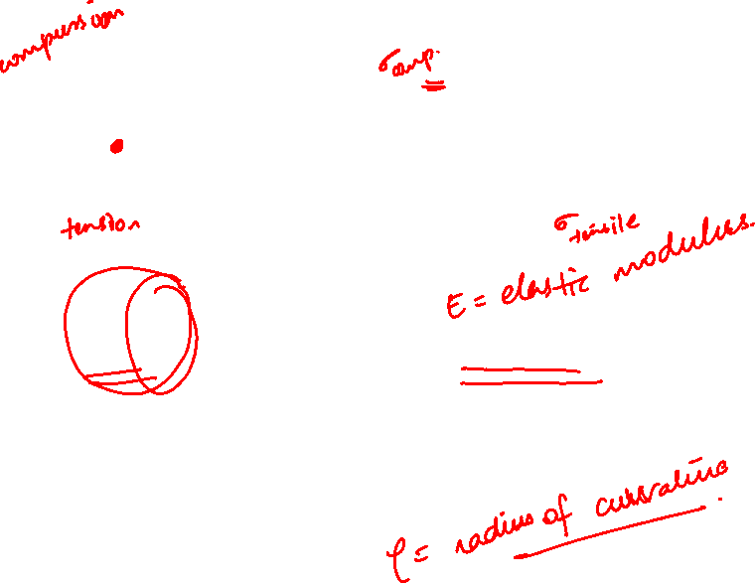
Flexural Stresses due to Bending
Axial Strain,
As a result of the above Euler-Bernoulli assumptions, it can be shown that the axial strain ε_{x} across a perpendicular cut in the beam where y is measured from the neutral surface of the beam and ρ is the radius of curvature of the deflection curve for the loaded beam.
For a linearly-elastic material for the beam, the normal stress distribution in y

Slide 11
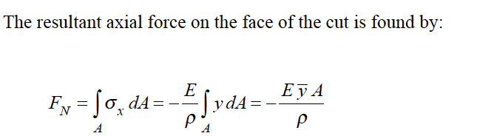
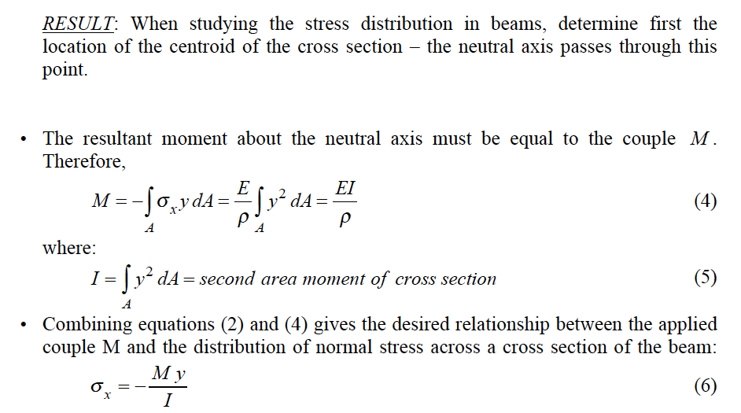
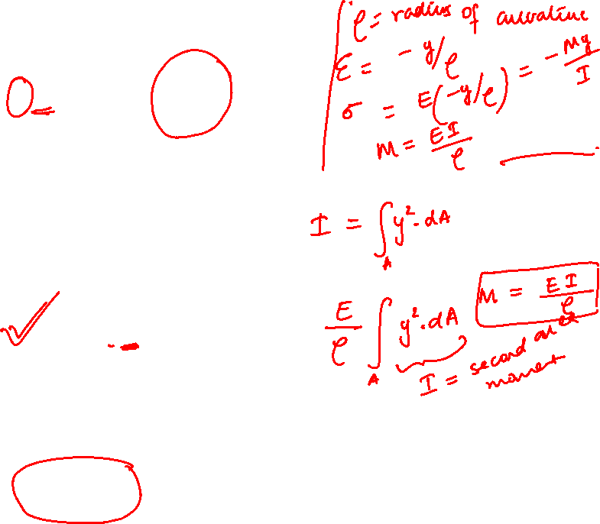

Slide 12
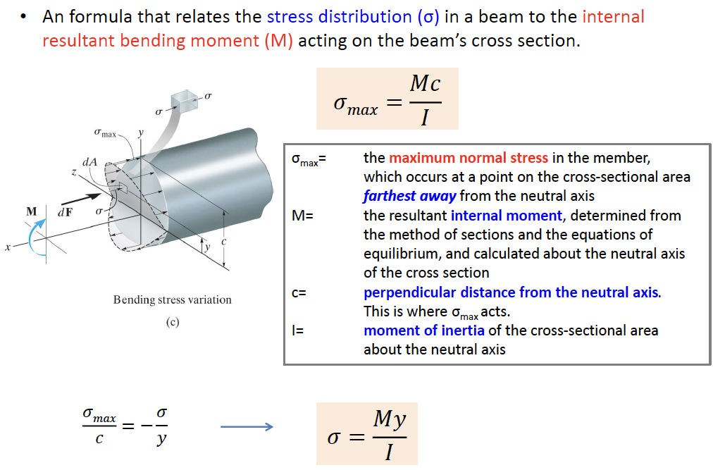
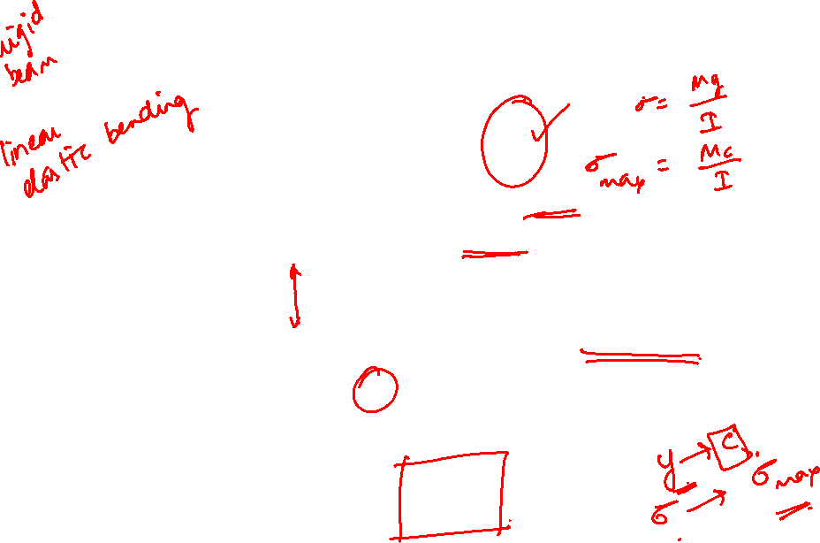
Flexural Stress Formula

Slide 13
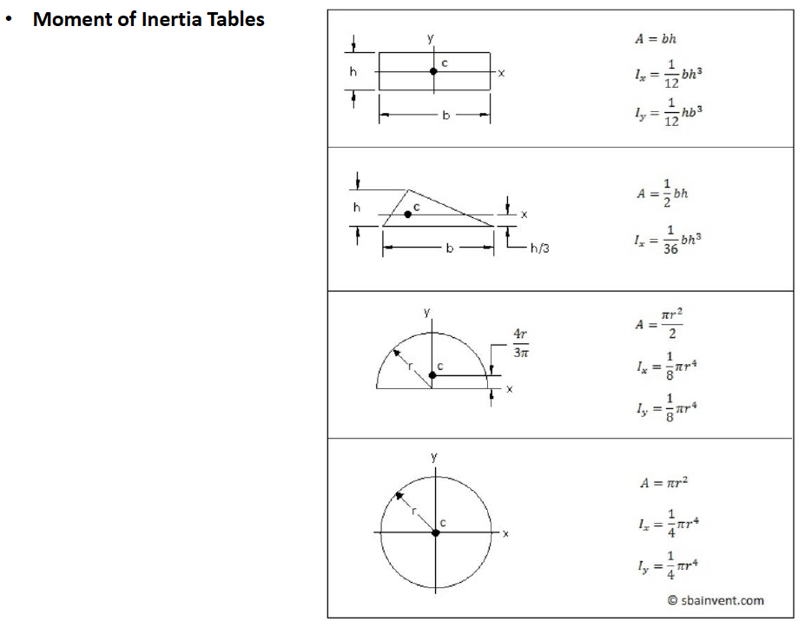
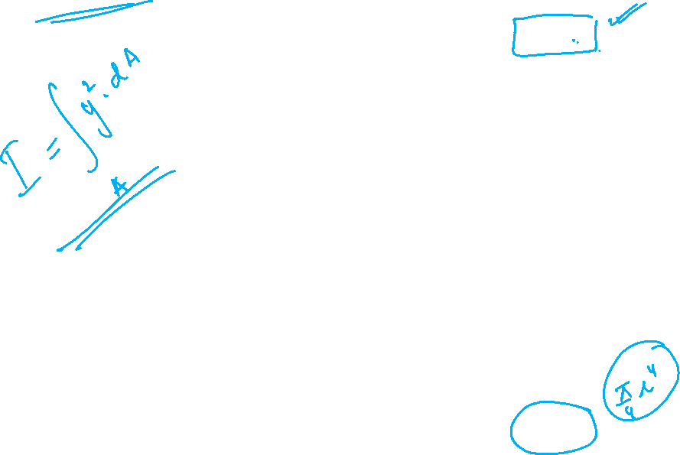
second area moment

Slide 14
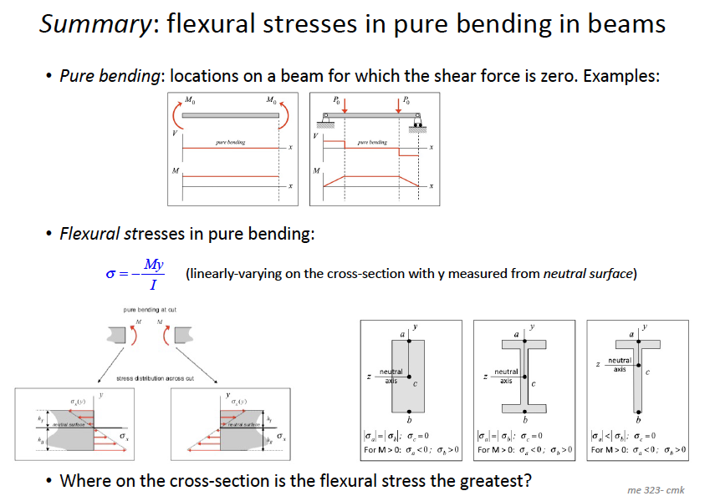
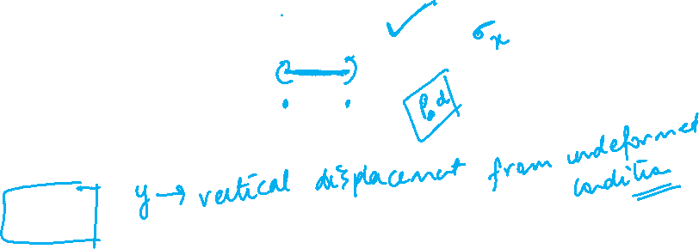

Slide 15
Thank You

