Slide 1
MECHANICS OF MATERIALS
Fall 2023
ME 323- 005
Instructor: Shubhra Bansal
Lecture 11: Torsion Members- Determinate

Slide 2
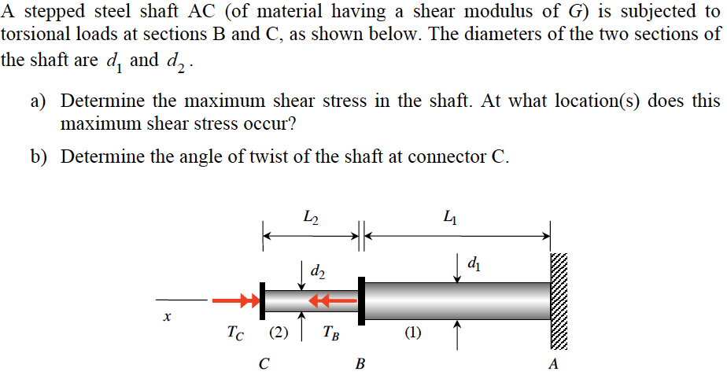
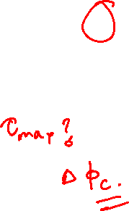
Example 8.3 from Lecturebook

Slide 3
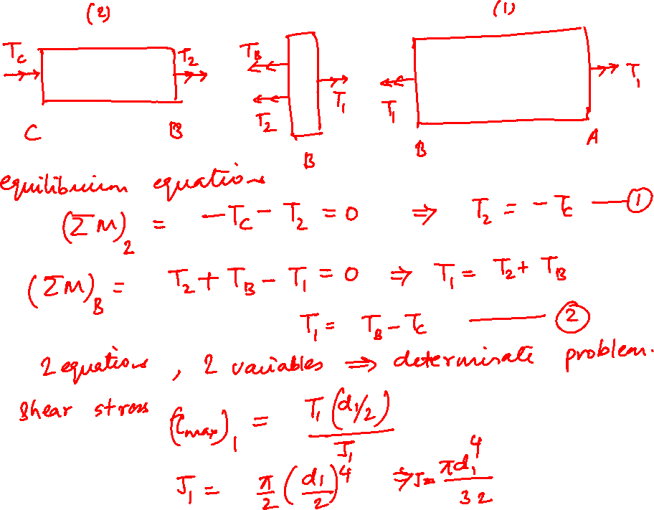

Slide 4
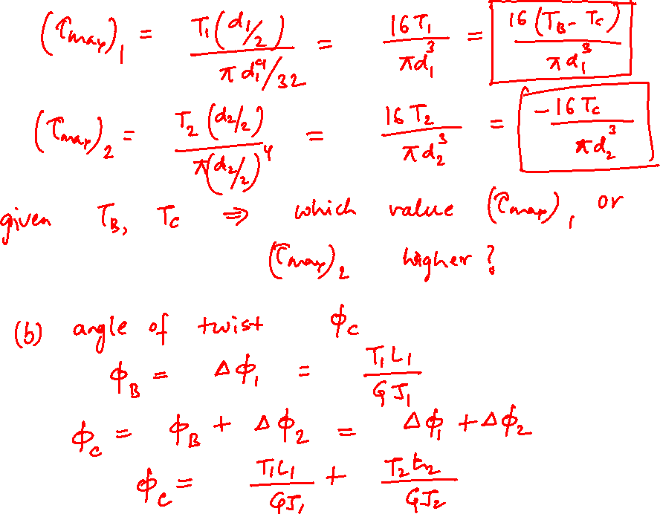

Slide 5
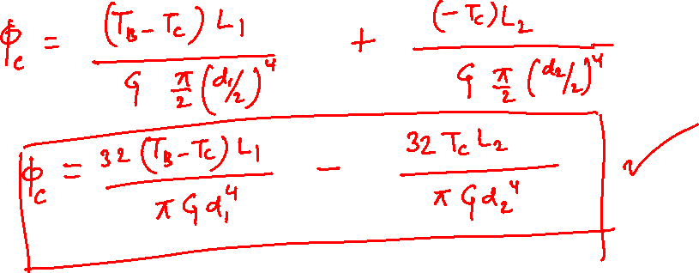

Slide 6
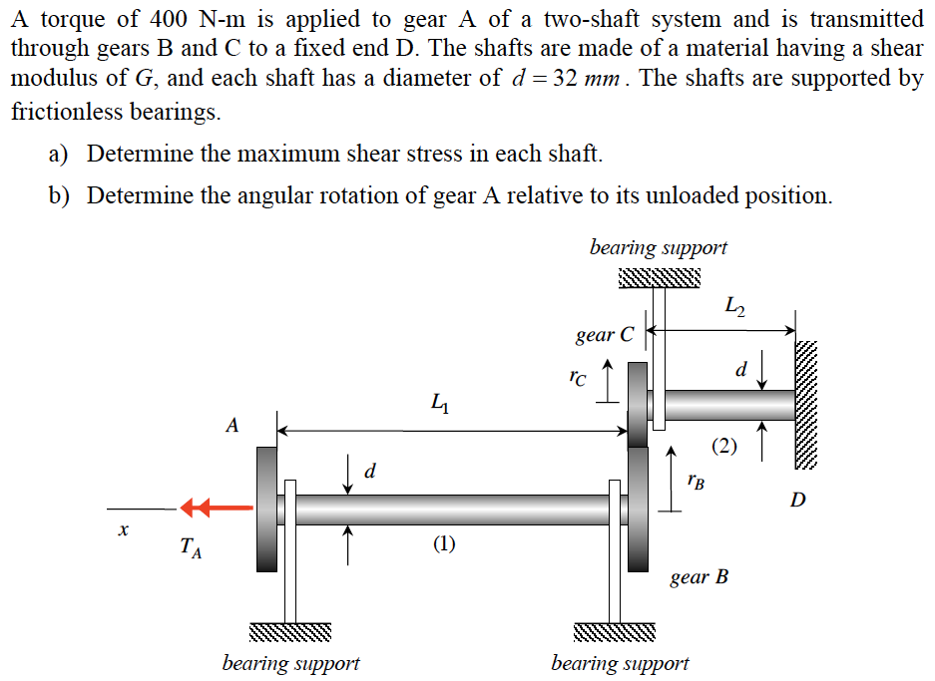

Example 8.4

Slide 7
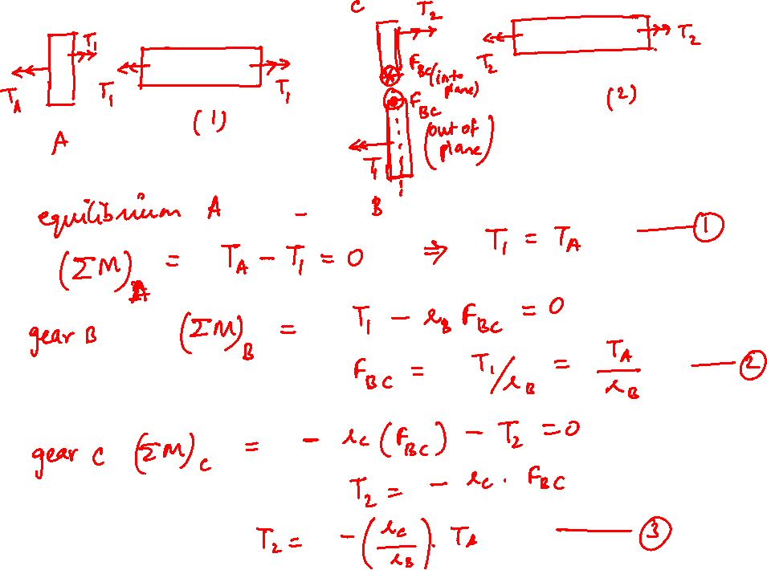

Slide 8
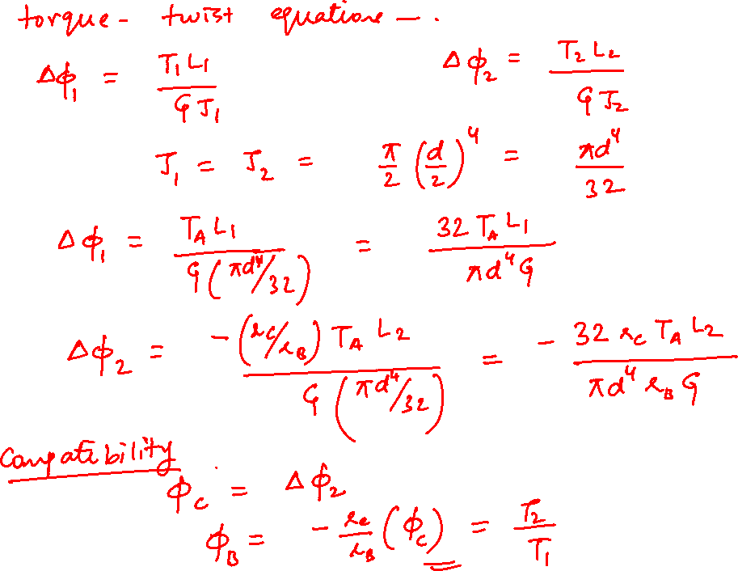

Slide 9

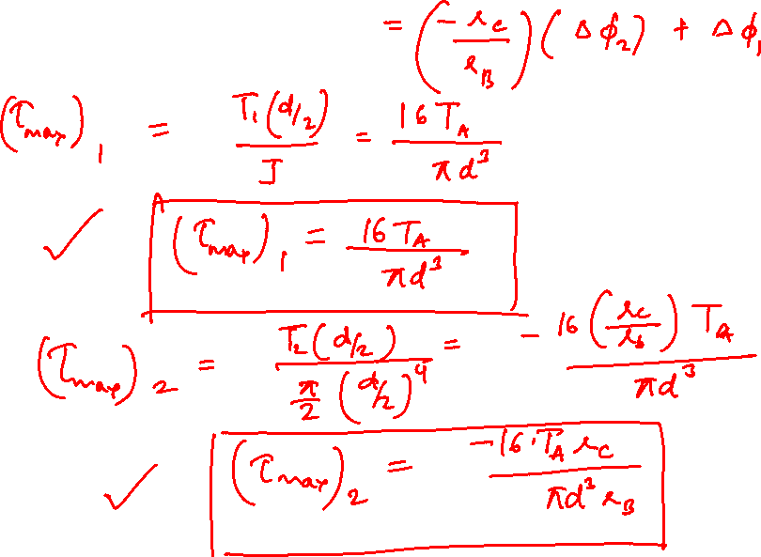

Slide 10
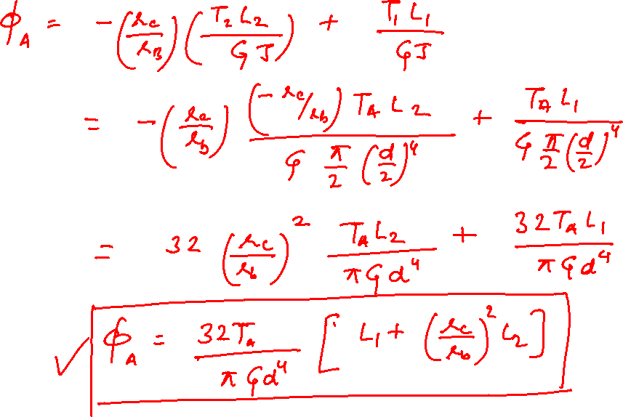

Slide 11
Thank You

