Slide 1
Parent & FAMILY presentation
Welcome to Exploratory Studies!
Student Transition, Advising & Registration
Notes:
Welcome to the second of our Parent & Family Presentations! It is my pleasure to welcome you and your son or daughter to the Exploratory Studies Program!

Slide 2
2
Exploratory Studies Advising
Notes:
In this section, we will talk about how academic advising works at Purdue and how to help your student forge a strong academic relationship with their Exploratory Studies advisor.

Slide 3
Introduction
Jennifer McDonald
Senior Academic Advisor
Education:
B.A. Psychology (Purdue)
M.S. Ed. Counseling (Purdue)
M.L.S. Library Science (IUPUI)
M. Cert. Instructional Design (Purdue Global)
Hometown: Indianapolis, IN
Fun Facts: I have two cats who I have leash trained. Also, I am big historical costuming, science, and music fan!
Notes:
Before we get started, let me introduce myself! My name is Jennifer McDonald and I am a Senior Academic Advisor in the Exploratory Studies Program. I have been an advisor for EXPL since 2006. Prior to that, I worked in various offices on campus, including First-Year Engineering Advising, our Career Placement Center, and the Office of the Dean of Students. My original hometown is Indianapolis, IN, but I consider West Lafayette, IN to be just as much my home now. When not advising students, I can be found walking my cats and watching any sort of media that features historical costuming, music, or science.

Slide 4
What is Academic Advising at Purdue?
College Academic Advising = Consultant & Coach
Takes a less prescriptive and more supportive role
Focuses on student’s academic, personal, and career growth
Reference point for a complex campus
Professional advisors
Membership in PACADA & NACADA
Consistent professional development
Notes:
As I said, I am a senior academic advisor. But what is academic advising at Purdue and what can you expect from us? First of all, college advising tends to be less prescriptive and more about being a consultant or a coach for your students. Our focus is on students’ academic, personal, and career growth. To that end, we want to support and challenge them to develop independence and problem-solving skills.
Advisors are also a reference point for students learning to traverse our complex campus. There are a lot of offices, each with its own specialized knowledge base. For example, staff in the Division of Financial Aid are going to be the most up-to-date on the constantly changing state and federal student aid laws. Similarly, International Students and Scholars is the go-to office for visa, I-9, and immigration information. It is important to us that our students’ questions are answered by the most expert office. So, during our advising sessions, we help students determine the best office to reach out to, then work with them to develop questions to ask once they get there. In this way, we continue to support students’ information gathering skills and assist them in building their campus resource network.
Finally, nearly all Purdue advising is carried out by professional advisors. It is our job to be the experts in curriculum, courses, and career development and we’re called upon to keep current with policy and process changes. That is why we are so fortunate to have strong local and national academic advising associations that promote and sponsor continuing education. NACADA is the National Academic Advising Association and PACADA is our Purdue-specific Academic Advising Association. In addition, individual departments hold professional development events. In Exploratory Studies we have biweekly visits from academic units to keep us updated on course and curriculum changes. PACADA also allows advisors the opportunity to craft or modify University policies that might affect our students.

Slide 5
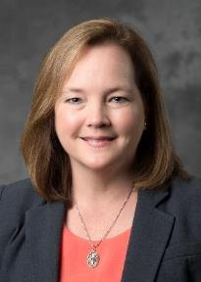
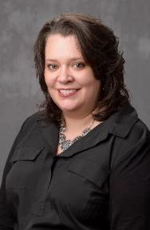
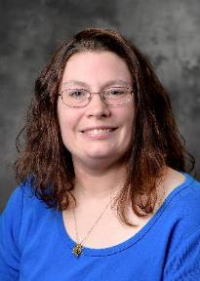
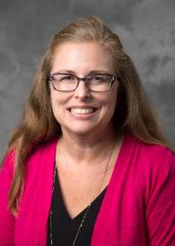
Exploratory Studies Program Leadership
Linda Gregory
Executive Director
Colleen Banter
Associate Director
Cara Wetzel
Assistant Director
Mary Beth Lencke
Assistant Director
Our Staff Biography Booklet is available at: https://www.purdue.edu/exploratory/parents/2022-STAR-Staff-Bios-Final.pdf
Notes:
Now that I have described how academic advising works at Purdue, I would like to introduce you to the Exploratory Studies Program leadership, advisors, and support staff on the next five slides. This is a great time to put a face with the name of your student’s advisor! For more details about each of our awesome staff, check out the Staff Biography Booklet on our Parents & Families VSTAR page or at the link above.

Slide 6
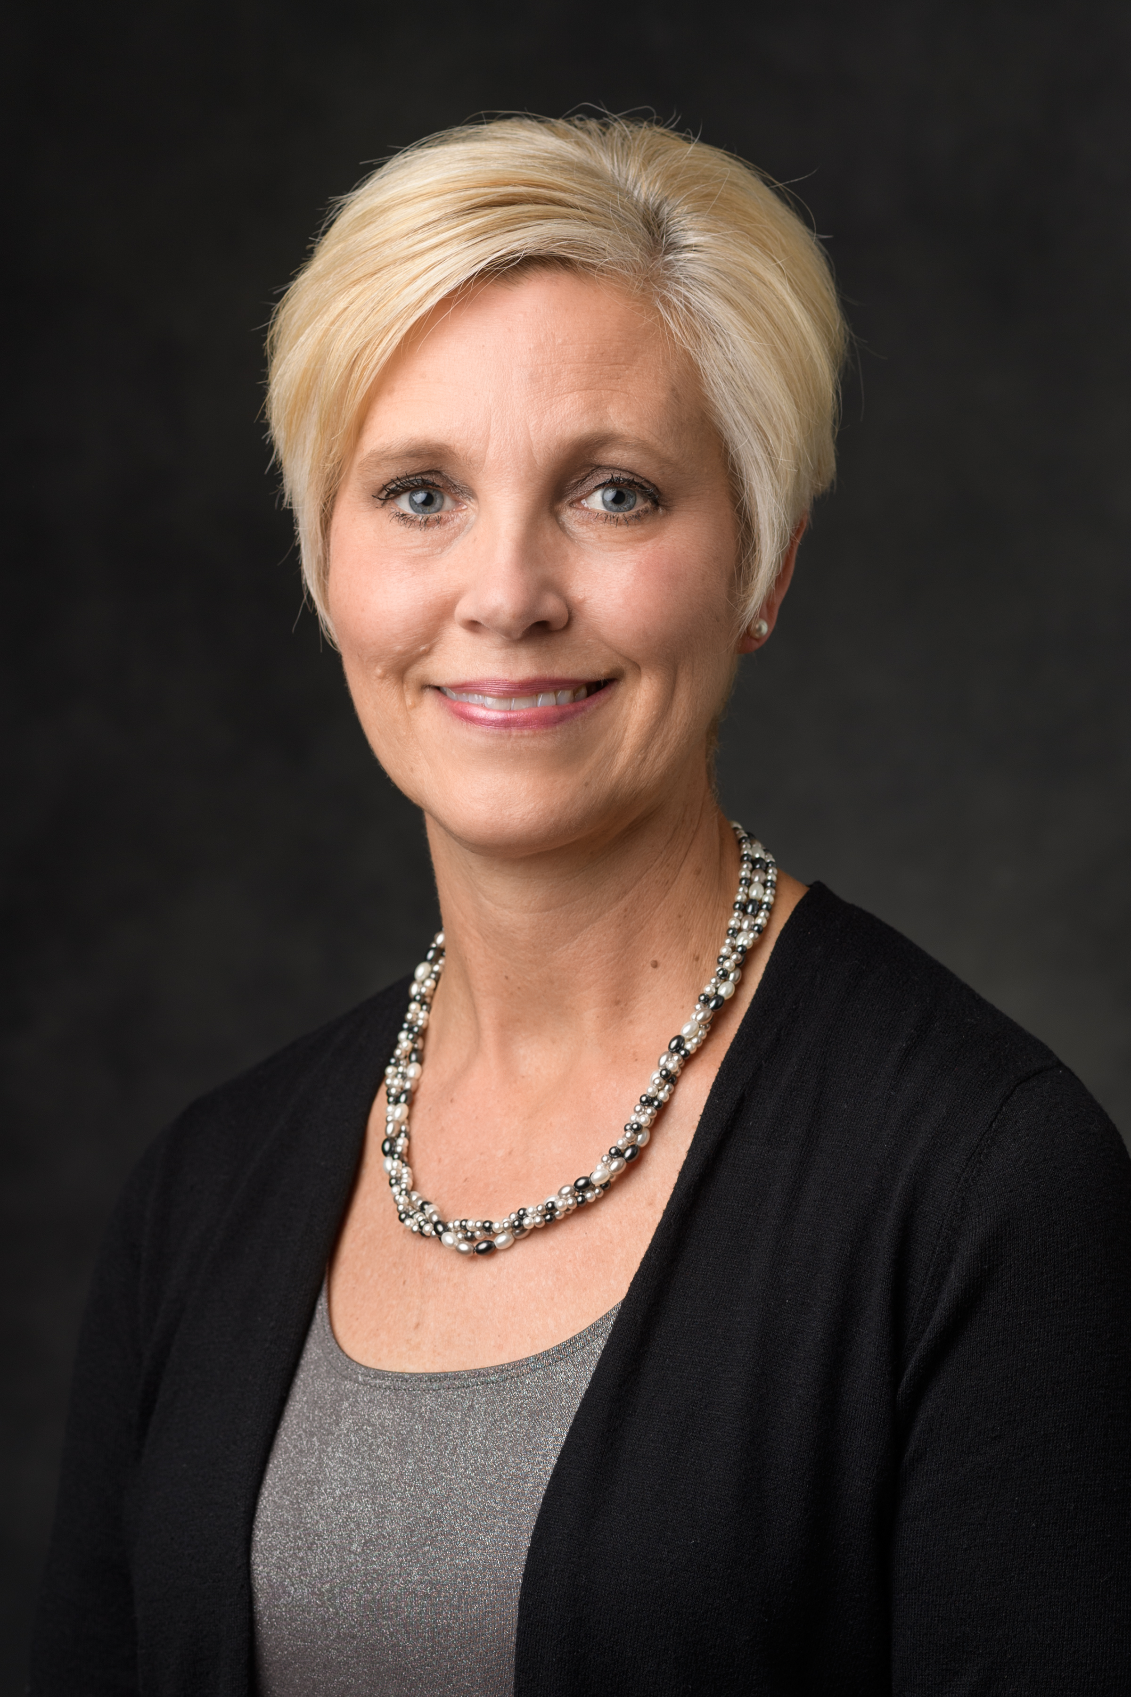
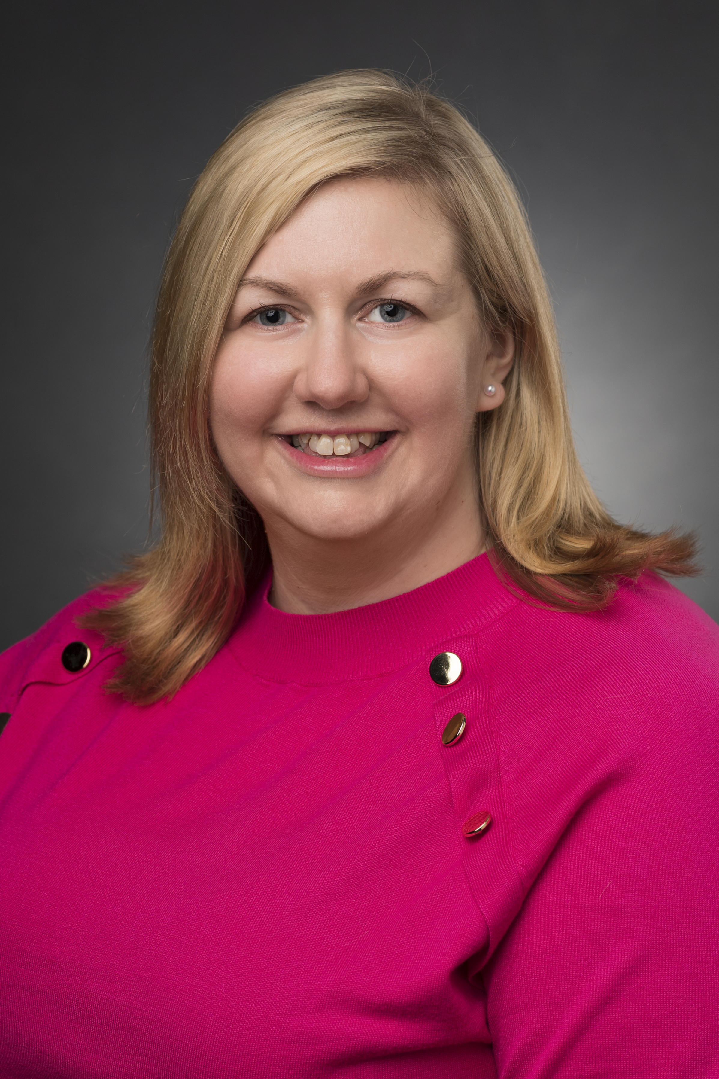
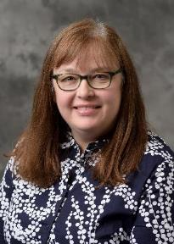
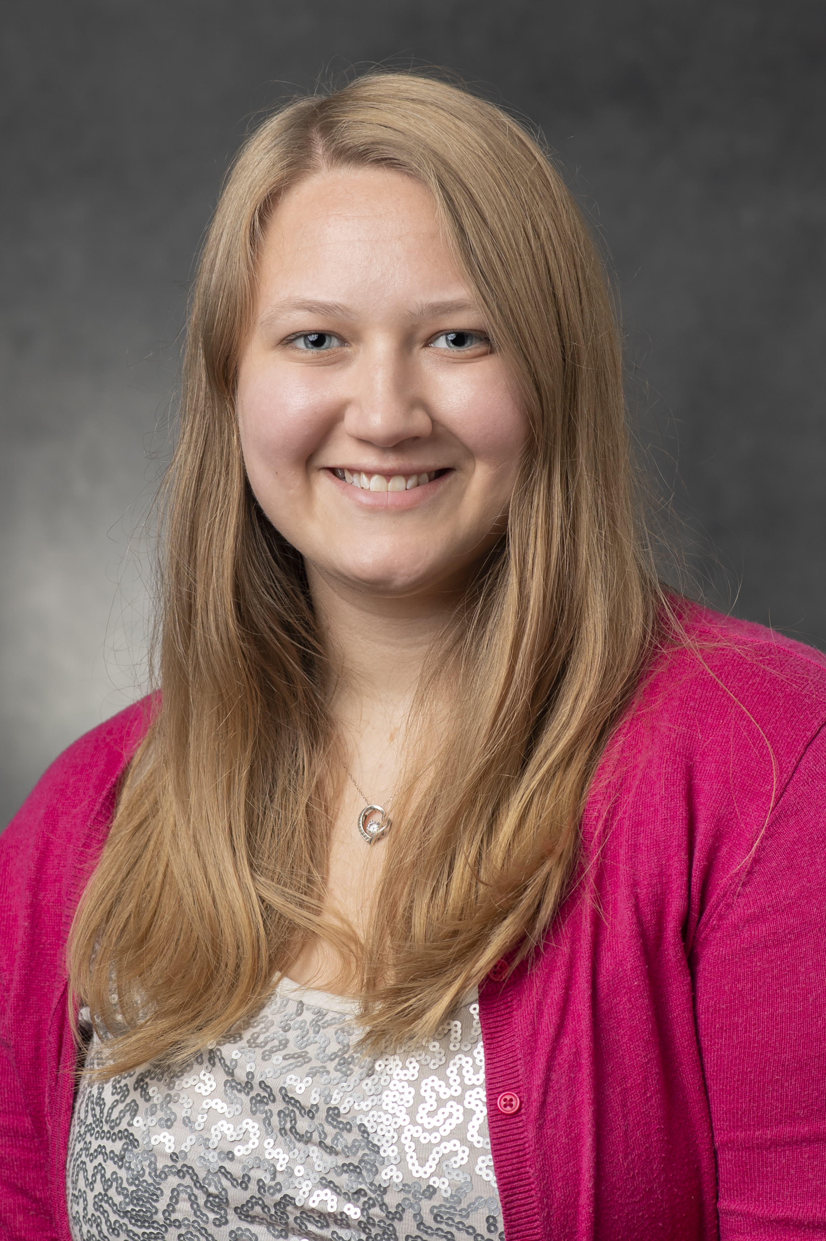
Exploratory Studies Program Advisors
Lynette Bleed
Academic Advisor
Jessica Chapman
Academic Advisor
Karla Cunningham
Senior Academic Advisor
Kara Green
Academic Advisor

Slide 7
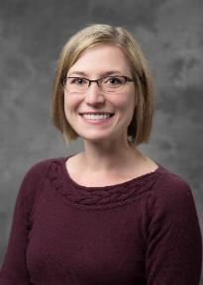
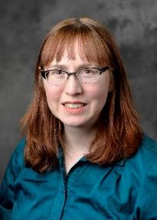
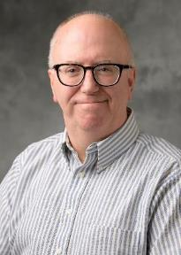
Exploratory Studies Program Advisors (cont’d)
Miranda Jack
Academic Advisor
Jennifer McDonald
Senior Academic Advisor
Ashlyn Ruff
Senior Academic Advisor
Scott Vana
Senior Academic Advisor

Slide 8
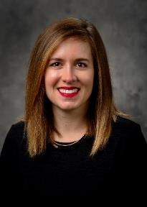
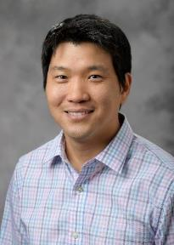
Exploratory Studies Program Advisors (cont’d)
Kate Winton
Academic Advisor
Nathan Wong
Academic Advisor

Slide 9
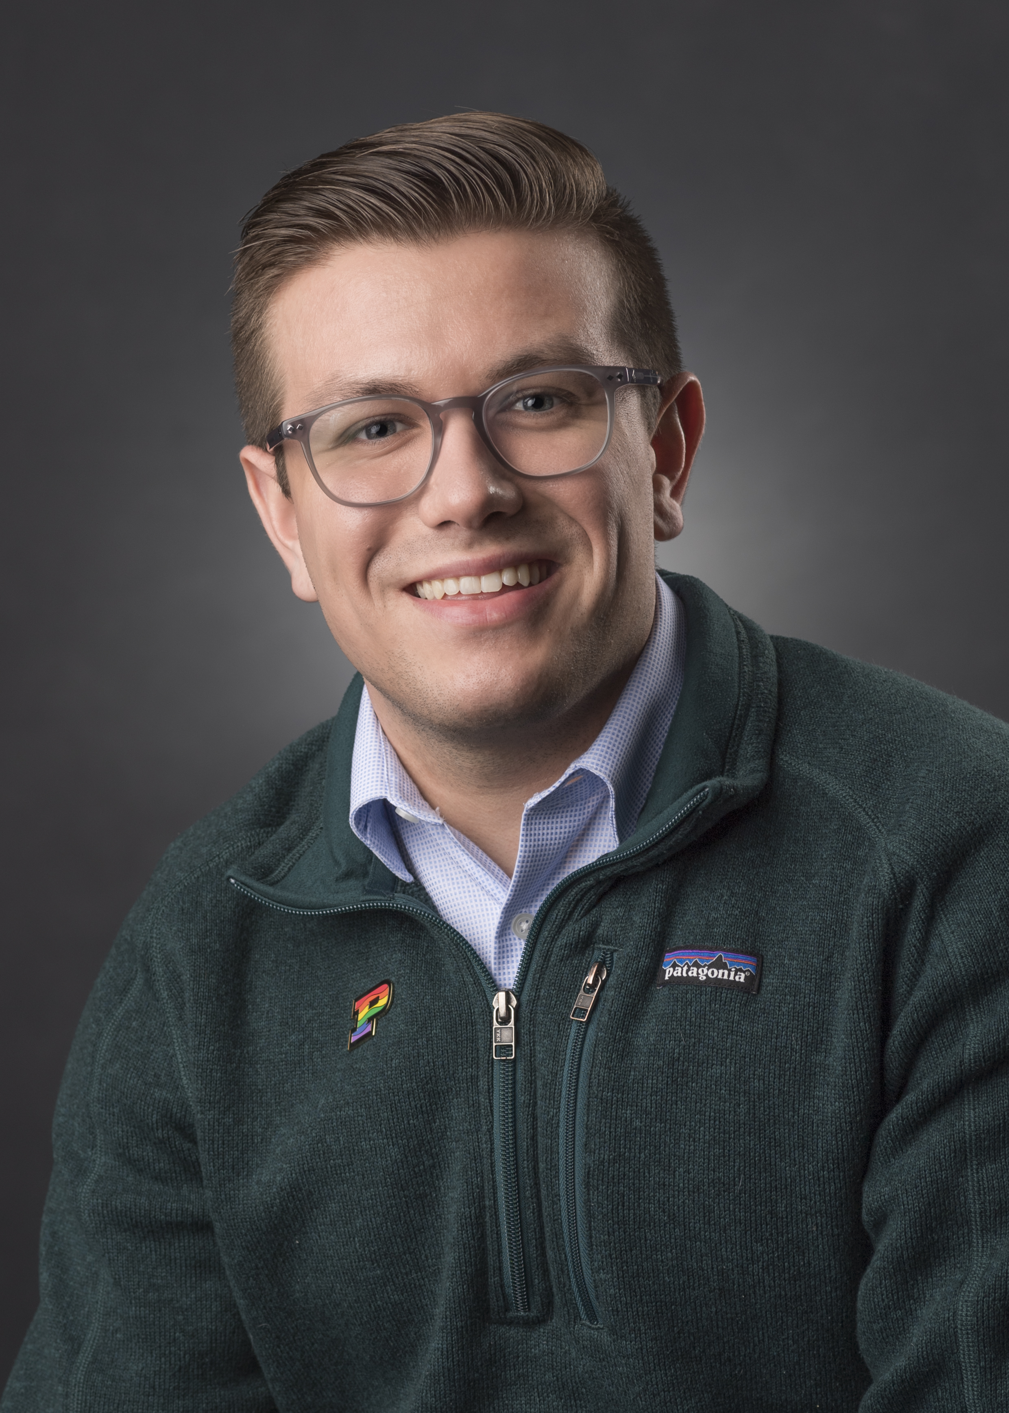
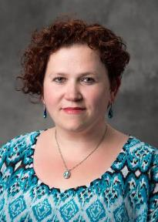
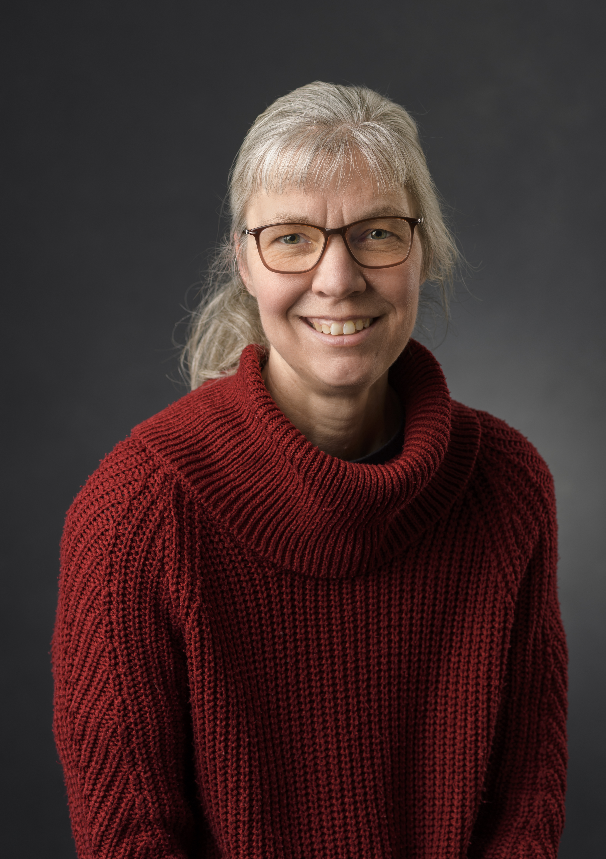
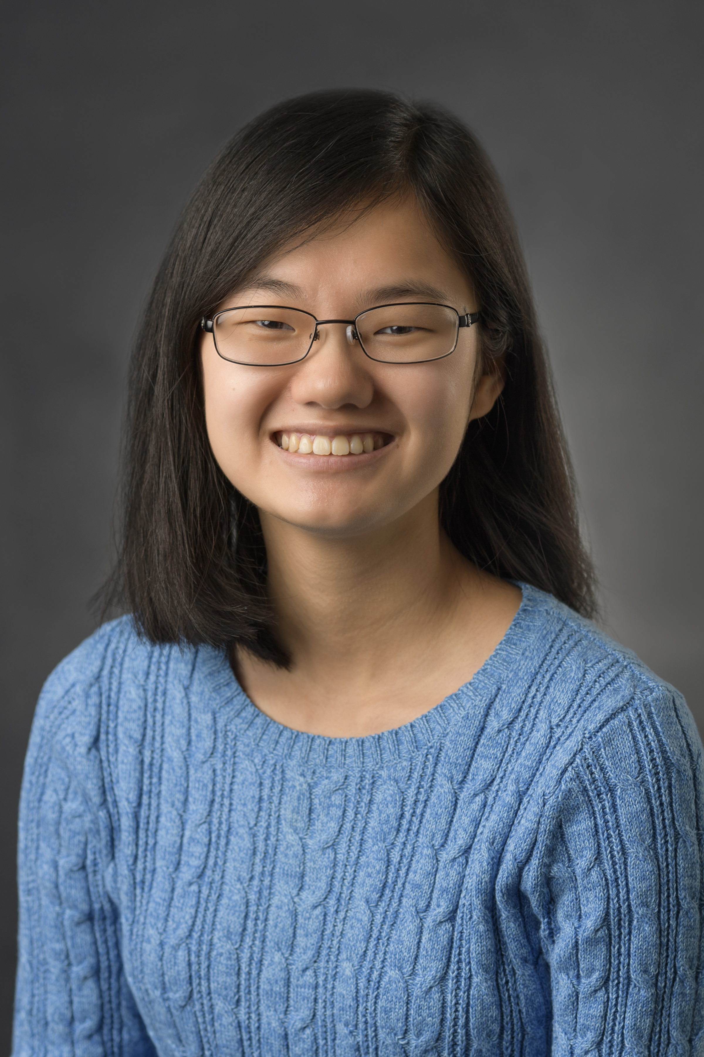
Exploratory Studies Program Support Staff
Jo Boileau
Senior Recruitment Manager
Angie Sigo
Senior Administrative Assistant
Andrea Yeoman
Administrative Assistant
Leah Criss
Administrative Assistant

Slide 10
Develop Connection with Advisor
Consistent Connection and Collaboration
Increases student retention and prevents delayed graduation
Our office is a safe, non-judgmental space
Two required meetings during the fall semester
Communication between student and parent is key
Notes:
We know that you and your family are your student’s #1 support resource as they make their college transition. However, we advisors would love to be your student’s main Purdue resource. Research shows that regular advising increases student retention and prevents delayed graduation. Therefore, we strongly believe that it is important for your student to develop a positive and consistent connection with his or her advisor.
One of the ways we encourage this is to create a safe, non-judgmental space for students so that they can talk out their concerns and receive feedback. Another way is that we hold two required meetings with each of our students in the Fall semester, so that we can get to know each other. This includes a September check-in appointment and a November registration appointment. Of course, outside of these appointments, students can set up a meeting any time during the semester – and we hope they will!
Keep in mind that because of the FERPA federal privacy law, advisors and other campus staff cannot discuss information about students with their parents or family. This is why it is so important that parents and their student maintain an open and honest communication channel. Together, parents and the advising staff can create an environment where students’ growth and independence are supported.

Slide 11
How You Can Help Your Student Connect
Encourage students to talk to advisor before little problems become big
Have them check, store, and refer back to advisor’s e-mail and Brightspace page information
Help your student brainstorm questions for meetings
Notes:
So, how you can help us help your students?
First, encourage your student to discuss concerns with their advisor while problems are small and can be more easily solved. Students often wait way too long to report academic issues. Remember, we won’t judge your student! It is very normal for students to find that their high school study skills aren’t quite enough to handle college work. We will let them vent, of course, but we will also coach them through developing and trying out solutions.
Second, impress upon your student the need to check and respond to their e-mail daily. Assist them in developing good e-mail and information organization strategies, so they won’t become overwhelmed. Also, encourage your student to ask you or their advisor if they don’t understand what an e-mail means or what action they need to take after reading it. Lastly, encourage them to use advisor e-mails as a first resource for answering their questions. We don’t mind answering questions, but we do kind of mind answering the same questions whose answers were already explained in three previous e-mails!
Finally, help your student brainstorm questions as they are preparing for meetings with advisors, professors, or any of our other staff. Without a lot of experience, coming up with good questions in the moment can be difficult. In addition, many students simply get nervous speaking to campus staff and professors. Having the questions thought out in advance can keep the conversation more focused and less stressful. The less stressful the experience, the more your student will feel comfortable asking for help!

Slide 12
Change of Degree Objective (CODO)
Changing majors at Purdue
CODO = GPA and course requirements to enter major
Different for each major
Selective majors have higher and more complex requirements
CODO discussed in advising sessions and EDPS 10500
How you can support your student
See the Purdue Catalog > Major Change (CODO) Requirements
Annual updates to the CODO Requirements available in June
Good grades open doors!
Encourage meeting with their advisor for interpretation and planning
Notes:
A key topic that will often be discussed during a student’s advising appointment is the CODO requirements for their preferred major.
CODO stands for “Change of Degree Objective.” It consists of the minimum grades students must earn and courses that students must complete before they can officially enter a degree-granting major.
Every major’s CODO requirements are different. The requirements are determined by the faculty to be the minimum needed to be successful in a major once accepted into it. There are also majors that have more applicants than spaces and so have more stringent and complex requirements, such as engineering, computer science, nursing, and aviation technology.
During the fall semester, our Exploratory Studies students are introduced to CODO in both our advising meetings and in our EDPS 10500 Academic and Career Planning course. You can help your student keep on top of their CODO requirements by doing a few things:
First, encourage them to read the CODO requirements for their preferred majors early and often, so they can plan ahead. CODO requirements are updated every June 1st for the incoming class and can be found on the Purdue Catalog home page in the left navigation column. Then, scroll down to the student’s college and major link. The CODO requirements that students begin with remain the same until graduation.
Second, promote strong study skill strategies. Assist your student in building good learning and self-management habits. Good grades open the doors to a wide range of majors for your undecided student!
Finally, CODO requirements can be complex and sometimes tricky to interpret. Encourage your student to talk with their advisor. The advisor can make sure your student understands the CODO requirements and which courses should be taken to prepare.

Slide 13
Thank You
Further Resources:
Parents & Families Frequently Asked Question (FAQ) page: https://www.purdue.edu/exploratory/parents/parents-families-faq.php
Parents & Families Support Documents: https://www.purdue.edu/exploratory/parents/star-vstar-parent-families.php
Parent & Family Connections homepage:
https://www.purdue.edu/parentandfamily/
Notes:
Thank you for your attention! Although we cover a lot of information in these presentations, we know that you may still have questions about the Exploratory Studies Program. To help answer these, here are three fantastic resources from the Exploratory Studies and the Purdue Parents & Family Connections webpages. Thanks again and Boiler Up!!

