Slide 1
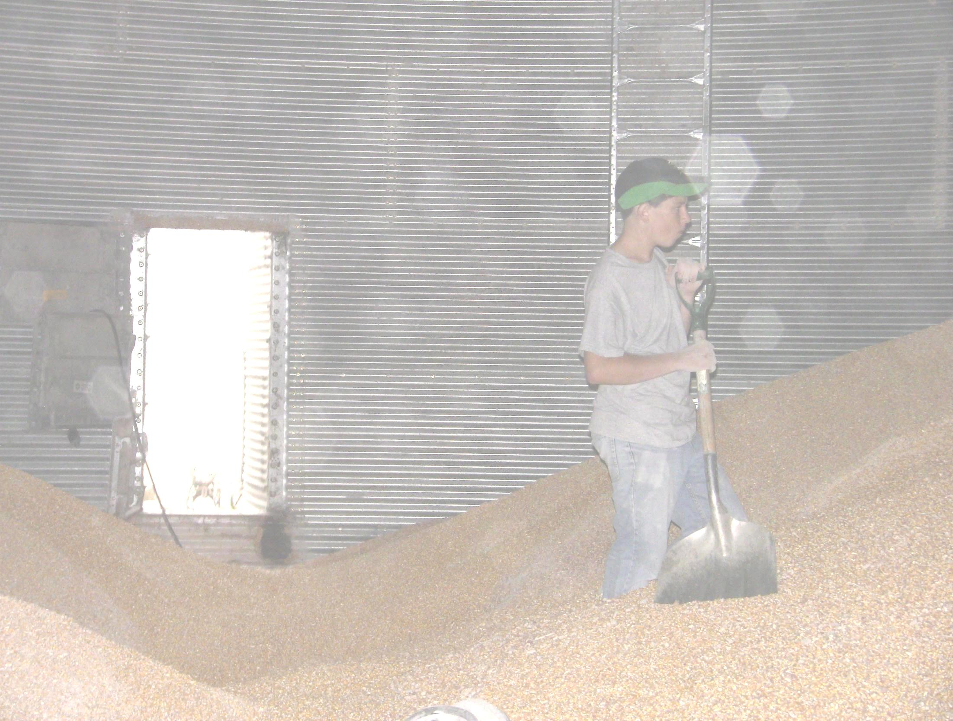
Safe Grain Storage and Handling Practices for Young and Beginning Workers
Unit 3-Summary of Grain-related Incidents Involving Youth
Against the Grain
Developed by:
  Purdue University
  Agricultural Safety and Health Program
  Department of Agricultural and Biological Engineering
  West Lafayette, IN
This material was produced under grant number SH23575SH3 from the Occupational Safety and Health Administration, U.S. Department of Labor. It does not necessarily reflect the views or policies of the U.S. Department of Labor, nor does mention of trade names, commercial products, or organizations imply endorsements by the U.S. Government.
Notes:
Instructor Notes:
This unit is the third in the Against the Grain curriculum. Before showing this PowerPoint presentation, take the time to review the contents of the Instructor's Guide. The Guide contains a tremendous amount of background information that relates specifically to the hazards faced by young and beginning workers who are assigned to work in and around grain storage, handling and processing facilities, and other types of agricultural confined spaces. The Annual Summary of Incidents in agricultural confined spaces should be helpful in presenting this unit.
Each of the PowerPoint units are designed to stand alone, but are most effective if all are shown in sequence. In this unit, participants will learn more about the most frequent types of grain-related incidents and the consequences they can have on young and beginning workers.

Slide 2
Objectives
Explain the scope and magnitude of the U.S. grain industry.
Explain the proportion of victims involved in agricultural confined spaces under the age of 21.
Describe the nature and characteristics of incidents involving agricultural confined spaces.
Describe the characteristics of youth that make them so vulnerable to grain-related incidents.
Identify the regions of the U.S. where most grain entrapments occur.
Explain the role that out-of-condition grain has on the frequency of grain entrapments.
Explain the reasons why youth are the most frequent victims of grain transport vehicles.
Notes:
Instructor Notes:
Briefly review the objectives of this unit.

Slide 3
Introduction
Approximately one out of five documented agricultural confined space fatalities or injuries involves a person, just like you, under the age of 21.
Notes:
Instructor Notes:
Youth under the age of 21 account for one out of five agricultural confined space-related incidents, including those involving free flowing grain, feed, and other agricultural products. Do a quick exercise by counting how many participants there are in the room and assume that each represents a worker in the grain industry who have experienced an injury or death at a grain storage, handling processing facility. Calculate how many would have been under the age of 21. (For example: If there are 25 participants in the class representing injured or killed workers, five would have been under the age of 21).
Ask participants if they believe that 20% of all work done around grain operations is performed by those under the age of 21.
Ask participants why they think that workplace injuries and fatalities involving those under the age of 21 receive so much media attention. Ask if anyone in the class knows of an incident involving a youth injured or killed while working around grain, or in an agricultural confined space.

Slide 4

There are better ways to be remembered than being the victim of a grain-related incident
Notes:
Instructor Notes:
There have been several high profile cases that have raised awareness of the problem of younger workers being injured or killed in the grain industry. Remind participants of the three youth entrapped in a grain bin in Illinois as reported in the video presented in Unit 1, or other high profile cases that might have occurred in your area. You might also summarize the case studies found in the Instructor’s Guide.
For more information on the case that took place in 2010 in Mount Carroll, Illinois please see the online article at www.npr.org/post/fines-slashed-in-grain-bin-entrapment-deaths or apps.npr.org/buried-in-grain/. This latter site contains several case studies of incidents involving younger workers.
Remind participants that there are better ways to be remembered than being the victim of an entrapment or engulfment in grain.

Slide 5
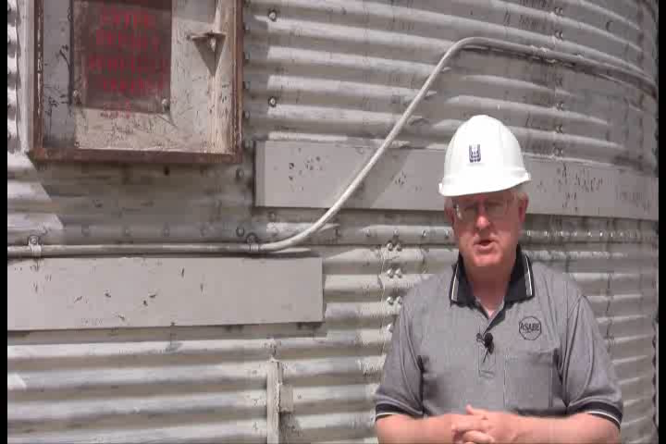
Dr. Field Data Video
Notes:
Instructor Notes:
Imbedded in this set of PowerPoints is video interview with Professor Bill Field, Extension Safety Specialist at Purdue University, who has gathered data on agricultural confined space-related incidents for over 30 years.
This interview provides a good foundation for the balance of this unit that will summarize the problem of grain-related incidents involving youth and young workers.

Slide 6
Incidents in Agricultural Confined Spaces Are Much Too Common!
Over the last 40 years no fewer than 1,700 cases have been documented.
There are many other cases that have gone unreported.
Over 1,100 of the documented cases have related to grain storage and handling.
Over one in five victims were children and youth under the age of 21.
Over 97% were male.
Source: Purdue University
Notes:
Instructor Notes:
The best source of data regarding incidents involving grain storage, handling, and processing, and other types of agricultural confined spaces is found in the Purdue University Agricultural Incident Database. Though incomplete it provides the best summary of documented events such as entrapments, engulfments, entanglements, asphyxiations, falls, and electrocutions in and around agricultural confined spaces. The overwhelming majority of these cases have been in grain storage and handling facilities. Annual summaries of incidents can be found at www.grainsafety.us or www.agriculturalconfinedspaces.org and a recent copy is included in the Instructor’s Guide as Attachment #1.
Take the time to walk through each of the points on this slide in order to have the participants see themselves as meeting the criteria for being a potential victim of a grain-related incident.

Slide 7
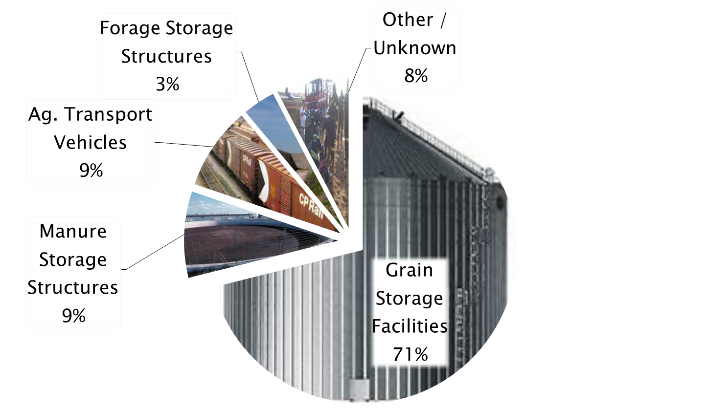
Why Focus on Grain Storage and
Handling Facilities?
Notes:
Instructor Notes:
As already noted, over 1,700 incidents involving agricultural confined spaces have been documented. The actual number, due to incomplete reporting, is much higher. These cases primarily involved flowing agricultural material, manure storage and handling facilities, agricultural transport vehicles, such as grain wagons, and forage storage structures such as silos.
The data presented clearly indicate why so much attention is currently being given to grain storage and handling operations and why the focus of this curriculum is the effects of grain-related incidents on youth.
Notice that the vast majority of the documented cases, over 1,100, occur red in grain storage, handling and processing facilities. The second most frequent type of incident involved manure storage structures and agriculture transport vehicles with each representing about 130 cases. There were also about 100 cases in which the site of the incident was unknown.
The remaining part of the presentation will focus on grain storage and handling facilities since they represent the vast majority of incidents. It will also cover grain transport vehicles since these incidents primarily involve children and youth.

Slide 8

Grain/Feed Entrapments and Engulfments in the United States
Every year about 36 workers die/or are injured from grain bin entrapments in the United States
Red - Fatalities
Black - Injuries
Notes:
Instructor Notes:
This figure shows the current five year average for entrapments and engulfments occurring at grain storage and handling facilities. The red figures represent the victims who did not survive the incident while the red figures represent those who survived. There is a total of 36 figures, 17 red and 19 green. Over the past thirty years approximately 50% of all grain entrapment victims did not survive.
Ask the participants why the number of fatalities is such a large percentage of the total. Would this be true for other types of incidents like motor vehicle crashes, falls, or ATV incidents? Historically about half of those entrapped in grain end up being suffocated even though only initially they were only partially entrapped. As rescue techniques have been improved the proportion of survivors has been increasing.
An effort has been made to communicate the data associated with grain storage and handling facilities in an easy to understand way. The goal is not to have them remember the data, but to realize that as a youth or beginning worker, potentially exposed to agricultural confined spaces, they are at greater risk of injury or death.

Slide 9
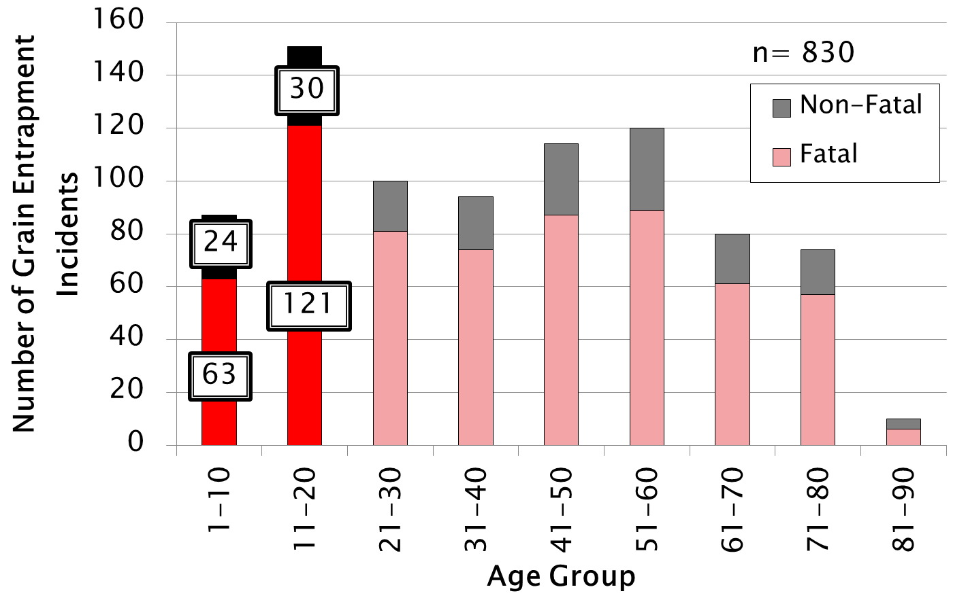
Age distribution of documented grain entrapments
Notes:
Instructor Notes:
In this graph all documented grain entrapment incidents with a known age group are summarized. Along the left side is the number of cases recorded and along the bottom are the age groups of the victims.
The red/pink bars represent all the fatal incidents recorded, while the black/grey bars represent the non-fatal incidents.
Notice that the age group 11-20 represent the largest segment of injuries and fatalities. Nearly one out of five incidents involve a child or youth under the age of 21.
Again, the goal here is not the numbers, but rather to communicate that participants in this class have a higher risk of injury or death than any other age group.

Slide 10
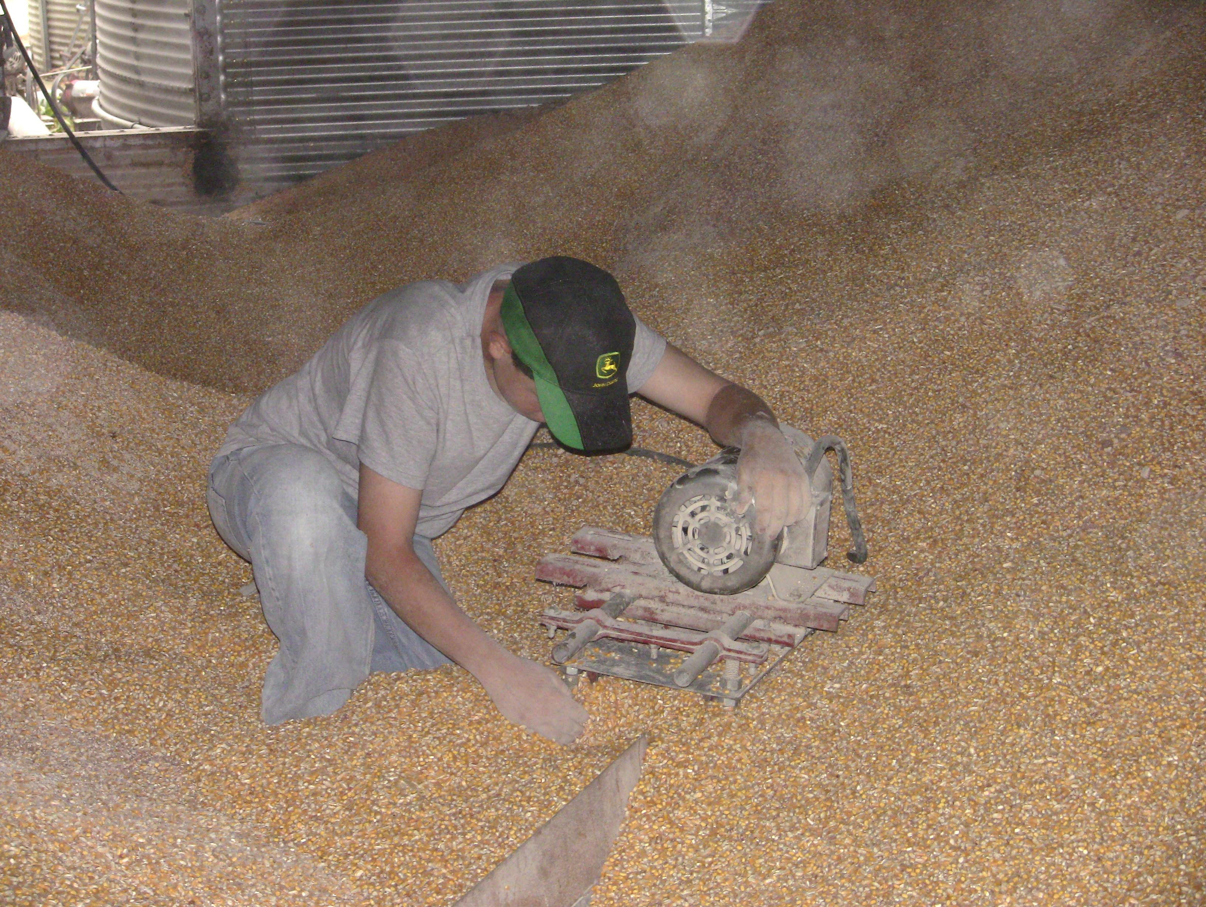
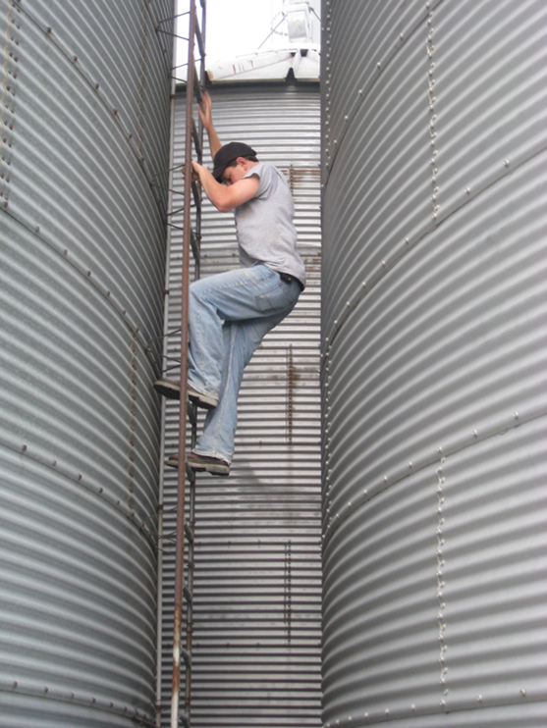
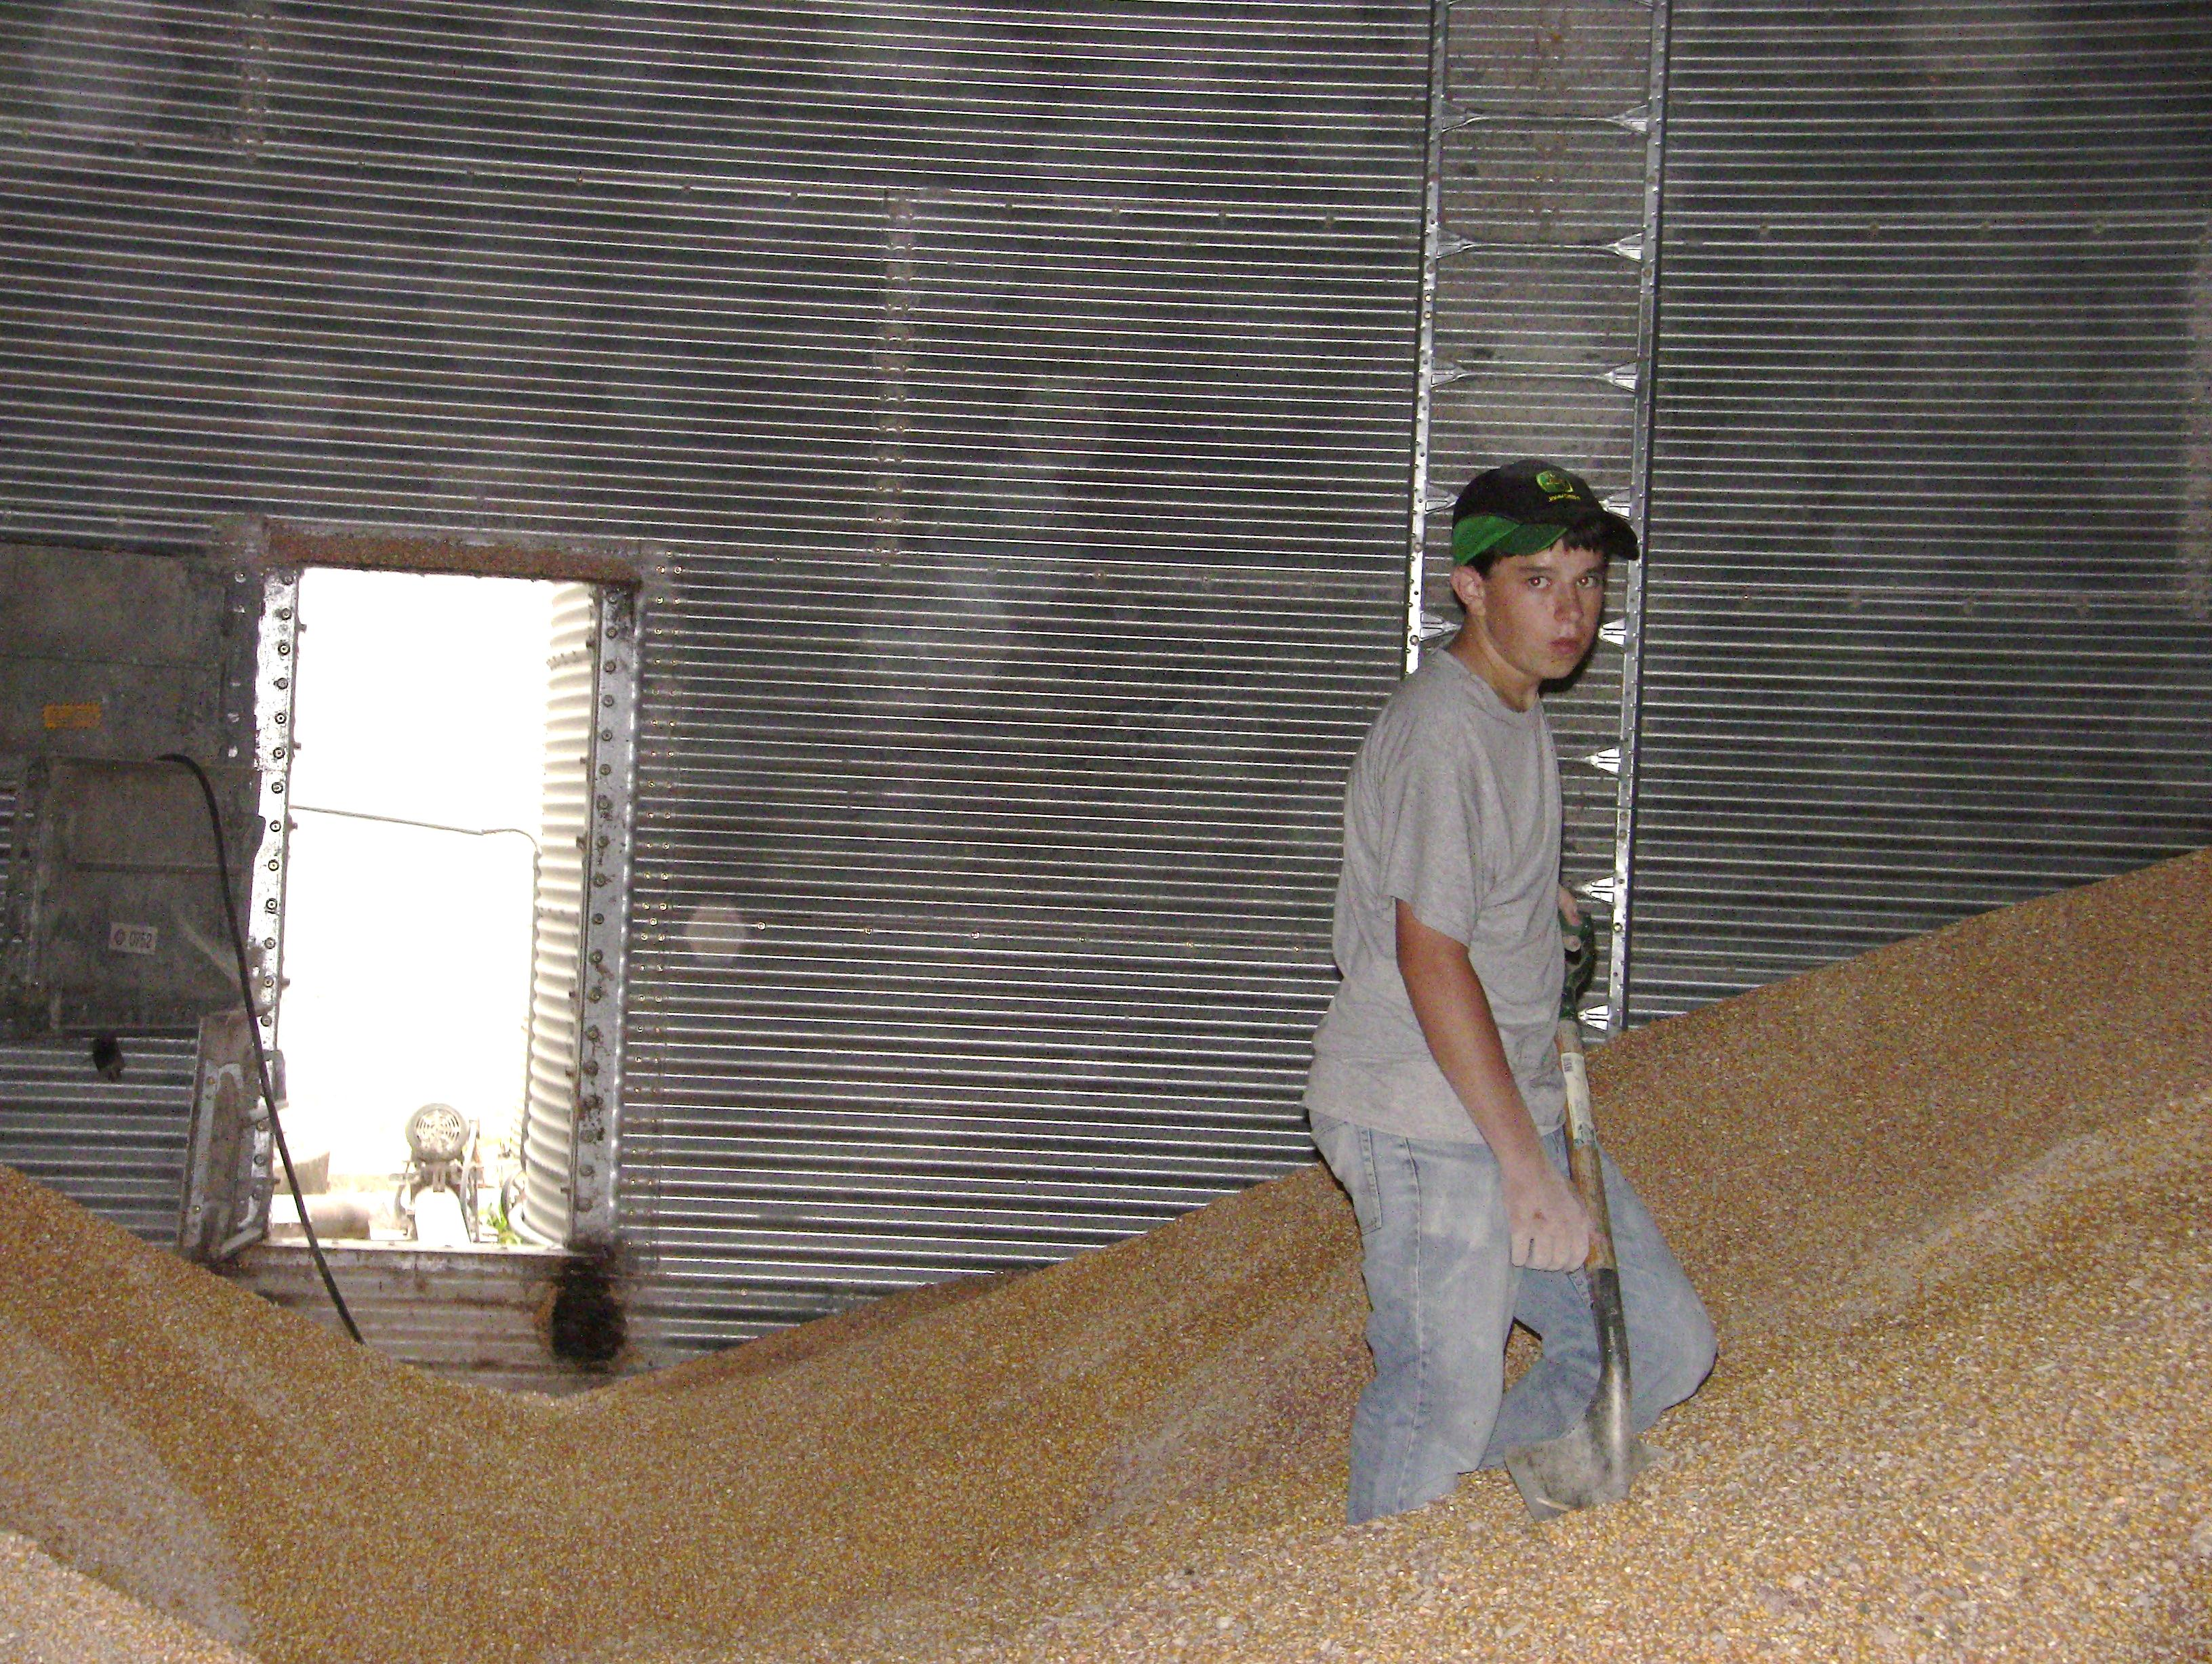
Do you remember why youth are so vulnerable to being involved in grain-related incidents?
Inability to assess risk
Natural risk takers
Lack of training
Immaturity
Notes:
Instructor Notes:
Those sitting in your class are at the greatest risk of “accidental” or unintentional injuries and death. Youth between the ages of 16 and 20 are at greatest risk from:
Motor vehicular crashes
Drowning
Fires and burns
Incidents involving recreational vehicles (ATVs, dirt bikes, ski mobiles, boats, etc.)
On top of these hazards, youth employed in agricultural work are engaged in an occupation that is recognized by the Department of labor as one of the most hazardous. The probability of an agricultural worker being killed in the workplace is 4-5 greater than for the typical employee. The risk grows even higher for those under 21.

Slide 11
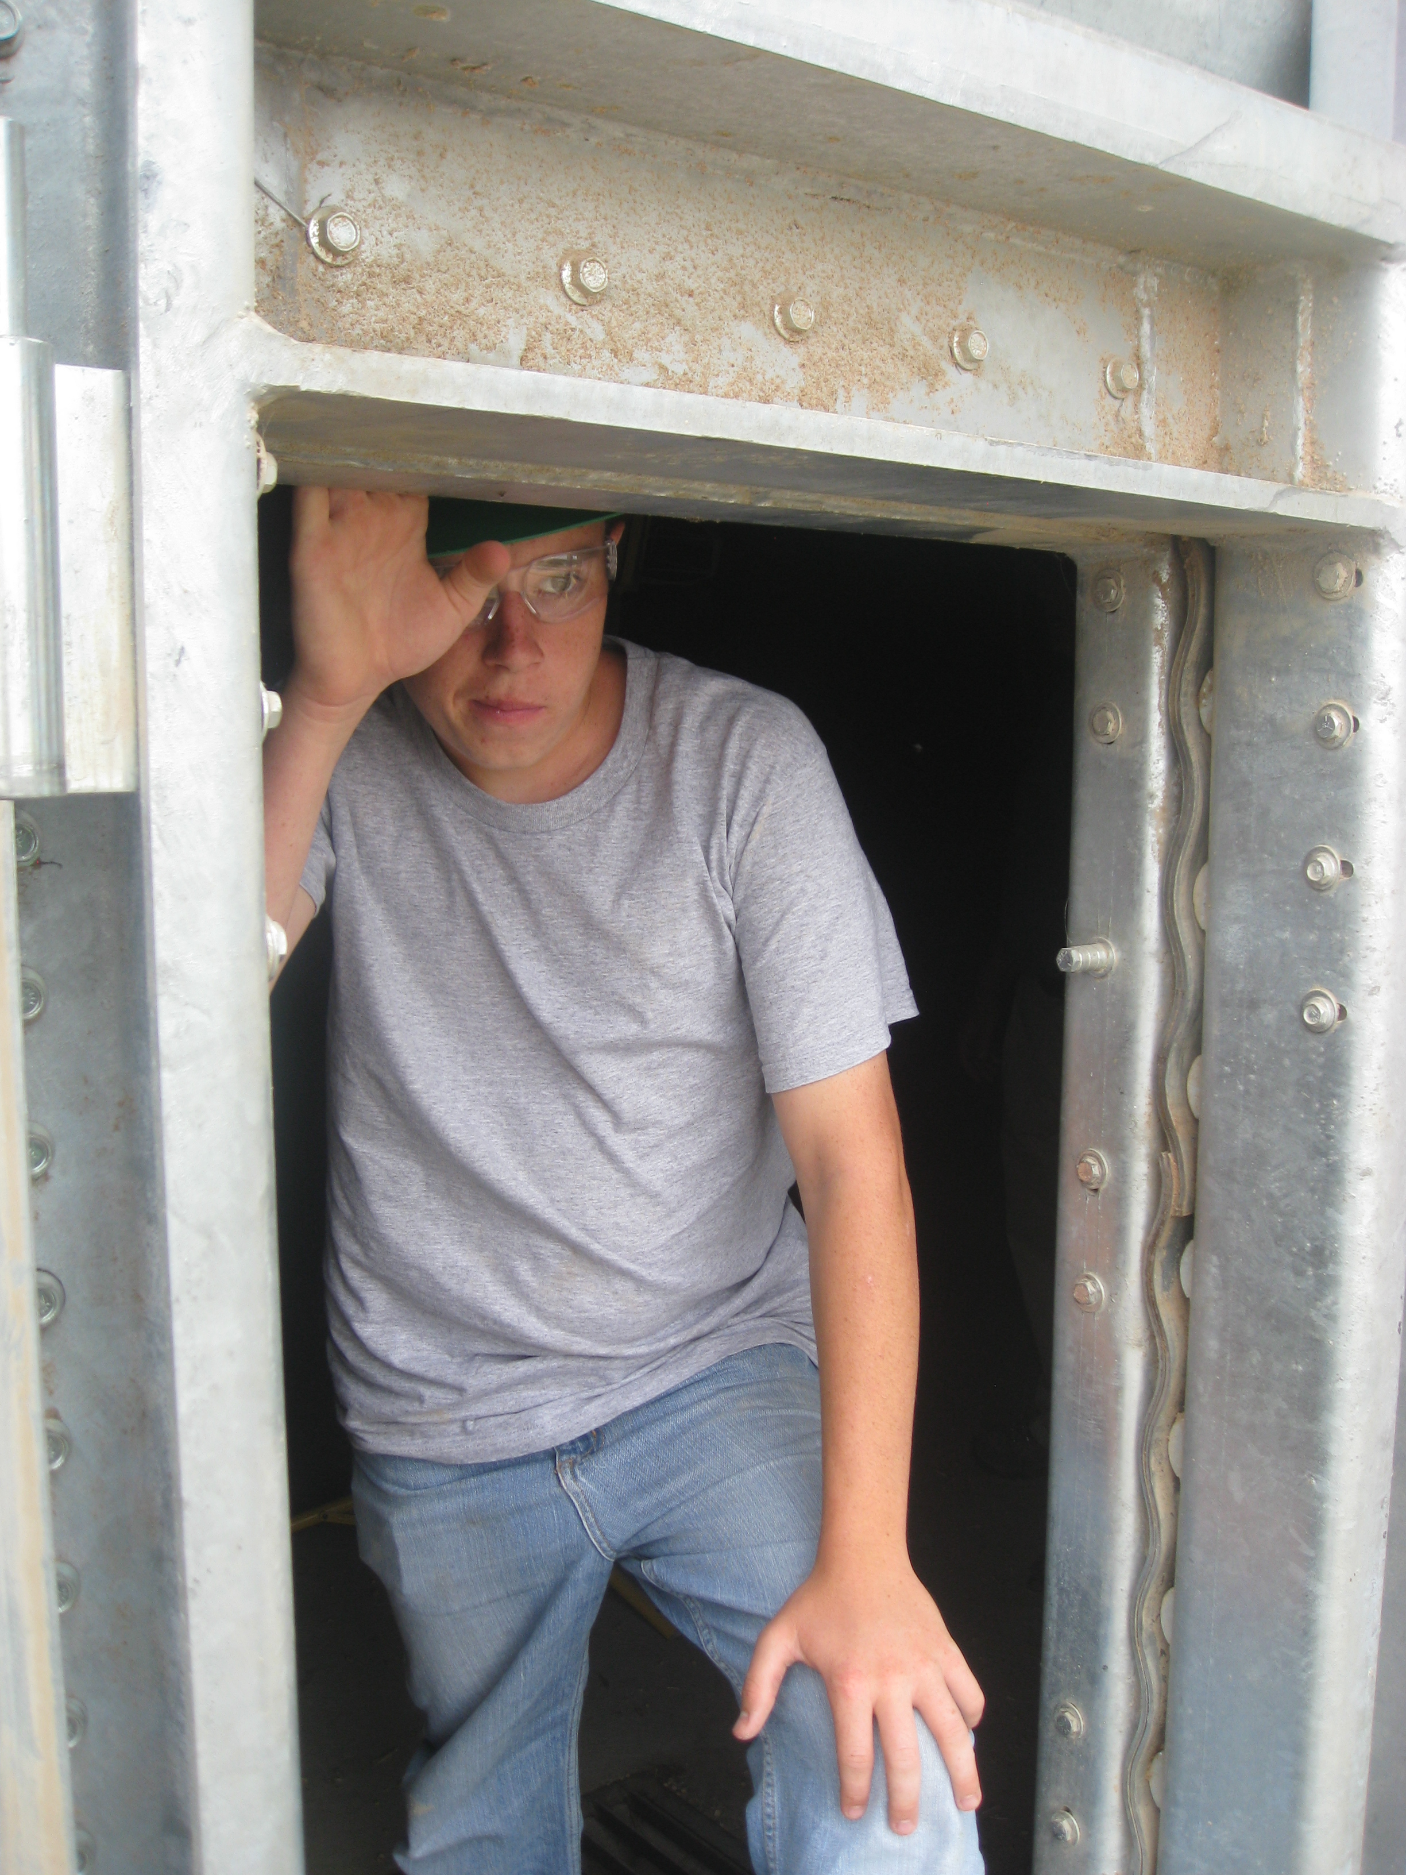
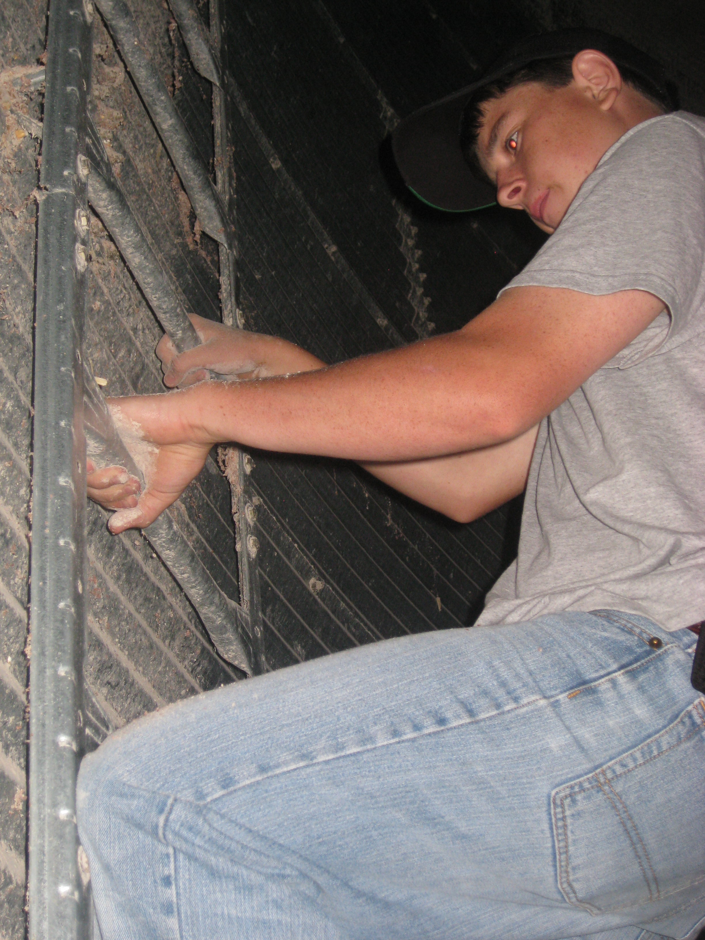
When are younger workers most likely to be exposed to grain-related hazards?
Notes:
Instructor Notes:
Try to get a sense of what time of year youth are most likely to be exposed to grain-related hazards. Highlight those responding “harvest season”. Ask how many help out after school during harvest season. How does knowing when most incidents occur help efforts to reduce the problem?
The next slide provides a breakdown of incidents by month.

Slide 12
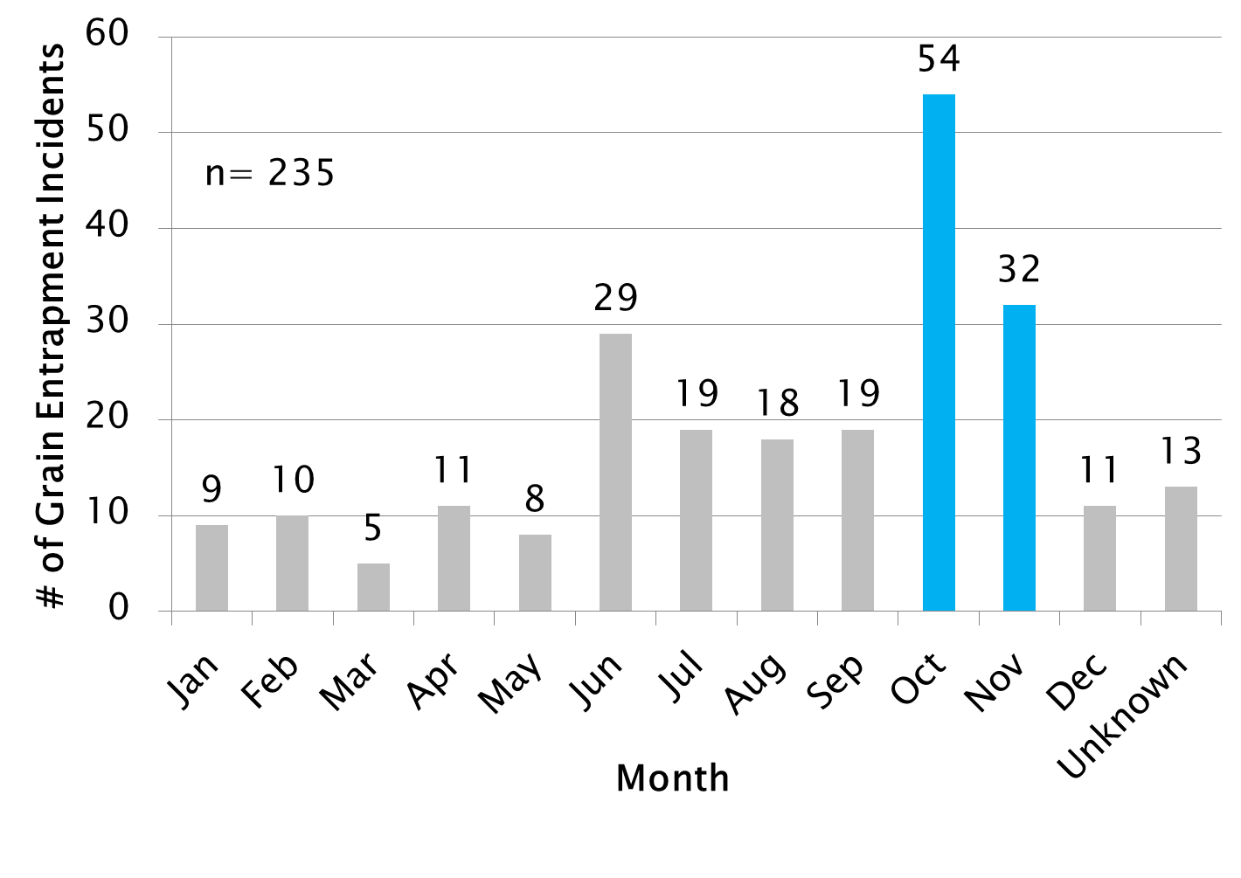
Grain Entrapments Incidents by Month for Ages 1-20
Notes:
Instructor Notes:
When it comes to youth, most entrapments occur in October and November, during harvest. Hopefully, this makes sense to everyone because it is the time of year when most grain, especially corn and soybeans are harvested and put into storage.
Ask participants why there is also a peak in June. What are many farmers doing with their grain during that month? It is believed that the peak in June represents an increase in grain being moved from storage to prepare bins for the new crop.
Ask students to consider when there should be a greater emphasis placed on promoting safe work practices at grain storage and handling facilities.

Slide 13
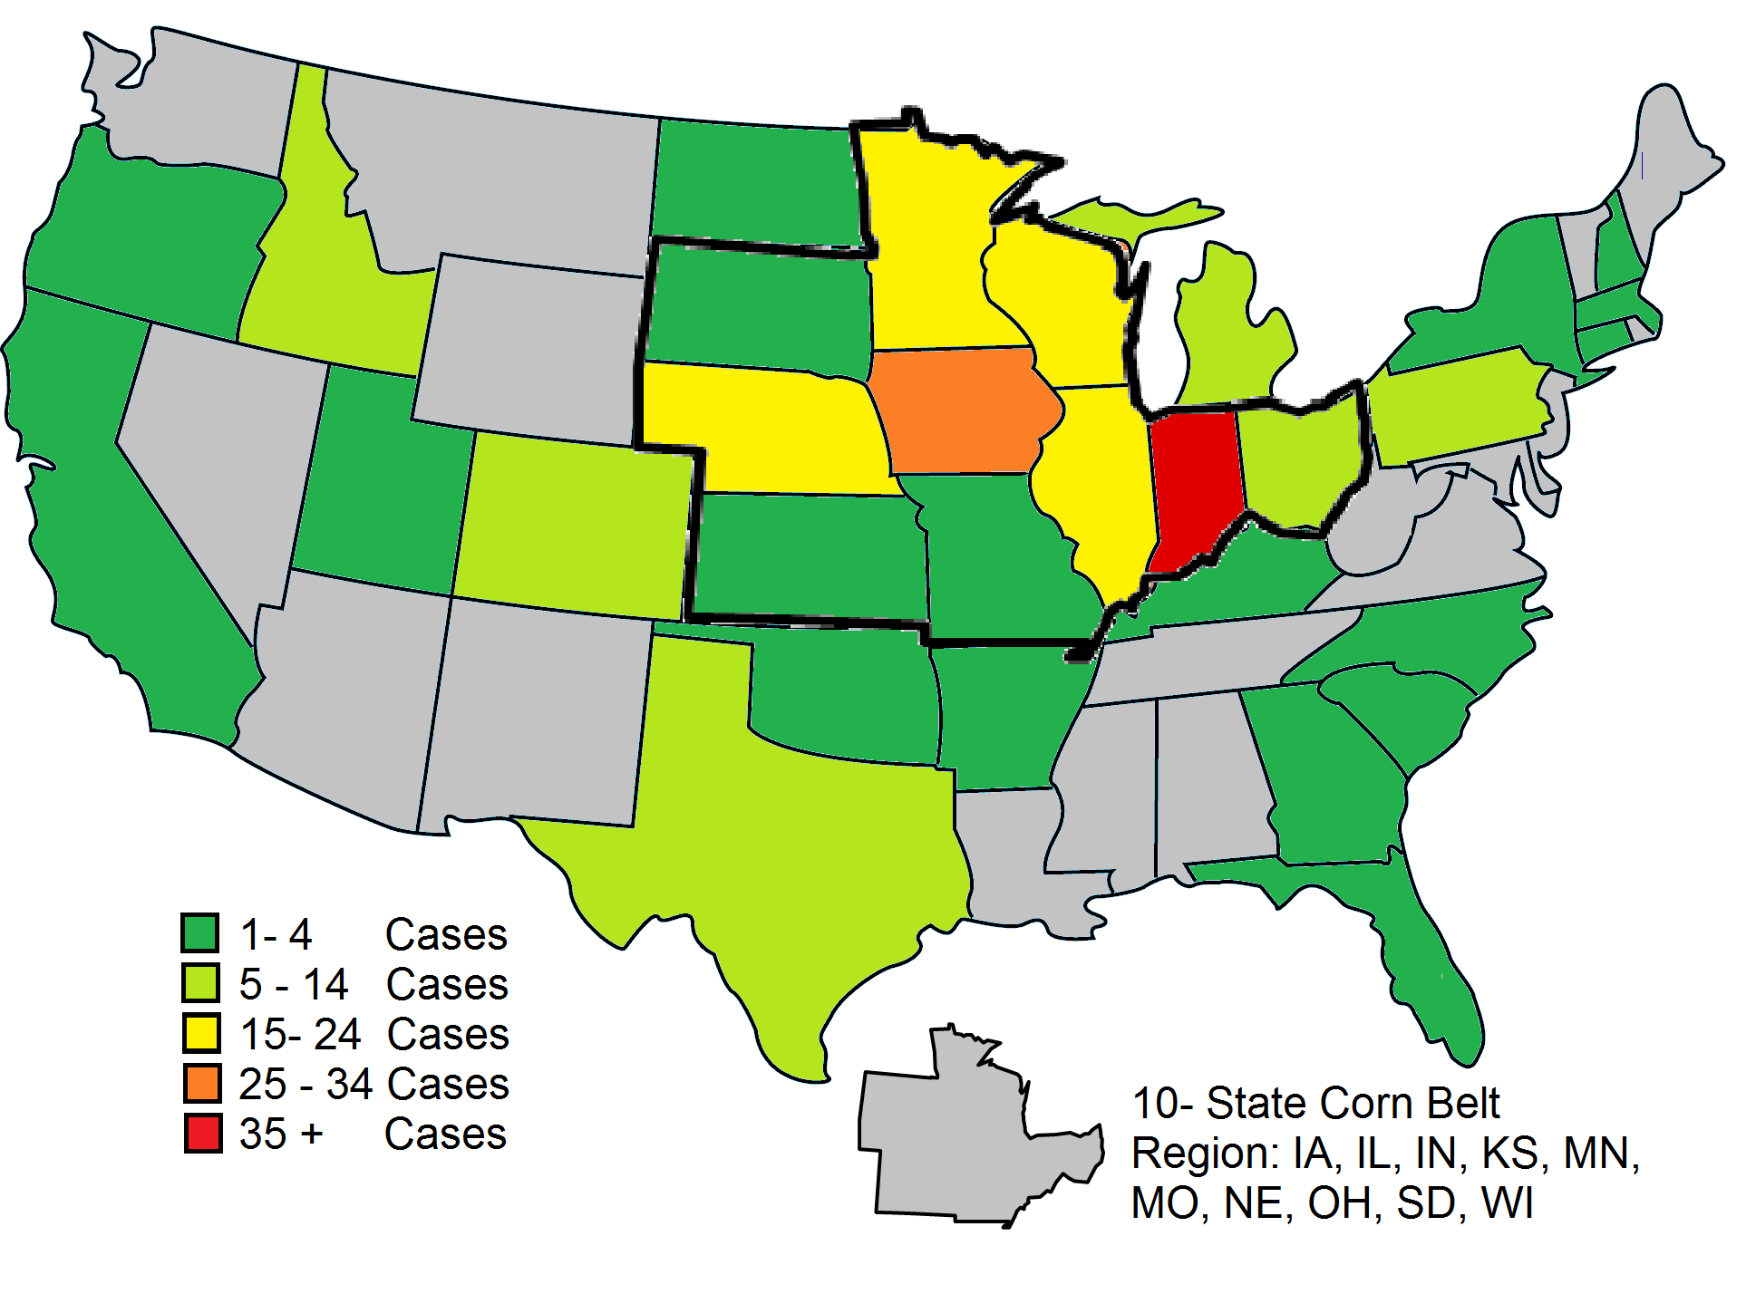
Distribution of Grain Entrapment Incidents By State for Age Group 1-20.
Notes:
Instructor Notes:
The majority of incidents involving those under the age of 21 occur in the Cornbelt. The states with the most documented cases over the past 40 years are:
Indiana
Iowa
Illinois
Nebraska
Minnesota
Wisconsin
Ask students why these six states account for most of the documented incidents. What do they have in common? They are all major corn producing states.
It should be noted that Indiana has more cases than any other state because Purdue University has been monitoring these incidents for over 40 years. If the other states had made similar efforts, it would be projected that states such as Iowa and Illinois would have had greater numbers of incidents because they produce more grain. Purdue has estimated that the number of documented incidents should be at least 30% higher if all incidents had been reported.

Slide 14
Most Frequent Types of Flowing Grain/Feed Entrapments
Entrapment in a free flowing column of grain
Bridging/crusted horizontal surface entrapment
Collapse of vertically crusted grain surface (avalanche entrapment)
Entrapment in free standing pile of material (avalanche entrapment)
Entrapment in grain transport vehicle
Entrapment due to unintended release of material or structural failure
Entrapment while using a grain vacuum machine
Notes:
Instructor Notes:
The next series of slides will summarize the seven most frequent types of entrapments and engulfments in free-flowing agricultural material.

Slide 15
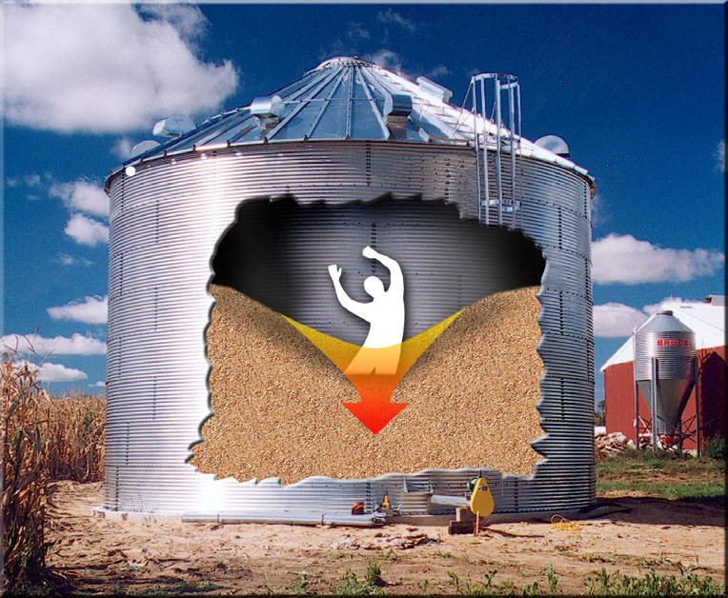
Entrapment in a Flowing
Column of Grain
Notes:
Instructor Notes:
Becoming entrapped in a free flowing column of grain or feed in the center of a grain bin is the most frequently documented cause of grain entrapment. A worker enters the bin, usually alone, in an attempt to break up crusted grain, unplug the well or remove residual grain from the walls and become drawn into the flowing grain. The grain flow towards the center of the bin and quickly pulls the victim beneath the surface until the victim comes to rest directly over the opening in the floor.
This type of flow is referred to as funnel flow.
The speed of the grain flow is determined by the capacity of the unloading system. An unload capacity of 1000-1500 bushels per hour can entrap and engulf a 200 pound man in just a few seconds.
The typical process of entrapment is generally as follows:
individual enters bin during unloading process to clear a plugged outlet or walk down the grain
as the bin empties, a rapidly moving column of grain forms over the floor outlet
the victim is drawn toward the center of the bin by flowing surface of the grain
central vertical column of grain acts somewhat like a fluid
the central column of grain flows at nearly the rate of the unloading auger
flow rate at top of a bin is so great that once a person is trapped in flow, escape is impossible
the victim is pulled to the floor directly over the outlet often plugging flow
The most immediate action needed in these cases is to stop the flow of grain at the outlet, before the victim is fully engulfed.
Entering a grain bin while the unloading equipment is operating is so hazardous it is illegal under the provisions of CFR 1910.272, the OSHA Grain Handling Standard.

Slide 16
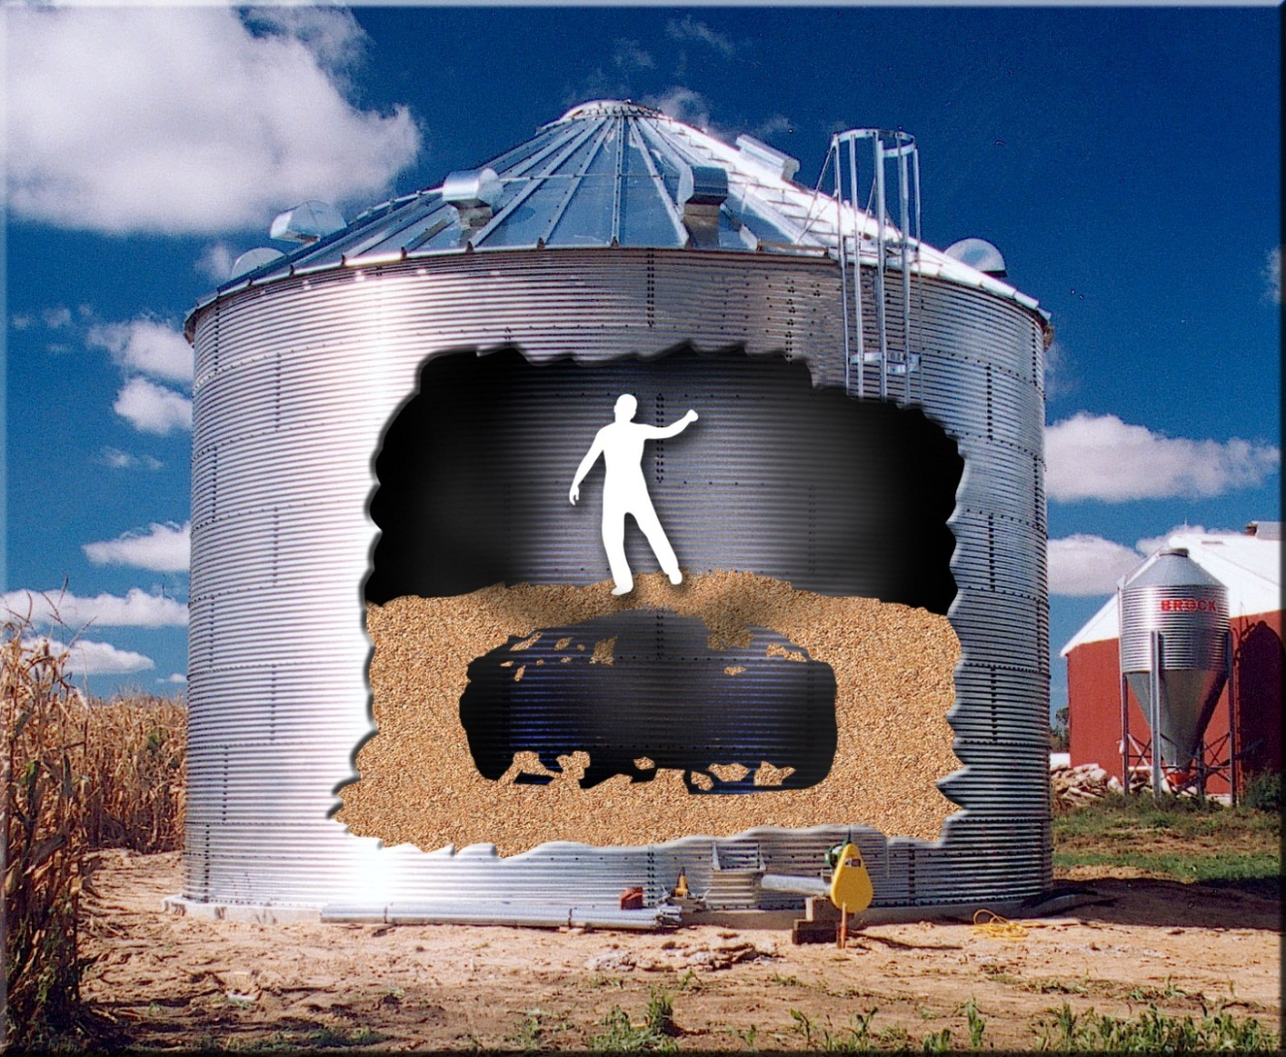
Collapse of Horizontally Crusted or Bridged Grain Surface
Notes:
Instructor Notes:
This slide summarizes the steps that generally occur when a victim is engulfed due to the collapse of a horizontal surface of crusted or bridged grain.
The victim enters a bin in which the grain has become caked because of spoilage. It can form a hard crusted surface over the top of the grain mass that can appear to support the weight of the victim.
The surface, though appearing solid, can, in fact, be a thin crust concealing a void that has formed as grain was withdrawn from the bottom of the bin
Victim breaks through the crust and is quickly covered by the avalanche of grain into the cavity
Often the unloading equipment is still operating, which causes the victim to be pulled deeper into the grain
The victim is generally found directly over the outlet in the floor of the bin

Slide 17
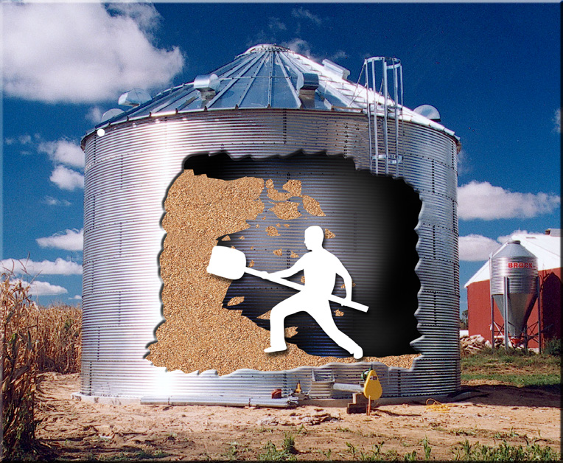
Collapse of Vertically Crusted Grain
Notes:
Instructor Notes:
Vertically crusted grain or grain that is free standing due to spoilage can break free and avalanche down on workers at its base. Grain that sticks to the inside of the bin walls is also considered vertically crusted grain.
Dry grain in good condition will pile at a 25-30 degree angle, but spoiled or caked grain can stand almost vertical.
When grain is removed from base of a caked mass, the potential for avalanche and engulfment increases.
This type of engulfment can take place inside bins where spoiled grain is clinging to walls.
Attempting to remove these chunks of grain by standing on the floor of the bin using a long pole can be extremely dangerous due to the avalanche effects of the grain when it breaks free of the wall.
No worker or first responder should ever enter a grain storage structure with overhanging grain stuck to the bin walls.
Falling chunks of crusted grain from off the walls of a bin or silo can cause crushing injuries to those underneath.

Slide 18
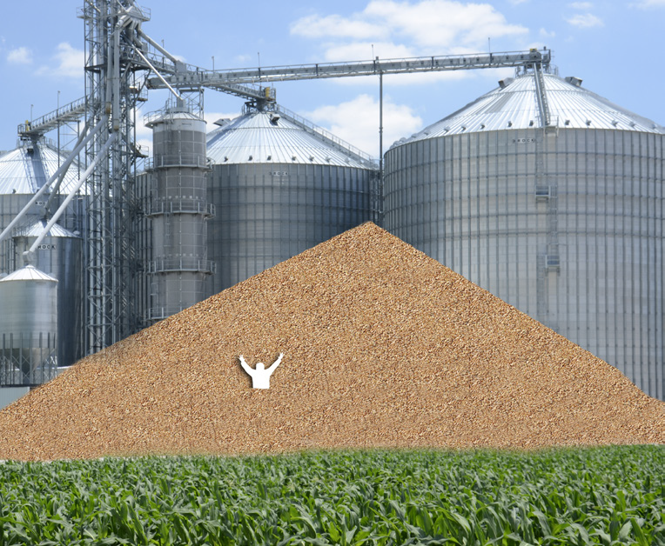
Entrapment in Free-Standing
Pile of Grain
Notes:
Instructor Notes:
Entrapments and engulfments in free standing piles of grain are rare, but have been some of the most difficult rescues to carry out due to the substantial amount of grain involved.
Walking on the surface of a free standing pile of grain can cause an avalanche of grain from above that is impossible to stop until it reaches its natural angle of repose.
Entrapments and engulfments of this type are more common inside of large storage structures where residual grain can stand 10-20’ high along the walls. A worker at the base of the pile can become entrapped if something triggers a flow of grain towards the center of the structure. Once started this surface flow of grain is almost impossible to stop until the pile reaches it’s angle of repose.

Slide 19
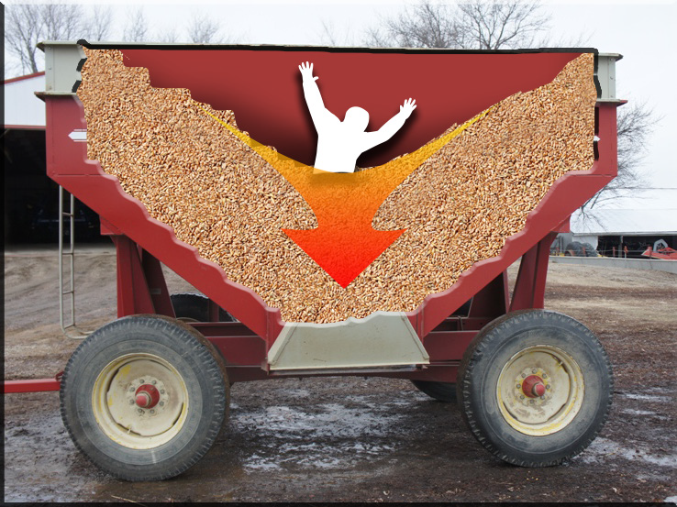
Entrapment in Grain Transport Vehicles
Notes:
Instructor Notes:
Review the following characteristics of entrapments in grain transport vehicles.
The risk of engulfment is present around any grain transport vehicles such as wagons, trucks, rail cars, and hopper wagons.
High-volume unloading capacity of modern grain handling equipment can bury someone in a vehicle in seconds. No one should be allowed to be transported inside any grain transport vehicle.
It’s not difficult to imagine someone being covered in seconds during an unloading process from a combine that can unload a 300 bushel hopper in less than 2 minutes.
Most victims of this type of suffocation, historically, have been children, nearly all boys with an average age of 11.
Most of these incidents are fatal due to the victim becoming wedged into the opening at the bottom of the vehicle.
In a few cases, unbalanced grain transport vehicles have flipped over on victims resulting in engulfment and suffocation. This type of incident has also occurred when grain became crusted in the vehicle causing the vehicle to become unbalanced when unloaded unevenly.

Slide 20
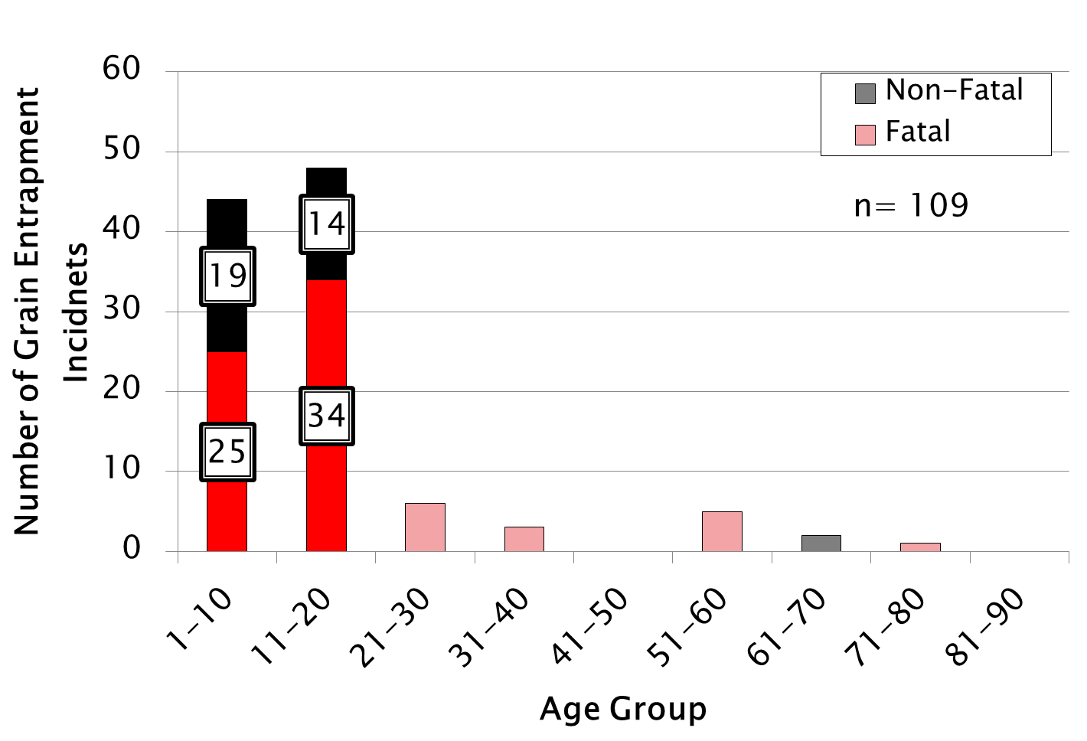
Grain Entrapment Incidents Involving Grain Transport Vehicles
Notes:
Instructor Notes:
This graph focuses on grain transport vehicle cases and the ages they occur. On the left side of the graph is the number of cases recorded and on along the bottom are the age groups of the victims.
The red/pink bars represent all the fatal incidents recorded, while the black/grey bars represent the non-fatal incidents.
Notice that the age group 1-10 and 11-20 represent the vast majority of the cases. This highlights the danger grain transport vehicles are for children and young adults. Emphasis to the participants that they should NEVER ride in the grain wagon, empty or full.

Slide 21
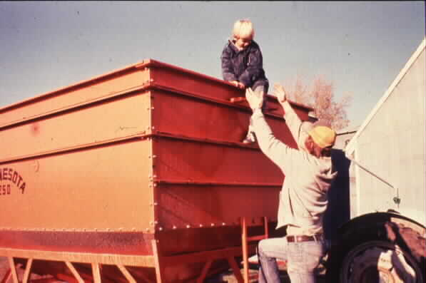
Why do so Many Entrapments in
Grain Transport Vehicles Involve Children?
http://web.extension.illinois.edu/agsafety/equipment/grainbinsafety.cfm
Notes:
Instructor Notes:
The overwhelming majority of entrapments in grain wagons, truck, trailers, and other grain transport vehicles involve youth ages 11 to 12.
Nearly all of the victims were male.
Ask students if they had ever ridden on a load of grain? Were they aware of the risks involved?

Slide 22
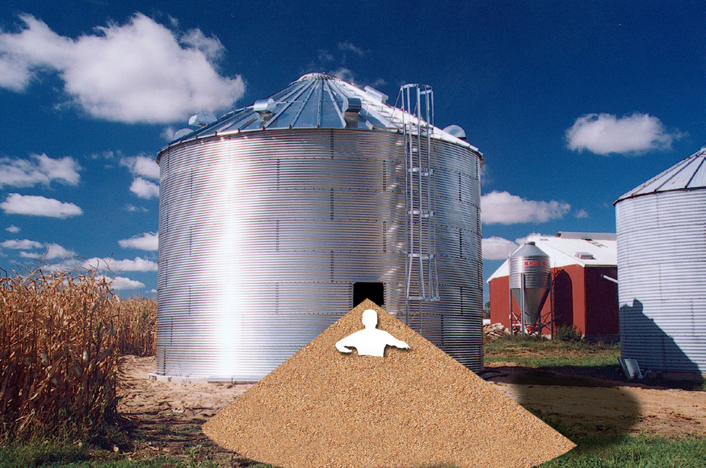
Entrapment Due to Unintended Release of Material or Structural Failure
Notes:
Instructor Notes:
Workers have become entrapped or engulfed when grain or feed was unexpectedly released from an access point or due to structural failure. The force of the grain suddenly released from a large structure has the power to derail railcars and engulf nearby structures.
In one case a worker was removing an access door at the bottom of a hopper bottom bin causing a sudden release of grain that completely buried him on the ground outside the structure. Before he could be uncovered by co-workers he had suffocated.
The issue of potential structure failure should be considered during any rescue attempt. Care needs to be taken if the structure is cut open to allow for the rapid removal of it’s contents. Damaging the structural integrity of the storage structure could lead to catastrophic failure and uncontrolled release of large quantities of grain. This topic will be addressed during the hands-on portion of the training.

Slide 23
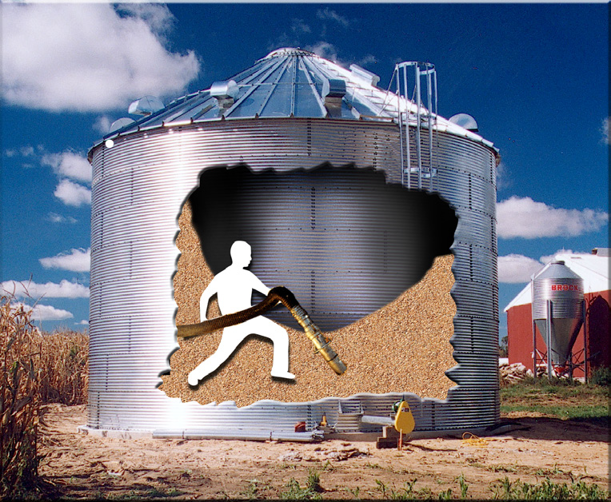
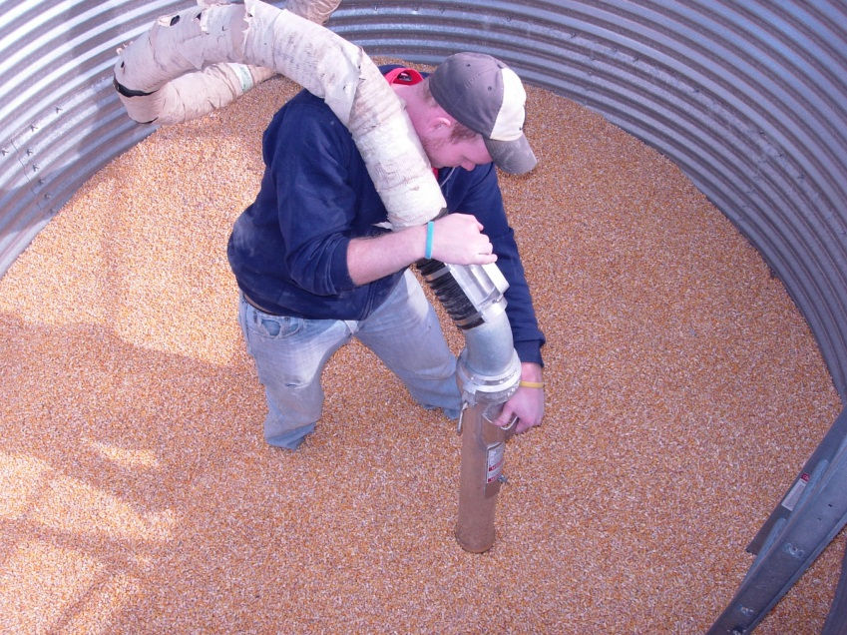
Entrapment While Using Grain Vacuum Machines
Notes:
Instructor Notes:
As alternative methods are being considered to remove residual grain from storage structures, the use of grain vacuum machines has increased. These machines are able to “suck up” grain at very high volumes (1000-2000 bushels per hour). If the operator places the inlet at his feet, the unit can literally suck the grain from beneath the victim causing him to be rapidly drawn into the grain.
These incidents are rare but increasing in frequency
More commonly found at commercial grain facilities
Involve the operator standing on the grain surface which is clearly discouraged by grain vacuum machine manufacturers
Entrapment can occur in seconds
Use of grain vacuums can generate substantial dust and noise
The use of grain vacuum machines will be discussed in the hands-on portion of the class as an important rescue tool to remove grain from around an entrapped victim. Care should be taken during use of grain vacuum machines at rescue scenes to avoid secondary entrapment.

Slide 24
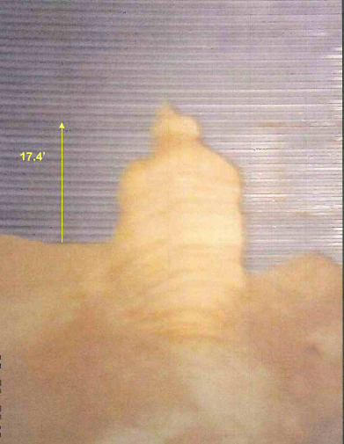
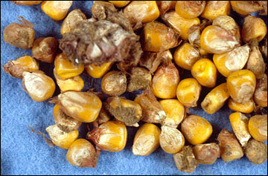
The Single Most Important Contributing Factors to Grain Entrapment is Out-of-Condition Corn
Notes:
Instructor Notes:
Excessive moisture in stored agricultural crops can lead to spoilage, crusting, bridging and free standing grain. This can also be caused by extensive insect infestation. The presence of any bridging, crusting, or free standing grain should be a clear warning of an extreme hazard to first responders.
Maintaining the proper moisture content in stored grain and feed is a significant step in reducing the risk of entrapment or engulfment. This is, however, outside the control of first responders.
Most grain in long term storage should be dried to no more than 14-15% moisture. Higher moisture levels will lead to rapid spoilage or out-of-condition grain due to biological decomposition. This is especially true at higher ambient temperatures. This out-of-condition grain will begin to crust or form chunks of grain that can be free standing or stick to the walls of the storage structure. It is these conditions that often led previous entrapment victims to enter the structure to remove crusted material from the walls or to break up chunks of grain plugging the outlet.
Ask participants what other hazards may be present when grain or feed goes out-of-condition. Moldy grain can generate billions of mold spores that can lead to allergic reactions and respiratory distress. Airborne dust can be a significant risk to first responders.

Slide 25
Factors Influencing the Trend in Grain-Related Entrapments
Increasing production of grain
Longer term storage of grain increasing potential for spoilage
More storage being built at exempt facilities
Increased rate of grain handling
Increased size of storage structures
Expanded use of grain for energy production
Changing workforce
Increased cost of drying grain
Notes:
Instructor Notes:
There is no single contributing factor that can be blamed for the slight increase in the frequency of grain-related entrapments. The problem is a result of numerous influences that have increased the level of exposure to flowing grain.
Since time is limited, time cannot be spent discussing each of the contributing factors shown. Additional information is available at www.grainsafety.us.

Slide 26
Summary
1 out of 5 injuries/fatalities involve youth under age of 21
Nearly all victims are male
Entrapments involving GTVs occur mostly to males under age of 21
Most entrapments happen in October during harvest season
Corn is the grain most likely involved
Most entrapments occur in Midwest
Out-of-condition corn is a significant contributor
Notes:
Instructor Notes:
A quick summary of the statistics of grain entrapments for youth, try to get the youth involved by having them add their own summary points as well.

Slide 27

Questions
Notes:
Instructor Notes:
Provide time for participant questions. If you don’t know the answer have them visit the Most Frequently Asked Questions Section of the online Instructor’s Guide.

