Slide 1
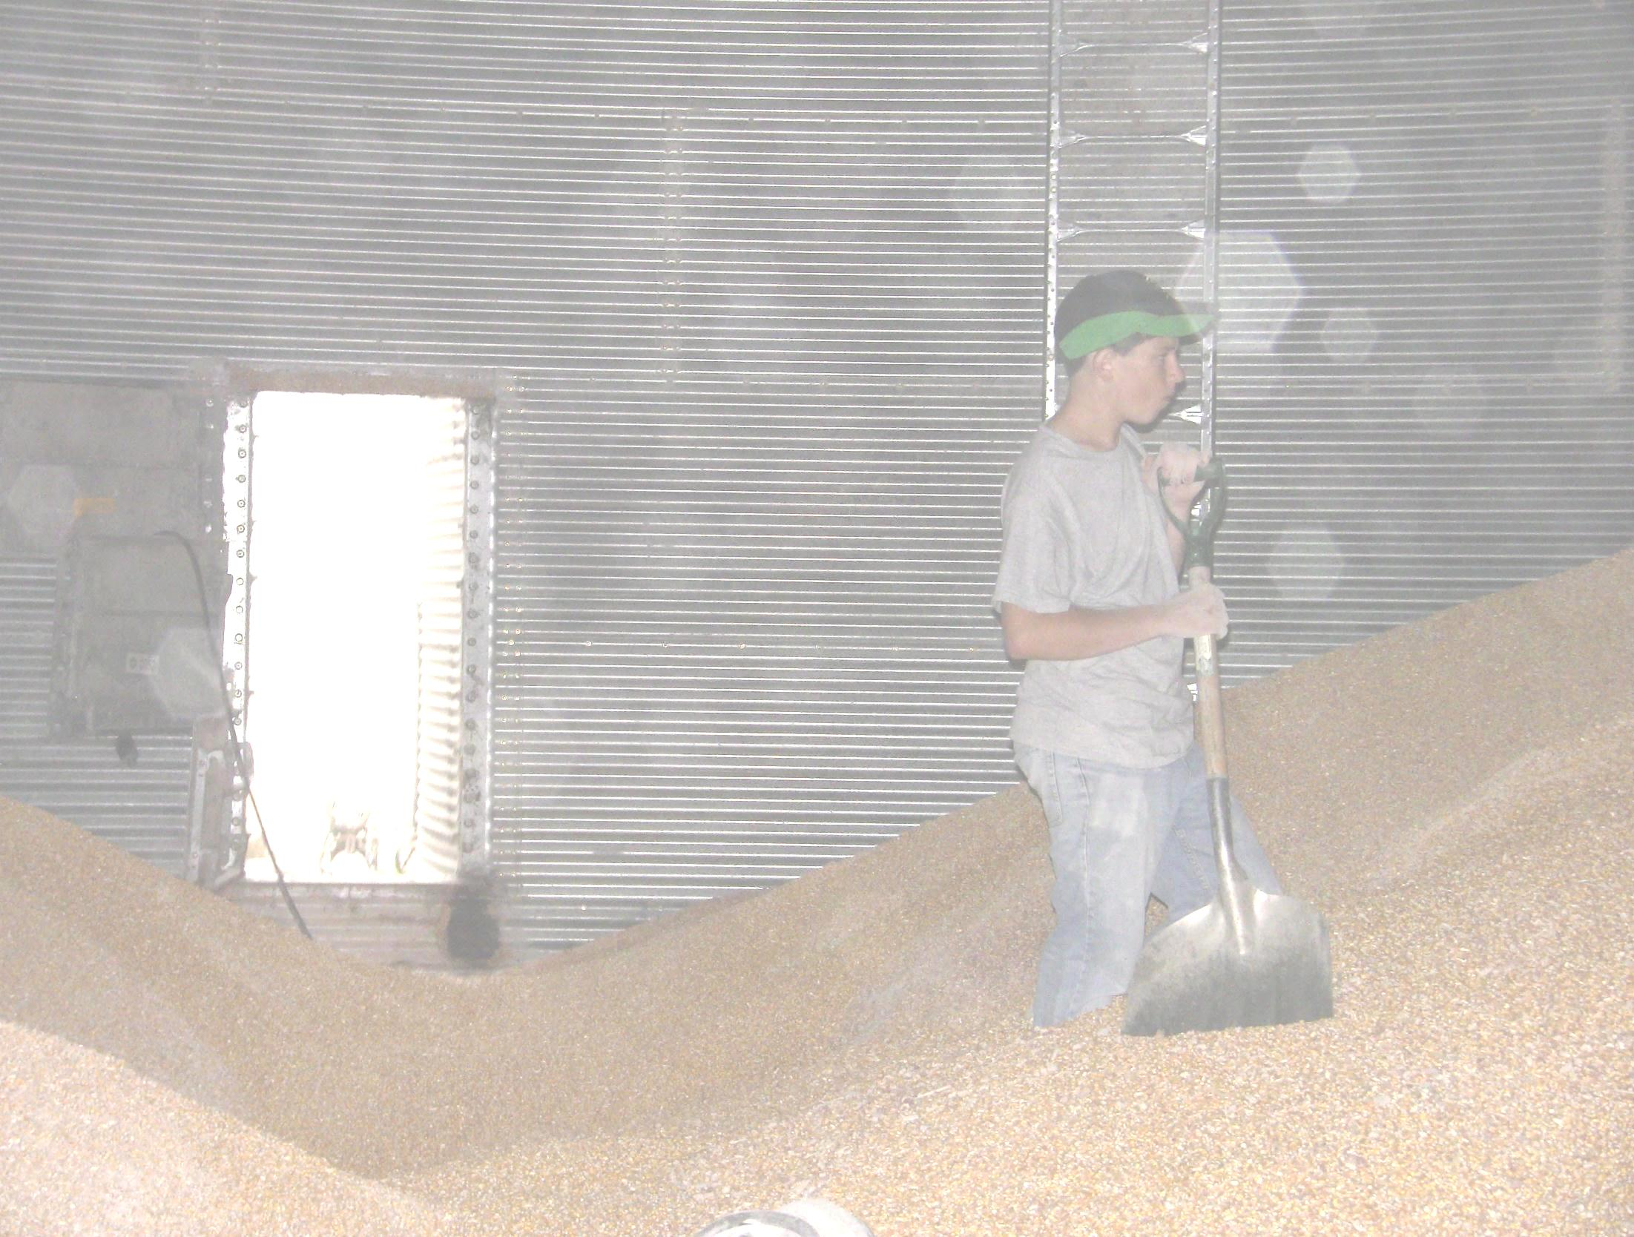
Against the Grain
Safe Grain Storage and Handling for Young and Beginning Workers
Unit 1 – Orientation
Developed by:
  Purdue University
  Agricultural Safety and Health Program
  Department of Agricultural and Biological Engineering
  West Lafayette, IN
This material was produced under grant number SH23575SH3 from the Occupational Safety and Health Administration, U.S. Department of Labor. It does not necessarily reflect the views or policies of the U.S. Department of Labor, nor does mention of trade names, commercial products, or organizations imply endorsements by the U.S. Government.
Notes:
Instructor Notes:
Before beginning this training, take the time to review the accompanying Instructor’s Guide. This document includes a great deal of information that will help prepare you in presenting each of the units contained in the curriculum.
Unit 1 of the Against the Grain curriculum is designed to provide participants a brief overview of the grain industry and the many career opportunities that it offers to young and beginning workers. But it also provides an opportunity to introduce participants to the potential hazards that may be found in this industry and become better prepared to become a safe and efficient worker.
This unit also provides an introduction to the other four units including an overview of the training goals, the target audience, and learning outcomes.
The bulk of the unit is the showing of the video “Grain Bin Safety” produced by the National Corn Growers Association and the National Grain and Feed Association. This video provides a good foundation for communicating the importance of this training to young and beginning workers. The video can be previewed as part of the electronic version of the curriculum at www.agriculturalconfinedspaces.org, or at http://www.youtube.com/watch?u=zqbi.JubNAVEO&feature=youtube.
You may also consider inviting in a manager of a local commercial grain storage and handling facility to address the career opportunities in the industry and the important role that safety plays in protecting the well being of employees.

Slide 2
Objectives
Provide an overview of the scope and size of the grain industry in the U.S.
Explain the role that young and beginning workers play in the number of documented fatalities and injuries in the grain industry.
Explain the goal of the training including desired outcomes.
Identify the characteristics that might explain why youth are more vulnerable to being involved in grain-related incidents.
Notes:
Instructor Notes:
Briefly review the learning objectives of this unit.

Slide 3
Introduction
There are over 14,000 commercial grain storage and handling facilities located throughout the U.S.
There are over 300,000 farms that store grain on-site.
Over 1 million workers are engaged in storage, handling, processing, and transporting grain.
Nearly one of every five victims of entrapment, engulfment, entanglement, asphyxiation, falls, or electrocutions at grain storage and handling facilities are under the age of 21.
Notes:
Instructor Notes:
There are many career opportunities in the grain industry at locations scattered all over the U.S. In some cases these jobs are full-time positions that provide career advancement opportunities. In other cases, such as farms, the positions are seasonal, especially during the fall harvest. In most commercial facilities, it is rare to find anyone working under the age of 18 while on some farms employees as young as 16 can be legally employed.
As noted, however, in the slide, workers under the age of 21 account for nearly one out of five of all documented fatalities and injuries at grain storage and handling facilities. It is this disproportionate number of incidents involving young and beginning workers that led to the development of the Against the Grain curriculum.

Slide 4
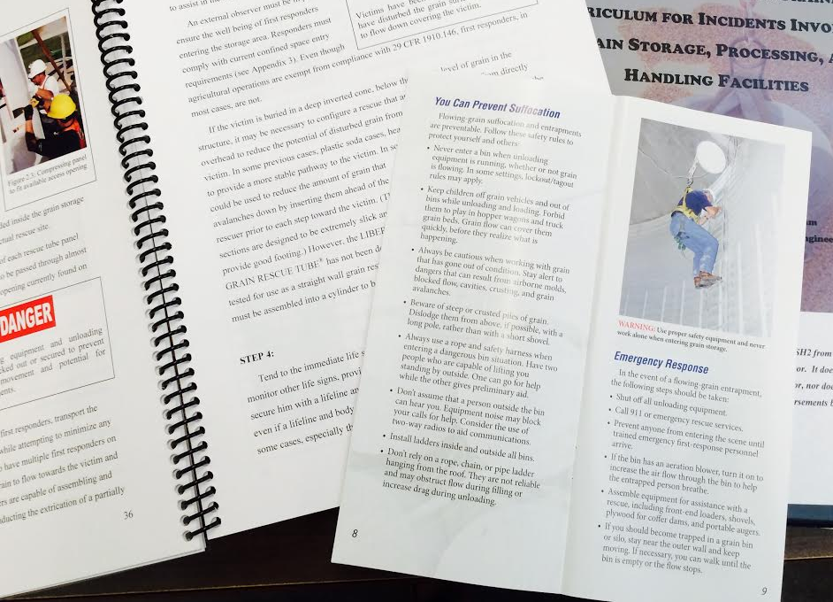
Goal of Training
The goal of this training is to provide basic awareness level safety and health training needed by young and beginning workers interested in employment in the commercial grain industry or who are already working on family operated farms with grain storage operations.
Notes:
Instructor Notes:
The goal of the Against the Grain curriculum is to provide basic awareness level safety and health training needed by youth and beginning workers interested in employment in the commercial grain industry or who are already working on family operated farms with grain storage operations. The focus of the training is on “basic” and “orientation.” The hope is that the training will give participants a head start to being a safe and productive worker.
There should be no claim made that the training will prevent all injuries or guarantees that participants will always act in a safe manner. Safety training is not a vaccine against harmful events. It is one of the essential ingredients to achieving a safe and healthy workplace. In addition to training there are many other components to an effective safety program including written policies, access to personal protective equipment, adequate supervision and having in place emergency action plans.

Slide 5
Desired Outcomes
A reduction in the number of injuries and fatalities involving young and beginning workers in the grain industry.
A better prepared workforce of young and beginning workers who recognize hazards and the need for safe work practices in the grain industry.
Notes:
Instructor Notes:
Each year there are between 30 and 40 entrapments and engulfments in grain. In addition there are asphyxiations, entanglements, falls, and electrocutions that occur during the storage and handling of grain and during exposure to other agricultural confined spaces. As already noted, a disproportionate number of these incidents involve youth under the age of 21.
This curriculum was designed to reduce the frequency of injuries and fatalities involving youth who are exposed to the hazards of grain storage and handling, including accessing of confined spaces. It is also recognized that there is a need for a well trained workforce in the grain industry that appreciates the importance of following safe and healthy work practices. By completing this training participants should be more competitive in pursing positions in the grain industry.

Slide 6
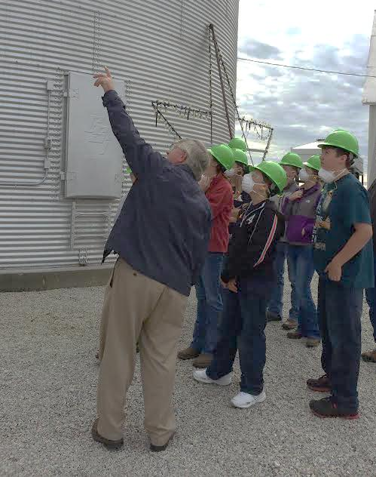
Target Audience
This training will benefit:
  Farm youth working on family operated grain farms
  Students pursuing careers in the grain industry
  FFA members involved with SAE Programs
  Beginning workers in the commercial grain industry
Notes:
Instructor Notes:
The list shown in the slide make up the target audience for which this curriculum was developed. It has been tested with youth between the ages of 15 and 20.
As an instructor, you may find that each of the audiences listed will have different needs. Some participants may be exploring for the first time a possible career in the grain industry, while others may have already started working and are looking for training on specific safe work practices. Feel free to modify the training to meet the specific needs of participants.

Slide 7
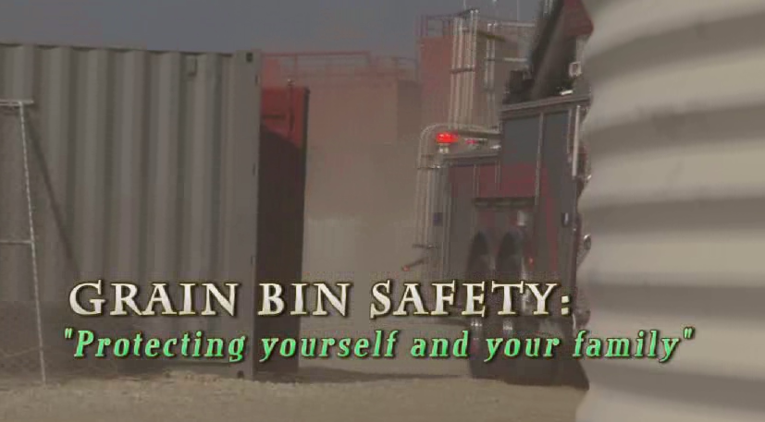
Grain Bin Safety Video
Notes:
Instructor Notes:
The Grain Bin Safety video comes in two lengths. One is about 8 minutes long and the second is about 18. Both are available with the electronic version of the Against the Grain curriculum or can be found at www.agriculturalconfinedspaces.org. Based upon time, you are free to select the length that best suits your needs.
This video was produced jointly by the National Corn Growers Association and the National Grain and Feed Association.
Two videos are available under the Video Folder in the thump drive.

Slide 8
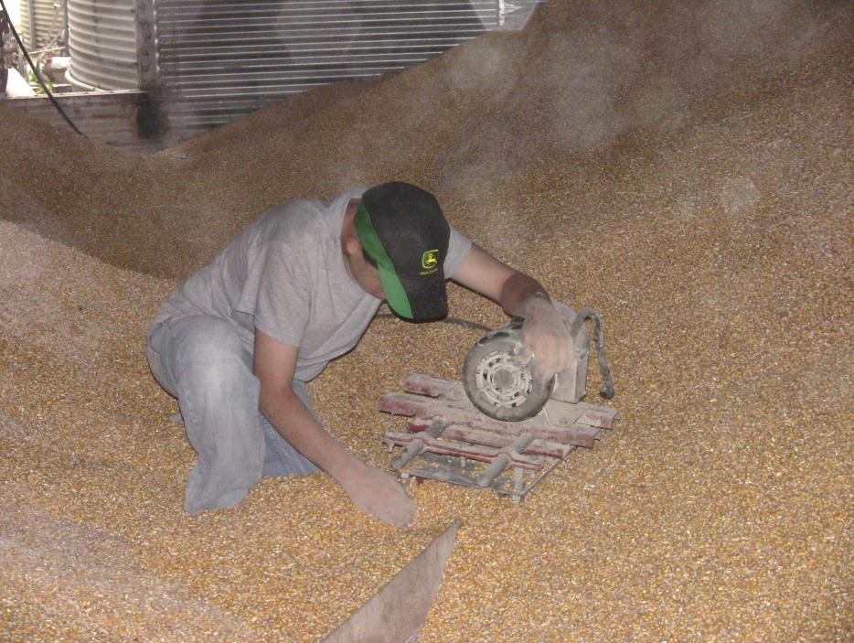
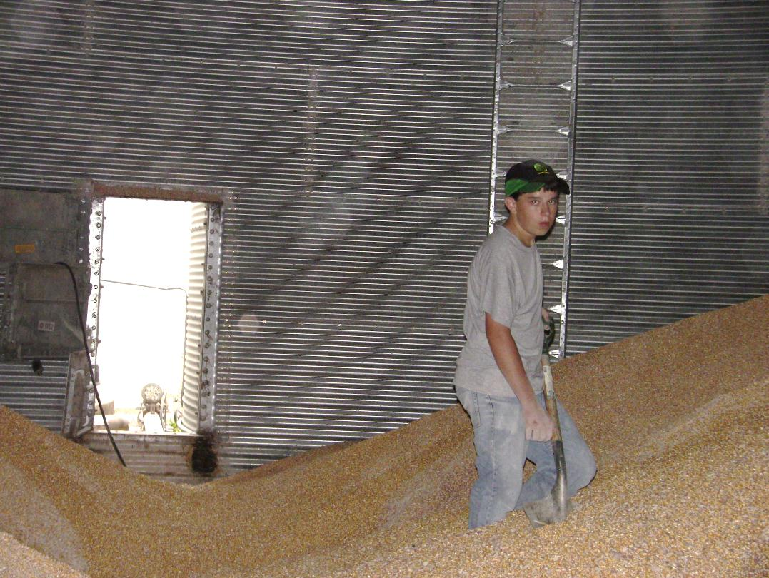
Video Summary
Why do you think that youth are so vulnerable to being involved in grain-related incidents?
Notes:
Instructor Notes:
Following the showing of “Grain Bin Safety”, ask participants why they believe that youth, their age, are so vulnerable to being involved in a grain-related entrapment or engulfment. If you have access to white board or flip chart write down their answers.
Ask participants to identify what could have been done to prevent the tragedy that was presented in the video.

Slide 9
Young and Beginning Workers are at Greater Risk of Work-related Injuries Because They:
Lack of training and experience
Lack knowledge about hazards
Don’t have the ability to assess risk
Are natural risk takers
Lack coordination and physical strength
Lack maturity
Lack of patience
Others: ______________________________
Notes:
Instructor Notes:
Review the specific reasons that some young and beginning workers may have a greater potential of being injured or killed while working than older more experienced workers. Participants should personally recognize how each of these characteristics could contribute to a harmful event.

Slide 10

Notes:
Instructor Notes:
Answer any questions anyone has from this unit before moving on

