Slide 1
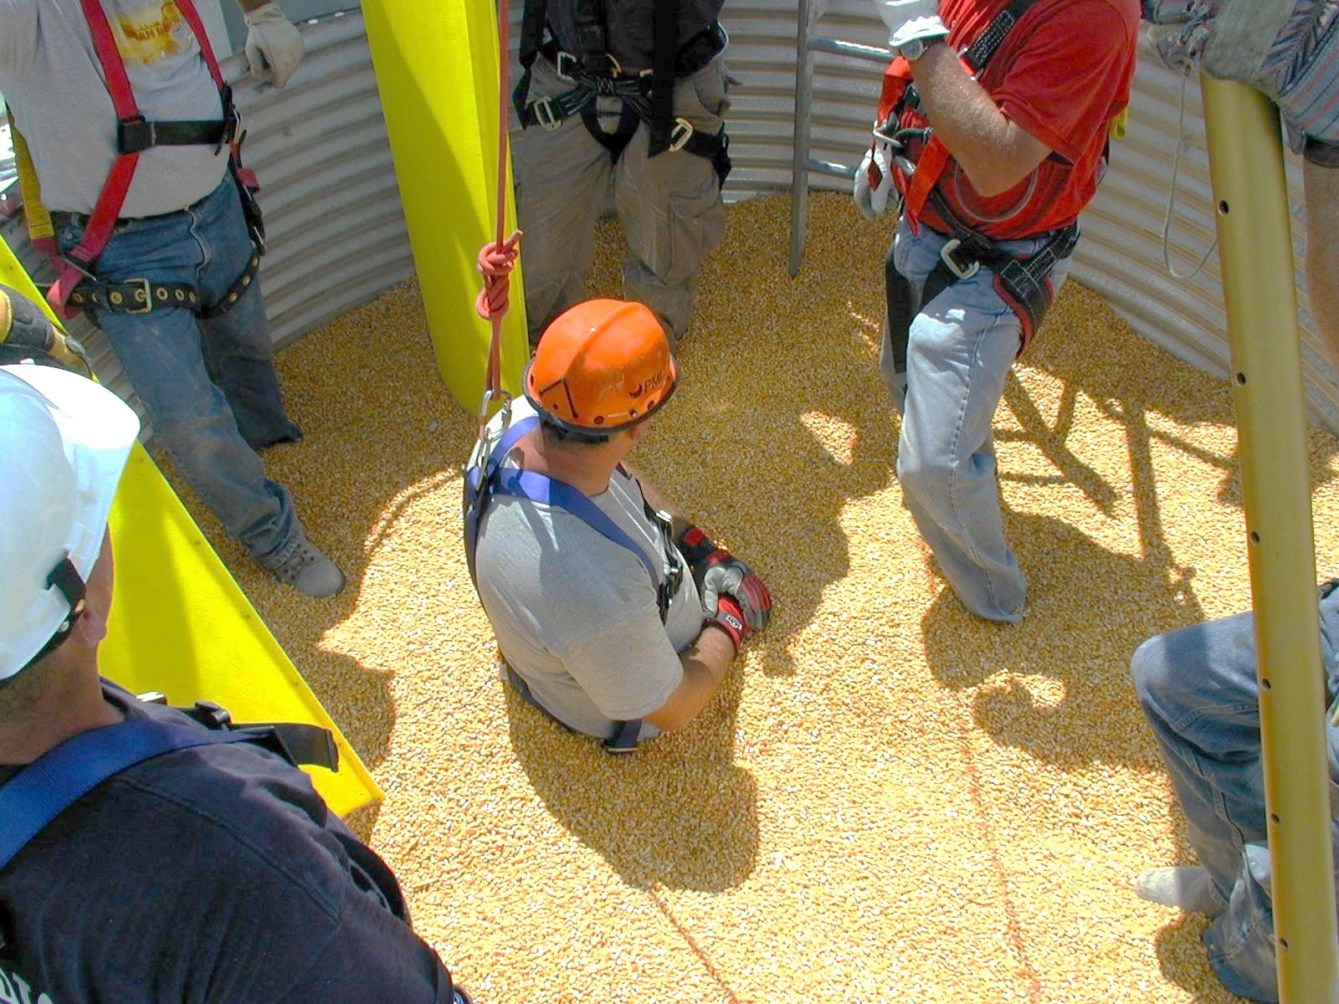
Basic First Responder Training for Incidents Involving
Grain Storage and Handling Facilities
Unit 5– Introduction to Demonstrations and Hands On Training Activities
Developed by:
  Purdue University
  Agricultural Safety and Health Program
  Department of Agricultural and Biological Engineering
  West Lafayette, IN
This material was produced under grant SH23575SH2 from the Occupational Safety and Health Administration, U.S. Department of Labor. It does not necessarily reflect the views or policies of the U.S. Department of Labor, nor does mention of trade names, commercial products, or organizations imply endorsements by the U.S. Government.
Notes:
Instructor Notes:
This short set of visuals is designed to briefly review the four components of the afternoon session devoted to relevant demonstrations and hands-on activities. Participants will be divided into three groups for the hands-on activities and a group leader and safety officer appointed for each group.
There is no scheduled break for the afternoon session except during rotations between each workstation.

Slide 2
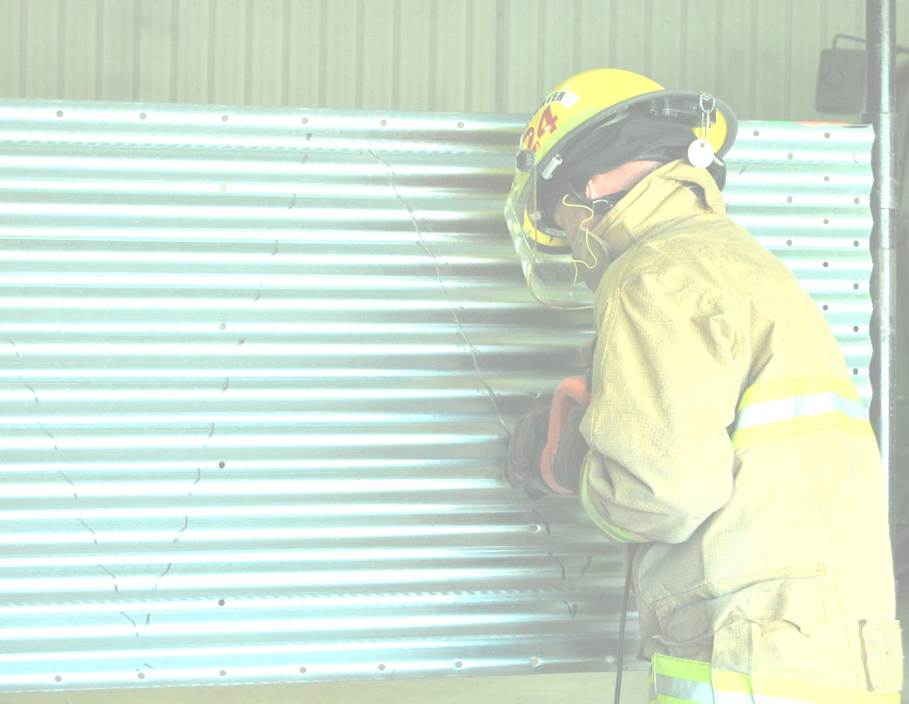
Objectives
The demonstrations and hands-on activities conducted during this session are designed to enhance familiarity with basic grain storage and handling facilities; to demonstrate, and provide experience using emergency grain bin emptying techniques and grain containment devices; and to review various rescue strategies in a real world setting.
Notes:
Instructors Notes:
Participants should again be reminded that this training is intended to be at the “basic awareness” level. There is no way that all potential rescue scenarios can be addressed in such a short period of time.
The flow of activities during this unit is designed to encourage greater participant engagement. No one, however, should be forced to do anything that he or she doesn’t feel comfortable doing. What is especially important is providing the opportunity for participants to ask questions and gain hands-on experience. Participants with more experience can be called upon to share their insights, demonstrate specific skills, and mentor less experienced participants.

Slide 3
Summary of Activities
Tour of “typical” grain storage and handling facility
Work Station #1 – Tour inside of typical grain storage structure (Lockout/Tagout/Augers)
Workstation #2 – Demonstration of emergency bin emptying techniques (panel cutting demonstration)
Workstation #3 – Use of grain containment devices (rescue tubes)
Questions and answers
Post-test and class evaluation
Notes:
Instructor Notes:
Briefly review the contents of the afternoon session.
Break participants up into three teams, encouraging them to remain together during the afternoon. Assign a team leader for each group.
Set up the rotation based upon the remaining time and location of each workstation. Assign someone to be the time keeper and to signal when it is time to rotate between workstations.
Assign a safety officer for each team and charge them to ensure the appropriate use of personal protective equipment.

Slide 4
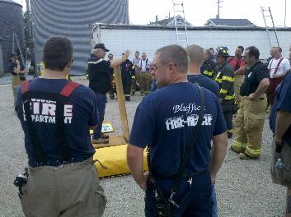
Grain Storage and Handling Facilities Tour
Look for:
Size of structure including height and volume
Location of access points and ladders
Location of controls
Types of grain handling equipment in use
Location of overhead power lines
Types of nearby structures
Presence of LP gas storage tanks
Locations to position rescue vehicles
Natural boundaries to establish perimeter to secure site
Identify obvious first responder hazards
Notes:
Instructor Notes:
Take the entire group on a tour of the grain storage and handling facility located at the training site. There is, however, no such thing as a “typical” grain storage and handling facility and entrapments and engulfments have occurred in every imaginable facility.
The purpose of this visual is to ask the participants to consider each characteristic during the tour. Emphasize the need to point out any obvious hazards that could be a problem for first responders.
Consider inviting a local manager or owner of a grain storage and handling facility to conduct the tour. He or she would be able to address similarities and differences between facilities.
Encourage participants to become familiar with facilities in their home community by requesting permission to conduct a pre-emergency planning tour of each major facility in their service area. Most commercial grain storage and handling facilities are required by OSHA to develop an Emergency Action Plan that includes pre-planning with local emergency management agencies.
During the tour, the external features of the facility will be addressed. There is not a need to climb on or into any structure during this tour. The tour is designed to help assess the facility from the outside, as if first arriving at the scene.
Consider asking questions for the participants to think about such as:
Where would an aerial platform truck be positioned to gain access to the structures?
Where could a landing pad be set up in case a medical helicopter was needed at the scene?
Are there any nearby structures, residences, or hazards that could prove problematic during a rescue or recovery operation?

Slide 5
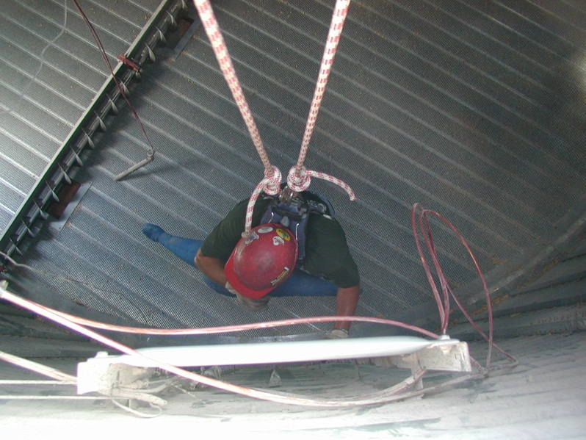
Workstation #1 – Tour of Inside of Typical Grain Storage Structure
Look for:
access points and ladders
size of access doors
level of lighting inside
types of augers involved
size and location of floor wells
potential anchor points
location of controls/lockout/tagout sites
internal temperature
working platform on roof
Notes:
Instructor Notes:
This workstation provides every participant the opportunity to safely access an empty grain storage structure in order to become familiar with the following:
access points and ladders
size of access doors
level of lighting inside
types of augers involved
size and location of floor wells
potential anchor points
location of controls/lockout/tagout sites
internal temperature
working platform on roof (Again there is no need to climb on any structure.)
The grain bin selected for this workstation should be largely empty (less than knee depth) in order to expose internal components. All access doors on the roof and at ground level must be open and all powered equipment locked out. Since there is no danger of entrapment or exposure to a toxic environment, access can be made without the need for life line and harness or respiratory protection. However, participants who know that they may be hypersensitive to grain dust or mold should not enter without a dust mask (N-95).
One feature that needs special attention is the typical size of access doors which can be as small as 24” in diameter. Most fire fighters wearing bunker gear cannot get through an opening that size. For this activity access to the structure should only be through the access door at ground level.
Encourage the group to look for specific hazards that may be a problem for first responders such as slippery bin floors, excessive heat inside the bin, unguarded floor openings, or inadequate or unsafe ladders.

Slide 6
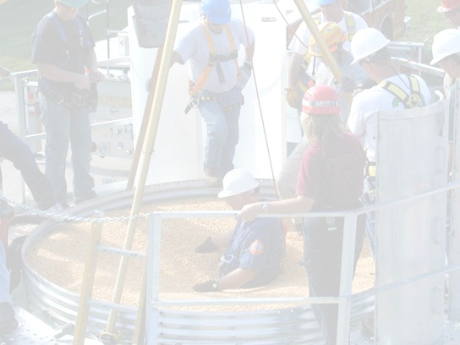
Workstation #2 – Emergency Bin Emptying Techniques
Consider:
manner in which panels are assembled to form a round circle
thickness, design and coatings used on bin panels
types of cutting tools available
hazards associated with each type of cutting equipment
types of personal protective equipment needed
need for a charged line
need to maintain structural integrity
Notes:
Instructor Notes:
To conduct this demonstration, several used grain bin panels and basic types of metal cutting equipment are needed. In some cases, used bin panels can be obtained from a local grain bin manufacturer or distributor.
Bin panels can be mounted between two posts driven into the ground to simulate their position in the wall of a grain bin. The panels can be easily cut in this position.
Only instructors trained in the use of the cutting equipment being demonstrated, and with the appropriate personal protective equipment, should demonstrate this activity.
Since this metal cutting activity produces flying sparks and debris, all participants must have appropriate eye protection and protective clothing. Since metal cutting can be extremely loud, access to hearing protection is also needed. This demonstration should be located away from areas where other participants may be gathered.
Review the very low risk of fire or explosion that has been documented during these operations. Historically, most emergency bin emptying procedures used in actual rescues have used heat generating tools such as saws and torches.

Slide 7
Workstation #3 – Use of Grain Containment Devices
Consider:
Characteristics of free flowing grain
Why grain containment devices are needed
Alternative means of grain containment
Advantages and disadvantages of different grain containment devices
The role of a vacuum unit while using a grain containment device
The hazards involved in using a grain containment device
Notes:
Instructor Notes:
Again, it is impossible in an hour to develop proficiency with grain containment devices or systems. This activity will ensure that all participants are familiar with the different approaches for moving the grain away from the victim so that extrication is possible. At least two different devices or systems should be demonstrated and options provided when a commercially available rescue device is not available.
It is ideal to provide participants the opportunity to install a grain containment device around a mock victim in free flowing grain. This activity has been successfully completed in a:
grain bin rescue simulator
grain bin with a small amount of residual grain in it
truck bed, semi-trailer or gravity flow grain wagon with grain in it
Alternative approaches for controlling grain flow can be demonstrated with plywood sheets, back boards and barrels with the ends removed.
Demonstrating the use of a vacuum unit to remove the grain from inside the grain containment device is important. Successful rescues have been conducted with small portable battery operated shop vacuums, venturi vacuums operated off compressed air, wet/dry shop vacuums and large capacity commercial grain vacuum machines.

Slide 8

Closing Activities
Questions and Answers
Completion of post-test
Completion of workshop evaluation
Distribution of certificates of completion
Notes:
Instructor Notes:
Encourage all participants to stay until the end of the day. Only those who have completed the full training should receive certificates of completion.
Closing activities should take place in the classroom setting used earlier in the day.
Completion of the post-test should be emphasized as an essential part of the workshop and needs to be completed in order to receive a certificate of completion.
Feedback from the participants using the provided program evaluation tool should be helpful in making future workshops more effective.

Slide 9

Notes:
Instructor Notes:
Encourage participants to ask questions now or later by emailing them to you. There are lots of new resources becoming available on flowing grain rescue strategies that should be helpful.

