Slide 1
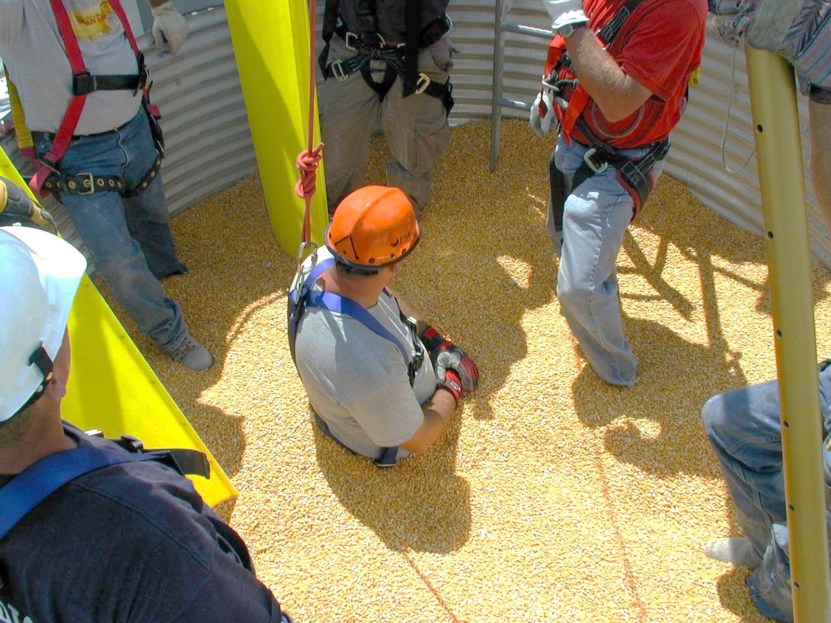
Basic First Responder Training
For Incidents Involving
Grain Storage and Handling Facilities
Unit 1 – Confined Spaces in Agriculture
Developed by:
  Purdue University
  Agricultural Safety and Health Program
  Department of Agricultural and Biological Engineering
  West Lafayette, IN
This material was produced under grant number SH23575SH2 from the Occupational Safety and Health Administration, U.S. Department of Labor. It does not necessarily reflect the views or policies of the U.S. Department of Labor, nor does mention of trade names, commercial products, or organizations imply endorsements by the U.S. Government.
Notes:
Instructor Notes:
This unit is the first of four subject matter presentations that will be presented during the first half of the seven hour training. It will provide a general overview of the types of confined spaces and their related hazards that are found at agricultural workplaces. A general foundation related to all agricultural confined spaces is provided because of many common characteristics.
A very brief overview of the frequency and severity of incidents involving agricultural confined spaces will be provided.
Since most incidents involving agricultural confined spaces involve grain and feed storage, handling, and processing facilities, the focus will be on these facilities.
This first unit is also appropriate for audiences who could benefit from a better knowledge of the types of confined spaces found in agricultural workplaces and the potential hazards associated with each. This presentation has been successfully used with farmers, farm youth, and employees of commercial grain handling operations.

Slide 2
Objectives
Identify key terms related to agricultural confined spaces
Identify the typical types of confined spaces found in agricultural workplaces
Identify the hazards related to agricultural confined spaces
Review the Federal OSHA safety and health standards relevant to agricultural confined spaces
Explain the difference between OSHA exempt and non-exempt confined spaces
Identify work practices that reduce the risk of agricultural confined space-related emergencies
Notes:
Instructor Notes:
To help everyone get on the same page, definitions of several basic terms related to agricultural confined spaces will be reviewed. A more complete list of terms and definitions can be found in the Instructor Guide. Please review this list before conducting the class.
The typical types of confined spaces found in agricultural workplaces will be described and shown. Time doesn’t allow for discussion of every possible confined space that might be encountered by emergency first responders. A fairly comprehensive list of agricultural confined spaces is included as Attachment 5 in the Instructor Guide. This list can be reproduced as a handout.
The most serious hazards will be identified and will be repeated throughout the training. These hazards include those related to both the victim and the first responder.
There is considerable confusion over the Federal OSHA standards that apply to agricultural confined spaces and grain handling facilities. In some cases, certain confined spaces at facilities such as farms, feedlots, and certain seed processing operations maybe exempt from the standards. The relevant standards should be reviewed and their exemption provisions discussed. The two most relevant standards (29 CFR 1910.146 and 29 CFR 1910.272) are included as Attachments 1 and 2 of the Instructor Guide.
Safe work practices around agricultural confined spaces are listed and should be briefly discussed.
However, the focus of this training is not safe work practices or worker safety, but rather first responder safety at the scene. There are numerous safety resources related to agricultural confined spaces that can be found online or from local Cooperative Extension Offices located in every county. See Attachment 16, a list of supplemental resources.

Slide 3
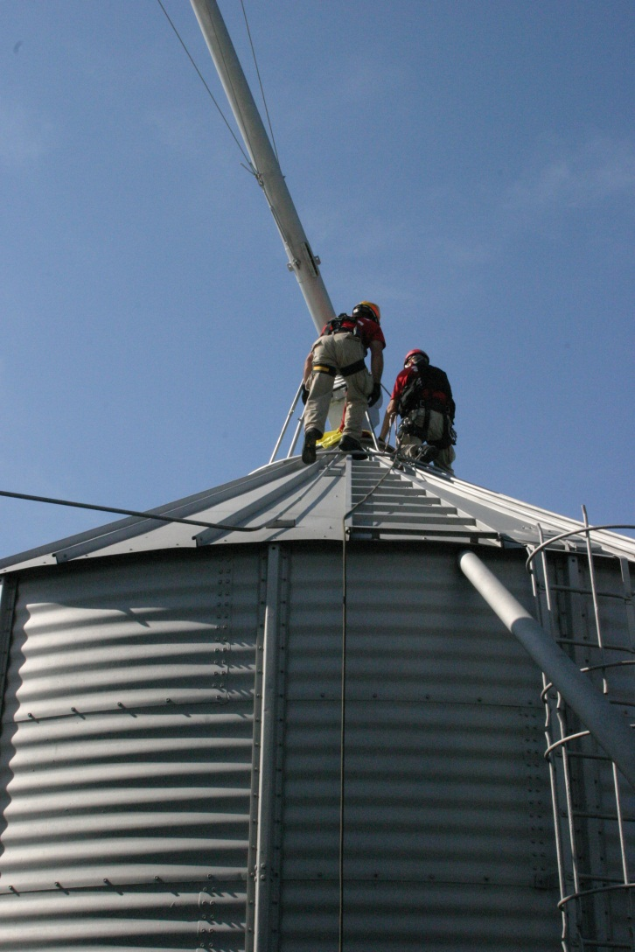
Agricultural Confined Space
Any space found in an agricultural workplace that was not designed or intended as a regular workstation, has limited or restricted means of entry or exit, and has associated with it potential physical and/or toxic hazards to workers who intentionally or unintentionally enter the space.
Notes:
Instructor Notes:
A review of the technical literature reveals that there are numerous definitions for what constitutes a confined space. There are engineering descriptions, regulatory definitions and definitions that apply to specific applications. This definition was developed by the USDA-Agricultural Safety and Health Research and Extension Coordinating Committee – 197, specifically for agricultural confined spaces and actually goes beyond the current regulatory definition used by OSHA for compliance purposes.
One added definition that is often used at the application level, that might be easy to remember is “a space that requires you to use your hands to get in and out of”. Give the group a moment to apply this very simple definition to places they have gotten into.
As will be noted later, not all agricultural confined spaces are covered by OSHA regulations.

Slide 4
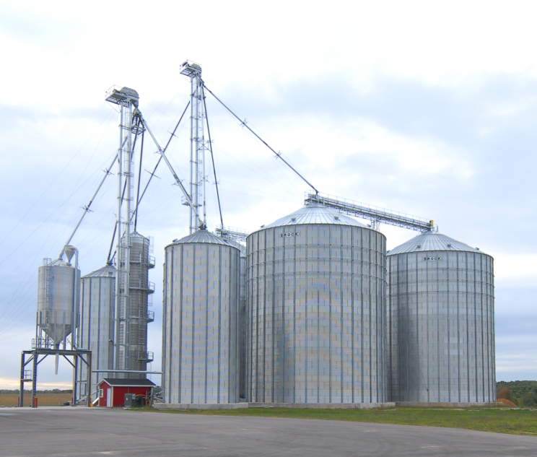
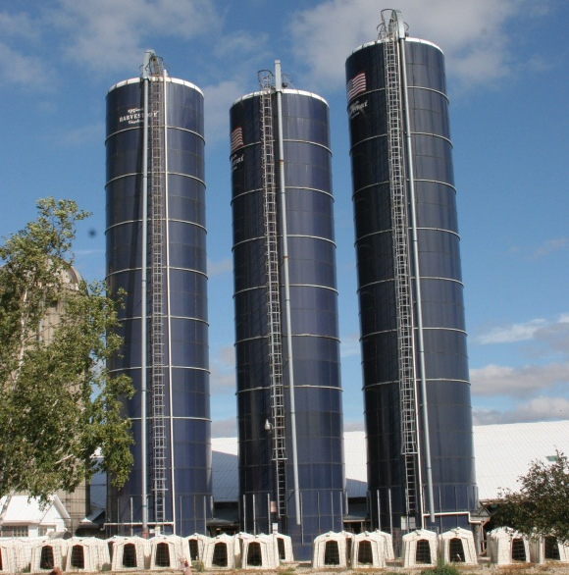
Confined Space – OSHA Definition
A Confined Space:
      is large enough for an employee to enter fully and perform assigned work
      has a limited or restricted means of entry or exit
      is not designed for continuous employee occupancy
Notes:
Instructor Notes:
This basic OSHA definition for a confined space is drawn from 29 CFR 1910.146 (OSHA Confined Space Entry Standard)
This standard is included as Attachment 2 in the Instructor Guide and can be copied for handout material if needed.
The defining characteristics of a confined space under the OSHA provisions are quite simple and should not be complicated to communicate. They include:
a space that is accessible to a worker
a space that has limited or restricted means of entry or exit
a space not designed for continuous occupancy

Slide 5

Permit Required Confined Space
OSHA Definition
A Permit-Required Confined Space – has one or more of the following:
      Contains or has the potential to contain a hazardous atmosphere
      Contains a material with the potential to engulf someone
      Has an internal configuration that might cause an entrant to be trapped or asphyxiated by inwardly converging walls or by a floor that slopes downward and tapers to a smaller cross section
      Contains any other recognized serious safety or health concerns
Notes:
Instructor Notes:
The definition for a “permit-required confined space” is more descriptive and specifically addresses the hazards that may be present such as toxic atmospheres and engulfment hazards. This definition is drawn from 29 CFR 1910.146 (OSHA Confined Space Entry Standard).
What is meant by “permit-required” is the need for a written permit to be issued by the employer or management to the worker before entering the space. Not all “confined spaces” are “permit-required confined spaces”.
It should be noted that emergency first responders may or may not be covered under the OSHA Permit Required Confined Space Entry regulations. For additional information on the application of 28 CFR 1910.146 see Attachment 21. Again, don’t be surprised to find that many first responders participating in the class are not aware of the OSHA standards that apply to confined spaces.

Slide 6
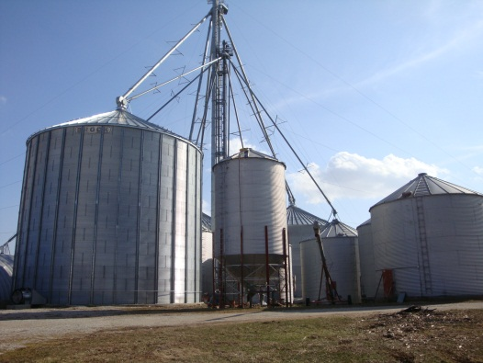
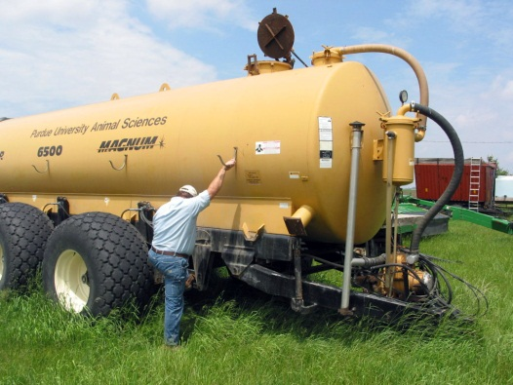
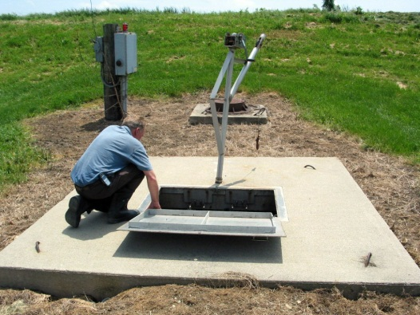
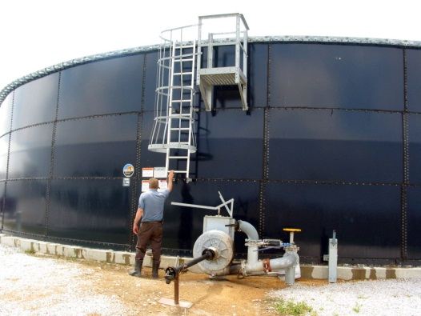
Types of Confined Spaces in Agriculture
Examples:
        Grain bin
        Silo
        Manure storage
        facilities
        Hopper bottom feed bin
        Grain transport vehicle
        Septic tank
        Fertilizer storage tank
        Fermentation tank
        Other
Notes:
Instructor Notes:
There is no comprehensive listing of all types of confined spaces that could potentially be encountered on agricultural production sites or at grain storage and handling facilities. A fairly complete listing of agricultural confined spaces is found as Attachment 5 in the Instructor Guide. This list can be reproduced as a handout.
The Department of Labor provides a list of examples of 23 industry types of confined spaces, but does not include spaces generally found in agriculture.
The general categories of agricultural confined spaces include:
Grain and feed storage facilities
Forage storage structures
Manure storage structures
Agricultural transport vehicles
Agricultural equipment
Food processing and storage equipment/facilities
Ask participants to identify specific examples of agricultural confined spaces that they are aware of.
The following seven slides provide images of some of the primary types of confined spaces found in agriculture. The emphasis is a grain and feed storage since most emergencies involving agricultural confined spaces involve grain or feed storage units.
There are considerable resources available online regarding the hazards associated with agricultural confined spaces, including manure storage and grain transport vehicles.

Slide 7
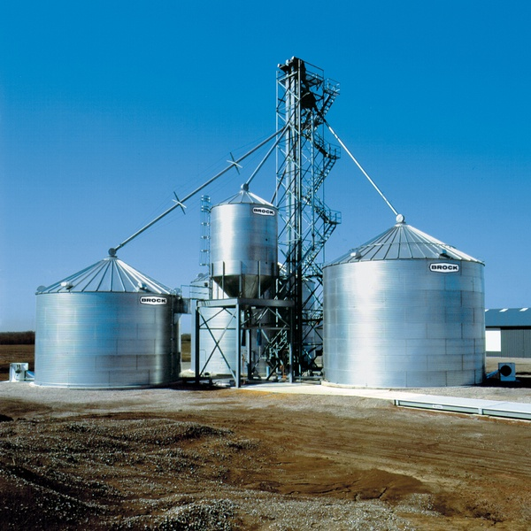
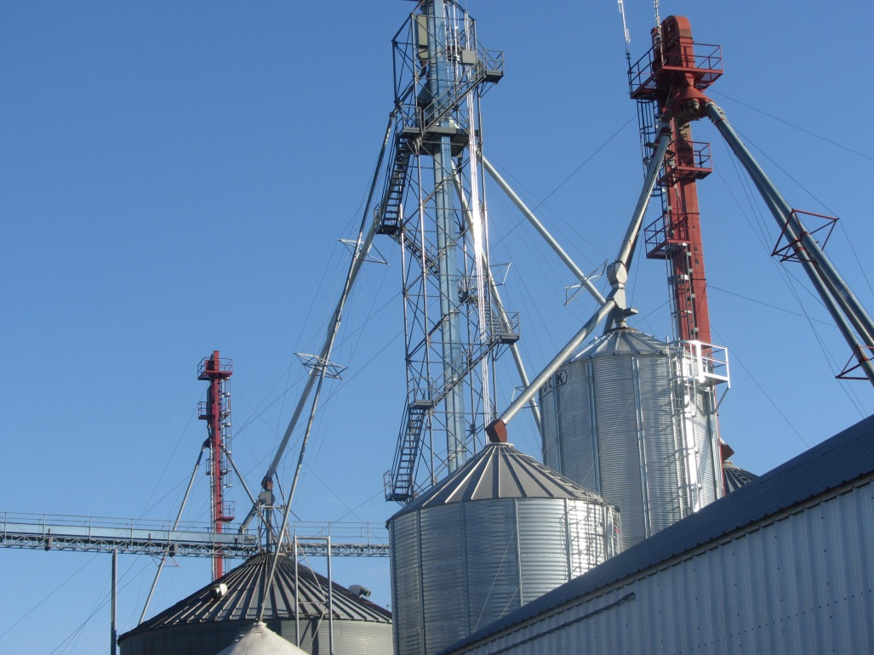
Farm Grain Storage and
Grain Leg Operation
Notes:
Instructor Notes:
On-farm grain storage facilities can range from a single 10,000 bushel structure in an isolated location to a complex facility containing multiple structures capable of storing hundreds of thousands of bushels of grain. On some modern farm operations, the grain storage capacity can exceed that of many commercial, OSHA non-exempt facilities. In some major grain growing regions, bins that can store over 300,000 bushels of grain are being built on farms. This is equivalent to 16,800,000 pounds of grain or over 8,400 tons. Reports of storage structures with over a half million bushels of storage capacity being built on farms have been documented.
Point out, using the image shown, the challenges that first responders could face in responding to an emergency at this site, including the height of the facility that could exceed 125 feet; location of key access points, often on the roof of the structure; the presence of hopper bottom units and the lack of space around the individual structures to position rescue equipment.
Historically, most entrapments and engulfments have occurred in smaller bins (less than 50,000 bushels) located on exempt farm operations.
Based upon recent USDA data, more grain is being stored on farms than at commercial grain elevators. There are estimated 300,000 farms in the U.S. that have grain storage facilities.

Slide 8
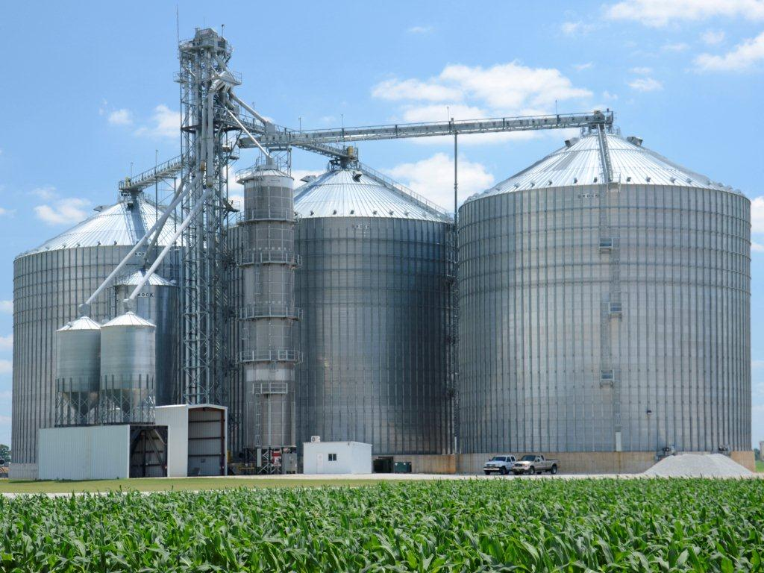
Large Scale Commercial Grain Operation
Notes:
Instructor Notes:
Commercial grain storage and handling facilities regardless of size, are required to comply with relevant OSHA standards including 29 CFR 1910.272 and for some confined spaces, 29 CFR 1910.146. There are approximately 14,000 commercial facilities in the U.S. Because of targeted enforcement, those facilities are among the most regulated workplaces in America. Approximately 5 percent of these facilities are inspected annually by OSHA compliance personnel.
Commercial facilities can range from small country elevators that have the capacity to store 100,000 bushels of grain and may process feed for local farmers, to facilities that are capable of storing millions of bushels of grain and include rail or boat access for shipping grain. Individual storage structures at these facilities can exceed 500,000 bushels in capacity.
Larger commercial facilities often have their own trained confined space entry teams and emergency response teams.

Slide 9
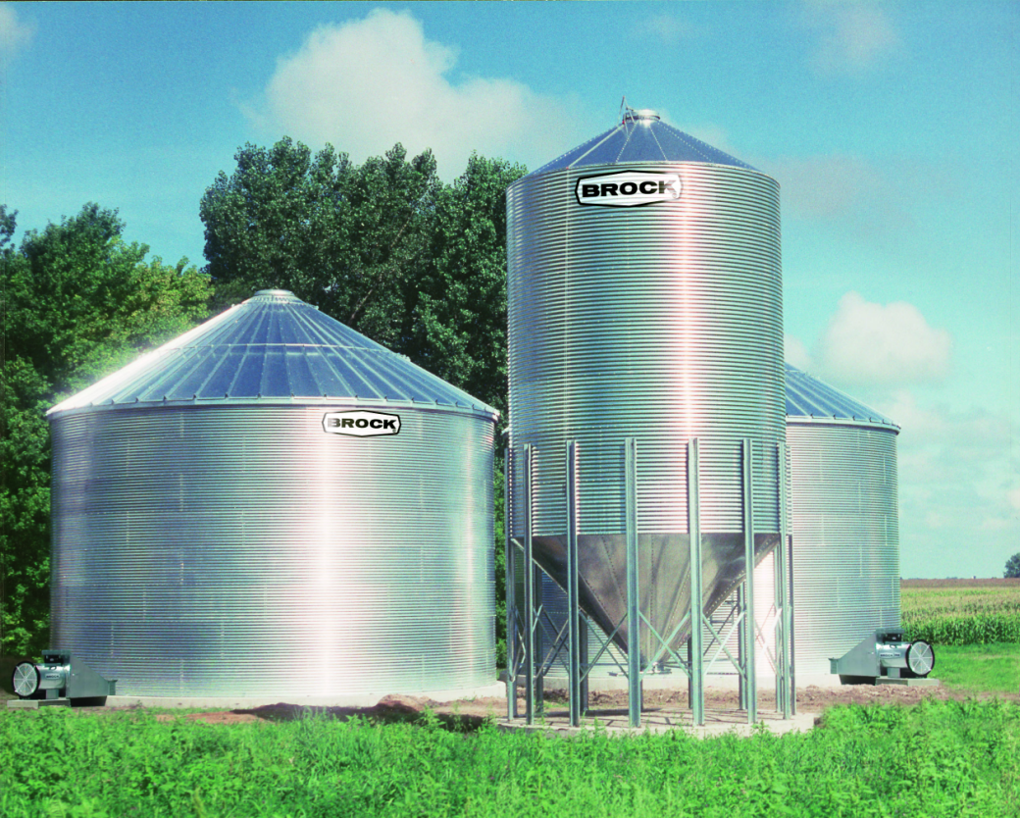
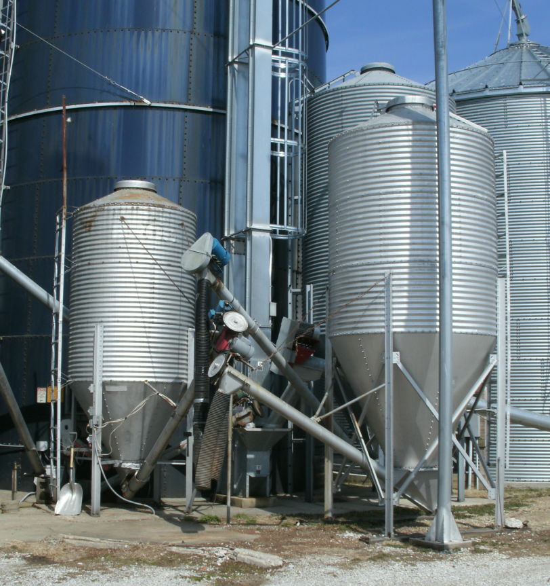
Hopper Bottom Feed/Grain Bin
Notes:
Instructor Notes:
Historically, hopper bottom bins were relatively small and were used to store small quantities of grain and feed. They are widely found on both small and large livestock farms. As the interest in self-unloading structures increased, these structures have increased in number and size. Hopper bottom silos with capacities of thousands of tons are now used to store grain feed, meal, sawdust, wood chips, meat and fish meal and other bulk products.
A person caught in the flow from a hopper bottom bin can easily become wedged in the bottom of the funnel or unable to climb out on their own due to the steepness of the sides. The structure shown, because it has “inwardly converging walls” could be classified as an OSHA Permit Required Confined Space. However, since it is located on an exempt farm operation, the owners may be exempt from having to comply with the OSHA standards.
In some hopper bottom bins where the bulk material does not flow easily or bridges frequently, mechanical reclaim systems are used. These unguarded augers break up the material to aid in its removal, but also expose a victim of entrapment to the risk of entanglement.

Slide 10
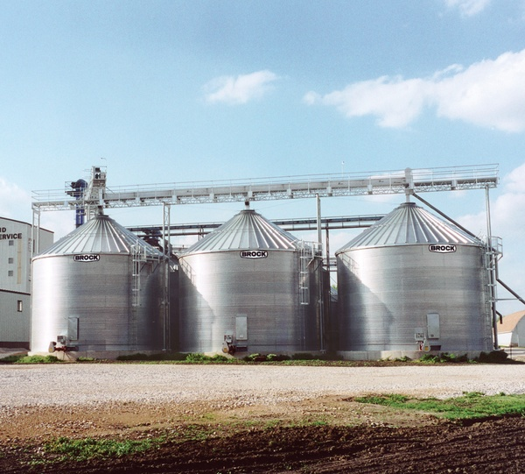
Commercial Seed Corn Operation
Notes:
Instructor Notes:
Commercial seed corn or popcorn storage operations also utilize large grain/seed storage structures. These facilities, in some cases, are exempt from the OSHA Grain Handling or Confined Space Standards. However, if the seed or popcorn is being processed at the facility, the owners must comply with the relevant standards for the processing part of the operation.
Note the horizontal loading system across the top of each bin, and how close together each structure is located.
There are seed processing facilities that incorporate 50-60 bins such as those shown.
There has historically been some confusion over whether popcorn storage on other food grade storage facilities are covered by OSHA grain handling standards. For additional information on OSHA’s interpretation, review Attachment 21 of the Instructor’s Guide. In most cases, large food grade storage facilities operate under the provisions of OSHA’s CFR1910.272 Grain Handling standard that will be discussed later.

Slide 11
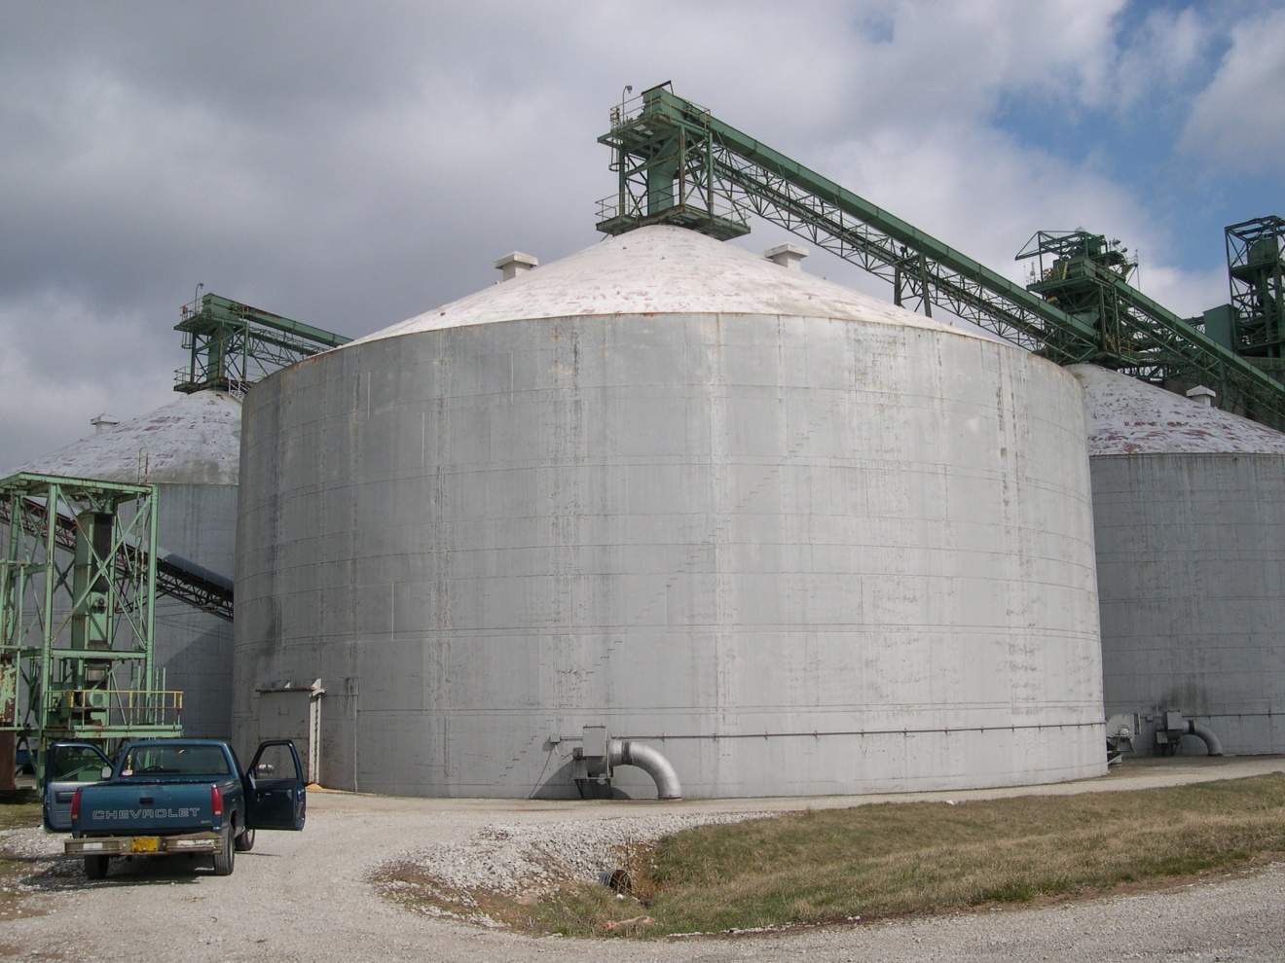
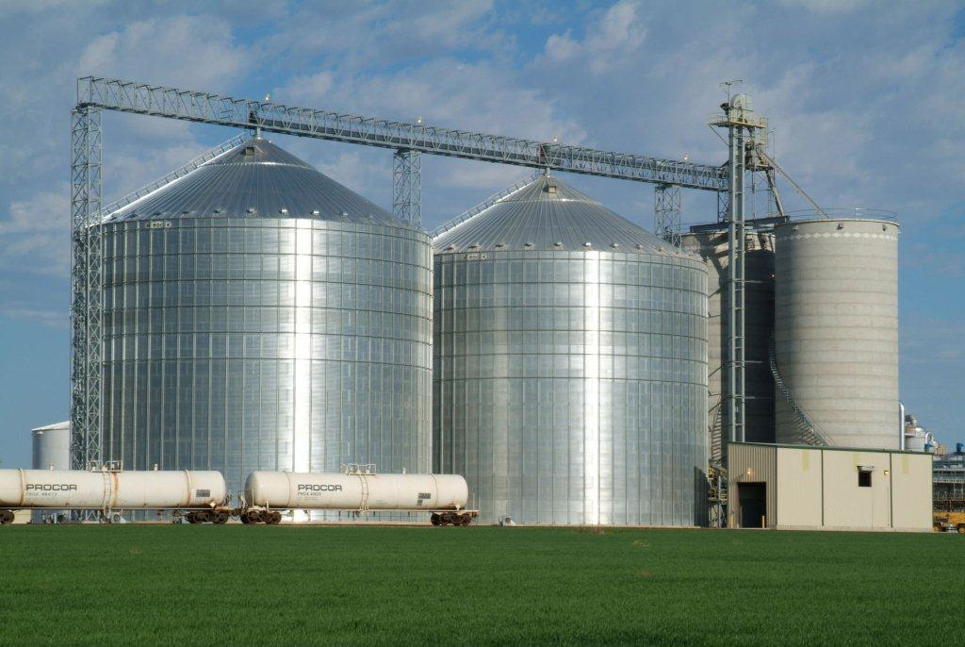
Large Capacity Storage Tanks
Notes:
Instructor Notes:
The size of new grain storage structures is difficult for many to comprehend. The welded steel tank shown above can store approximately one half million bushels of grain while the corrugated bin will hold over 300,000 bushels. If filled with corn at 56 pounds per bushel, a 325,000 bushel bin is holding over 17 million pounds of grain or over 350 semi-truck loads. Currently, structures are being built with over one million bushels of storage capacity.
The size of grain storage structures across the U.S. has increased dramatically over the last decade.
The shear volume of grain becomes an enormous obstacle to first responders. The reason why many rescue operations have taken 6-8 hours to complete is because so much grain has to be removed and transported away from the immediate scene.
None of these large structures can be safely cut and drained without significant risk of structure failure.
Historically, very few entrapments in grain have been documented in these larger facilities. Most occur in smaller structures under 50,000 bushels.

Slide 12
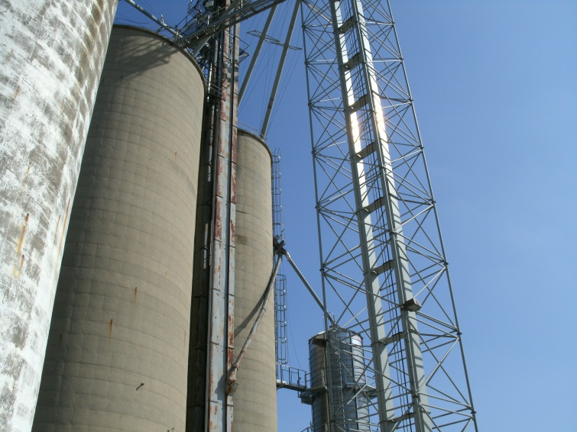
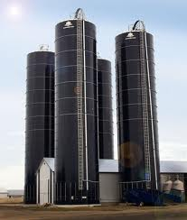
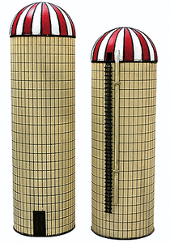
Silos
Concrete Poured Silo
Oxygen-limiting silo
Concrete Stave Silo
Notes:
Instructor Notes:
There are several types of silos in use in agricultural workplaces. They include:
Poured concrete silos that can be 30-60’ in diameter and stand over 100’ tall. These structures generally unload from the bottom and load through the top. If not ventilated properly they can contain either a toxic atmosphere or oxygen levels insufficient to support life, especially if grain with an excessive moisture content is being stored.
Oxygen limiting steel silos (Harvestore) that were designed to store high moisture grain, corn silage or fermented forages. Due to being designed to be nearly airtight and the lack of adequate ventilation they can contain high concentrations of nitrogen dioxide and carbon dioxide that are released during the fermentation process. Designed to be nearly air tight, when working properly, they will not support life. They load from the top and unload from the bottom. Access is limited to a roof hatch and a bottom access point where the unloader is installed. The roof hatch is approximately 25” in diameter. When material is removed from these structures it is considered plug flow since the first material in is the first out.
Concrete stave silos were widely used on dairy farms to store silage and load from the top and can be unloaded from either top or bottom.
Most on-farm silos have ladders in place that do not meet current OSHA standards because the lack of fall-protection such as cages and rest platforms at required intervals. At the time many of these structures were built there were no applicable standards.
Incidents involving silos have become very infrequent. The most common incidents involve entanglement in the silo unloading equipment. They sometimes involve more than one victim.

Slide 13
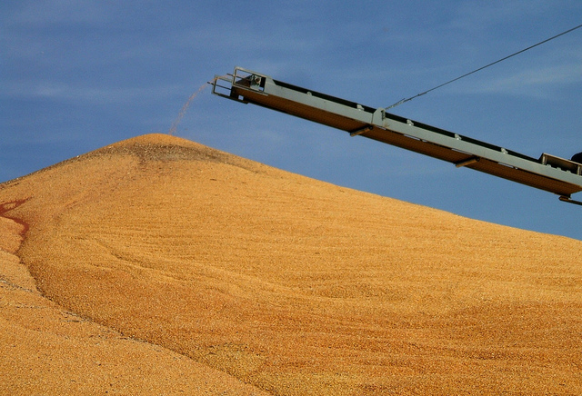
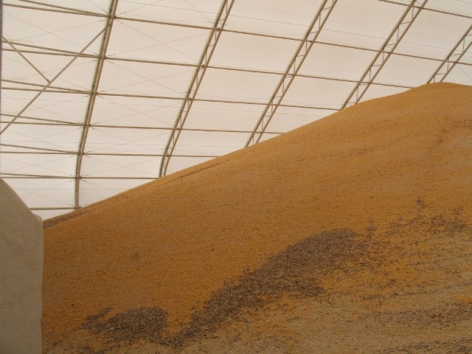
Flat Storage
Outside Pile
Flat Storage Building
Notes:
Instructor Notes:
Grain is also stored in large outdoor piles for short durations during harvest. These piles can contain hundreds of thousands of bushels of grain and stand over 50 feet tall. Some piles can be covered by tarps or large sheets of plastic.
Large, flat-bottom buildings of various shapes can be used to store grain. These buildings have all the characteristics of a confined space but may not be identified as one.
Entrapments and engulfments have been documented in both outside piles and flat storage buildings. Rescues from large piles of grain have proven to be among the most difficult due to the shear volume of grain involved and the instability of free standing piles.

Slide 14
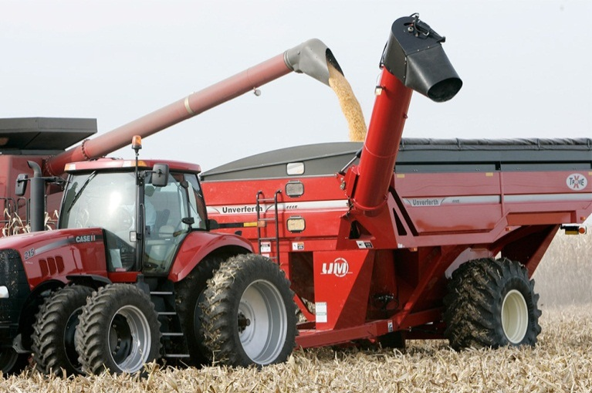
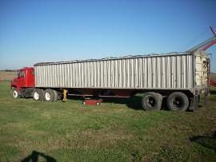
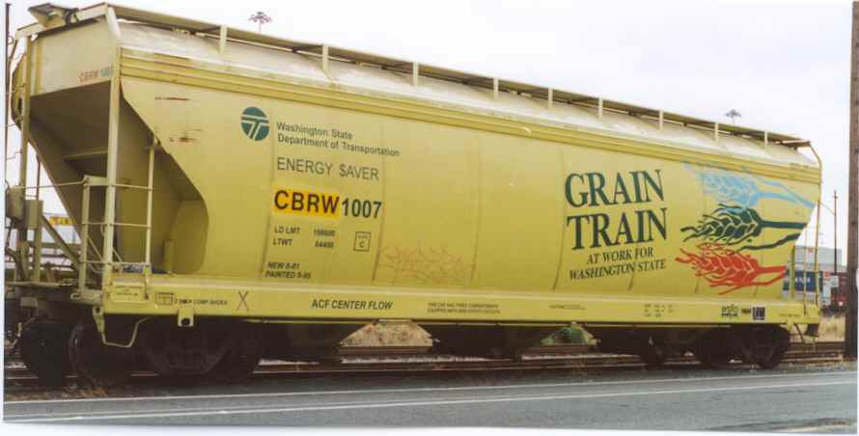
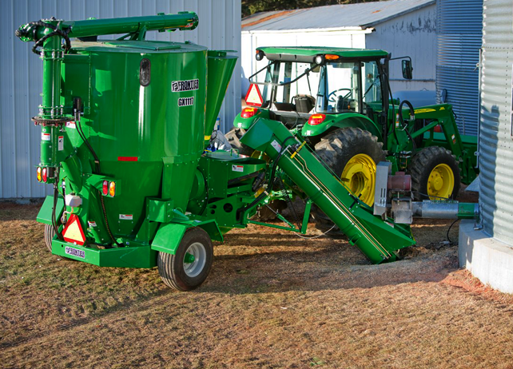
Grain Transport Vehicles
Grain Carts
Hopper Bottom Semi
Rail cars
Portable grinder mixer
Notes:
Instructor Notes:
Grain transport vehicles (GTVs) are used to transport grain and other free flowing agricultural products including feed and other processed forms of grain. These vehicles include gravity flow grain wagons, powered grain carts, trucks, rail cars, portable grinder mixers and feed mixing wagons. Fatalities and severe injuries, including entrapments and entanglements, have occurred with each of these vehicles.
The overwhelming percentage of fatalities involving GTVs have been males under the age of 16.
Photo credit:
Upper left: http://www.umequip.com/grain-handling/grain-carts/xtreme/
Upper right: http://www.uship.com/shipment/hopper-bottom-semi-trailer/309607657/
Bottom left: http://www.trainweb.org/ttos-pnw/Articles.htm
Bottom right: http://www.deere.com

Slide 15

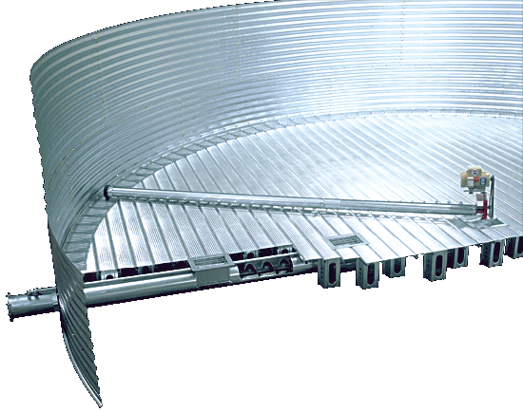
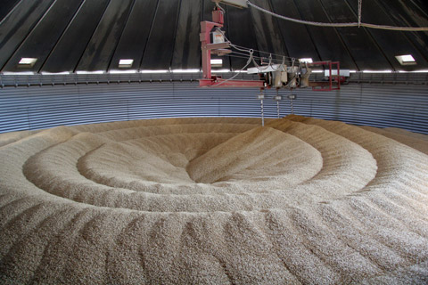
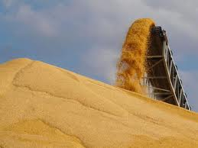
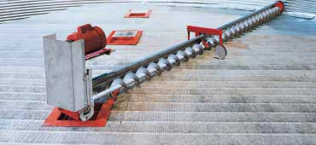
Grain Handling Equipment
In floor auger
Portable grain auger
Stirrator
Sweep auger
Belt Conveyor
Notes:
Instructor Notes:
There has been considerable confusion among non-farm audiences concerning the different types of grain handling equipment found in and around grain storage structures. The purpose of this visual is to show the difference between the basic types of equipment used to transport grain.
Portable grain auger – typically mounted on wheels to allow for easy transport and alignment of the auger from one bin to another. They can be raised and lowered to accommodate different height bins. They come in varying lengths of 10’ – 100’ and are powered by either an electric motor or tractor PTO.
Sweep auger – powered auger that rotates around the inside of the bin at floor level to move residual grain towards the center well or floor opening for removal. They travel at relatively slow speeds.
In floor auger – installed under the floor of the bin to allow grain, as it falls through floor openings above the auger, to be transported out of the bin. In-floor augers that are left unguarded are a significant source of leg and foot amputations.
Stirrator auger –generally mounted vertically, suspended from the roof of the bin. They are powered by electric motors, and are designed to stir the grain to ensure that it is maintained in good condition without crusting.
Belt conveyor – installed under the floor of the bin to transport grain from the floor openings. Belt conveyors serve the same function as in-floor augers, but have higher capacity to move grain. Generally found in larger facilities.
Photo credit:
Upper left: http://www.hutchinson-mayrath.com/hutch-binunload.html
Upper right: http://web.extension.illinois.edu/agsafety/equipment/grainaugersafety.cfm
Bottom left: http://almaskorn.dk/billedgalleri/billede-4/
Bottom right: http://www.hutchinson-mayrath.com/hutch-binunload.html
Middle: http://www.cdc.gov/niosh/docs/86-119/

Slide 16
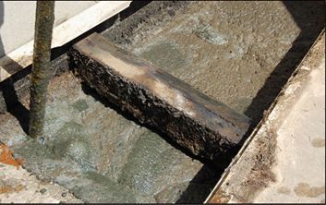
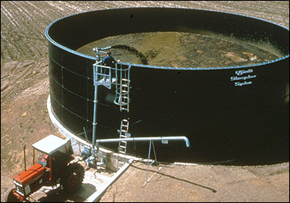
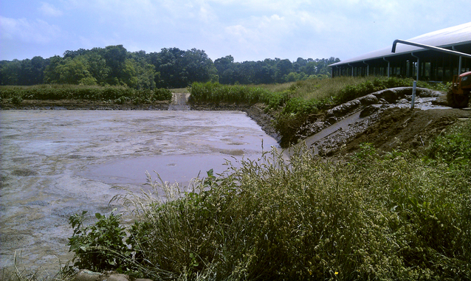
Manure Storage Facilities
Below ground pit
Above ground storage tank
Lagoon
Notes:
Instructor Notes:
Manure storage facilities have accounted for several hundred incidents resulting in deaths and injuries, including at least two cases in which there were five fatalities in each incident. It is estimated that nearly one-third of all fatalities in manure storage facilities have been first responders, including both untrained employees or family members, and trained emergency personnel.
All manure releases toxic or flammable gases as it decomposes during storage. These include methane, carbon dioxide, hydrogen sulfide, and ammonia. Each has the potential of reducing the oxygen level below the acceptable level of 19% needed to sustain life. No one should enter a manure storage facility to attempt a rescue without full respiratory protection and compliance with all permit-required confined space entry requirements.
Because of the generation of methane, there is a potential for fires and explosions to occur if the right concentrations develop. Before accessing any facility built over a manure storage structure, the facility should be well ventilated to ensure that methane levels are not excessive. If foaming is present o the surface of the manure, care should be taken to avoid potential ignition sources.
The greatest risk of exposure to toxic manure gases is during extremely hot weather and during agitation of the liquid manure.

Slide 17
Hazards Related to Agricultural Confined Spaces
Entrapments requiring extrication from flowable agricultural materials
Engulfments – fully buried in flowable agricultural material
Entanglements in energized machinery
Asphyxiation due to exposure to toxic environments
  Carbon Dioxide
  Methane
  Hydrogen Sulfide (manure)
  Ammonia (manure)
  Smoke/Carbon monoxide (fires)
  Silo gas
Suffocation due to oxygen limited environments
Falls
Electrocutions
Drowning
Respiratory distress due to exposure to dust and microtoxins
Burns from fires and explosions
Notes:
Instructor Notes:
The list of potential hazards that first responders may encounter in and around agricultural confined space is quite lengthy. It is unlikely that even the best trained tactical rescue team will have sufficient experience or training to address all of the hazards associated with the various confined spaces found in agriculture or the rescue strategies needed to conduct a safe and timely rescue. That is why becoming aware of the different types of confined spaces and their hazards, along with pre-planning is so important.
Participants need to be made aware that a team approach is almost always needed to conduct a safe and effective response while avoiding the potential hazards. No, single, first responder will have all the knowledge or experience needed to conduct the rescue.
Ask participants if they are familiar with other potential hazards that might be encountered during a response to an incident at a grain storage and handling facility. Other possibilities include:
unfriendly farm dog
close proximity to LPG tanks
nearby active rail lines
disgruntled employees
close proximity to overhead power lines
automatic controls that engage operations at predetermined times

Slide 18
Relevant Federal OSHA Standards
29 CFR 1910.146 – Permit-required confined space standard
  Exempts agriculture
29 CFR 1910.272 – Grain handling standard
  Covers all commercial grain storage and handling operations
  Original focus on preventing grain dust explosions
  Exempts farms, feedlots, and certain seed processing operations
  Takes precedence over CFR 1910.146
Notes:
Instructor Notes:
Please review the two relevant OSHA Standards included as Attachments 1 and 2 to the Instructor Guide. Become familiar with these standards since they do have application to both volunteer and paid emergency first responders responding to an incident at a grain storage, handling, or processing facility.
These standards may also be copied and used as handout material, or they are available online at www.OSHA.gov.
Time does not allow for in-depth discussion of the provisions of these two standards. Participants should be encouraged to review them on their own.
There has been ongoing confusion over what appears to be contradictions between the Permit-required Confined Space Standard and the Grain Handling Standard. According to OSHA’s interpretation of the two standards (See Attachment 21 of Instructor’s Guide), the provisions of the Grain Handling Standard take precedence over the confined space standard. It is the provisions of the Grain Handling Standard that have identified most on-farm grain storage and handling facilities as exempt from compliance requirements of OSHA’s confined space regulations.

Slide 19
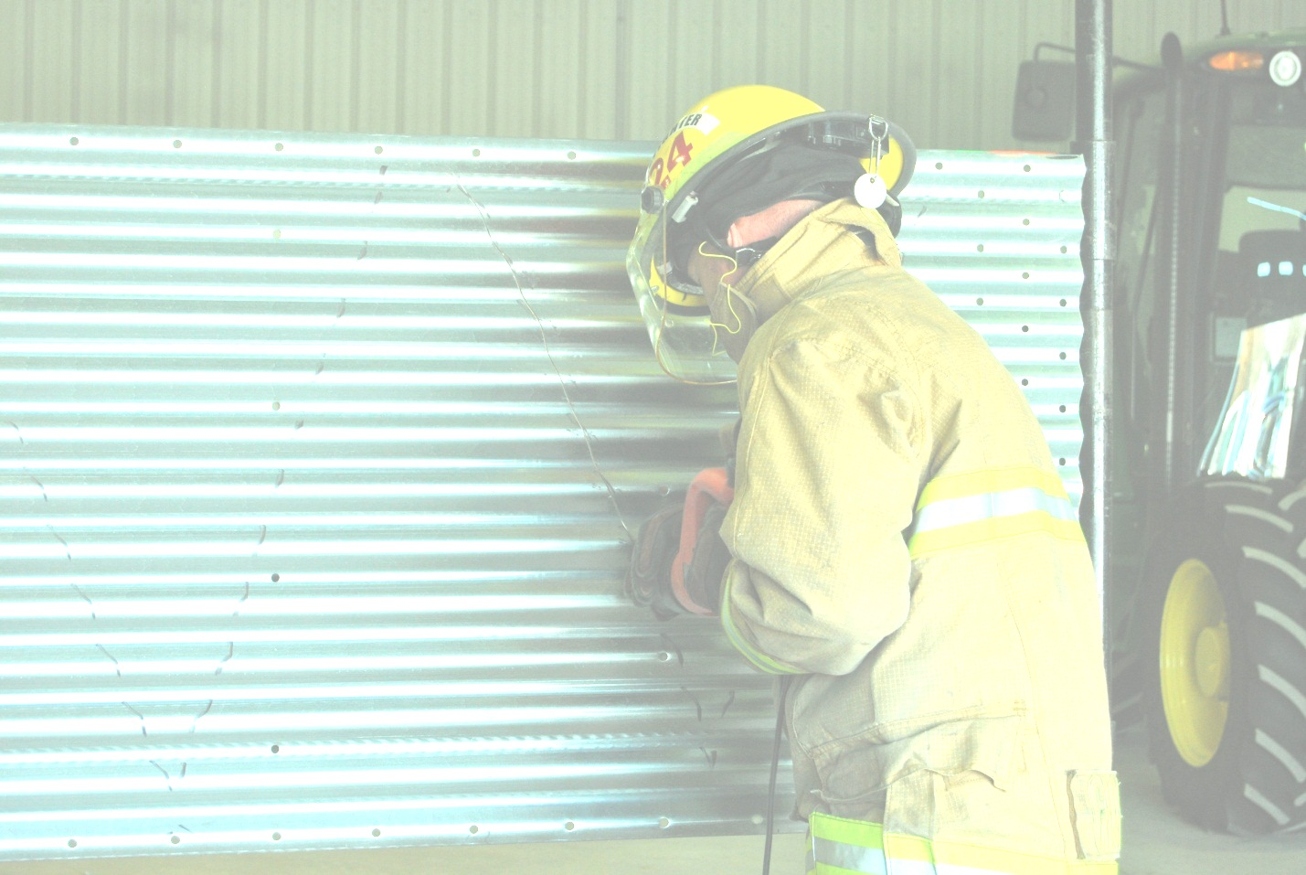
OSHA Application to Local Fire/Rescue Services
Federal OSHA does not have enforcement jurisdiction over local government entities such as local fire departments
Some OSHA State Plans cover emergency workers
Prudent employers would preplan to assure that local emergency services have the needed equipment and trained personnel if relying on those services to conduct a rescue
Notes:
Instructor Notes:
There has been considerable confusion regarding the application of the OSHA Standards to emergency first responders at the scene of a grain entrapment or engulfment. Based upon OSHA interpretation of the language found in CFR 1910.146, federal OSHA does not have enforcement jurisdiction over local government entities including local fire/rescue agencies. However, some states such as Indiana have chosen to extend the coverage of the OSHA Standards to emergency personnel who are employed by a government agency or who volunteer for a local emergency service (See Attachment 7 of the Instructor’s Guide).
The OSHA interpretation does include an important statement – “However, a prudent employer would preplan to assure that any local emergency entity has the equipment, trained personnel, etc., if it were to rely on that outside service to conduct rescue” (See Attachment 21 of Instructor’s Guide).
During an emergency the issue of exempt versus non-exempt is not central, but rather whether or not first responders are trained and equipped to respond safely using recognized safe work practices.

Slide 20
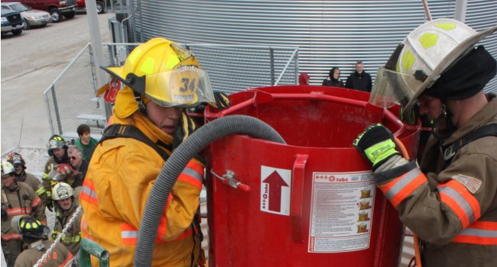
Key Provisions of the OSHA Standards Relevant to On-Site First Responders
Need for Emergency Action Plan
Need for appropriate personal protective equipment
Need for emergency response team
Preplanning
Notes:
Instructor Notes:
Highlight some of the key provisions that specifically address on-site first responders responding to emergencies involving grain storage and handling facilities.
Participants should be encouraged to consider returning to their respective agencies and companies, and developing a protocol for responding to emergencies such as grain entrapments inside a grain storage structure. This is especially important if the area being served contains large numbers of grain storage structures.
The need to work with local facilities to conduct preplanning for emergencies and conducting on-site training should be emphasized.

Slide 21
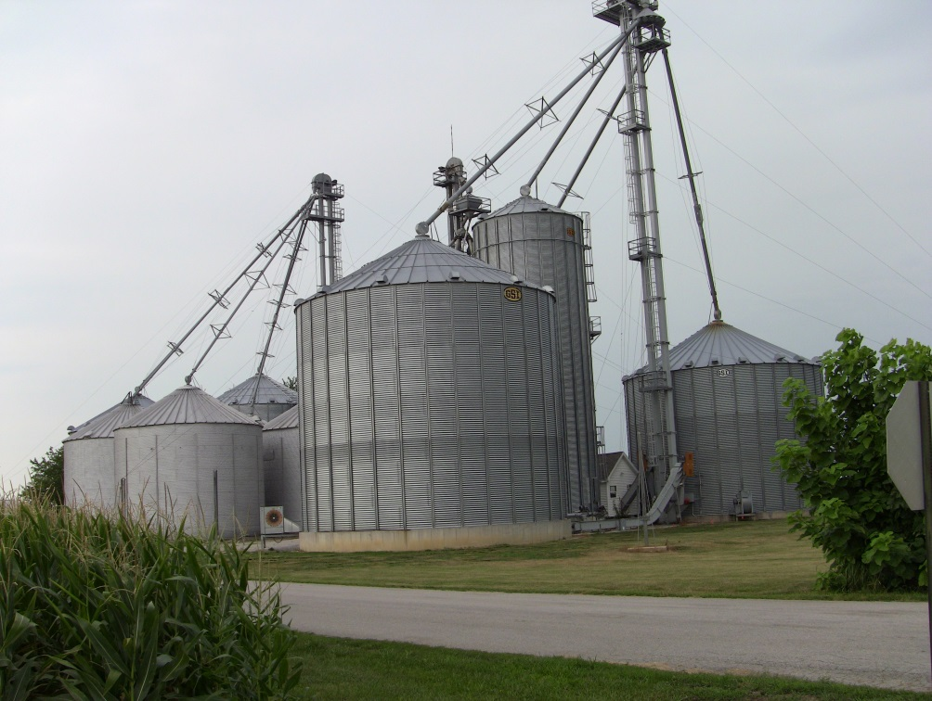
Exempt Facilities
The OSHA Grain Handling Standard (1910.272) currently exempts from compliance
certain farming operations:
    Farms with 10 or fewer employed
    Feedlots
    Operations that prepare seeds
    for future crops
The OSHA Permit-required Confined Spaces Standard (1910.146) generally exempts agricultural operations that:
  Grow or harvest crops
  Raise livestock or poultry
Notes:
Instructor Notes:
In addition to the application of OSHA Standards to first responders, here also has been considerable confusion regarding the application of OSHA standards to grain storage and handling facilities. The two most relevant standards, 29 CFR 1910.272 Grain Handling Standard and 29 CFR 1910.146 Permit-required Confined Space Standard, are not universally applicable to all facilities due to exemption provisions included in the standards. The reasons why these exemptions exist are complex and include political pressure placed by special interest groups on legislators when the standards were drafted and the potential cost of bringing existing facilities into compliance. In some cases, these exemptions don’t make sense. For example, a 100,000 bushel bin at a commercial, OSHA non-exempt, storage operation that employs any number of employees must comply with the provisions of CFR 1910.146 and CFR 1910.272, while a grain facility with the capacity of 500,000 bushels, and 9 employees across the highway from the first, but classified as a farm or feedlot, is exempt from compliance with the OSHA workplace standards. Whether or not the rules make sense is immaterial. Incidents at both sites need to be approached using appropriate strategies to reduce the risk of secondary victims. To assist in better understanding the applicability of the two standards, instructors should review both standards found as attachments and the relevant OSHA Quick Takes, also found as attachments.
It should be noted that many incidents, especially non-fatal, at exempt facilities go unreported since there are no reporting requirements.
Even if the issue of exempt versus non-exempt has created considerable confusion among first-responders, they should, however, be instructed to treat all apparent confined spaces, regardless of location, as potentially hazardous sites, and to follow confined space entry procedures to the extent possible.
Again, it is confusing to consider that small farm owners and their employees operate under a different set of “rules” when responding to an emergency in their workplace versus the municipal first responders who arrive at the scene. Participants should be encouraged to visit farmers in their service areas and warn them of the potential hazards to untrained first responders, and the critical need to develop emergency action plans and to call for emergency assistance in the event of an entrapment or engulfment.
One key instruction to all owners of grain storage facilities is to immediate call for assistance (911) if there is any indication of an entrapment, engulfment, asphyxiation, or entanglement at the facility.

Slide 22
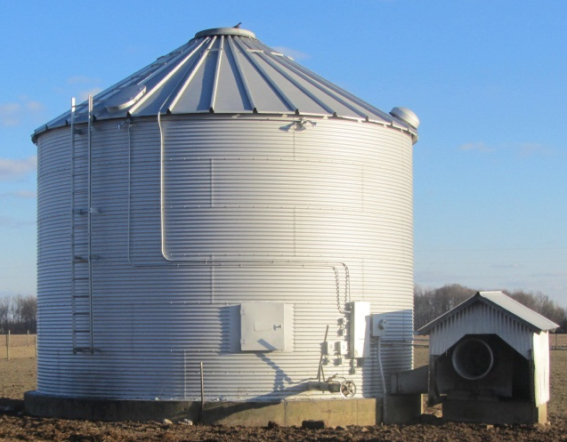
Exempt Facilities Represent the Greatest Risks to First Responders
Over half of all grain storage capacity in the U.S. is currently exempt from OSHA compliance.
Historically, about 70% of all documented grain-related entrapments have occurred at exempt facilities.
Exempt facilities are less prepared to respond to an emergency due to:
  Fewer trained personnel
  Less access to rescue equipment
  Workplace safety rules not in place
  No emergency management plan
Notes:
Instructor Notes:
For a number of reasons, the potential risks to emergency first responders when responding to an exempt facility are greater than those found at non-exempt facility. Historically, because more grain is stored at exempt facilities, the risk of entrapment is higher. In some years, the incidents documented at exempt facilities have accounted for 70 percent of all incidents. The overall average is over 50%. As noted earlier, there are over 300,000 exempt farm operations and only about 14,000 commercial, non-exempt facilities.
Other reasons that exempt farms and feedlots may present a greater risk to first responders include:
fewer workers who have completed emergency response training
less access to emergency rescue equipment onsite
less developed corporate safety planning and internal compliance with safety rules
lower probability of having an emergency management plan in place.

Slide 23
Non-Exempt Facilities Must Have
Confined space entry permit system
Appropriate confined space entry equipment
  Lifeline and harnesses
  Air monitoring equipment
  Communication system
Emergency action plan
Documented training
Incident reporting policies in place
Notes:
Instructor Notes:
Again, non-exempt facilities under current OSHA standards includes almost all commercial grain storage and handling operations regardless of size.
Confined space entry permits must be filled out by all employees and filed prior to entering the space.
Prior training is required to use lifelines, body harnesses, and retrieval equipment.
Air monitoring must include at a minimum an oxygen monitor.
Communications equipment must be tested at that facility at least annually and documented.
Emergency Action Plan must be communicated to employees, reviewed and updated regularly, and include procedures for the facility operators and local responders.
Training must be documented and on file along with a training roster.
Non-exempt operations are required to report to OSHA workplace injuries or incidents involving multiple workers. This is why there is such a high percentage of documented events at non-exempt facilities.

Slide 24
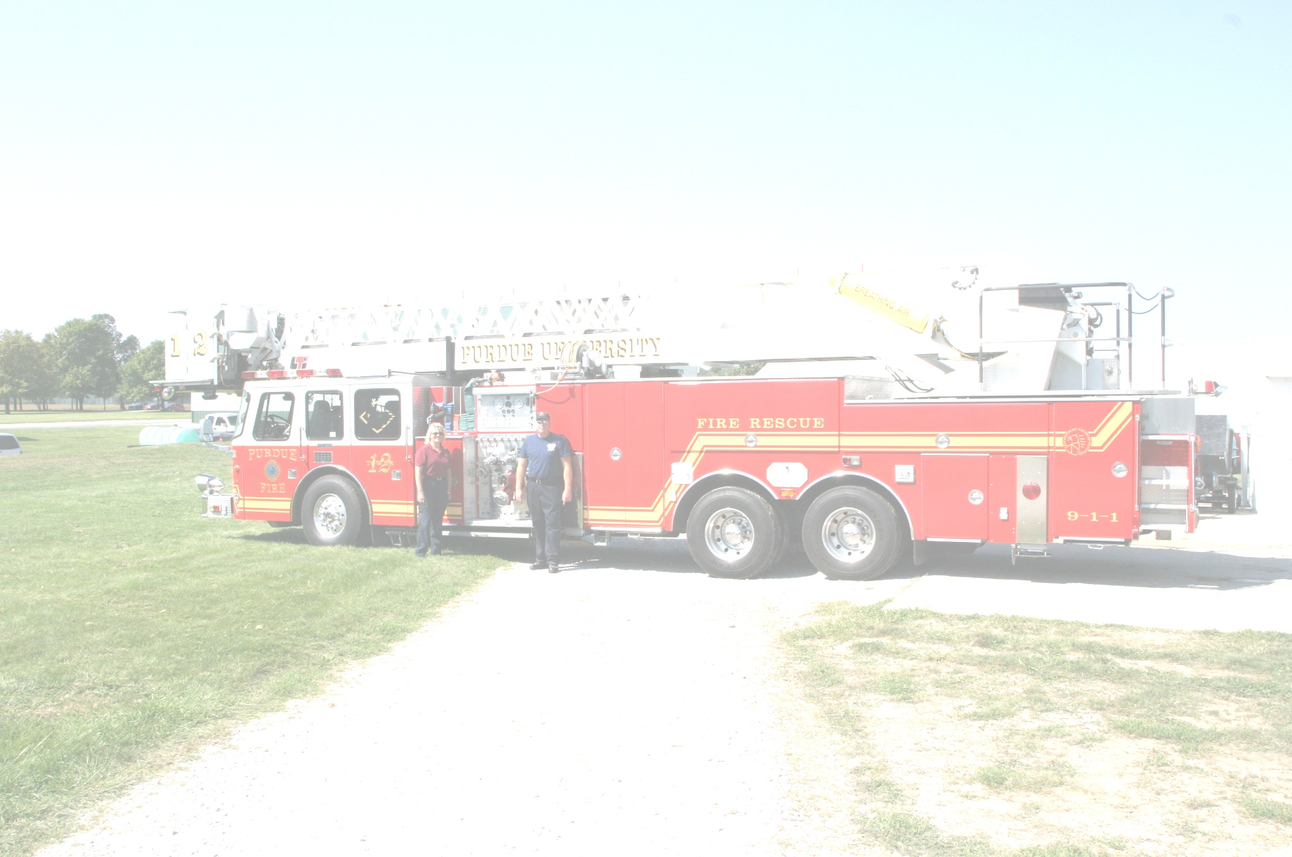
Paid and Volunteer Response - Summary
Both volunteer and paid responders should comply with OSHA standards where applicable, regardless of OSHA jurisdiction
Volunteer responders to exempt facilities should still follow all applicable OSHA confined space rules
Volunteer emergency first responders may not be considered public sector employees under OSHA provisions
Paid responders to non-exempt facilities may not be covered by OSHA Confined Space Rules, but should comply
Provisions are provided in the regulations for a timely response
Responding agencies should develop an SOP for responses
Notes:
Instructor Notes:
Both volunteer and paid responders should comply with applicable OSHA standards whether responding to an exempt or non-exempt location. This does not mean that they are required to stand down and wait, especially if a victim’s life is at stake. There is flexibility in the law to allow for on-site incident commanders to carryout rescue strategies that may not be specifically covered.
Volunteer emergency first responders are considered in some states, such as Indiana, as public sector employers (IN Code “36-8-12-2”). Therefore, they are covered by the provisions of relevant OSHA standards. Contact the OSHA office in your state to determine the status of OSHA compliance for first responders.
The OSHA standards provide provisions to allow for a “timely response” if certain safeguards are put in place. In many rural locations, it may take an hour or more for a tactical rescue team to arrive and set up. Incident Commanders may choose other alternative mitigating actions prior to the arrival of the team. These actions should be consistent with the agencies Standard Operating Procedures.
Every rural or urban first responder agency that covers grain storage handling and processing operations should develop internal standard operating procedures (SOP) for responding to these facilities. These procedures will vary by agency based upon the resources available and level of training of personnel.
This issue will be addressed further in the unit on rescue strategies.

Slide 25
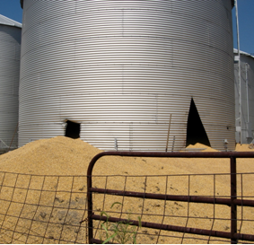
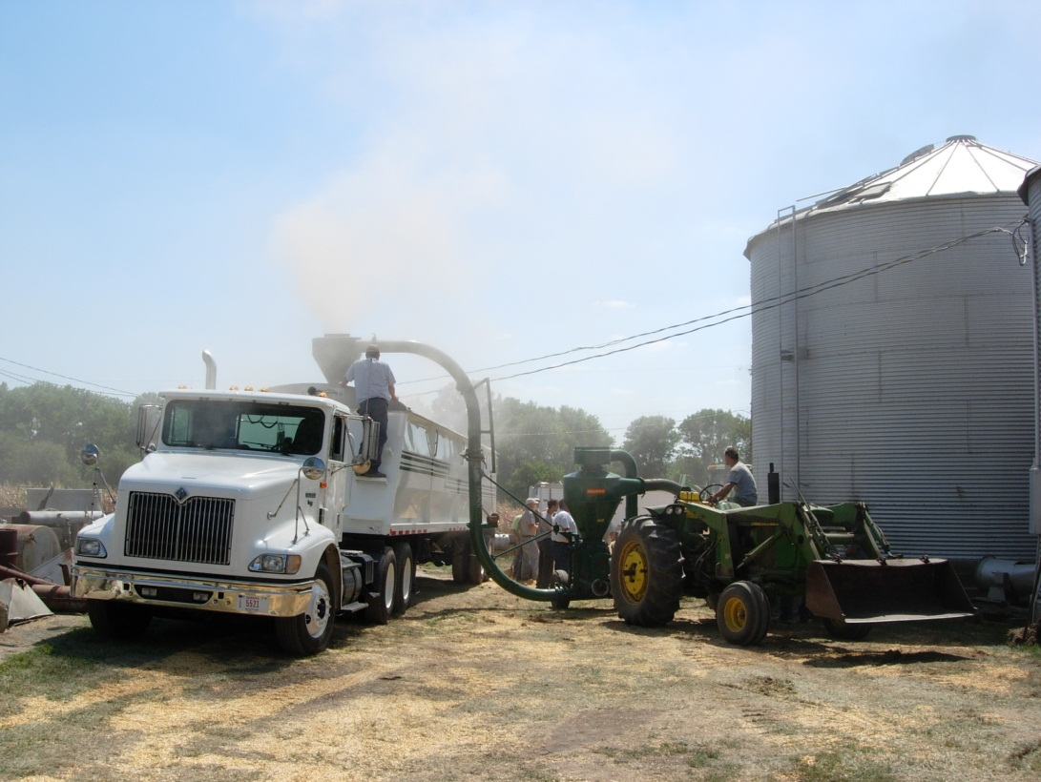
Case Study
Addressing conflict over rescue strategies
Notes:
Instructor Notes:
In this case a farmer was completely engulfed in a 25,000 bushel bin of corn. He had been missing for over an hour before family members concluded that he was in the bin. The first responders to the scene were the local volunteer fire department comprised of several farmers and an employee of a local commercial grain operation. They began immediately cutting open the bin to release the grain while a call was issued for a tactical rescue team. When the tactical team arrived on the scene there arose an immediate conflict on the appropriate procedure for retrieving the victim. The conflict was serious enough that local law enforcement had to become involved. Key issues dealt with cutting open the structure and accessing the bin. The tactical team ended up leaving the scene. The victim was eventually extricated but had died due to suffocation.
Questions for participants:
Who was in charge at the scene? (The Incident Commander)
Were all parties required to comply with the provisions for accessing a “Permit Required Confined Space”? (No, it is grain storage space.)
Do the OSHA standards apply to rescues conducted by a professional confined space rescue team? (Generally, yes)
How could pre-planning between the responding emergency management agencies have reduced the potential for conflict? (Having in place mutual aid agreements between responding agencies can significantly reduce conflicts over jurisdiction and response protocols.) Under the National Incident Management System (NIMS) the Incident Commander can determine the strategy that will be followed.
This issue will be addressed further in the unit on rescue strategies.

Slide 26
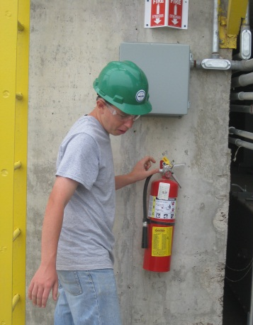
Preventing Emergencies in Confined Spaces in Agriculture
Every worker deserves a safe and healthy workplace and the opportunity to go home at the end of the day.
The priority at grain storage and handling facilities should be on preventing situations that require an emergency response.
Emergency first responders should not be expected to “fix” a problem that should have been prevented.
Notes:
Instructor Notes:
First, take time to let these points sink in. Every worker, including each first responder at the scene of an emergency, deserves the right to return home safe and healthy.
Second, participants need to recognize that the priority at grain storage and handling facilities should not be emergency management and preparedness, but rather prevention of workplace fatalities, injuries, and work-related diseases.
The closing slides of this unit will be used to briefly review work practices that should reduce the risk of agricultural confined space-related incidents. These practices are relevant to both the employee at the site and to any first responder responding to an emergency at the site.

Slide 27
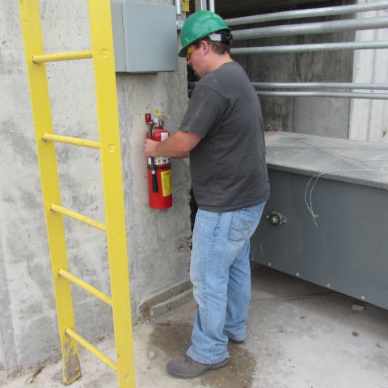
Workplace Safety
Develop a culture of safety and health
  It starts at the top
  Involves everyone
  Is clearly communicated
Identify hazards/threats
  Conduct assessments
  Encourage reporting of hazards
  Train workers to identify hazards
Remove or isolate hazards
  Guards, railings
Use appropriate personal protective equipment
Notes:
Instructor Notes:
The Instructor Guide includes several general safety publications that target agricultural confined spaces with a special emphasis on grain storage and handling. Feel free to duplicate these publications for distribution or to direct participants to www.grainsafety.us for access. There is included as Attachment 16 an extensive list of supplemental resources relating to all aspects of grain storage and handling safety, and emergency response.

Slide 28
Worker Rights
Workers are entitled to working conditions that do not pose a risk of serious harm. To help assure a safe and healthful workplace, OSHA also provides workers with the right to:
Ask OSHA to inspect their workplace;
Use their rights under the law without retaliation and discrimination;
Receive information and training about hazards, methods to prevent harm, and the OSHA standards that apply to their workplace. The training must be in a language you can understand;
Get copies of test results done to find hazards in the workplace;
Review records of work-related injuries and illnesses;
Get copies of their medical records;
For more information, visit the OSHA.gov website.
Notes:
Instructor Notes:
All employees have the right to:
Ask OSHA to inspect their workplace;
Use their rights under the law without retaliation and discrimination;
Receive information and training about hazards, methods to prevent harm, and the OSHA standards that apply to their workplace. The training must be in a language you can understand;
Get copies of test results done to find hazards in the workplace;
Review records of work-related injuries and illnesses;
Get copies of their medical records.
Often employees are unfamiliar with their workplace rights. Participants should be encouraged to become more familiar with them by visiting the OSHA website at www.OSHA.gov.
As noted earlier, even first responders have rights and should not be required to perform activities for which they are not trained or adequately equipped.

Slide 29
Complaint Filing Options
You have these options to file your safety and health complaint:
Online - Go to the Online Complaint Form at www.OSHA.gov
Download and Fax/Mail - Download the OSHA compliant form* [En Espanol*]
Telephone - your local OSHA Regional or Area Office. OSHA staff can discuss your complaint and respond to any questions you have. If there is an emergency or the hazard is immediately life-threatening, call your local OSHA Regional or Area Office or 1-800-321-OSHA.
Notes:
Instructor Notes:
Inform participants that they have the following options to file a complaint with OSHA.
Online - Go to the Online Complaint Form Written complaints that are signed by workers or their representative and submitted to an OSHA Area or Regional office are more likely to result in onsite OSHA inspections. Complaints received on line from workers in OSHA-approved state plan states will be forwarded to the appropriate state plan for response.
Download and Fax/Mail - Download the OSHA complaint form* [En Espanol*] (or request a copy from your local OSHA Regional or Area Office), complete it and then fax or mail it back to your local OSHA Regional or Area Office. Written complaints that are signed by a worker or representative and submitted to the closest OSHA Area Office are more likely to result in onsite OSHA inspections. Please include your name, address and telephone number so we can contact you to follow up. This information is confidential.
Telephone - your local OSHA Regional or Area Office. OSHA staff can discuss your complaint and respond to any questions you have. If there is an emergency or the hazard is immediately life-threatening, call your local OSHA Regional or Area Office or 1-800-321-OSHA.

Slide 30

Notes:
Instructor Notes:
Answer any questions anyone has from this unit before moving on

