Slide 1
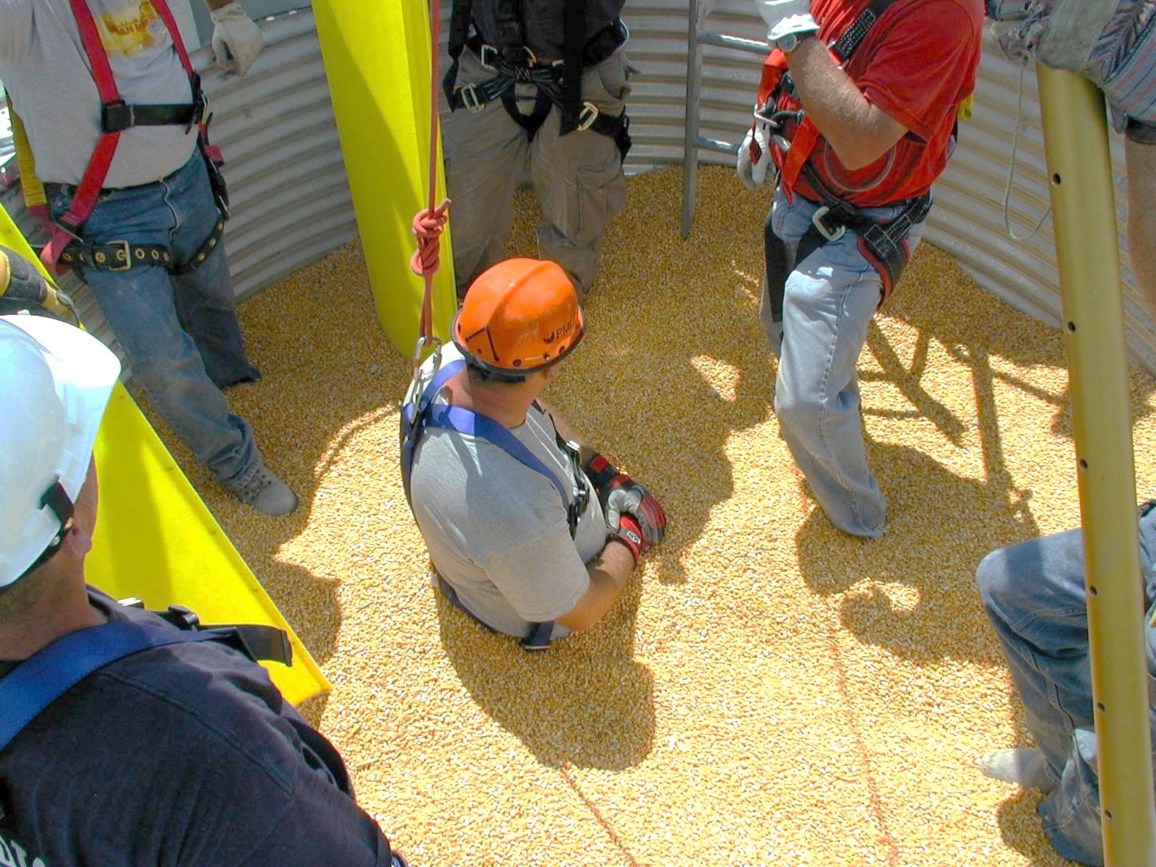
Basic First Responder Training
For Incidents Involving
Grain Storage and Handling Facilities
Introduction – Pre-Testing –
Training Overview
Developed by:
  Purdue University
  Agricultural Safety and Health Program
  Department of Agricultural and Biological Engineering
  West Lafayette, IN
This material was produced under grant number SH23575SH2 from the Occupational Safety and Health Administration, U.S. Department of Labor. It does not necessarily reflect the views or policies of the U.S. Department of Labor, nor does mention of trade names, commercial products, or organizations imply endorsements by the U.S. Government.
Notes:
Instructor Notes:
Please acknowledge that financial support for developing the contents of this training curriculum came through a Susan Harwood Grant awarded to Purdue University by the U.S. Department of Labor. As discussed in the Instructor’s Guide, feel free to add to or modify the visuals in order to update the content or incorporate local or regional information that would enhance the relevance of the contents to participants. Please note, under the provisions of the grant, this material can only be used for non-profit purposes.
You may wish to distribute any handout material to participants as they register. Encourage them to review the material as they wait for the training to begin.

Slide 2
Training Agenda - Overview of the Day
8:00 – 8:30 |  | Registration and Independent Review of Course Material
8:30 – 9:00 |  | Introductions, Pre-Test, and Training Overview
9:00 – 9:45 |  | Unit 1: Confined Spaces in Agriculture
9:45 – 10:15 |  | Unit 2: Summary of Emergencies at Grain Storage and Handling Facilities
10:15 – 10:30 |  | Break
10:30-11:15 |  | Unit 3: Preplanning/Training/Rescue Equipment
11:15 – 12:00 |  | Unit 4: Emergency Response Strategies
12:00 – 12:45 |  | Lunch (Grain Safety Video Presentation)
12:45 - 1:00 |  | Unit 5: Overview of Demonstrations and Hands-on Activities
1:00 – 4:00 |  | Demonstrations and Hands-on Exercises
2:00 – 2:30 |  | Break
4:00 – 4:45 |  | Q&A and Post-test
4:45 – 5:00 |  | Evaluation and Closing Comments
Notes:
Instructor Notes:
Briefly review the agenda for the day. Point out that participants must attend the full day (7 hours) of training to receive certification of completion.
If, at all possible, encourage participants to turn off cell phones and pagers. If that is not possible, have them switch to an inaudible setting.
Encourage participants to ask questions freely and that there is scheduled a question and answer time at the end of the day.
Encourage those with more hands-on experience to briefly share their experiences related to grain storage and handling facilities, and emergencies they have been involved with.
The schedule is based on conducting over 60 previous classes. It is doable to get through all of the material if the instructor stays on task and monitors the time. It becomes very easy to get behind if participants are given too much time to share first hand experiences or too much time is spent on case studies. As always, in an instructional setting a balance needs to be achieved between meeting objectives and encouraging participation.
If the training is conducted at a site without a grain handling or storage facility to tour, the 30 minute time allocated for the tour can be distributed to the three workstations.

Slide 3
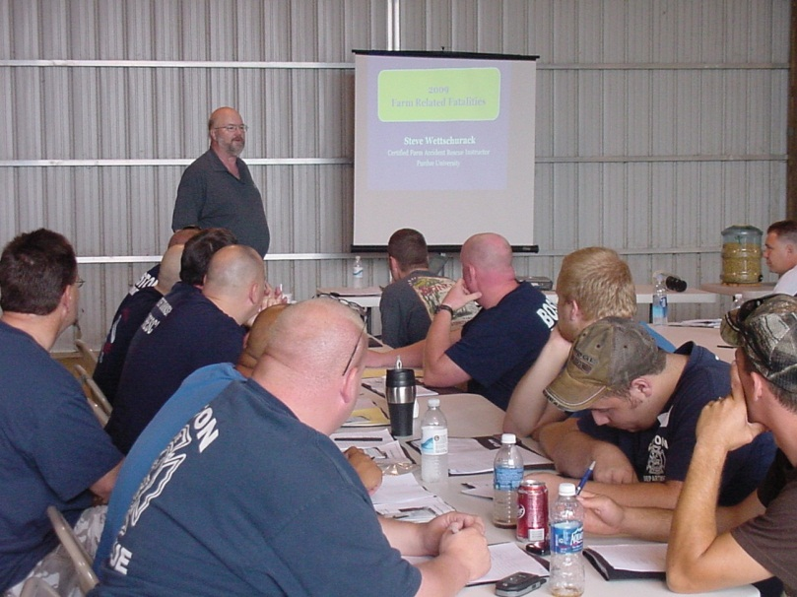
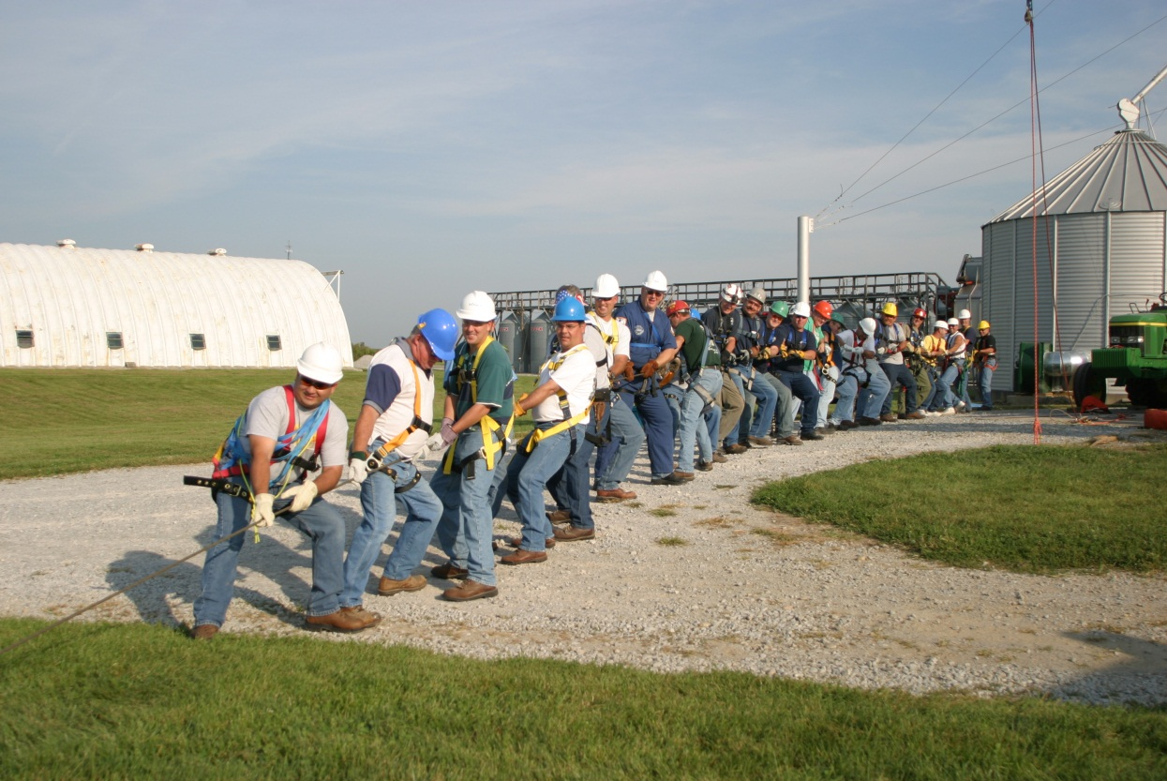
Introductions
Notes:
Instructor Notes:
Provide a brief introduction of yourself and why you are qualified to provide a basic awareness course on responding to emergencies at grain storage and handling facilities. Provide each participant no more than 30 seconds to give their name and who they represent (i.e. fire department, commercial grain operation, EMS). Remember, this section is limited to 30 minutes and you don’t have time to allow anyone to utilize too much time. There will be time later in the training to share personal experiences.
Also, ask if anyone has actually been involved in an emergency situation at a grain or feed storage or handling facility. If so, consider reserving time for him or her to share their experience during the day, preferably during the hands-on activities.
If there are any sponsors for the training, this would be a good time to acknowledge their support.
If appropriate, point out where the emergency exits and restroom facilities are located.

Slide 4

Pre-Testing
The purpose of pre-testing is to aid in assessing learning outcomes, or in other words “What did you learn today?” It also helps identify gaps that may need more attention in future training.
Complete the written pre-test to the best of your ability by circling what you believe is the most correct answer. If you don’t know the correct answer, don’t
guess. There’s nothing wrong with not
knowing the answers – that’s why you
are attending this training.
Notes:
Instructors Notes:
Previously validated pre- and post-tests are included in the Instructor Guide and can be duplicated as needed. The key is also included.
Encourage each participant to complete the written pre-test to the best of their ability without guessing. Each question provides an option for answering “unsure”. It is not a weakness to admit that you don’t have all the answers.
If you want to compare pre- and post-test for knowledge gain, number each pre-test 1 through the total number of participants. Have each participant jot down the number on their test and add it to the post-test taken at the end of the training. Or have each participant put their phone number on the top of each test and match them later using their phone numbers.
Some participants are extremely uncomfortable taking a written exam. The purpose of this test is not to embarrass anyone. Again, encourage each participant to try their best.
As the instructor you may wish to require completion of a written test in order for the participant to receive certification of completion. This is your call since there is no administrative agency that oversees training of this type. The training is also voluntary and requiring completion of a test, unless determined to be essential a certification of completion, may be difficult to enforce.
Also, don’t be surprised to have several participants show up with nothing to write with or to write on. Having a box of pencils available will make completion of the pre-testing more efficient.

Slide 5
Training Overview
Goal of Training:
The goal of the Basic First Responder Training is to provide basic awareness-level training needed by emergency first responders to enhance their ability to safely and effectively respond to entrapments, engulfments, asphyxiations, entanglements, falls, and electrocutions involving operations that transport, store, or process free flowing agricultural products such as grain, feed, or grain by products.
Notes:
Instructor Notes:
Review the primary goal of the training. Focus on the fact that it is designed as a BASIC awareness class with limited exposure to operational or tactical response protocols. For example, you will not be covering high angle rescue strategies or accessing confined spaces with known toxic atmospheres. This type of training is available elsewhere and is far more extensive.
This is the first opportunity to stress that the safety of first responders at the scene is of utmost importance. No first responder should become a secondary victim at the site of a grain storage and handling emergency. Every first responder has the right to return from an emergency the same way they went.
Point out that all the Power Points presented during the training are available for later review at www.grainsafety.com.

Slide 6
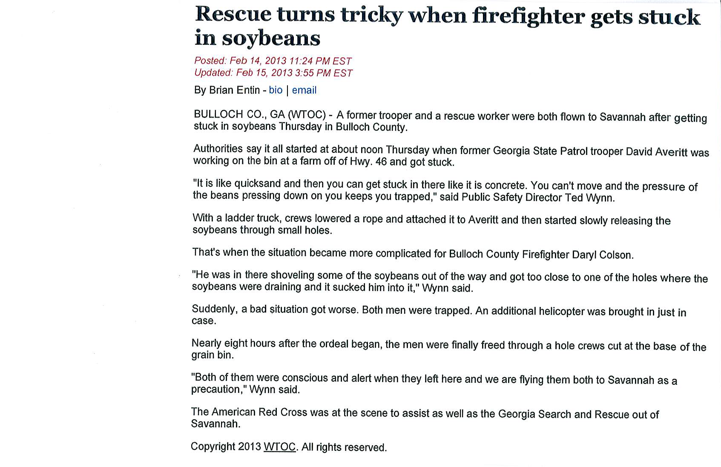
Case Study
Notes:
Instructor Notes:
Every worker in America has the right to return home at the end of the day safe and healthy.
Every emergency first responder has the same right.
In this entrapment case in Georgia an untrained first responder became a secondary victim who had to be extricated along with the initial victim.
It is one of the primary goals of this training to prevent this type of incident.

Slide 7
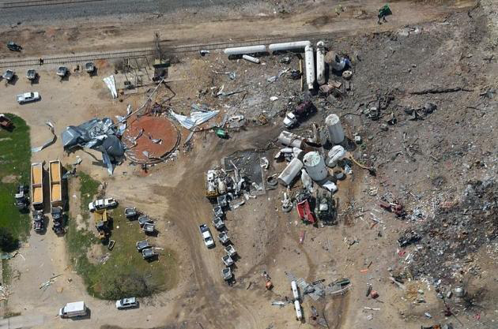
What Went Wrong?
Notes:
Instructor Notes:
Though different agents were involved, reference to the explosion at the fertilizer facility in West, Texas in which 12 first responders lost their lives, may prove a useful tool to reinforce the potential risks involved in responding to a large, complex agricultural facility.

Slide 8
Training Application
The training is intended to address incidents that occur at facilities that are required to be in compliance with relevant OSHA workplace safety and health standards such as 1910.272 (Grain Handling Facilities) and 1910.146 (Confined Space Entry), as well as currently OSHA exempt farm, feedlot, and certain seed processing operations that utilize grain and feed storage and handling facilities.
Notes:
Instructor Notes:
Considerable attention is given to the status of grain storage and handling facilities in the federal regulatory language that governs safety and health work practices. In some cases, such as grain storage and handling facilities located on farms, feedlots, and certain seed processing operations, the current Federal and State OSHA regulations may not apply. This is true even though the majority of incidents historically have occurred at these facilities. For additional insight into the exempt versus non-exempt issues see Attachment 21 that addresses OSHA interpretations regarding exempt agricultural operations.
This training does not distinguish between exempt and non-exempt facilities. It is designed to provide training to first responders at any site that transports, stores, or processes free flowing agricultural materials, including grain and feed.
Do not assume that participating first responders are familiar with the relevant OSHA Standards such as 1910.272 or 1910.146. Most are not. Copies of these standards are included in the Instructor Guide as Attachments 1 and 2. You may wish to review them prior to the class or direct participants to them at www.grainsafety.com or the official OSHA website (www.osha.gov).

Slide 9
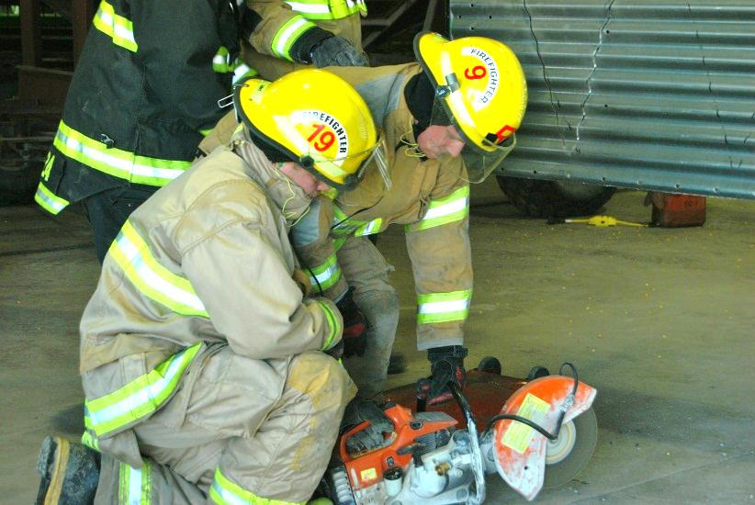
Primary Target Audience
The training is designed for those who have the greatest probability of being first responders to an entrapment, engulfment, entanglement, asphyxiation, fall, or electrocution at a grain or feed storage, handling, or processing facility. This includes:
Managers and employees of commercial grain storage, handling, or processing facilities
Owners and employees of currently exempt grain storage and handling facilities (farms, feedlots, and certain seed processors)
Fire/rescue personnel
Emergency medical personnel
Law enforcement personnel
Tactical rescue team members
Notes:
Instructor Notes:
Review who the course is designed for. Point out that in many rural communities the first responders to a grain-related incident will be volunteers, many of whom may not have much experience or knowledge related to grain storage, handling, or processing facilities. In the past, most rescues and rescue attempts were conducted by a diverse group of volunteer and paid first responders and rarely involved highly trained tactical rescue teams.
Again, the focus is basic awareness and the goal is to conduct a safe and successful response without causing additional victims at the scene.
As an instructor, anticipate a wide range of skill sets and experiences in the class. Some of the participants will ask questions that are incredibly basic, while others will push you for a deeper understanding of the issues.
Once again, the goal is to raise the basic awareness level across the board in order to reduce the risk of injury for all first responders. Spend more time responding to the easy questions and encourage those with more experience and training to be mentors to the others, especially during breaks and over lunch.
Remind participants that most states provide complimentary training that would enhance first responder capabilities. This includes ropes and high angle rescue, confined space rescue and monitoring of toxic environments.

Slide 10
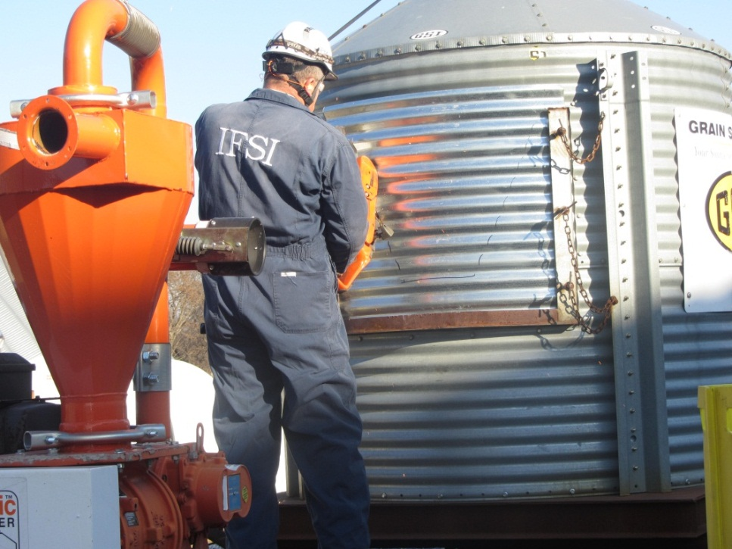
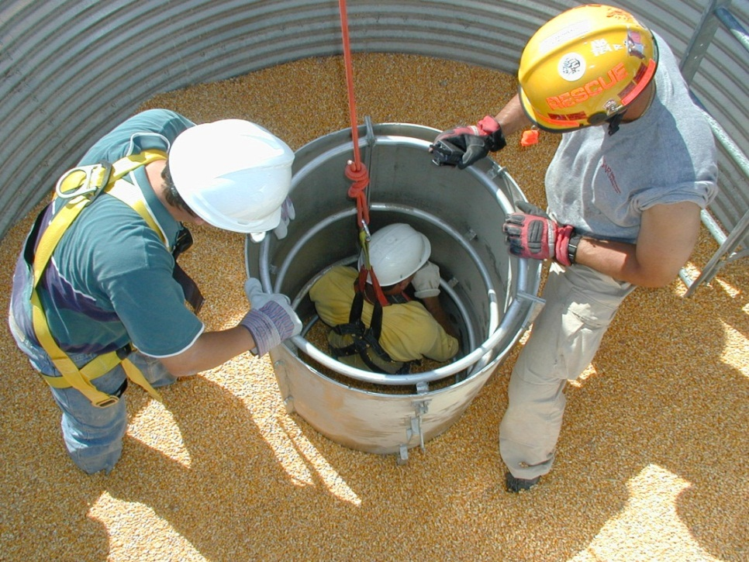
Minimum Core Competencies
The handout provided lists the minimum core competencies that you are expected to demonstrate at the completion of this training.
Notes:
Instructor Notes:
Distribute a copy of the Minimum Core Competencies handout provided with the Instructor’s Guide as Attachment 6. Duplicate copies for every participant. Time does not permit you to review each one, but encourage participants to review them and identify those competencies that they need to give special attention to during the training.
The pre- and post-tests are designed to measure, as much as possible, success in achieving the minimum core competencies.
The core competencies were developed by seeking input from a panel of subject matter experts, a review of current training resources and pilot testing of the curriculum content with over 475 emergency first responders. There is no question that this list could be much longer, or more comprehensive. The list was the result of prioritizing a longer list and the limitations of what can be appropriately fit into an seven hour training. Again, the goal is basic awareness, therefore many of the more advanced skills that may be needed are not included.
Point out that additional competencies can be acquired by attendance at other related training events.

Slide 11
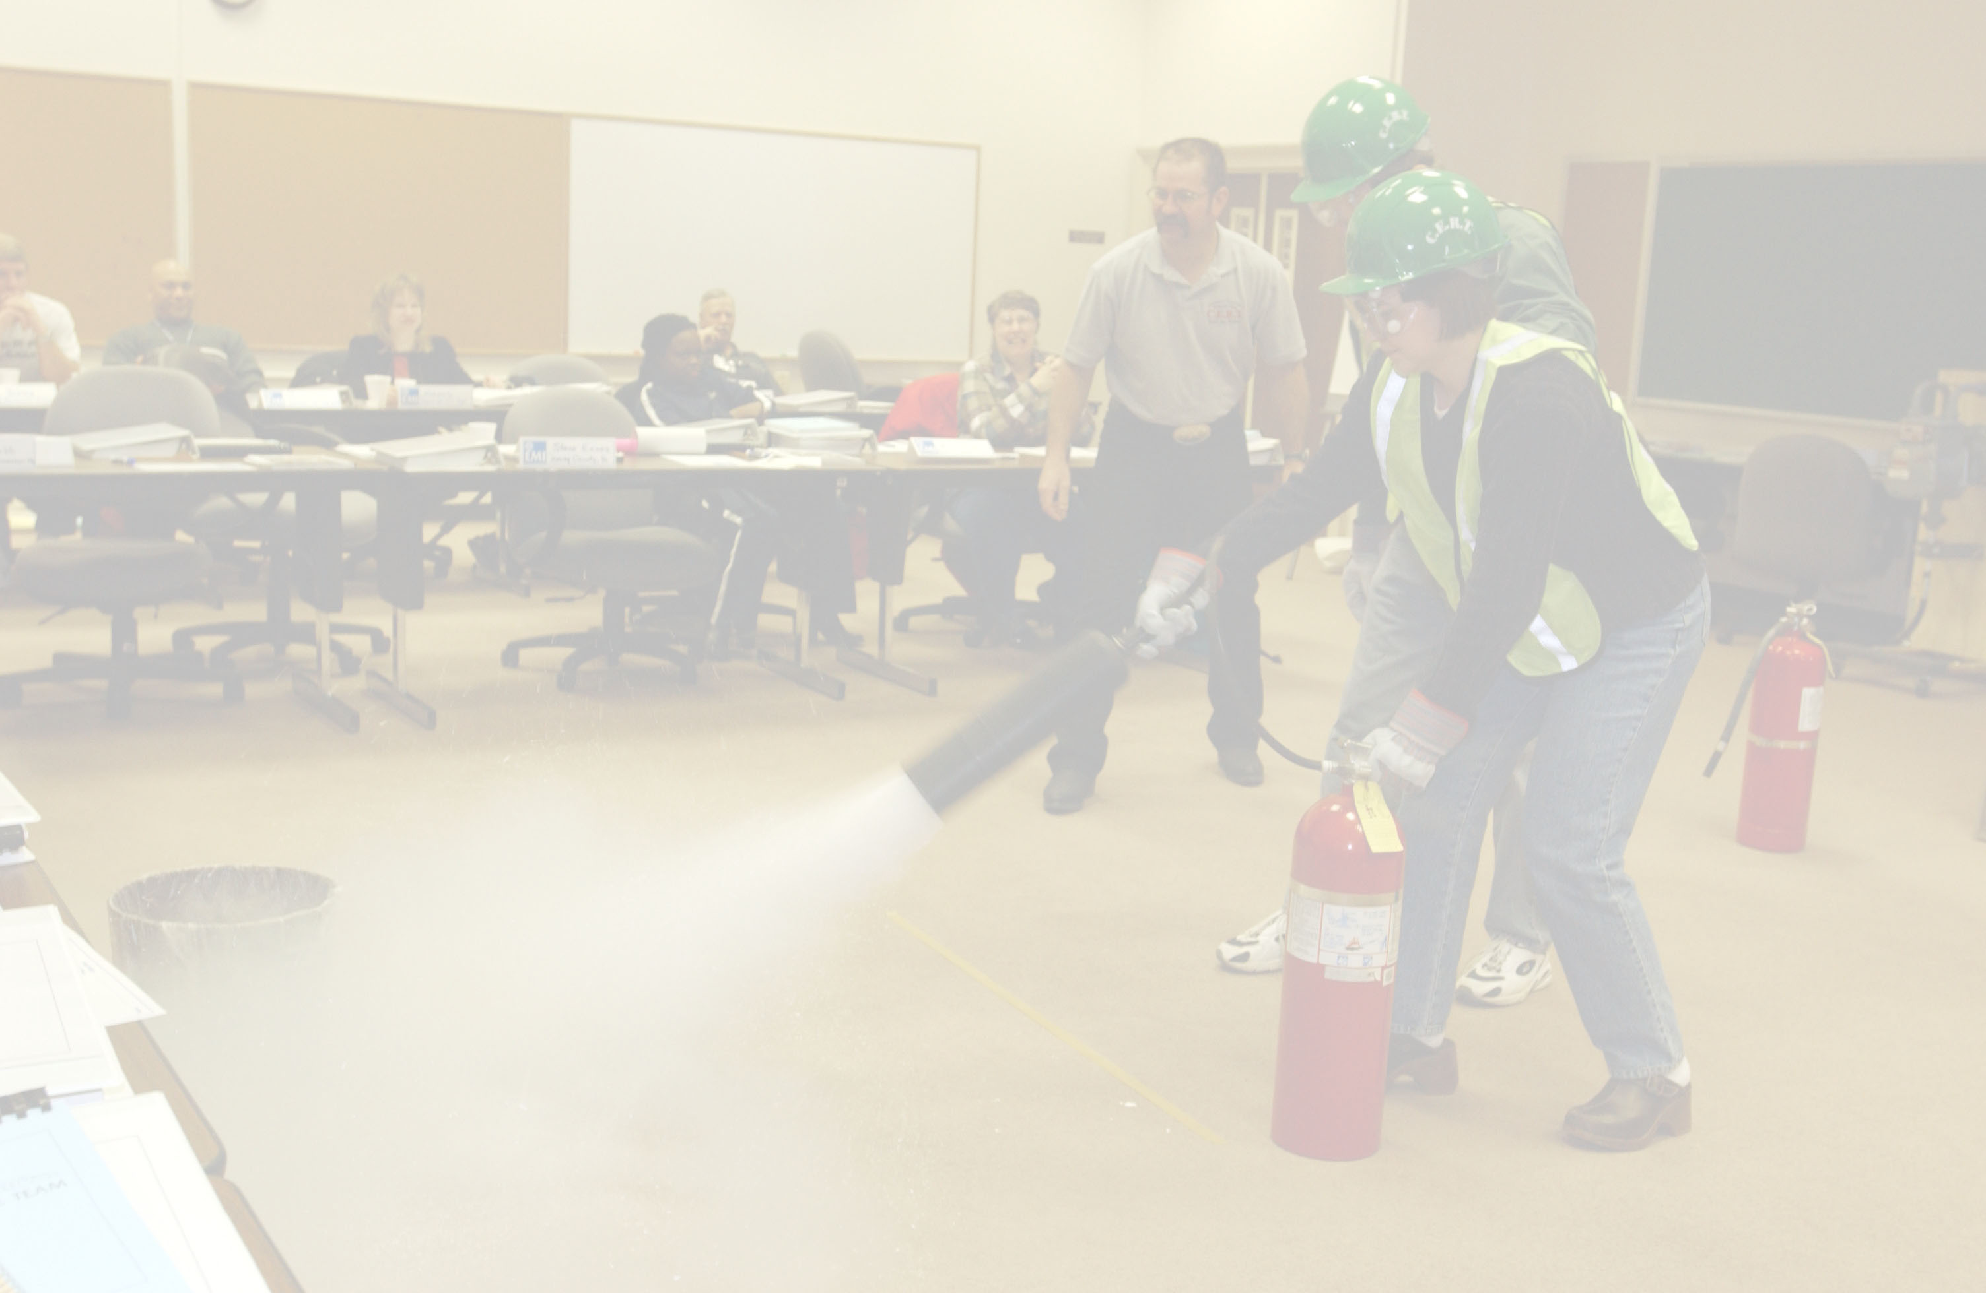
Training Overview
Anticipated Outcomes:
Reduction in the frequency and severity of injuries to emergency first responders
Increase in the probability of successful rescues
Increased participant awareness of general hazards in the grain industry
Increased community awareness concerning hazards in the grain industry
Enhanced first response capabilities at non-exempt grain storage and handling facilities
Notes:
Instructor Notes:
Briefly review the listed anticipated outcomes of the training. They can be expanded as follows:
There will be a reduction in the frequency and severity of injuries to emergency first responders responding to incidents at grain and feed storage and handling facilities.
The probability of successful rescues will increase due to the use of proven rescue strategies that will cut response time and reduce the potential of secondary injury to the victim.
Individuals participating in the training will become more aware of the general hazards associated with the transport, storage, and handling of grain, feed, and other free-flowing agricultural material.
There will be increased community awareness concerning the hazards associated with grain or feed storage, handling, and processing.
Currently non-exempt facilities (commercial elevators) will enhance their first response capabilities by having employees participate in the training.

Slide 12
Training Overview Continued
Anticipated Outcomes:
Increased awareness of general hazards by owner/operators of exempt facilities
Increased access to appropriate grain rescue equipment.
Increased number of mutual aid agreements for complex incidents
Increased emphasis on emergency pre-planning
Increased compliance with relevant current safety and health standards
Notes:
Instructor Notes:
Continue the review of the listed anticipated outcomes of the training. They can be expanded as follows:
Currently exempt farms, certain seed processors, and feedlots will become more aware of the hazards associated with grain and feed transport, storage, and handling facilities and take steps to reduce the risk for entrapment, engulfment, entanglement, asphyxiations, falls, or electrocutions.
Access to appropriate rescue equipment, such as life lines, harnesses, and grain rescue tubes will increase, especially in rural communities where the exposure to entrapment and engulfment hazards is greatest.
There will be more local and regional mutual aid agreements put in place between emergency services. These will be used to improve the effectiveness of emergency first responders responding to entrapments, engulfments, entanglements, asphyxiations, falls, and electrocutions at grain storage and handling facilities.
Emergency preplanning will receive greater attention through enhanced collaboration between owners of grain storage and handling operations and local first response agencies.
There will be better understanding of and compliance with current OSHA safety and health workplace standards, including the provisions of the Grain handling and Permit-required Confined Spaces standards.

Slide 13
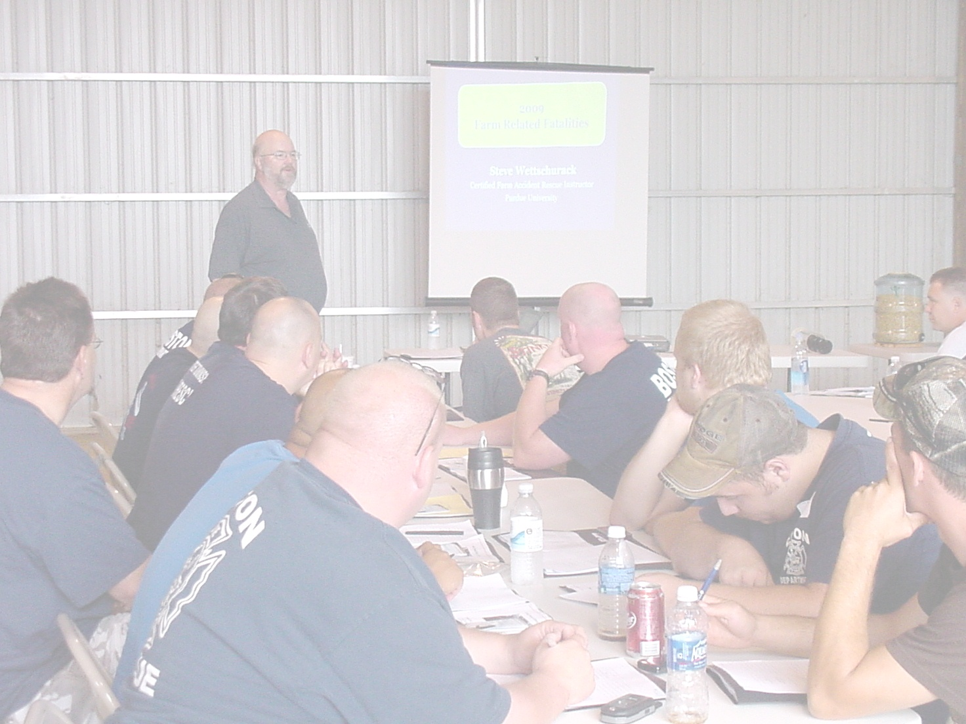
Training Limitations
The key word is BASIC
Each first responder arrives at the training with a different set of skills and experiences, strengths and weaknesses
No seven hour class can fully prepare any first responder for all the complexities involved with incidents such as a grain entrapment
It is unrealistic to expect emergency first responders to “fix” a problem that should have been prevented
Notes:
Instructor Notes:
Remind participants that this training intentionally does not include many topics often associated with grain rescue such as high angle rescue, ropes, victim packaging, and monitoring or accessing toxic environments. The training is designed at the BASIC awareness level. No seven hour class is capable of addressing all of the potential hazards and issues that may arise during a response to a relatively rare emergency involving grain storage and handling facilities, especially where a victim requires extrication. The greatest number of these incidents that have ever been documented in a single year in the U.S. was 59 in 2010, and over half of those were body recoveries. The probability of any participant in the training ever responding to an emergency situation at a grain storage or handling facility is relatively low.
Participants should be encouraged to pursue additional training that will expand their skill sets to include the other rescue strategies that could be used during an emergency at a grain storage and handling facility, or has application to similar incidents.
Point out that every entrapment, engulfment, entanglement, asphyxiation, fall, or electrocution was preventable. It is not the job of the first responder to fix what could have been prevented through compliance with safe work practices, training, and use of appropriate technology. Once something bad has happened, the first responder is there to lessen the damages and to prevent secondary injuries. Someone else's mistake should not require a first responder to be placed in a position where there is a high probability of him or her becoming another victim.

Slide 14

Have a Great Day!
Participate
Ask questions
Share your experiences
Encourage others
Be safe
Notes:
Instructor Notes:
This final slide of this section is intended to give the participants a clear charge for the day.
Encourage everyone to be completely free to ask questions. There is no such thing as a “dumb” question in emergency management training.
Point out that not everyone, who would like, is able to attend a class of this type. Participants need to be encouraged to take home what they learn at the training and share it with others.
Remind everyone that there may be risks involved with some of the planned activities. Everyone needs to be alert and be mindful of others.

