Slide 1
Preparing for Emergencies at Home
Mathias Ingle
Agriculture and Natural Resources
Extension Educator Howard County

Slide 2
Major Weather Emergencies in Indiana
Thunderstorms
Tornadoes
Winter Storms/Extreme Cold
Extreme Heat
Floods

Slide 3
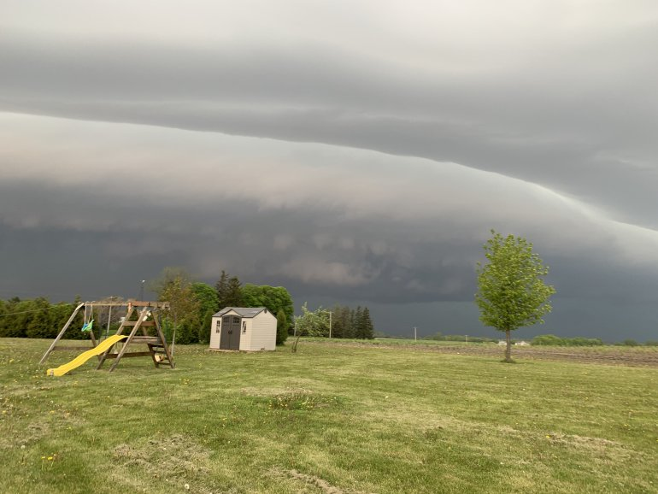
Thunderstorms

Slide 4
Thunderstorms
All thunderstorms are dangerous. Every thunderstorm produces lightning. In the United States, an average of 300 people are injured and 80 people are killed each year by lightning. Although most lightning victims survive, people struck by lightning often report a variety of long-term, debilitating symptoms.
Most lightning victims are not struck during the worst of a thunderstorm but rather before or after the storm reaches its greatest intensity. This is because many people are unaware that lightning can strike as far as 25 miles away from its parent thunderstorm, much farther out from the area of rainfall within the storm!
Other associated dangers of thunderstorms include tornadoes, strong winds, hail, and flash flooding. Flash flooding is responsible for more fatalities—more than 140 annually—than any other thunderstorm-associated hazard.

Slide 5
Thunderstorms – Key Terms
Severe Thunderstorm Watch - Thunderstorms are likely to occur. Remain alert for approaching storms. Watch the sky and stay tuned to NOAA Weather Radio, commercial radio, or television for information
Severe Thunder Storm Warning – A thunderstorm has been reported by spotters or indicated by radar. Warnings indicate imminent danger to life and property to those in the path of the storm.

Slide 6
Before a Thunderstorm
If you hear thunder or see lightening get inside of a home, building, or hard top automobile.
Close the windows of your home
Unplug appliances and other electrical items such as computers. Power surges from lightening can cause serious damage

Slide 7
During a Thunderstorm
If you are:
Then you should:
In a forest
In an open area
Seek shelter in a low area under a thick growth of small trees.
Go to a low place such as a ravine or valley. Be alert for flash floods.

Slide 8
During a Thunderstorm contd.
If you are:
Then you should:
On open water
Anywhere you feel your hair stand on end (which indicates that lightening is about to strike)
Get to land and find shelter immediately.
Squat low to the ground on the balls of your feet. Place your hand over your ears and your head between your knees. Make yourself the smallest target possible to minimize your contact with the ground. DO NOT lie flat on the ground.

Slide 9
Following a Thunderstorm
Check for injuries. Call 911 if someone is severely injured or in need of medical help.
If you are trapped, cover your mouth with a cloth or mask to avoid breathing dust. Try to get help by calling someone, texting, bang on pipe or wall, whistle, or shout.
Be aware of exhaustion. Don’t try to do too much at once.
Drink plenty of water
Eat well
Wear proper clothing (long pants, long sleeve shirts, work boots, gloves)
Wash hands thoroughly with soap and clean water often when working in debris.

Slide 10
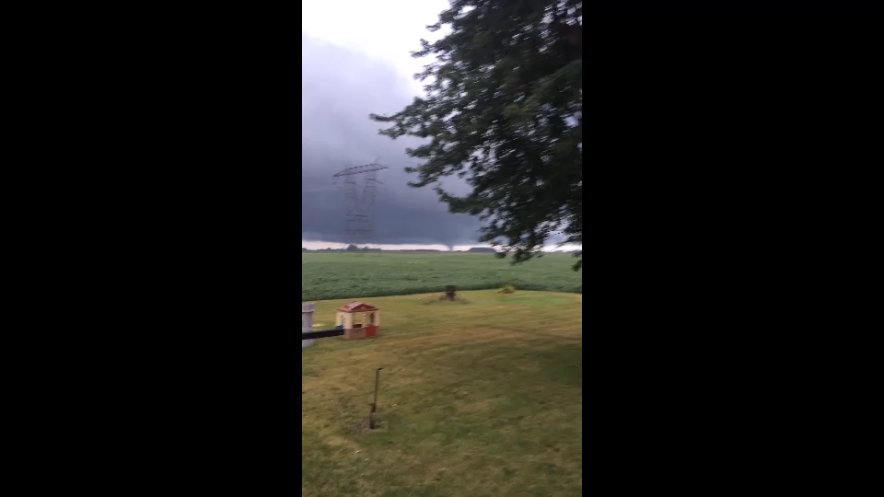
Tornadoes
Video by R.M. Ingle

Slide 11
Tornadoes
Tornadoes are one of nature’s most violent storms. Spawned from powerful thunderstorms, tornadoes can cause fatalities and devastate a neighborhood in seconds.
A tornado appears as a rotating, funnel-shaped cloud that extends from a thunderstorm to the ground with whirling winds that can reach 300mph. Damage can be in excess of one mile wide and 50 miles long. Every state is at risk from this hazard.
Some tornadoes are clearly visible, while rain or nearby low-hanging clouds obscure others. Occasionally tornadoes develop so rapidly that little, if any, advance warning is possible.
Tornadoes usually occur on near the trailing edge of a thunderstorm. It is not uncommon to see clear, sunlit skies behind a tornado.

Slide 12
Tornado - Key Terms
Tornado Watch – Tornadoes are possible. Remain alert for approaching storms. Watch the sky and stay tuned to NOAA Weather Radio, commercial radio, or television for information.
Tornado Warning – A tornado has been sighted or indicated by weather radar. Take shelter immediately.
* A tornado can occur with no watch or warning in place.

Slide 13
Before a Tornado
Be alert to changing weather conditions.
Listen to NOAA Weather radio or to commercial radio or television newscasts for the latest information.
Look for approaching storms.
Look for following signs of danger:
  Dark, often greenish sky
  Large hail
  A large dark, low-lying cloud (particularly if rotating) – loud roar, similar to a freight train.
If you see approaching storms or any of the danger signs, be prepared to take shelter immediately.

Slide 14
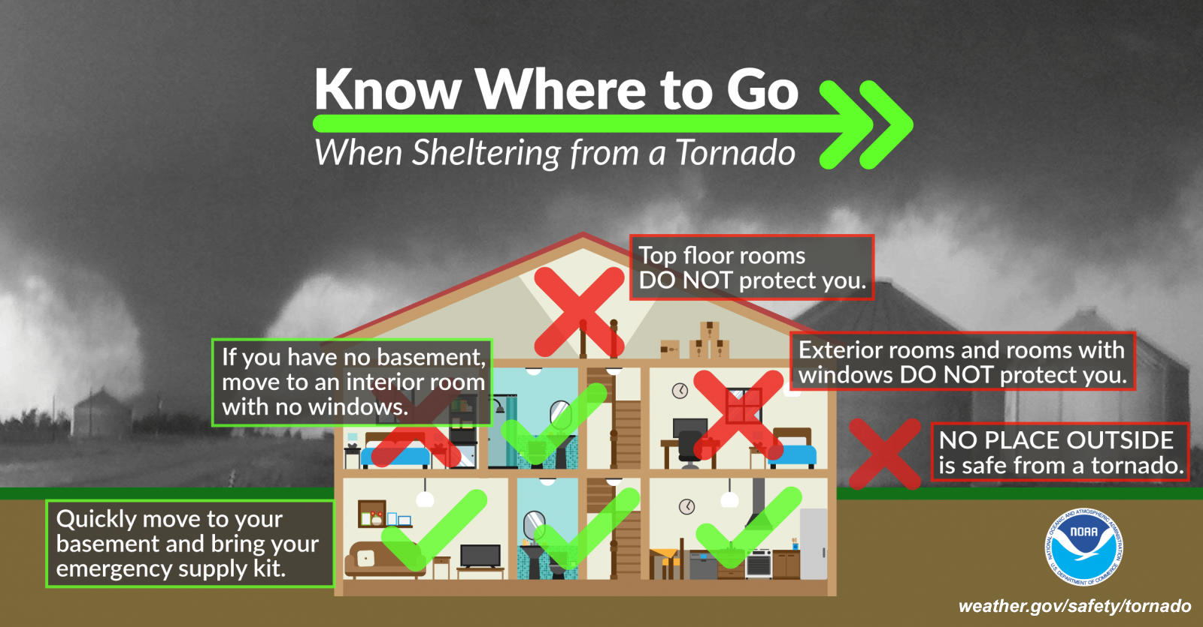
During a Tornado
If you are in:
Then:
A structure (home, small building, commercial building, barn)
Go to a pre-designated shelter such as a safe room, basement, storm cellar, or the lowest building level. If there is no basement, go to the center of an interior room on the lowest level (closet, interior hallway) away from corners, windows, doors, and outside walls. Put as many walls as possible between you and the outside. Get under a turdy table and use your arms to protect your head and neck. DO NOT open windows.

Slide 15
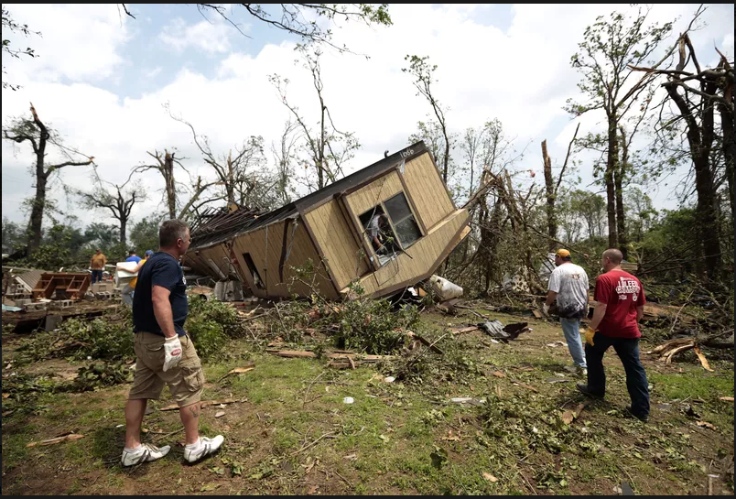
During a Tornado Contd.
If you are in:
Then:
A vehicle, trailer, or mobile home.
Get out immediately and go to the lowest floor of a sturdy, nearby building or a storm shelter. Mobile homes, even if tied down, offer little protection from tornadoes.

Slide 16
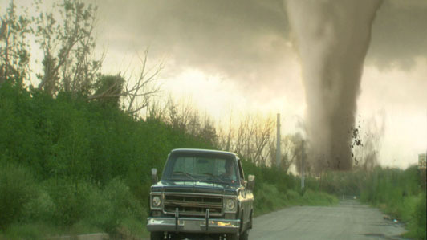
During a Tornado Contd.
If you are in:
Then:
The outside with no shelter
Lie flat in a nearby ditch or depression and cover your head with your hands. Be aware of the potential for flooding.
  Do not get under an overpass or bridge. You are safer in a low, flat location.
  Never try to outrun a tornado in urban or congested areas in a car or truck. Instead, leave the vehicle immediately for safe shelter.
  Watch out for flying debris. Flying debris from tornadoes causes most fatalities and injuries.

Slide 17
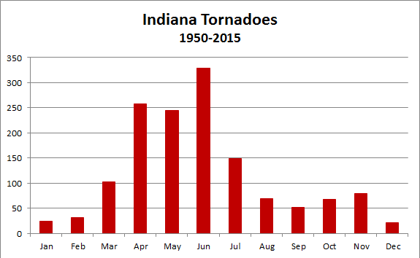
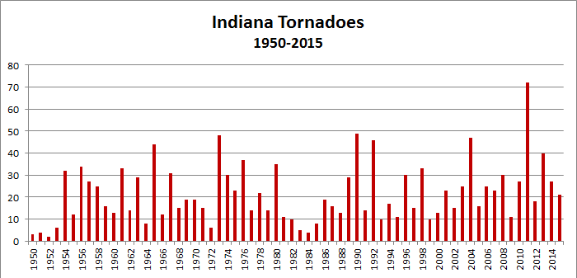
Other Information about Tornadoes
https://www.weather.gov/ind/tornadostats

Slide 18
Following a Tornado
Safety is the primary issue, as are mental and physical well-being. If assistance is available, knowing how to access it makes the process faster and less stressful. This section offers some general advice on steps to take after disaster strikes in order to begin getting your home, your community, and your life back to normal.
Check for injuries. Call 911 is someone is hurt and in need of medical attention.
If you are trapped, cover your mouth with a cloth or mask to avoid breathing dust. Try to get help by calling someone, texting, bang on pipe or wall, whistle, or shout.
Be aware of exhaustion. Don’t try to do too much at once.
Drink plenty of water
Eat well
Wear proper clothing (long pants, long sleeve shirts, work boots, gloves)
Wash hands thoroughly with soap and clean water often when working in debris.

Slide 19
Following a Tornado Contd.
Be aware of the new safety issues created by disaster.
Inform local authorities about health and safety issues, including chemical spills, downed power lines, washed out roads, smoldering insulation, and dead animals.
Keep a battery-powered radio with you so you can listen for emergency up- dates and news reports.
Use a battery-powered flash light to inspect a damaged home.
Use the phone only to report life-threatening emergencies.
Stay off the streets. If you must go out, watch for fallen objects; downed electrical wires; and weakened walls, bridges, roads, and sidewalks.
Walk carefully around the outside and check for loose power lines, gas leaks, and structural damage. If you have any doubts about safety, have your residence inspected by a qualified building inspector or structural engineer before entering.
Do not approach or attempt to help an injured or stranded animal.
Do not attempt to move a dead animal. Animal carcasses can present serious health risks. Contact your local emergency management office, health department, Extension personnel, or Indiana Board of Animal Health for help and instruction

Slide 20
Following a Tornado Contd.
Know where you family meeting spot is and get there if at all possible.
Do not enter a structure if:
  You smell gas.
  Structure integrity appears to be severely degraded, or floodwaters remain in or around the building.
  Your home was damaged by a fire and the authorities have declared it unsafe.

Slide 21
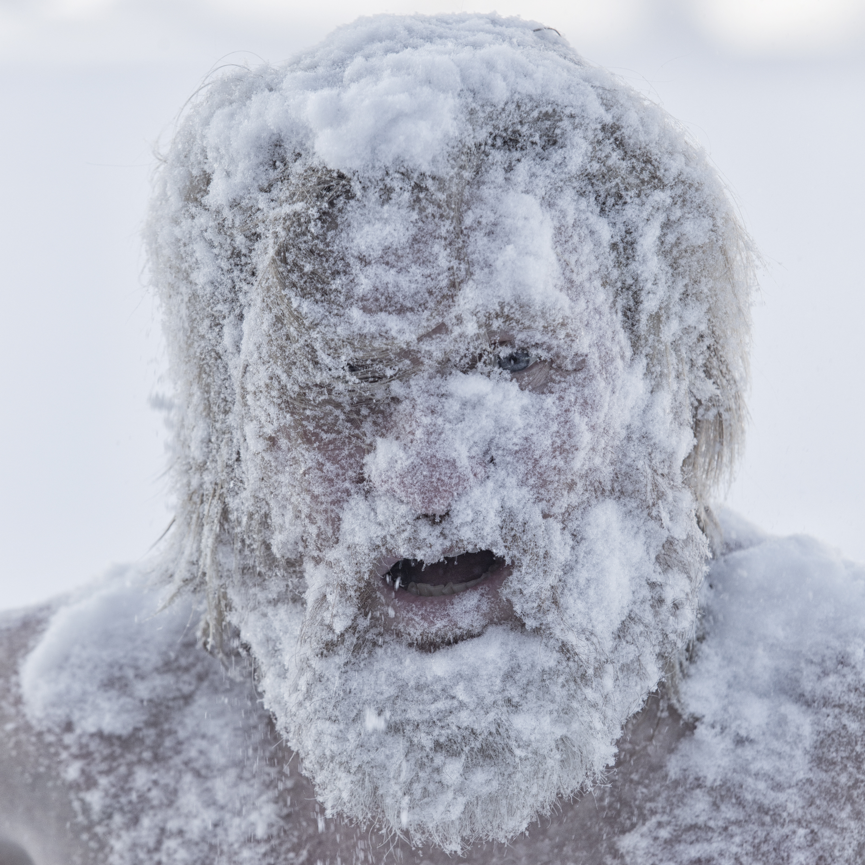
Winter Storms / Extreme Cold

Slide 22
Winter Storms / Extreme Cold
Heavy snowfall and extreme cold can immobilize an entire region. Even areas that normally experience mild winters can be hit with a major snowstorm or extreme cold. Northern-Indiana residents should prepare for increased snowfall (lake affect). Winter storms can result in flooding, storm surge, closed highways, blocked roads, downed power lines and hypothermia.

Slide 23
Winter Storms / Extreme Cold – Key Terms
Freezing rain - rain that freezes when it hits the ground, creating a coating of ice on roads, walkways, trees, and power lines.
Sleet – rain that turns to ice pellets before reaching the ground. Sleet also causes moisture on roads to freeze and become slippery.
Winter Storm Watch – A winter storm watch is possible in your area. Tune in to NOAA Weather Radio, commercial radio, or television for more information.

Slide 24
Winter Storms / Extreme Cold – Key Terms Contd.
Blizzard Warning – sustained winds or frequent guests to 35mph or greater and considerable amounts of falling or blowing snow (reducing visibility to less than a quarter mile) are expected to prevail for a period of three hours or longer.
Frost/Freeze Warning – below freezing temperatures are expected.

Slide 25
Before a Winter Storm
Have a supply of:
  Rock Salt to melt ice on walkways
  Sand to improve traction
  Snow shovels and other snow removal equipment
Prepare for possible isolation in your home by having sufficient heating fuel; regular fuel sources may be cut off. For example, store a good supply of dry, seasoned wood for your fireplace or wood-burning stove, and/or maintain a sufficient amount of LP in your tank for at least two-weeks. Winterize your home to extend the life of your fuel supply by insulating walls and attics, caulking and weather-stripping doors and windows, and installing storm windows or covering windows with plastic.

Slide 26
During a Winter Storm
Listen to your radio, television, or NOAA Weather Radio for weather reports and emergency information.
Eat regularly and drink ample fluids, but avoid caffeine.
Avoid overexertion when shoveling snow. Overexertion can bring on a heart attack—a major cause of death in the winter. If you must shovel snow, stretch before going outside.
Watch for signs of frostbite. These include loss of feeling and white or pale appearance in extremities such as fingers, toes, ear lobes, and the tip of the nose. If symptoms are detected, get medical help immediately.

Slide 27
During a Winter Storm Contd.
Watch for signs of hypothermia. These include uncontrollable shivering, memory loss, disorientation, incoherence, slurred speech, drowsiness, and apparent exhaustion. If symptoms of hypothermia are detected, get the victim to a warm location, remove wet clothing, warm the center of the body first, and give warm, non-alcoholic beverages if the victim is conscious. Get medical help as soon as
possible.
Conserve fuel, if necessary, by keeping your residence cooler than normal. Temporarily close off heat to some rooms.
Maintain ventilation when using kerosene heaters to avoid build-up of toxic fumes. Refuel kerosene heaters outside and keep them at least three feet from flammable objects.
Drive only if it is absolutely necessary. If you must drive, consider the following:
  Travel in the day, don’t travel alone, and keep others informed of your
  schedule
  Stay on main roads; avoid back road shortcuts
  Maintain a emergency supply kit in your vehicle.

Slide 28
Guidelines for Traveling
It is not recommended to travel during a winter storm, however, if you become trapped or stranded while traveling consider the following.
Pull off the highway. Turn on hazard lights and hang a distress flag from the radio antenna or window.
Remain in your vehicle where rescuers are most likely to find you. Do not set out on foot unless you can see a building close by where you know you can take shelter. Be careful; distances are distorted by blowing snow. A building may seem close, but be too far to walk to in deep snow.
Run the engine and heater about 10 minutes each hour to keep warm. When the engine is running, open an upwind window slightly for ventilation. This will protect you from possible carbon monoxide poisoning. Periodically clear snow from the exhaust pipe.

Slide 29
Guidelines for Traveling Contd.
Exercise to maintain body heat, but avoid overexertion. In extreme cold, use road maps, seat covers, and floor mats for insulation. Huddle with passengers and use your coat for a blanket.
Take turns sleeping. One person should be awake at all times to look for rescue crews.
Drink fluids to avoid dehydration (water, Gatorade, PowerAde, vitamin water).
Be careful not to waste battery power. Balance electrical energy needs—the use of lights, heat, and radio—with supply.
Turn on the inside light at night so work crews or rescuers can see you.
If stranded in a remote area, stomp large block letters in an open area spelling out HELP or SOS and line with rocks or tree limbs to attract the attention of rescue personnel who may be surveying the area by airplane.
  Leave the car and proceed on foot— ONLY if necessary—once the blizzard passes.

Slide 30
Following a Winter Storm
Limit your time outside.
  If you need to go outside, wear layers of warm clothing and keep a close watch for frostbite.
Avoid carbon monoxide positioning.
  Never heat your home with a gas or stovetop oven.
  If a generator is used to provide power to your home, be sure to maintain the manufacturers recommended distance from the house (only operate in a well ventilated area)
Reduce your risk of heart attack.
  Overexertion from shoveling show is often a contributor to severe health issues.

Slide 31
Following a Winter Storm Contd.
Check on your neighbors, especially elderly or those living alone.
Keep a watch for signs of hyperthermia or frost bite
  Frostbite signs: numbness, white or grayish-yellow skin, firm or waxy skin.
  Frostbite action: go to a warm place, soak in warm water. Do not massage or use a heating pad.
  Hyperthermia signs: shivering, exhaustion, fumbling hands, memory loss, slurred speech and drowsiness
  Hyperthermia action: Go to a warm place and focus on warming the body core first (chest, neck, head and groin). Keep dry, and wrapped with blankets (including head and neck).

Slide 32
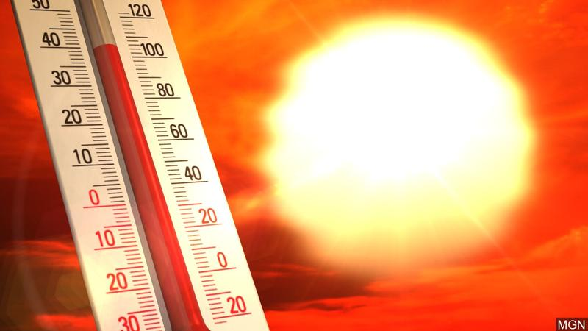
Extreme Heat

Slide 33
Extreme Heat
Heat kills by pushing the human body beyond its limits. In extreme heat and high humidity, evaporation is slowed and the body must work extra hard to maintain a normal temperature.
Most heat disorders occur because the victim has been overexposed to heat or has over-exercised for his or her age and physical condition. Older adults, young children, and those who are sick or overweight are more likely to succumb to extreme heat.
Conditions that can induce heat-related illnesses include stagnant atmospheric conditions and poor air quality. Consequently, people living in urban areas may be at greater risk from the effects of a prolonged heat wave than those living in rural areas. Also, asphalt and concrete store heat longer and gradually release heat at night, which can produce higher nighttime temperatures known as the “urban heat island effect.

Slide 34
Extreme Heat – Key Terms
Heat Wave - Prolonged period of excessive heat, often combined with excessive humidity.
Heat Index - A number in degrees Fahrenheit (F) that tells how hot it feels when relative humidity is added to the air temperature. Exposure to full sunshine can increase the heat index by 15 degrees.
Heat Cramps - Muscular pains and spasms due to heavy exertion. Although heat cramps are the least severe, they are often the first signal that the body is having trouble with the heat.

Slide 35
Extreme Heat – Key Terms Contd.
Heat Exhaustion - Typically occurs when people exercise heavily or work in a hot, humid place where body fluids are lost through heavy sweating. Blood flow to the skin increases, causing blood flow to decrease to the vital organs. This results in a form of mild shock. If not treated, the victim’s condition will worsen. Body temperature will keep rising and the victim may suffer heat stroke.
Heat Stroke - A life-threatening condition. The victim’s temperature control system, which produces sweating to cool the body, stops working. The body temperature can rise so high that brain damage and death may result if the body is not cooled quickly.
Sun Stroke – Another term for heat stroke.

Slide 36
Take Protective Measures
To prepare for extreme heat, you should:
  Install window air conditioners snugly; insulate if necessary.
  Check air-conditioning ducts for proper insulation.
  Install temporary window reflectors (for use between windows and drapes), such as aluminum foil covered cardboard, to reflect heat back outside.
  Weather-strip doors and sills to keep cool air in.

Slide 37
During a Heat Emergency
Stay indoors as much as possible and limit exposure to the sun.
Stay on the lowest floor out of the sunshine if air conditioning is not available.
Consider spending the warmest part of the day in public buildings such as libraries, schools, movie theaters, shopping malls, and other community facilities. Circulating air can cool the body by increasing the perspiration rate of evaporation.
Eat well-balanced, light, and regular meals. Avoid using salt tablets unless directed to do so by a physician.
Drink plenty of water. Persons who have epilepsy or heart, kidney, or liver disease; are on fluid-restricted diets; or have a problem with fluid retention should consult a doctor before increasing liquid intake.

Slide 38
During a Heat Emergency Contd.
Dress in loose-fitting, lightweight, and light-colored clothes that cover as much skin as possible.
Protect face and head by wearing a wide-brimmed hat.
Check on family, friends, and neighbors who do not have air conditioning and who spend much of their time alone.
Never leave children or pets alone in closed vehicles.
Avoid strenuous work during the warmest part of the day. Use a buddy system when working in extreme heat, and take frequent breaks.

Slide 39
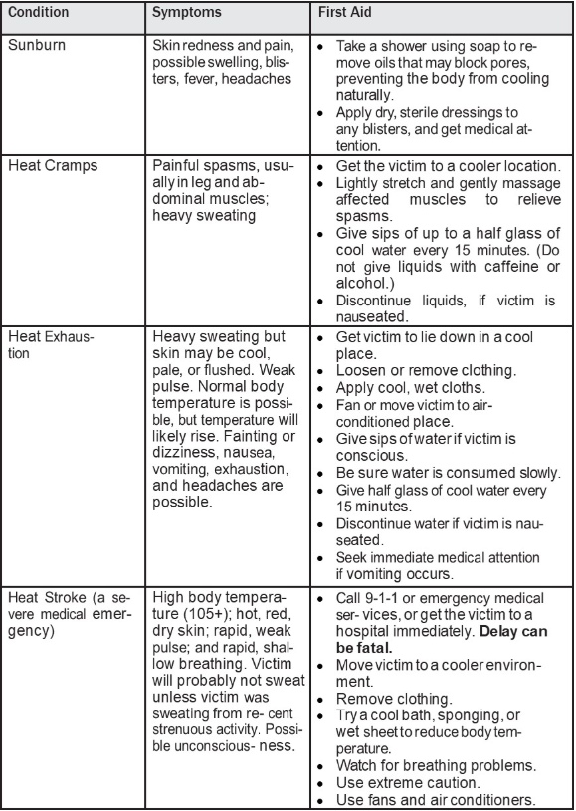
First Aid for Heat – Induced Illness

Slide 40
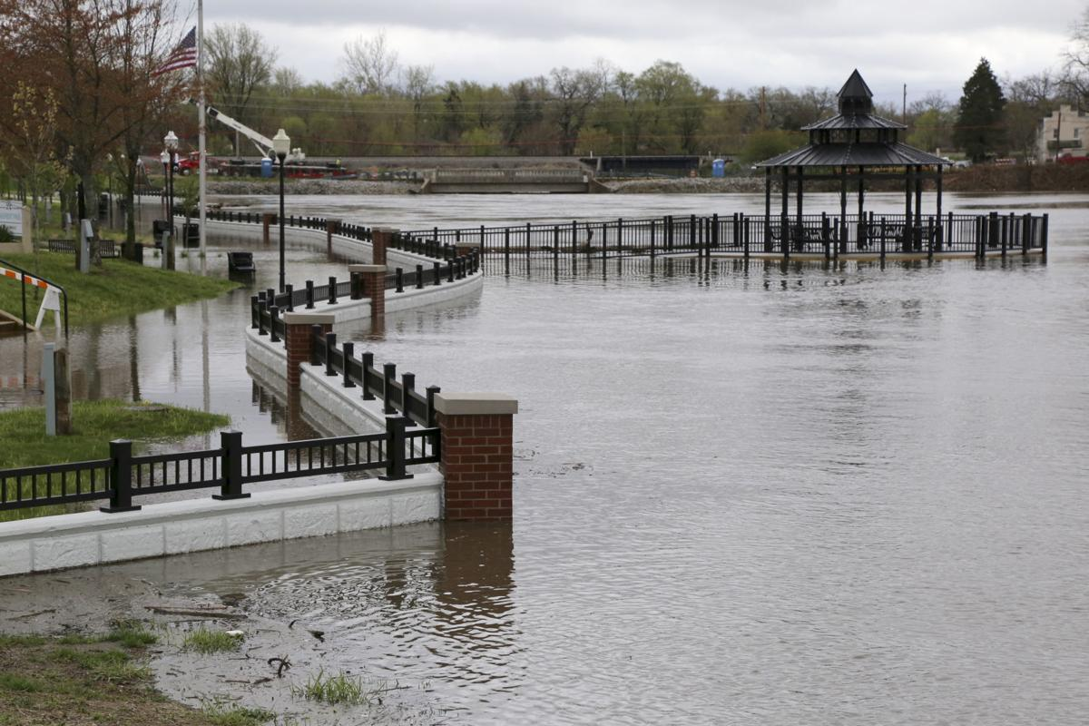
Floods

Slide 41
Floods
Floods are one of the most common hazards in the United States. Flood effects can be local, impacting a neighborhood or community, or very large, affecting entire river basins and multiple states.
However, all floods are not alike. Some floods develop slowly, sometimes over a period of days. But flash floods can develop quickly, sometimes in just a few minutes and without any visible signs of rain. Flash floods often have a dangerous wall of roaring water that carries rocks, mud, and other debris and can sweep away most things in its path. Overland flooding occurs outside a defined river or stream, such as when a levee is breached, but still can be destructive. Flooding can also occur when a dam breaks, producing effects similar to flash floods.
Be aware of flood hazards no matter where you live, but especially if you live in a low-lying area, near water or downstream from a dam. Even very small streams, gullies, creeks, culverts, dry streambeds, or low-lying ground that appear harmless in dry weather can flood. Every state is at risk from this hazard.

Slide 42
Floods – Key Terms
Flood Watch – flooding is possible. Tune into NOAA Weather Radio, commercial radio, or television for information.
Flash Flood Watch – flash flooding is possible. Be prepared to move to higher ground; listen to NOAA Weather Radio, commercial radio, or television for information.
Flood Warning – flooding is occurring or will occur soon; if advised to evacuate, do so immediately
Flash Flood Warning – a flash flood is occurring, seek higher ground on foot immediately

Slide 43
Before a Flood
Avoid building in a floodplain unless you elevate and reinforce your home.
Elevate the furnace, water heater, and electric panel if susceptible to flooding.
Install “check valves” in sewer traps to prevent flood water from backing up into the drains of your home.
Construct barriers (levees, beams, floodwalls) to stop floodwater from entering the building.

Slide 44
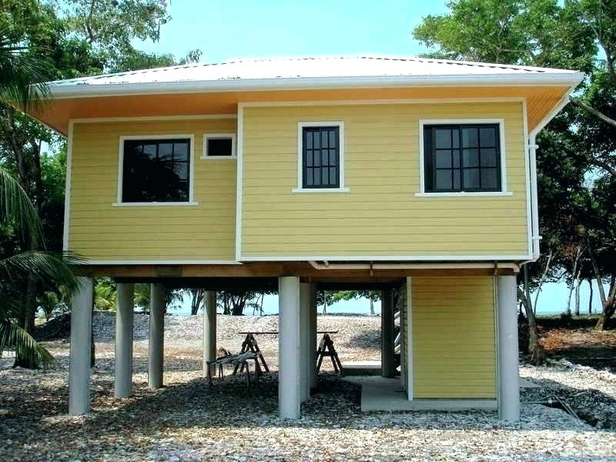
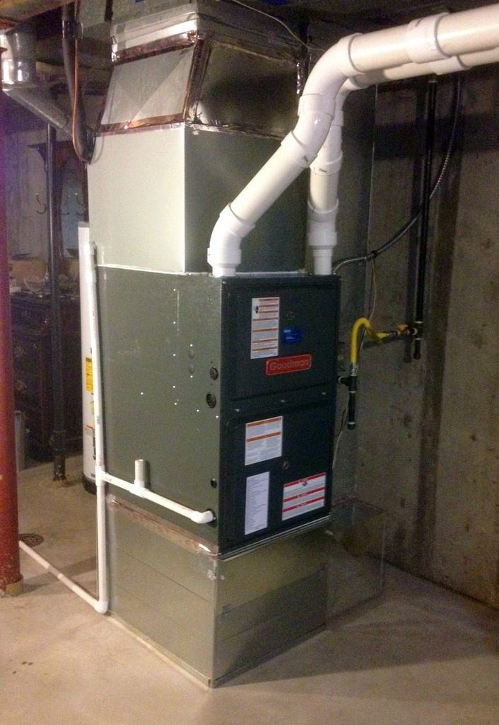
Elevated House
Elevated Furnace

Slide 45
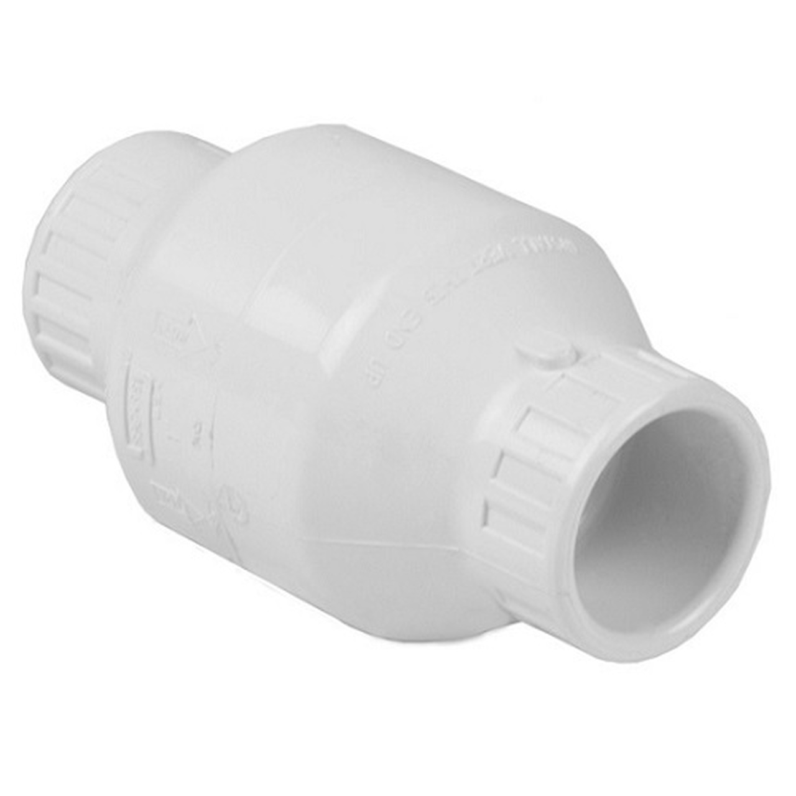
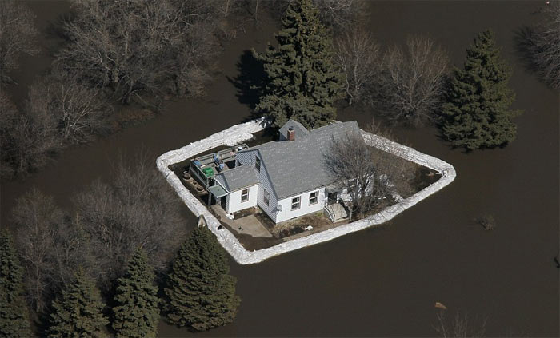
Check Valve
Barriers

Slide 46
During a Flood
Listen to the radio or television for information.
Be aware that flash flooding can occur. If there is any possibility of a flash flood, move immediately to higher ground. Do not wait for instructions to move.
Be aware of streams, drainage channels, canyons, and other areas known to flood suddenly. Flash floods can occur in these areas with or without such typical warnings as rain clouds or heavy rain.
If you must prepare to evacuate, you should do the following:
  Secure your home. If you have time, bring in outdoor furniture. Move essential items to an upper floor.
  Turn off utilities at the main switches or valves if instructed to do so. Disconnect electrical appliances. Do not touch electrical equipment if you are wet or standing in water.

Slide 47
Evacuation Tips
Do not walk through moving water. Six inches of moving water can make you fall. If you have to walk in water, walk where the water is not moving. Use a stick to check the firmness of the ground in front of you.
Do not drive into flooded areas. If floodwaters rise around your car, abandon the car and move to higher ground if you can do so safely. You and the vehicle can be quickly swept away.
Pack a light bag with some essentials (clothes, snacks, basic hygiene items)

Slide 48
Following a Flood
Listen for news reports to learn whether the community’s water supply is safe to drink.
Avoid floodwaters; water may be contaminated by oil, gasoline, or raw sew- age. Water may also be electrically charged from underground or downed power lines.
Avoid moving water.
Be aware of areas where floodwaters have receded. Roads may have weakened and could collapse under the weight of a car.
Stay away from downed power lines, and report them to the power company

Slide 49
Following a Flood Contd.
Return home only when authorities indicate it is safe.
Stay out of any building if it is surrounded by floodwaters.
Use extreme caution when entering buildings; there may be hidden damage, particularly in foundations.
Service damaged septic tanks, cesspools, pits, and leaching systems as soon as possible. Damaged sewage systems are serious health hazards.
Clean and disinfect everything that got wet. Mud left from floodwater can contain sewage and chemicals.

Slide 50
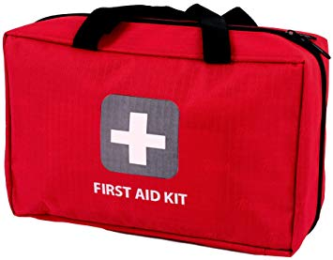
Home Emergency Kit

Slide 51
Items to Include in Home Emergency Kit
Water – one gallon per person per day for at least 3 days for drinking and sanitation
Food – 3 day supply of non perishable food
Battery powered or hand crank radio and NOAA Weather Radio with tone alert
Flashlight
Extra Batteries
First Aid Kit
Whistle to signal for help
Dust mask to help filter contaminated air and plastic sheeting and duct tape to shelter-in-place

Slide 52
Items to Include in Home Emergency Kit Contd.
Moist towelettes, garbage bags, and plastic ties for personal sanitation needs
Manual can opener for food
Local paper maps
Cell phone with chargers and a backup battery or solar charger
Clothing – seasonal, rain gear/sturdy shoes
Pet care items
Cash – banks and ATM’s may not be open for an extended period of time
Critical documents sored in waterproof container – ID, medical needs
Fire starter – matches/lighter, dry tinder and/or camp stove with fuel

Slide 53

Questions?

Slide 54
Thank You!!
R. Mathias Ingle
ANR Educator Purdue Extension Howard County
120 E Mulberry St. Suite 105
Kokomo, IN 46901
765-456-2313
rmingle@purdue.edu

