Slide 1
Laser safety Retraining
Revised to include content from ansi z136.1-2014

Slide 2
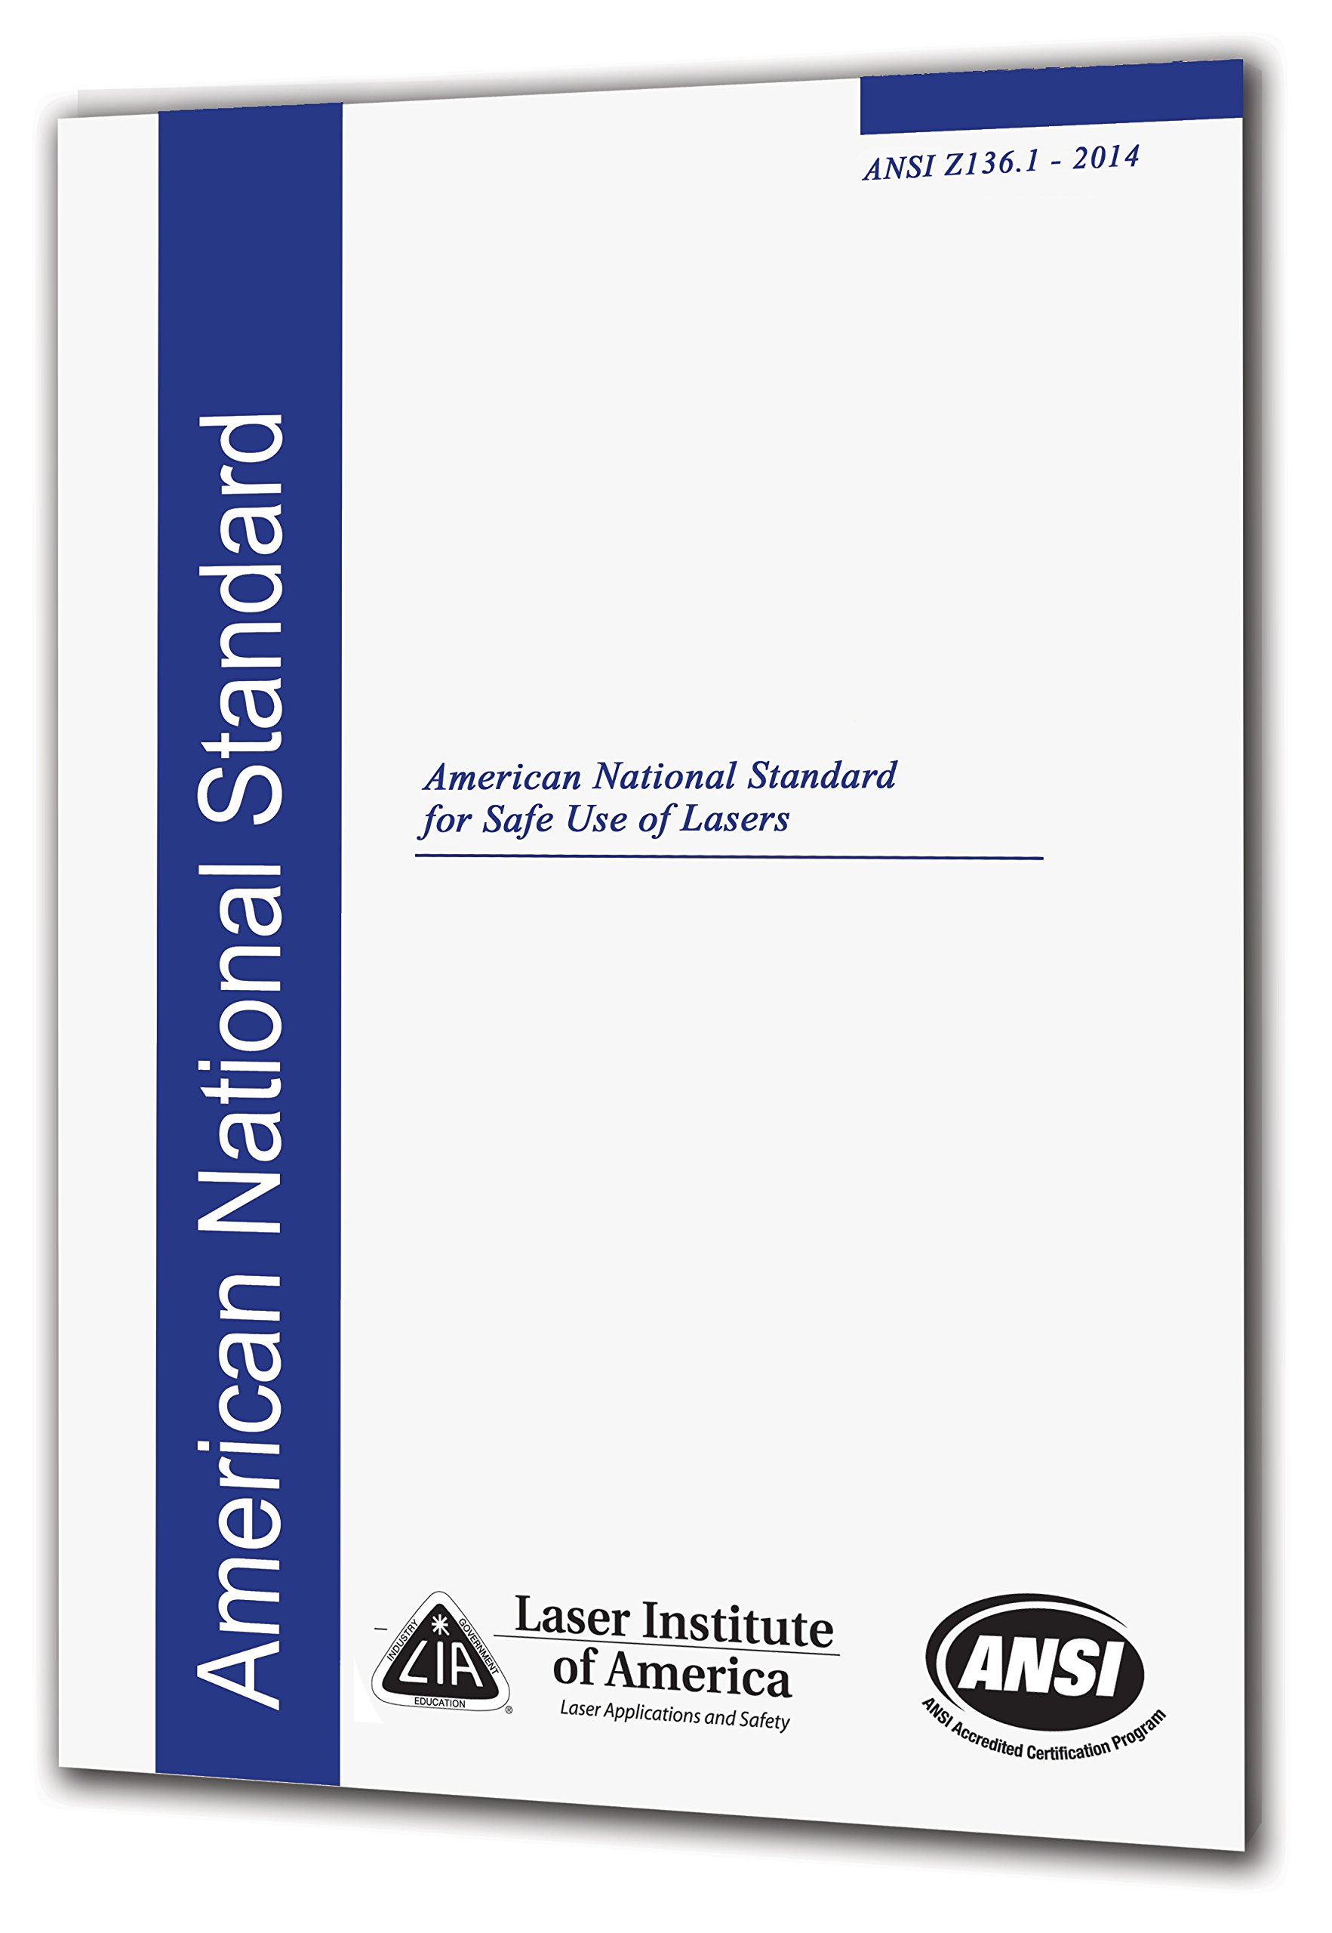
Laser safety at Purdue
Laser safety at Purdue University is managed by the Laser Safety Officer (LSO) and Radiological and Environmental Management (REM)
Purdue’s laser safety program is overseen by the Laser Safety Committee (LSC)
Purdue University adheres to the American National Standard for Safe Use of Lasers (ANSI Z136.1).

Slide 3
Biological effects,
Exposure pathways and non-beam hazards
This section reviews the health risks associated with laser beam exposure, exposure pathways and non-beam hazards.

Slide 4
Laser spectrum
Lasers operate in the ultraviolet (UV), visible, near infrared (Near IR) and far infrared (Far IR) regions of the electromagnetic spectrum.
Visible light has a wavelength range of 400-700 nm and can be seen by the eye. This can help you avoid hazardous exposures.
UV (190-400 nm), Near IR (700-1400 nm) and Far IR (1400-10600 nm) light cannot be seen by the eye. Lasers have the potential to cause permanent eye injury and loss of vision
Laser injuries can occur very quickly (e.g., thermal burns and microcavitation), or they can occur over time (e.g. cataract formation)
Lasers emitting in the UV, Near IR, and Far IR regions of the electromagnetic spectrum present an invisible eye hazard which people do not usually realize until their vision has been severely damaged
Therefore, the best way to prevent injuries is by having the LSO perform hazard evaluations and applying essential laser control measures.

Slide 5
Eye injury mechanisms
How laser light affects the eye
Thermal Burns:
Burns caused by elevated temperature after absorption of laser energy
Injury to both eyes and skin
Occurs at all wavelengths
Microcavitation:
Small volumes of tissue are instantly heated when short pulses are absorbed in the retina, resulting in a steam explosion
The explosion shockwave ruptures blood vessels leading to hemorrhaging within the retinal layers and retinal detachment. Usually results in severe loss of vision
Photochemical:
The chemical reactions in eye tissue after absorption of UV light can result in cataracts, welder’s flash and retinal injury that is similar to sunburn on skin, except that the retina never recovers.
Results in injuries to the cornea and lens of eye
Occurs only with wavelengths less than 600 nm

Slide 6
Eye injuries at various wavelengths
Wavelength (nm) | Type of Injury
180-400 | Thermal, photochemical injury to cornea (e.g., photo keratitis or welder’s flash), and photochemical injury to lens (e.g. cataracts), retinal injury.
400-1400 | Microcavitation to retina
400-600 | Thermal, and photochemical injury to retina (Greater blue light retinal hazard at shorter wavelengths)
600-1400 | Thermal injury to retina
1400-2600 | Thermal injury to cornea or lens
2600-1,000,000 | Thermal injury to cornea (Mostly surface burns)

Slide 7
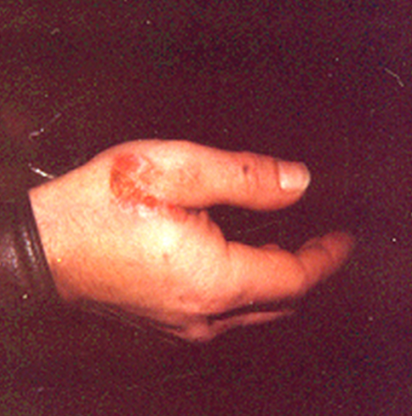
Mechanisms of skin injury
How laser light affects the skin
Thermal Burns:
Surface burns (i.e., first, second and third degree burns) from high power beams
Deeper burn penetration at 1000 nm wavelengths
Tissue vaporization by focused beams resulting in penetrating burns.
Depending on the laser, the wound may be cauterized or it may result in a cut and profuse bleeding
Photochemical skin injuries:
Sunburn from scattered UV
Increased risk of skin cancer from UV exposure

Slide 8
Hazardous Exposure pathways
How harmful laser exposures occur
Intrabeam Viewing – where a laser beam enters directly into the eye.
Specular Reflection – where a beam reflects off a mirror-like surface into the eye.
Diffuse Reflection – where the scattered light from a high powered (i.e. Class 4) laser beam is powerful enough to cause eye injury.
These situations can be prevented by:
Not looking directly into or placing any part of the body into the beam path
Applying proper laser control measures
Ensuring that laser beams are not eye level
Remove and/or avoid using objects that could provide a reflective surface (e.g., wrist watches, reflective metallic tools, etc.)

Slide 9
non-beam hazards
Electrical hazards – Fatal electric shock hazard possible with energized electronic components. Protective housings and electrical hazards should be covered. Only qualified personnel should work with energized electronics
Laser Generated Air Contaminants (LGACs) – Cutting, welding, engraving, materials processing applications and medical procedures can generate hazardous air contaminants. Notify LSO if LGAC production is possible.
Mechanical hazards – Moving robotic parts can cause severe physical trauma.
Process radiation – Certain applications can generate plasmas which emit light capable of causing eye injury. Protective eyewear and clothing can offer protection. Notify LSO if plasmas will be generated.
Pump lamp light – Light from laser lamps produces a white light optical hazard. Laser optical pumping lamps shall not be operated with protective housing removed. If such operation is required, consult the LSO.
Chemical hazards – Some laser dyes can be toxic and carcinogenic.

Slide 10
Control measures
The American National Standard for Safe Use of Lasers (ANSI Z136.1) REQUIRES the application of control measures to prevent the occurrence of harmful laser exposures. This section presents the various control measures and their required application.

Slide 11
Types of control measures
Laser control hierarchy
Engineering:
Should be the first line of defense against laser hazards
Generally more reliable and should be given priority
Administrative (Procedural):
The second line of defense against laser hazards
If engineering controls are impractical or inadequate, an effective combination of administrative and personal protective equipment shall be used.
Personal Protective Equipment (PPE):
Last line of defense against laser hazards
Use when engineering and administrative control measures cannot adequately prevent laser hazards

Slide 12
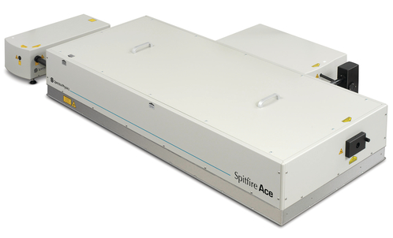
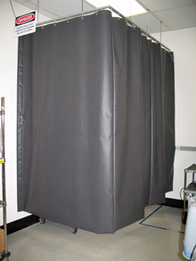
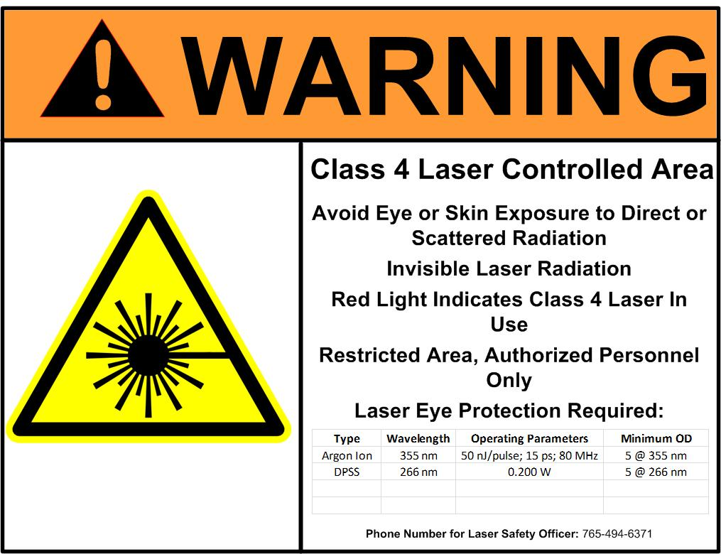
Engineering controls (1)
Protective Housing and Interlocks - Protects against electrical shock and pump lamp light exposure. Interlocks turn off laser when housing is opened. Do not attempt to defeat interlocks. Housing should be in good condition.
Laser Controlled Area (LCA) – An area where there is potential exposure to a laser beam that could result in laser injury. May be the entire room or an enclosure within the room. Only authorized users may enter a LCA during laser operation.
Area Warning Sign – Warning sign that provides safety information. Sign must be conspicuously posted at all entryways to Class 3B and 4 laser controlled areas. REM will provide these signs. Notify REM if signs are missing, defaced, incorrect, or outdated.

Slide 13
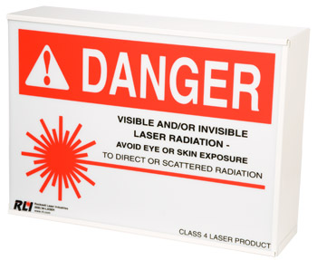
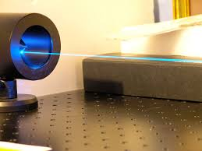
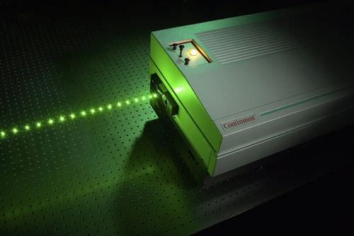
Engineering controls (2)
Area Warning Device – A visual or audible device that indicates laser is operating. Visual devices may be a single lamp or a laser warning sign that is illuminated or flashes when the laser is operating. If a simple light is used, a sign must be placed next to the light stating, “Laser in Use.”
Beam Dumps – Provide a safe method to terminate high-powered laser beams. They can be air or water cooled.
Laser Radiation Emission Warning Device – Audio or visual device that ensures people in the LCA are aware that the laser is or about to emit laser radiation.
Laser Barriers and Curtains – Specially designed and tested equipment rated to withstand a particular laser irradiance (e.g., 250 W/cm² for 100 seconds)

Slide 14
Engineering controls (3)
Entryway Controls – Prevents the possibility of exposure to laser radiation to individuals entering the LCA. There are 3 options
Non-defeatable Entryway Controls
Doorway interlock is non-defeatable. Interlocks trip when door to LCA is opened, causing the laser to power down.
Used when there is a laser radiation hazard at the entry
Training of authorized users only
Defeatable Entryway Controls
Doorway interlock is defeatable, allowing user into LCA without causing laser to power down.
Used when it is evident that there is no laser radiation hazard at the entry
Training of all personnel with access
Full-height laser barrier/curtain and laser eye protection at door
Procedural Entryway Controls
No doorway interlock
Training of all personnel with access
Full-height laser barrier and laser eye protection at door
Visible or audible area warning device

Slide 15
Engineering control requirements
engineering controls
The table below lists the engineering control requirements per LCA classification. Those engineering controls with a SHALL requirement are NOT OPTIONAL.
Engineering Control Measures | Classification
 | 3B | 4
Laser Controlled Area | X | X
Laser Warning Sign | X | X
Protective Housing | X | X
Protective Housing Interlocks | X | X
Area Warning Device | • | X
Laser Radiation Emission Warning Device | • | X
Entryway Controls | − | X
Protective Barriers and Curtains | • | •
Beam Dumps | − | •
Legend:
X | Shall
• | Should
− | No Requirement

Slide 16
Administrative controls (1)
administrative controls
Standard Operating Procedures (SOP) – Step-by-step procedures for the safe operation, maintenance, and servicing of lasers and laser systems. The SOP must:
Be written by competent and experienced individuals
Specify the type of laser eye protection required.
Alignment Procedures – Step-by-step procedures and methods for the safe alignment of laser beams. The alignment SOP must:
Describe methods to view invisible laser beams.
Be written by competent and experienced individuals.

Slide 17
Administrative controls (2)
administrative controls
Authorized Personnel – laser and laser systems shall only be operated, maintained and serviced by authorized personnel. Authorization requires training, and approval from both Principal Investigator (PI) and LSO. Only authorized users may be present in a LCA during laser operation.
Training – There are three types of laser training required to be a laser user:
Initial Online Laser Safety Training
On-The-Job Training – Administered by the Principal Investigator (PI) or designee on the safe setup, alignment and use of a laser system
Biennial Laser Safety Retraining

Slide 18
Administrative control requirements
administrative controls
The table below lists the administrative (procedural) control requirements per LCA classification. Those administrative (procedural) controls with a SHALL requirement are NOT OPTIONAL.
Administrative Control Measures | Classification
 | 3B | 4
Standard Operating Procedures | • | X
Education and Training | X | X
Authorized Personnel | X | X
Alignment Procedures | X | X
LEGEND: | X | Shall
 | • | Should
 | − | No Requirement

Slide 19
Personal protective equipment (1)
Laser Eye Protection (LEP) – Specialized safety eyewear used to protect eyes from hazardous laser radiation. The proper selection of LEP is crucial to ensuring user safety. Two characteristics must be considered when selecting LEP:
Wavelength:
The lenses contain special dyes that absorb specific wavelengths, allowing all other to pass through
Therefore, LEP is wavelength specific; it only offers protection at specific wavelengths.
Optical Density (OD):
The OD specifies the percent of incident laser radiation that will be transmitted (see table)
The OD varies with the wavelength (see figure on next page)
OD | Percent Transmitted
0 | 100%
1 | 10%
2 | 1%
3 | 0.1%
4 | 0.01%
5 | 0.001%
6 | 0.0001%
7 | 0.00001%

Slide 20
Personal protective equipment (2)
Laser Eye Protection (LEP)
The wavelength and OD requirements for LEP are dependent on the operating parameters of the laser. Therefore, different lasers may require different LEP. There is no one-size-fits-all.
The LSO can perform calculations to determine the wavelength and OD requirements.
The LEP used MUST meet or exceed the wavelength and OD requirements in order to provide sufficient protection.
The wavelengths and ODs MUST be INSCRIBED on the lenses or frame
LEP that don’t meet this requirement WILL NOT provide sufficient protection. These SHALL NOT be used, but they MUST be disposed to avoid confusion.
Before using LEP, ALWAYS ensure that the wavelength and OD requirements are met and that its in good working order.
DO NOT use LEP that is broken or damaged. When in doubt ask the LSO.

Slide 21
Eye protection for ultrafast lasers
Exposure to ultrafast lasers (pulse duration < 1 ns) can temporarily reduce the optical density of some laser eye protection (LEP).
This effect is called, saturable absorption.
With saturable absorption, the effective optical density decreases substantially as laser power increases.
LEP affected by saturable absorption may not provide adequate protection in an accident.
Ultrafast rated LEP have been tested to certify that they are not affected by saturable absorption.
LEP that are ultrafast rated will have an ‘M’ designation on the LEP or on the data sheet provided by the manufacturer.
The ‘M’ rating is wavelength specific.
REM can assist with obtaining ultrafast LEP.

Slide 22
Skin protection
personal protective equipment
Skin injuries are really only a problem when working with Class 4 and UV lasers. Class 4 lasers can result in thermal skin burns while UV lasers can cause photochemical changes in the skin which can result in sunburns and skin cancer.
Skin Protection and Protective Clothing offers protection to the skin and body from laser radiation.
In some cases a laboratory jacket or coat may fulfill the requirement, although tightly-woven, flame-retardant fabrics provide the best protection for Class 4 lasers.
Most gloves will provide some protection against scattered laser radiation, although opaque, flame-retardant gloves (e.g. welder’s gloves) provide the best protection for Class 4 lasers.
When working with UV lasers, skin protection should be used if frequent exposures are likely.

Slide 23
Ppe requirements
Personal Protective Equipment
The table below lists the personal protective equipment requirements per LCA classification. Those personal protective equipment with a SHALL requirement are NOT OPTIONAL.
Personal Protective Equipment Control Measures | Classification
 | 3B | 4
Laser Eye Protection | X | X
Skin Protection | • | •
Protective Clothing | • | •
LEGEND: | X | Shall
 | • | Should
 | − | No Requirement

Slide 24
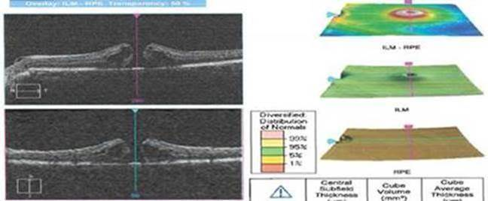
Laser Accident at Purdue
In February 2019, a Purdue student was injured when a laser beam reflected off a sample and into the student’s eye.
The laser burned a hole in the retina of the student’s eye, causing a partial loss of vision.
The student was not wearing laser eye protection at the time.
You MUST wear laser eye protection whenever you are inside the laser control area and lasers are turned on.

Slide 25
Common causes of
Laser injuries And safe work practices
This section outlines common causes of laser accidents that you should avoid and/or eliminate in your laser lab. This section also outlines good practices and safe alignment practices that you should implement.

Slide 26
Common causes of laser injuries
Misaligned optics and upwardly directed beams
Unanticipated eye exposure during alignment
Available laser eye protection (LEP) not used
Equipment malfunction
Improper methods of handling high voltage
LEP worn not appropriate for laser in use
Intentional exposure of unprotected personnel
Operators unfamiliar with laser equipment
Lack of protection from non-beam hazards
Improper restoration of equipment following service
Improper barriers (e.g., substituting laser rated barriers with cardboard, blackout fabric, etc.)
Unattended laser operation
Failure to follow standard operating procedures (SOPs)
Poor working conditions (e.g., long/unusual hours, poor housekeeping and ergonomics).

Slide 27
Safe work Practices (1)
Position the laser so that it is well above or below eye level. Never place computer monitors on the same level as laser beams.
Do not view a Class 3R (or higher) laser with optical instruments
Operate lasers only in the area designated for their use and be certain that the beam is terminated at the end of its use path. Never allow a laser beam to escape its designated area of use.
All stray reflections should be eliminated or blocked as near their source as possible.
Unless the beam is entirely enclosed, always wear LEP when in the LCA and the laser is operating. Even if the laser system has been aligned, NEVER assume the system is safe.
Do not enter a designated Class 3B or 4 laser area without approval from a qualified laser operator. Laser eye protection is required in these areas.

Slide 28
Safe work Practices (2)
Remove all unnecessary reflective objects from the area near the beam’s path. This may include tools and jewelry.
Always wear laser eye protection (LEP) when lasers are operating and the laser beam is not fully enclosed.
Do not remove LEP to view computer monitors, equipment, or the experiment.
Never intentionally look directly into a laser. Do not stare at the light from any laser. Allow yourself to blink if the light is too bright.
Never direct the beam toward other people
As much as possible, enclose the beam with laser curtains/barriers, fiber optics, and laser beam tubes

Slide 29
Safe laser Alignment principles
Only trained personnel may align class 3B and 4 lasers, NO EXCEPTIONS!
Exclude unnecessary personnel from the laser lab during alignments.
Where possible, use low-power (Class 3R or lower) visible lasers for path simulation of high power visible or invisible lasers.
Always anticipate the possibility of an uncontrolled beam or reflection and protect yourself and others by using beam barriers and wearing appropriate LEP.
When aligning invisible beams, use beam display devices such as UV and IR viewers or laser viewing cards to locate laser beams.
Perform alignment tasks using high-power lasers at the lowest power level possible.
Place table barriers behind optics to terminate beams that might miss mirrors during alignment.
Locate and block all stray reflections before proceeding to the next optical component or section
Be sure all beams and reflections are properly terminated before high-power operation
NEVER remove laser eye protection (LEP) to view the laser beam. Instead use laser viewing cards and other techniques that can emit visible light, not filtered out by the LEP

Slide 30
Alignment safety Video

Slide 31
Responsibilities of the
Principal investigator and laser user
This section explains the responsibilities the Principal Investigator (PI) and laser user in maintaining a safe laser environment.

Slide 32
PI responsibilities
The Principal Investigator has the responsibility to:
Will not permit operation of a laser unless control measures are adequate.
Issues appropriate instruction and training material on laser hazards of their specific laser
Ensures that all laser users have completed the laser safety training provided by REM and the on-the-job training prior to working with lasers.
Ensures that operation of the laser meets all safety requirements, both for the lab members and anyone else who may enter the lab (e.g., custodial staff, visitors, etc.)
Inform REM when the area warning sign posted at the laser control area entrance is no longer accurate
Notifies the LSO of any known or suspected injuries
If necessary, ensures appropriate medical attention is received
Will not permit operation of a new or modified Class 3B or 4 laser under his/her authority without LSO approval.
Shall ensure that SOPs are available for each laser.
Will not permit operation of a new or modified Class 3B or Class 4 laser without approval of the LSO.
Will not permit operation of lasers in new locations without approval of the LSO.

Slide 33
Primary Responsibility for safety
Question:
Who has primary responsibility for laser safety any time a Class 3B or Class 4 laser is operated?
Answer:
The person operating the laser always has the primary responsibility for all hazards associated with laser use
You have the duty to report unsafe conditions and practices to the Principal Investigator (PI). If the situation is not resolved within a reasonable time, contact REM.

Slide 34
Laser user responsibilities
The laser user has the responsibility to:
Inform the LSO before changing the operating parameters (i.e., emitted wavelength, energy per pulse, power, etc.) of a particular laser, modifying a laser, or drastically changing a laser setup.
Maintain a safe laser environment by adhering to all laser safety principles, rules and practices
Inform your PI and REM of any safety hazards or concerns
Inform REM when the area warning sign posted at the laser control area entrance is no longer accurate
Ensure all control measures (i.e., engineering, administrative procedural, and PPE) are in place and/or activated prior to using the laser
Ensure that all individuals within the lab are aware that the laser is in use, and follow safe laser practices.
Energize or work with lasers only when authorized to do so.
Notify supervisor or LSO in case of potential accident or injury.

Slide 35
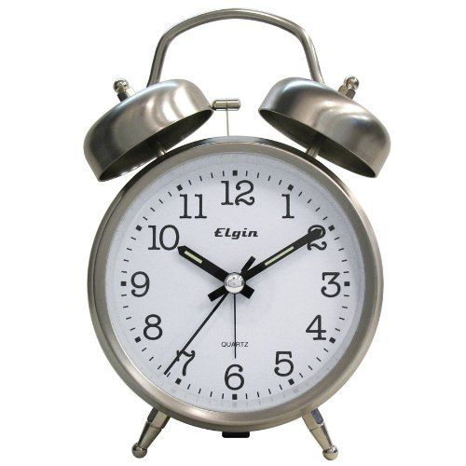
Maintain a safe lab environment
Safety should never be sacrificed for convenience, or to save time and money.
You can do breakthrough research without compromising on safety. REM can help!
Laser accidents can result in laser lab closures, and a loss of thousands of dollars of research grants.
Laser safety equipment can be expensive. However, REM has a cost sharing program which can pay up to 50% of the total cost.
Must receive LSO’s approval prior to purchase.
REM also has equipment that can be loaned.

Slide 36
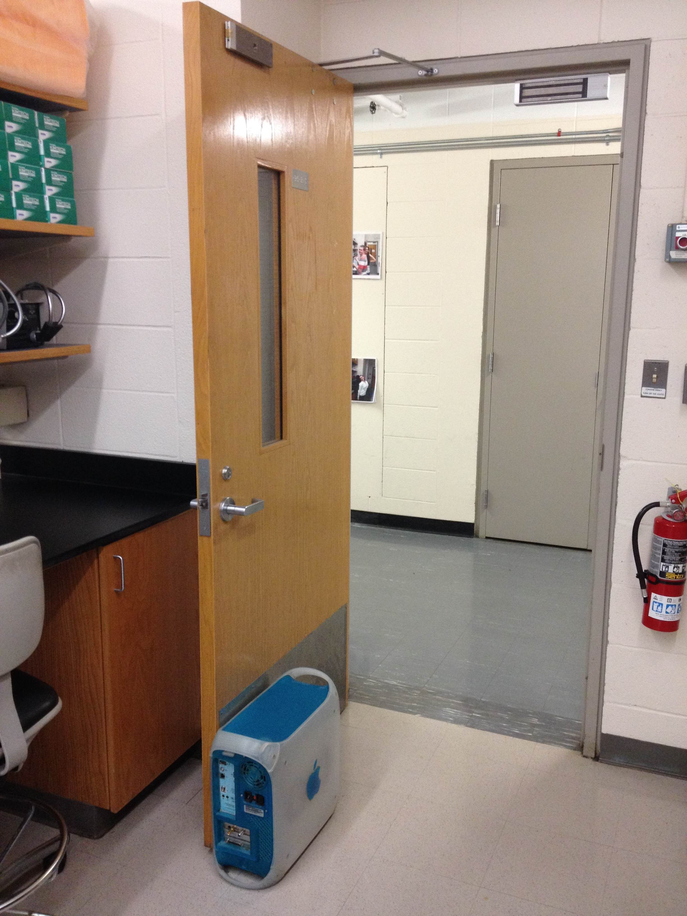
Final Thoughts
ALWAYS ensure that laser curtains/barriers and lab doors are closed when lasers are turned on
ALWAYS turn on the “laser in use” light before turning on lasers
ALWAYS turn off the “laser in use” light after turning off lasers
ALWAYS ensure that the engineering controls are in place before turning on lasers
NEVER leave operating lasers unattended; you must be present when a laser is in use
X

Slide 37
injury
If a laser-related injury occurs:
Turn off the laser system
Contact medical personnel (call 911). Inform them of the accident.
If injured personnel requires medical assistance, don appropriate personal protective equipment (e.g. gloves), and provide minimum assistance, as needed. Ensure someone remains with the victim until medical personnel arrive
Inform REM (765-494-6371)
Complete an incident report and a First Report of Injury.
If a suspected or actual laser-induced injury occurs, a medical surveillance must be performed as soon as possible, but no later than 48 hours after the incident
Do not operate the laser again until the LSO has evaluated the incident and corrective actions have been taken.

Slide 38
fire
If a fire starts in the laser controlled area:
Turn off the laser system
Sound the fire alarm
Contact fire department (call 911) and inform them of the incident
If the fire has gone out, call the Purdue University Fire Department (PUFD) at the non-emergency number (765-494-6919)
Evacuate area
Contact REM (765-494-6371)
Complete incident report

Slide 39
Contact information
Rem laser safety staff
Joshua A. Young, MS, Laser Safety Officer
765-494-2721
young127@purdue.edu
Main Office
765-494-6371

Slide 40
End of training module
This concludes the PowerPoint portion of the training.
Complete the test indicated below. You must have 75% of correct responses to pass.
Your results will be emailed to you
Click here to begin the test.

