Slide 1


Unsealed radioactive Material safety training
2018

Slide 2
Properties of radiation

Slide 3
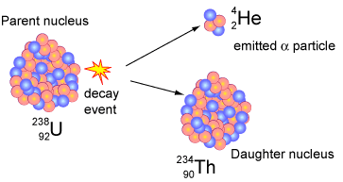
Radioactive Decay
Radioactive material is made up of radioactive atoms that emit radiation when the unstable nucleus undergoes radioactive decay.
Radioactive decay is a spontaneous transformation that is unaffected by physical and chemical processes.
During radioactive decay, radiation (typically a highly energetic particle and/or photon) is emitted from the unstable parent nucleus.
After decay, the daughter nucleus is left in a more stable state.
Isotopes that are radioactive are often called radioisotopes, radionuclides or radioactive nuclides.

Slide 4
Types of radiation
The types of radiation emitted during and examples of radionuclides that emit that type of radiation is included
Alpha (α) – Energetic Helium nucleus.
  ²³⁸U, ²³²Th, ²⁴¹Am, ²²⁶Ra and ²²²Rn
Beta Minus (β⁻) – Energetic electron, occasionally called a negatron.
  ³H, ¹⁴C, ³²P, ³⁵S and ⁹⁰Sr
Beta Positive (β⁺) – Energetic electron antiparticle, commonly called a positron.
  ¹¹C, ¹³N, ¹⁵O and ¹⁸F
Gamma (γ) – Photon emitted from a daughter nucleus left in an energetic state following radioactive decay.
  ^{99m}Tc, ¹³⁷Cs, ⁶⁰Co, ¹²⁵I and ¹³¹I
Neutron (n) – Energetic unbound neutron.
  ²⁵²Cf, ²⁴¹Am Beryllium and ²³⁹Pu Beryllium

Slide 5
Radiation Shielding (1)
Radiation interacts with matter through a variety of mechanisms to block or reduce the intensity of the incident radiation. The optimum shielding material is described below:
Alpha (α) – Unable to penetrate the dead layer of the skin, therefore, shielding not required.
Beta Minus (β⁻) – Penetration (and therefore shielding thickness) is dependent on beta particle energy. Best shielded by low and medium density (low and medium atomic number) material such as wood, plastic and acrylic.
  Low energy beta emitters (e.g. ³H, ¹⁴C, ⁶³Ni, ³⁵S) are minimally penetrating so shielding is not required.
  Refrain from using high density materials (e.g. lead) to shield high-energy betas since this can generate X-rays.

Slide 6
Radiation shielding (2)
Beta Positive (β⁺) – When interacting with matter, positrons will slow down and annihilate with atomic electrons, producing high energy gamma radiation. Therefore, we shield for the gammas rather than the positrons
Gamma (γ) – Very penetrating. Penetration (and therefore shielding thickness) is dependent on gamma energy
  Best shielded by high density (high atomic number) material such as lead and concrete.
Neutron (n) – Extremely penetrating.
  Best shielded by hydrogenous material such as water, paraffin and polyethylene. Concrete and concrete block are effective shielding material, but not as effective as hydrogenous material.

Slide 7
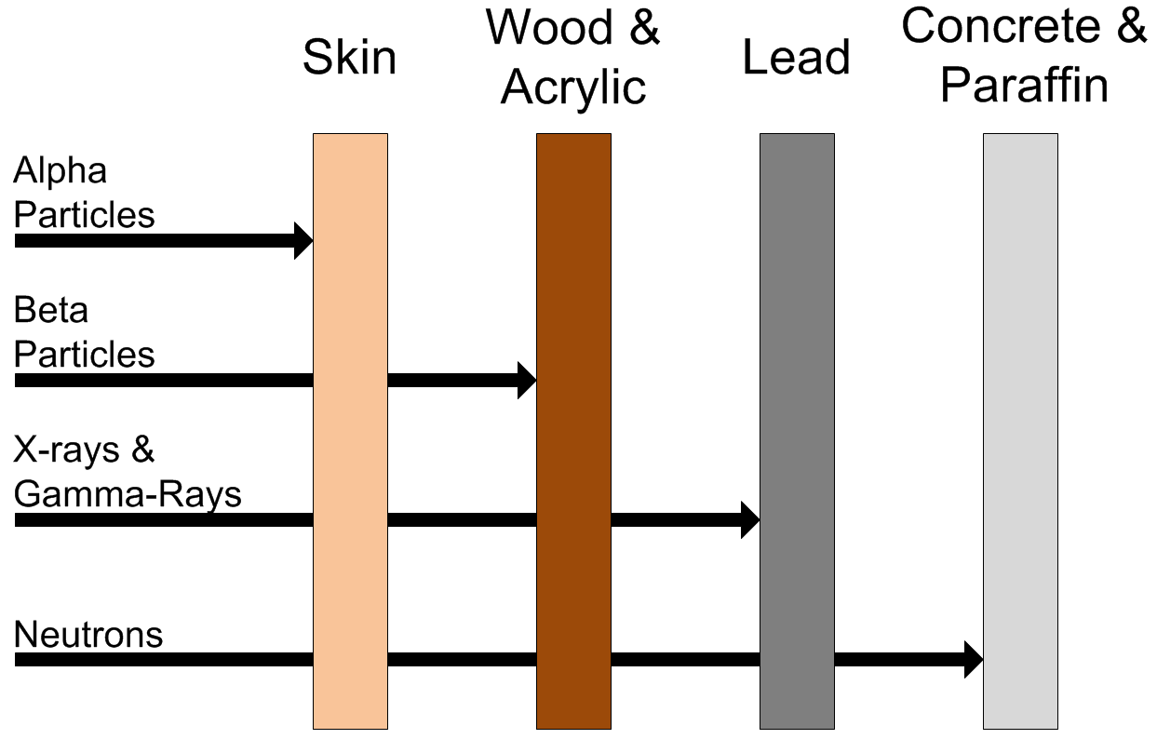
Radiation shielding (3)
The figure below displays the relative penetrating power and the recommended shielding material

Slide 8
Radiation shielding (4)
The following table lists the optimal shielding material (if any) per radionuclide. Please contact REM if the radionuclide you are using is not listed.
Radionuclide | Shielding Material
¹⁴C | None Required
³H | None Required
¹²⁵I | Lead
¹³¹I | Lead
³²P | Plexiglas/Acrylic
³⁵S | None Required
^{99m}Tc | Lead
¹⁸F | Lead
⁴⁵Ca | None Required
²³⁸U | None Required
²³²Th | None Required

Slide 9
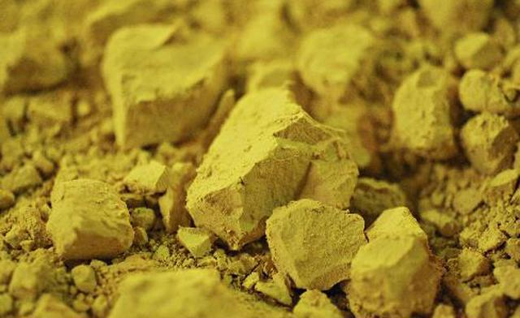
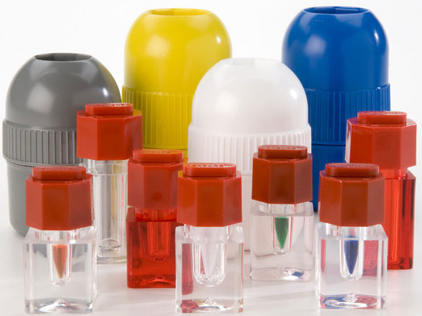
Physical characteristics
Radioactive material can come in multiple physical states:
  Solid
  Liquid
  Gas
Radioactive isotopes have the same chemical characteristics as and are totally indistinguishable from stable isotopes
The emitted radiation is entirely undetectable by human physical senses such as sight, hearing, taste, smell and touch.
Therefore, radioactive material cannot be easily distinguished from non-radioactive material.

Slide 10
Activity (1)
Activity Conversion
1 Ci | 3.7x10¹⁰ Bq
1 mCi | 37x10⁶ Bq
1 μCi | 37x10³ Bq
1 nCi | 37 Bq
Activity is the rate of radioactive decay and is used to quantify amount of radioactive material.
The unit of activity is the becquerel (Bq) which is defined as one radioactive decay per second.
The unit of activity commonly used in the United States is the curie (Ci) which is defined as 3.7x10¹⁰ decays per second or 3.7x10¹⁰ Bq.
The activity of radioactive material decreases exponentially with time.

Slide 11
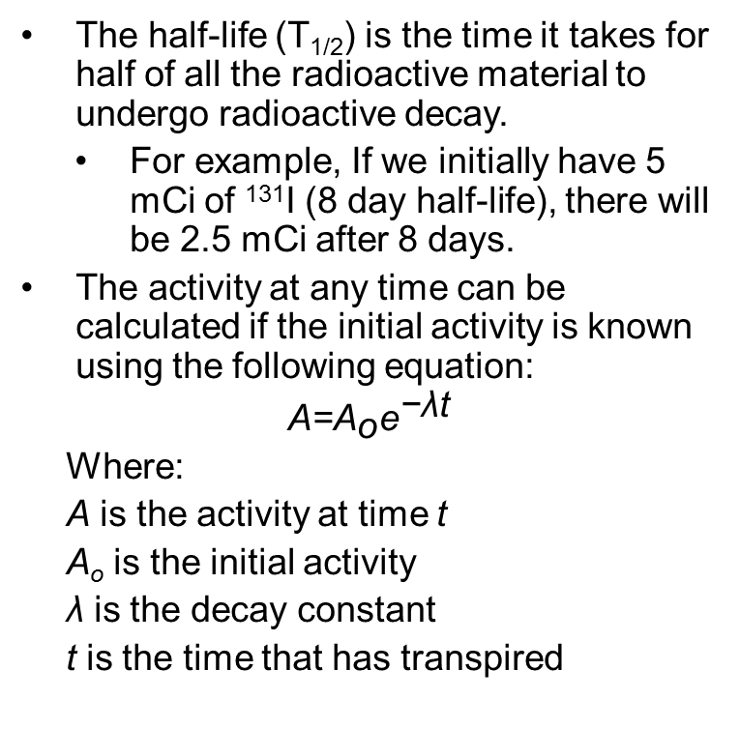
Activity (2)
Activity Conversion
1 Ci | 3.7x10¹⁰ Bq
1 mCi | 37x10⁶ Bq
1 μCi | 37x10³ Bq
1 nCi | 37 Bq
The half-life (T_{1/2}) is the time it takes for half of all the radioactive material to undergo radioactive decay.
  For example, If we initially have 5 mCi of ¹³¹I (8 day half-life), there will be 2.5 mCi after 8 days.
The activity at any time can be calculated if the initial activity is known using the following equation:
$$\text{A}\text{=}{\text{A}}_{\text{o}}{\text{e}}^{\text{−}\text{λ}\text{t}}$$
Where:
  A is the activity at time t
  A_{o} is the initial activity
  λ is the decay constant
  t is the time that has transpired

Slide 12
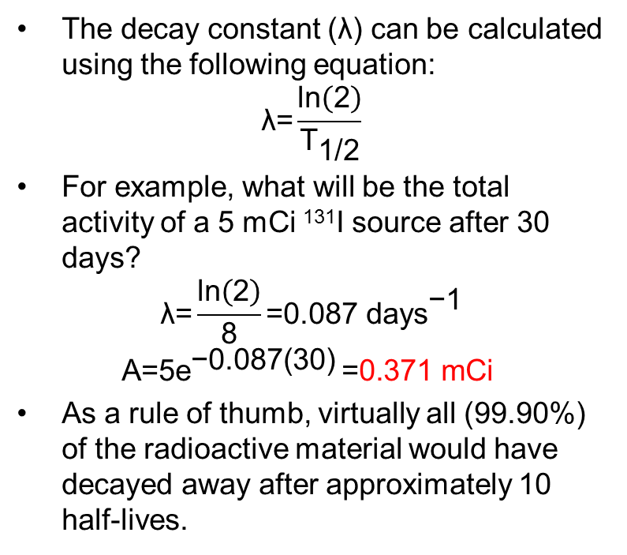
Activity (3)
Activity Conversion
1 Ci | 3.7x10¹⁰ Bq
1 mCi | 37x10⁶ Bq
1 μCi | 37x10³ Bq
1 nCi | 37 Bq
The decay constant (λ) can be calculated using the following equation:
$$\text{λ}\text{=}\frac{\text{ln}\left(\text{2}\right)}{{\text{T}}_{\text{1/2}}}$$
For example, what will be the total activity of a 5 mCi ¹³¹I source after 30 days?
$$\text{λ}\text{=}\frac{\text{ln}\left(\text{2}\right)}{\text{8}}\text{=0.087 }{\text{days}}^{\text{−1}}$$
$$\text{A}\text{=5}{\text{e}}^{\text{−0.087(30)} }\text{=}\text{0.371 }\text{mCi}$$
As a rule of thumb, virtually all (99.90%) of the radioactive material would have decayed away after approximately 10 half-lives.

Slide 13
Biological effects, dose limits, and Radiation Safety principles

Slide 14
dose
When radiation interacts with living material such as our bodies, they may deposit enough energy to cause biological damage. Biological damage can occur as a result of chemical bonds being broken, DNA damage, and cells being damaged or killed.
Radiation induced health effects are dependent on radiation dose.
  The ‘rem’ is the common unit of dose in the U.S.
  1 rem = 1000 millirem (mrem)
  The ‘sievert’ is the common international unit of dose.
  1 sievert = 100 rem

Slide 15
Health Effects of Radiation Exposure
Health effects from exposure to radiation range from no effect at all to death, including diseases such as cancer.
The health effects can be divided into two categories:
  Early Effects
  Delayed Effects

Slide 16
Early Effects (1)
Occur shortly after exposures resulting in very large doses (>100 rem), delivered within a short time period (acute exposure)
Acute exposures cause extensive biological damage to cells so that large numbers of cells are killed.
The severity of the health effects is proportional to the dose.
Possible health effects include: vomiting, diarrhea, skin burns, cataracts, hair loss, fever, lethargy, loss of appetite, changes in blood count, and death.

Slide 17
Early Effects (2)
An estimated dose of around 325 rem for young healthy adults without medical intervention will result in death to 50% of the group within 60 days.
For a dose of less than about 800 rem, an exposed person is likely to survive with appropriate hospital care.
Under normal operation, the occurrence of early effects is highly unlikely.

Slide 18
Delayed Effects
Occur years after acute or chronic (low doses over a long time period) exposures.
Possible health effects include: leukemia, cancer, life span shortening, cataracts, and genetic defects.

Slide 19
Delayed Effects - genetic effects
Radiation studies suggest the possibility of heritable genetic effects in humans if there is radiation damage to the cells of the sperm or eggs.
These effects may show up as genetic defects in the children of exposed individuals and succeeding generations.
Scientists have studied populations of individuals exposed to radiation (e.g., atomic bomb survivors and radiation workers) to identify the presence of heritable genetic effects.
To date, no heritable genetic effects from radiation have ever been observed in any human population exposed to doses ranging from natural background to that received by atomic bomb survivors.

Slide 20
Delayed Effects – stochastic
Leukemia, cancer, and genetic effects are considered stochastic effects; the probability of occurrence is dependent of dose.
  As dose increases, the probability of occurrence increases.
Conservative studies estimate a 0.04% increase of developing an adverse health effect per rem received.
For additional information, refer to Regulatory Guide 8.29

Slide 21
NRC dose Limits (1)
In an effort to reduce the risk of potential health effects caused by radiation, the Nuclear Regulatory Commission (NRC) has set dose limits for those working with radioactive material.
These limits are put in place to create an upper limit of how much radiation a worker is allowed to be exposed to within a certain time period.
Individuals who stay below the dose limits:
  Will not develop any early effects.
  Will maintain a very small risk of developing delayed effects.

Slide 22
NRC dose Limits (2)
The annual dose limits by body part from radioactive material is tabulated below.
NRC Dose Limits (10 CFR 20.1201)
Section of Body | Limit (rem)
Whole Body (Head, torso and organs) | 5
Lens of the Eye | 15
Extremities (Hands, forearms, feet and ankles) | 50

Slide 23
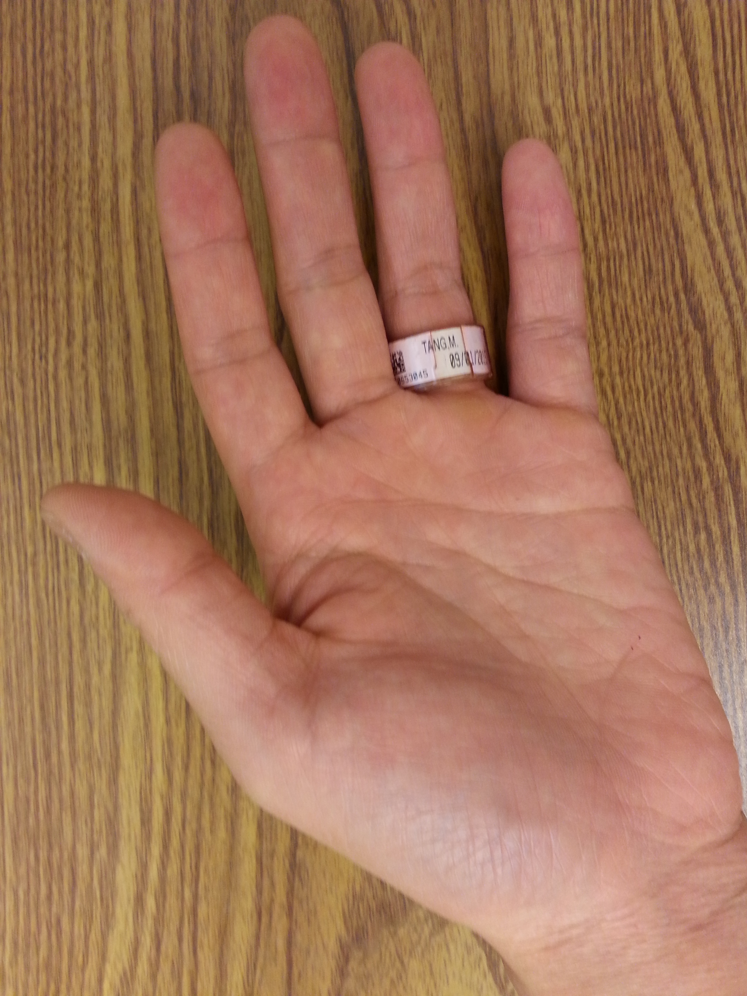
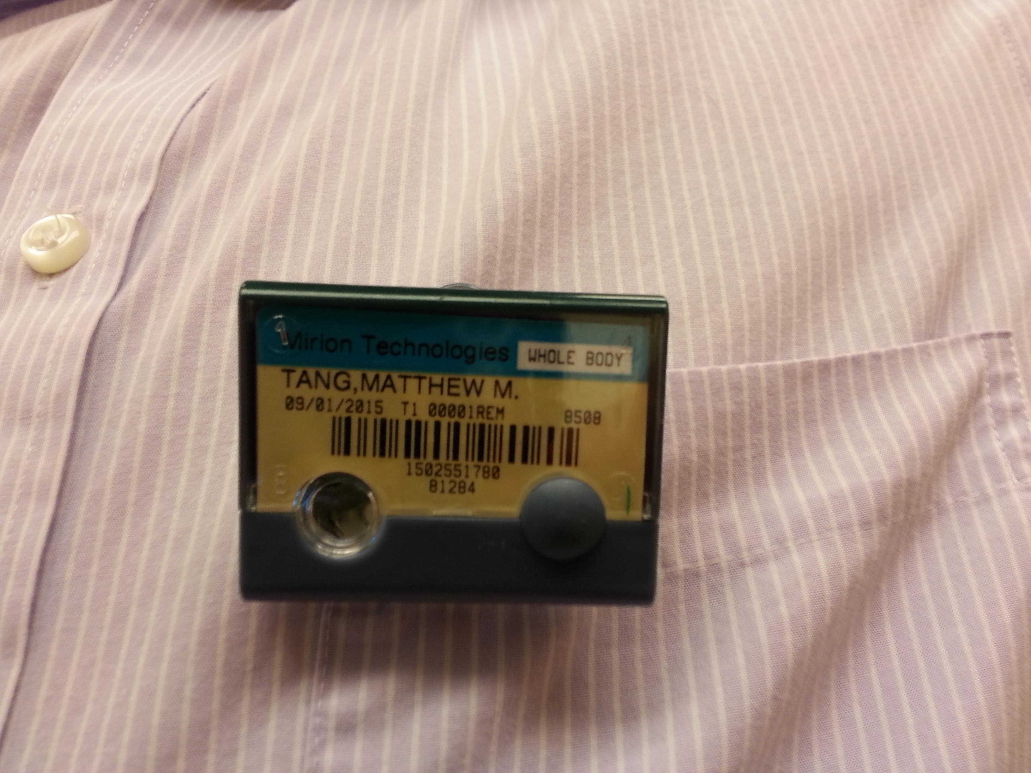
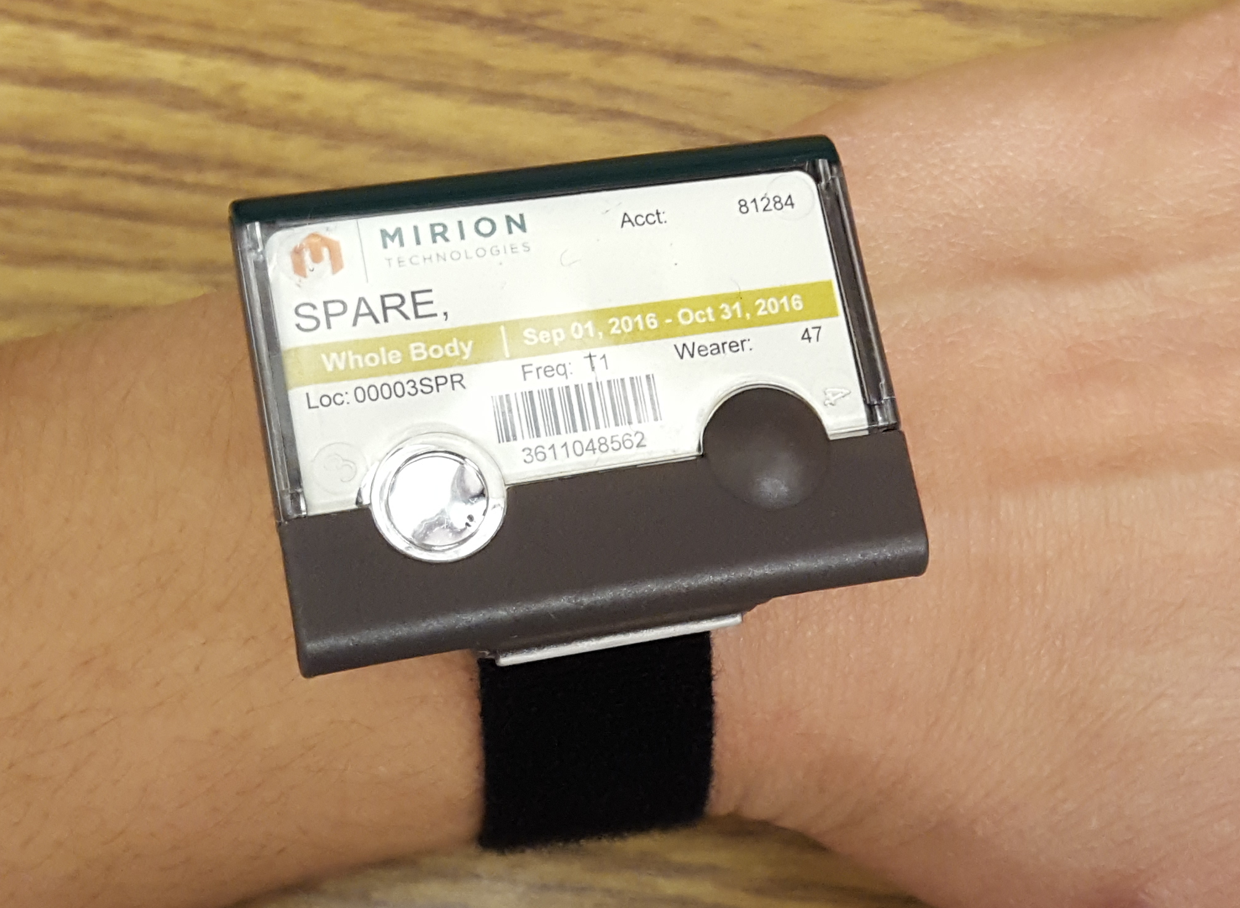
Dosimetry (1)
Dosimetry – Device worn by radiation users to measure their accumulated dose. It is used to ensure that you do not exceed NRC dose limits. There are three types:
Ring – measures dose to the hands, worn on the hand receiving the highest dose with name facing the palm side
Whole-body – measures dose to the torso and head, worn on the part of the torso that will receive the highest dose. If wearing a lead vest, attach the dosimeter outside of the lead vest.
Wrist – measures neutron dose to the extremities, worn on the wrist that will receive the highest dose.

Slide 24
Dosimetry (2)
If issued dosimetry, you MUST wear it every time you are working with radioactive material
Dosimetry must be returned at the end of the wear period (monthly or bimonthly), to be analyzed.
Dose measurement may be lost if dosimeter is returned late
Lost dosimetry may result in charges to your department
REM is obligated to furnish the annual dose report of an individual if he/she requests.

Slide 25
Radiation & pregnancy (1)
Epidemiological studies of the A-bomb survivors, pregnant women who received pelvic X-rays, and animal studies indicate that embryos and fetuses are extremely radiosensitive.
The principal effects of radiation on the developing embryo and fetus, are embryonic, fetal, or neonatal death; congenital malformations; growth retardation; and functional impairment, such as mental retardation; and cancer.
The effects depend on the stage of gestation, the dose, and the dose rate.
These occurrences are extremely unlikely at Purdue because the doses possible from normal operations are very low.

Slide 26
Radiation & pregnancy (2)
Pregnant individuals should take all precautions possible to keep exposures to the embryo or fetus as low as possible.
Extra precautions are taken by Purdue University for a Declared pregnant woman.
Declared pregnant woman means a woman who has voluntarily informed Purdue, in writing, of her pregnancy and the estimated date of conception.
  If a declaration is made, it must be given to the Radiation Safety Officer (RSO) in writing.

Slide 27
Radiation & pregnancy (3)
Once in effect, the pregnant worker’s exposure limit will be reduced to 10% of the occupational dose limit.
In addition, that worker will be given a fetal dosimeter to monitor the dose received by the embryo or fetus.
The declaration remains in effect until the declared pregnant woman withdraws the declaration in writing or is no longer pregnant.
For additional information, refer to Regulatory Guide 8.13

Slide 28
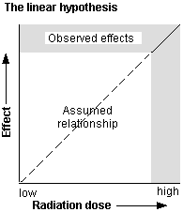
Alara (1)
The risk of developing delayed effects can be decreased by decreasing dose.
Scientists accept the linear no-threshold theory which states that even low-doses carry some risk of developing delayed effects.
The goal is not only to remain below the dose limits, but to keep it even lower by trying to keep doses As Low As Reasonably Achievable (ALARA).
ALARA is not just a good idea, it is REQUIRED by law (10 CFR 20.1101(b)).

Slide 29
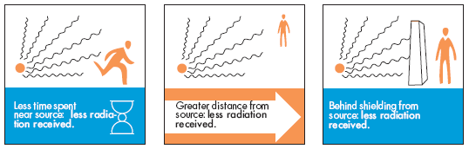
ALARA (2)
There are several practices that will help you to keep your dose As Low As Reasonably Achievable (ALARA).
  Time – Decreasing the time spent in a radiation area results in a lower accumulated dose. Plan all work efficiently.
  Distance – The greater the distance between you and the radioactive material, the lower the dose.
  Shielding – Use shielding to reduce your dose rate.

Slide 30
exposure pathways

Slide 31

External exposure
External exposure occurs when radioactive material outside the body emits radiation that interacts with the individual’s body and deposits a dose.
The principles of time, distance and shielding can protect an individual from external exposures.
☢

Slide 32
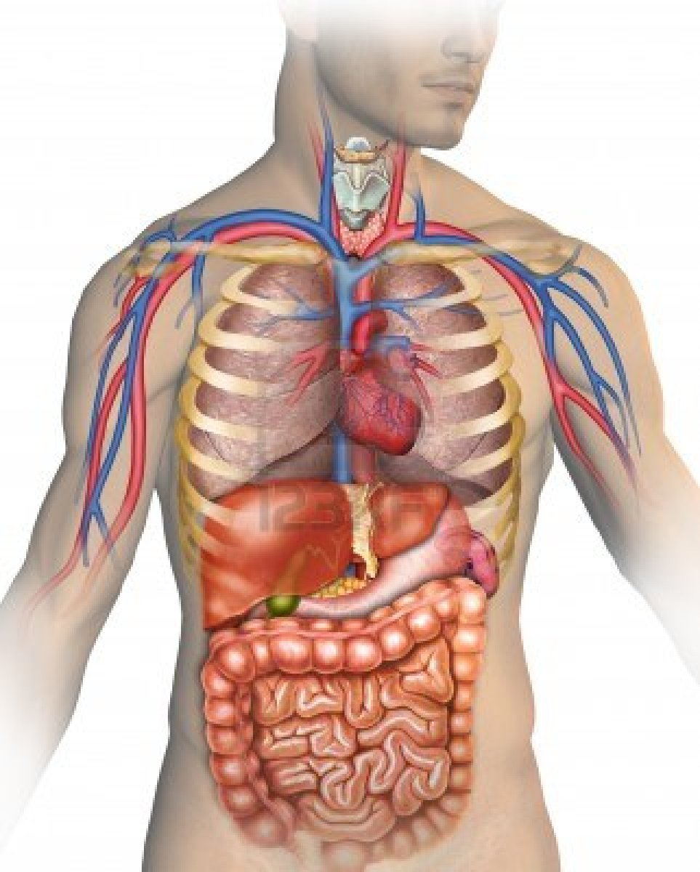
Internal exposure (1)
Internal exposure occurs when radioactive material has entered the body through inhalation (breathing in), ingestion (eating or drinking), absorption through skin and open wounds.
Once in the body, radioactive material will transport and accumulate in the target tissue.
The target tissue depends on the biological behavior of the element/compound.
  For example, ¹³¹I will accumulate in the thyroid gland, ³H will disperse uniformly throughout the body and ⁹⁰Sr will accumulate in the bones.
The target tissue will receive the highest dose.
☢
☢
☢
☢
☢
☢
☢
☢
☢
☢
☢
☢
☢
☢
☢
☢
☢
☢
☢
☢
☢
☢
☢
☢

Slide 33
Internal exposure (2)
Although alpha emitting radionuclides do not pose an external exposure hazard, they are a potent internal hazard.
The principles of time, distance, and shielding will not offer protection.
If you suspect that you have an internal exposure, contact Radiological and Environmental Management (REM). REM will perform a bioassay and a physician may prescribe a treatment plan to remove the radioactive material from your body.
☢
☢
☢
☢
☢
☢
☢
☢
☢
☢
☢
☢
☢
☢
☢
☢
☢
☢
☢
☢
☢
☢
☢
☢

Slide 34
External contamination
External contamination occurs when radioactive material is deposited onto the body or clothing of an individual.
The contamination presents an external exposure hazard.
The principles of time, distance, and shielding will not offer protection.
The only solution is to remove the contaminated clothing and decontaminate the contaminated parts of the body.
☢
☢
☢
☢
☢
☢
☢
☢
☢
☢
☢
☢
☢
☢
☢
☢
☢
☢
☢
☢
☢
☢

Slide 35
exposure controls

Slide 36
Safety Controls
In general, controls are used to protect individuals from external and internal exposures.
There are multiple types of control types. The hierarchy of controls types are as follows:
  Engineering
    Should be the first line of defense
    More reliable and effective and should be given priority
  Administrative (procedural)
    Should be the second line of defense
    If engineering controls are impractical or inadequate, an effective combination of administrative and personal protective equipment shall be used.
  Personal Protective Equipment (PPE)
    Should be the last line of defense
    Required if engineering and administrative controls don’t entirely remove the hazard
Radiological and Environmental Management (REM) will assist you with determining the controls that are appropriate for your application.

Slide 37
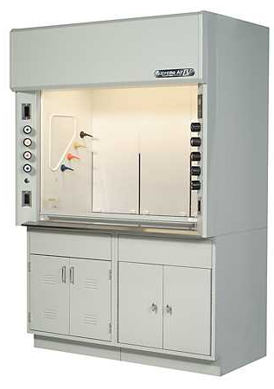
Engineering controls – Fume hood
You should use a fume hood if the procedure/experiment uses or is likely to produce:
  Volatile radioactive material (e.g. radioactive iodine and tritiated water)
  Radioactive gas (e.g. radioactive xenon and radon) or aerosols
Fume hoods must vent into the outdoor environment
  Biological safety cabinets and laminar flow hoods do not meet this requirement and should not be used for radiological protection.
Only use fume hoods that are in good working order, and inspected and certified by REM.

Slide 38
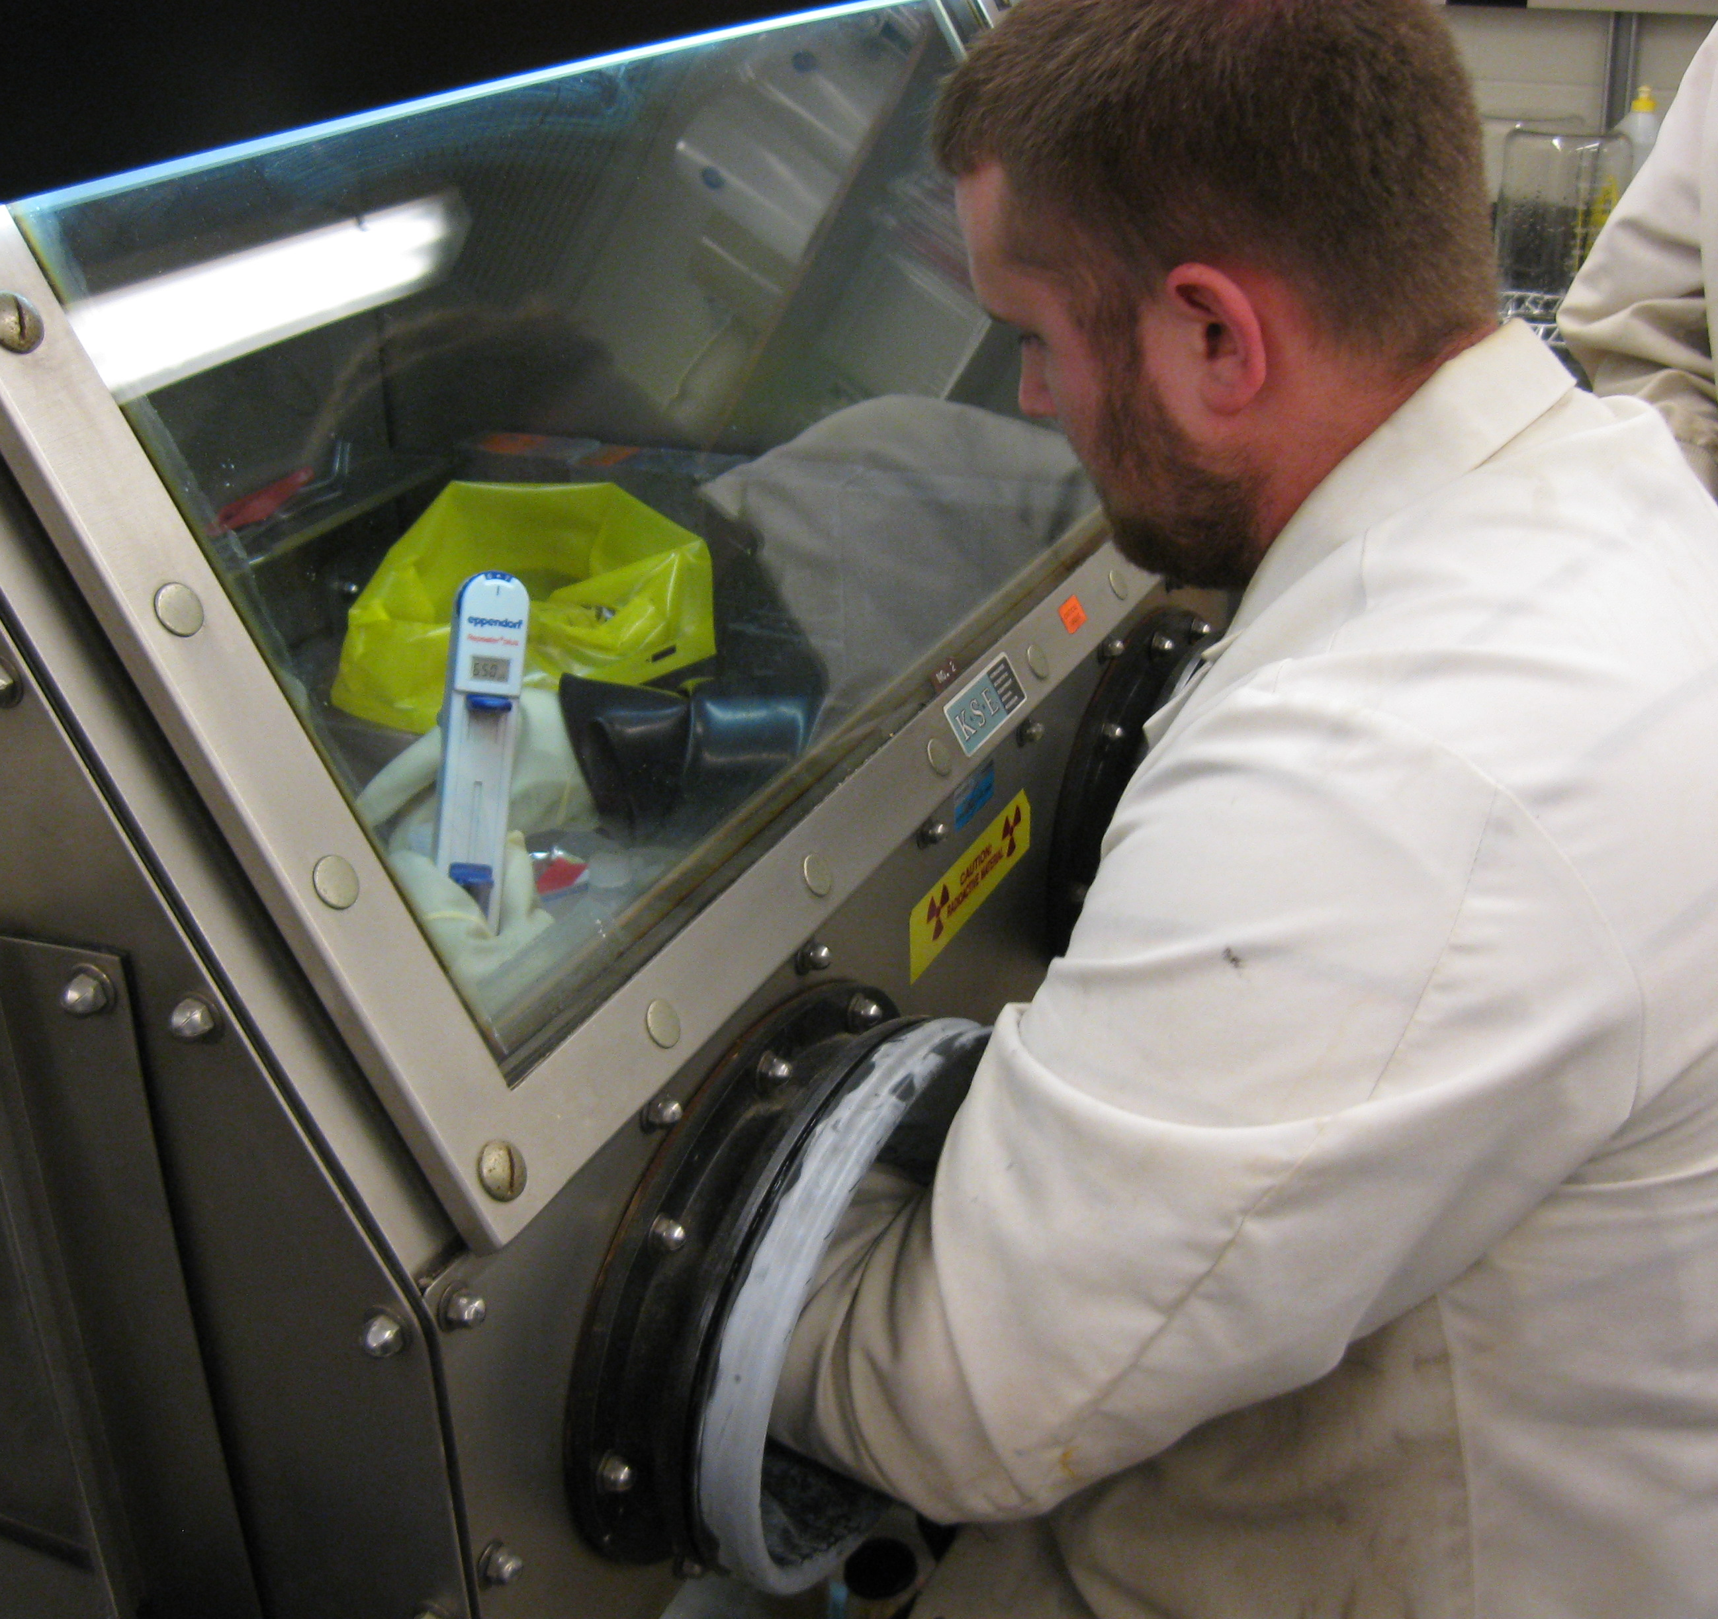
Engineering controls – Glove Box
You should use a glove box if the procedure/experiment uses or is likely to produce:
  Radioactive powders or particulates
  Alpha emitting radionuclides (e.g. ²³⁵U, ²³⁸U, ²³²Th, etc.)
Gloveboxes must maintain a negative air pressure such that radioactive material will not escape the glove box in the event of a leak.
The gloves must be in good condition and free of holes.

Slide 39
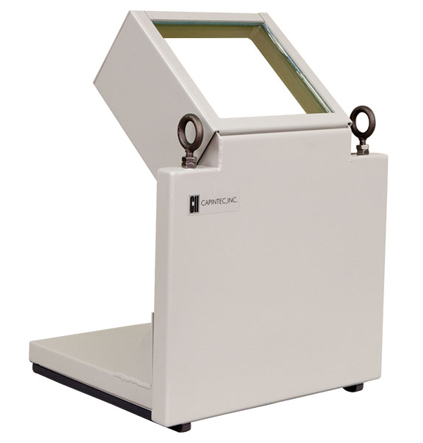
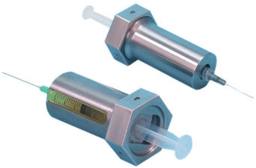
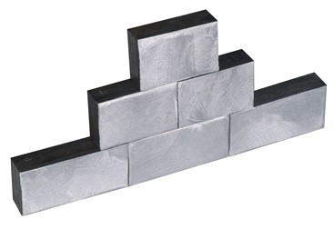
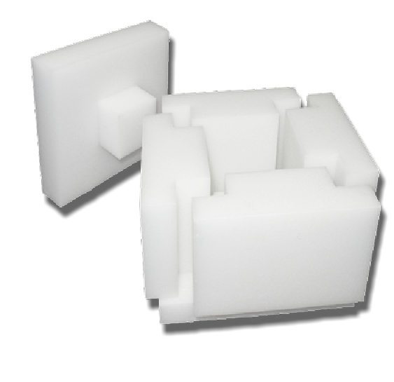
Engineering controls – shielding
This slide lists examples of shielding that are commercially available.
As much as possible, shielding should be used when using and storing radionuclides that emit:
  Gamma-rays (e.g. ^{99m}Tc, ¹³¹I, ¹²⁵I, ¹⁸F, etc.)
    Lead “L” block table top shields
    Syringe shields
    Lead Bricks
  High-energy beta particles (e.g. ³²P, etc.)
    Acrylic “L” block table top beta shields
    Acrylic beta shield boxes
  Neutrons (²⁵²Cf, ²⁴¹Am Beryllium and ²³⁹Pu Beryllium, etc.)
    Paraffin and polyethylene blocks
    Concrete
REM will help you select the optimal shielding

Slide 40
Administrative controls - training
Nuclear Regulatory Commission (NRC) and Purdue University require individuals to receive the following training prior to working with or around radioactive material:
Initial Online Radiation Safety Training
  This presentation
Hands-on Radiation Safety Training
  Covers the following: How to use detectors, performing contamination surveys, decontamination and radioactive waste
On-The-Job Training
  Instruction by the supervisor or PI on the safe completion of the task involving radioactive material
Biennial Radiation Safety Retraining
  Reviews the principles covered in the initial training.

Slide 41

Administrative controls – sop
Standard Operating Procedures (SOP) are step-by-step instructions that ensures the safe use of radioactive material in a particular experiment or procedure.
When developing SOPs, emphasis should be given to reducing radiation exposure and contamination.
Standard Operating Procedures (SOP) should be developed and followed when one of the following applies:
  Performing a novel procedure
  Using large quantities of radioactive material
  Using unsealed alpha-emitting radionuclides

Slide 42
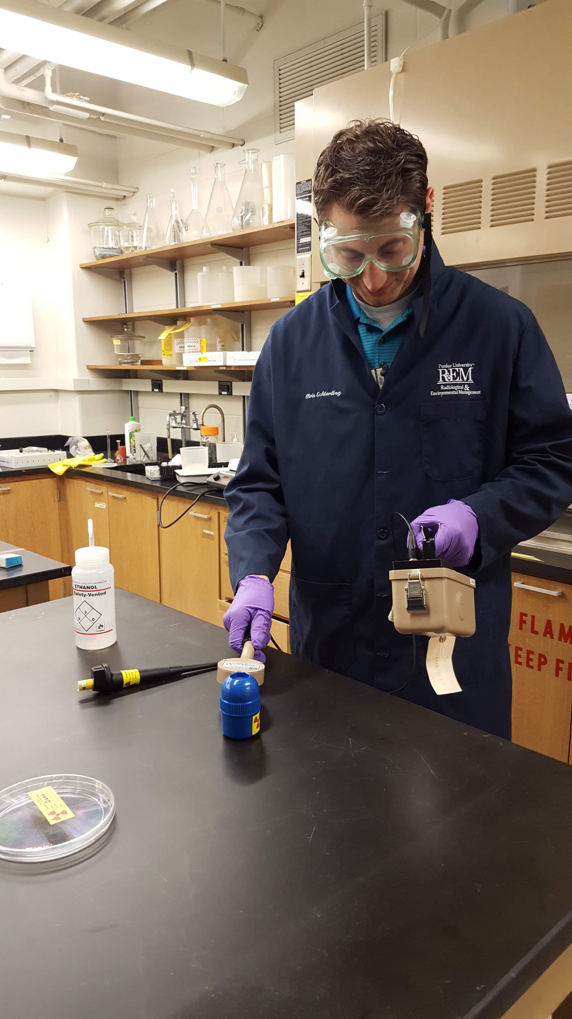
Administrative controls – Surveys
Despite extreme care, laboratory surfaces (e.g. benchtop, floors) and equipment (e.g. pipetts, glassware) can become contaminated with radioactive material.
You are required to perform surveys to detect radiological contamination using the proper detection method and techniques.
The radiation lab must be surveyed:
  Immediately after completing experiments involving radioactive material, or samples containing radioactive material.
  On a monthly basis if radioactive material has been used that month.
    The survey frequency may increase depending on the quantity and isotope used.

Slide 43
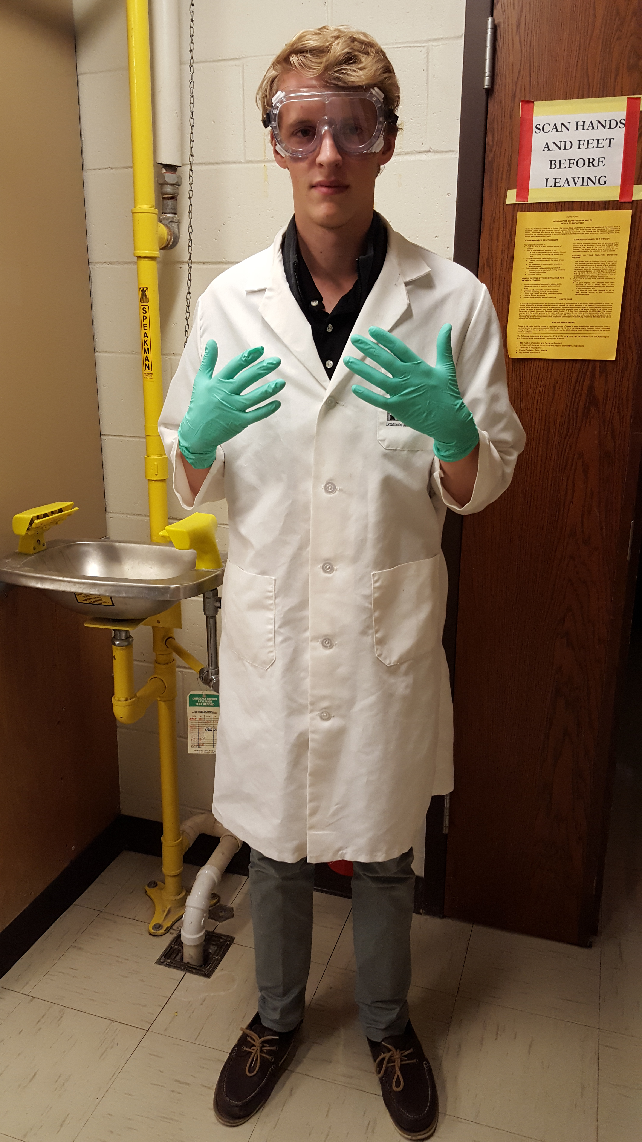
PPE – minimum required
When working with or handling radioactive material, radioactive samples, or animals containing radioactive material, the minimum personal protective equipment (PPE) is required:
  Gloves
  Lab coat
  Safety glasses or goggles
  Closed-toe shoes
  Long pants

Slide 44
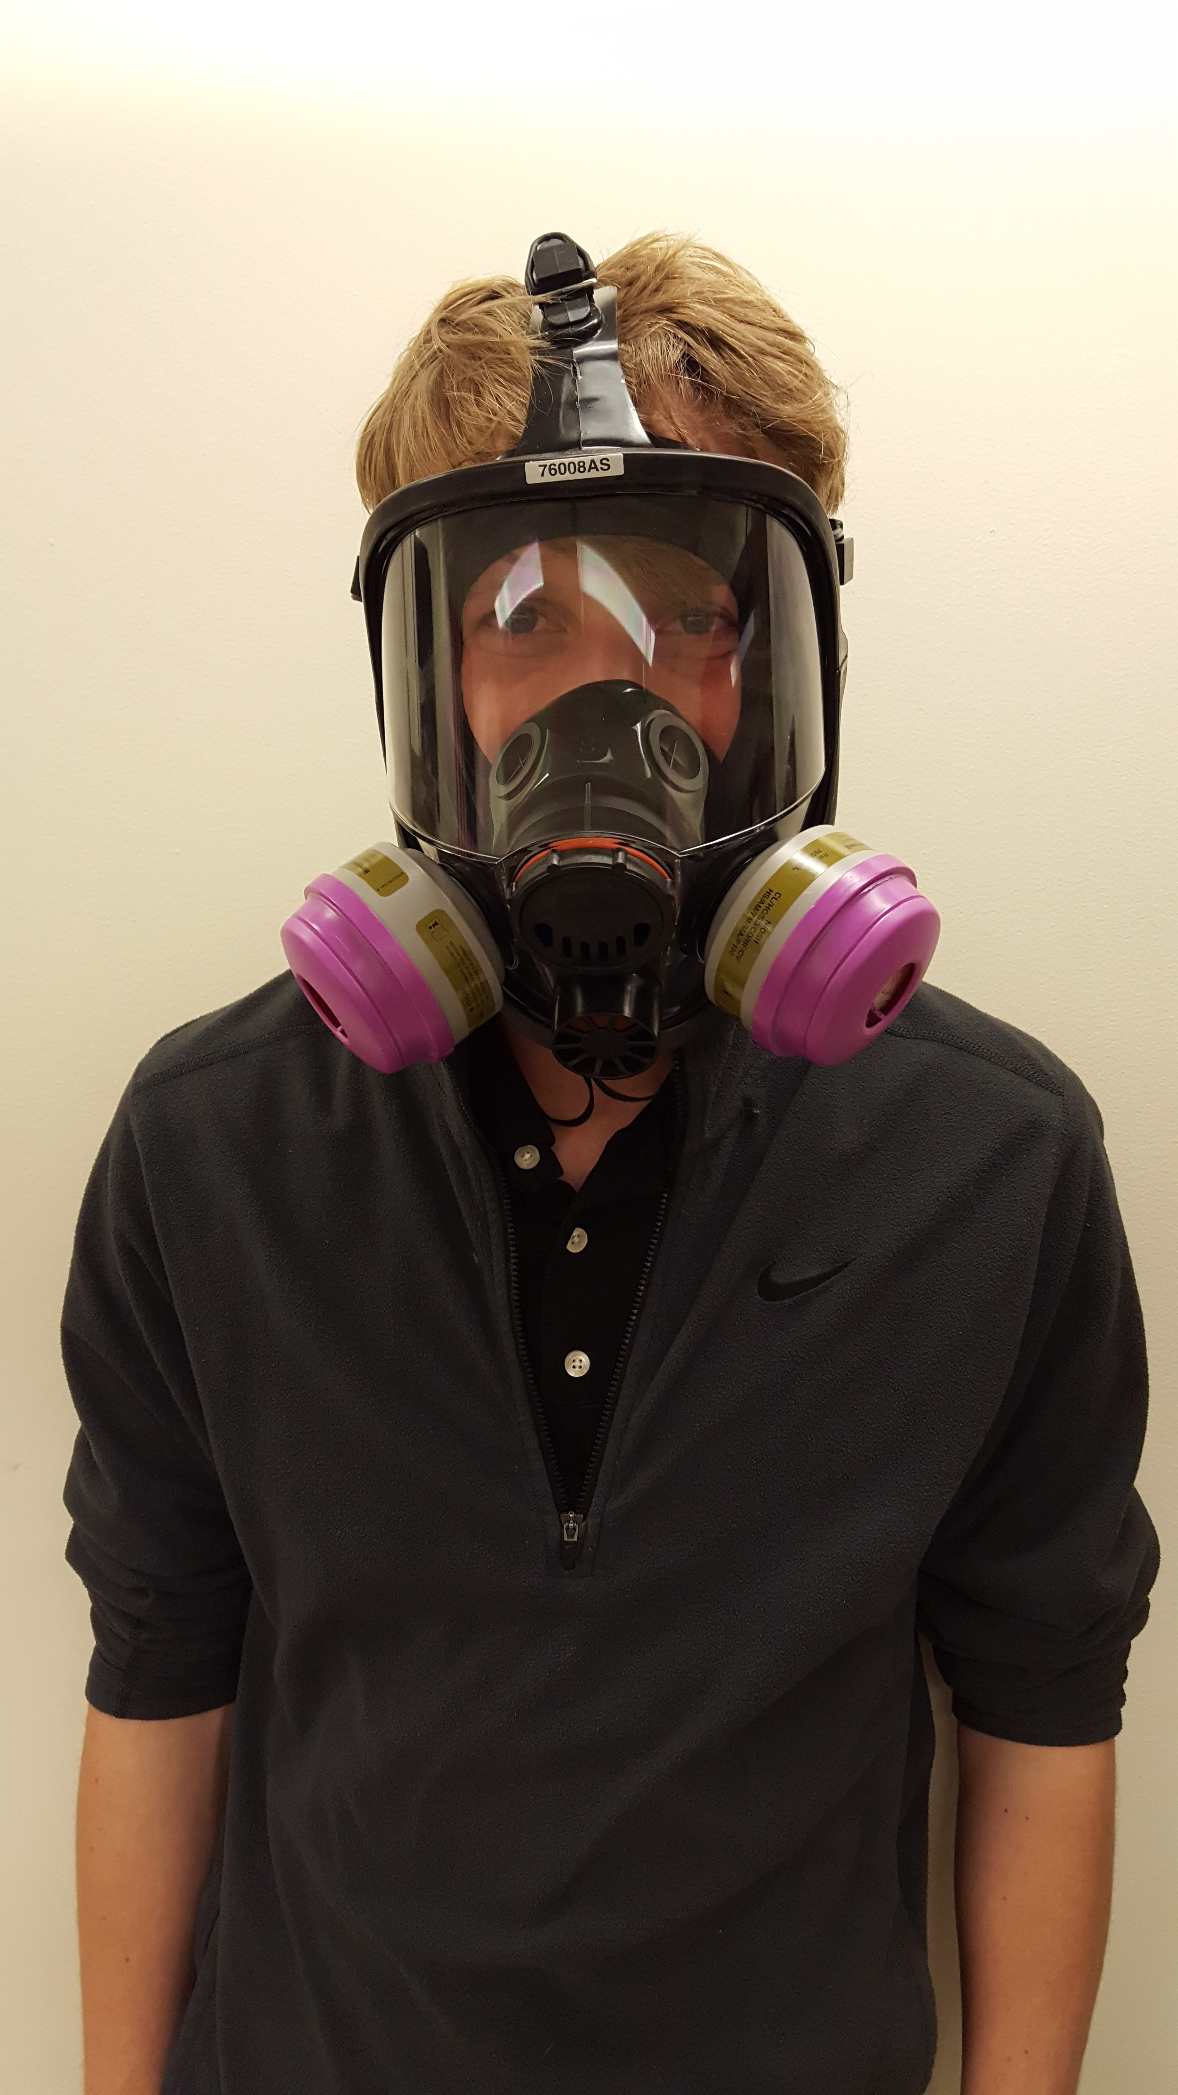
PPE – respirators
If you cannot use fume hoods or gloveboxes to protect from airborne radioactive contaminants respirators are an option.
There are multiple types of respirators (i.e. full and half-faced respirators, and N95 masks).
Before using a respirator, you must contact REM to participate in it’s respiratory protection program
  Improper respirator usage can result in serious injury or death.
There are a variety of filter cartridges. REM will help you select the filter that works for your application.
Respirators are required if you are working inside a walk-in fume hood.
Individuals may not use respirators if they have facial hair along their jaw and neck because this prevents a good seal.

Slide 45
Detection methods

Slide 46
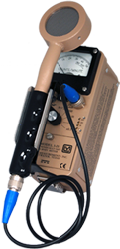
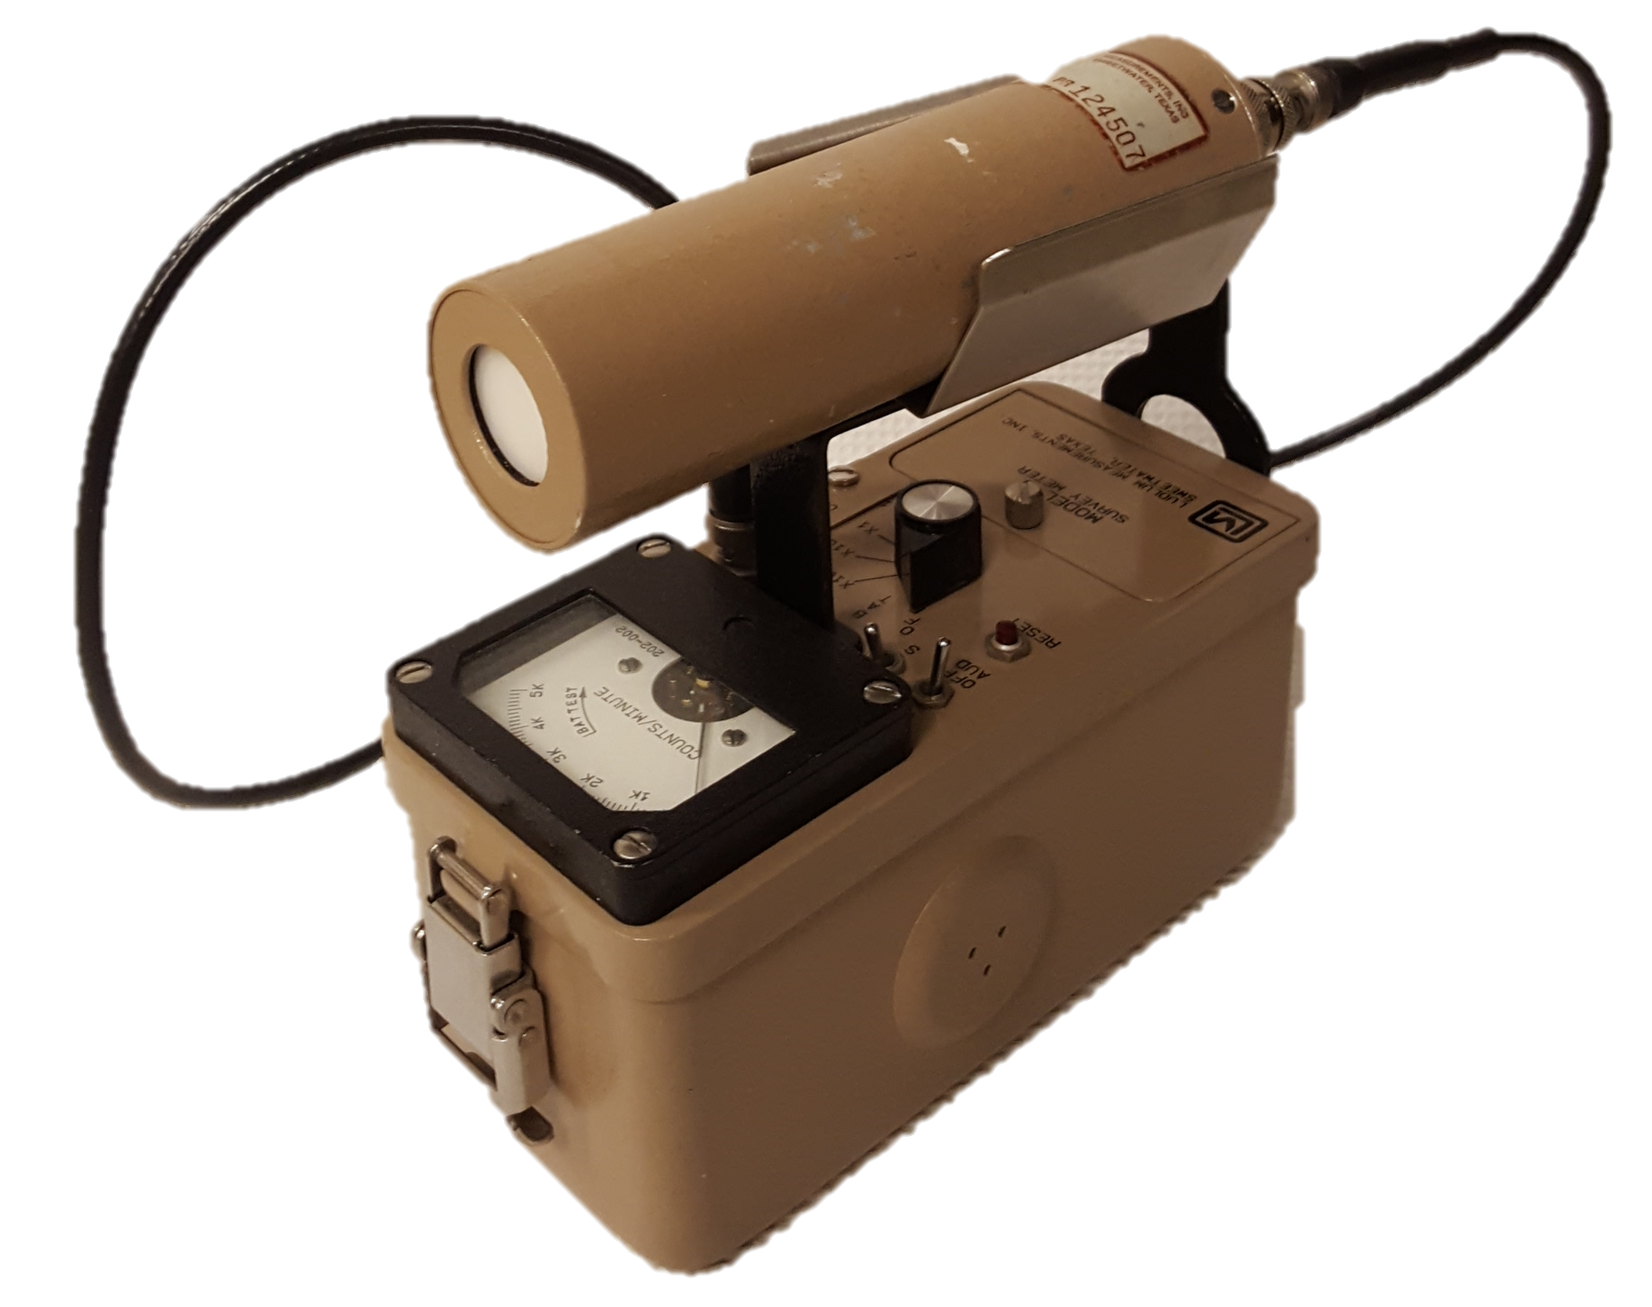
Common detection methods (1)
Geiger (GM) Detector
  Able to detect high-energy beta particles and gamma-rays.
  Unable to detect low-energy beta particles, alpha particles and neutrons.
  Output has units of counts per minute (cpm)
Sodium Iodide (NaI) Detector
  Able to detect gamma-rays with a high efficiency
  Unable to detect beta particles, alpha particles and neutrons
  Output has units of counts per minute (cpm)

Slide 47
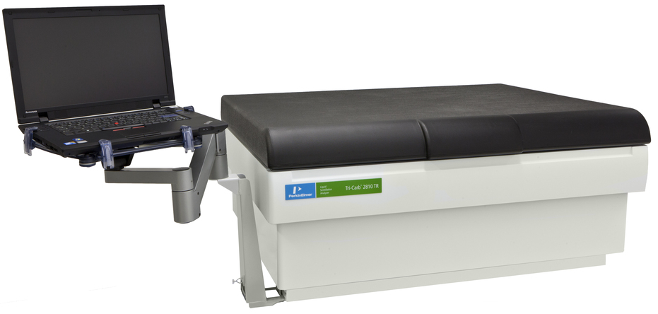
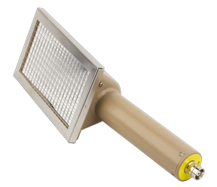
Common detection methods (2)
Liquid Scintillation Counter (LSC)
  Able to detect low and high-energy beta particles gamma-rays and alpha particles
  Unable to detect neutrons.
  Output has units of decays per minute (dpm)
Alpha Detector
  Able to detect alpha particles with a high efficiency
  Unable to detect beta particles, gamma-rays and neutrons.
  Output has units of counts per minute (cpm)
You will be trained on the operation of these detectors during the hands-on radiation safety training.

Slide 48
Selecting the Detection method
When performing surveys, make sure you are using the correct detection method. The table below lists most common isotopes used and the recommended detection method. If possible, you should use the ‘best’ detection method.
Radionuclide | Geiger Detector | Sodium Iodide Detector | Liquid Scintillation Counter | Alpha Detector
¹⁴C | Poor Detection | No Detection | Great Detection | No Detection
³H | No Detection | No Detection | Great Detection | No Detection
¹²⁵I | Good Detection | Great Detection | Good Detection | No Detection
¹³¹I | Good Detection | Great Detection | Great Detection | No Detection
³²P | Great Detection | No Detection | Great Detection | No Detection
³⁵S | Poor Detection | No Detection | Great Detection | No Detection
^{99m}Tc | Good Detection | Great Detection | Good Detection | No Detection
¹⁸F | Good Detection | Great Detection | Great Detection | No Detection
⁴⁵Ca | Good Detection | No Detection | Great Detection | No Detection
²³⁸U | Great Detection | Great Detection | Great Detection | Great Detection
²³²Th | Great Detection | Great Detection | Great Detection | Great Detection
 | Not Recommended – Do Not Use
 | Good
 | Best

Slide 49
Labeling, Procuring, transferring, securing, storing, transporting and shipping radioactive material

Slide 50
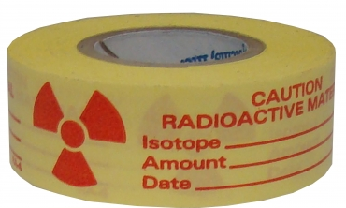
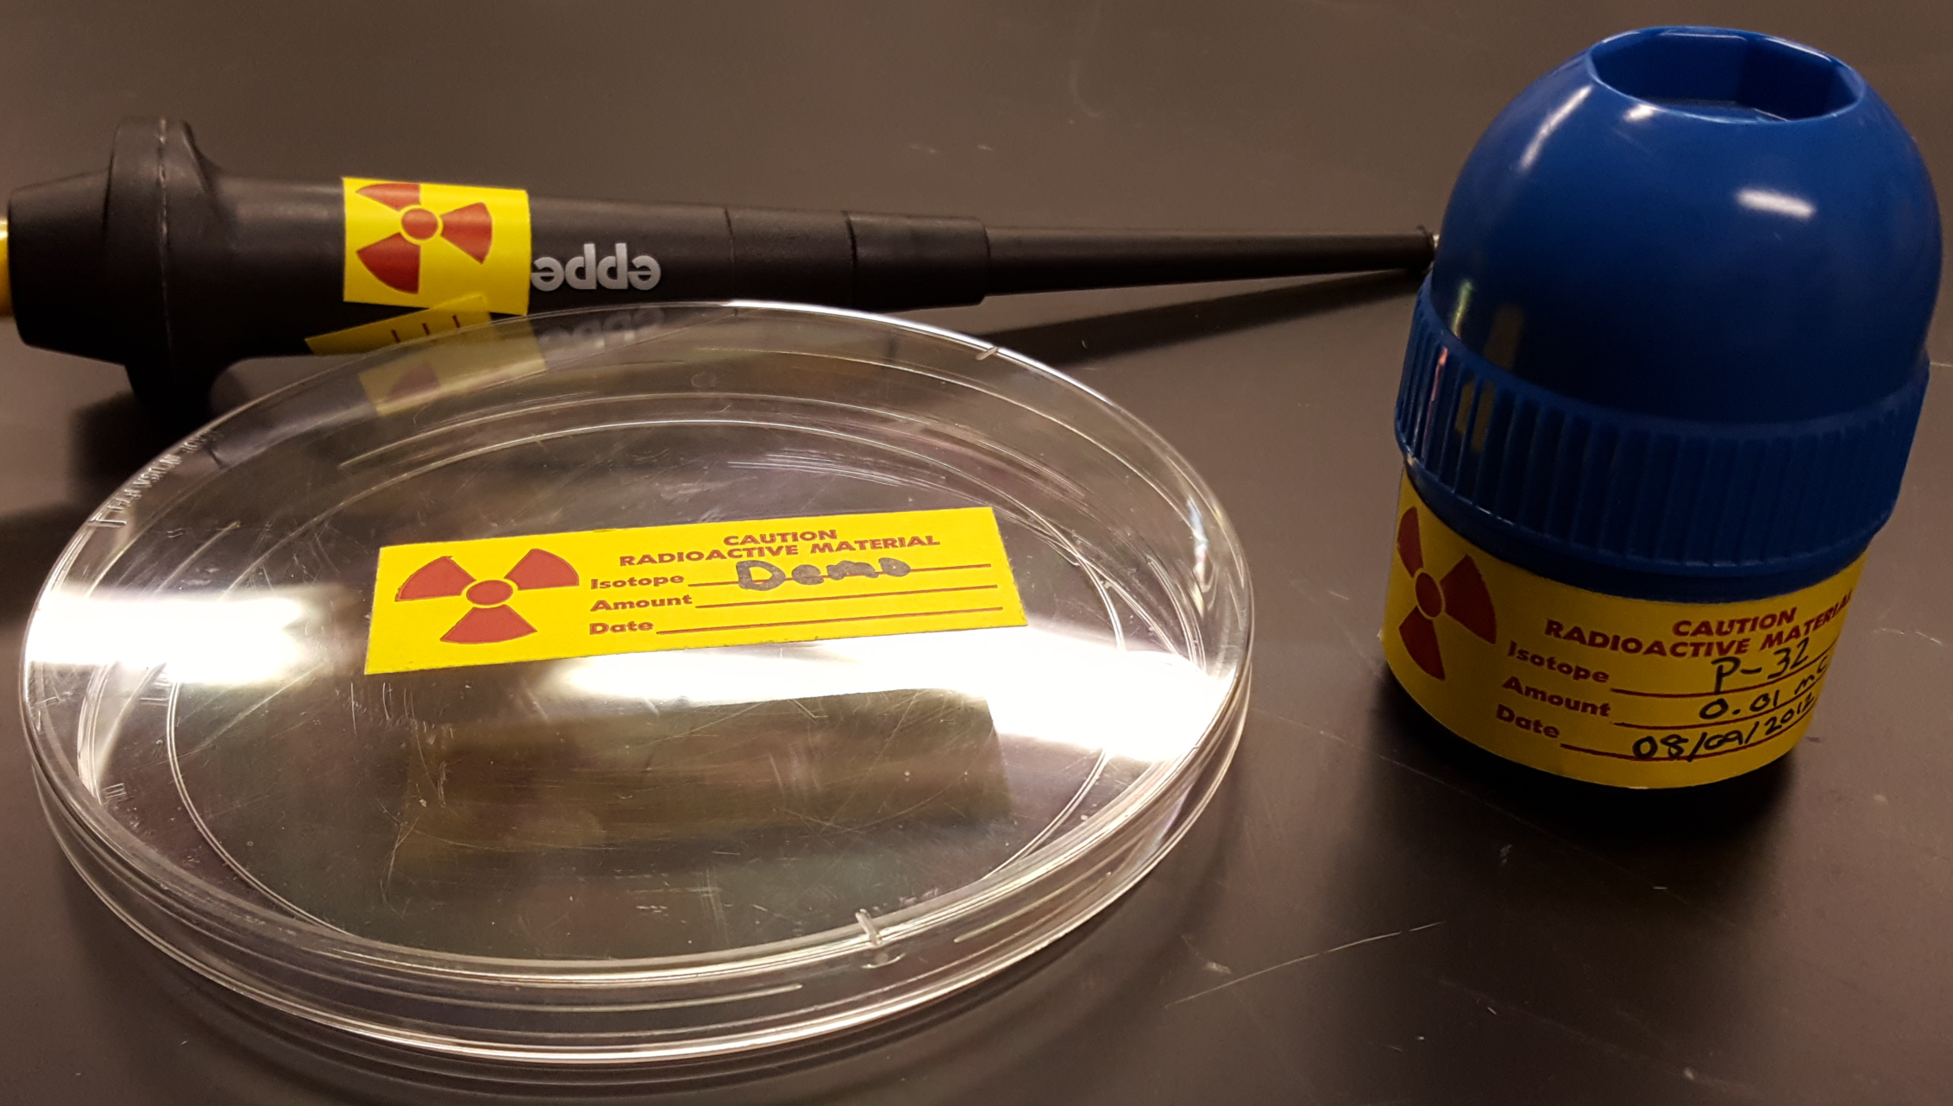
equipment and material Labeling
Radiation users have the responsibility to ensure that all radioactive reagents, radiation sources, radioactive samples, animals containing radioactive material, and equipment utilized in experiments involving radioactive material are properly labeled.
Labeling must have:
  The traditional radiation symbol
  The words ‘Caution Radioactive Material’
  The radioisotope listed
  The amount (activity) contained
  The date that the amount was determined

Slide 51
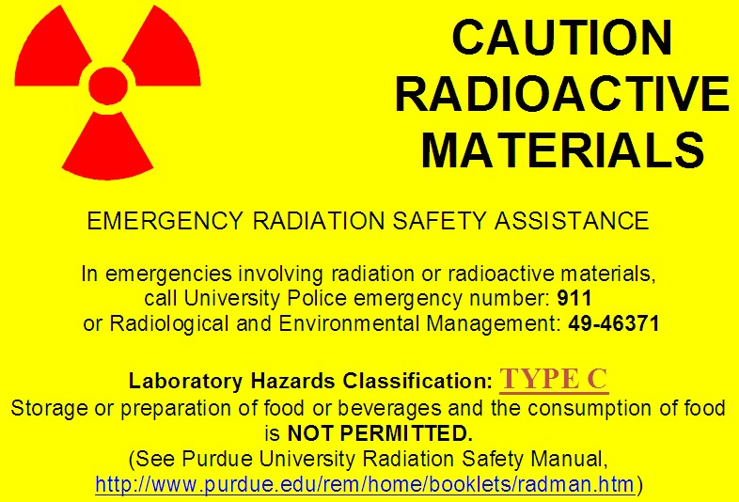
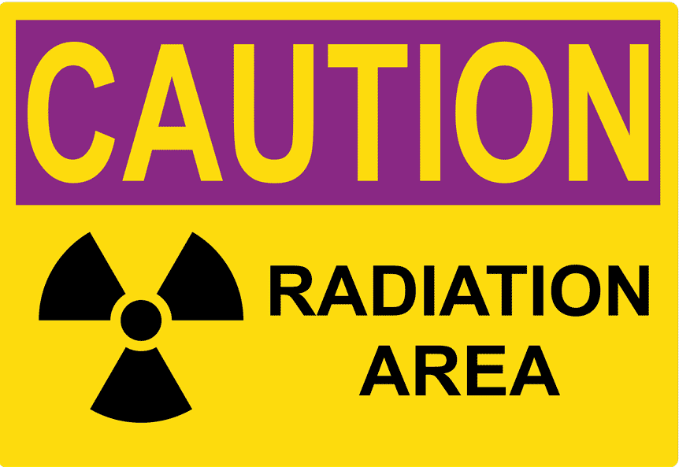
Laboratory postings
All locations that are used for the storage, use and counting of radioactive material must have the appropriate ‘Caution Radioactive Materials’ door posting that warns individuals of the presence of radioactive material prior to entering that location.
Contact REM if you want to store, use or count radioactive material in a location that does not currently have the appropriate door posting.
If the dose rate from the radiation source is greater than 5 mrem at 30 cm, but less than 100 mrem, a ‘Caution Radiation Area’ posting is also required.

Slide 52
Procuring and transferring
The possession of radioactive material is regulated by REM.
Principal Investigators that desire to obtain radioactive material must submit a Radioactive Material Requisition (Form R-1) to REM.
Your business office must follow a specific procedure when purchasing radioactive material.
  Failure to follow these procedures can delay your order.
Before transferring radioactive material, you must contact REM. REM will determine whether or not the recipient is permitted to possess the radioactive material.

Slide 53
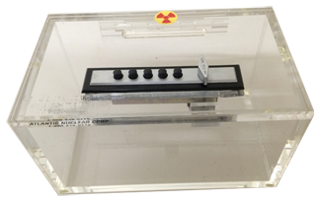
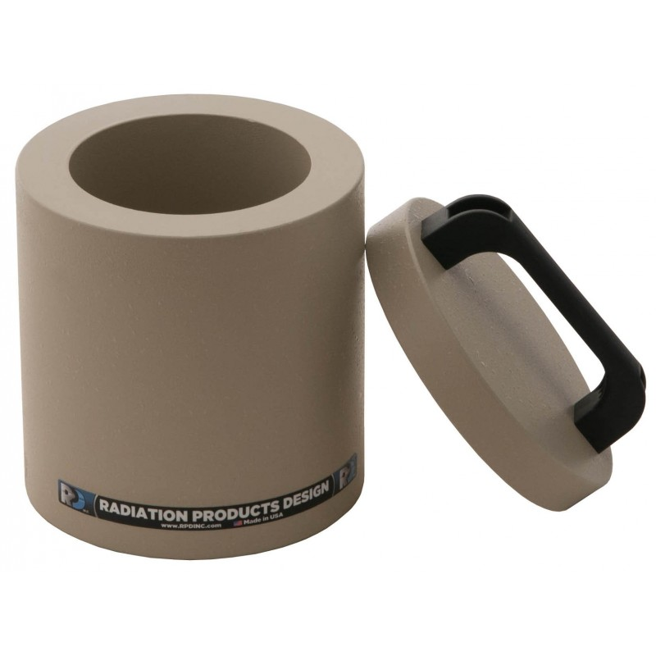
Security and storage
The NRC mandates the safeguarding of radioactive material to prevent:
  Theft and sabotage of radioactive material
  Accidental exposure to radiation
Radioactive material must be secured by locking doors when the room is unoccupied or, storing radioactive material in locked containers, safes or refrigerators.
Radionuclides that emit high-energy beta particles, gamma-rays and neutrons should be stored in shielded containers or behind radiation shielding.

Slide 54

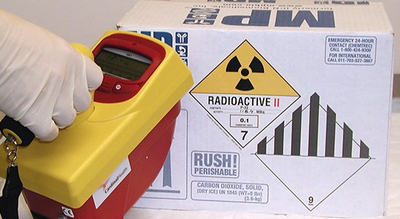
Transporting and shipping
The transportation and shipping of radioactive material is regulated by the Department of Transportation (DOT).
DOT regulations are meant to ensure the safe transport of radioactive material.
DOT regulations only apply when public roadways will be used.
If you are planning to transport or ship radioactive material, you must contact REM first.

Slide 55
Safety organizations

Slide 56

Nuclear regulatory commission
Purdue University is licensed to acquire, possess and use radioactive material by the Nuclear Regulatory Commission (NRC)
The NRC is an entity of the United States government.
The NRC has a two-fold mission:
  Ensure the safety of the public and radiation workers
  Safeguarding radioactive material
The NRC fulfills its purposes by developing and enforcing regulations affecting the receipt, possession, transfer, production and use of radioactive material.
The applicable NRC regulations are codified in Title 10, Code of Federal Regulations (10 CFR)

Slide 57
10CFR19 and 10CFR20 summary
In accordance with Title 10 of the Code of Federal Regulations part 19 and 20:
Purdue shall:
  Post the regulations in 10CFR20, the NRC issued radioactive material license, operating procedures, notices of violations and up-to-date versions of the NRC Form 3, “Notice to Employees.”
  Provide radiation safety training commensurate with the potential hazards
  Provide radiation exposure/dose records to radiation workers upon request
  Permit NRC inspections
  Ensure the dose to radiation workers, members of the public and minors are maintained below the dose limits and As Low As Reasonably Achievable
  Secure radioactive material from unauthorized removal and access
  Receive radioactive material shipments in accordance with 10CFR20.1906
  Dispose radioactive waste in accordance with 10CFR20, Subpart K
  Maintain records in accordance with 10CFR20, Subpart L
  Submit reports to the NRC in accordance with 10CFR20, Subpart M
Employees can request an NRC inspection without fear of retribution

Slide 58
Purdue University organization
Purdue University’s radiation safety program is empowered by Purdue University Executive Memorandum No. B-14
Purdue University’s radiation policies can be found in the Purdue Radiation Safety Manual
The radiation safety program is managed by the:
  Radiation Safety Committee (RSC)
  Ensures the safety of the University and community in the utilization of all radioactive materials and radiation producing devices at the University or by University faculty, staff or students.
  Department of Radiological and Environmental Management (REM)
  Carries out the directives of the RSC.
  Works to achieve compliance with regulations and license conditions.

Slide 59
Rem responsibilities
REM complies with NRC regulations by:
  Providing radiation safety training
  Monitoring radiation exposure to public and radiation workers
  Consulting support for any safety issues or concerns
  Performing safety audits
  Performing contamination surveys
  Overseeing decontamination efforts
  Maintaining an inventory of radioactive material
  Safeguarding radioactive material
  Ensuring the proper safety controls are in place

Slide 60
Final thoughts

Slide 61
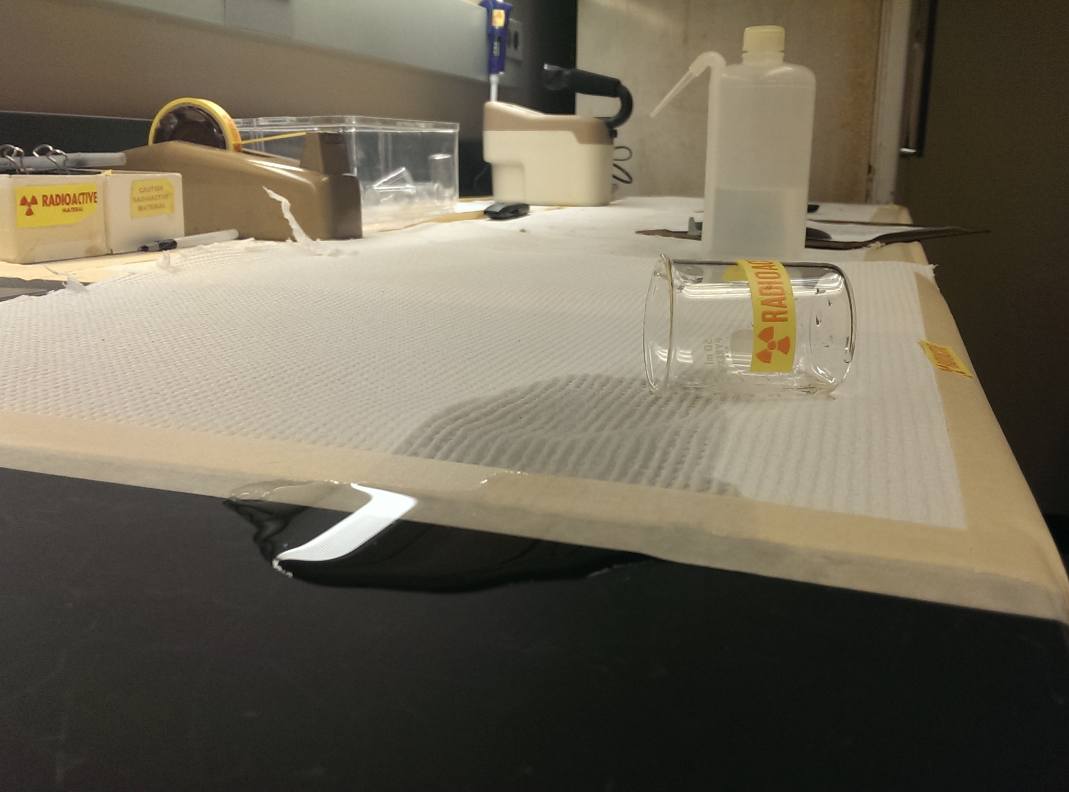
Good practices
Don’t order or use more radioactive material than you need
Do not perform work on porous surfaces
Cover work surfaces with bench paper
Perform work in trays when working with large volumes of liquids

Slide 62
Contact REM if…
You know or suspect there has been an overexposure to an individual
There has been a spill involving a large quantity (> 1 mCi) of radioactive material
You suspect or find contamination on the floor
You suspect or find contamination on an individual
You have questions or concerns
Personnel working on the project has been changed (added/dropped)
You observe any condition which may lead to or cause a violation of NRC regulations and licenses or unnecessary exposure to radiation and/or radioactive material

Slide 63
Enforcement
Failure to comply with the rules, regulations safe practices established by the Nuclear Regulatory Commission (NRC) or Purdue University can result in:
  Required retraining for all lab members
  Loss of work privileges with or around radioactive material
  Suspension of the project involving radioactive material
  Civil penalties
  Criminal penalties
  For willful violation of, attempted violation of or conspiracy to violate any regulation

Slide 64
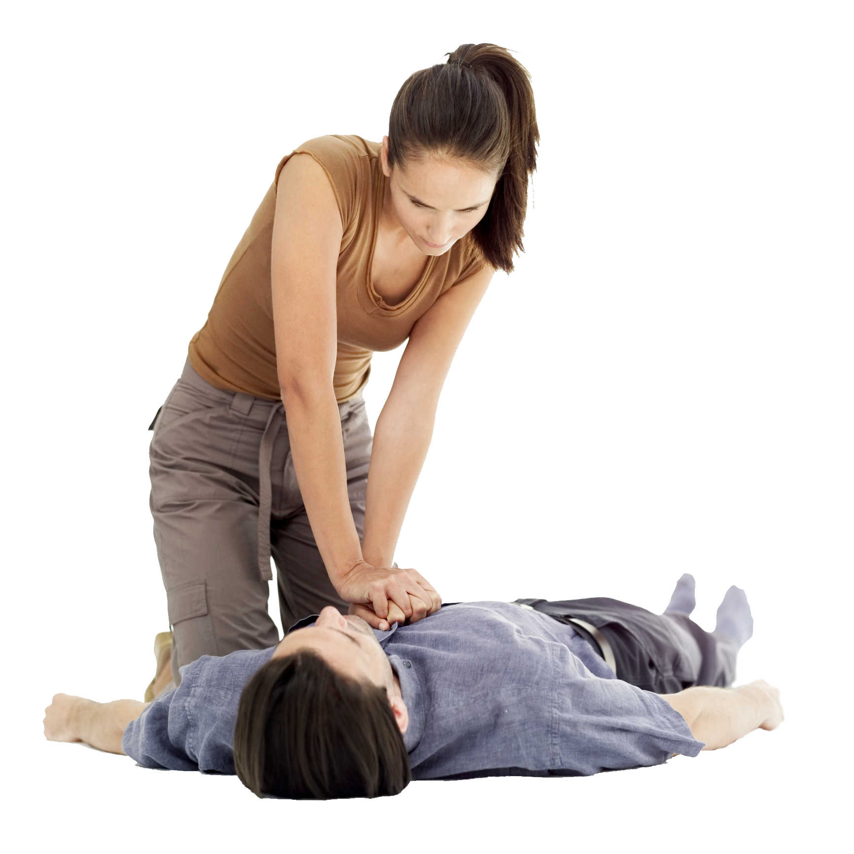
Personal injury
In the event of an emergency involving a life-threatening injury, priority should be given to life-saving.
Dial 911
Administer life-saving procedures without regard for radiological contamination.
Do not move a seriously injured person unless he/she is in further danger.
Notify REM (4-6371)

Slide 65
Radiation Safety Group
Joshua A. Young, M.S 494-2721
Radiation Safety Officer (RSO) young127@purdue.edu
Nathan Claus 494-1478
Health Physicist njclaus@purdue.edu
Jerry J. Gibbs 49-40207
Environmental Technician jjgibbs@purdue.edu
Anca Condret 49-47969
Environmental Technician acondret@purdue.edu
Josh Wade 49-40205
Environmental Technician wade54@purdue.edu

Slide 66
End of training module
This concludes the PowerPoint portion of the training.
Complete the test indicated below. You must have 75% of correct responses to pass.
  Your results will be emailed to you, and will constitute as your certification of your successful completion of the online portion of your training, if you have passed.
You still need to complete the classroom radiation safety training before you can start working with radioactive material.
Submit a completed Form A-4 (make sure that both you AND your Principal Investigator have signed the form), and send through campus mail to: Sharon Rudolph/REM/HAMP
Click here to begin the test.

