Slide 1
COVID-19 On-Site Employee Safety Training
Your health and the safety of everyone in the Purdue community is your personal responsibility.
v8

Slide 2
Training Purpose
This training is designed to…
Raise awareness about COVID-19
Provide guidance to protect yourself and to protect the most vulnerable campus populations
Provide instructions on how to correctly wear, remove, and dispose of personal protective equipment (PPE) and face masks

Slide 3
COVID-19: Things You Need to Know
For the most up to date COVID-19 information:
Get Purdue University information and updates from our COVID-19 Coronavirus Updates website. https://protect.purdue.edu/
Get Centers for Disease Control and Prevention (CDC) information and updates from their Coronavirus (COVID-19) website. https://www.cdc.gov/coronavirus/2019-ncov/index.html

Slide 4
What is COVID-19?
Overview
Coronavirus disease 2019, or COVID-19, is a viral respiratory illness spreading from person-to-person.
COVID-19 is considered a global pandemic with community spread.

Slide 5
COVID-19 Symptoms
What to Look for
Symptoms may appear 2-14 days after virus exposure.
Fever 100.4 °F or above
Cough
Shortness of breath or difficulty breathing
Chills
Repeated shaking with chills
Muscle pain
Headache
Sore throat
New loss of taste or smell
Notes:
Source: https://www.cdc.gov/coronavirus/2019-ncov/symptoms-testing/symptoms.html

Slide 6
How is COVID-19 spread?
Unprotected person-to-person interactions
Contacts within about 6 feet for more than 15 to 20 minutes
Respiratory droplets
Asymptomatic individuals can spread the disease
While less likely, touching contaminated surfaces or objects
Notes:
Source: https://www.cdc.gov/coronavirus/2019-ncov/prevent-getting-sick/how-covid-spreads.html

Slide 7
COVID-19 Risk Factors
Older adults and people of any age who have serious underlying medical conditions might be at higher risk for severe illness from COVID-19.
Additional risk factors:
Chronic lung disease or moderate to severe asthma
Serious heart conditions
Immunocompromised
Obesity – body mass Index of 40 or higher
Diabetes
For the full list and additional information, please see: https://www.cdc.gov/coronavirus/2019-ncov/need-extra-precautions/people-with-medical-conditions.html

Slide 8
Take Care of Yourself and Others ₍₁₎
Stay home if you are sick.
Contact the Protect Purdue Health Center (even if not a patient) at 765-496-4636 for an assessment and further guidance if you....
Feel ill with symptoms from below:
Cough
Shortness of breath or difficulty breathing
At least two of the following:
Fever 100.4 °F or above
Chills
Repeated shaking with chills
Muscle pain
Headache
Sore throat
New loss of taste or smell
Have had close contact with anyone including family members who has tested positive for COVID-19
Have had close contact with anyone who has been tested for COVID-19 and is waiting for results

Slide 9
Take Care of Yourself and Others ₍₂₎
Guidance on Illness or Exposure to COVID-19
If you are diagnosed with COVID-19 or have been exposed to COVID-19, follow your medical providers advice.
The CDC What To Do If You Are Sick webpage provides detailed COVID-19 diagnoses and exposures information. See https://www.cdc.gov/coronavirus/2019-ncov/if-you-are-sick/steps-when-sick.html.

Slide 10
Take Care of Yourself and Others ₍₃₎
#1 for Prevention: Excellent Hand Hygiene
Avoid touching eyes, nose, and mouth with unwashed hands.
Wash your hands with soap and water for at least 20 seconds
If soap and water are not available, use a hand sanitizer that contains at least 60 percent alcohol.
Cover all surfaces of hands and rub together until dry.

Slide 11
Take Care of Yourself and Others ₍₄₎
Good Respiratory Hygiene
Cover mouth and nose with tissues when coughing or sneezing or use the inside of elbow.
Immediately throw away used tissues in the trash; do not leave on top of surfaces.
Wash hands with soap and water or apply hand sanitizer.

Slide 12
Take Care of Yourself and Others ₍₅₎
Practice Safe Social Distancing on and off campus.
Minimize contacts within 6 feet for long periods of time, especially in enclosed areas and common areas.
Do not gather in large groups.
Stay out of crowded places and avoid mass gatherings.
Stay outside or come back later if a building is too crowded.
6 feet

Slide 13
Take Care of Yourself and Others ₍₆₎
Face Mask Guidance
You must wear a face mask when in
All hallways, public spaces and common areas, including classrooms. Masks must also be worn in office and lab spaces if social distancing of six feet is not possible.
You are not required to wear a face mask when
In individual offices or workspaces that are spaced apart to maintain proper social distancing.
Outside unless safe social distancing and gathering practices are not possible.
Cloth face masks should be washed daily.

Slide 14
Take Care of Yourself and Others ₍₇₎
Face Mask Materials and Design
Acceptable face masks include:
Your own purchased cloth or disposable
University provided cloth or disposable
A multi-ply tightly woven cotton cloth or multi-ply disposable face mask is preferred.
Face masks must not have an exhalation valve or introduce a hazard into the workplace.
Information regarding face masks, including how to make them, is provided by the Centers for Disease Control and Prevention (CDC) at https://www.cdc.gov/coronavirus/2019-ncov/prevent-getting-sick/diy-cloth-face-coverings.html.

Slide 15
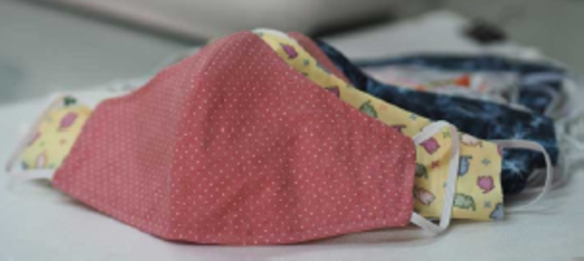
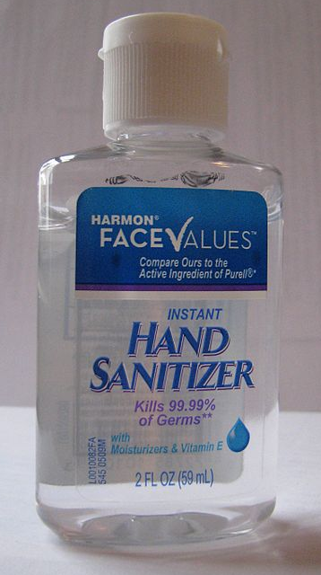
Carry a COVID-19 Kit
Keep a kit with you.
Kit Contents:
Two face masks
Personal hand sanitizer
Bag or Container for Storage
Notes:
This Photo by Unknown Author is licensed under CC BY-SA-NC
This Photo by Unknown Author is licensed under CC BY-SA

Slide 16
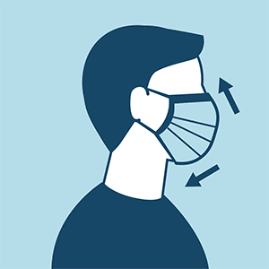
Donning (Putting On) a Face Mask
Wear your own or a university provided face mask.
Wash hands with soap and water or apply hand sanitizer before donning (wearing) a face mask.
Place mask on face touching only the ear loops over ears.
Cover your nose and mouth with no gaps between the mask and your face.
Wash hands with soap and water or apply hand sanitizer.
Avoid touching the face mask unless making adjustments.

Slide 17
Doffing (Removing) a Face Mask
Disposable face masks may be reused:
Wash hands with soap and water or apply hand sanitizer.
Use the ear loops to remove the face mask; avoid touching the front or back of the face mask or your face.
If the face mask is not soiled, damaged, or saturated you may reuse it.
Carefully place the face mask into a clean unsealed bag or container labeled with your name.
Wash hands with soap and water or apply hand sanitizer.

Slide 18
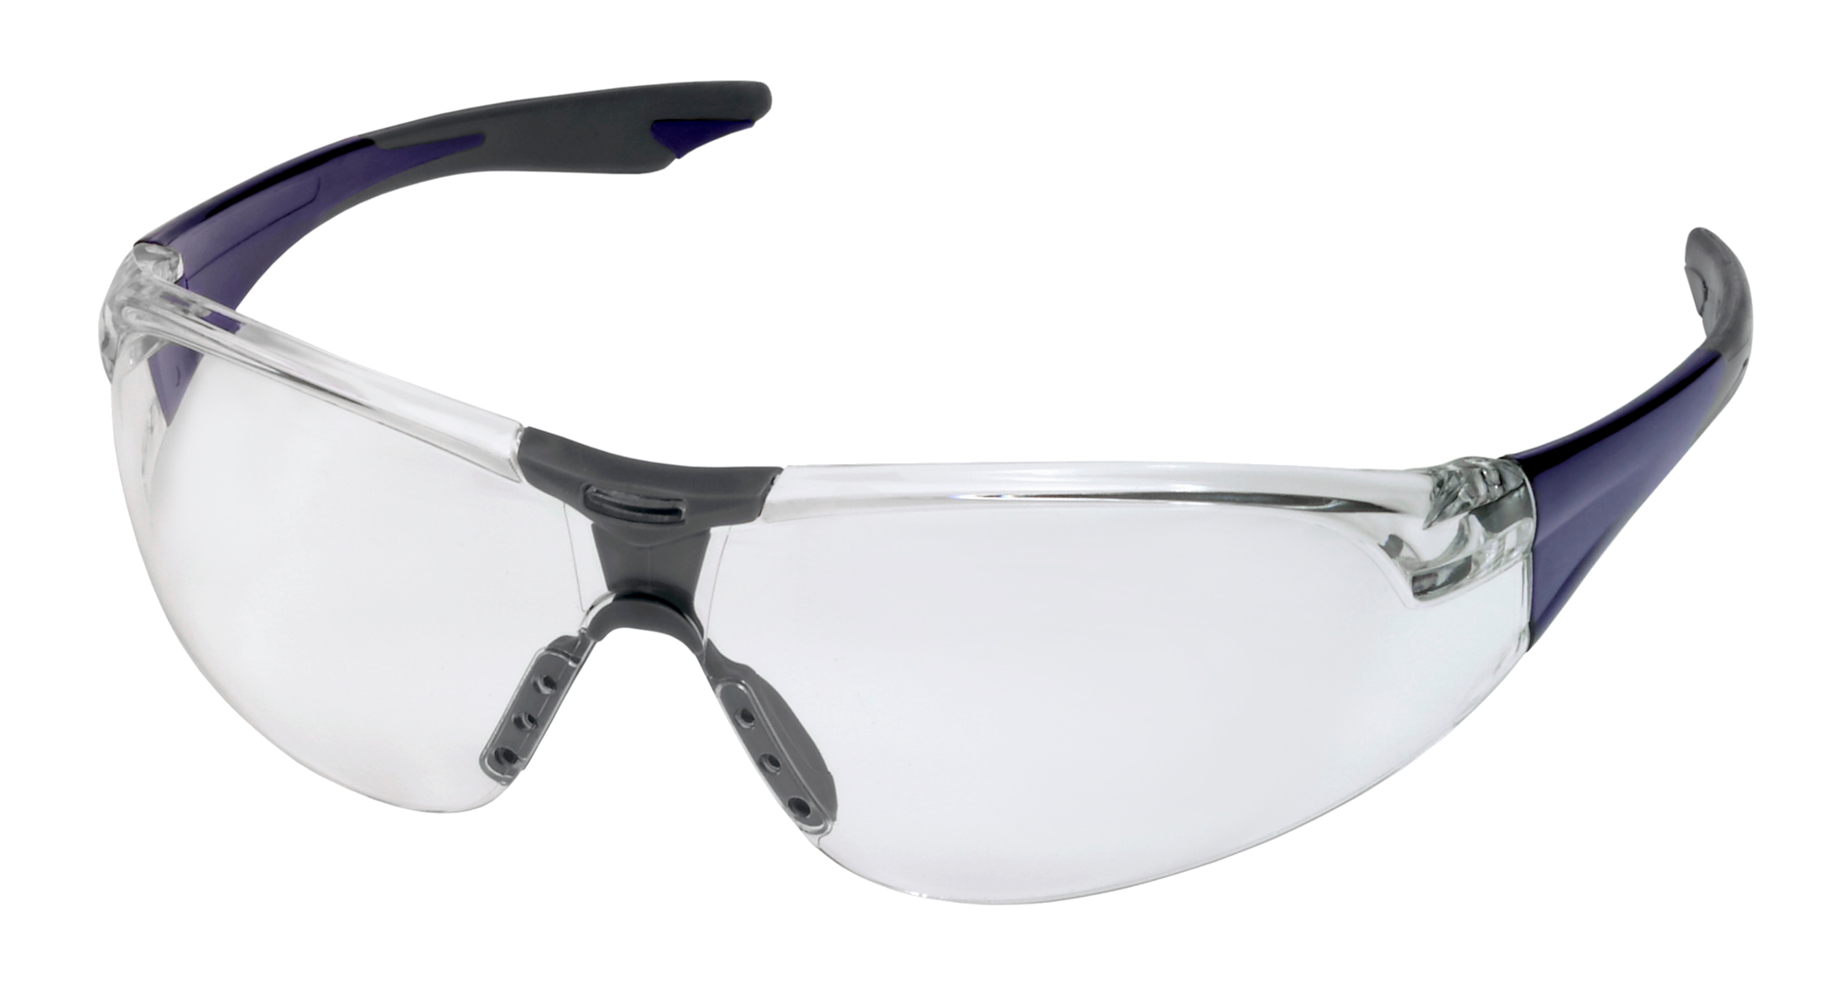
Donning Safety Glasses
If your work requires wearing safety glasses:
Wash hands with soap and water or apply hand sanitizer before donning safety glasses.
Remove the safety glasses from package or storage container.
Place safety glasses directly on your face; do not set the safety glasses on surfaces.

Slide 19
Doffing Safety Glasses
Removing and cleaning your safety glasses.
Wash hands with soap and water or apply hand sanitizer.
If wearing gloves, remove gloves before removing safety glasses.
Remove safety glasses; avoid touching your eyes and face.
Clean safety glasses with soap and water solution and let dry before storing them.
Place safety glasses in clean plastic container or plastic bag for reuse.

Slide 20
Tips for Face Masks and Glasses
How can I keep my glasses from fogging?
If compatible with your lenses, wash and rinse under warm soapy water.
Apply anti-fogging solution to your lenses like products used for scuba masks or ski goggles.
Minimize face mask gaps around the nose.
Insert a pliable piece of metal or tape to get a better seal.
Try sliding your glasses farther down your nose.

Slide 21
Cleaning and Disinfection
Help keep common areas clean and disinfected.
Clean and disinfect shared work surfaces such as chairs, desktops, countertops, keyboards, mice, telephones, and etc. before and after each use in…
Break rooms
Conference rooms
Computer rooms
Office spaces
Kitchenettes
Other common use areas

Slide 22
Disinfectants
Approved Disinfectants and Frequency of Use
Approved disinfectants are available for purchase from Procurement Services. Please work with Procurement Service when purchasing COVID-19 supplies.
Clean and disinfect shared frequently touched surfaces once a day:
Computer, keyboard, and mouse
Doorknobs and door handles
Lab faucet handles
Light switches
Phones
Tables, desks, and countertops
Tools and other shared equipment

Slide 23
Cleaning and Disinfection
What’s the difference?
Cleaning removes dirt and may reduce the amount of virus present.
Disinfection kills the virus and should follow cleaning for maximum effect.
Follow manufacturer’s instructions for using the disinfectant to ensure its effectiveness.

Slide 24
More Information
Risk Assessment Assistance
Radiological and Environmental Management (REM) conducts COVID-19 safety risk assessments to recommend best practices.
Any on-site employee can request a risk assessment
Please contact REM for more information at (765) 494-6371 or embutt@purdue.edu.

Slide 25
Personal Responsibility
Your health and the safety of the Purdue community is your personal responsibility.
Wear a face mask in all indoor public areas and shared work places.
Maintain appropriate safe distances for personal interactions more than 15 to 20 minutes.
Avoid large gatherings.
Practice good hygiene by washing your hands with soap and water often for 20 seconds or use hand sanitizer.
Keep work areas clean and wipe down surfaces following use.
Stay home if you or a family member is sick.
If you experience COVID-19 symptoms contact the Protect Purdue Health Center for an assessment and further guidance at (765) 494-2135 or https://www.protect.purdue.edu.
See Human Resources’ Working Through COVID-19 website at https://www.purdue.edu/hr/COVID-19/index.php.
Get the latest information on COVID-19 from the Purdue’s COVID-19 Coronavirus Updates website at https://www.protect.purdue.edu.

Slide 26
Thank You
Please remember,
your health and safety is your personal responsibility.

Slide 27
Take Care of Yourself and Others _{(hidden)}
Safe Social Distancing for Elevators
Limit elevator use to one person per elevator if you are not able to maintain a distance of at least six feet from others.

