Slide 1
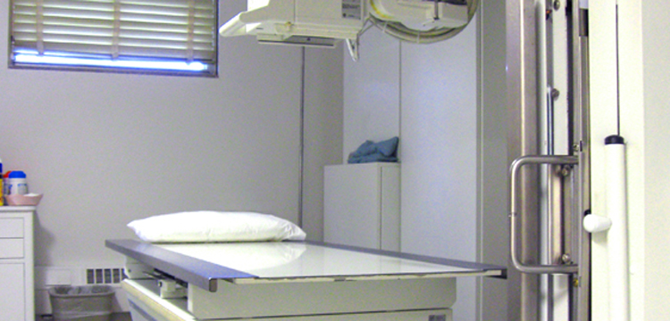

Diagnostic x-ray imaging safety training
2023

Slide 2
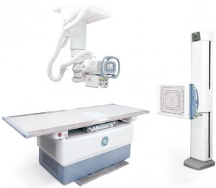
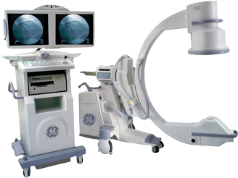
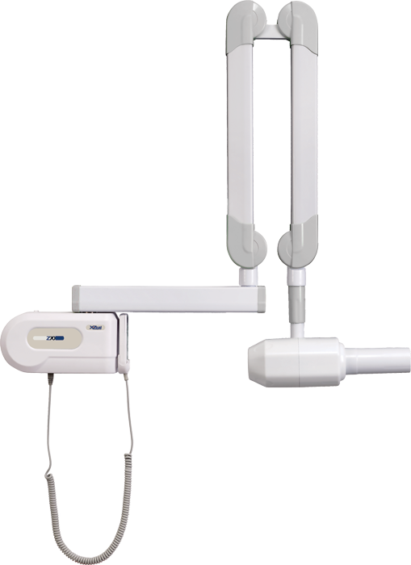
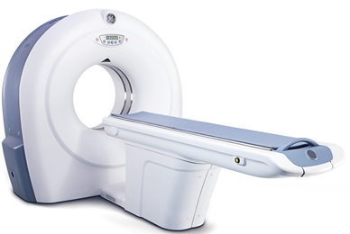
Different imaging modalities
This training presentation covers the following imaging modalities involving X-rays:
Radiography
Fluoroscopy (under-table and C-arm)
Computed Tomography (CT)
Intraoral Dental

Slide 3
X-ray characteristics and production

Slide 4
X-rays
X-rays are a type of ionizing electromagnetic radiation.
X-rays are a valuable tool, but there are associated health risks.
  These risks can be minimized by adhering to certain principles and practices as explained in this presentation.
X-rays are capable of traveling great distances and penetrating through low-density materials such as wood and plastic.
However, they can be blocked or attenuated by shielding made from high-density materials such as lead and concrete.

Slide 5
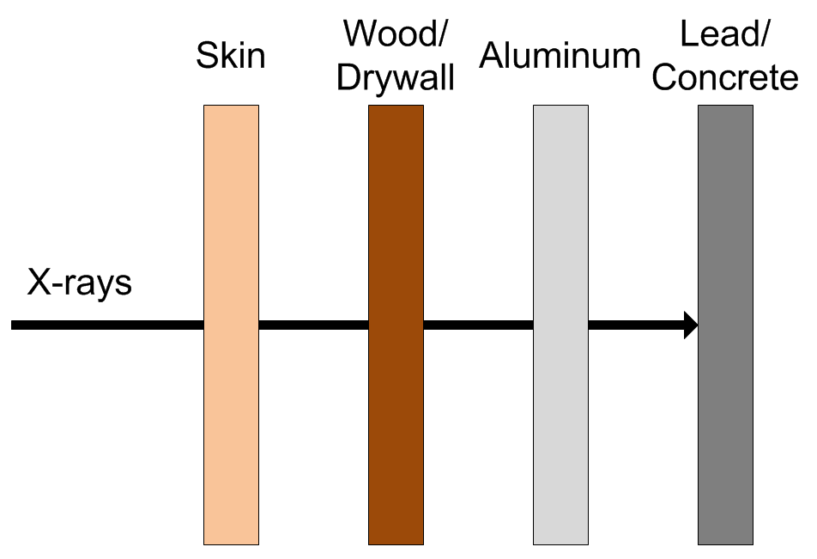
X-ray Shielding
While all materials absorb X-rays, dense materials such as lead, steel and concrete are the most effective. Hence, they are the preferred shielding materials.

Slide 6
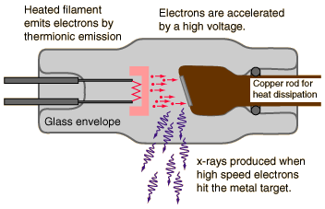
X-ray Production (1)
X-ray are generated in the X-ray tube of the device.
Electrons, that have been accelerated using a high voltage source, are abruptly decelerated by striking a metal target (e.g., copper, molybdenum, and tungsten).
Some of the energy of the electrons that impinge upon the target are converted into X-rays.
Notes:
http://hyperphysics.phy-astr.gsu.edu/hbase/quantum/xtube.html

Slide 7
X-ray Production (2)
X-ray production is proportional to operating potential (kVp) and current (mA)
When the X-ray unit is not operating or it is powered down, the high voltage is not applied and X-rays are not produced.
Therefore, there is no danger present when the machine is not operating or it is powered down.
Notes:
http://hyperphysics.phy-astr.gsu.edu/hbase/quantum/xtube.html

Slide 8
Biological effects, dose limits, and Radiation Safety principles

Slide 9
dose
When radiation interacts with living material such as our bodies, they may deposit enough energy to cause biological damage. Biological damage can occur as a result of chemical bonds being broken, DNA damage, and cells being damaged or killed.
Radiation induced health effects are dependent on radiation dose.
  The ‘rem’ is the common unit of dose in the U.S.
  1 rem = 1000 millirem (mrem)
  The ‘sievert’ is the common international unit of dose.
  1 sievert = 100 rem

Slide 10
Health Effects of Radiation Exposure
Health Effects from exposure to radiation range from no effect at all to death, including diseases such as cancer.
The health effects can be divided into two categories:
  Early Effects
  Delayed Effects

Slide 11
Early Effects (1)
Occur shortly after exposures resulting in large doses (>100 rem), delivered within a short time period (acute exposure)
Acute exposures cause extensive biological damage to cells so that large numbers of cells are killed.
The severity of the health effects is proportional to the dose.
Possible health effects include: vomiting, diarrhea, skin burns, cataracts, hair loss, fever, lethargy, loss of appetite, changes in blood count, and death.

Slide 12
Early Effects (2)
An estimated dose of around 325 rem for young healthy adults without medical intervention will result in death to 50% of the group within 60 days.
For a dose of less than about 800 rem, an exposed person is likely to survive with appropriate hospital care.
Under normal operation, the occurrence of early effects is highly unlikely.

Slide 13
Delayed Effects
Occur years after acute and chronic (low doses over a long time period) exposures.
Possible health effects include: leukemia, cancer, life span shortening, cataracts, and genetic defects.

Slide 14
Delayed Effects - genetic effects
Radiation studies involving fruit flies and mice suggest the possibility of heritable genetic effects in humans if there is radiation damage to the cells of the sperm or eggs.
These effects may show up as genetic defects in the children of exposed individuals and succeeding generations.
Scientists have studied populations of individuals exposed to radiation (e.g., atomic bomb survivors and radiation workers) to identify the presence of heritable genetic effects.
To date, no heritable genetic effects from radiation have ever been observed in any human population exposed to doses ranging from natural background to that received by atomic bomb survivors.

Slide 15
Delayed Effects – stochastic
Leukemia, cancer, and genetic effects are considered stochastic effects; the probability of occurrence is dependent of dose.
  As dose increases, the probability of occurrence increases.
Conservative studies estimate a 0.04% increase of developing an adverse health effect per rem received.
For additional information, refer to Regulatory Guide 8.29

Slide 16
Government dose Limits
In an effort to reduce the risk of potential health effects caused by radiation, the Indiana State Department of Health (ISDH) has set dose limits for those working with radiation producing devices.
These limits are put in place to create an upper limit of how much radiation a worker is allowed to be exposed to within a certain time period.
Individuals who stay below the dose limits:
  Will not develop any early effects.
  Will maintain a very small risk of developing delayed effects.

Slide 17
Dose Limit values
The ISDH has permitted Purdue University to use Nuclear Regulatory Commission (NRC) dose limits.
NRC Dose Limits (10 CFR 20.1201)
Section of Body | Limit (rem)
Whole Body (Head, torso and organs) | 5
Lens of the Eye | 15
Extremities (Hands, forearms, feet and ankles) | 50

Slide 18
Radiation & pregnancy (1)
Epidemiological studies of the A-bomb survivors, pregnant women who received pelvic X-rays, and animal studies indicate that embryos and fetuses are extremely radiosensitive.
The principle effects of radiation on the developing embryo and fetus, are embryonic, fetal, or neonatal death; congenital malformations; growth retardation; and functional impairment, such as mental retardation; and cancer.
The effects depend on the stage of gestation, the dose, and the dose rate.
These occurrences are extremely unlikely at Purdue because the doses possible from normal operation are very low.

Slide 19
Radiation & pregnancy (2)
Pregnant individuals should take all precautions possible to keep exposures to the embryo or fetus as low as possible.
Extra precautions are taken by Purdue University for a Declared pregnant woman.
Declared pregnant woman means a woman who has voluntarily informed Purdue, in writing, of her pregnancy and the estimated date of conception.
  If a declaration is made, it must be given to the Radiation Safety Officer (RSO) in writing.

Slide 20
Radiation & pregnancy (3)
Once in effect, the pregnant worker’s exposure limit will be reduced to 10% of the occupational dose limit.
In addition, that worker will be given a fetal dosimeter to monitor the dose received by the embryo or fetus.
The declaration remains in effect until the declared pregnant woman withdraws the declaration in writing or is no longer pregnant.
For additional information, refer to Regulatory Guide 8.13

Slide 21
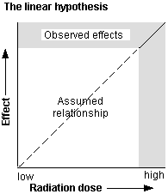
alara
The risk of developing delayed effects can be decreased by decreasing dose.
Scientists accept the linear no-threshold theory which states that even low-doses carry some risk of developing delayed effects.
The goal is not only to remain below the dose limits, but to keep it even lower by trying to keep doses As Low As Reasonably Achievable (ALARA).
ALARA is not just a good idea, it is REQUIRED by law (410 IAC 5 Rule 4).

Slide 22
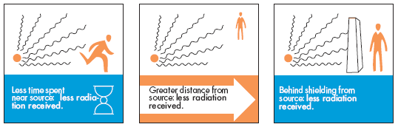
ALARA principles
There are several practices that will help you to keep your dose As Low As Reasonably Achievable (ALARA).
  Time
  Distance
  Shielding

Slide 23
ALARA Practices – Time
Decreasing the time spent in a radiation area results in a lower accumulated dose.
  Plan all work efficiently.
  Follow the procedures or optimization techniques to avoid having to retake an X-ray.
  Remember, X-rays units do not produce radiation unless they are in operation.

Slide 24
ALARA Practices – Distance
The greater the distance between you and the X-ray unit, the lower the dose.
  Your goal is to never allow the distance between you and the unit to become zero.
  Unless it’s necessary, avoid the need to hold the patient during an imaging procedures.
    If you have to hold the patient during imaging, you must wear leaded aprons, gloves and thyroid collars.

Slide 25
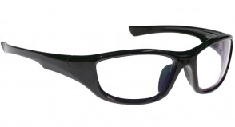

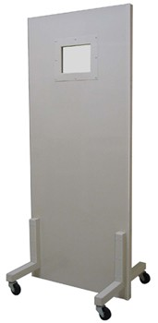
ALARA Practices – Shielding
Always use shielding. The greater the shielding, the lower the dose.
  Lead and concrete works well to attenuate X-rays.
  Available shielding includes:
    Lead lined doors
    Shielded X-ray control room
    Portable X-ray barriers
    Shielded glasses
    Leaded aprons, thyroid collars, gloves and gonadal shields.
  EHS and your department will ensure sufficient shielding is available

Slide 26
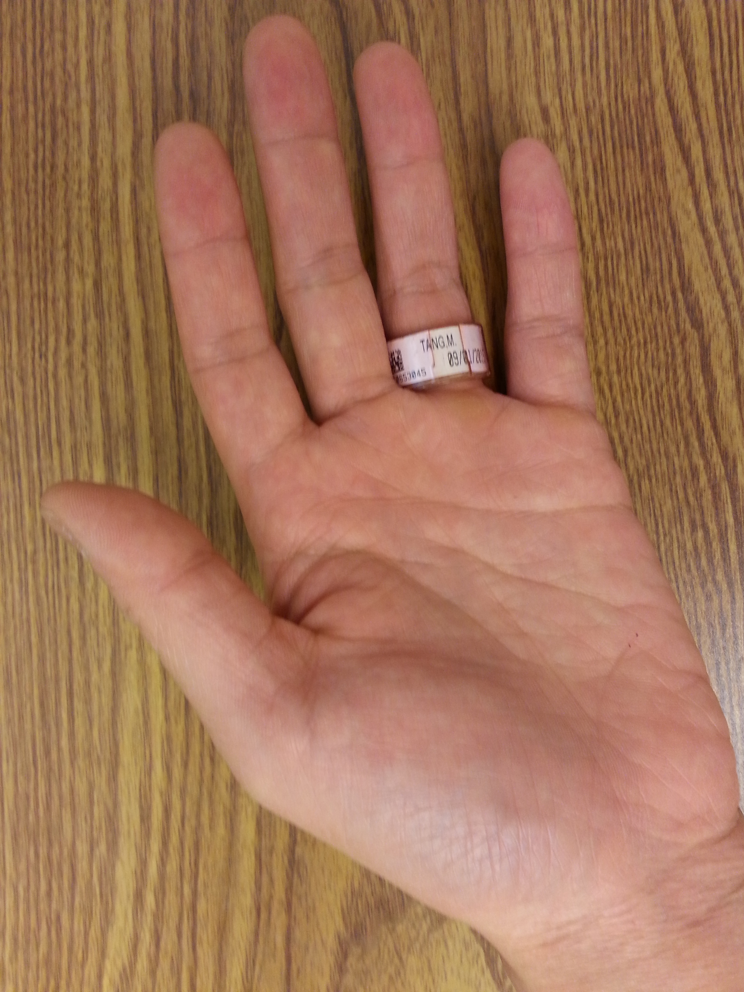
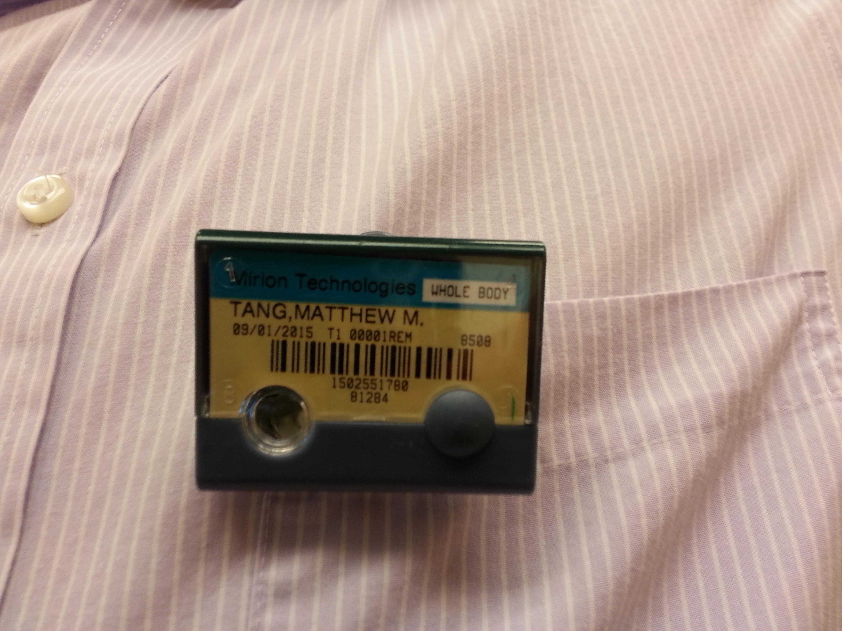
Dosimetry (1)
Dosimetry – Device worn by radiation users to measure their accumulated dose. It is used to ensure that you do not exceed the government-established dose limits. There are two types:
Ring – measures dose to the hands, worn on the hand receiving the highest dose with name facing the palm side
Whole-body – measures dose to the torso and head, worn on the part of the torso that will receive the highest dose. If wearing a lead vest, attach the dosimeter outside of the lead vest.

Slide 27
Dosimetry (2)
If issued dosimetry, you MUST wear it every time you are operating X-ray equipment
Dosimetry must be returned at the end of the wear period (monthly or bimonthly), to be analyzed.
Dose measurement may be lost if dosimeter is returned late
Lost dosimetry may result in a monetary fine

Slide 28
X-ray device safety features, and exposure pathways

Slide 29
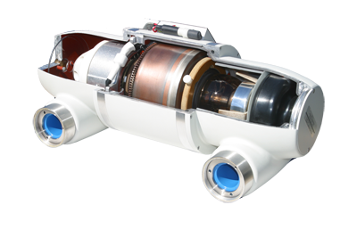
Safety features – housing
X-ray Tube Housing – When operating, X-rays are emitted in all directions. To protect operators and bystanders, the X-ray tube is enclosed in a shielded vessel that greatly reduces the dose.

Slide 30
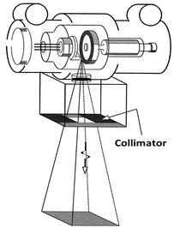
Safety Features - Collimator
Beam Collimator – When operating, X-rays are emitted in all directions. To avoid exposing more of the body than necessary to X-rays, the collimator restricts the size of the exposed area to the tissue of interest.
The X-rays that are allowed to exit the collimator is called the primary beam

Slide 31
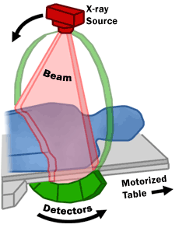
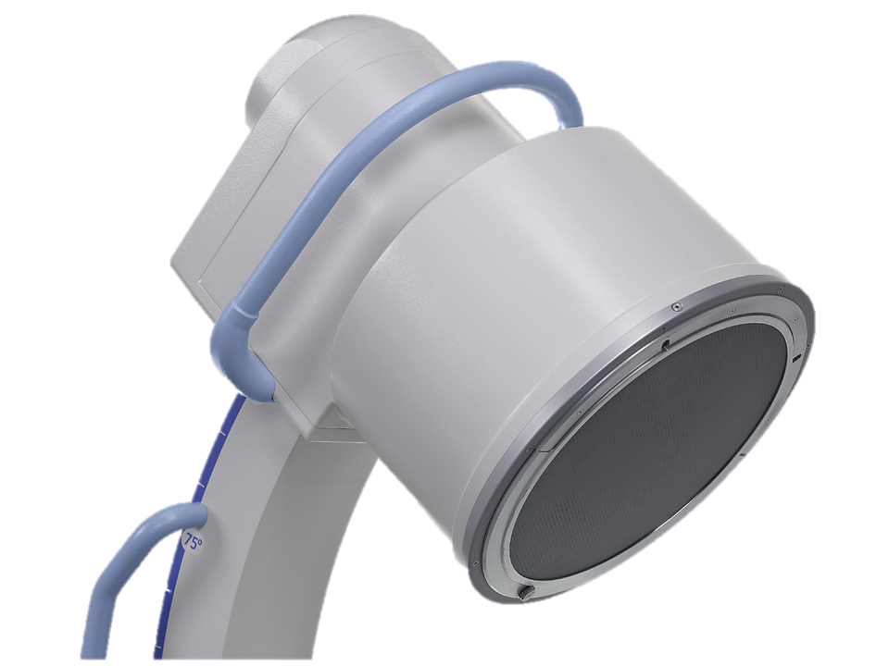
Safety Features – Beam stop
Beam Stop – The beam stop blocks many of the X-rays transmitted through the patient. This helps reduce the dose to occupants in adjacent rooms. The unit should never be operated without the beam stop.
For radiography units, the beam stop is usually the table bucky or bucky stand.
For Computed Tomography (CT) units, the detectors attached to the gantry operates as the beam stop.
For fluoroscopy units, the image intensifier operates as the beam stop.
For intraoral dental units, the beam stop is the patient and film.

Slide 32
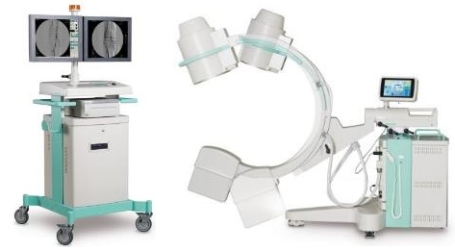
Safety Features – Warning signals
Visual and Audible Warning Signals – Signals are activated when the device is emitting X-rays.
  The warning lights are usually located on the device or control panel

Slide 33
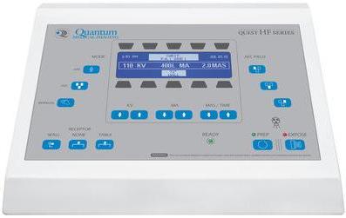
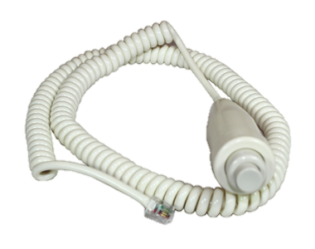
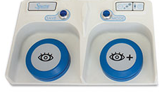
Safety features – dead man switch
Dead Man Switch – X-rays will only be generated when the operator actively presses the switch (i.e. button or foot pedal). When the operator ceases pressing the switch, X-rays are not generated.

Slide 34
Safety features – shielding
Shielded Room and Control Station – X-ray facilities have shielded walls to reduce the dose to individuals in adjacent rooms and to the staff involved in the imaging procedure.
Environmental Health and Safety (EHS) performs a shielding analysis to ensure sufficient shielding is present

Slide 35
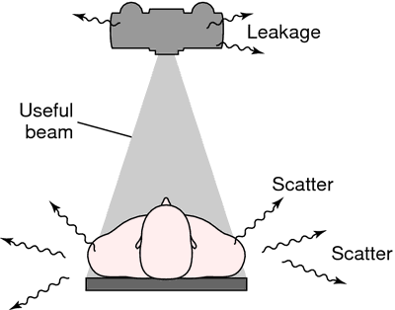
Exposure Pathway
With X-ray devices, an individual may get a dose from the following:
Primary/useful beam
Leakage radiation
Scatter radiation

Slide 36
Exposure pathway – Primary beam
Primary Beam – The useful beam of X-rays emitted from the X-ray tube.
Capable of acute radiation doses
Individuals working with or around X-ray devices should be familiar with the primary beam path

Slide 37
Exposure Pathway – leakage
Leakage Radiation – Despite the shielded X-ray tube housing, X-rays will escape.
  Capable of causing chronic radiation doses
  Manufacturer ensures that the dose rate from leakage radiation meets state regulations.
  For fluoroscopic units – it is always preferred to operating with the tube below the patient. This will cause scatter to be oriented toward the floor

Slide 38
Exposure Pathway – Scatter
Scatter Radiation – As X-rays from the primary beam interacts with the patient or couch, many of these will scatter in multiple directions, irradiating nearby individuals.
  Capable of causing chronic radiation doses

Slide 39
Mandatory Safe practices and state regulations

Slide 40
Mandatory safe practices (1)
NEVER attempt to remove or bypass any system component (e.g. safety features).
  These are meant to protect you and others from harmful radiation doses
DO NOT operate the unit in any manner other than specified in the procedures
DO NOT modify the X-ray device in any manner without approval of the radiation safety officer.

Slide 41
Mandatory safe practices (2)
ALWAYS follow the ALARA principles discussed earlier
When producing X-rays, don’t stand closer to the device than necessary
When producing X-rays, reduce the amount of time spent around the system
DO NOT operate the X-ray system unless all system components and features are in good repair
NEVER place any part of your body in the primary beam

Slide 42
State Regulations (1)
No person other than the medical doctor, veterinarian or state licensed radiation technician is allowed to operate a radiation producing device on humans.
Individuals who will be operating the X-ray equipment shall be adequately instructed in proper operating procedures for such equipment.
Written safety procedures and rules shall be available to each individual operating x-ray equipment, including any restrictions of operating technique required for the safe operation of the particular x-ray system.
In the vicinity of each x-ray control panel, a technique guide shall be provided for routine examinations performed utilizing that system.
Standard/Normal Operating Procedures: Step-by-step instructions necessary to accomplish the imaging.

Slide 43
State Regulations (2)
Except for patients who cannot be moved out of the room, only the staff and ancillary personnel required for the medical procedure or training shall be in the room during the radiographic exposure. IN ADDITION to the patient being examined, others will be protected in the following manner:
  All individuals shall be positioned such that no part of the body will be struck by the useful beam unless protected by 0.5 mm lead equivalent.
  Staff and ancillary personnel shall be protected from direct scattered radiation by protective aprons or whole body protective barriers of not less than 0.25 mm lead equivalent.
  Patients who cannot be removed from the room shall be protected from direct scattered radiation by whole body protective barriers of 0.25 mm lead equivalent or shall be positioned so that portion of the body nearest to the tube head is at least 2 meters from both the tube head and the nearest edge of the image receptor.

Slide 44
State Regulations (3)
Humans shall not be exposed to the useful beam, except for healing arts purposes and such exposure has been authorized by a practitioner of the healing arts. Deliberate exposure for training, demonstration, or other non-healing arts purposes is prohibited.
The following apply when a patient or film must be provided with auxiliary support during a radiation exposure:
  Mechanical holding devices shall be used when the technique permits.
  The human holder shall be protected as required in the previous slide.
  No individual shall be used routinely to hold film or patients.
    In those cases where the patient must hold the film, except during intraoral examinations, any portion of the body other than the area of clinical interest struck by the useful beam shall be protected by not less than 0.5 mm lead equivalent material.
Gonadal shielding of not less than 0.25 mm lead equivalent shall be used for patients who have not passed the reproductive age during radiographic procedures in which the gonads are in the useful beam, except for cases in which this would interfere with the diagnostic procedure.

Slide 45
Environmental Health and safety (ehs)

Slide 46
University organization
The radiation safety program is empowered by Purdue University Executive Memorandum No. B-14
Purdue University’s radiation policies can be found in the Purdue Radiation Safety Manual
The radiation safety program is managed by the:
  Radiation Safety Committee (RSC)
  Ensures the safety of the University and community in the utilization of all radioactive materials and radiation producing devices at the University or by University faculty, staff or students.
  Environmental Health and Safety (EHS)
  Carries out the directives of the RSC.

Slide 47

Access requirements
The following requirements must be met before you are authorized to operate or work around X-ray devices:
  Permission from the supervisor responsible for the X-ray device
  Completion of EHS’s X-ray safety training (this training presentation)
  Submit completed A-4 form to EHS
    EHS will only issue dosimetry to individuals who submit the A-4 form.
  Specific training from the supervisor for the operation of the X-ray device.
  Any additional requirements deemed necessary by the supervisor.

Slide 48
Enforcement
Failure to comply with the rules, regulations safe practices established by Indiana State Department of Health (ISDH) or Purdue University can result :
  Re-training
  Loss of work privileges with or around X-ray producing devices
  Obtaining an injunction or court order to prevent a violation
  Civil penalties
  Criminal penalties
  For willful violation of, attempted violation of or conspiracy to violate any regulation

Slide 49
EHS Responsibilities
EHS is responsible for:
  Performing X-ray machine inspections when new diagnostic X-ray devices are acquired, when diagnostic X-ray devices are moved, and on a routine basis afterwards.
  Providing dosimetry to monitor radiation dose of users
  Providing X-ray safety training for X-ray users.
  EHS is also responsible for complying with regulations set forth by the Indiana State , for the safe use of radiation producing devices such as X-ray units.
  This is accomplished by providing training, calibration services, personnel dosimetry to monitor radiation exposure and consulting support for any safety issues identified by Purdue University employees and students.

Slide 50
Contact EHS if…
You know or suspect there has been an overexposure to an individual
The X-ray unit is to be modified
Personnel working on the project has been changed (added/dropped)
A new (or used) diagnostic X-ray unit has been acquired
The diagnostic X-ray unit will be operated in a different location

Slide 51
Contacts
Joshua A. Young, MS, CLSO 765-494-2721
Radiation Safety Officer (RSO) young127@purdue.edu
Indiana State License Health Physicist
Indiana State Licensed X-Ray Machine Inspector
Nathan Claus 765-494-1478
Health Physicist njclaus@purdue.edu

Slide 52
End of training module
This concludes the PowerPoint portion of the training.
Complete the test indicated below. You must have 75% of correct responses to pass.
  Your results will be emailed to you and will constitute as your certification of your successful completion of the online portion of your training, if you have passed.
Submit a completed Form A-4 (make sure that both you AND your Principal Investigator have signed the form), and send through campus mail to: Anca Condret/EHS/HAMP
Click here to begin the test.

