Slide 1
Independent Load Forecast
MISO Planning Advisory Committee
October 19, 2016

Slide 2
Draft Results
While these results have been shared with stakeholders, they are subject to revision based on stakeholder comments
Stakeholder comments were due October 17

Slide 3
Approach for 2016
Changes in approach from Year 1 to Year 2 were continued in Year 3
  Energy efficiency, demand response, and distributed generation (EE/DR/DG)
  Model multiple weather stations in the state econometric models
  Confidence intervals that capture uncertainty around the macroeconomic variables
Conversion of the energy forecasts to peak forecasts further adjusted from 2015

Slide 4
EE/DR/DG Adjustments
In the 1st year, adjustments were made at the state level
  based on state mandates, supplemented with discussions with individual state experts
Last year and this year, net forecasts are determined using adjustments at the LRZ level
  the economic potential from the AEG study was input to EGEAS; the amount selected by EGEAS is used here

Slide 5
Energy to Peak Conversion
In 2015 we used an after-the fact adjustment to correct for bias in the model results
  The models provided mean load for a given temperature, but peaks occur at the tails of the distribution
It was suggested that we use binary variables instead
  We have implemented this; some binary variables have weak statistical significance but the results of this model formulation were not directionally biased

Slide 6
Other Analyses
Weather normalization
  We used the models developed for the ILF to estimate the effect of weather on historical energy and peak demands at the LRZ and MISO levels
Forecast comparison
  We provided comparison charts of the ILF and Module E forecasts
Results of these analyses are on the MISO ILF webpage

Slide 7
Embedded DSM
Per stakeholder request, we are attempting to estimate the impact of DSM on the historical data used to construct our models and the potential for double counting with the EE/DR/DG adjustments in the forecast

Slide 8
LRZ-level Results: 2017-26 CAGR
LRZ | 1 | 2 | 3 | 4 | 5 | 6 | 7 | 8 | 9 | 10
Gross Energy | 1.68 | 1.49 | 1.66 | 0.64 | 1.25 | 1.32 | 1.07 | 1.07 | 0.94 | 1.63
Net Energy | 1.59 | 1.49 | 1.32 | 0.45 | 1.10 | 1.25 | 0.87 | 1.06 | 0.90 | 1.63
Net Peak | 1.41 | 1.36 | 1.17 | 0.44 | 1.12 | 1.20 | 0.81 | 0.97 | 0.84 | 1.63
Notes
CAGR – compound annual growth rate (%)
Gross – prior to adjustments for energy efficiency, demand response, and distributed generation
Net – after adjustments for energy efficiency, demand response, and distributed generation

Slide 9
LRZ-level Results
Graphical comparison of LRZ-level forecasts are included in the Appendix to this slide deck

Slide 10
MISO-level Results: CAGR
 | Year 1 (2015-2024) | Year 2 (2016-2025) | Year 3 (2017-2026)
Gross Energy | 1.42 | 1.33 | 1.25
Net Energy | 0.87 | 1.13 | 1.15
Gross Summer Peak | 1.42 | 1.30 | 1.24
Net Summer Peak | 0.86 | 0.96 | 1.06
Gross Winter Peak | 1.41 | 1.32 | 1.25
Net Winter Peak | 0.86 | 0.91 | 1.02
Notes
CAGR – compound annual growth rate (%)
Gross – prior to adjustments for energy efficiency, demand response, and distributed generation
Net – after adjustments for energy efficiency, demand response, and distributed generation

Slide 11
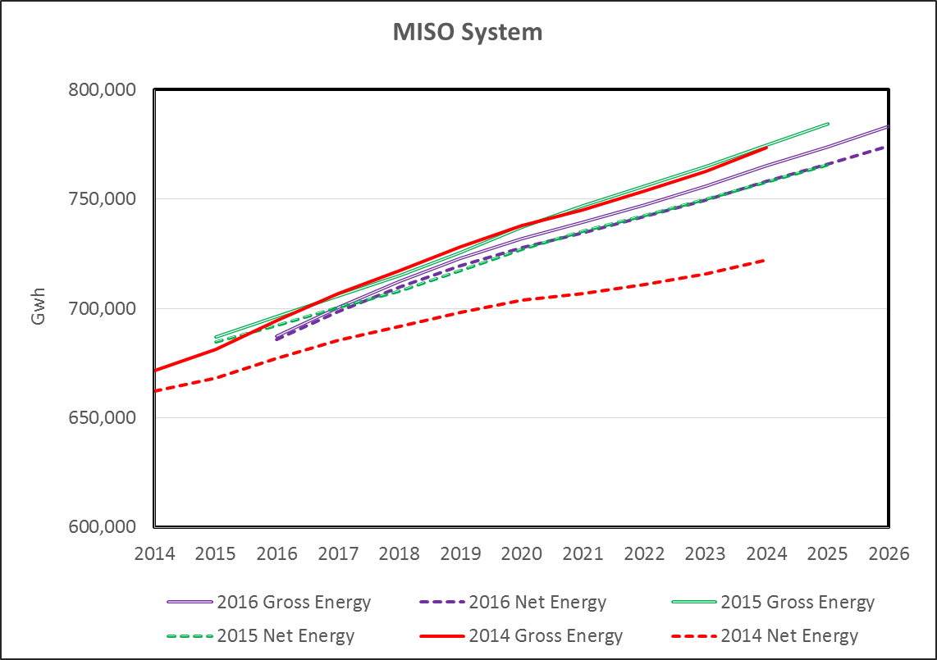

Slide 12
DR Assumption
All available DR was included in the adjustment, which reduces demand throughout the forecast period
  This will not always be the case in reality because sometimes it will not be needed
  Thus, the net peak forecast will be lower than actual if all DR is not called upon
This is a common assumption when forecasting for resource needs

Slide 13
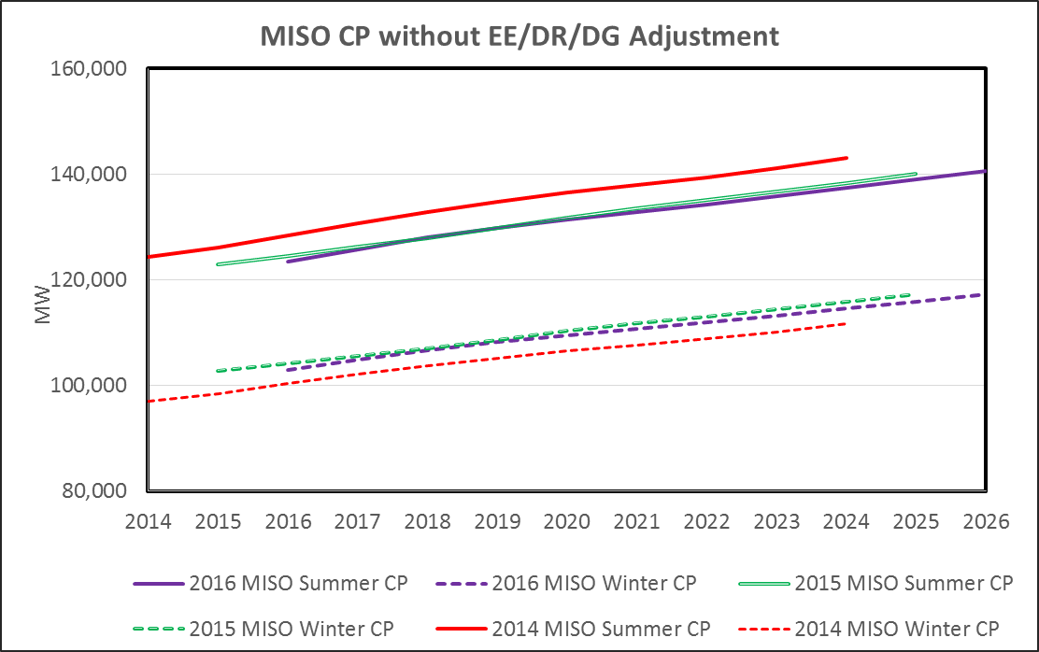

Slide 14
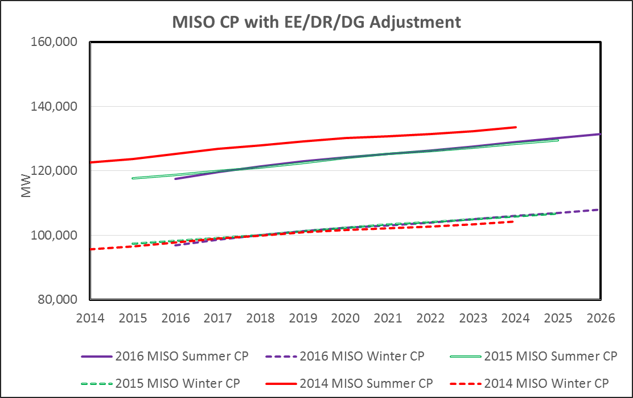

Slide 15
Summary
Gross forecast is slightly lower (5-10 GWh, 400-1100 MW) than the Year 2 forecast
The EE/DR/DG adjustment is somewhat smaller this year
Resulting net forecast is nearly identical to the Year 2 forecast

Slide 16
90/10 Net Forecasts:
CAGR 2017-2026
 | BASE | HIGH | LOW
Energy | 1.15 | 1.58 | 0.65
Summer Peak | 1.06 | 1.51 | 0.52
Winter Peak | 1.02 | 1.48 | 0.49

Slide 17
Next Steps
Report due November 1
Continued work on embedded DSM

Slide 18
Contact Information
State Utility Forecasting Group
765-494-4223
http://www.purdue.edu/discoverypark/energy/SUFG/
Doug Gotham
765-494-0851
gotham@purdue.edu

Slide 19
Appendix

Slide 20
Notes
The estimated hourly historical loads for LRZs 8 and 9 that were used in the 2014 forecast were erroneous. This was corrected for the 2015 and 2016 forecasts.
LRZ 10 is included in LRZ 9 in the 2014 forecast and is separate in the 2015 and 2016 forecasts.

Slide 21
Notes
LRZ peak demands are coincident at the LRZ level and non-coincident at the MISO-system level.
Gross and net forecasts are presented separately for peak demand for the sake of clarity.

Slide 22
Annual Energy

Slide 23
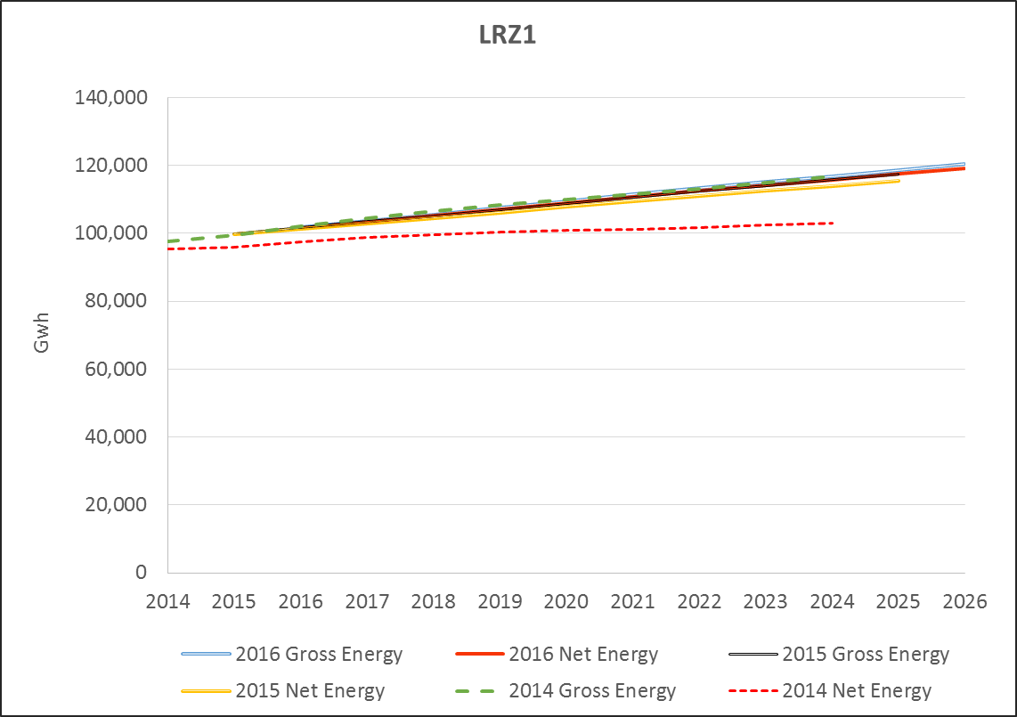

Slide 24
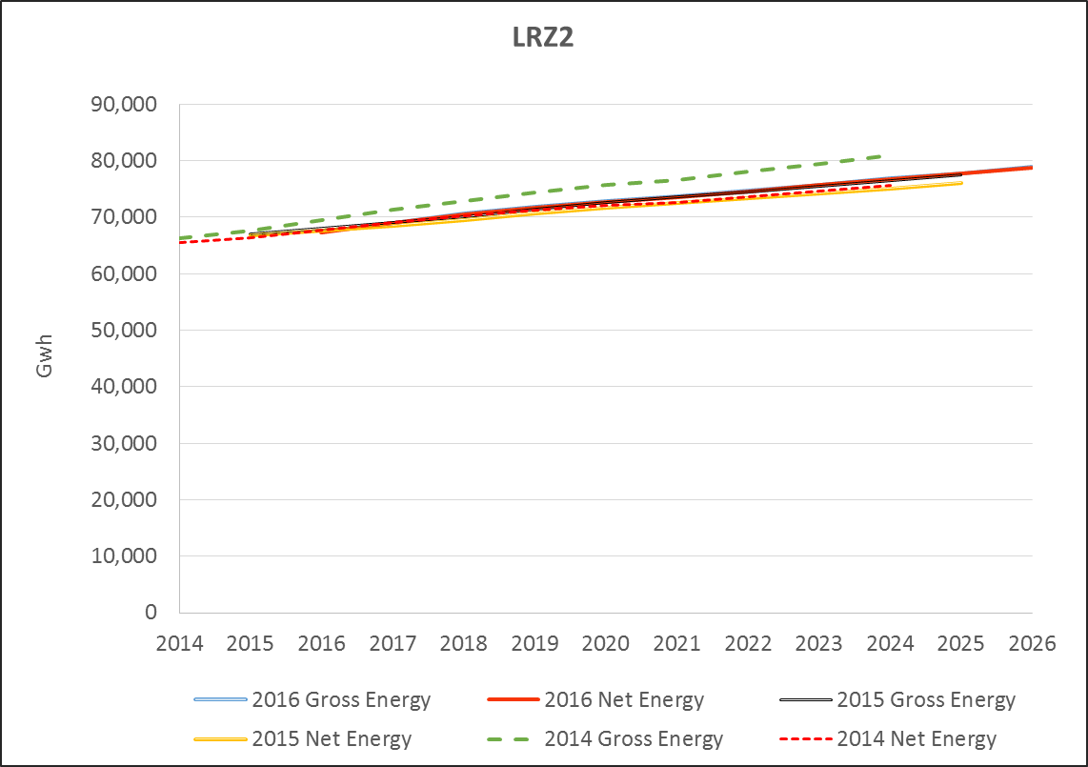

Slide 25
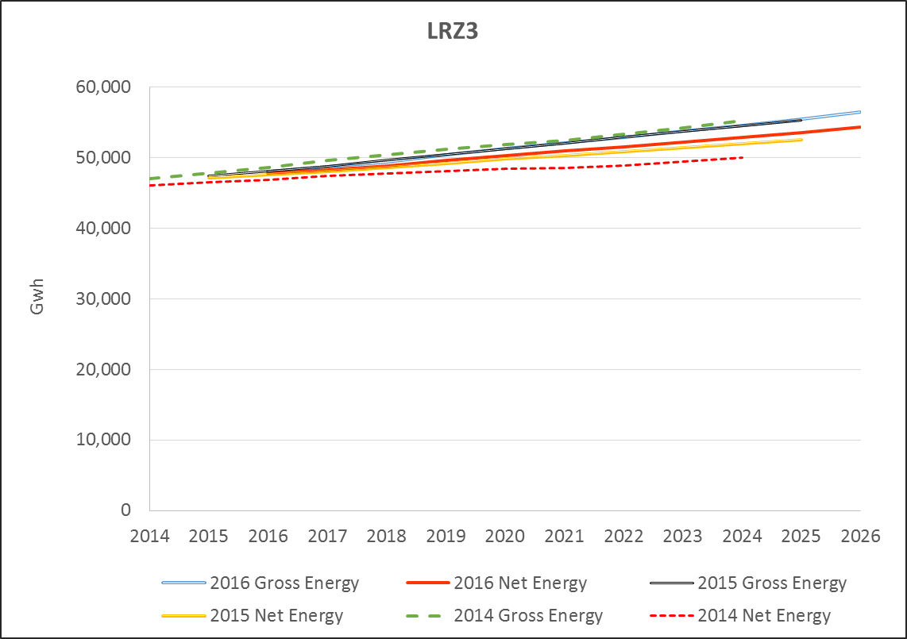

Slide 26
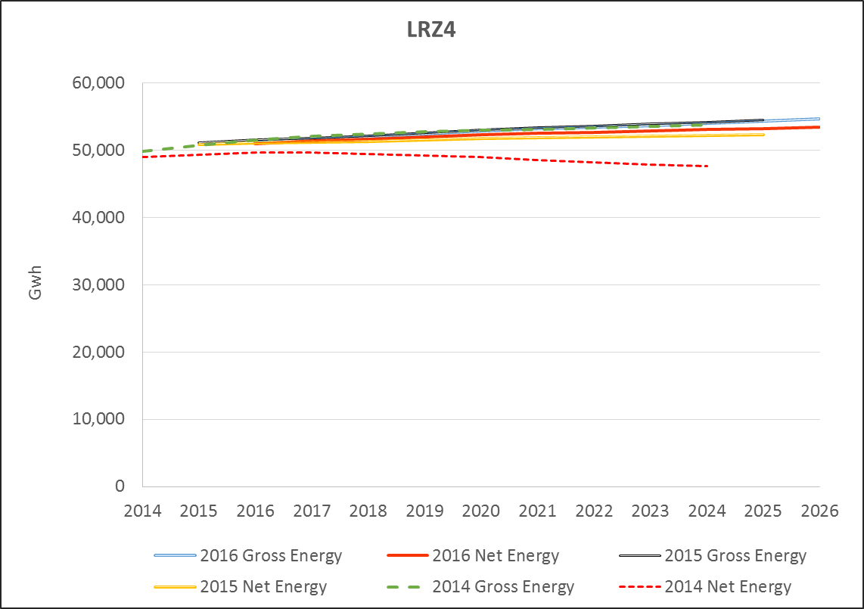

Slide 27
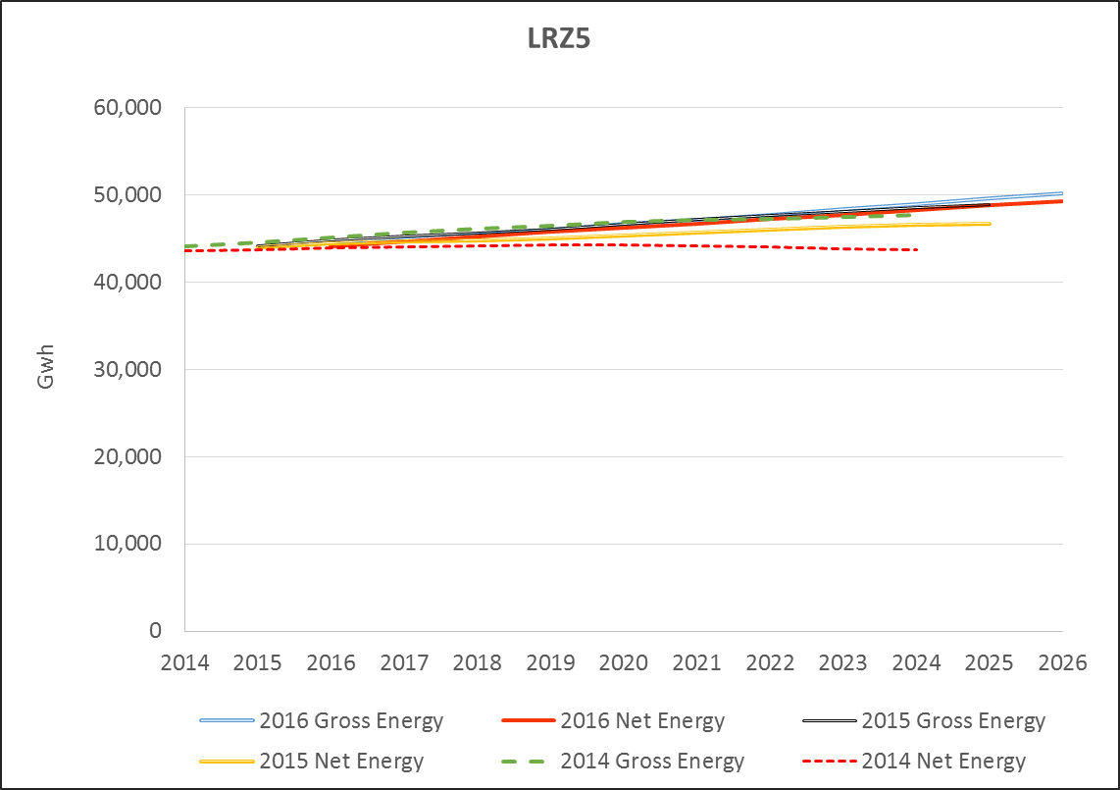

Slide 28
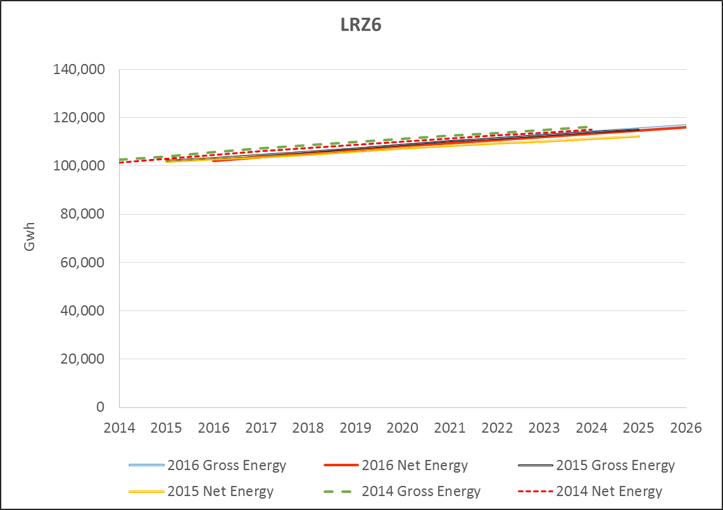

Slide 29
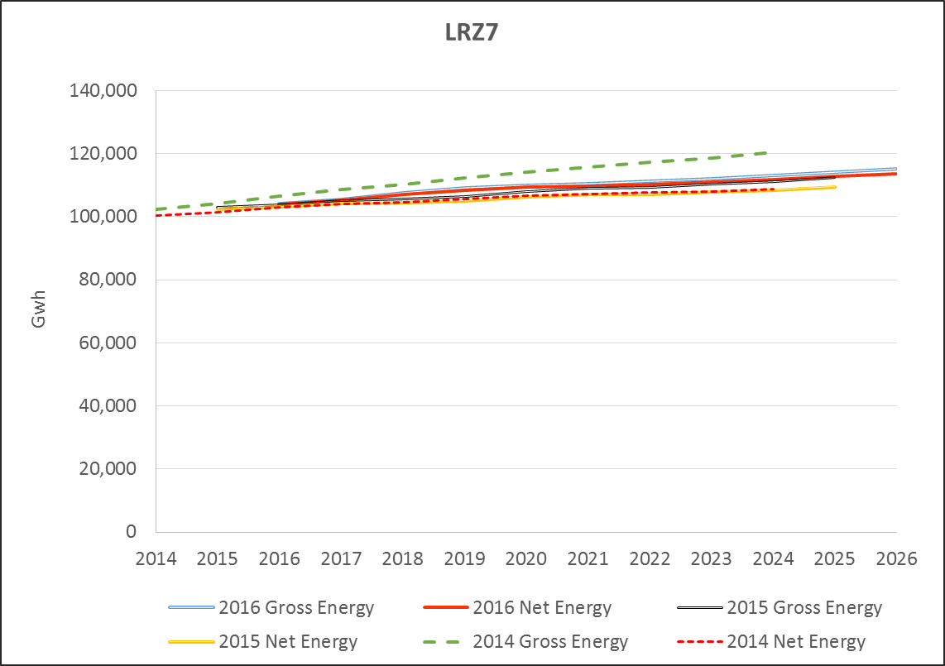

Slide 30
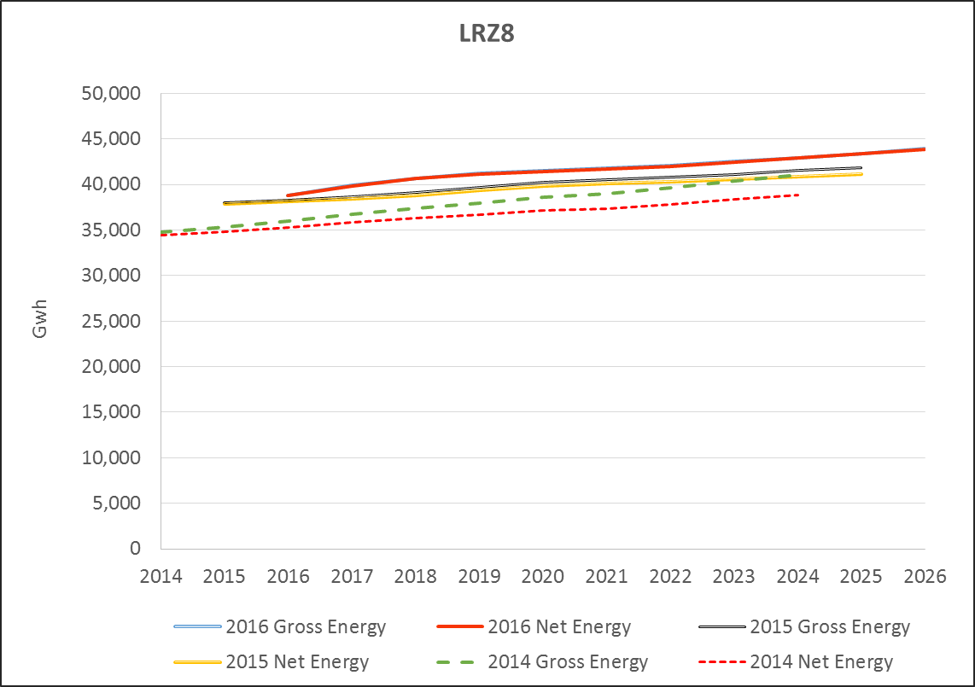

Slide 31
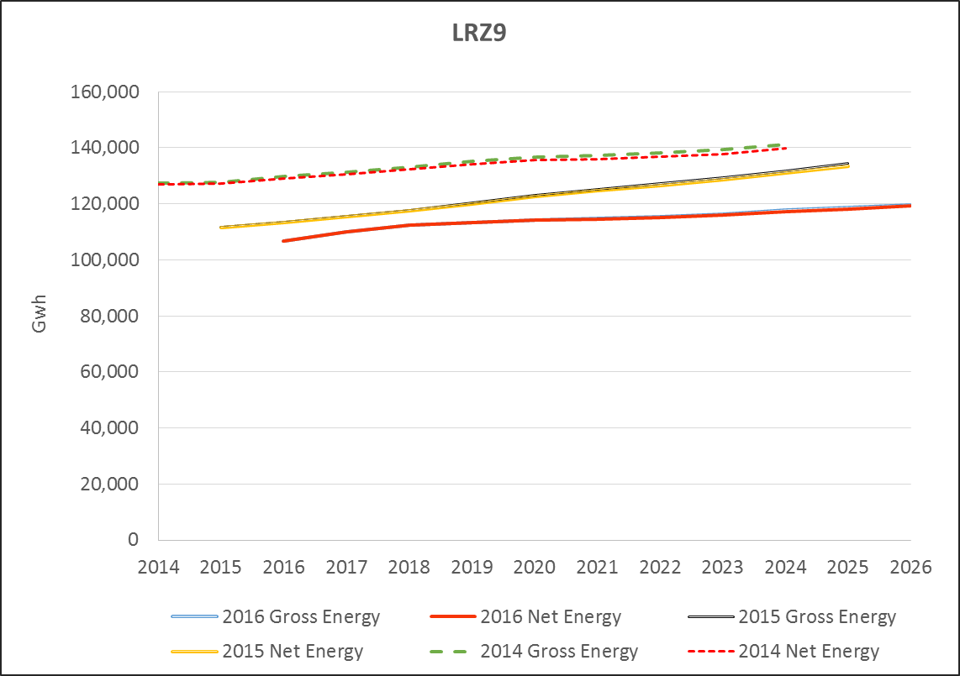

Slide 32
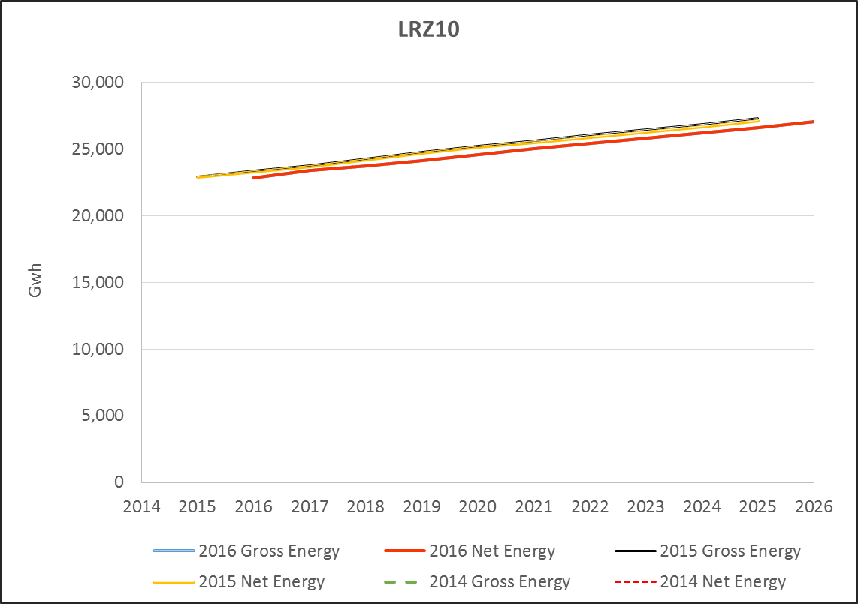

Slide 33
Peak Demand

Slide 34
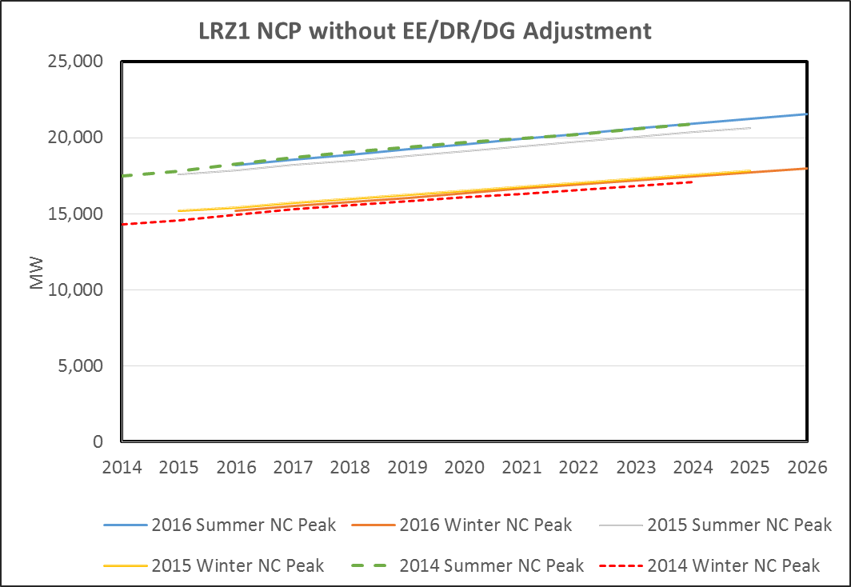

Slide 35
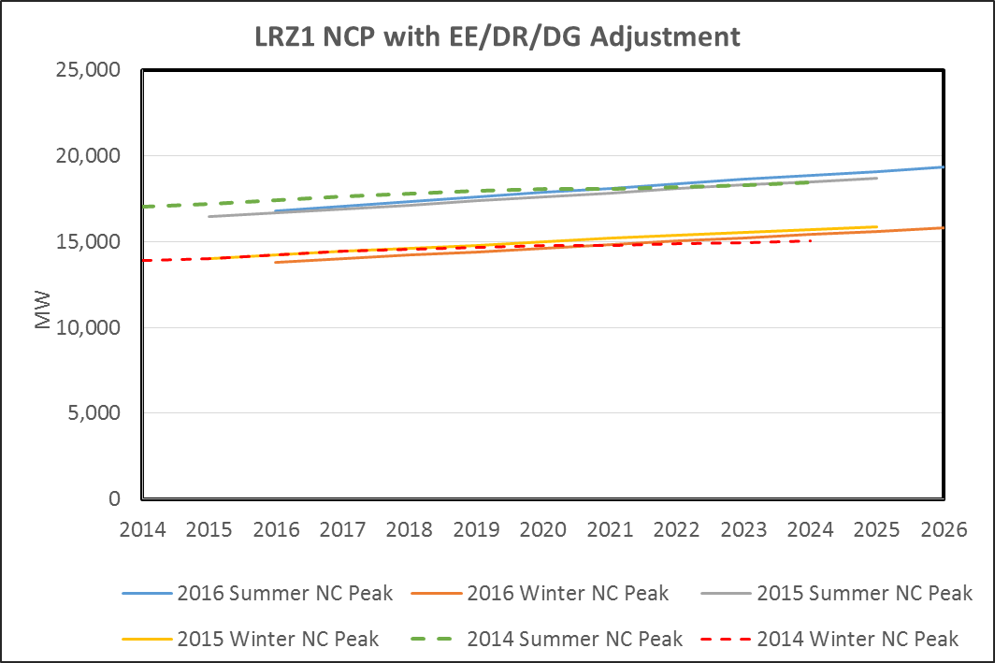

Slide 36
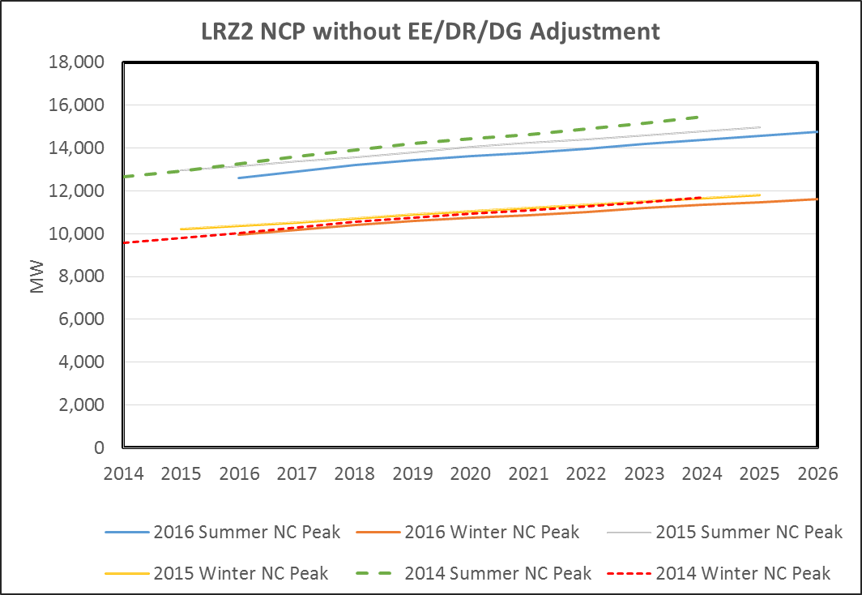

Slide 37
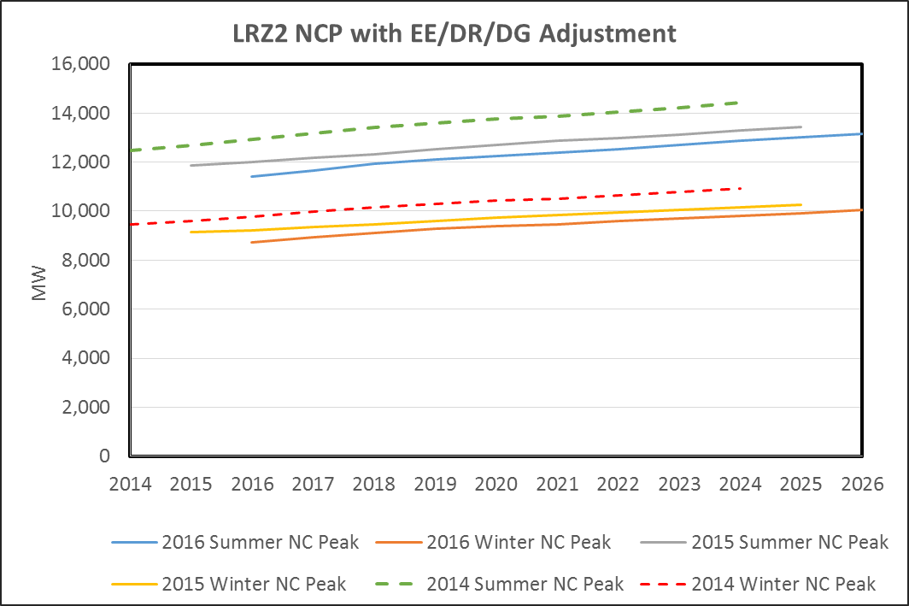

Slide 38
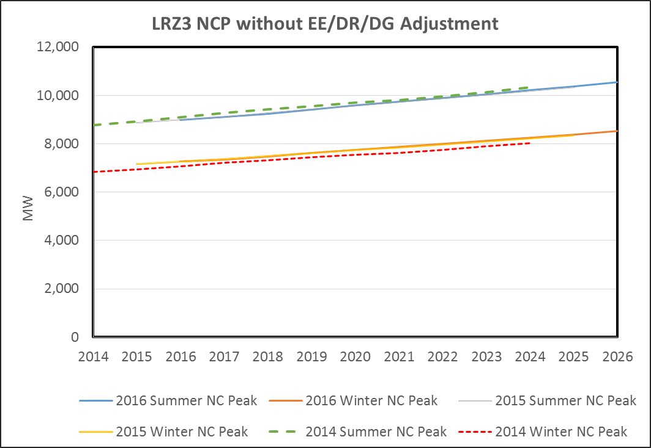

Slide 39
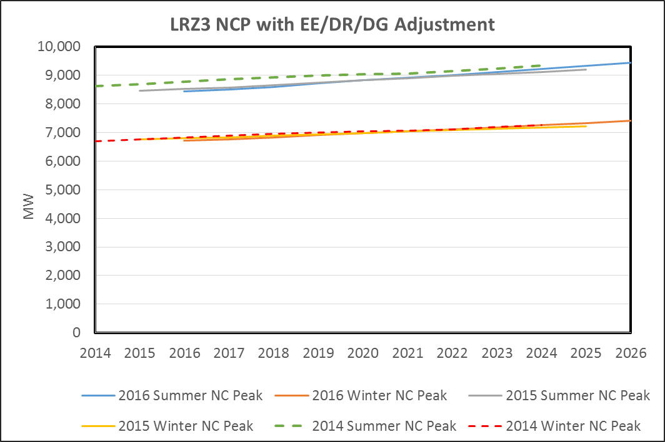

Slide 40
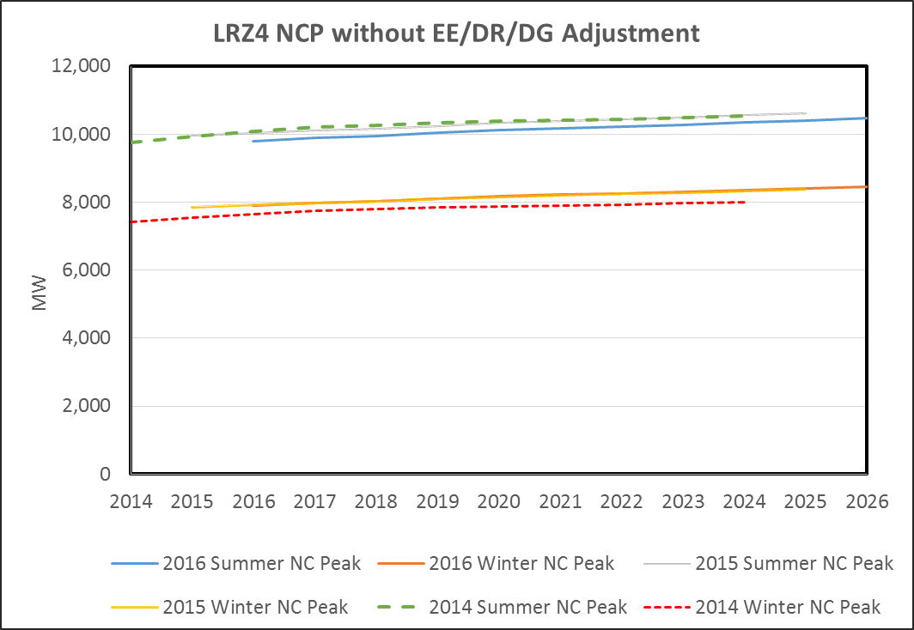

Slide 41
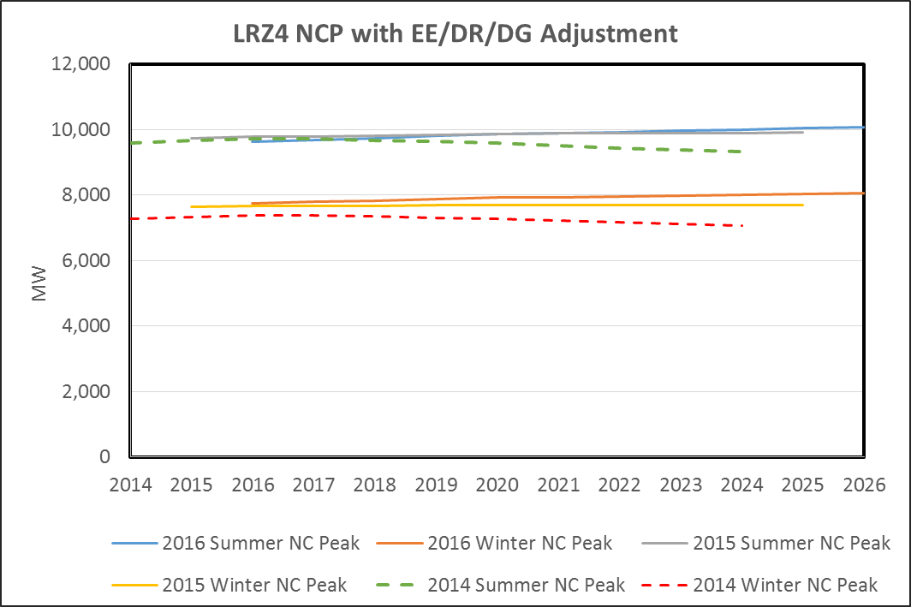

Slide 42
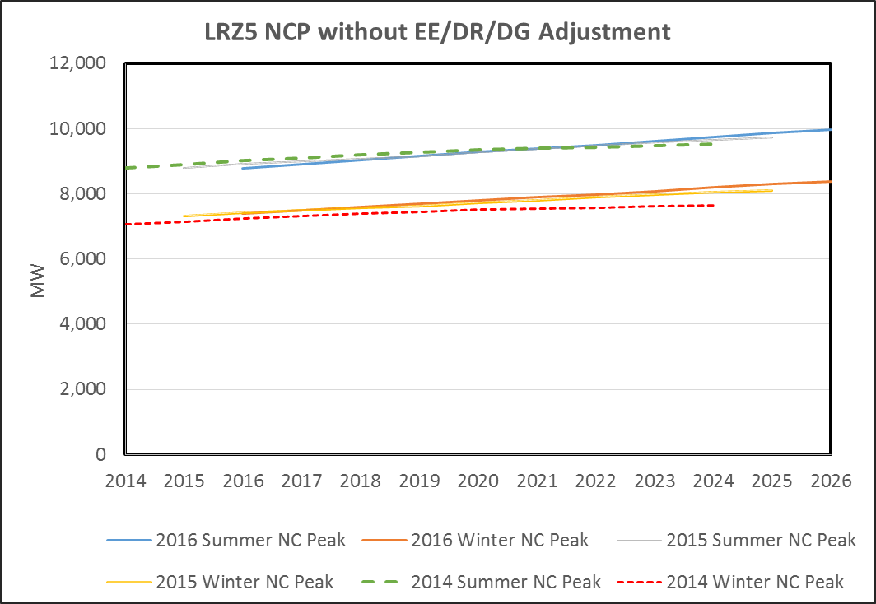

Slide 43
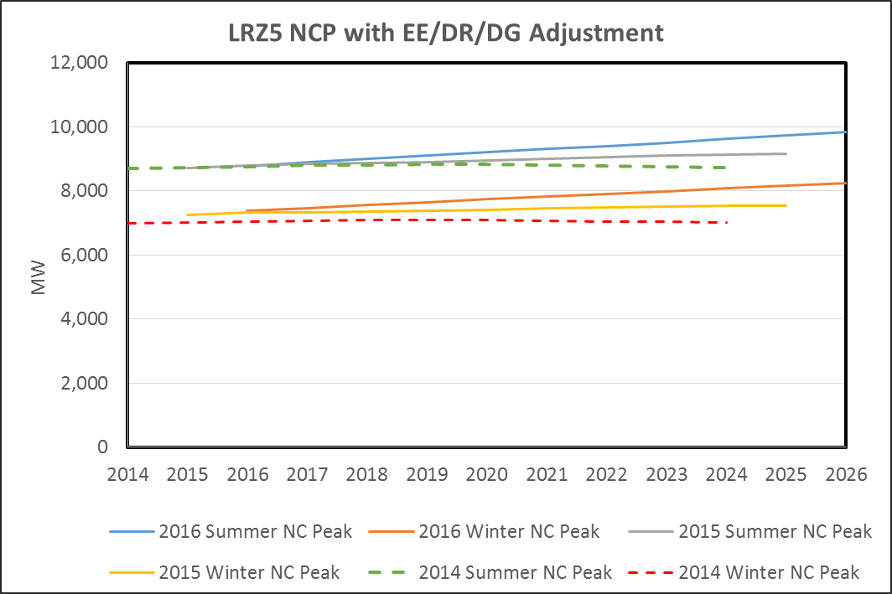

Slide 44
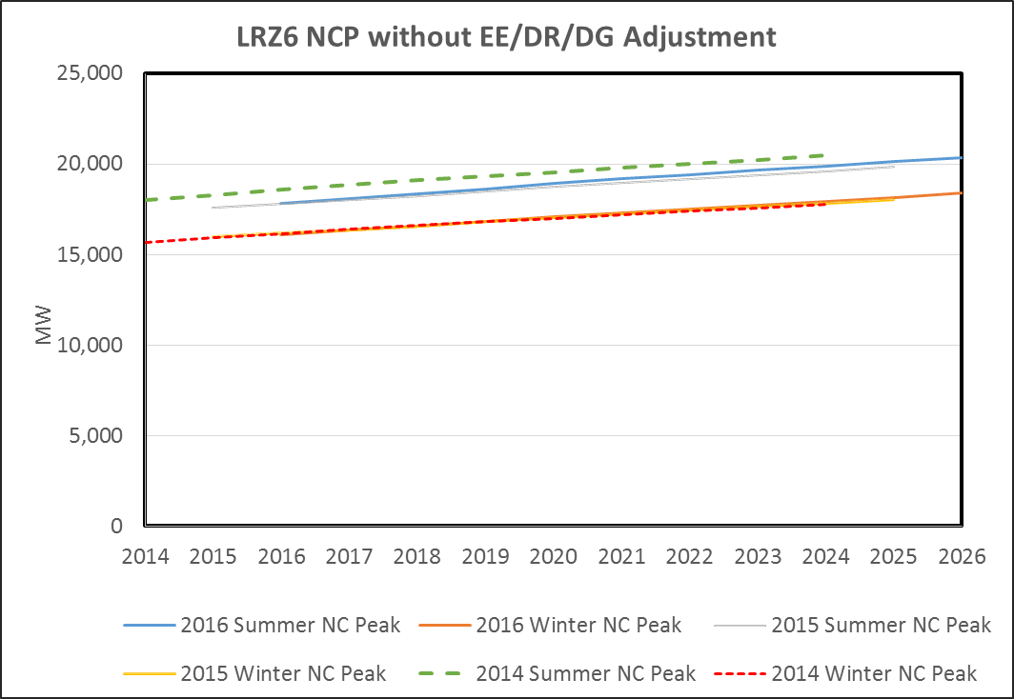

Slide 45
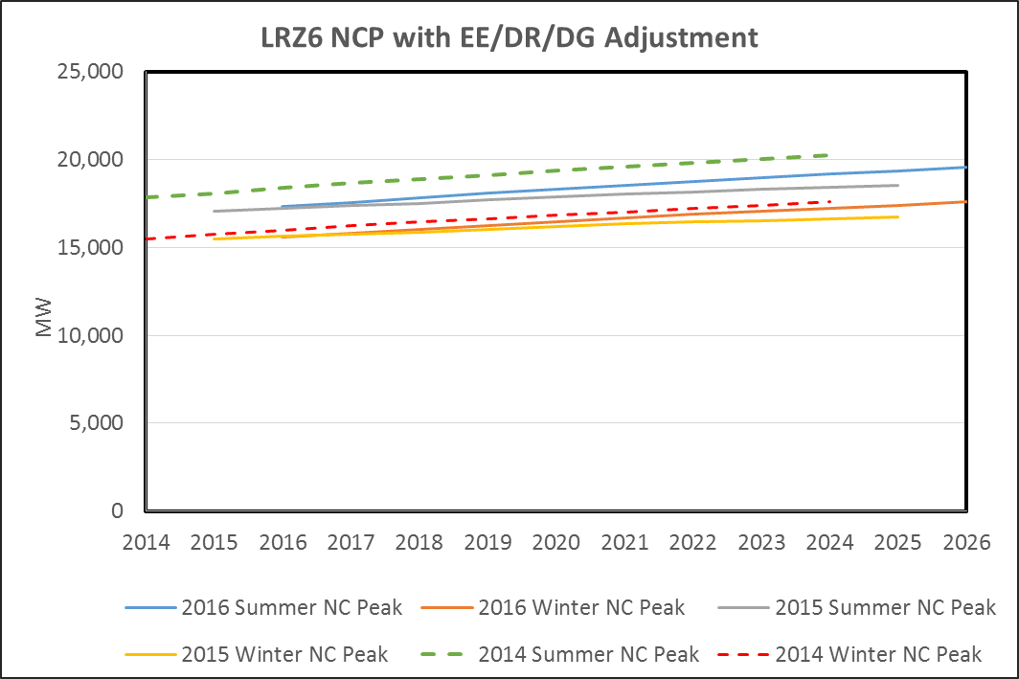

Slide 46
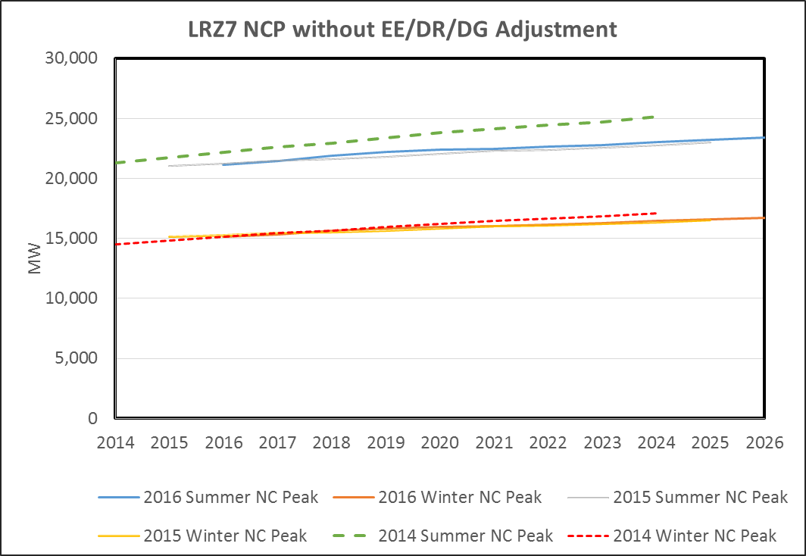

Slide 47
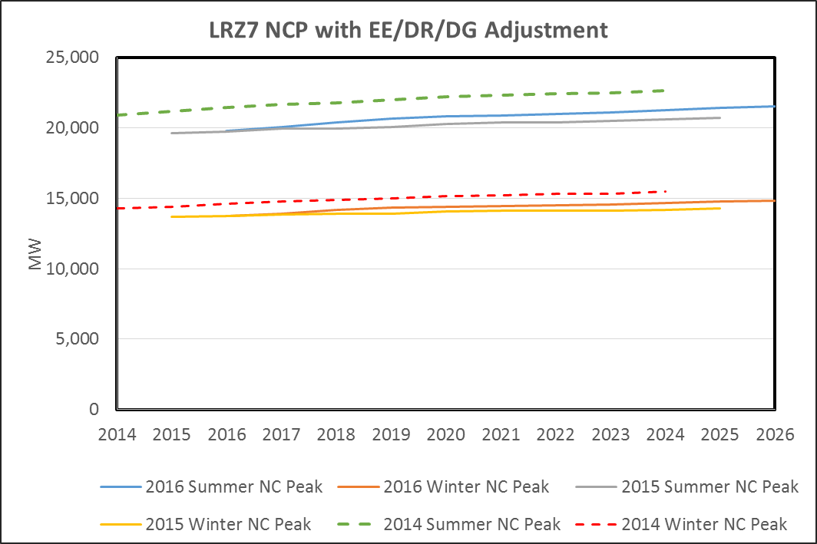

Slide 48
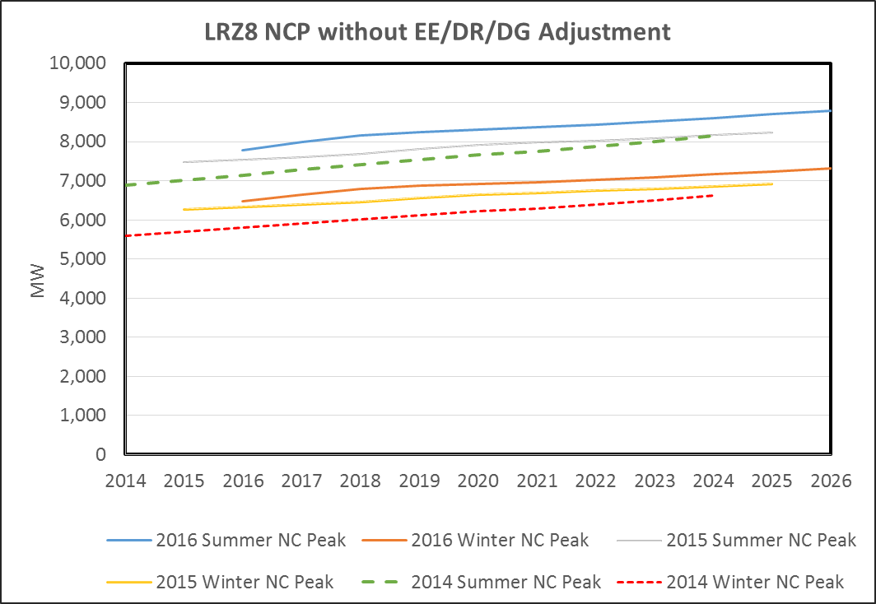

Slide 49
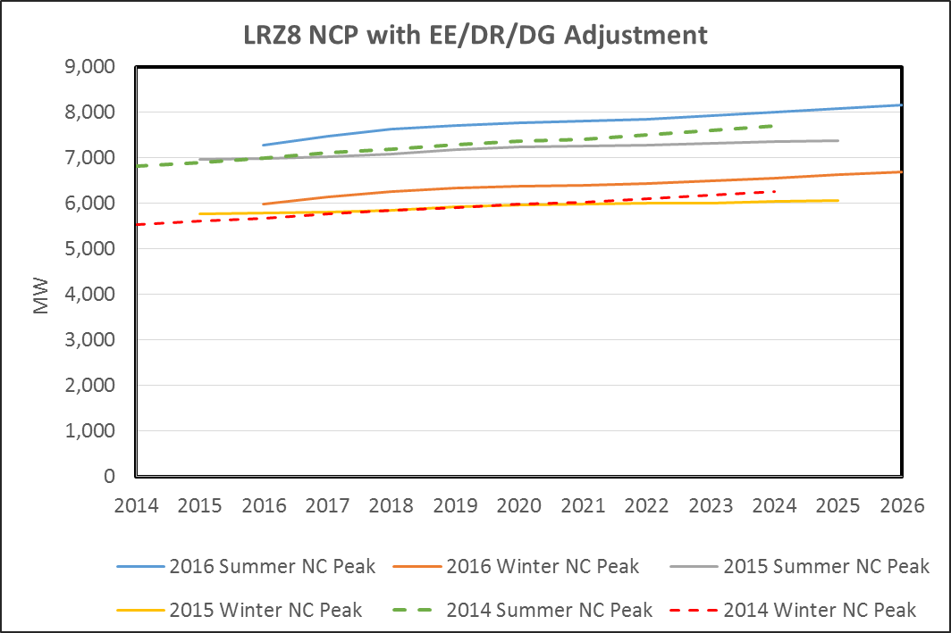

Slide 50
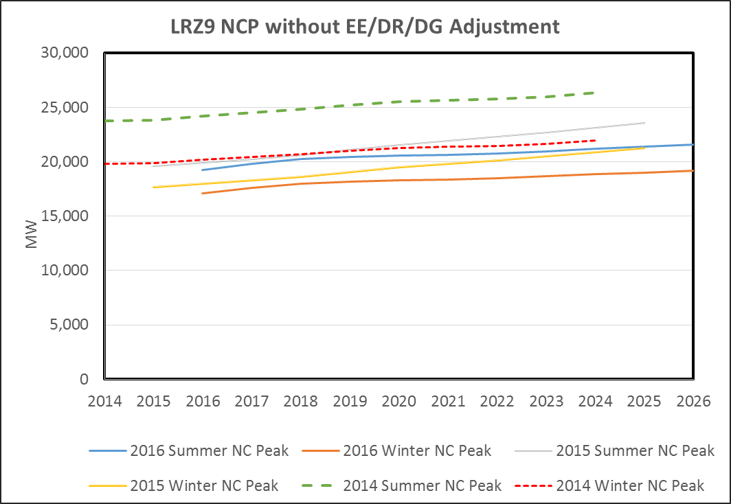

Slide 51
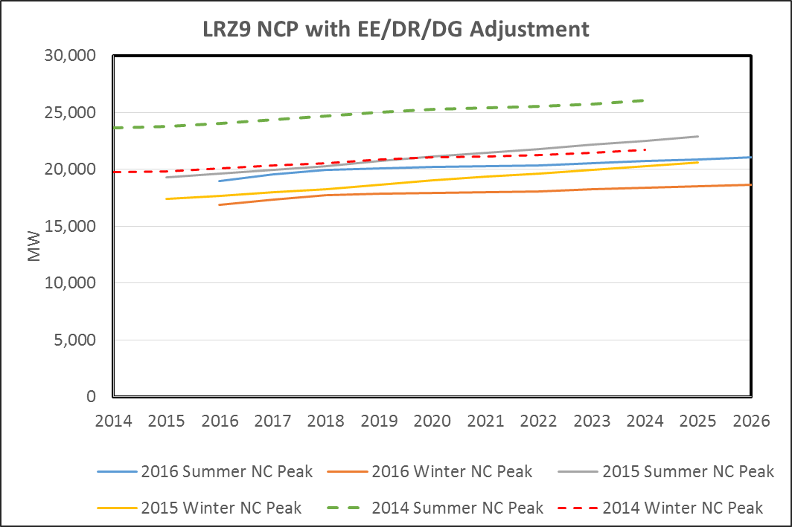

Slide 52
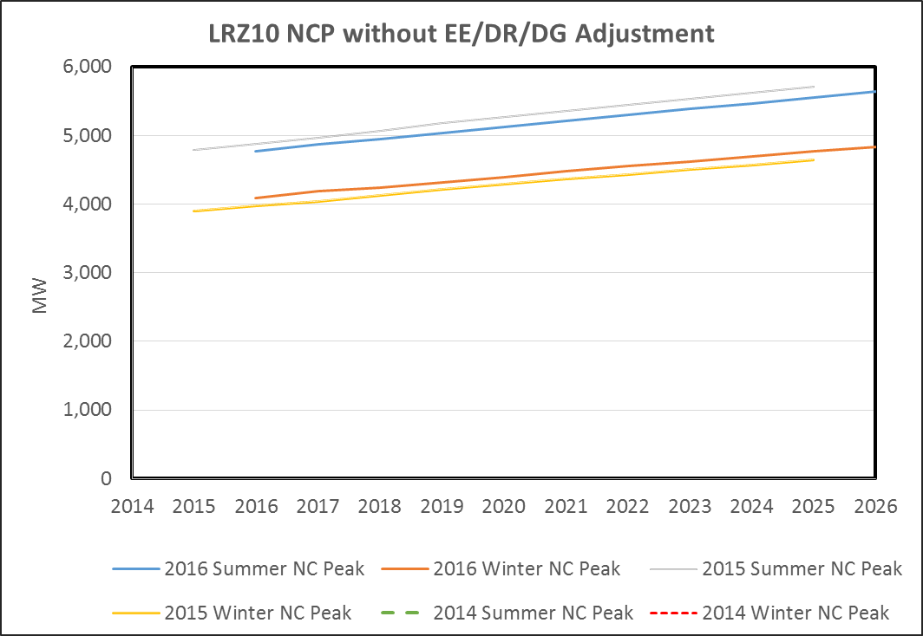

Slide 53
