Slide 1
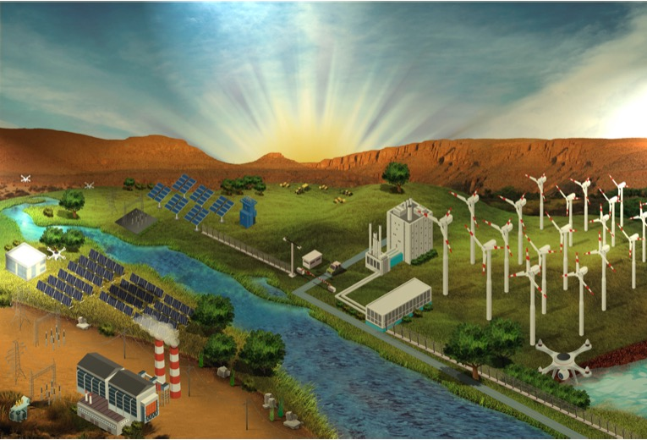
The Energy Corridor Along the USA-Mexico Border:
CHANGING THE CONVERSATION
Jay Gore (Reilly Chair, founding (former) Director Energy Center at Purdue)
Wally Tyner (James and Lois Ackerman Professor, Senior Fellow, National Ag Policy)
Rathziel Roncancio (Ph.D. student)
Techno-economic Analysis for FEWIEP
June , 2019
University of California at San Diego

Slide 2
Agenda
Population at the border
Solar Energy at the border
Wind Energy at the border
Natural Gas at the border
USA Electricity Production by Source
Mexico Electricity Production by Source
Natural Gas Utilities in the USA
Natural Gas Utilities in Mexico
Universities at the border
Techno economic analysis

Slide 3
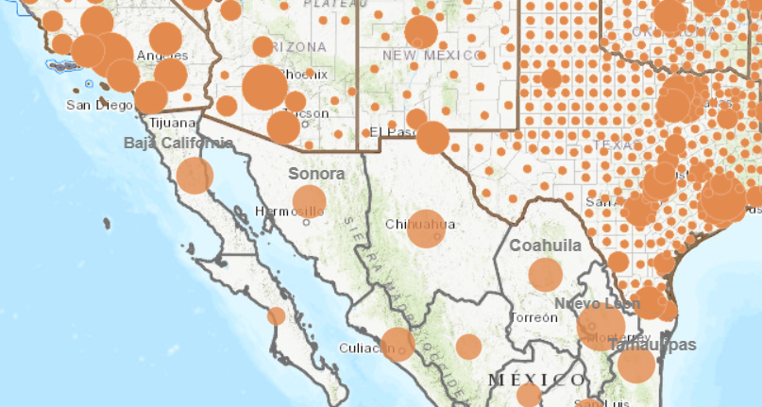
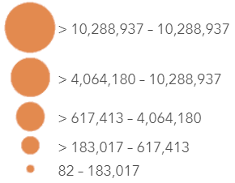
Population in the 4 Border States (USA) and 6 Border States (Mexico)
Population
USA | 327.2 million
Border | 77.52
CA | 39.56
AZ | 7.17
NM | 2.09
TX | 28.7
Mexico | 129.2 million
Border | 21.53
BC | 3.32
SO | 2.85
CH | 3.85
CO | 2.95
NL | 5.12
TM | 3.44
million
Source: Census Bureau, INEGI
Notes:
INEGI: National Institute of Statistics and Geography of Mexico.
The information for the US is by county and the information for Mexico is by state.

Slide 4
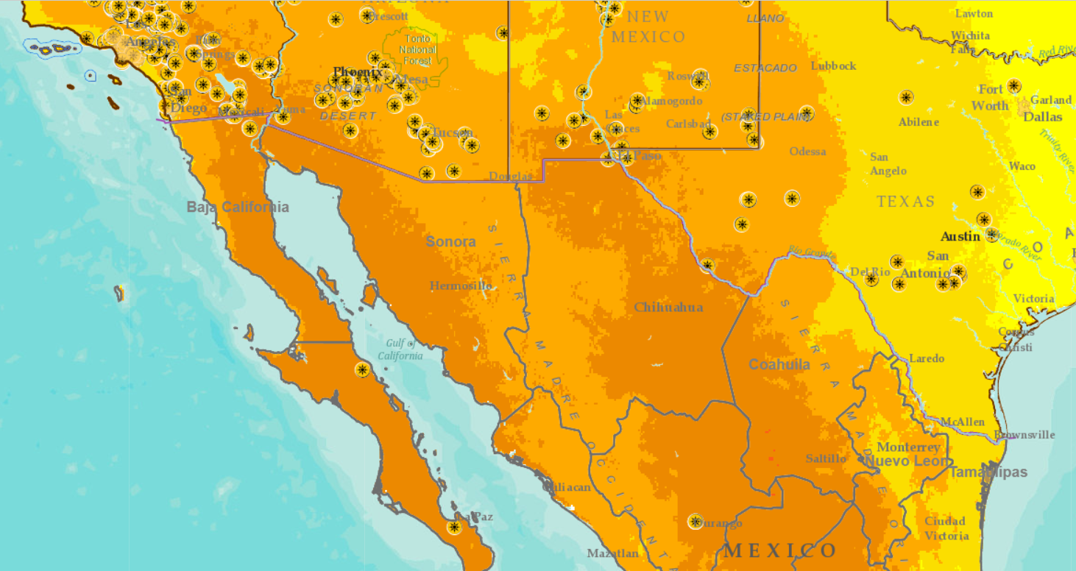

Solar Energy in the 4 Border States (USA) and 6 Border States (Mexico)
Installed Solar Power
USA | 64.2 GW
Border | 31.8
CA | 24.4
AZ | 3.7
NM | 0.8
TX | 2.9
Mexico | 3.0 GW
Border | 1.2
BC | 0.004
SO | 0.227
CH | 0.318
CO | 0.658
NL | 0
TM | 0
kW/m² per day
Source: North American Cooperation on Energy Information (NACEI), SEIA, ASOLMEX
Notes:
Direct Normal Irradiance (DNI) is the amount of solar radiation received per unit area by a surface that is always held perpendicular (or normal) to the rays that come in a straight line from the direction of the sun at its current position in the sky
Global Horizontal Irradiance (GHI) is the total amount of shortwave radiation received from above by a surface horizontal to the ground.
SEIA=Solar Energy Industries Association.
ASOLMEX: Mexican Association of Solar Energy.
BC=Baja California
SO=Sonora
CH=Chihuahua
CO=Coahuila
NL=Nuevo Leon
TM=Tamaulipas

Slide 5
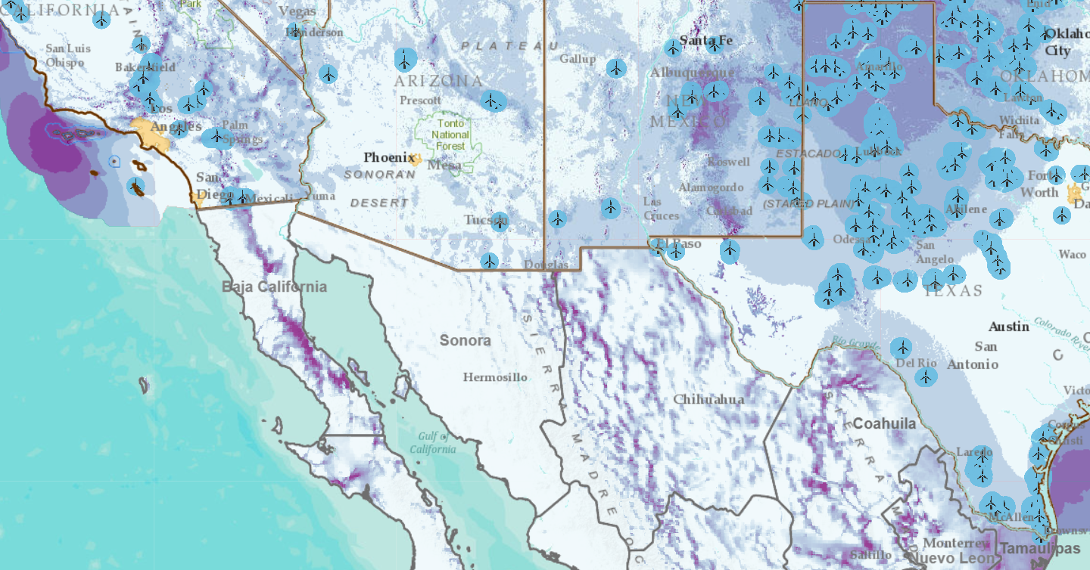
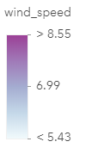
Wind Energy in the 4 Border States (USA) and 6 Border States (Mexico)
Installed Wind Power
USA | 97.2 GW
Border | 32.77
CA | 5.84
AZ | 0.3
NM | 1.73
TX | 24.9
Mexico | 4.2 GW
Border | 1.11
BC | 0.166
SO | 0.002
CH | 0
CO | 0.2
NL | 0.274
TM | 0.47
m/s
Source: NREL, AWEA, AMDEE
Notes:
Wind energy accounts for 8% of US energy production.
More than 20% of all US wind capacity is located in Texas
AWEA: American Wind Energy Association
AMDEE: Mexican Association of Wind Energy,2018

Slide 6
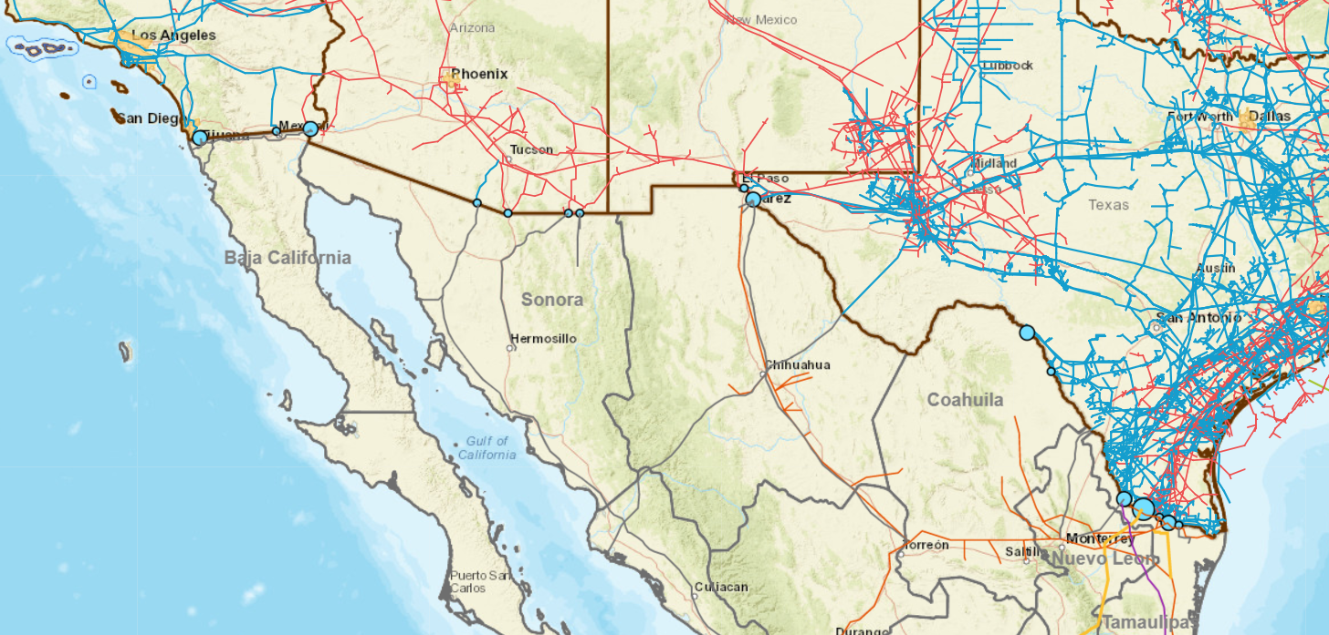
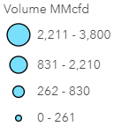
Natural Gas Energy in the 4 Border States (USA) and 6 Border States (Mexico)
Installed Natural Gas Power
USA | 124.6 GW
Border | 32.77
CA | 37.7
AZ | 13.7
NM | 3.3
TX | 69.9
Mexico | 45.7 GW
Border | ~16
BC | ~3.0
SO | ~3.0
CH | ~1.0
CO | ~3.0
NL | ~3.0
TM | ~3.0
Source: EIA, SENER (Secretariat of Energy Mexico)
Notes:
Tcf=Trillion Cubic Feet
The US has been a net exporter of Natural Gas for the second year
Natural gas exports were 3.61 Tcf in 2018, 47% of which went to Mexico.
U.S. Point of Entry/Exit Corresponding Mexican Point of Entry/Exit U.S.Transporter Foreign Transporter
Alamo, Texas Reynosa, Tamaulipas Tennessee Gas Pipeline PEMEX Pipeline
Calexico, California Mexicali, Baja California SoCalGas DGN Pipeline
Clint, Texas Ciudad Juarez, Coahuila Samalayuca Pipeline PEMEX Pipeline
Del Rio, Texas Acuña, Coahuila West Texas Gas, Inc. PEMEX Pipeline
Douglas, Arizona Naco, Sonora El Paso Natural Gas Company PEMEX Pipeline
Eagle Pass, Texas Piedras Negras, Coahuila West Texas Gas, Inc. Reef International Pipeline
El Paso, Texas Ciudad Juarez, Coahuila Norteno Pipeline PEMEX Pipeline
Galvan Ranch, Texas Coahuila, Mexico Encinal Gathering, Ltd. PEMEX Pipeline
Hidalgo, Texas Reynosa, Tamaulipas Texas Eastern Pipeline PEMEX Pipeline
McAllen, Texas Reynosa, Tamaulipas Kinder Morgan Border Pipeline PEMEX Pipeline
Nogales, Arizona Nogales, Mexico El Paso Natural Gas Company PEMEX Pipeline
Ogilby, California Algodones, Baja California North Baja Pipeline Gasaducto Bajanorte
Otay Mesa, California Rosarito, Baja California San Diego Gas & Electric Sempra Energy International
Penitas, Texas Arguelles, Tamaulipas El Paso Natural Gas Company PEMEX Pipeline
Sasabe, Arizona Sasabe, Sonora El Paso Natural Gas Company Gasoducto de Aguaprieta
Rio Bravo, Texas Rio Bravo, Tamaulipas Tennessee Gas Pipeline Gasoducto Del Rio
Rio Grande City, Texas Ciudad Camargo, Nuevo Leon NET Mexico Pipeline, LP Las Ramones Pipeline
Roma, Texas Monterrey, Nuevo Leon Kinder Morgan Texas Pipeline PEMEX Pipeline
Yucca Power Plant Algodones, Baja California North Baja Pipeline Gasoducto Bajanorte

Slide 7
USA Border States Electricity Production by Source
Electricity Prod. Monthly (thousand MWh)
AZ | 8500
CA | 14600
NM | 3000
TX | 33000
Source: EIA, SEDS
Notes:
EIA: Energy Information Administration
SEDS; State Energy Data System

Slide 8
Mexico Electricity Production by Source
Total: 256 million MWhr
Source: SENER (Secretariat of Energy Mexico)

Slide 9
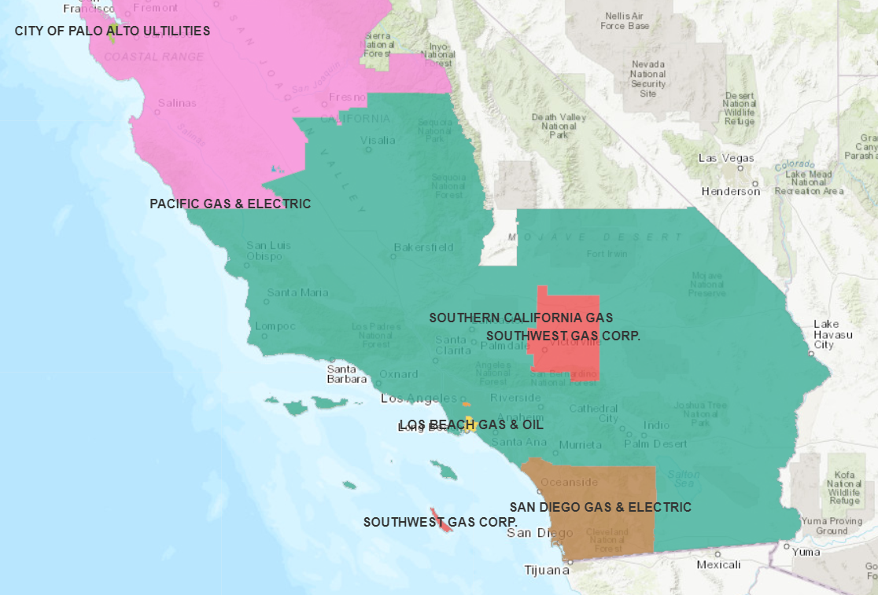
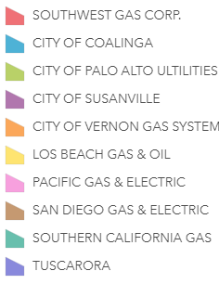
Natural Gas Utilities in California
Source: California Energy Commission
Notes:
The vast majority of California's natural gas customers are residential and small commercial customers, referred to as "core" customers, who accounted for approximately 32% of the natural gas delivered by California utilities in 2012. Large consumers, like electric generators and industrial customers, referred to as "noncore" customers, accounted for approximately 68% of the natural gas delivered by California utilities in 2012.

Slide 10
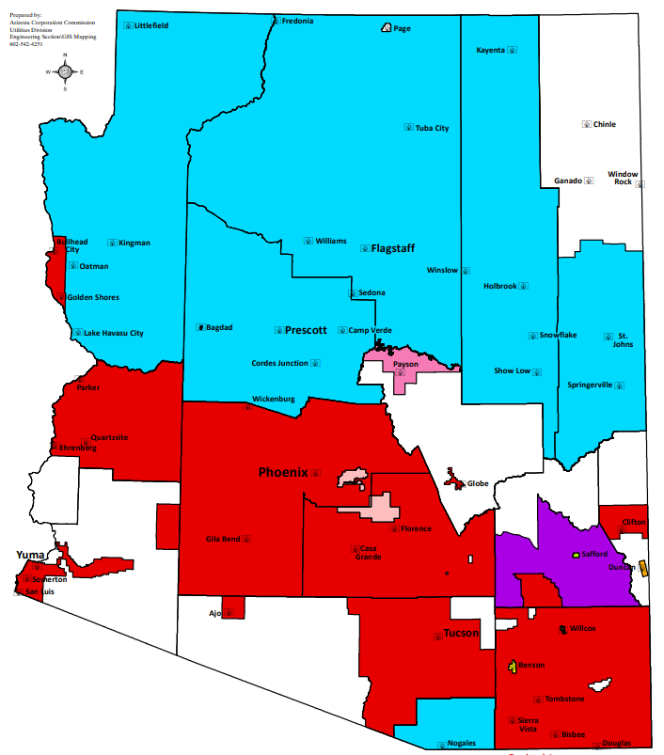
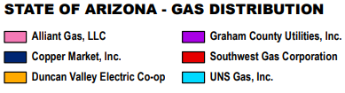


Natural Gas Utilities in Arizona
Source: Arizona Corporation Comission

Slide 11
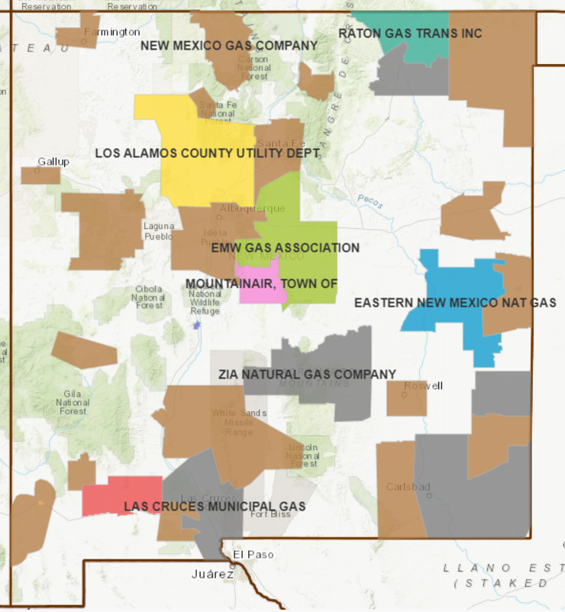
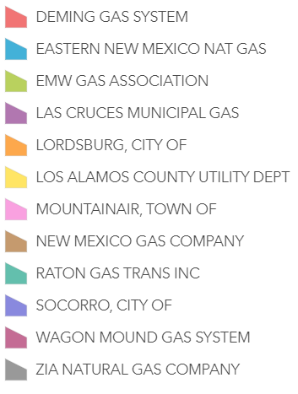
Natural Gas Utilities in New Mexico
Source: HIFLD
Notes:
HIFLD: Homeland Infrastructure Foundation-Level Data

Slide 12
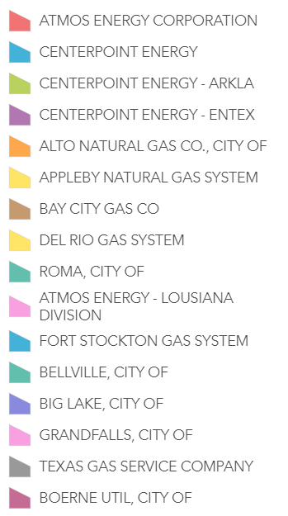
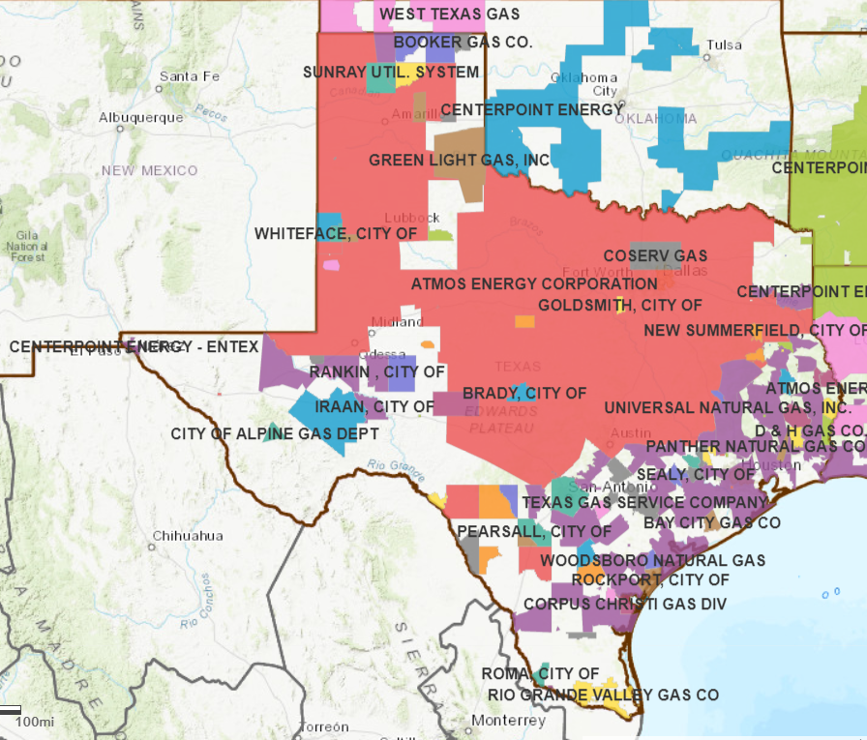
Natural Gas Utilities in Texas
Source: HIFLD
Notes:
. HIFLD: Homeland Infrastructure Foundation-Level Data

Slide 13
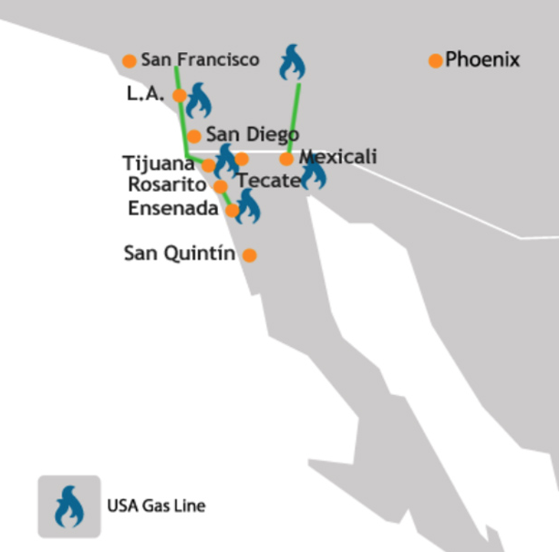
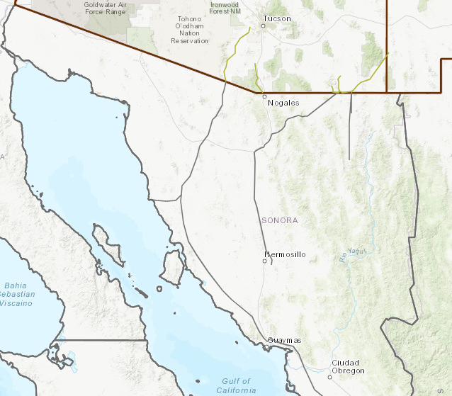
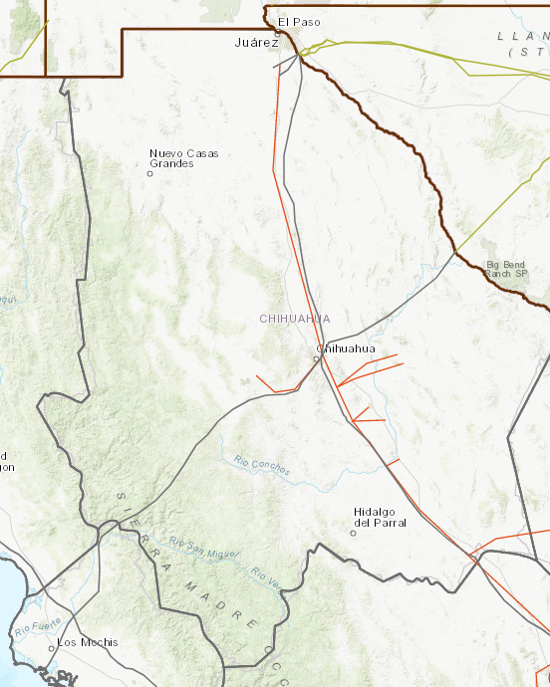
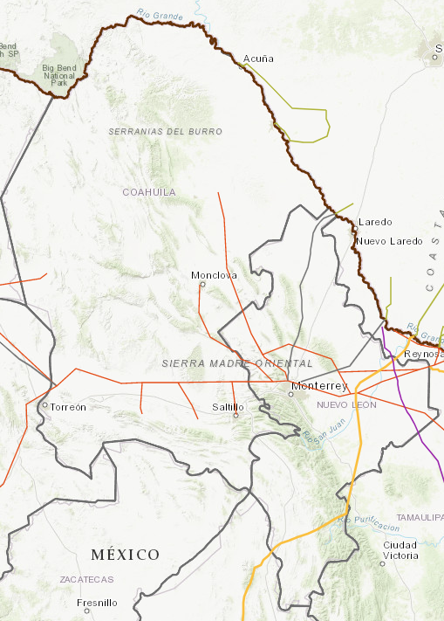
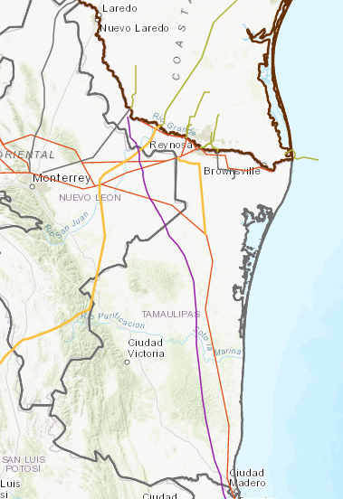
Natural Gas Utilities in Mexican States
Sources: SEDECO, SENER
Chihuahua
Sonora
Nuevo Leon
Baja California
Natural gas energy is much larger but the pipeline infrastructure is not developed. Gas is delivered in cylinders.
IENOva, Sempra, Cenagas, Transcanada, Ecogas, Northwestern NG, Gas Central, Naturgy, ENGIE, and others.
Opportunities to translate USDOE supported high efficiency (65%), low CO₂ gas turbines research to the new installations in Mexico
Coahuila
Tamaulipas
Notes:
SEDECO: Economy Development Secreatariat of Baja California

Slide 14
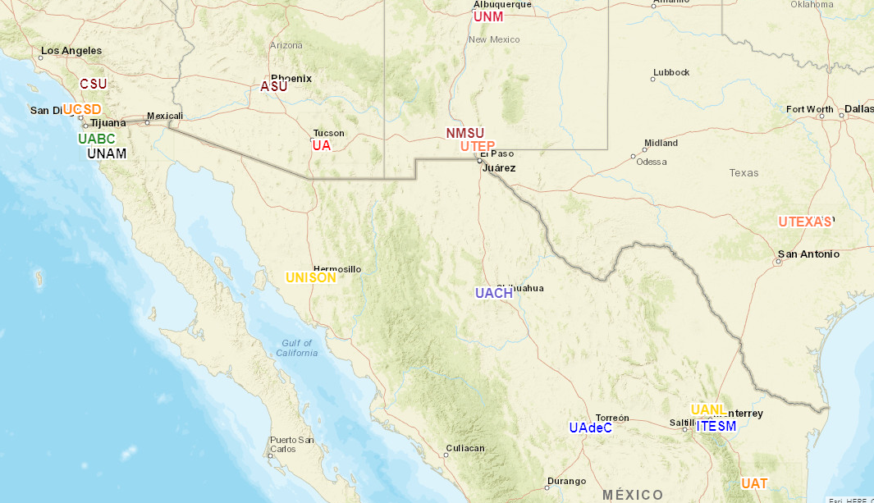
Universities at the Border
United States
California State University (CSU)
University of California (UC-SD)
Arizona State University (ASU)
University of Arizona (UA)
University of New Mexico (UNM)
New Mexico State University (NMSU)
University of Texas (System)
Branch of the Best!
Mexico
Autonomous University of Baja California (UABC)
National Autonomous University of Mexico (UNAM)
University of Sonora (UNISON)
Autonomous University of Chihuahua (UACH)
Autonomous University of Coahuila (UAdeC)
Autonomous University of Nuevo Leon (UANL)
Monterrey Institute of Technology (ITESM)
Autonomous University of Tamaulipas (UAT)
Main Campus of the 2nd Best!
Notes:
Secretariat of Energy Mexico

Slide 15
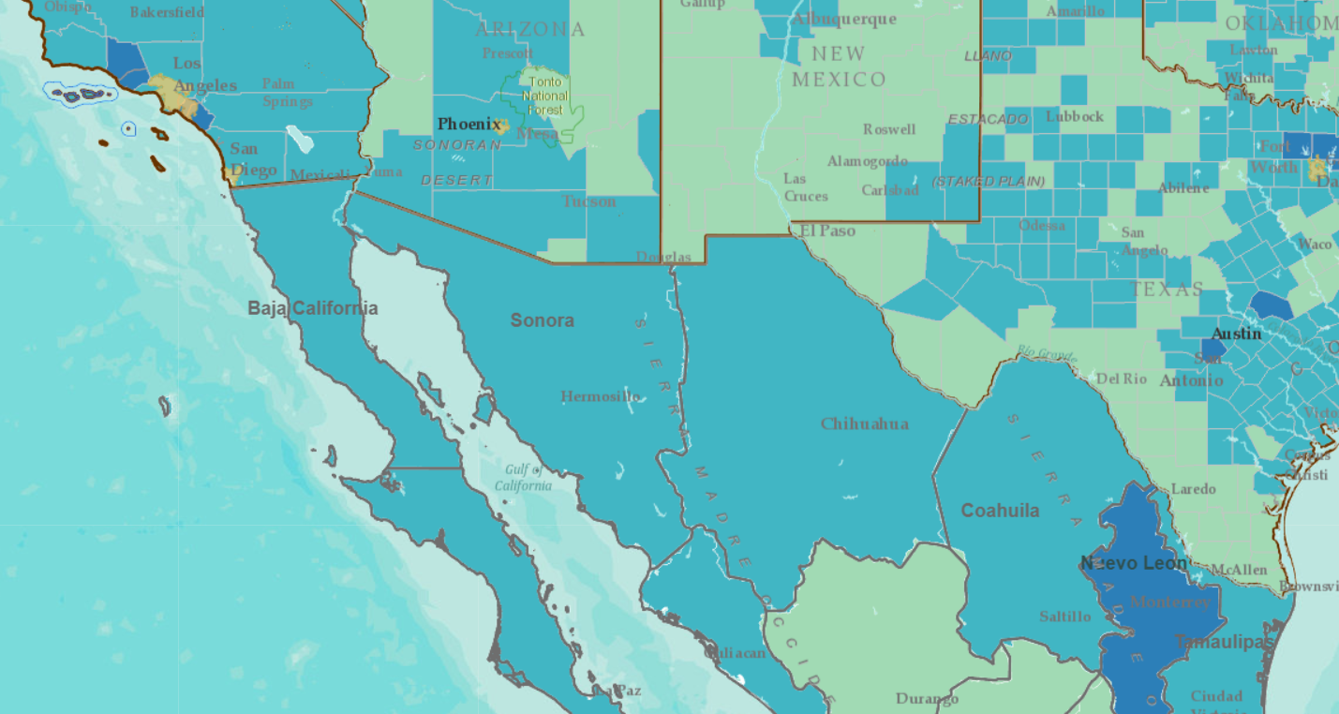
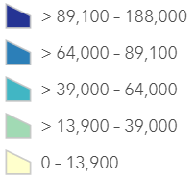
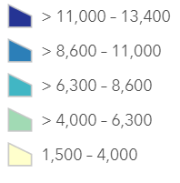
Techno- analysis Purchasing Power per Capita
Minimum Wage
USA | 7.25/hr
CA | 12/hr
AZ | 11/hr
NM | 7.50/hr
TX | 7.25/hr
Mexico-rest | 5.1/day
BC | 8.78/day
SO | 8.78/day
CH | 8.78/day
CO | 8.78/day
NL | 8.78/day
TM | 8.78/day
US
Mexico
Sources: Census Bureau, INEGI

Slide 16
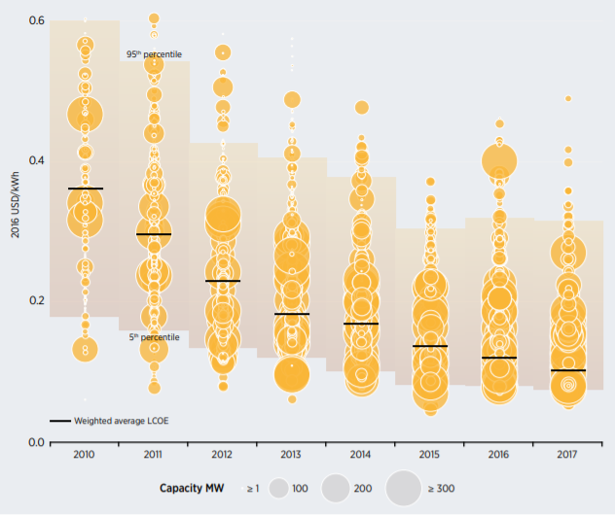
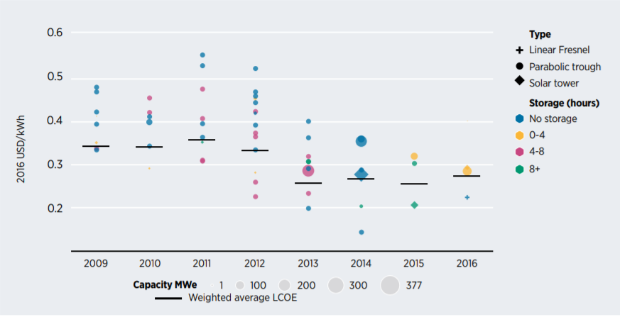
Techno- analysis Solar
PV
CSP
Source: IRENA
Notes:
LCOE: Levelized Cost of Electricity
IRENA: International Renewable Energy Agency
PV:Photovoltaic
CSP: Concentrated Solar Power
.

Slide 17
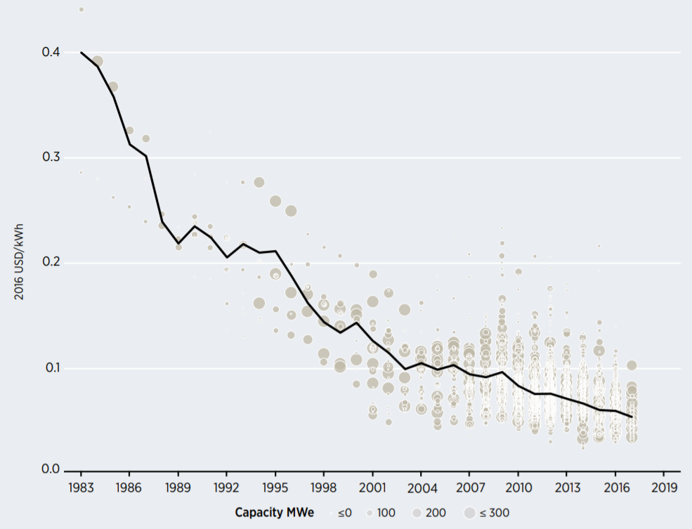
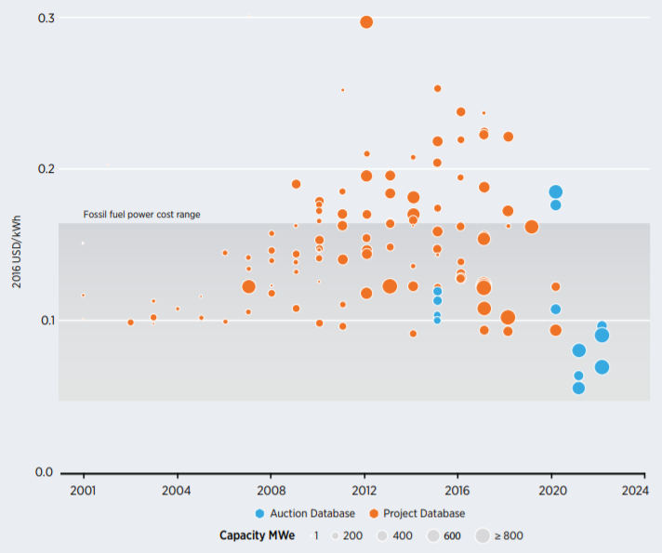
Techno- analysis Wind
On-Shore
Off-Shore
2016 US$/KWh
2016 US$/KWh
Source: IRENA
Notes:
IRENA: International Renewable Energy Agency (2017)
LCOE: Levelized Cost of Electricity

Slide 18
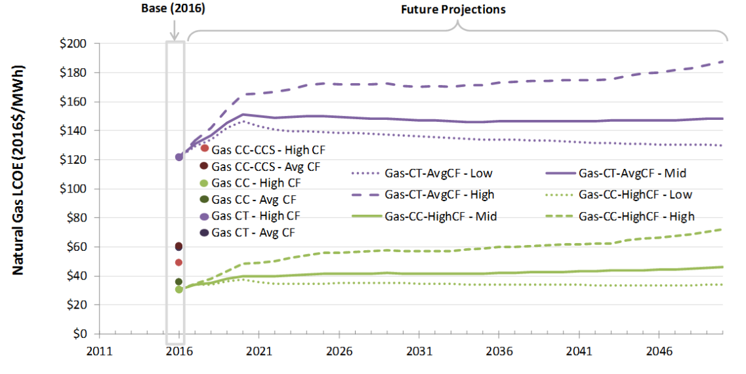
Techno- analysis Gas
Source: NREL
Notes:
Gas CC-CCS=Combined Cycle and Carbon Capture and Storage
Gas CC=Combined Cycle
Gas CT=Conventional Gas Turbine

Slide 19
Techno-economic analysis
We will do techno-economic analysis (TEA) for the entire system (system boundaries yet to be determined) as well as the component parts
TEA will be used to help identify areas to focus greater attention in improving the system. That is, areas for which the payoff for additional improvement in efficiency or reduction in cost has the best return.
We will also use TEA to provide comprehensive analysis of the system as a whole under a range of assumptions.

Slide 20
Renewable energy component
Most analysis of renewable energy cost today reports levelized cost of energy, and that is an important component of the analysis.
However, it is not the total cost of a renewable energy system. Renewable energy is interruptible (not dispatchable in electric systems lingo), which means systems integration costs must be included.
Renewable sources can be balanced with any combination of backup capacity (often combined cycle gas), energy storage (often battery) and improved transmission and smarter grids. The costs of whatever options are included in the system must be included to get the total energy cost.

Slide 21
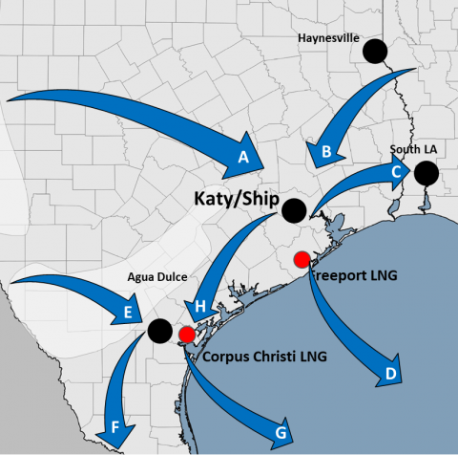
Natural gas as backup
)
If the pilot site is in Texas, there should be ample supply of inexpensive natural gas from the Permian basin in Texas.
Flow F is the current flow of Permian gas for export to Mexico.
Recently, Permian gas has been so abundant that at times, prices have turned negative.
It should be possible to build a small combined cycle gas plant to work with the renewable energy to produce reliable, renewable, and reasonably priced power.
Other options, of course, will be examined, as well
Texas Gulf Coast Gas Flow Patterns.
Source: RBN (Click

Slide 22
TEA for other system components
The economics team will work with the engineers to develop a data set for all components envisioned for the system.
Again, we will do the analysis for each component and for the system as a whole.
This analysis could lead to some components being eliminated from the design and/or others being added.
We must have a system that produces all the described social and environmental benefits at costs that can be documented and are sustainable.

