Slide 1
The Energy Corridor Along the US/Mexico Border: Changing the Conversation
PI: Luciano Castillo (Renewable Energy),
Co-PIs: Wallace E. Tyner (Agriculture & Energy Economy),
Rosalee A. Clawson (Policy), David Warsinger (Water),
Jay Gore (Energy) and Dev Niyogi (Climate Change).

Slide 2
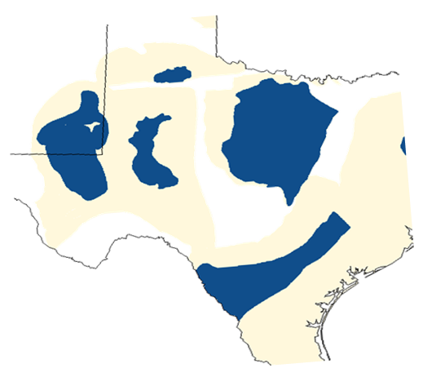
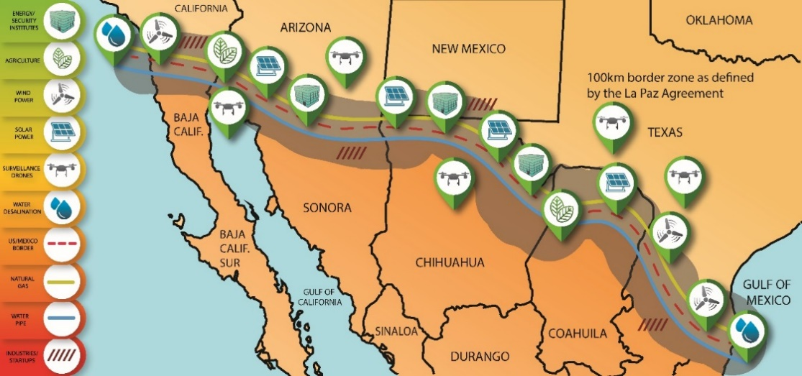
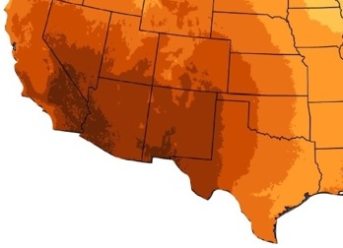
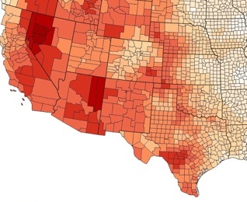
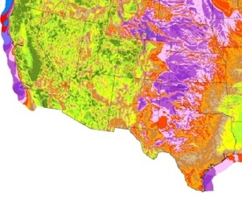
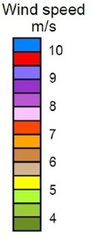

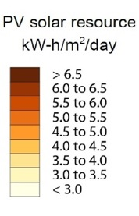
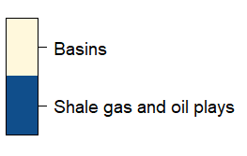
Value Proposition
Mexico ($612B) is the third trading partner of US, after China ($670B) & Canada ($617B) in 2017.
Wind
Drought
Solar
Natural
Gas
SOLUTION: Replace the CONCRETE WALL by an energy (solar, wind & natural gas)–water “opportunity” corridor that addresses above challenges while building an oasis in the dessert and enhance security!
Notes:
CHALLENGE: Border region (1,954 miles) exposed to mass migration, violence, geopolitical tensions, and facing a water crisis.
415 Immigrant deaths in 2017
396,579 apprehensions in 2018
361,087 apprehensions in 2019
Longest US Government shutdown in history (34 days and Cost $11B).
$500 Million per year business of human smuggling.

Slide 3
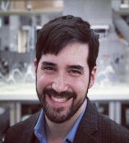


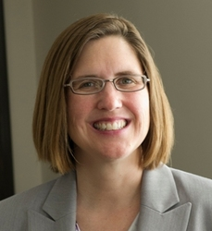
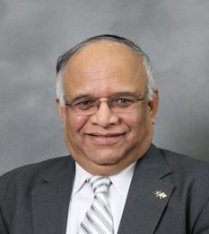

Team Description
Water
Energy
Agriculture
David Warsinger
Luciano Castillo
Wallace E. Tyner
Dev Niyogi
Rosalee A. Clawson
Jay Gore
Climate Change
Policy & Economics
TRACK RECORD:
Co-founding or Advising Startups: 12
Journal Papers (1,130), Patents (18), Books (10). Combined H-index: >170
Combined time team has worked together: >50 years
Leadership: Center Directors (3), Deanship (1), Dept. Head (2), etc
Energy/Economy
IMPACT OF THIS BIG IDEA 2.0:
Over 25 publications, Scientific American, 2 TV appearances (Televisa), Podcast, WAPO Article by President Daniels, Consortium (Caltech, Stanford) etc), If Idea Festival August 2019.
Notes:
Our team working on FOOD-ENEGY-WATER Nexus is the #1 Sustainability Problem of the world.
Working in Peru.
Fact check interdisciplinary line please

Slide 4
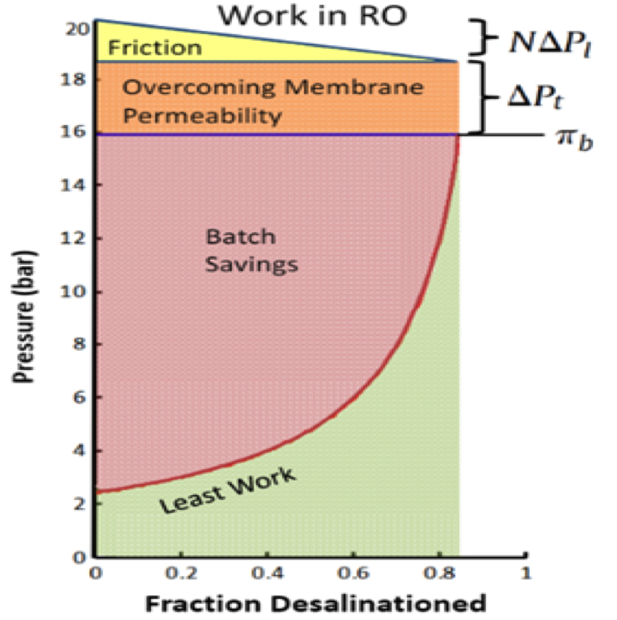
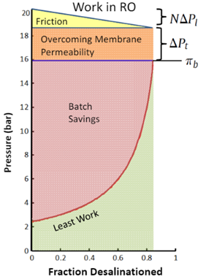
Approach
YEAR #1: GOALS
New Technologies: Bio-inspired micro-surface (Patent), Hydraulic Wind Turbine integrated with Reverse Osmosis (Patent).
techno-economic analysis: Energy (solar, wind, natural gas), Water, Industries.
Master Plan: for Entire Project, Strategy for Policy & Economic Potential.
YEAR 2: GOALS
Dramatic cost Reduction in Water Desalination (30%), COE (10-24%) Off shore wind Energy
Deploy prototypes: Renewable Energy Systems integrated with Natural Gas in Arizona.
New science: water-energy-Food Nexus for humanitarian Challenges
APPROACH: The energy-water corridor will take advantage of the unique energy resources (Solar, Wind & Natural Gas) along the border states to produce water & economic development of the region--- reduce migration by creating opportunities.
Notes:
We will conduct a complete techno-economic analysis of the electricity production system and optimize it to be able to provide lowest cost renewable electricity available.
There will be high demands for the water produced in the project, and we will evaluate the slate of industrial and agricultural applications to ensure high value added applications get priority.
Given that the project will be providing inexpensive renewable electricity and clean renewable water, we will develop promotional materials to show the value of these infrastructure inputs to their decision to invest in the corridor.
Market Potential: Combined water-energy system technologies targeting the markets: electricity ($460B), demand-response (~$50 billon/year), water
Super energy resources + new technologies: price reduction over state of the art of >35%

Slide 5

Plan for External Funding/Why Purdue?
Path Forward for Future Funding
#1. Foundations: W.M. Keck Foundation, Bill & Melinda Gates, $100 M MacArthur.
#2. Federal Funding: Department Transportation, DOE, NSF, NASA, Bureau of reclamation.
#3. Private Donors (Jay Kahn), State Infrastructure Projects.
#4. Present to congress
#5. Partnerships: Maeva Investments
Why Purdue?
#1. Purdue Consortium Lead of 32: (NAE, NAS, Medal Science)
#2. WHAT IF Festival in August.
#3. Purdue Cement as World Leader on Humanitarian Grand Challenges
#4. Paris Peace Forum 2019
#5. Strong support by President Daniels
Notes:
TWUA is texa’s water utility

