Slide 1








The New RO: A Game Changer for Water and Energy
David M. Warsinger
Assistant Prof
Previously:
PostDoc
PostDoc
Ph.D., PostDoc
B.S., M.Eng.
Notes:
What are the most critical grand challenges humanity is facing today?
What are the best scientific tools and questions to address these challenges?

Slide 2
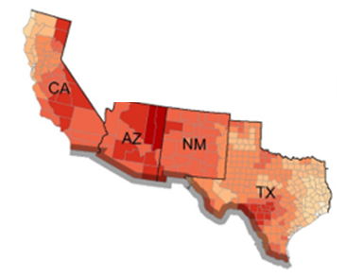
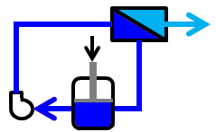
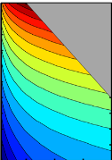
Outline
Lab Intro
Salinity crisis
Context: desalination energy efficiency
Batch fundamentals
New designs
Energy efficiency results
Cost savings
Other technologies

Slide 3
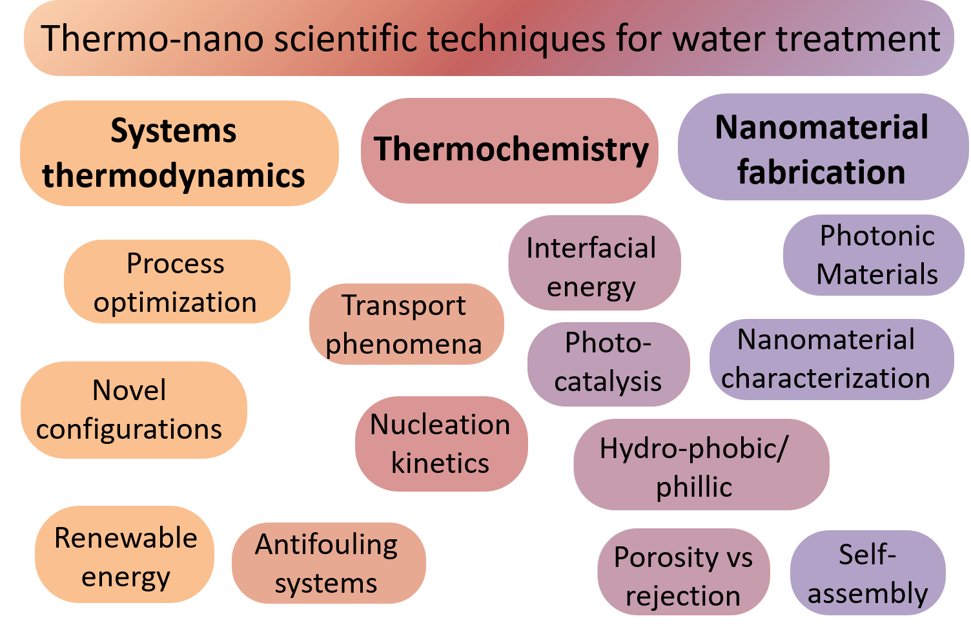
Research Summary
Warsinger Water Lab Research
Briefly describe research areas
Can use one or two illustrations
Relevant Scientific Principles
Warsinger Lab Research
MEMBRANE NANOMATERIALS
Eg. Photonic membranes
THERMODYNAMICS & TIME VARYING PROCESSES
Eg. Batch Reverse Osmosis
THERMAL DESALINATION
Eg. Membrane distillation

Slide 4
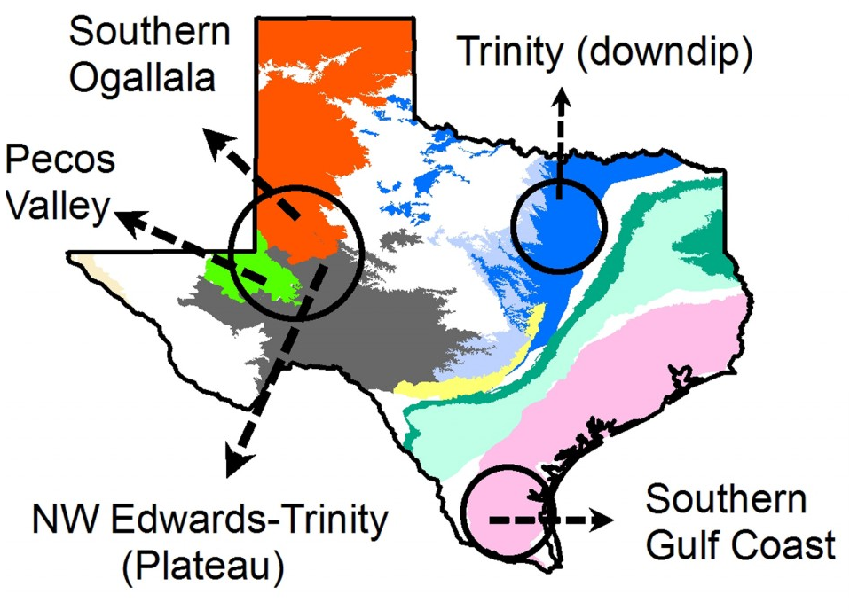
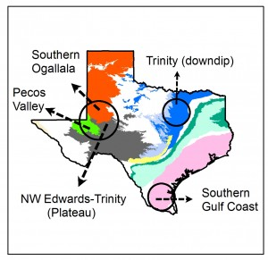
Salinization Crisis
Saline waters:
reduce crop yields by up to half
carries health and taste concerns for consumption
risks destroying plumbing
Salinization in the Border Region
In Texas, 15% of wells are at risk to high salinity
Surface waters increase substantially in salinity. E.g. Rio Grande increased 5 to 200ppm.
Hot spots of groundwater salinity found in major aquifers across Texas. Shown in black, shallow aquifer measurements exceeded secondary EPA limits in >60% of cases
Chaudhuri, S., & Ale, S. (2014). Long-term (1930–2010) trends in groundwater levels in Texas: influences of soils, landcover and water use. Science of the Total Environment, 490, 379-390.
Notes:
Trinity aquifer exceeded limits in 72% of cases

Slide 5
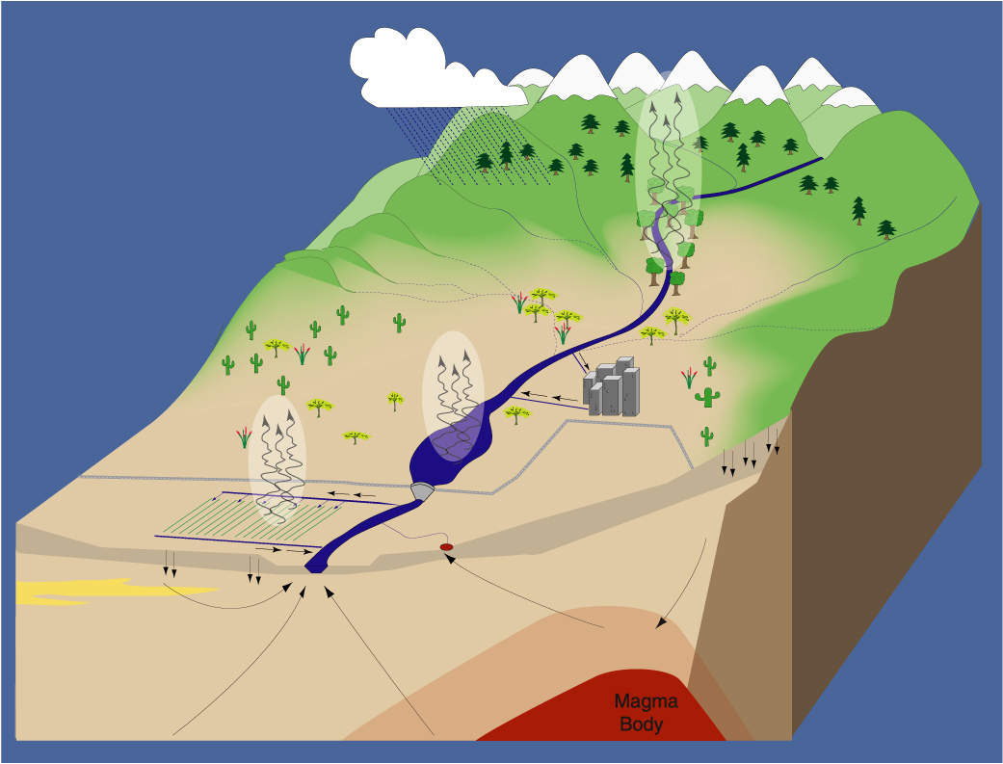
Salinity Sources
Cyclic salts and
Weathering
Riparian
Transpiration
Open Water
Evaporation
Consumptive use
Agricultural
Evapotranspiration
Waste water
Hydrocarbon Exploration
Geothermal
waters
Saline
Groundwaters
Source: Fred Phillips et. al, Salinity Dynamics of the Rio Grande: Shallow Groundwater, Deep Groundwater, and the Rio Grande
Notes:
Ale said groundwater mixing via cross-formational flow between aquifers, seepage from saline plumes and playas, evaporative enrichment, hydrocarbon exploration activities and irrigation return flows led to groundwater salinization in West Texas.

Slide 6
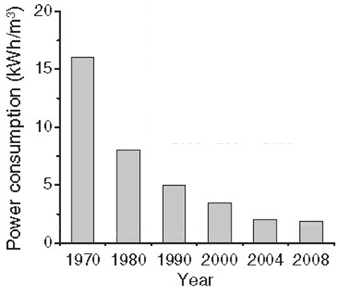
Desalination Energy Efficiency
SWRO = Seawater Reverse Osmosis
MSF= Multistage Flash
MED = Multi-Effect Distillation
TVC = Thermal Vapor Compression
SWRO energy over time
(Adapted from: M. Elimelech, W. A Phillip, Science 333, 712, 2011.)
1
minimum possible
2nd law efficiency of leading desalination technologies (Mistr, 2011.)
Other technologies
SWRO
Low Carbon Desalination: Status and Research, Development, and Demonstration Needs, J. H. Lienhard, G.P. Thiel, D.M. Warsinger, L. D. Banchik, Massachusetts Institute of Technology

Slide 7
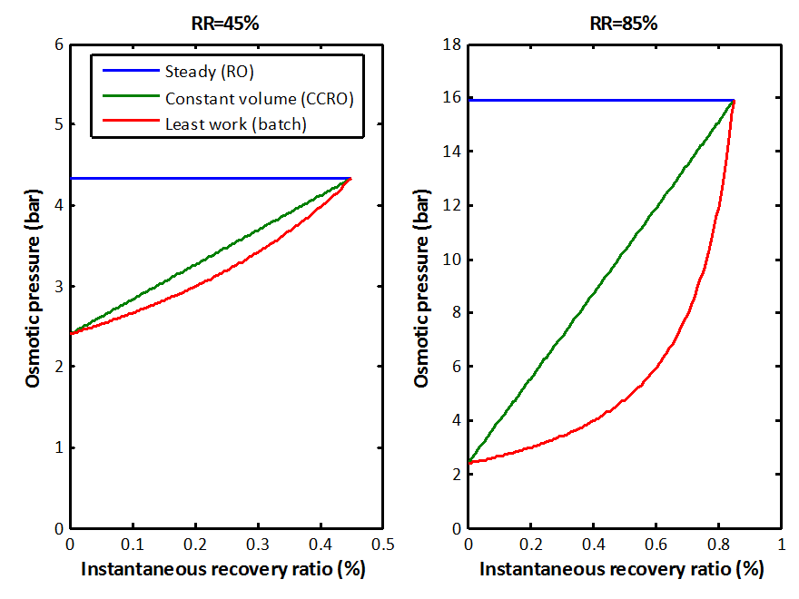
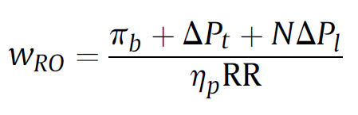
Batch Reverse Osmosis
Work in
RO
Batch
Friction
Overcoming Membrane Permeability
Pure Water
Terminal Overpressure
Viscous losses each pass
Osmotic pressure
Batch Savings
Pressure (bar)
Pump efficiency
Recovery Ratio
Overcoming Membrane Permeability
Friction
Osmotic pressure
Least Work
D. M. Warsinger¹, E. W. Tow¹, K. Nayar, and J. H. Lienhard V, “Energy efficiency of batch and semi-batch (CCRO) reverse osmosis desalination,” Water Research, vol. 106, pp. 272-282, 2016.
D. M. Warsinger, E. W. Tow, R. McGovern, G. Thiel, and J. H. Lienhard V. Batch Pressure-Driven Membrane Separation with Closed-Flow Loop and Reservoir. Full Patent Application, US non-provisional application No. 15/350,064 November 2016
Instantaneous recovery ratio
Fraction Desalinated
7
7

Slide 8
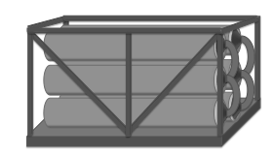
Continuous Reverse Osmosis
RO module
Pump
Pure Water
Feed
Brine
D. M. Warsinger¹, E. W. Tow¹, K. Nayar, and J. H. Lienhard V, “Energy efficiency of batch and semi-batch (CCRO) reverse osmosis desalination,” Water Research, vol. 106, pp. 272-282, 2016.
D. M. Warsinger, E. W. Tow, R. McGovern, G. Thiel, and J. H. Lienhard V. Batch Pressure-Driven Membrane Separation with Closed-Flow Loop and Reservoir. Full Patent Application, US non-provisional application No. 15/350,064 November 2016

Slide 9
Batch RO: High Pressure Tank Concept
RO module
Pump
Pure Water
Feed, single fill
Variable volume high pressure tank
Brine
Recirculation
Brine reject after each cycle
Circulation Pump
D. M. Warsinger¹, E. W. Tow¹, K. Nayar, and J. H. Lienhard V, “Energy efficiency of batch and semi-batch (CCRO) reverse osmosis desalination,” Water Research, vol. 106, pp. 272-282, 2016.
D. M. Warsinger, E. W. Tow, R. McGovern, G. Thiel, and J. H. Lienhard V. Batch Pressure-Driven Membrane Separation with Closed-Flow Loop and Reservoir. Full Patent Application, US non-provisional application No. 15/350,064 November 2016

Slide 10
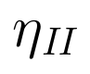
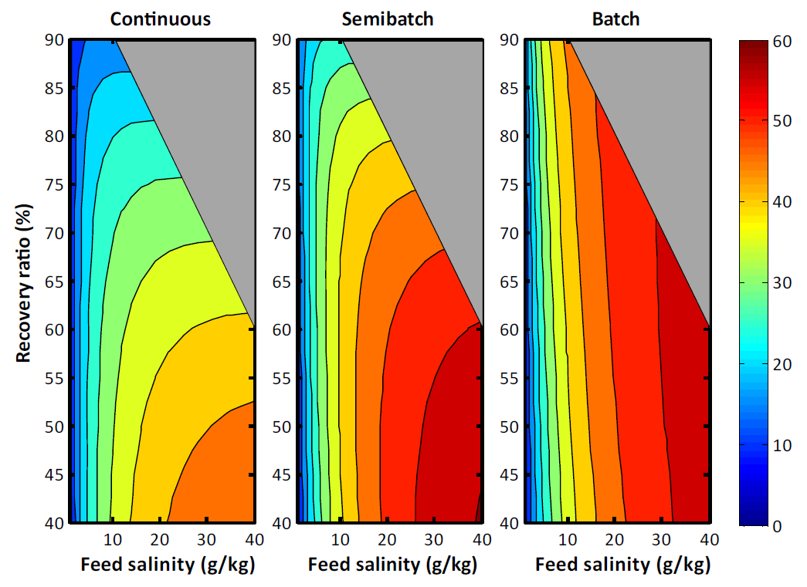
2nd Law Efficiency
Groundwater
& Water Reuse
Continuous RO
Batch RO
.9
.8
.7
.6
.5
.4
.9
.8
.7
.6
.5
.4
60%
40%
20%
0%
Recovery ratio
Recovery ratio
Continuous RO
Batch RO
.9
.9
60%
40%
20%
0%
.8
.8
.7
.7
Recovery ratio
Recovery ratio
.6
.6
.5
.5
0 10 20 30 40
0 10 20 30 40
Initial salinity [g/kg]
Initial salinity [g/kg]
.4
.4
Seawater
0 10 20 30 40
0 10 20 30 40
Initial salinity [g/kg]
Initial salinity [g/kg]

Slide 11
Cost savings from Batch + Ultrapermeable Membranes
Energy OpEx CapEx
Relative costs of different components in variants of RO and also MED. Calculated for a system size of 4,000 m³/day.
Includes batch RO (BRO), standard single stage RO (RO), and Multi-effect distillation (MED
D. M. Warsinger et. al “IDA 2017 World Congress on Water Reuse and Desalination, São Paulo, Brazil, October 15-20, 2017.

Slide 12
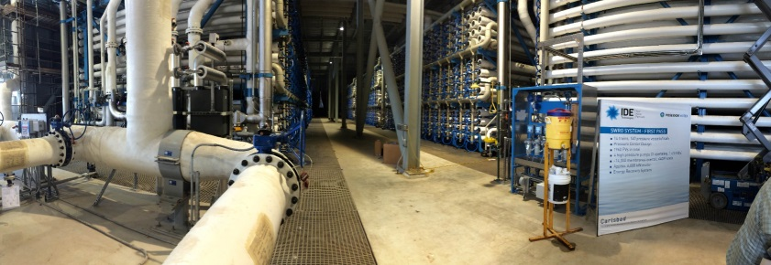
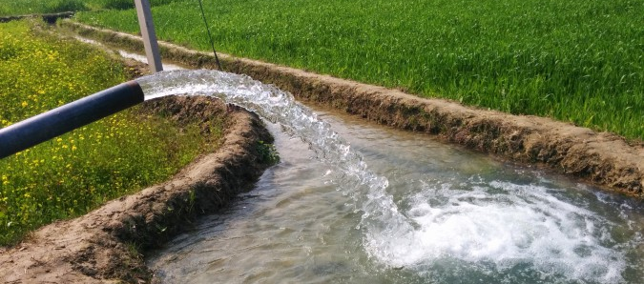
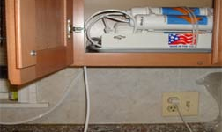
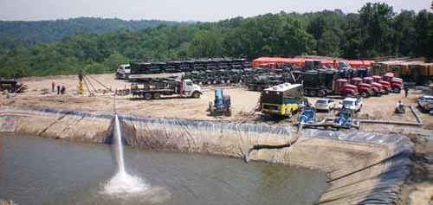
Applications
Large-scale desalination
Agricultural water use: more efficient, cheaper, water savings
Household disinfection for India etc. 70% water savings
Mining Water treatment
Notes:
Ag image: http://waterforfood.nebraska.edu/wp-content/uploads/2015/11/Wheat_Irrigation_Sultanpur-675x381.jpeg
RO unit: http://www.freedrinkingwater.com/images-new/Setuppics/reverse-osmosis-countertop-HL.jpg
Frack water: http://www.powermag.com/Assets/Image/GAS%20POWER%20Direct/GP_050112/050112+F1+Fracking+fig+3.jpg

Slide 13
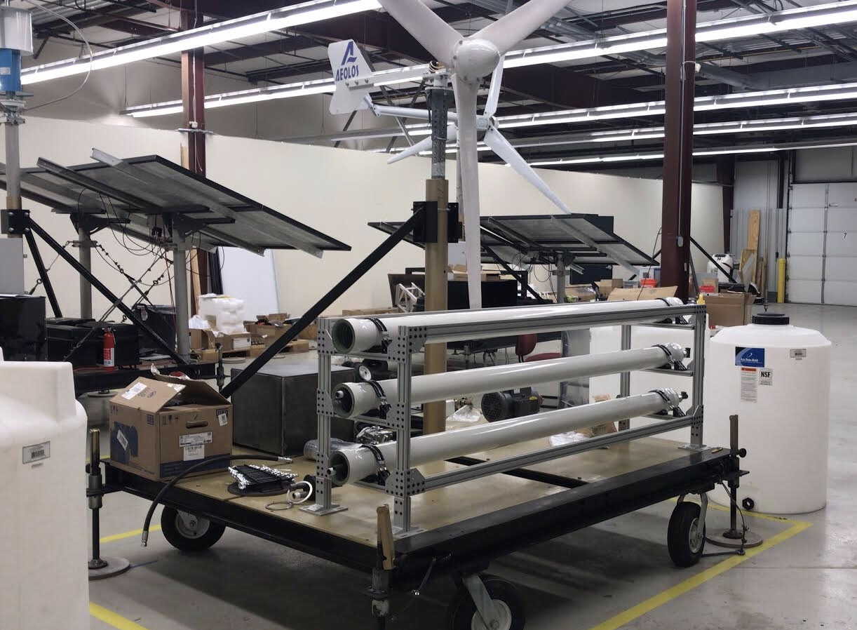

Slide 14







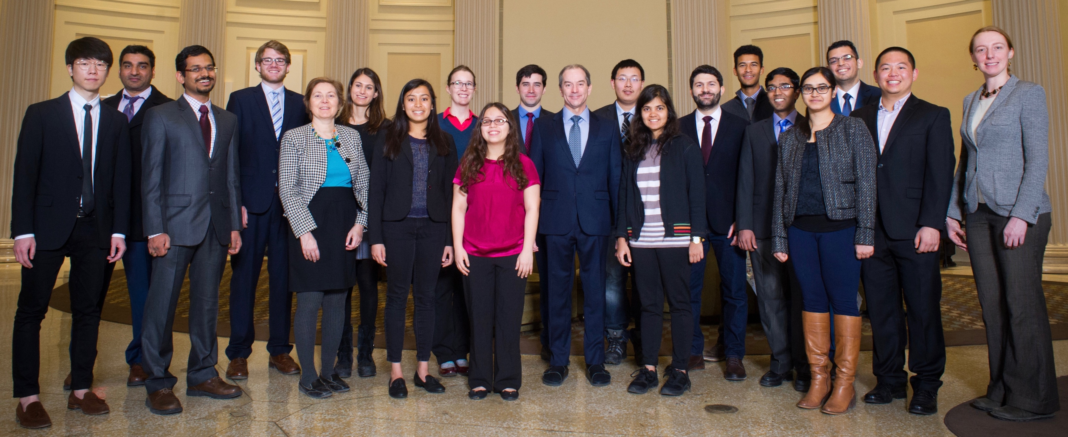
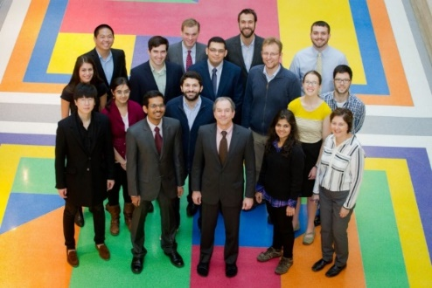
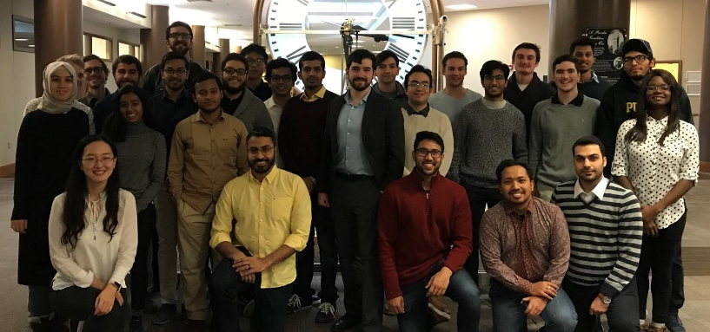

Acknowledgements
Bob Boulware
Coauthors
John Lienhard
Emily Tow
Jaichander Swaminathan
Grace Connors
Laith Maswadeh
Sandra Cordoba
MIT Team (Lienhard)
Warsinger Lab (My Lab)

Slide 15
Questions?

Slide 16
Water overuse
More than 80% of Rio Grande’s discharge to gulf is diverted for consumption, parts of it run dry (e.g. near Presidio)
Reliance on ground water (“fossil water”) for public needs for TX (36%), AZ (43%), NM (87%)
Dominant consumptive use is agriculture, but industrial use, potable use, cooling towers play a role
Droughts past 14 years:
Border states have high levels
of droughts.
Castillo, et al. to be submitted to Nature Energy (2019)
Notes:
I deleted this, wasn’t as relevant I thought:
USA withdraws about 45% of our water for cooling of power plants in production of electricity (Castillo, et al. Scientific American, 2018)

Slide 17
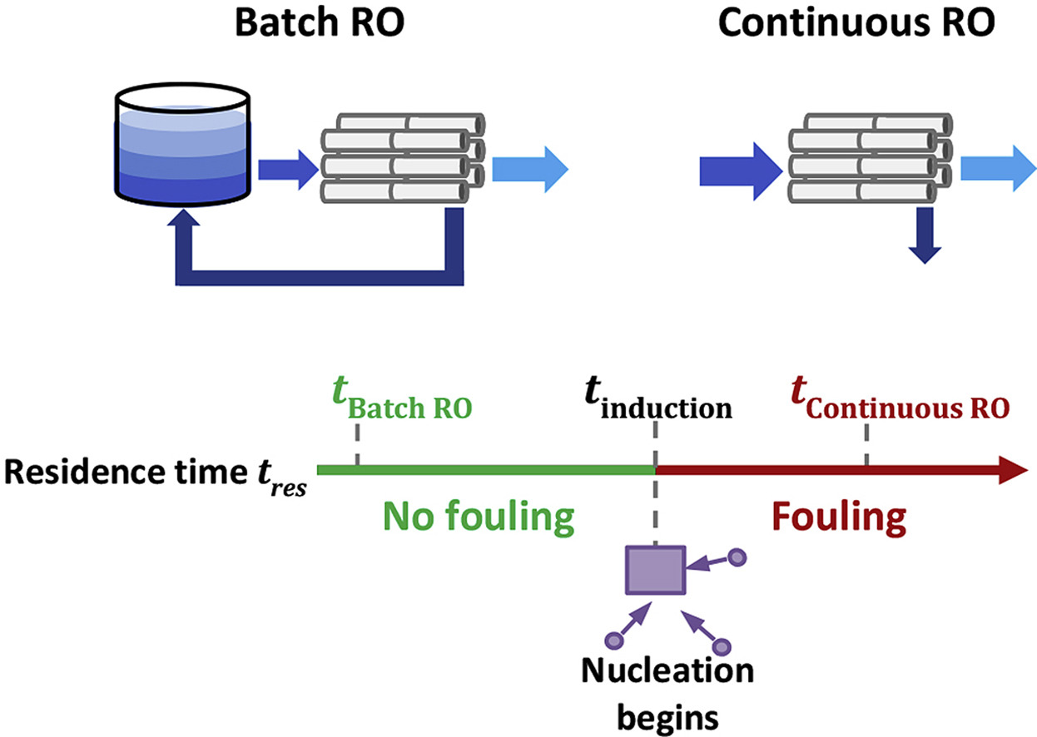


Batch RO anti-fouling
Warsinger, et. al, “Water Research, vol. pp. 137 384-3942018

Slide 18
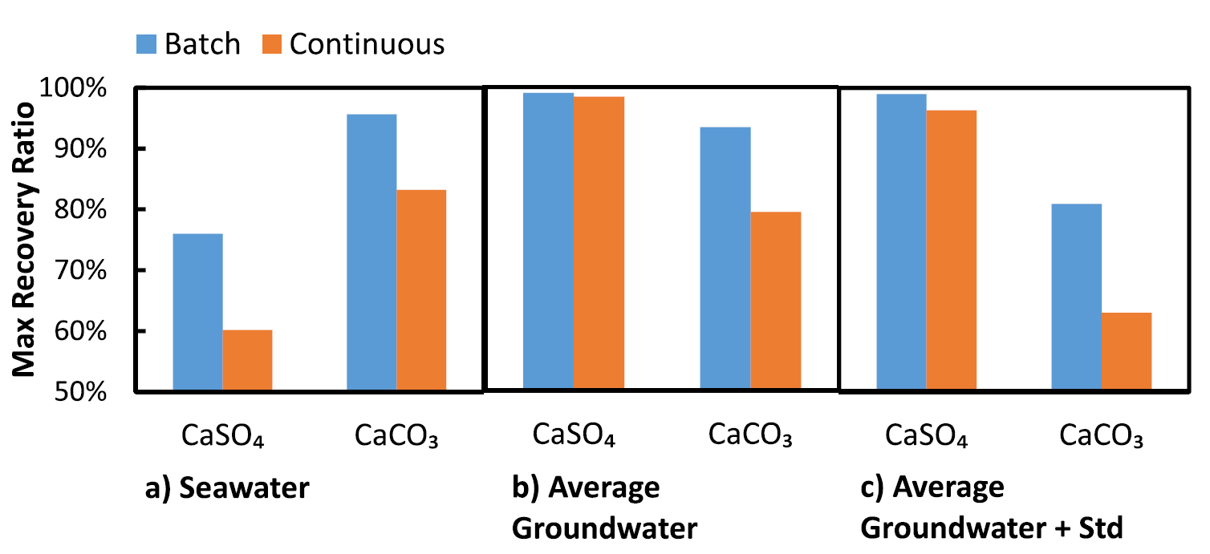
Batch RO Antifouling
Max recovery is increased by short residence times
Warsinger, et. al, “Water Research, vol. pp. 137 384-3942018

Slide 19
What is Batch?
A set volume of liquid is concentrated
Pressure varies over time
Standard RO
20
10
Maximum Salinity [g/kg]
Pressure [bar]
1st cycle
2nd cycle
5
3
Batch RO
10
20
Time [min]

Slide 20
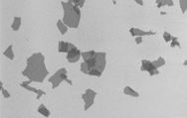
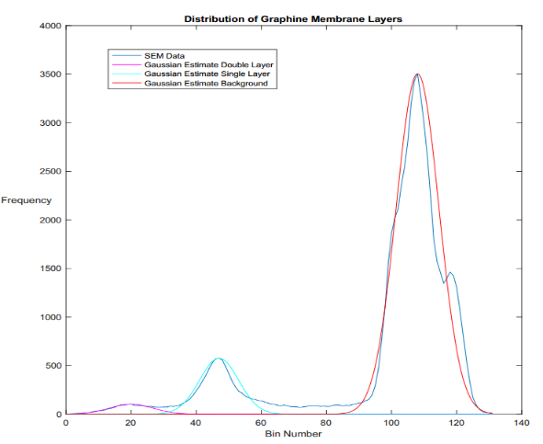
Ultrapermeable Nanomaterials + Batch: Highest Potential Desalination Efficiencies
Graphene Oxide (GO) Flakes Fabricated by modified Hummers Method.
Past collab w/ Carlo Amadei and Chad Vecitis)
Energy consumption in batch reverse osmosis based on permeability at high (seawater) and low (brackish) salinity.
For ultrapermeable membranes, also considering aquaporin, and improved polyamide TFC fabrication (w/ roll-to-roll methods)
GO
D. M. Warsinger et. al “IDA 2017 World Congress on Water Reuse and Desalination, São Paulo, Brazil, October 15-20, 2017.

Slide 21
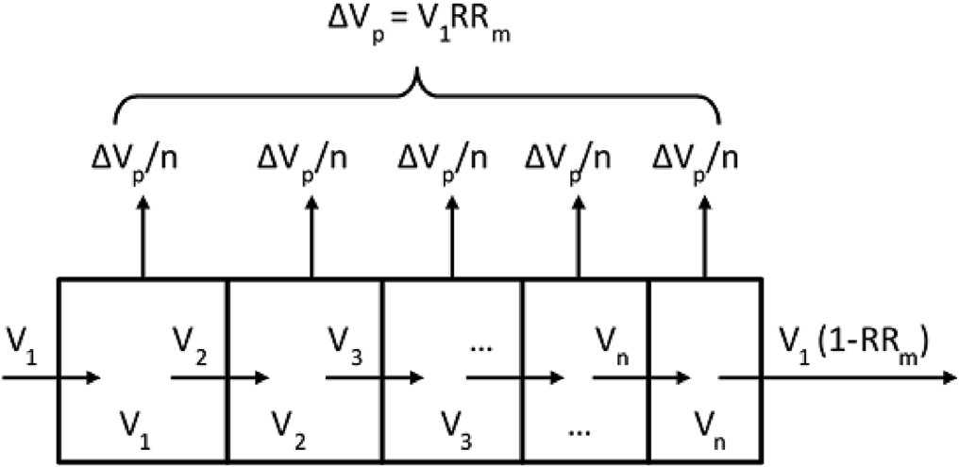
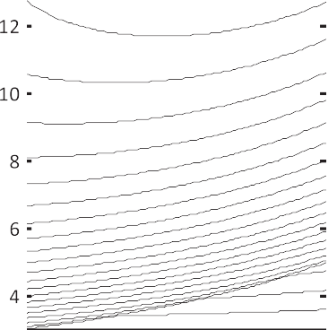
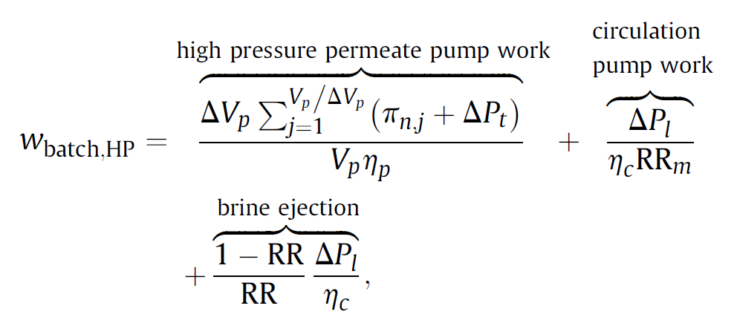
Analysis details
Volume discretization of membrane module for batch models.
The module is divided into unequal volumes, and in each step, equal amounts of permeate are removed from each section and the remaining liquid moves to the next section.
Salinity proﬁles in the membrane module as recovery increases during each cycle for the batch process with 3 ppt at 75% recovery.
Dimensionless distance (The abscissa) is deﬁned as the fraction of the module recovery achieved as the ﬂuid traverses the module (equivalently, i/n). Lines are equally spaced by permeate production; arrows indicate the direction of cycle progression.
Which is discretized across the membrane module for spatial effects, and also calculated over time

Slide 22
Enhanced Heat Transfer for Thermal Desalination
25 µm
top
Enhanced Air-Gap Membrane Distillation Desalination
jumping droplets
50 µm
side
Liquid repelling membrane
Feed preheating
25 µm
Nanoengineered condensing surface
nanostructured surface
Silane-coated copper-oxide-leaf superhydrophobic condensing surfaces
Mass transfer enhancement
Saline feed
Jumping droplets
Warsinger et al, J. of Memb.Sci., 2018

Slide 23
Salinity Gradient Energy Storage
2 modes
1) Desalination (BRO)
BRO’s higher efficiency makes its energy needs vary more by salinity
Uniquely compatible with demand-response renewable energy
2) Electric gen. (PRO)
Electric use
Dual-use membranes
Pure Water
Grid
Electric generation,
stabilization
Turbine
2) Reverse to generate electricity when prices are high
Pump
or
Seawater or
Water Reuse
Mid
Salinity Reservoir
High Salinity Reservoir
1a) Fill when normal electricity prices
1b) Fill when cheap electricity
Figure 1. A new means of grid-scale storage, using reservoirs of high salinity. By integration with desalination, it needs no additional parts, as the desalination membranes provide for PRO (Pressure Retarded Osmosis) electric generation, and desalination already has the pumped hydro components (high pressure pump, pressure recovery turbine)

