Slide 1
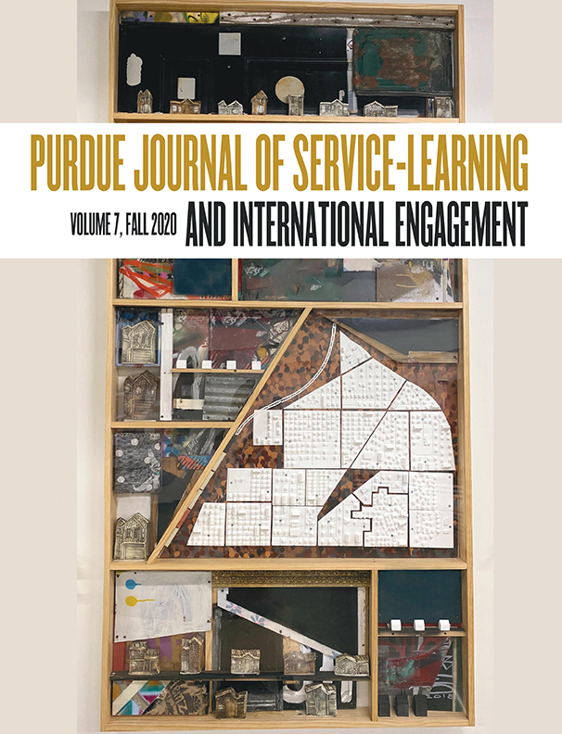
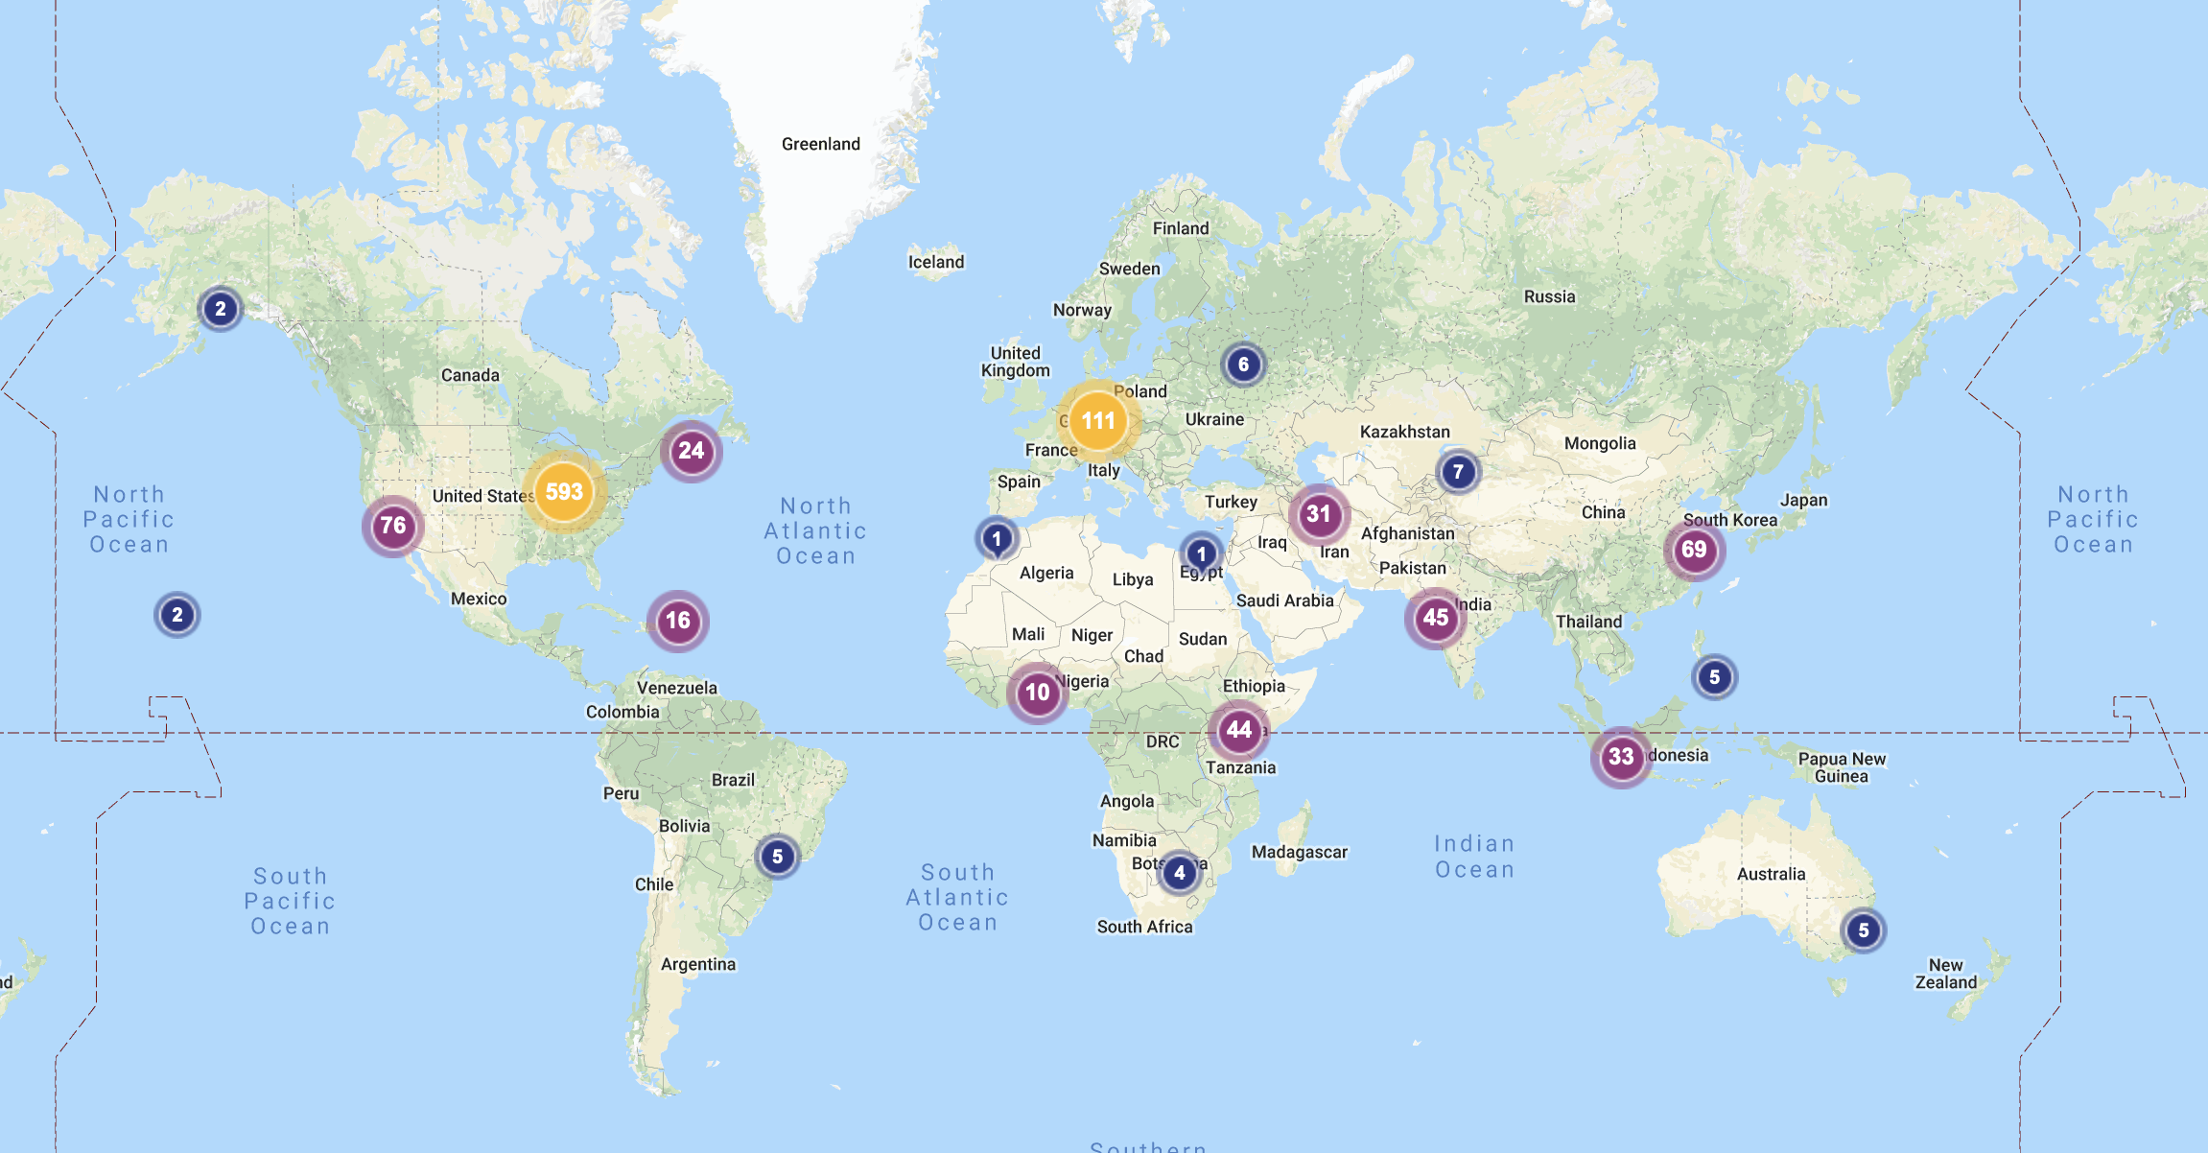
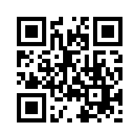
PURDUE JOURNAL OF SERVICE-LEARNING & INTERNATIONAL ENGAGEMENT
Editor: Dr. Jennifer Bay, Associate Professor of English | Coordinator: Korbyn Torres
Why publish in PJSL?
Five Types of Submissions
Write with guidance from a faculty or community member
Learn about the academic publishing process
Publish in a reviewed journal
Showcase your contributions to society and your community
Enhance your applications, resume, and CV
Faculty Profile Interview
Community Partner Snapshot
Community Inspired Cover Art
Describes a faculty member’s use of service-learning as a pedagogical approach, their personal and professional engagement activities, as well as the impact on student learning and the community.
Word limit: 1000
Author: Student(s) only
Describes the mission/vision of a community partner and highlights potential engagement opportunities for Purdue students with the organization and community
Word limit: 1000
Author: Student(s) only
Community inspired cover art is artwork, photograph, digital design, or graphic illustration that captures the spirit of community engagement.
The purpose of community inspired cover art is to show how the learning in community engagement can be conveyed in different media.
The submission includes two parts: the work itself and an artist’s statement.
Artist’s statement: 500 word limit
Research with Reflection
Reflective Essay
Describes and critically reflects on a student’s community engagement experience and demonstrate impact via research.
Word limit: 3500
Author: Student/Faculty/Community Partner(s)
Describes and critically reflects on a student’s service-learning or community engagement experience.
Word limit: 3500
Author: Student(s) only
Learn More
Global Readership
Scan QR Code or visit: http://docs.lib.purdue.edu/pjsl/

