Slide 1
Promotion and Tenure
FAST meeting
Peter Hollenbeck
Vice Provost for Faculty Affairs

Slide 2
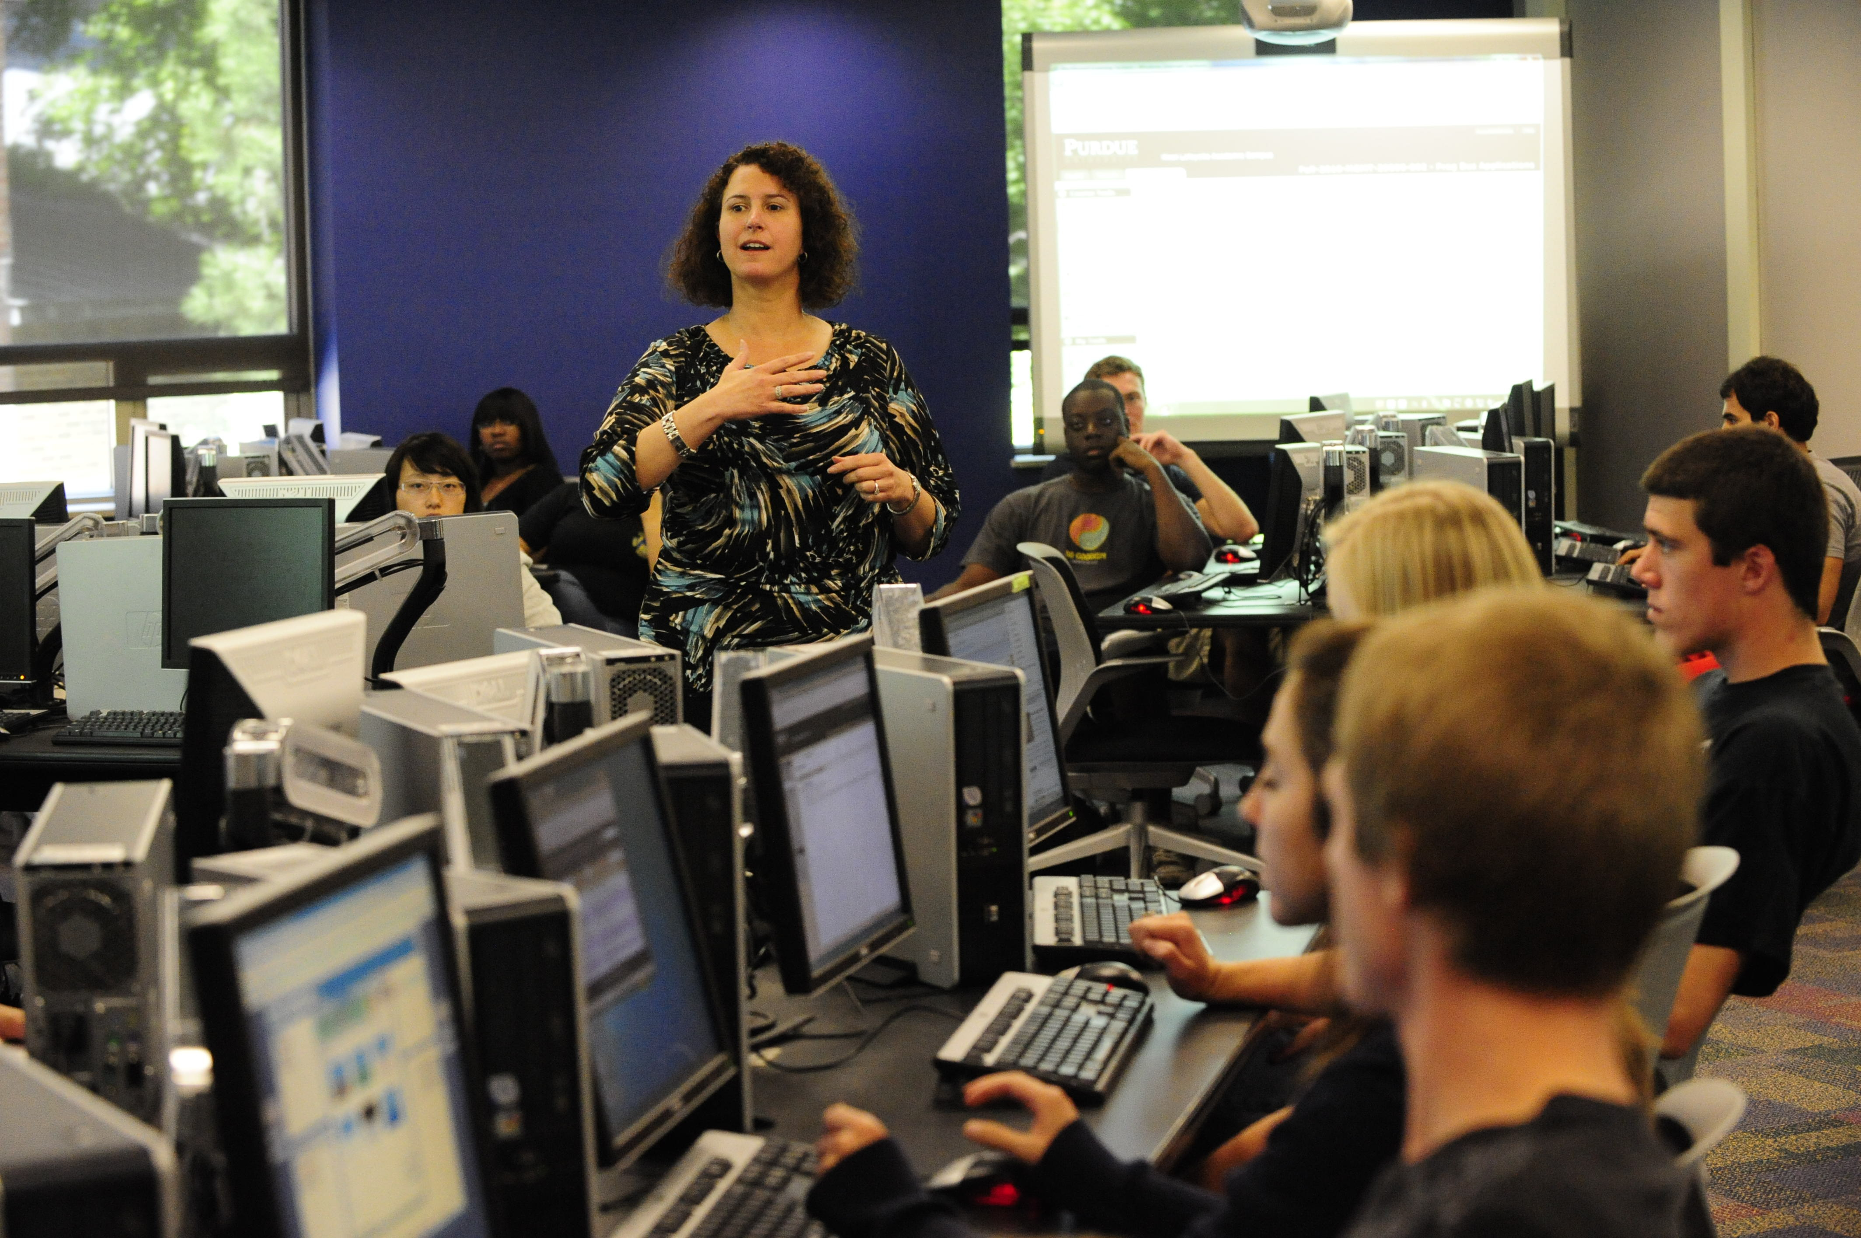
Types of faculty at Purdue
Tenured/Tenure Track | 1931
Clinical/Professional | 170
Research | 34
Visiting (temporary) | 101
Adjunct | 337
Notes:
We have about 2000 faculty, with about 200 of these being clinical or research faculty (2016 snapshot numbers)
Note also: CTLs and LTLs = 388

Slide 3
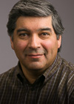
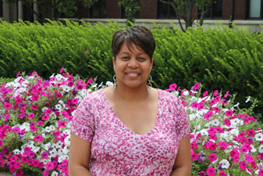
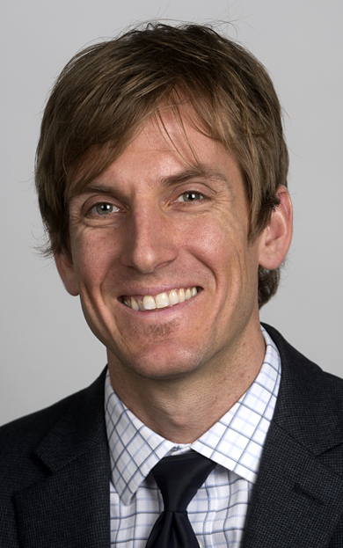
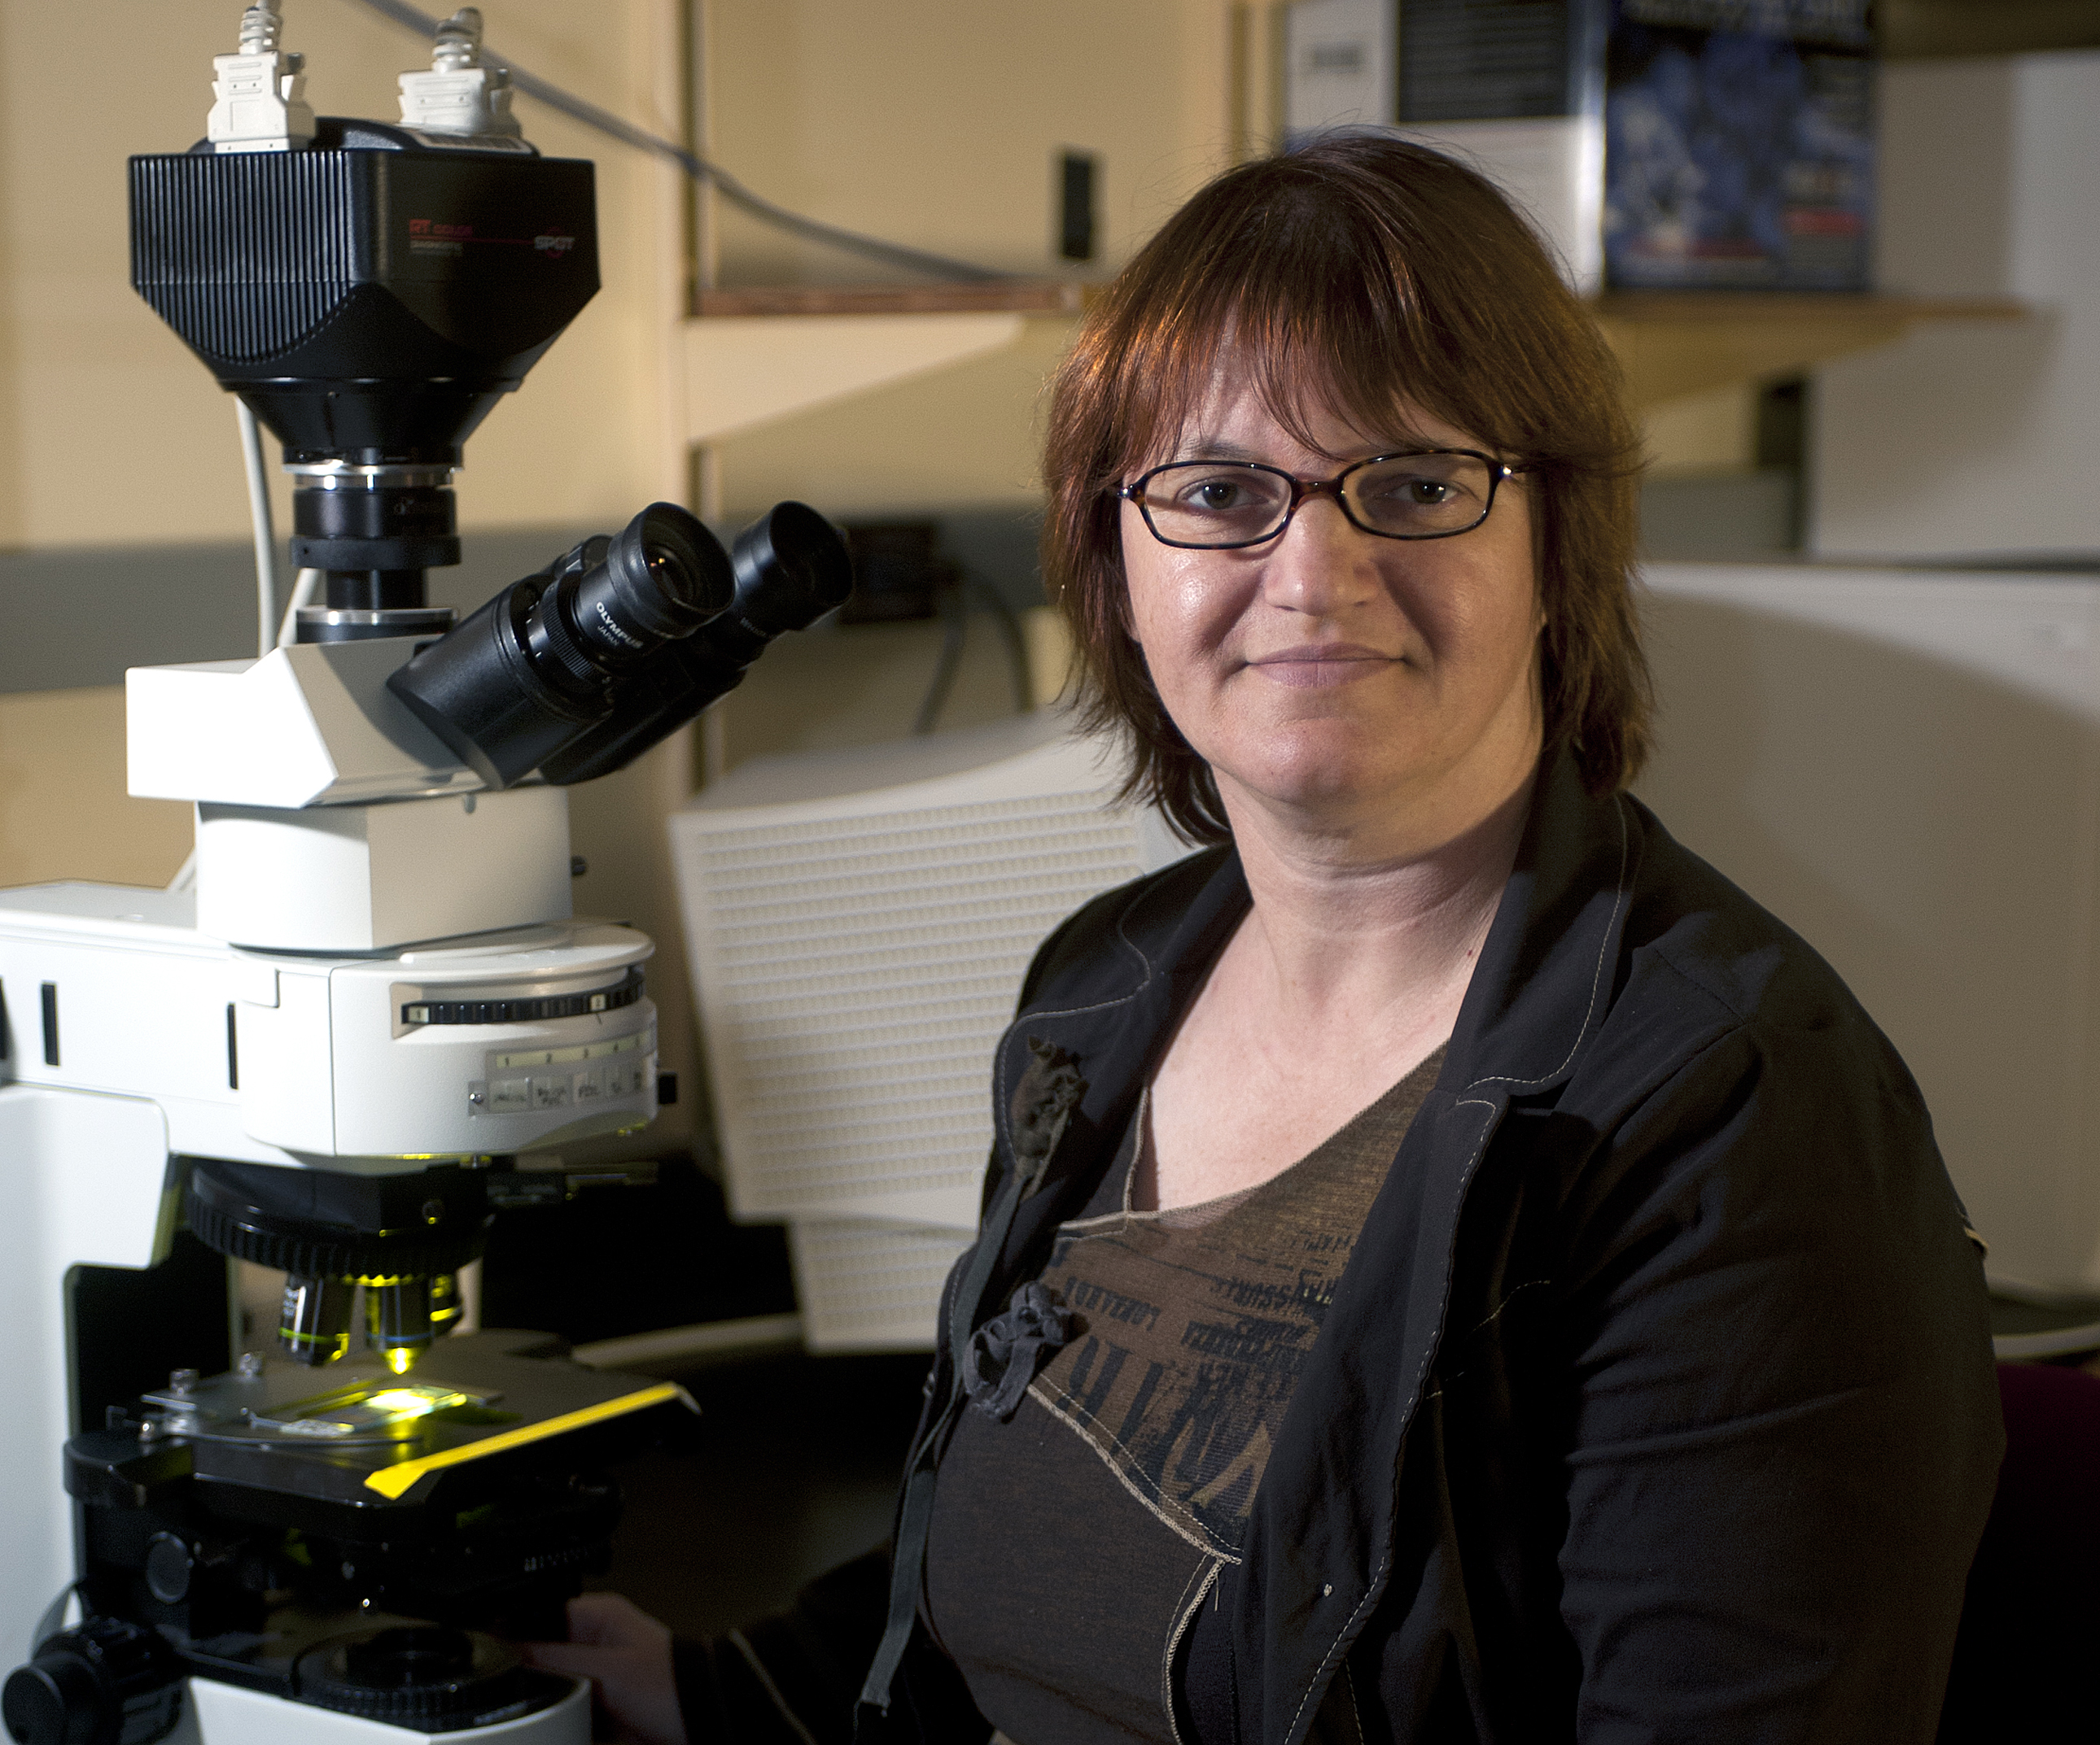
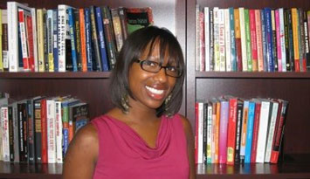
PURDUE TENURE-TRACK FACULTY BY RANK
2016
Notes:
Purdue Faculty:
Over 2000 faculty members generate more than 70% of the
student credit hours and over half a billion dollars in research
expenditures
they come from all over the world; more than 2/3 are American born
most educated in the U.S. usually at the most prestigious universities.
71% are male, 29% women, 8% URM.
Big 10 Faculty (2015 numbers, Full incudes Heads and Deans)
among the best in the world.
nation’s most “formidable intellectual capital”
With Big 10 peers produce 1/3 of nation’s Ph.D.s and garner more research $$ than Ivies or West Coast taken together

Slide 4
PROMOTION AND TENURE
Strong predictor of pre-tenure faculty satisfaction and success: understanding the P & T process.
P & T Policy, Procedures, and Criteria have been refined and clarified, are posted on the web site.
Process also summarized and reinforced for all units in annual letter, the “Provost’s Memo”
http://www.purdue.edu/provost/faculty/promotionandtenure.html
Notes:
Why are we looking at P&T carefully already? The better you understand it, the more likely you are to be successful.
We have a newly-framed, clarified set of three documents now: Policy, procedures, and Criteria, which I’ll thumbnail for you in a moment.
Also, each year the Provost issues a memo that summarizes and reminds DHs and primary cmtes of the key parts of the process.
So, how is this structured…

Slide 5
Promotion and Tenure
Three related but separate documents:
POLICY: defines what do we do, why, and who is responsible
PROCEDURES: exactly how is the process carried out?
CRITERIA: what are the yardsticks by which faculty achievement is measured in each discipline?
(Plus, the annual Provost’s Memo)
Notes:
There should be no secret handshakes – and as of this year we have newly-crafted, clarified tenure Policy, Procedures, and Criteria documents. They are on the web (Provost’s office site), everyone knows about them – and you should too. Let me thumbnail this for you now.
POLICY: what do we do, why, and who is responsible?
PROCEDURES: Exactly how do we carry out promotions; what are the stages and what occurs in each one; how must the process unfold?
CRITERIA: How do we decide whether someone will be promoted, exactly what do we expect? [campus- and discipline-specific?]
Provost’s Memo – an annual document that reminds DH’s of important points and clarifies the process.

Slide 6
PROMOTION AND TENURE
Three related but separate documents:
POLICY: defines what do we do, why, and who is responsible
PROCEDURES: exactly how is the process carried out?
CRITERIA: what are the yardsticks by which faculty achievement is measured in each discipline?
(Plus, the annual Provost’s Memo)
Notes:
CRITERIA: How do we decide whether someone will be promoted, exactly what do we expect? [campus- and discipline-specific?]
Just to emphasize: the specific criteria for expectations, for achievement that warrants promotion and tenure are DISCIPLINE-SPECIFIC and CAMPUS-SPECIFIC.

Slide 7
TENURE AT PURDUE
“…to be considered for promotion, a faculty member should have demonstrated excellence and scholarly productivity in at least one of these areas. Ordinarily, strength should be manifest in more than one of these areas.”
DISCOVERY (research)
LEARNING (teaching)
ENGAGEMENT (dept., PU, profession, community, state, world)
Notes:
But there are GENERAL criteria to which we are all held: first, the “three pillars” of academic life
To be promoted, PU faculty must be outstanding in at least one of these areas (WHICH ONE should be made clear to you by your dept head and unit!), and to have significant achievement in more than one area

Slide 8
PROMOTION AND TENURE
Your college and school/dept should have written promotion criteria
These will differ among units, and perhaps even among sub-disciplines within a dept
In all cases, these criteria, by university guidelines, must value impact foremost
Notes:
For tenure track and clinical faculty, the criteria for promotion must be clear
Purdue is committed to measuring IMPACT, rather than weighing your output

Slide 9
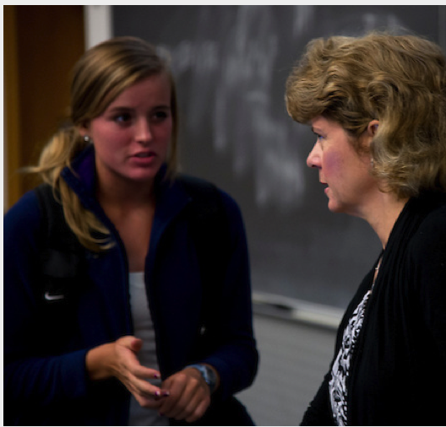
Mentoring
Faculty-to-Student
“Commitment to active and responsive mentorship, as well as an active role in mentoring, advising and supporting the academic success of students and postdoctoral scientists, will also be documented as part of the process that defines tenure and promotion.”
Range of skills and opportunities
Classes and labs, honors tutorials, TAs
Inclusion in your research group
Student organizations and activities
Notes:
An additional activity that will be documented in your faculty record = student mentoring
Mentoring requires a duality of skills. One must…
Guide without dictating.
Challenge the intellect while (sometimes) shoring up the emotions.
Play the role of both the hard-hitting coach and the number-one fan.

Slide 10
TIME TO TENURE
Assistant Professors usually have probationary period of up to 6 years to earn P & T.
6th year is the “penultimate year:”
- last year in which one is eligible for tenure
Entering Associate Professors have 3 years to work toward tenure:
3rd year is penultimate year
This should be specified in your offer letter
Notes:
What’s the timing for most Asst professors?

Slide 11
TIME TO TENURE
On the way to the penultimate year: contract renewals
For Asst Profs, the arrangement varies by college, examples:
4y/2y/1y (Engineering/Krannert/Pharmacy),
3y/1y/1y/1y/1y (Science/Agriculture),
4y/3y (CLA), 3y/3y (Education)
Should be specified in your contract/offer letter
You and your unit head should take these seriously
Notes:
What’s the timing for most Asst professors?

Slide 12
TENURE CLOCK EXTENSIONS
When conditions and personal circumstances substantially interfere with progress toward achieving tenure
One-year automatic approval for birth or adoption of child
Request for Tenure-Clock Extension form
Submit within 1 year of occurrence, prior to penultimate year
Applies to either or both parents.
Extensions can also be approved for:
Severe illness, disability, care-giving of family member
Delays in availability of lab space
Notes:
Important point: the timing can be changed by agreement, or by childbirth/adoption

Slide 13
TENURE PROCESS AT PURDUE
Primary promotions committee (dept./school)
Summer prior to penultimate year – assembles your promotion document and solicits outside letters
Fall of penultimate year – votes on your case
Area promotions committee (college)
Votes on your case in winter of penultimate year
Campus promotions committee (“Panel A”)
Votes on your case in early spring of penultimate year
Notes:
So, there are the procedures – how does this actually work every year?
Note composition of the primary cmte = DH is chair; contains all tenured faculty
Area cmte = Dean is chair; every dept head plus elected full profs from each dept/school
Campus cmte = Provost is chair; Deans plus one tenured Prof from each college plus at-large Profs (elected by Senate Nominating Cmte)
Campus cmte results are reviewed by Provost and sent on to President

Slide 14
CLINICAL FACULTY
Clinical Faculty have a distinct path to promotion (but not tenure). They are considered by a different campus promotions panel (“Panel B”) rather than Panel A. Panel B incorporates more clinical faculty.
Procedures for Appointing and Promoting Clinical Faculty:
http://www.purdue.edu/policies/human-resources/vif10.html

Slide 15
RESEARCH FACULTY
Research Faculty have a distinct path to promotion (but not tenure). They are considered by a different campus promotions panel (“Panel C”) rather than Panel A.
Procedures for Appointing and Promoting Research Faculty:
http://www.purdue.edu/policies/human-resources/vif8.html

Slide 16
2016-17 PROMOTION AND TENURE
2016-17:
84 faculty were reviewed for promotion by the Campus Promotions Committee - 84 were approved for promotion
45/45 were successfully promoted to full Professor
39/39 were successfully promoted to Associate Professor
10 nominations did not go to CPC
Failed: 4 at area and 6 at primary committee
9 Clinical Faculty were promoted (7 to Associate, 2 to full)
4 Research Faculty were promoted (3 to Associate, 1 to full)

Slide 17
2016-17 PROMOTION AND TENURE
By major area of focus, all promotions (# of people)
One basis
 | Discovery | Engagement | Learning
Full Professor | 34 | 7 | 3
Associate Professor | 40 | 0 | 6
 | Discovery and Engagement | Discovery and Learning | Learning and Engagement | All three
Full Professor | 0 | 3 | 0 | 1
Associate Professor | 0 | 0 | 3 | 0
Two or more bases
Notes:
These numbers are panels A + B + C
Most people go up on one basis, and most people go up on research, but numbers promoted on engagement and learning are increasing
Going up on multiple bases, Discovery and something else

Slide 18
KEYS TO FACULTY SUCCESS AND WELL-BEING
Start Early, Plan and Gather Information
Get oriented to the institution, learning what is expected
Understand the promotion and tenure process
Begin and plan with the goal in mind
Start with research and teaching, don’t lose focus!
Seek excellence (as defined by your discipline)
Engagement and service increase over one’s career
Create work-life balance
Find a sustainable rhythm
Be aware of supports and seek help and advice
Ask for what you need: clock extension, parental leave
Notes:
You have 5 years (without any tenure clock extensions) to showcase your excellence
Quality and impact (not necessarily quantity) are key

Slide 19
ASKING FOR WHAT YOU NEED TO SUCCEED
You are not alone! Seek support actively and widely.
Ask for a mentor and solicit feedback from senior faculty
Ask for regular, written evaluation – and value it
Develop professional networks/mentors outside your department and Purdue
Get concrete advice about the criteria for quality and impact of research and teaching in your department
Look into the format for your promotion and/or tenure document – get past examples of success
Notes:
Senior faculty – they will be on your primary cmte
Will your promotion evaluation be separate from the annual merit salary review?
Is there a formal intermediate review, e.g., third year?

Slide 20
Thank You!
Peter Hollenbeck
Vice Provost for Faculty Affairs
17 October 2017
Notes:
Open for questions

