Slide 1
Faculty Advancement, Success and Tenure (FAST)
In Collaboration with
ADVANCE Purdue Center for Faculty Success
Office of the Provost

Slide 2
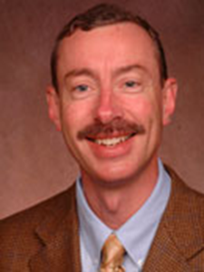
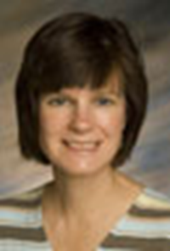
Agenda – January 29, 2013
9:00 – 9:10 Welcome and Introductions
9:10 – 9:50 Grant Writing
Sally Bond, Assistant Director, Research Development Services, OVPR
Jon Harbor, Professor and Head, Department of Earth, Atmospheric and Planetary Sciences and Interim Director, Purdue Global Sustainability Center
9:50 – 10:10 Facilitated Small Group Discussion
10:10 – 10:15 Wrap Up

Slide 3
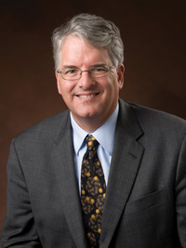
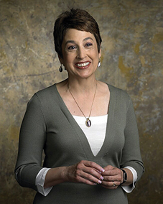
Upcoming FAST Sessions
February 19, 2013 Advice from Two Deans
STEW 313
Jeff Roberts, Dean, College of Science Maryann Santos de Barona, Dean, College of Education
March 19, 2013 Work/Life Integration
STEW 313
Clint Chapple, Head, Biochemistry, Agriculture
Pam Nesbitt, Director, Academic Units, VPHR
Tammy Synesael, Leave of Absence Administrator, VPHR
Melissa Martin, Talent Acquisition Specialist, VPHR

