Slide 1
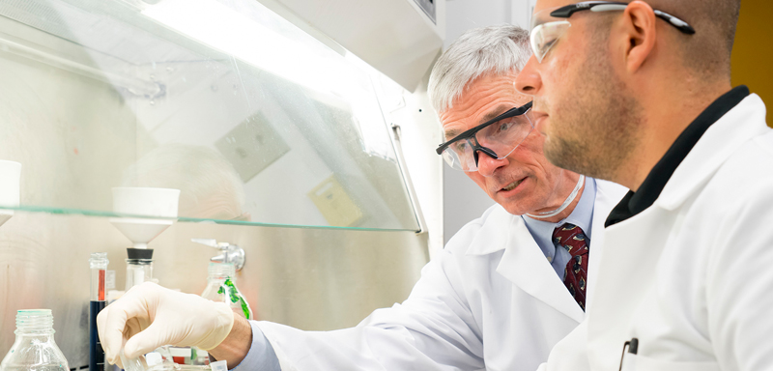

Unsealed radioactive Material safety Retraining
2023

Slide 2
Biological effects, dose limits, and Radiation Safety principles

Slide 3
Health Effects of Radiation Exposure
Radiation can cause biological damage due to chemical bonds being broken, DNA damage, and cells being damaged or killed.
Health effects from radiation range from no effect at all to death, including diseases such as cancer.
The health effects is dependent on the dose.
  The common unit of dose is the ‘rem’
The health effects can be divided into two categories:
  Early Effects
  Delayed Effects

Slide 4
Early Effects
Occur shortly after exposures resulting in very large doses (>100 rem), delivered within a short time period (acute exposure)
Acute exposures cause extensive biological damage to cells so that large numbers of cells are killed.
The severity of the health effects is proportional to the dose.
Possible health effects include: vomiting, diarrhea, skin burns, cataracts, hair loss, fever, lethargy, loss of appetite, changes in blood count, and death.
Under normal operation, the occurrence of early effects is highly unlikely.

Slide 5
Delayed Effects
Occur years after acute or chronic (low doses over a long time period) exposures.
Possible health effects include: leukemia, cancer, life span shortening, cataracts, and genetic defects.
Studies suggest the possibility of heritable genetic effects in humans if there is radiation damage to the cells of the sperm or eggs. However, no heritable genetic effects from radiation have ever been observed in any human population exposed to radiation.
Leukemia, cancer, and genetic effects are considered stochastic effects; the probability of occurrence is dependent of dose.
  As dose increases, the probability of occurrence increases.
Conservative studies estimate a 0.04% increase of developing an adverse health effect per rem received.
For additional information, refer to Regulatory Guide 8.29

Slide 6
NRC dose Limits
The Nuclear Regulatory Commission (NRC) has set dose limits for those working with radioactive material (see table below).
Individuals who stay below the dose limits:
  Will not develop any early effects.
  Will maintain a very small risk of developing delayed effects.
Annual NRC Dose Limits (10 CFR 20.1201)
Section of Body | Limit (rem)
Whole Body (Head, torso and organs) | 5
Lens of the Eye | 15
Extremities (Hands, forearms, feet and ankles) | 50

Slide 7
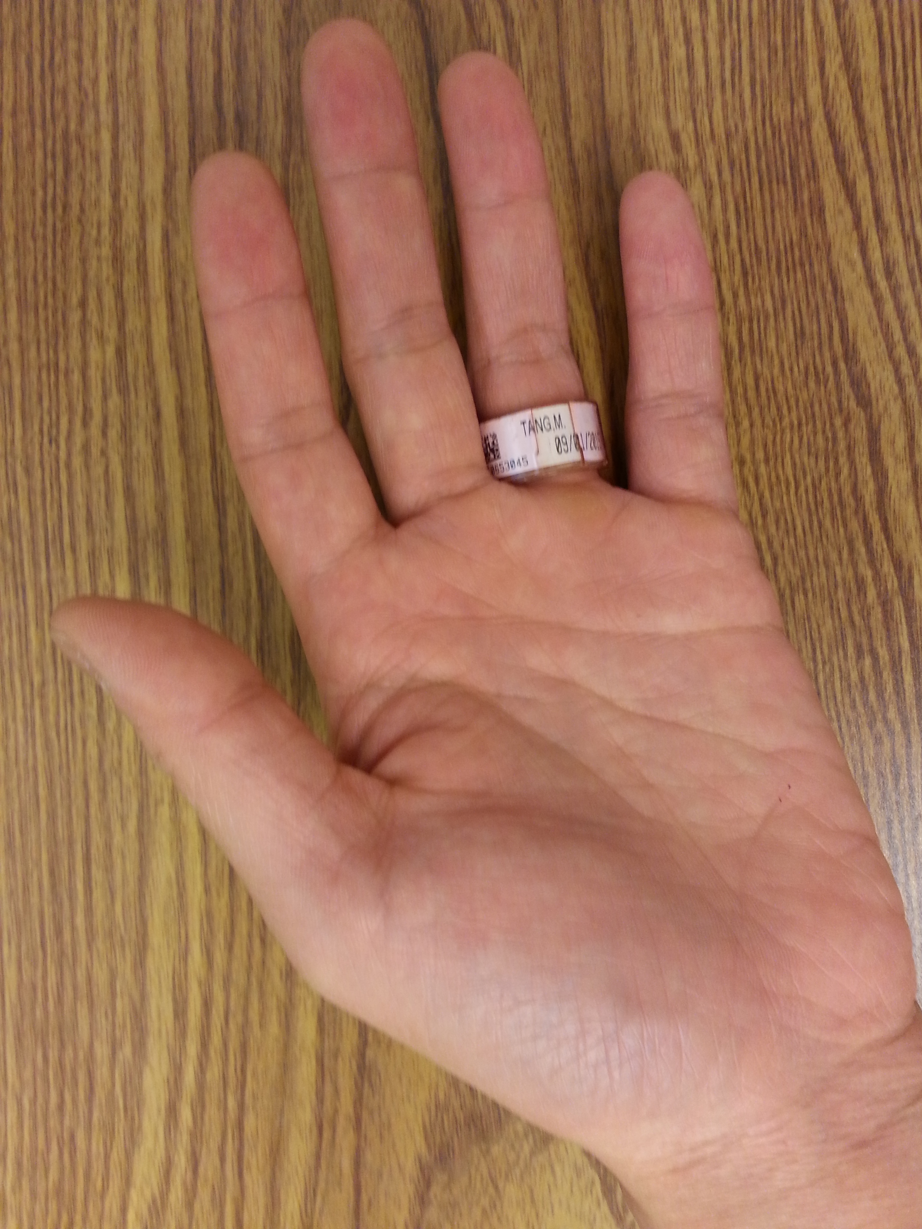
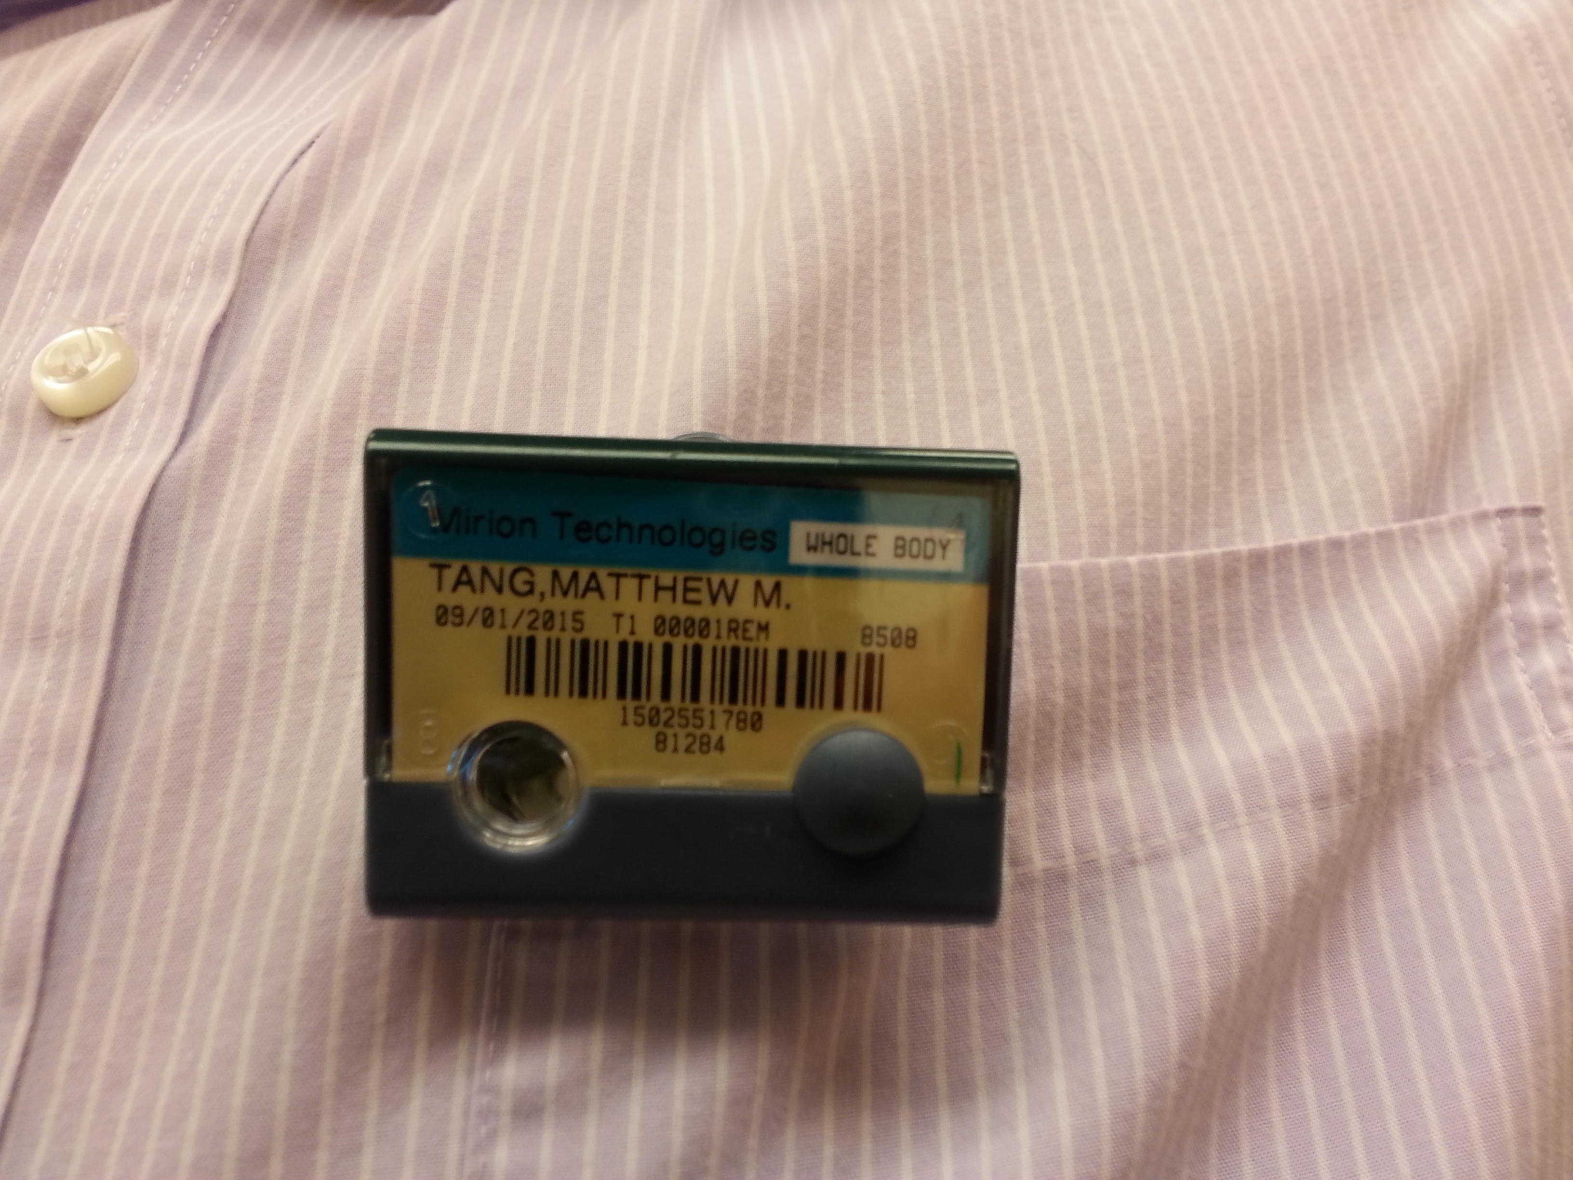
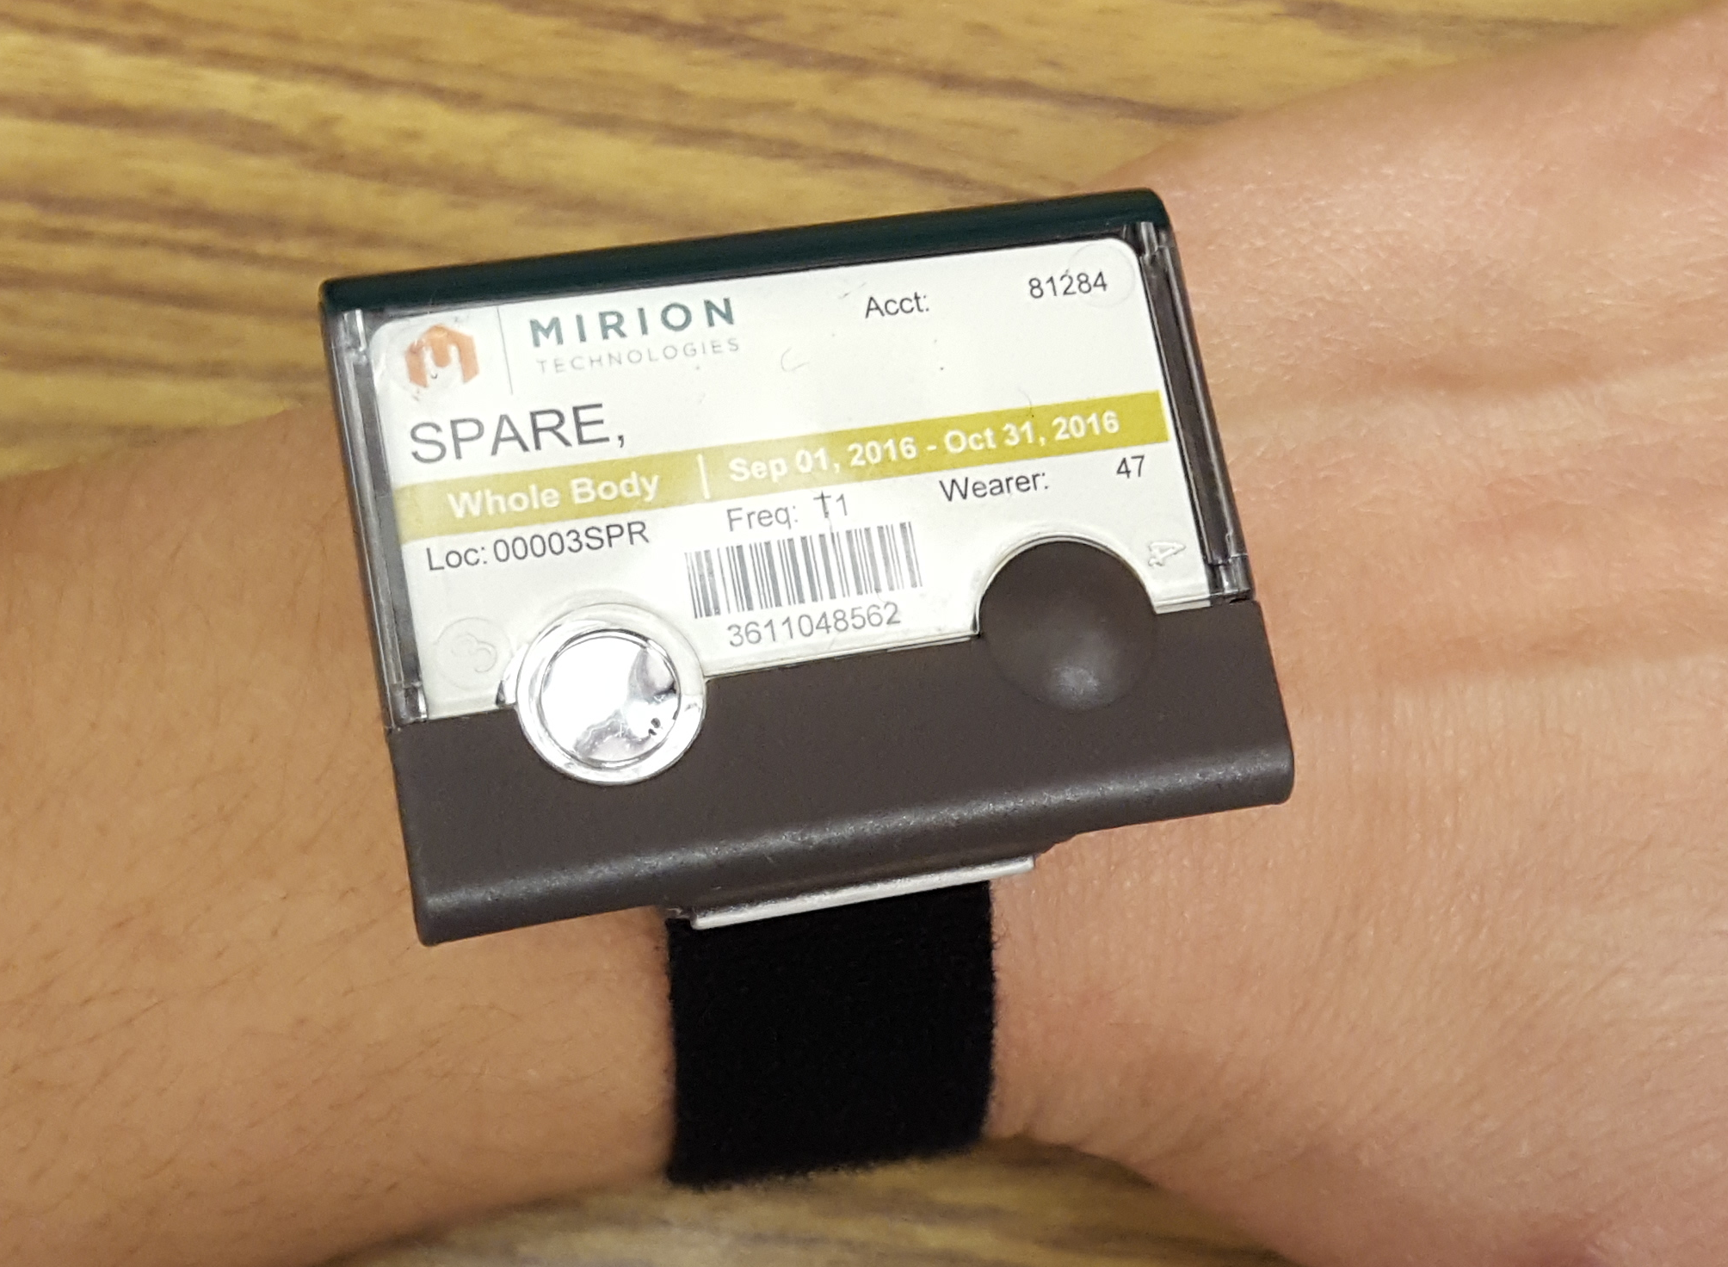
Dosimetry
Dosimetry – Measures accumulated dose. Used to ensure that you do not exceed NRC dose limits. There are 3 types:
Ring
Whole-body
Wrist
If issued dosimetry, you MUST wear it every time you are working with radioactive material
Dosimetry must be returned at the end of the wear period (monthly or bimonthly), to be analyzed.
Dose measurement may be lost if dosimeter is returned late
Lost dosimetry may result in charges to your department
EHS is obligated to furnish the annual dose report of an individual if he/she requests.

Slide 8
Radiation & pregnancy (1)
Embryos and fetuses are extremely radiosensitive.
The principal effects of radiation on the developing embryo and fetus are:
    embryonic, fetal, or neonatal death
    congenital malformations
    growth retardation
    functional impairment, such as mental retardation
    cancer
The effects depend on the stage of gestation, the dose, and the dose rate.
Pregnant individuals should take all precautions possible to keep exposures to the embryo or fetus as low as possible
These occurrences are extremely unlikely at Purdue because the doses possible from normal operations are very low.

Slide 9
Radiation & pregnancy (2)
Extra precautions are taken by Purdue University for a Declared pregnant woman.
Declared pregnant woman means a woman who has voluntarily informed Purdue, in writing, of her pregnancy and the estimated date of conception.
  If a declaration is made, it must be given to the Radiation Safety Officer (RSO) in writing.
  The declared pregnant woman will have a lower dose limit and she will be supplied with a dosimeter to monitor the fetus’s dose
For additional information, refer to Regulatory Guide 8.13

Slide 10
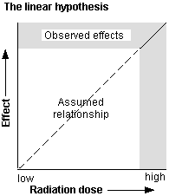
Alara (1)
The risk of developing delayed effects can be decreased by decreasing dose.
Scientists accept the linear no-threshold theory which states that even low-doses carry some risk of developing delayed effects.
The goal is not only to remain below the dose limits, but to keep it even lower by trying to keep doses As Low As Reasonably Achievable (ALARA).
ALARA is not just a good idea, it is REQUIRED by law (10 CFR 20.1101(b)).

Slide 11
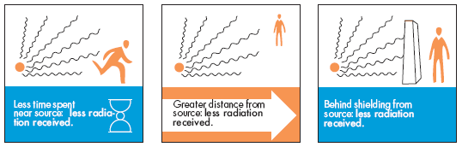
ALARA (2)
There are several practices that will help you to keep your dose As Low As Reasonably Achievable (ALARA).
  Time – Decreasing the time spent in a radiation area results in a lower accumulated dose. Plan all work efficiently.
  Distance – The greater the distance between you and the radioactive material, the lower the dose.
  Shielding – Use shielding to reduce your dose rate.

Slide 12
exposure controls

Slide 13
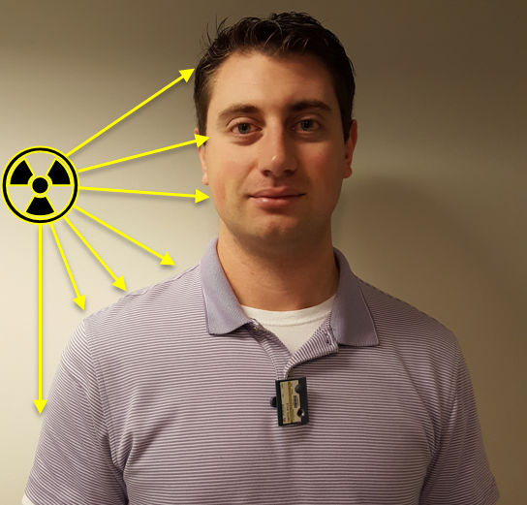
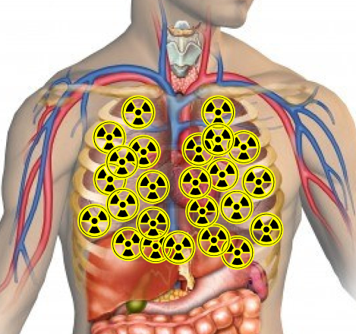
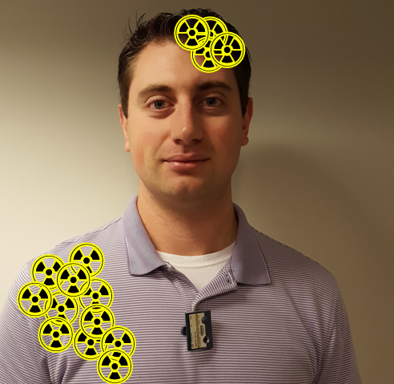
Exposure pathways
The pathways for an individual to get a dose is as follows:
External exposure – dose from an external source of radiation
    Time, distance and shielding offer protection
Internal exposure – dose from radioactive material that has entered body through inhalation, ingestion, skin absorption or open wounds
  Can be the most harmful exposure pathway
  EHS will perform bioassay and a physician may prescribe a treatment plan to remove radioactive material from your body
External contamination – dose from radioactive material deposited on the body or clothing
  Removing contaminated clothing and decontaminating the body will reduce dose
  The use of personal protective equipment will prevent external contamination

Slide 14
Safety Controls
In general, controls are used to protect individuals from external and internal exposures.
There are multiple types of control types. The hierarchy of controls types are as follows:
  Engineering
    More reliable and effective and should be first line of defense
  Administrative (procedural)
    If engineering controls are impractical or inadequate, an effective combination of administrative and personal protective equipment shall be used.
  Personal Protective Equipment (PPE)
    Required if engineering and administrative controls don’t entirely remove the hazard
Environmental Health and Safety (EHS) will assist you with determining the controls that are appropriate for your application.

Slide 15
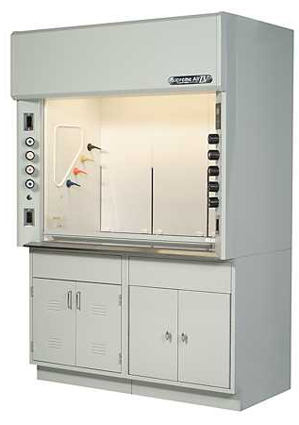
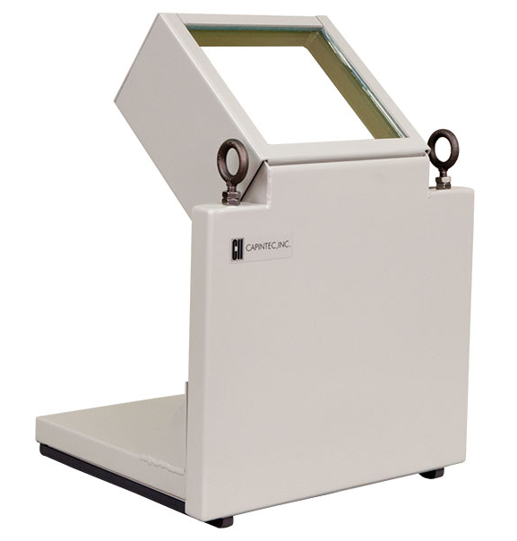
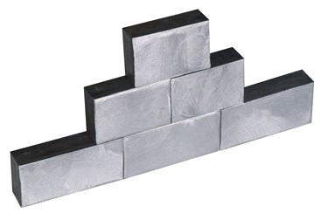
Engineering controls (1)
The following engineering controls should be used for the following hazards:
Airborne radioactive material
  Fume Hood
    Only use hoods in good working order and certified by EHS.
  Glove Box
    Must maintain negative air pressure
    Gloves must be in good condition
  Biological safety cabinets and laminar flow hoods should not be used for radiological protection.
External Exposure
  Shielding
    Lead, polyethylene, paraffin and concrete bricks can be used
    Lead and Plexiglas/acrylic “L” block table shields can be used
    Lead pigs, lead caves and beta shield boxes should be used when storing sources

Slide 16
Engineering controls (2)
The following table lists the optimal shielding material (if any) per radionuclide. Please contact EHS if the radionuclide you are using is not listed.
Radionuclide | Shielding Material
¹⁴C | None Required
³H | None Required
¹²⁵I | Lead
¹³¹I | Lead
³²P | Plexiglas/Acrylic
³⁵S | None Required
^{99m}Tc | Lead
¹⁸F | Lead
⁴⁵Ca | None Required
²³⁸U | None Required
²³²Th | None Required

Slide 17
Administrative controls
The following administrative controls should be applied
Standard Operating Procedures (SOP) – Step-by-step instructions that ensures the safe use of radioactive material in a particular experiment or procedure.
  Should be developed and followed when performing a novel procedure, using large quantities of radioactive material or using unsealed alpha-emitting radionuclides
Contamination Surveys – Use of detectors to detect radiological contamination.
  The radiation lab must be surveyed:
    Immediately after completing experiments involving radioactive material, or samples containing radioactive material.
    On a monthly basis if radioactive material has been used that month.
      The survey frequency may increase depending on the quantity and isotope used.
      The monthly survey must be recorded on a survey log.

Slide 18
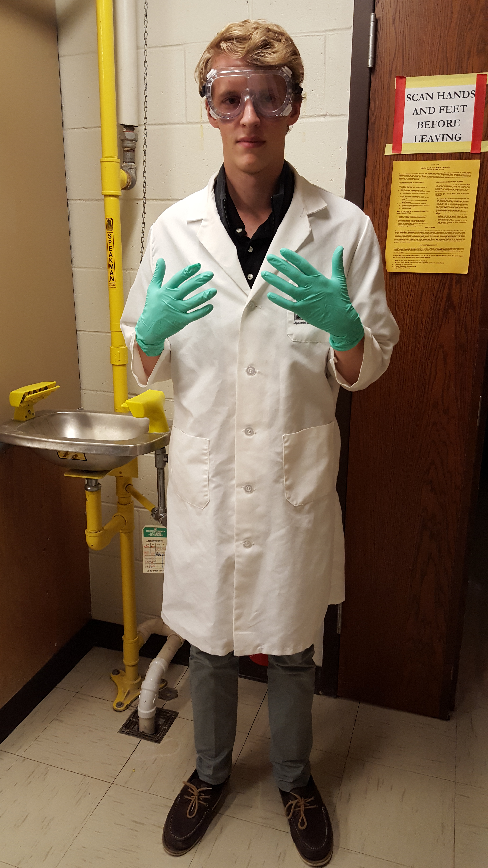
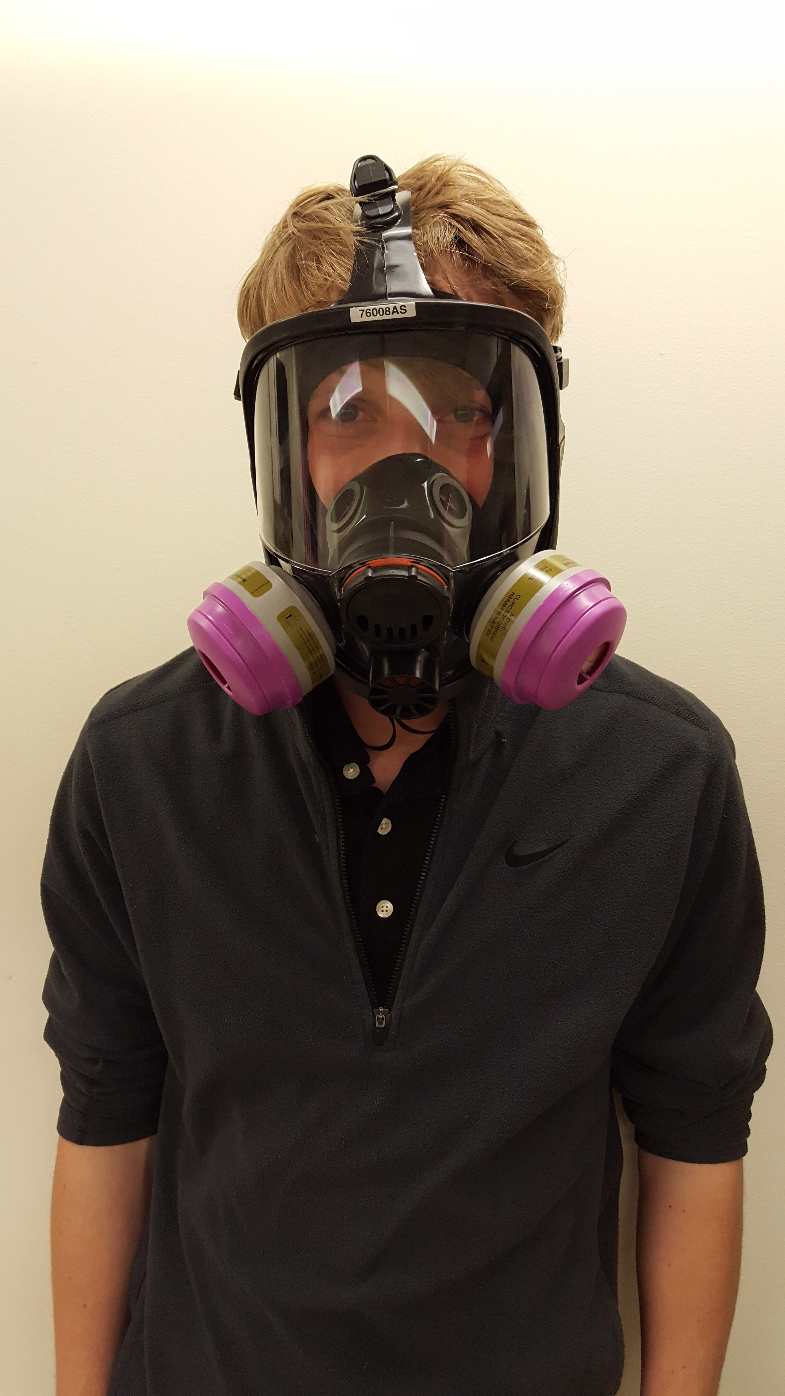
Personal protective equipment
When working with or handling radioactive material, radioactive samples, or animals containing radioactive material, the minimum personal protective equipment (PPE) is required:
  Gloves
  Lab coat
  Safety glasses or goggles
  Closed-toe shoes
  Long pants
If you cannot use fume hoods or gloveboxes to protect from airborne radioactive contaminants respirators are an option.
  Before using a respirator, you must contact EHS to participate in it’s respiratory protection program
    Improper respirator usage can result in serious injury or death.

Slide 19
Detection methods and decontamination

Slide 20
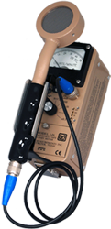
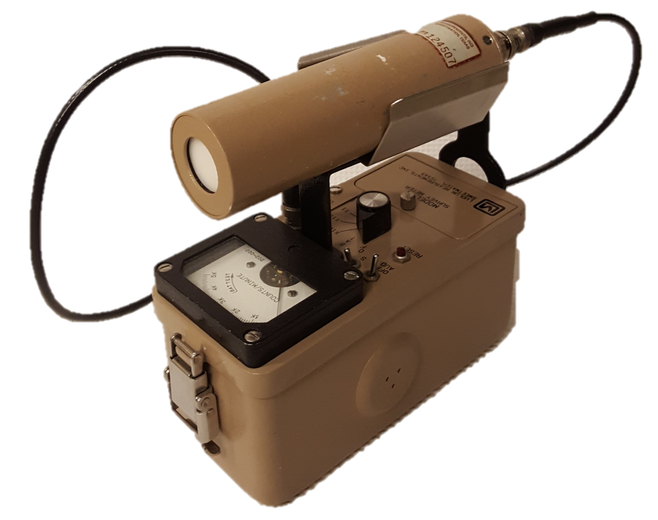
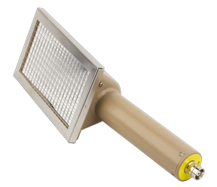
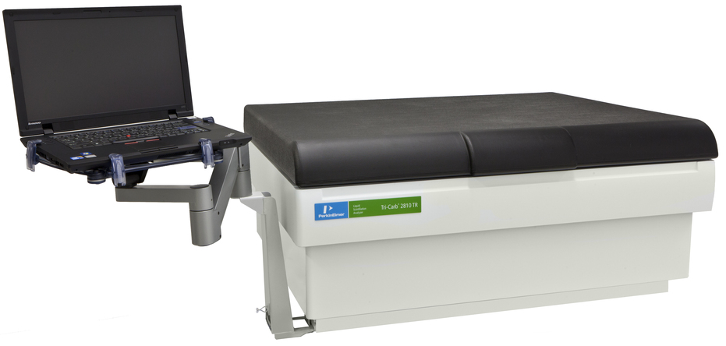
Common detection methods
Geiger Detector
  Able to detect high-energy beta particles and gamma-rays.
Sodium Iodide (NaI) Detector
  Able to detect gamma-rays with a high efficiency
Liquid Scintillation Counter (LSC)
  Able to detect low and high-energy beta particles, gamma-rays and alpha particles
Alpha Detector
  Able to detect alpha particles with a high efficiency

Slide 21
Selecting the Detection method
When performing surveys, make sure you are using the correct detection method. The table below lists most common isotopes used and the recommended detection method. If possible, you should use the ‘best’ detection method.
Radionuclide | Geiger Detector | Sodium Iodide Detector | Liquid Scintillation Counter | Alpha Detector
¹⁴C | Poor Detection | No Detection | Great Detection | No Detection
³H | No Detection | No Detection | Great Detection | No Detection
¹²⁵I | Good Detection | Great Detection | Good Detection | No Detection
¹³¹I | Good Detection | Great Detection | Great Detection | No Detection
³²P | Great Detection | No Detection | Great Detection | No Detection
³⁵S | Poor Detection | No Detection | Great Detection | No Detection
^{99m}Tc | Good Detection | Great Detection | Good Detection | No Detection
¹⁸F | Good Detection | Great Detection | Great Detection | No Detection
⁴⁵Ca | Good Detection | No Detection | Great Detection | No Detection
²³⁸U | Great Detection | Great Detection | Great Detection | Great Detection
²³²Th | Great Detection | Great Detection | Great Detection | Great Detection
 | Not Recommended – Do Not Use
 | Good
 | Best

Slide 22
Contamination vs Background
EHS suggests using the following threshold values to distinguish between background radiation and contamination:
  Geiger Detector – twice the background count
    For example, if you measure a natural background of 100 counts per minute (cpm), the threshold for contamination should be 200 cpm.
  Liquid Scintillation Counter (LSC) – if the sum total of the decays per minute (dpm) exceeds 200
    A sample LSC output is shown below. The DPM for each sample is summed and compared to the threshold value of 200. For sample 2, 5+5+1 =11 which is less than 200 so no contamination. For sample 3, 23+189+31=243 which is greater than 200 so there is contamination.
Sample | Count Time | CPMA | DPM1 | CPMB | DPM2 | CPMC | DPM3
1 | 10 | 5 | 0 | 9 | 0 | 2 | 0
2 | 1 | 3 | 5 | 5 | 5 | 1 | 1
3 | 1 | 15 | 23 | 180 | 189 | 30 | 31
4 | 1 | 2 | 3 | 20 | 21 | 4 | 4

Slide 23
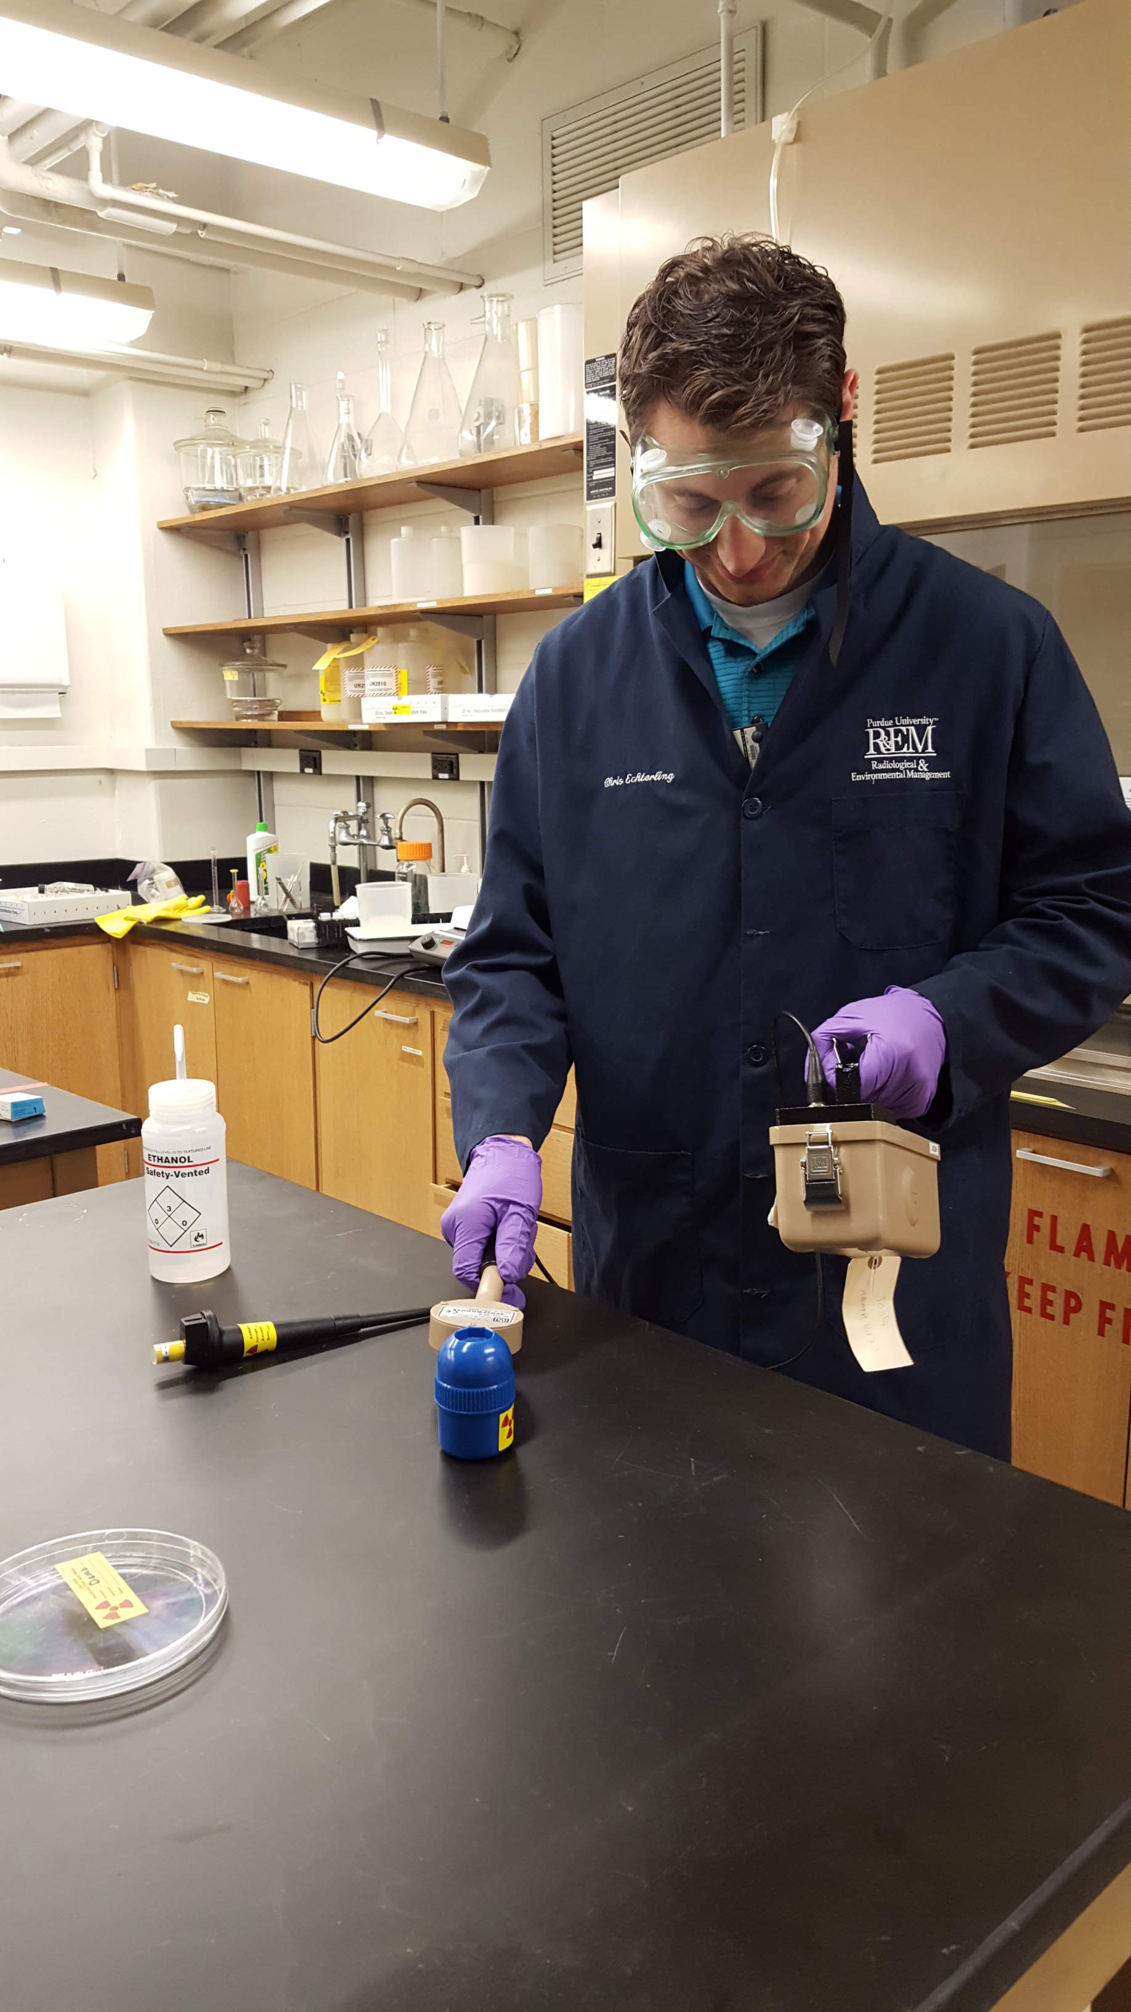
Preoperational check & technique
Before using a detector, users must perform a preoperational check
    When checking the detector the user should:
    Visually inspect the detector for damage
    Check the battery to see if it has sufficient power
    Expose the detector to a source of radiation to see if it responds to the radiation
  Do not use the detector if it doesn’t pass the preoperational checks.
When using a detector, the following techniques should be observed
  Probe should be about ½ inch (1 cm) from the surface of the object being surveyed
  Survey object as though you were painting it with a paintbrush.
  The probe should be moved slowly, about 3 inches (10 cm) per second
  Survey any surface or object that could potentially be contaminated (e.g. benchtops, floors, equipment, etc.)

Slide 24
decontamination
Radiological contamination must be removed as soon as possible by decontamination.
You must contact EHS immediately if contamination is found on individuals or the floor.
If contamination is found on an individual:
  Contaminated clothing must be removed and the skin (or clothing) underneath should be surveyed for contamination.
  Contaminated parts of the body should be washed with soap and water
    Do not use scrub with abrasive material that can break the skin.
Contaminated surfaces/objects should be decontaminated using appropriate cleaners and paper towels.
Contamination surveys should be performed to see if contamination has been removed. If survey still detects contamination, the surface/object should be decontaminated again and surveyed. Decontamination ends when contamination is no longer detected.

Slide 25
Lab Contamination Surveys and records

Slide 26
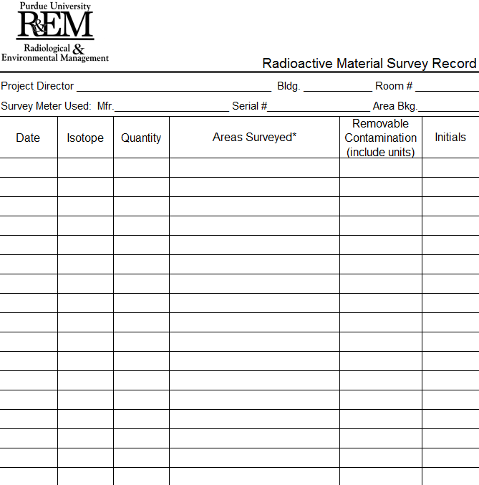
Contamination Surveys (1)
Radiological contamination can be detected by performing surveys with a detector that is appropriate for the radionuclide(s) used.
The radiation lab must be surveyed:
  Immediately after completing procedures involving radioactive material or samples (including lab animals) containing radioactive material
  On a monthly basis if radioactive material has been used that month
    The monthly survey must be recorded on a survey log
    The survey frequency may increase depending on the quantity and isotope used.

Slide 27
Contamination surveys (2)
When using a Geiger detector remember the following:
  Ensure the detector works properly before each use
    Check that the battery has sufficient power
    Check for damage
    Expose detector to radiation source to verify that it is working right
  Use good survey techniques
    Go slow
    Keep the detector about 1 cm from the surface or object being surveyed
    Be thorough

Slide 28
Labeling, Procuring, transferring, securing, storing, transporting and shipping radioactive material

Slide 29
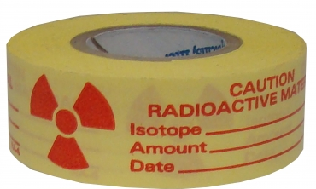
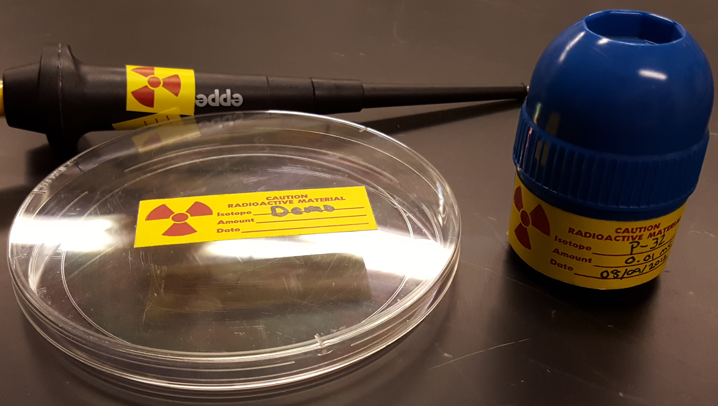
equipment and material Labeling
Radiation users have the responsibility to ensure that all radioactive reagents, radiation sources, radioactive samples, animals containing radioactive material, and equipment utilized in experiments involving radioactive material are properly labeled.
Labeling must have:
  The traditional radiation symbol
  The words ‘Caution Radioactive Material’
  The radioisotope listed
  The amount (activity) contained
  The date that the amount was determined

Slide 30
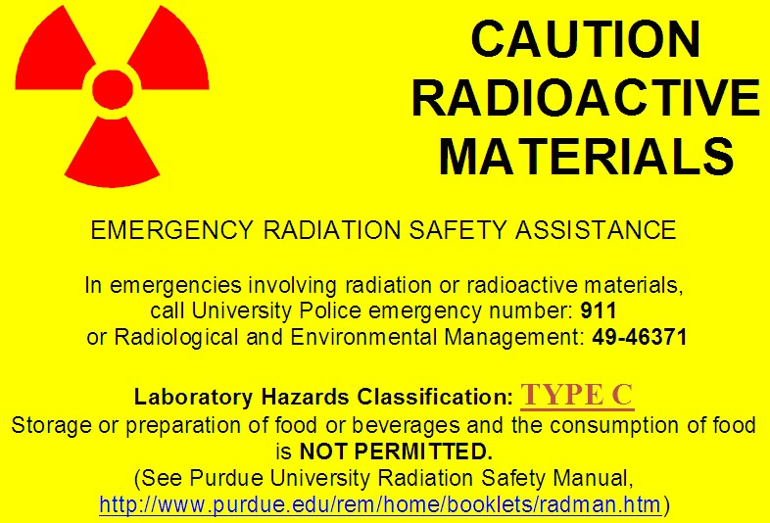
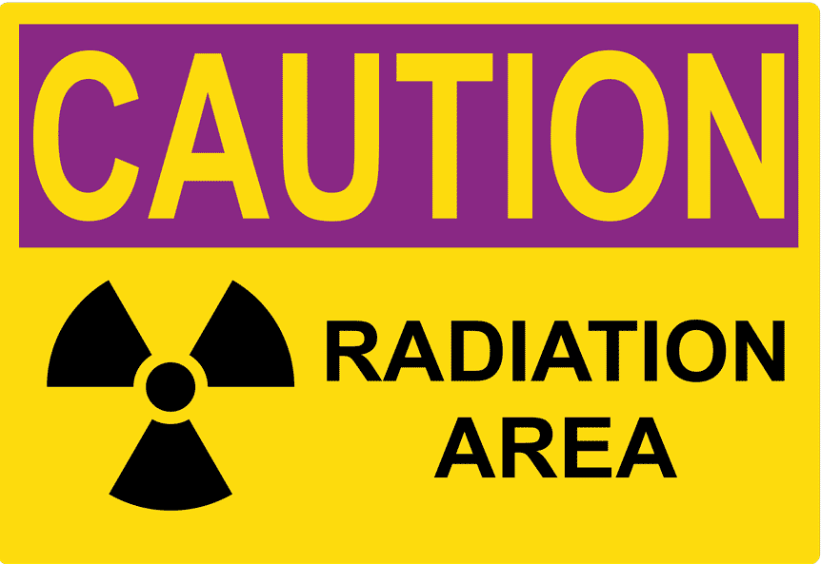
Laboratory postings
All locations that are used for the storage, use and counting of radioactive material must have the appropriate ‘Caution Radioactive Materials’ door posting that warns individuals of the presence of radioactive material prior to entering that location.
Contact EHS if you want to store, use or count radioactive material in a location that does not currently have the appropriate door posting.
If the dose rate from the radiation source is greater than 5 mrem at 30 cm, but less than 100 mrem, a ‘Caution Radiation Area’ posting is also required.

Slide 31
Procuring and transferring
The possession of radioactive material is regulated by EHS.
Principal Investigators that desire to obtain radioactive material must submit a Radioactive Material Requisition (Form R-1) to EHS.
Your business office must follow a specific procedure when purchasing radioactive material.
  Failure to follow these procedures can delay your order.
Before transferring radioactive material, you must contact EHS. EHS will determine whether or not the recipient is permitted to possess the radioactive material.

Slide 32
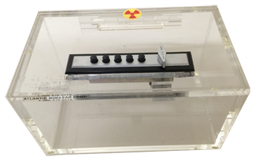
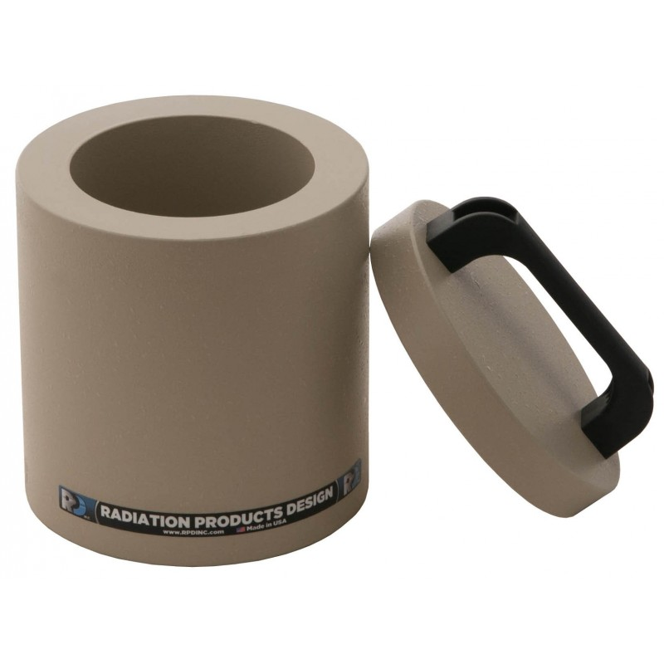
Security and storage
The NRC mandates the safeguarding of radioactive material to prevent:
  Theft and sabotage of radioactive material
  Accidental exposure to radiation
Radioactive material must be secured by locking doors when the room is unoccupied or, storing radioactive material in locked containers, safes or refrigerators.
Radionuclides that emit high-energy beta particles, gamma-rays and neutrons should be stored in shielded containers or behind radiation shielding.

Slide 33

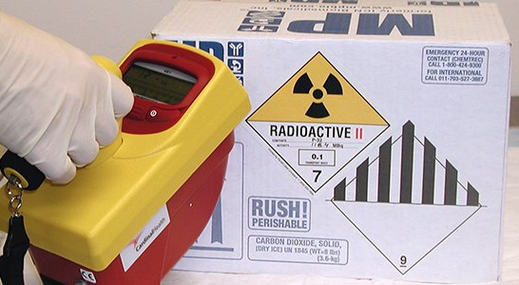
Transporting and shipping
The transportation and shipping of radioactive material is regulated by the Department of Transportation (DOT).
DOT regulations are meant to ensure the safe transport of radioactive material.
DOT regulations only apply when public roadways will be used.
If you are planning to transport or ship radioactive material, you must contact EHS first.

Slide 34
Radioactive waste

Slide 35
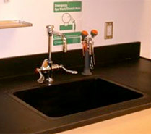
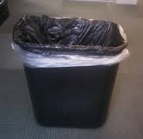
Waste disposal (1)
Radioactive waste SHALL NOT be disposed down the sink or in regular trash.
EHS provides radioactive waste containers and manages radioactive waste free of charge.
Do not place non-radioactive waste into radioactive waste containers. This results in increased costs for disposal of non-radioactive waste.
Liquid waste containers must be capped and screwed tight. Solid waste buckets and bags must be kept closed.
✗
✗

Slide 36
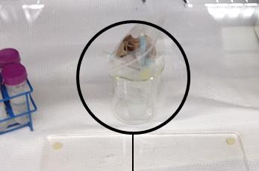
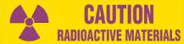
Waste disposal (2)
If required, radioactive waste can be temporarily stored for the duration of the experiment on lab countertops and work areas.
However, the container must be leakproof, have the proper label affixed on the outside (bottom right)
After the experiment, the contents of the waste container must be properly disposed in approved radioactive waste containers.

Slide 37
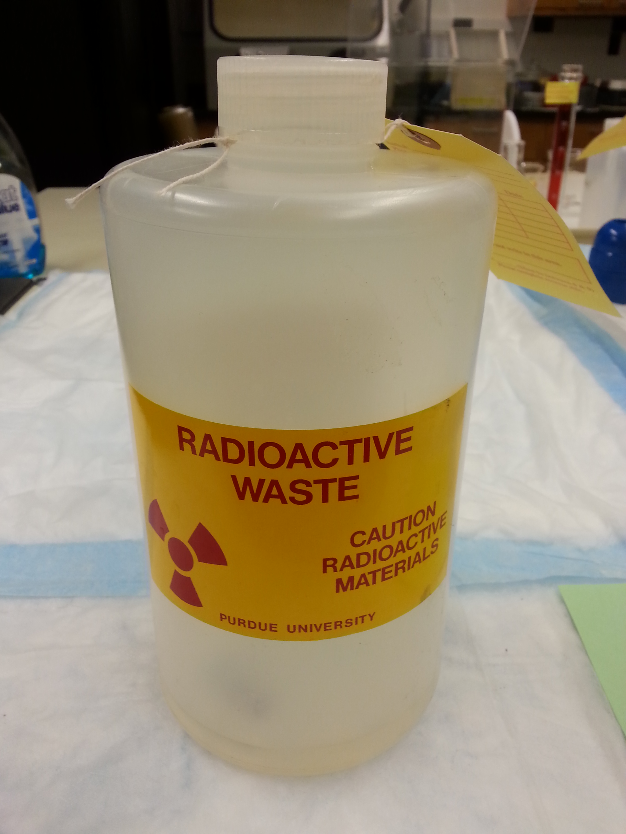
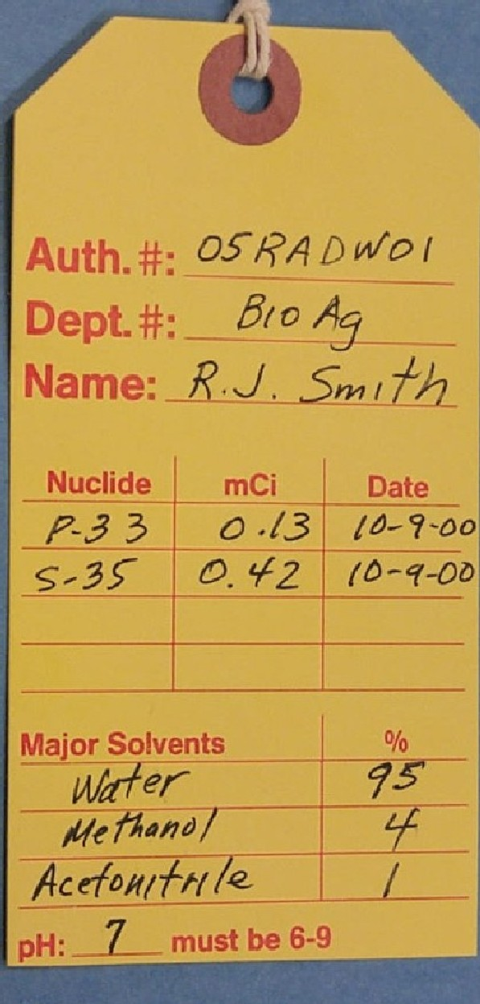
Waste disposal (3)
Separate waste between long and short half-life. (Short is defined as less than 30 days)
Record the radionuclide, amount and the date every time something is added to the container. Use a separate sheet if necessary.
Declare all chemicals in a percentage format
Record pH of solution. The pH must be between 6 and 9. You can use pH paper.
List all radionuclides and amounts in mCi
Date when container is sealed or full
Do not abbreviate or use acronyms for chemicals or solutions (e.g. write Phosphate Buffered Saline instead of PBS or water instead of H₂0)

Slide 38
Final thoughts

Slide 39
Contact EHS if…
You know or suspect there has been an overexposure to an individual
There has been a spill involving a large quantity (> 1 mCi) of radioactive material
You suspect or find contamination on the floor
You suspect or find contamination on an individual
You have questions or concerns
Personnel working on the project has been changed (added/dropped)
You observe any condition which may lead to or cause a violation of NRC regulations and licenses or unnecessary exposure to radiation and/or radioactive material

Slide 40
Enforcement
Failure to comply with the rules, regulations safe practices established by the Nuclear Regulatory Commission (NRC) or Purdue University can result :
  Required retraining for all lab members
  Loss of work privileges with or around radioactive material
  Suspension of the project involving radioactive material
  Civil penalties
  Criminal penalties
  For willful violation of, attempted violation of or conspiracy to violate any regulation

Slide 41
Radiation Safety Group
Joshua A. Young, M.S 765-494-2721
Radiation Safety Officer (RSO) young127@purdue.edu
Nathan Claus 765-494-1478
Health Physicist njclaus@purdue.edu
Jerry J. Gibbs 765-494-0207
Environmental Technician jjgibbs@purdue.edu
Anca Condret 765-494-7969
Environmental Technician acondret@purdue.edu

Slide 42
End of training module
This concludes the PowerPoint portion of this retraining.
Complete the test indicated below. You must have 75% of correct responses to pass.
  Your results will be emailed to you and will constitute as your certification of your successful completion your retraining, if you have passed.
Click here to begin the test.

