Slide 1
New Team Incident Investigation form (TIIF)

Slide 2
Training Objectives
The new TIIF form is added to the FROI – First Report of Injury.
The purpose of the Team Incident Investigation (TIIF) assessment is to determine:
the risk of incident re-occurring
appropriate corrective actions
appropriate controls
timeframe for completing corrective action(s)

Slide 3
Section 1: Basic Incident Information
Determining description – ask injured/involved employee(s) probing and clarifying questions:
What Happened?
– what was the task
– what happened during of the incident
include specific details of what happened (ie: moving furniture, scrubbing floors, etc.)
How did it happen?
– What caused the incident to occur?
– Equipment failure?
– Improper Procedure?
Unsafe action?
Lack of training?
Reference Hazard Assessment associated with task
– Can the hazard assessment be improved to reduce reoccurrence of incident; corrective action
Attach photographs or diagrams if necessary.

Slide 4
Section 2: Risk of Incident/Reoccurrence
Risk is not the identified hazard.
It is what could occur due to the hazard.
It is all about the potential severity for supposedly minor incidents.
Don’t just think about the outcome of an incident.
The potential outcome is what matters.
Risk Assessment Matrix
VL = Very Low Risk L=Low Risk M=Medium Risk H=High Risk |  | Severity
 |  | Minor | Moderate | Critical | Catastrophic
Likelihood | Remote | VL | VL | VL | L
 | Unlikely | VL | VL | L | M
 | Moderate | VL | L | M | M
 | Likely | VL | L | M | H
 | Extremely Likely | L | M | H | H
Very Low Risk | ☐ | Low Risk | ☐ | Medium Risk | ☐ | High Risk | ☐

Slide 5
Quantifying the Risk
Measure the severity of the risk identified
What is the likelihood of the incident occurring without putting in place any additional safeguards
Remote – You would be surprised if this happened
Unlikely – Possible, but not likely to happen
Moderate – Likely to occur, but not frequently
Likely – If employees exposed to risk daily, it is likely to occur several times in a month period
Extremely Likely – If employees exposed to daily/often, it is likely to occur at least weekly
What would the severity of the incident be if it occurred without putting in place additional safeguards?
Minor – Near miss or first aid treatment
Moderate – Recordable Treatment
Critical – Lost time injury less than 30 days
Catastrophic – Death, amputation, or permanent total disability
Determine overall risk rating factoring likelihood and severity together without additional safeguards, and utilizing the risk matrix

Slide 6
Section 3: Root Cause Determination
Select contributing factors to the Incident and then complete the Fishbone to determine root cause.
Select Contributing Factors to the Incident
Unsafe Acts
Unsafe Conditions
Management Deficiencies
Root Cause Tips
Determine the true root cause of the incident, even if you do not believe you can adequately eliminate it.
When selecting corrective actions, the team should select solutions that minimize the risk of the incident as much as possible by addressing the root cause or contributing factor(s).

Slide 7
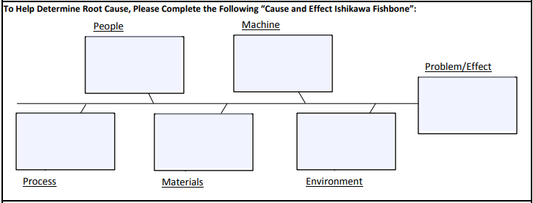
Root Cause Tips - Fishbone
This is a brainstorming tool for determining Root Cause
Not all categories are required to be filled in
Use the contributing factors to help fill in Fishbone and selecting Root Cause
Human Factors

Slide 8
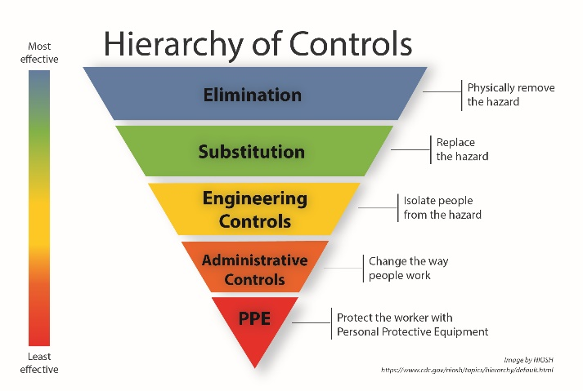
Section 4: Corrective Action Determination
Select Corrective Action
Utilize the teams risk assessment and hierarchy of controls to select the appropriate corrective action for this incident
*If no hazard assessment is associated with the task/incident, or it failed to identify the hazard/risk, one corrective measure should be reviewing the assessment or creating one if needed

Slide 9
Final Notes
Goals are to reduce risk of reoccurrence
NOTE: If corrective action does not lower the risk or get below High, then the corrective action is insufficient, and further investigation is required
Make sure responsible party(s) are aware of their assigned corrective action and all correcting actions are tracked to completion
Team Incident Investigation Forms should be completed within 3 business days of FROI

Slide 10
For questions regarding Team Incident Investigation Forms, contact:
Kristi Evans, EHS klevans@purdue.edu; 765-494-1431
Mike Silanskis, EHS msilansk@purdue.edu; 765-494-7426

