Slide 1
Faculty Advancement, Success and Tenure (FAST)
Office of the Provost
September 10, 2019
www.purdue.edu/advance-purdue
De Bush, Assistant Director/Project Manager
djbush@purdue.edu
Notes:
Contact me with questions or concerns

Slide 2
ADVANCE-Purdue Goals
Chris Sahley, Professor and Associate Head, Biological Sciences, Director of ADVANCE Purdue Center for Faculty Success, Special Advisor to the Provost, Gender Equity
NSF Grant started in October 2008
$3.92 M over 5 years
Now in collaboration with the Provost’s Office
Goal 1 – Recruit STEM faculty women, especially women of color
Goal 2 – Ensure the success of all faculty especially women in STEM
Goal 3 – Engage all faculty in transforming the institution
Notes:
Welcome and thanks for attending
Introductions
Chris, Director
De, Project Manager and Assistant Director
Senior Faculty
ADVANCE has many initiatives
Check our website for many different activities
FAST is part of Goal #2
Mentoring and Professional Development has shown to be effective for retention
FAST format
Meet once/month
Same day, time and room
Different topics and speakers
All newly hired professors and postdocs
Second year faculty who requested
One or more senior faculty per College/School
Recorded – on website

Slide 3
FAST Materials
Demystifying the Profession: Helping Junior Faculty Succeed by JoAnn Moody
FAST flyer from ADVANCE-Purdue
Summary of Guides on Mentoring
NCFDD link on ADVANCE-Purdue website front page at left - Memberships
Notes:
Flyer
Agenda
Moody publication - different sections apply to different participants in the mentoring relationship
Mentoring guide handout
National Center for Faculty Development & Diversity link on ADVANCE Purdue website

Slide 4
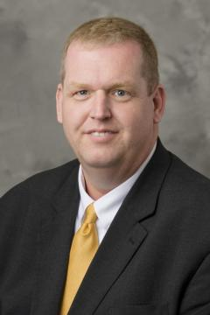
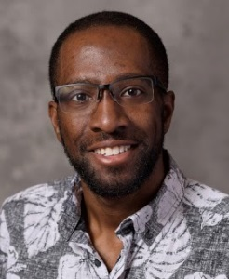
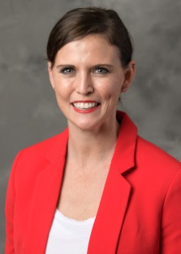
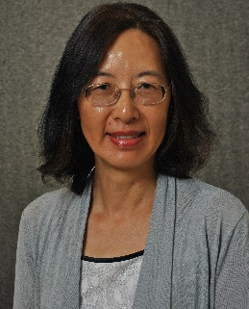
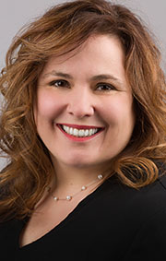
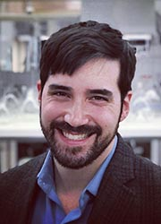
Panel of Assistant Professors
Jason Cutter, Aviation and Transportation Technology, Polytechnic Institute
Isaac Harris, Mathematics, College of Science
Adrie Koehler-Blair, Curriculum and Instruction, College of Education
Sa Liu, Health Sciences, College of Health and Human Sciences
Darcy Telenko, Botany and Plant Pathology, College of Agriculture
David Warsinger, Mechanical Engineering, College of Engineering

Slide 5
Questions for the Panel
Introduce yourself.
What is your experience with mentoring at Purdue?
What do you know now that you wish you had known when you first started at Purdue?
Questions and Answers

Slide 6
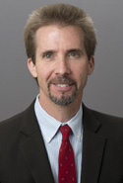
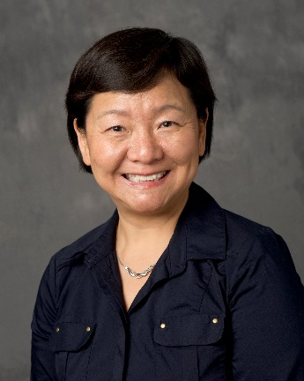
Upcoming Events
Promotion and Tenure
October 15th, STEW 278
Peter Hollenbeck, Vice Provost for Faculty Affairs and Professor of Biological Sciences, College of Science
Wei Hong, Associate Dean for Faculty Affairs and Professor of Languages and Cultures, College of Liberal Arts
Notes:
You will get to pick the other topics

Slide 7
Wrap Up
FAST will meet monthly in STEW/PMU
Future topics will be generated by you
ADVANCE materials are on website
Please complete the evaluations
Notes:
See flyer for FAST dates and rooms

