Slide 1
Successful Grant
Writing Strategies
Sally Bond
Assistant Director of Research Development Services
Proposal Coordination
Office of the Vice President for Research

Slide 2

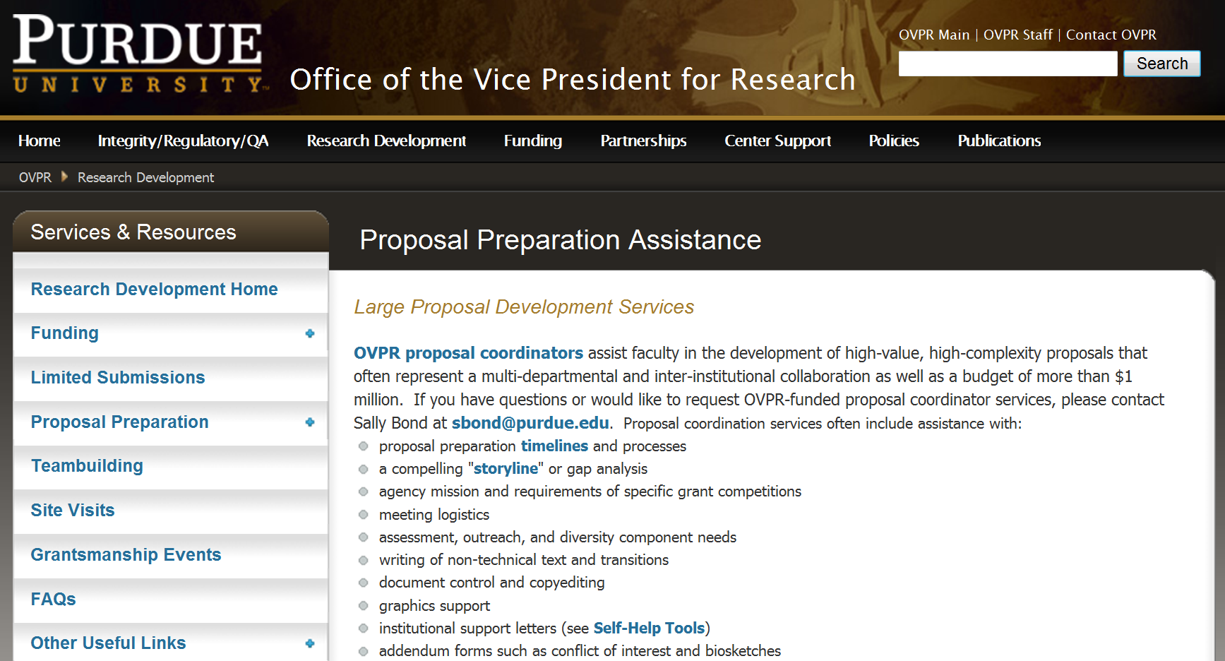

Large-Scale Proposal Coordination
Usually higher complexity, interdisciplinary, and over $1 million

Slide 3
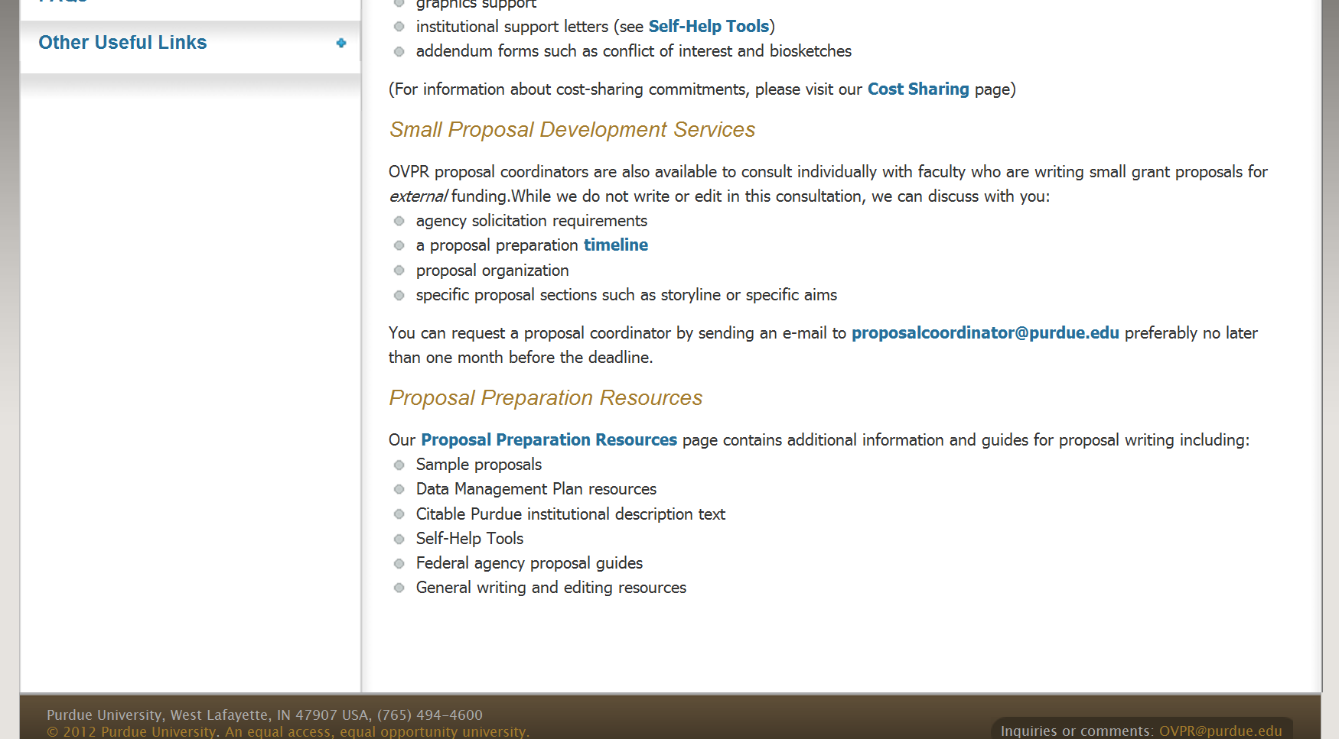
Small Proposal Development Services
Consultations for single investigator, less than $1 million

Slide 4
Being intentional
Basic grant writing strategies apply to almost any proposal
And so you just threw everything together?… Mathews, a posse is something you have to organize.”
From The Far Side by Gary Larson
Cartoon deleted for ppt distribution per copyright laws

Slide 5
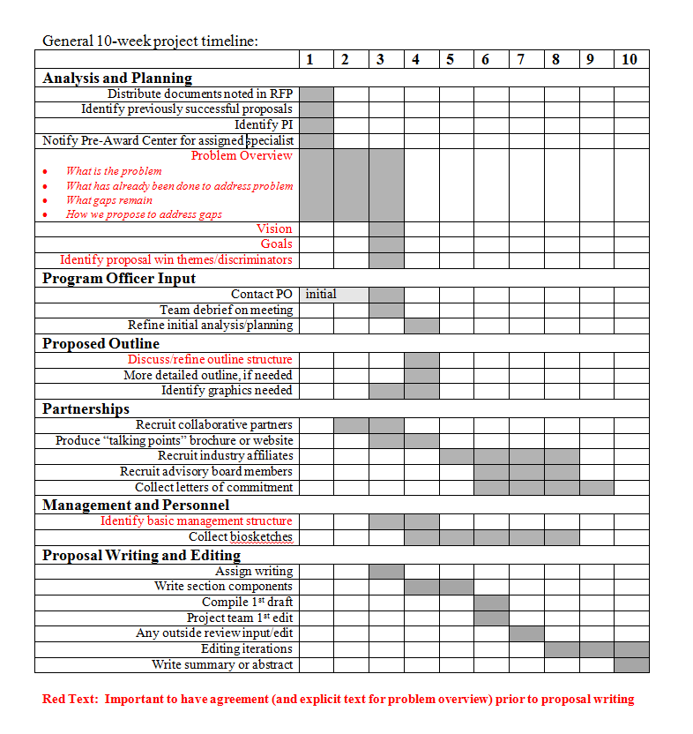
Proposal Preparation Timeline
Have a plan
Notes:
Abe Lincoln “Give me six hours to chop down a tree, and I will spend the first four hours sharpening the axe”

Slide 6
Key Strategies
Avoid common trouble spots
      tell a compelling storyline
      answer “Why Purdue?”
      respond to solicitation…outline!
      know your reviewer
      conduct internal review

Slide 7
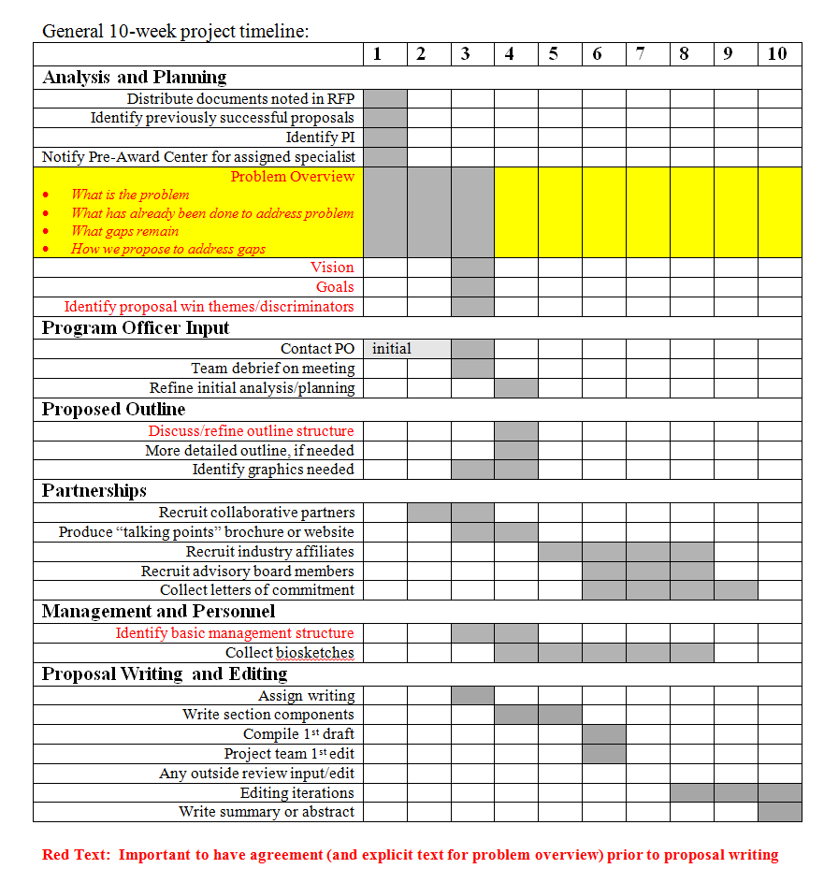
Building the Storyline
Storyline first!
storyline provides the “north star”
helps you not to be overly ambitious

Slide 8
Building the Storyline
Four helpful questions
      What is the problem?
      What has been done already to address the problem?
      What is the gap that remains?
      How do you propose to address this gap?

Slide 9
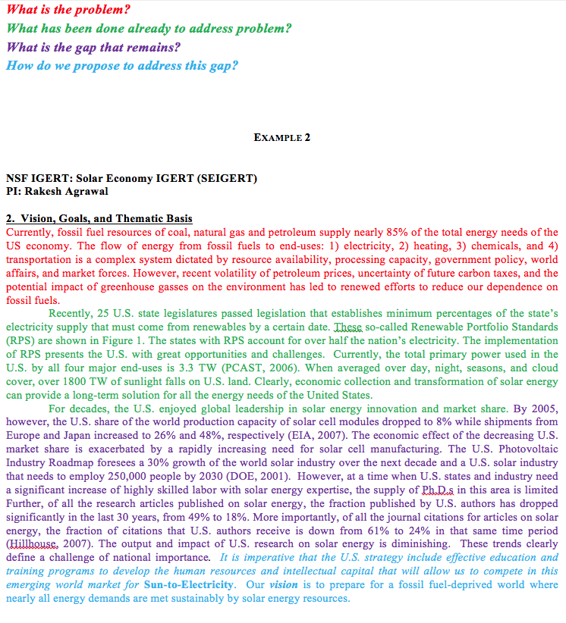
Building the Storyline
Example narrative…in op-ed language

Slide 10
Building the Storyline
Create a one-page brief
One-page project description sent to program officer that includes:
      concise storyline
      vision/goals
      team
      methodology/approach
      impact

Slide 11
Why Purdue?
You, your team, your institution
      researcher expertise
      equipment and facilities
      Purdue experience and campus environment
      strength or uniqueness of academic programs
      prior work

Slide 12
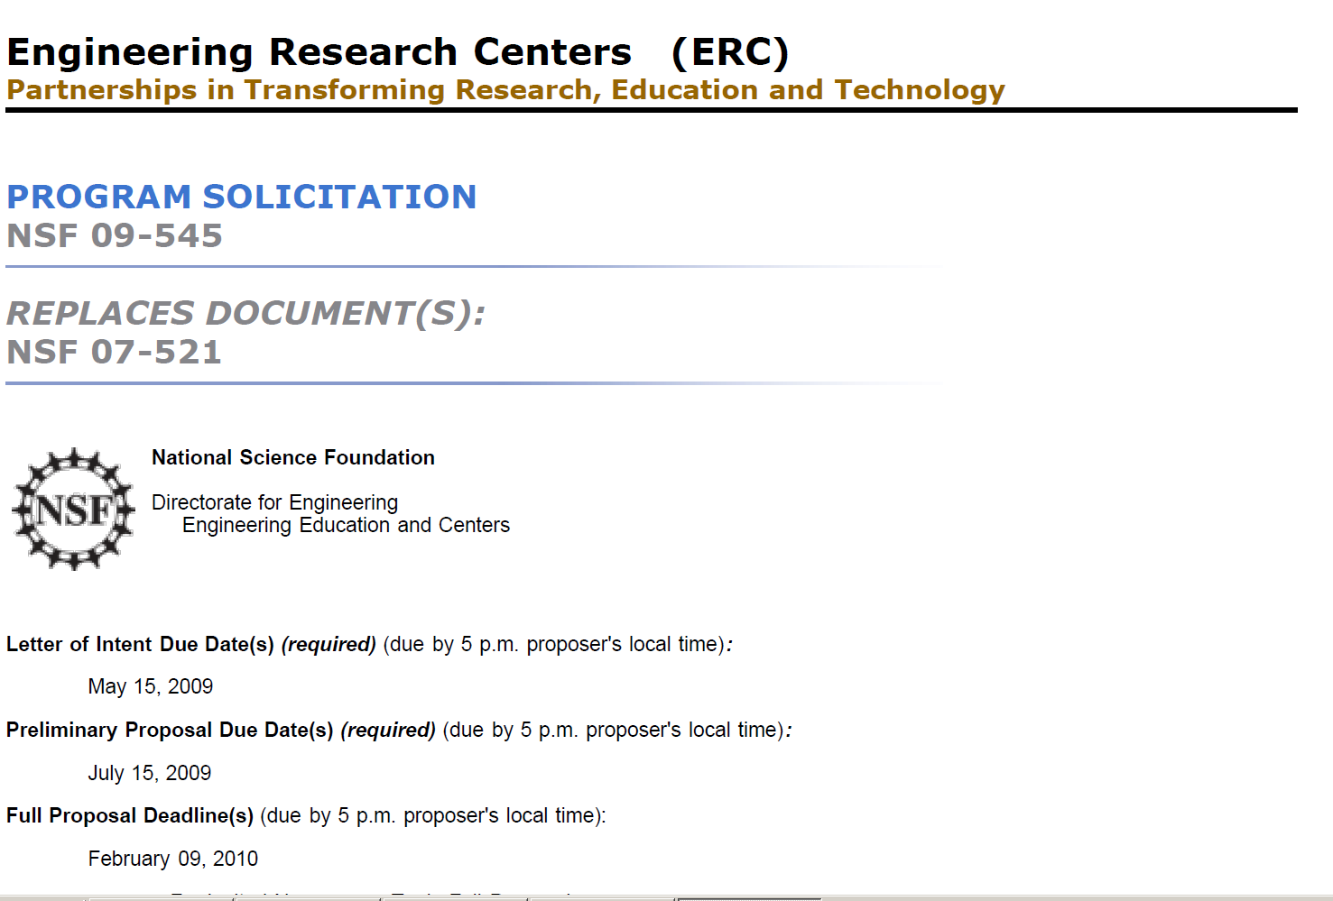
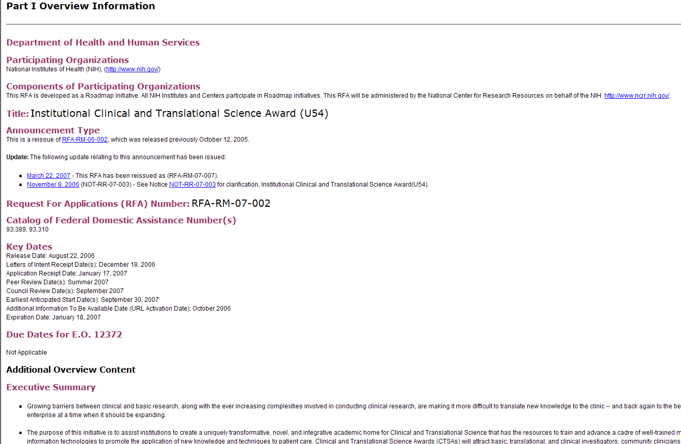
Responding to Solicitation
Read it. Mark it up.

Slide 13
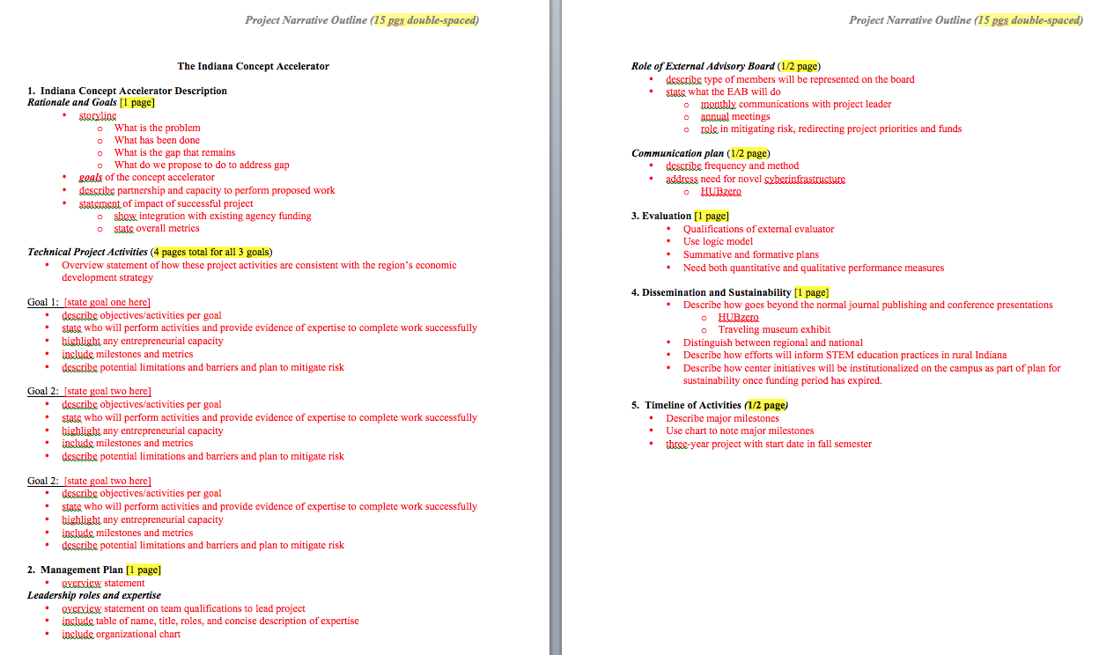
Responding to Solicitation
Always outline before you write
Notes:
Never, ever tell your team to “just send me a page or two of what you want to do.”

Slide 14
Knowing Your Audience
How is your reviewer reading your draft? How can you help?
sleepless, busy, rushed
stack of 25 proposals to review
reading proposal on plane or late at night
perhaps not an expert in your exact field
Notes:
Don’t go smaller type, smaller graphics.

Slide 15
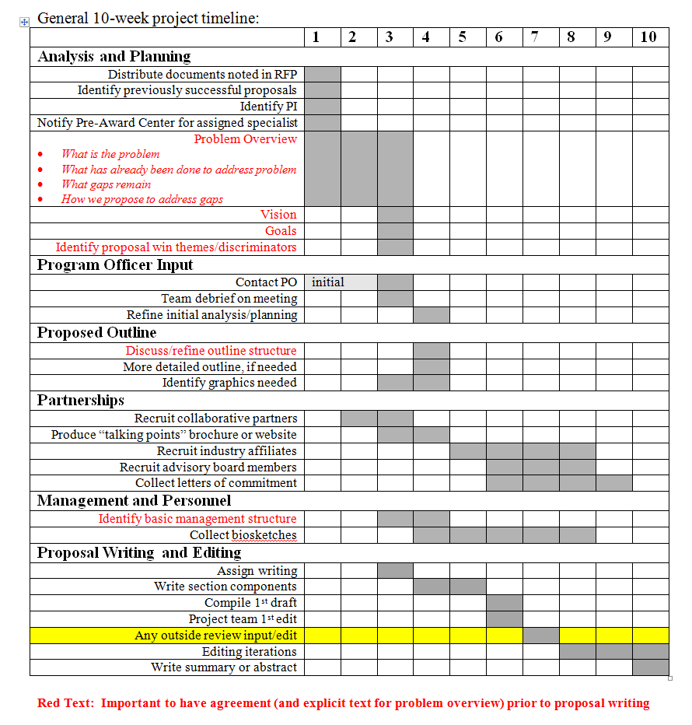
Internal Review
New eyes on your draft before submission
at least two weeks prior to submission
requires intentional planning from project beginning
formal or informal

Slide 16
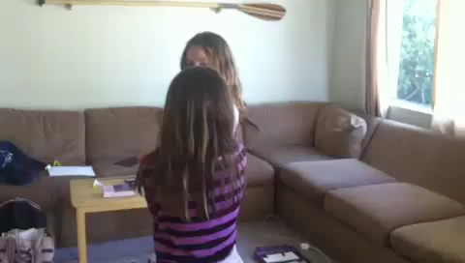
Internal Review
Because sometimes what is obvious to you is not obvious to others

Slide 17
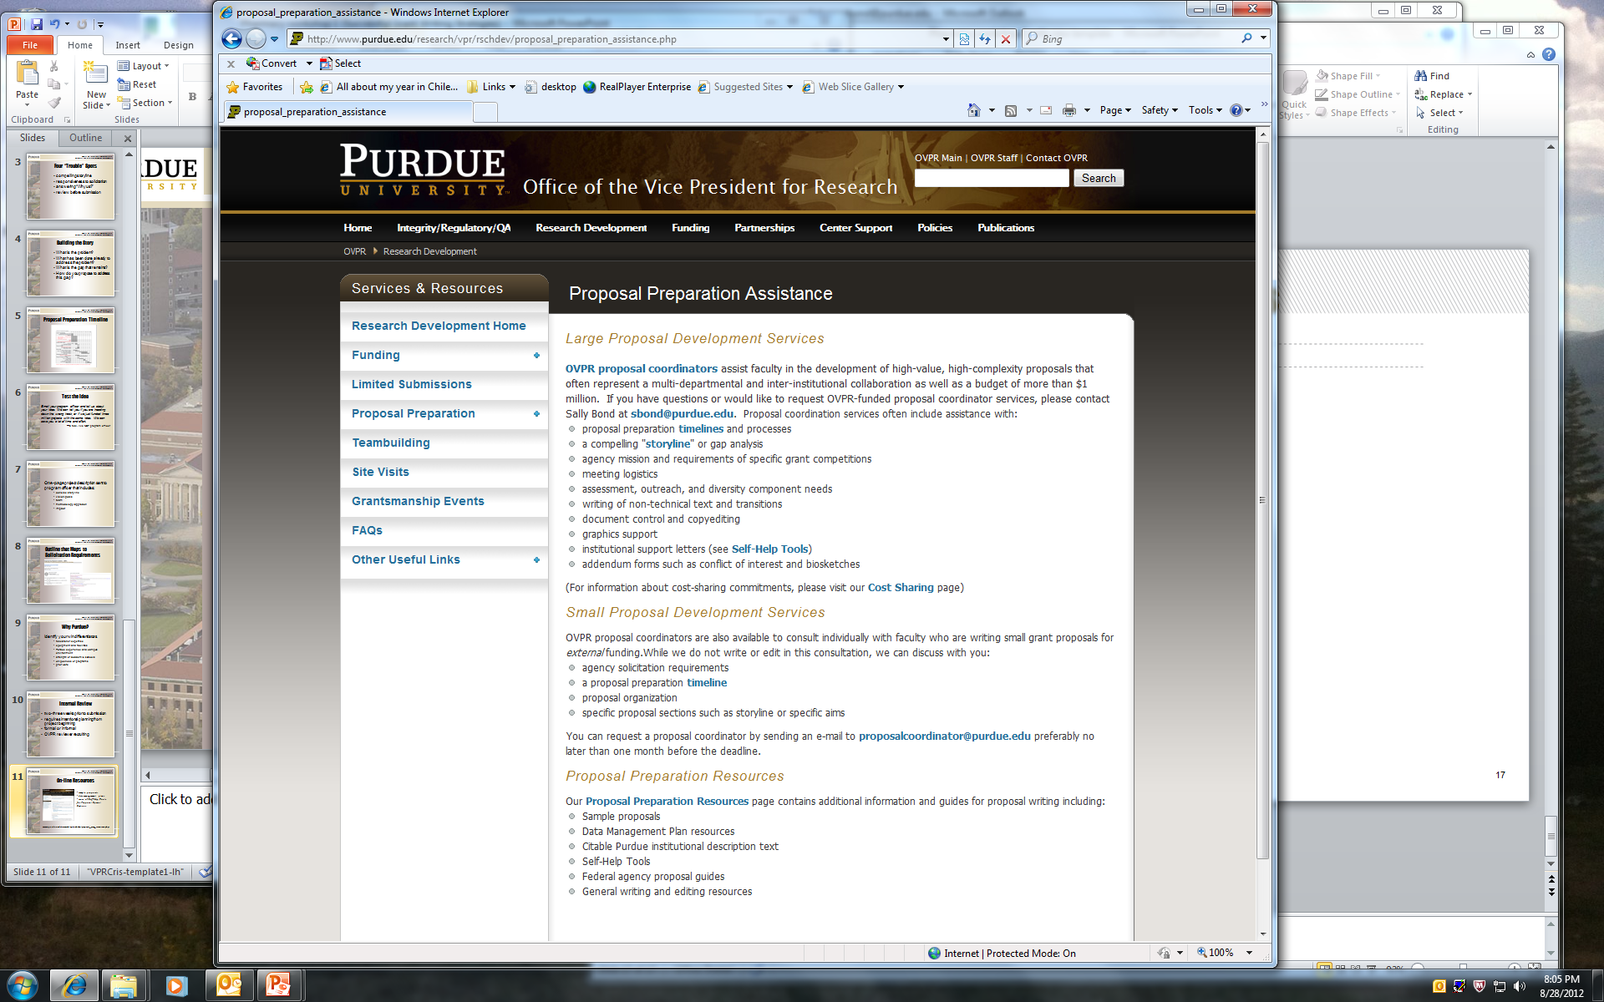
Additional Online Resources
OVPR website resources for proposal preparation
self-help tool series
data management plan templates
citable text
templates
coming soon…epubs
New!

Slide 18
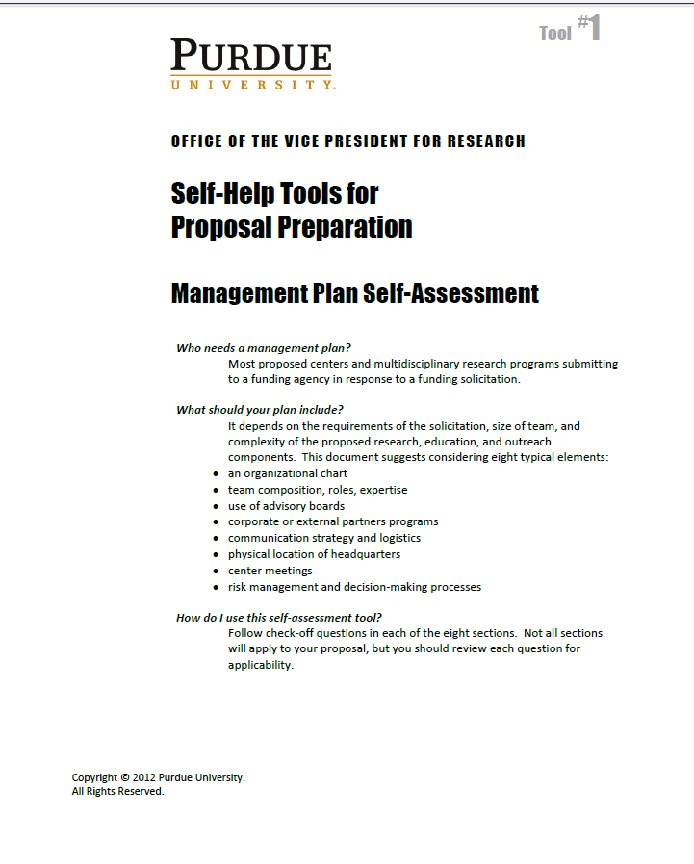
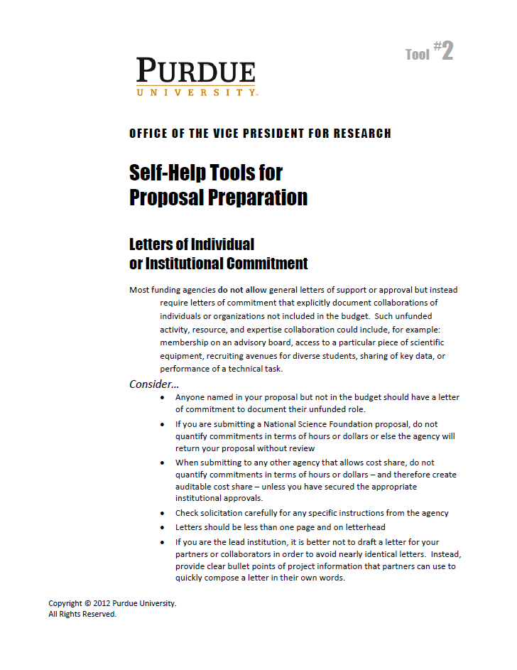
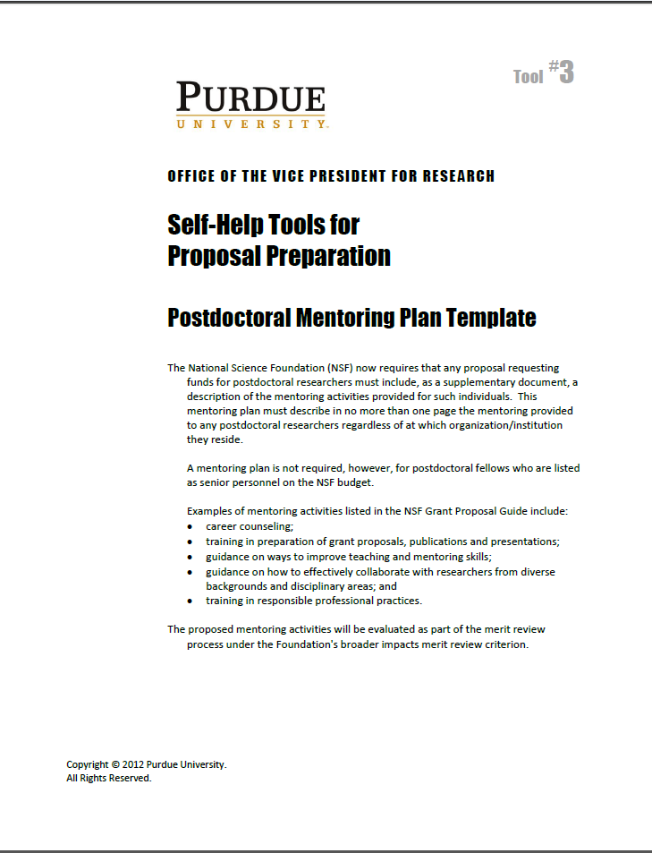
Additional Online Resources
Self-help tool series
Management Plan Self-Assessment
Letters of Individual or Institutional Commitment
Postdoctoral Mentoring Plan Template

Slide 19
Questions?

