Slide 1
Faculty Advancement, Success and Tenure (FAST)
In Collaboration with
ADVANCE Purdue Center for Faculty Success
Office of the Provost

Slide 2
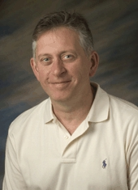
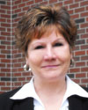
Agenda – March 19, 2013
9:00 – 9:10 Welcome and Introductions
9:10 – 9:55 Work/Life Integration
Clint Chapple, Head, Biochemistry, Agriculture
Pam Nesbitt, Director, Academic Units, VPHR
Tammy Synesael, Leave of Absence Administrator, VPHR
Melissa Martin, Talent Acquisition Specialist, VPHR
9:55– 10:10 Facilitated Small Group Discussion
10:10 – 10:15 Wrap Up

Slide 3
Upcoming FAST Sessions
April 23, 2013 Panel of Recently Tenured Associate Professsors
STEW 313
TBA

