Slide 1
Faculty Advancement, Success and Tenure (FAST)
In Collaboration with the Office of the Provost

Slide 2
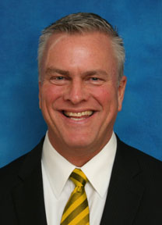
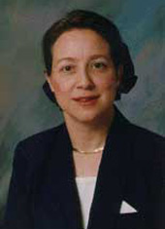
Agenda – November 6, 2012
9:00 – 9:10 Welcome and Introductions
9:10 – 9:50 Department Head Expectations for Faculty
Steve Abel, Associate Vice Provost for Faculty Affairs, Associate Dean for Clinical Programs, Bucke Professor, Pharmacy
Suzanne Nielsen, Professor and Head, Department of Food Sciences, College of Agriculture
9:50 – 10:10 Facilitated Small Group Discussion
10:10 – 10:15 Wrap Up

Slide 3
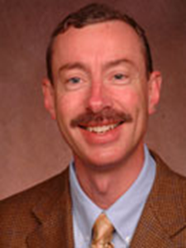
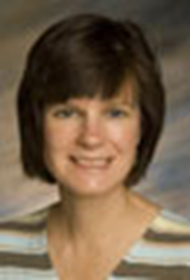
Upcoming FAST Sessions
January 29, 2013 Grant Writing
STEW 313
Sally Bond, Assistant Director, Research Development Services, OVPR
Jon Harbor, Professor and Head, Department of Earth, Atmospheric and Planetary Sciences and Interim Director, Purdue Global Sustainability Center
February 19, 2013 Advice from Two Deans
STEW 313
Jeff Roberts, Dean, College of Science Maryann Santos de Barona, Dean, College of Education

