Slide 1
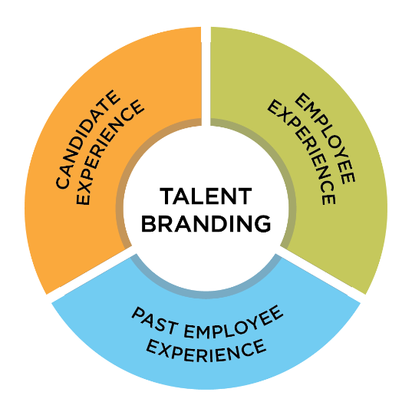
What is Talent Branding?
It is highly emotive, social, and public employer brand.
It considers what people think, feel, and share about our university and culture as a place to work.
It answers the questions:
“What sets our culture apart?”
“What unites and inspires our employees?”
1

Slide 2
The Value of a Talent Brand
Helps attract the right new talent
Can help retain our best talent
Decreases our cost per hire & cost per application

Slide 3
Why it Matters
"For the past two years, the U.S. has been locked into one of the tightest labor markets in modern memory.
Employers have nearly 10 million job openings, but only about 6 million people are actively looking for work.
That means that companies are fighting over a small and possibly shrinking pool of workers. In such a competitive environment, every employer should be thinking about their talent brand – the perceptions employees have about their companies, how those workers promote their employer to friends and family, and what they say about it online and to potential recruits.”
– ADP Research, Quarterly Workforce Research Report, May 2023
3

Slide 4
Implementation: Deliverables
TALENT ACQUISITION
Enhanced careers sites
Recruiters’ toolkit
Campus recruiting materials: booth, presentation, brochures, giveaways
Recruitment brochures
Job board templates
Employee day-in-the-life videos
Online employee referral program
Diversity communications
Social media recommendations
EMPLOYEE ENGAGEMENT
Culture videos
Onboarding site
Culture book
Brand training materials
Orientation presentation
Employee handbook
Benefits communications
Learning and development communications
Newsletters
4

